Slide 1
T-SEC-600 : Socat
Pré-Msc – mai 2024

Slide 2


What is this about?
Project Socat :
Groups of 3 students
4 weeks project
Web and network based
Inspired by real-life scenarios
On our new plateform: TryHackMe!

Slide 3




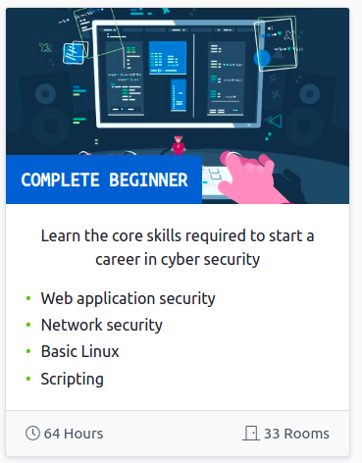

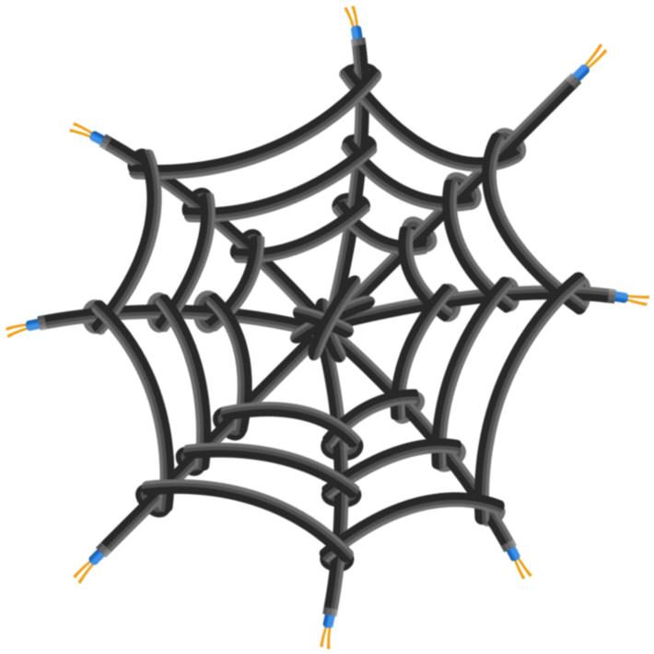
Why TryHackMe ?
Online Capture The Flag (CTF)
Web
Windows / Linux
Networking
Cryptography
Learning platform
Over 1 million users with 500+ rooms

Slide 4
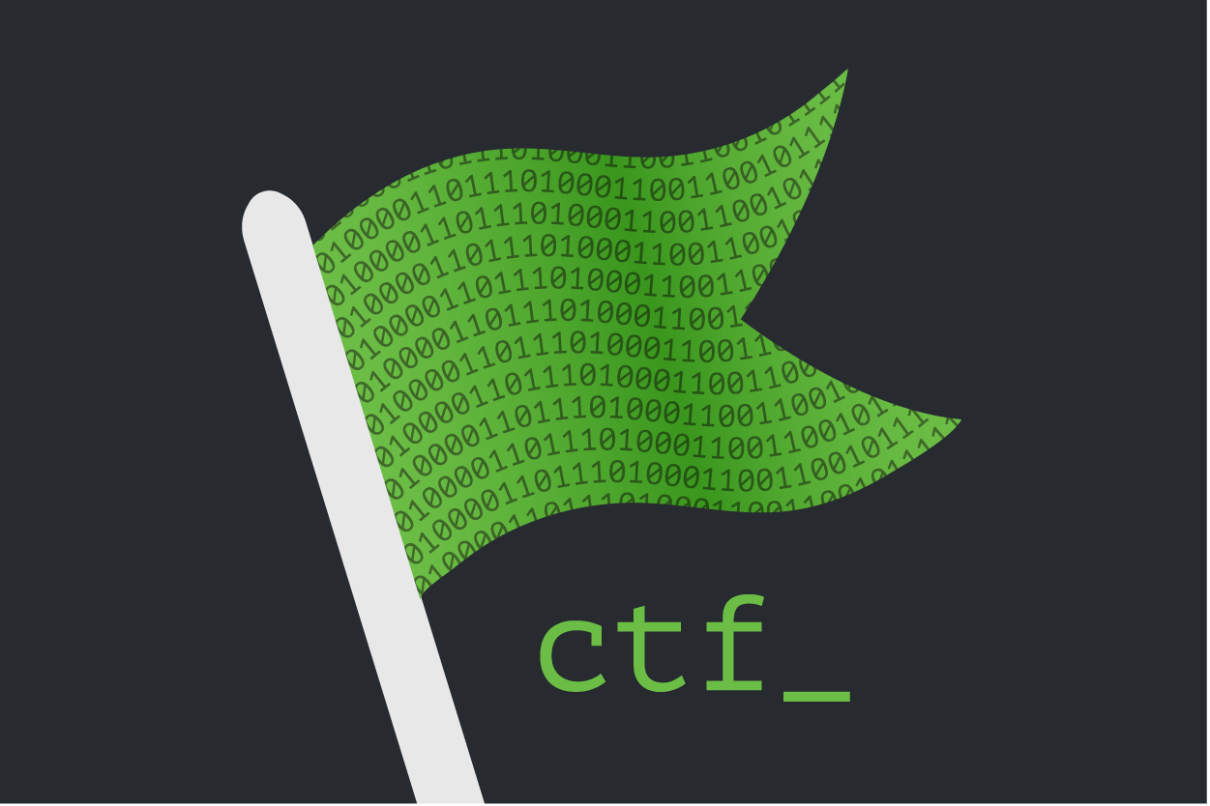
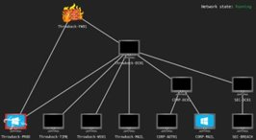
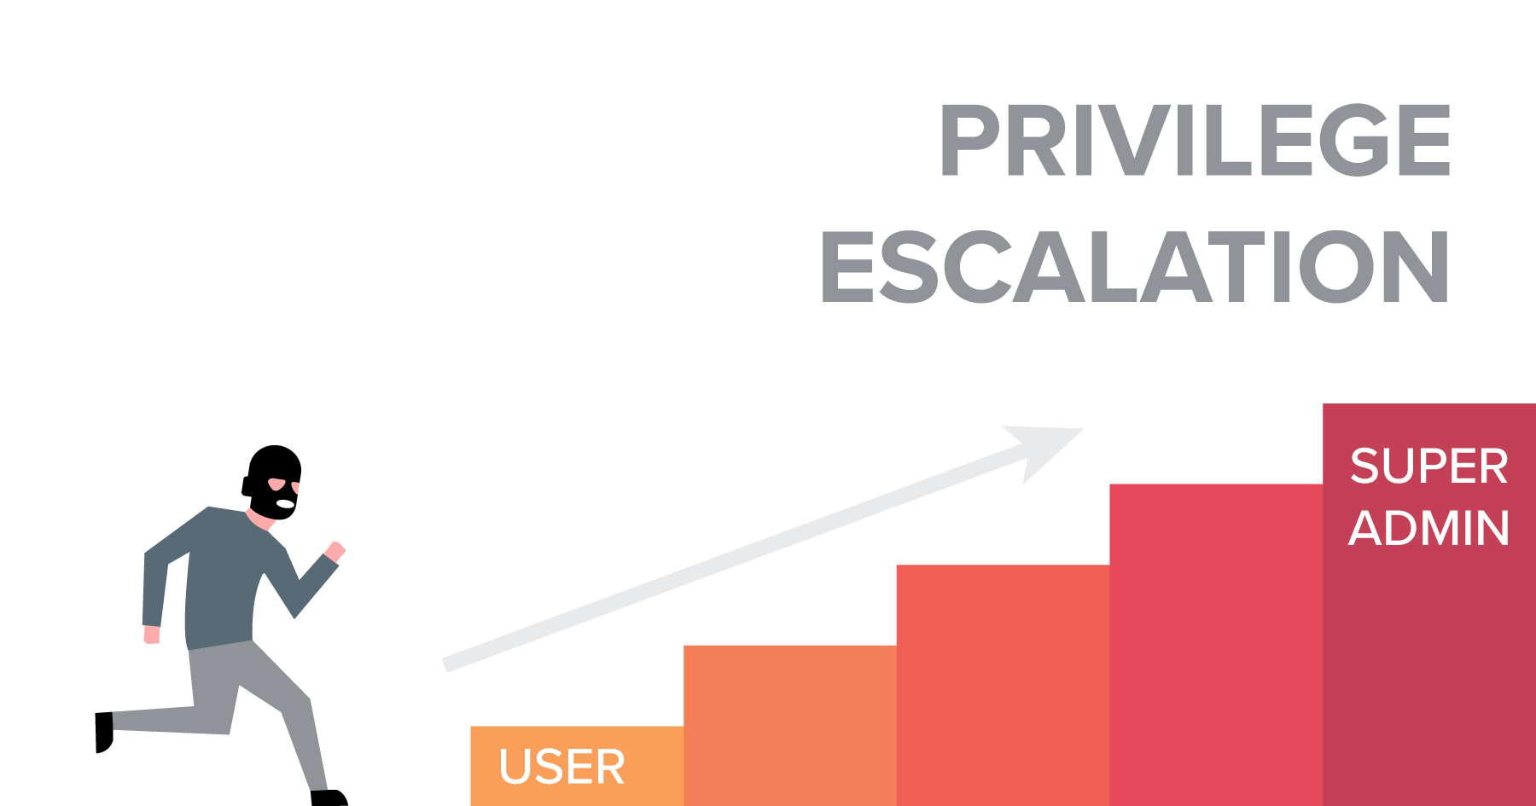
Socat : Content
Complex multi-services VM
Web, SSH, FTP, RDP, SMB …
Privilege escalation
Go from user to root
Get the flags

Slide 5
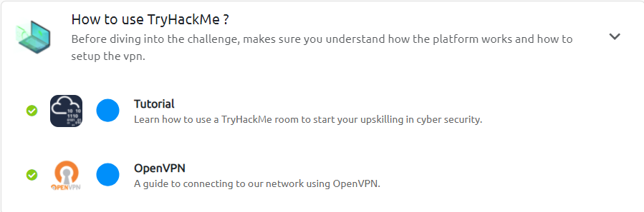

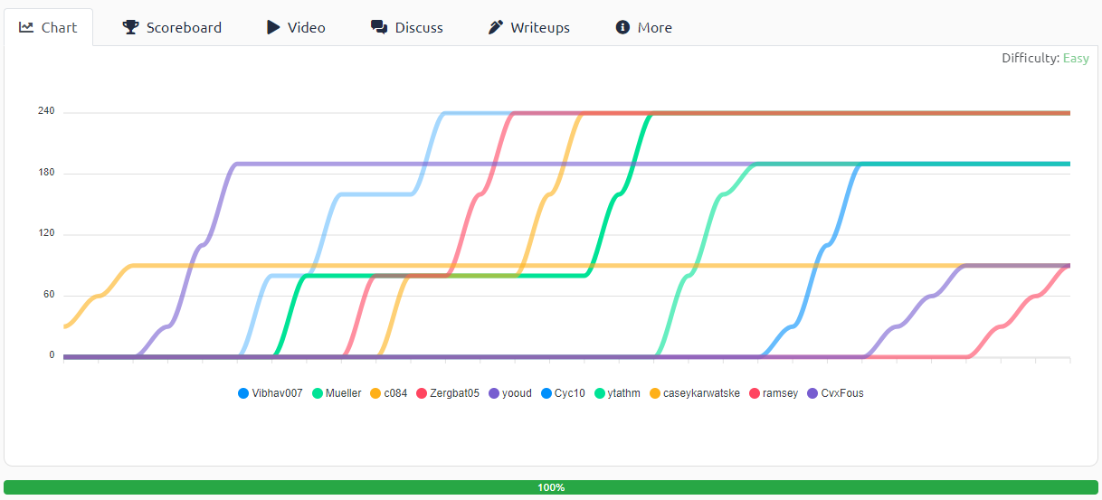
How does it works ?
Set of rooms on TryHackMe
One VM / user / challenge
Connect with OpenVPN
Realistic challenges
Different themes:
Python, CVE, Reversing…
Tunneling, hidden services
Hack all rooms
Find flags, get points

Slide 6
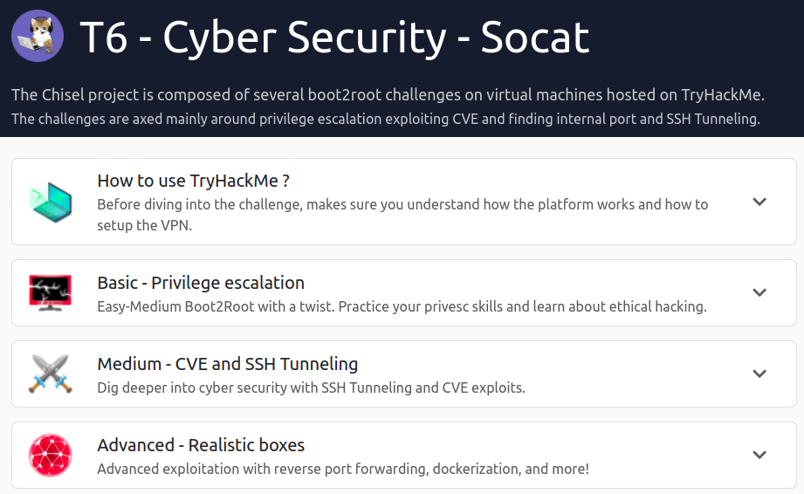
Planning
Kick-off (right now)
Bootstrap
Project : Socat
On TryHackMe
Groups of 2
Project defense

Slide 7

Project Defense
Review in front of the pedagogical team
The usual Keynote presentation
THEN
Explanation of challenges
1 challenge / student
The teacher will choose which challenge
This defense is MANDATORY to validate the module

Slide 8
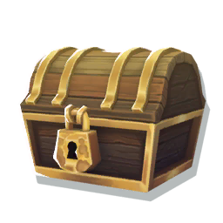
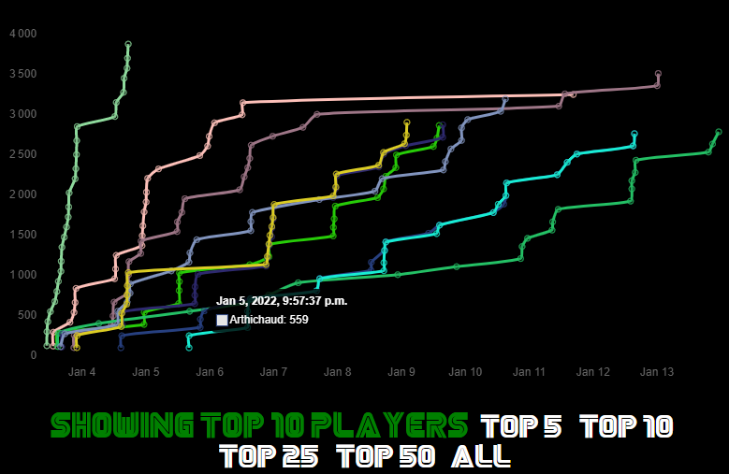
Perks and bonuses
1-month free subscription to TryHackMe
Over 500+ rooms
Faster machines
Access to networks
Fancy charts of your progress
Be the best of your city!
Be the best of all students!
Rewards to be gained

Slide 9
Bonuses
1-month free subscription to TryHackMe
Over 500+ rooms
Faster machines
Access to networks

Slide 10
Questions ?

