Slide 1

T-DEV-70x
Kick-off

Slide 2

Not only code
In professional context, developing software is much more than writing code.
Many additional challenges come with working as a team, on big projects, with the aim to satisfy clients.

Slide 3
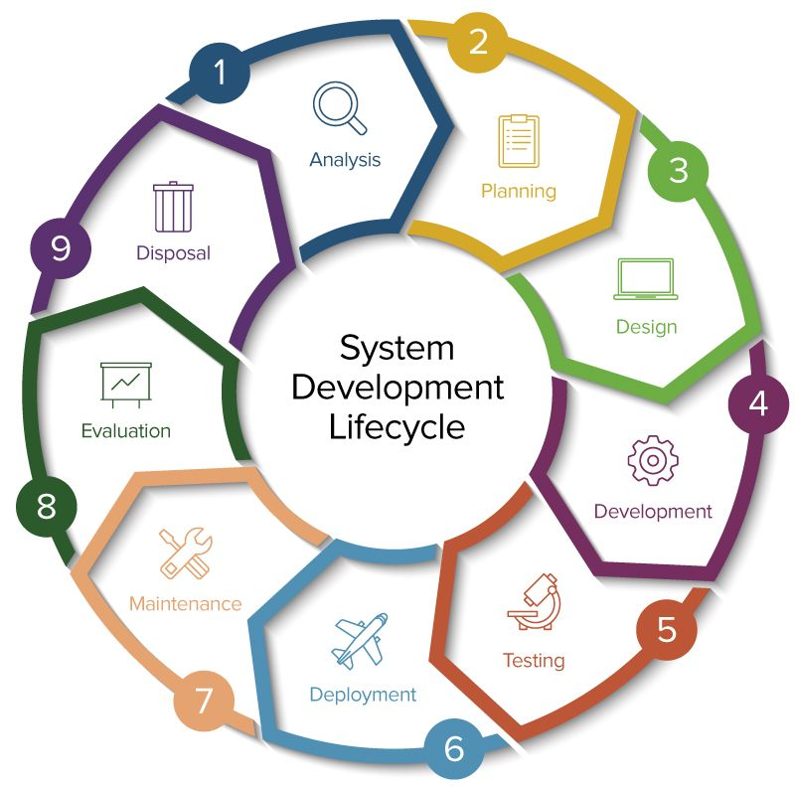
Software development lifecycle
Developing software is much more than writing code.

Slide 4

Challenges
Speculate on users’ expectations.
Define specifications
Design relevantly
Write consistent code
Test, secure, maintain, optimize code.
Work with constraints.
Interact with devices.

Slide 5

Difficulties
You should foresee quagmires.
You must overcome obstacles.
You need to brainstorm a lot.
You may talk with a rubber duck.

Slide 6
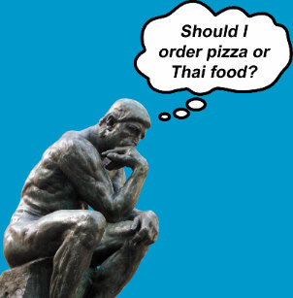
Feature or not feature?
Ask yourselves some questions, such as:
Mandatory Vs useful Vs volitional?
Is it a need or a wish?
What users’ problem am I trying to solve?
What are the resources required to implement it?
How will this feature impact the performance?
What is a good application?
What makes it better than others?
...

Slide 7
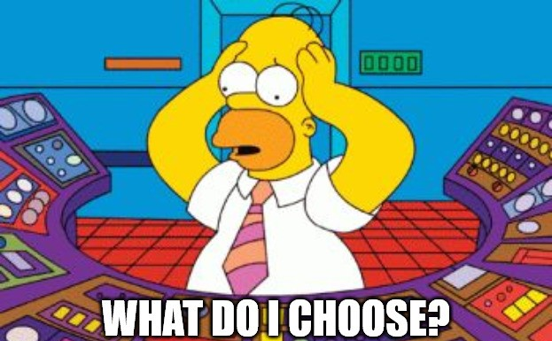
The right tool for the right job
Web and mobile applications can be built in various ways. Choosing the appropriate tools is up to you.

Slide 8
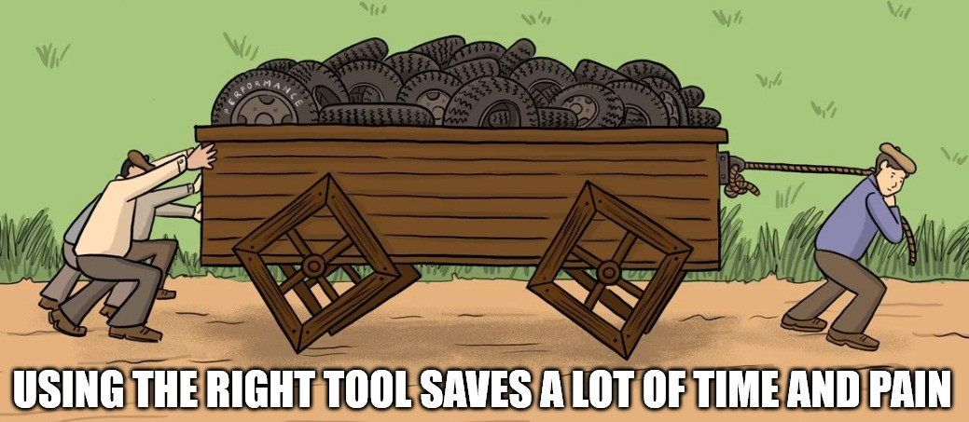
Why using development frameworks?
Increased efficiency.
Less repetitive work.
Consistent structure.
Built-in security features.
Growth support and scalability.
Community support.
Cross-platform development.
Testing and debugging tools.

