Slide 1

T-DEV-703 – APP Dev
Kick-off

Slide 2

Why practicing mobile development?
Mobile devices are the primary way people access digital services.
Mobile devices offer unique features (e.G. camera, GPS, ...) enabling the creation of highly engaging applications.
Mobile technology evolves rapidly, providing continuous learning and growth opportunities for developers.
Mobile development skills are in high demand.

Slide 3

App dev main challenges
OS variability (Android, iOS)
Countless devices and configs
Performance optimization
UX/UI strong expectations
Security concerns
Store compliance
Accessibility

Slide 4

Don’t neglect the design

Slide 5
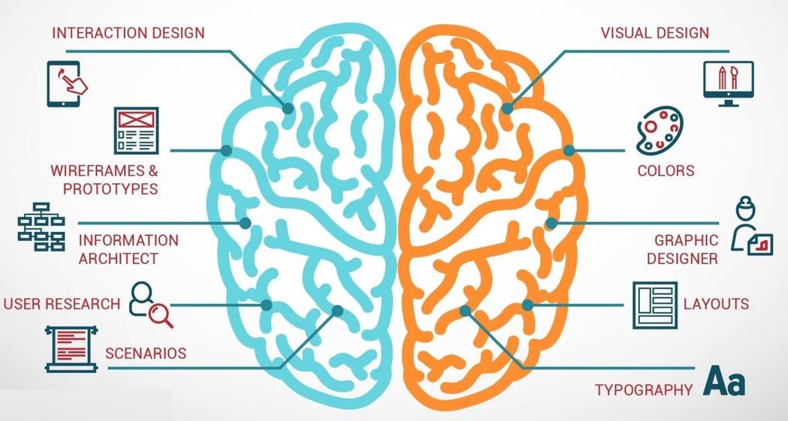
Design thinking

Slide 6
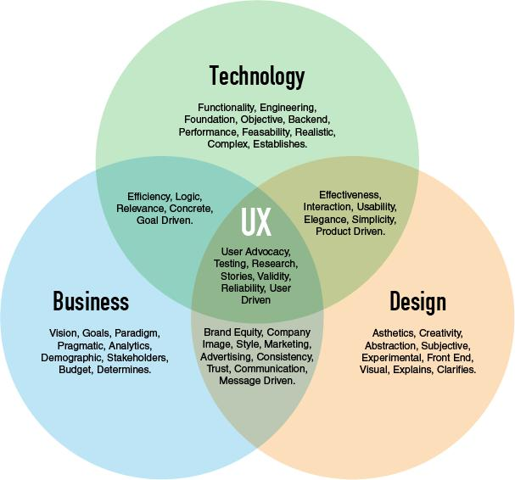
UX / UI

Slide 7
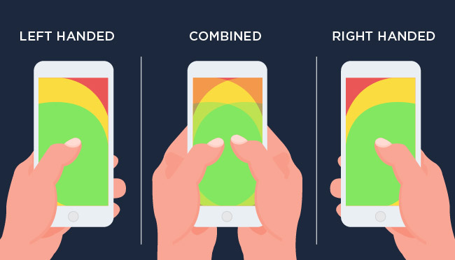
The Thumb Zone
D

Slide 8
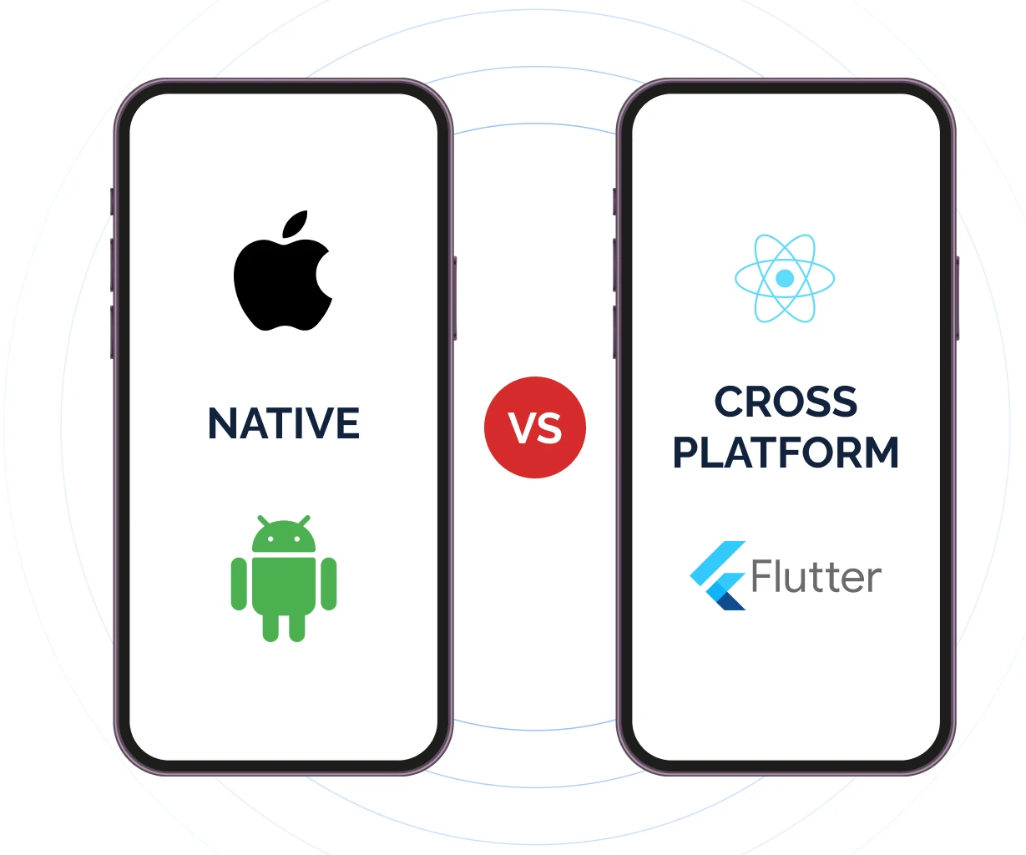
Cross platform / Native
Cross platform != Native

Slide 9






Native
One code for one platform
Specific language for a platform
Pros
Better app performance
Better user experience
Greater security
Cons
More ressource to develop app (one code, one platform)
No compatibility with other platform

Slide 10


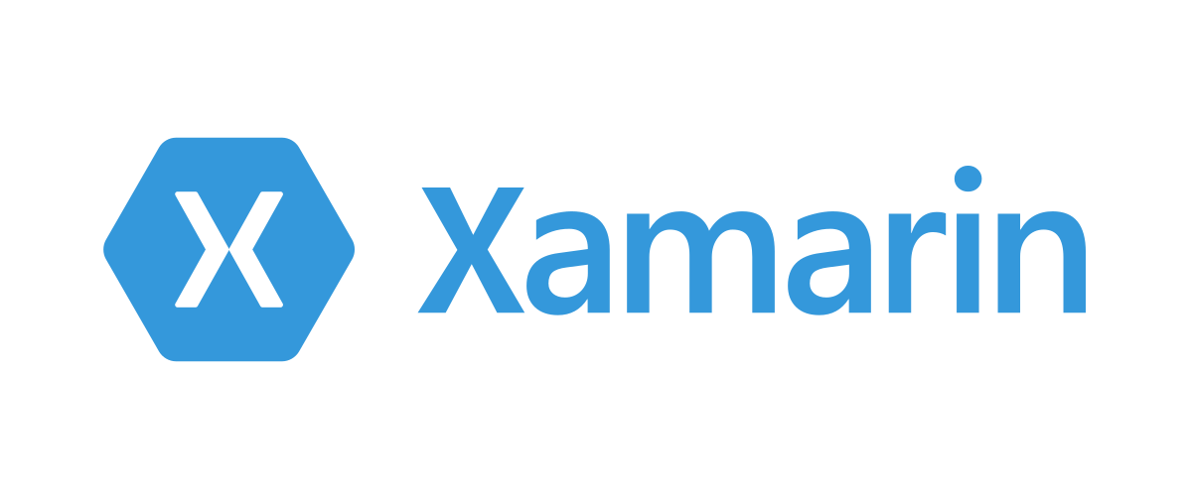
Cross Platform
One code for android and iOS
Pros
Single code base
Great collaboration
Lower app development cost
Cons
Necessity to write native code for some cases
Performance

Slide 11

Some mobile considerations to address
Does my product have to be nomadic?
Do I need to engage my audience?
Can my display be simplified?
Do I need to access mobile's native features?
Do I need to push notifications?
...

