Slide 1

Boston Air Bnb Visualization
Lauren Fletcher

Slide 2
Intro to the Visualization
Topic: Seasonal Air Bnb Prices for Bristol, RI
Problem Statement: How do Air Bnb prices change over the time of the year?
Data Source: http://insideairbnb.com/get-the-data
To analyze this problem, I have the following in my visualization
Choropleth map of Boston, MA colored by the population of air bnbs.
Air bnbs in the area are be plotted, and a user can hover over an air bnb to find more information about the Airbnb.
A slider to see how the price changes throughout the year.

Slide 3

Video of Visualization

Slide 4
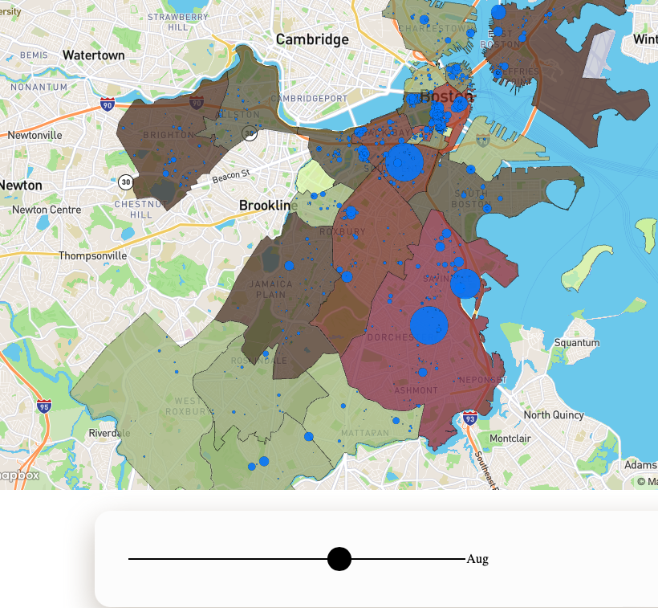
Explanation
The user can zoom and move around the map to see different areas.
The circles represent airbnbs. The circle size represents the price of the air bnb.
The user can use the range slider to see how air bnb prices change from month to month.
The user can hover over the air bnb to get more information on it.
Each neighborhood is categorized by a color dependent on the number of airbnbs in it.

Slide 5
Conclusion
Future work can entail,
The size of the circle changing dependent on the price of the air bnb is not as visual appealing as I thought it would be. Maybe instead of the size of the circle plot changing, I could put dollar signs above the plot depending on the price.
I could incorporate machine learning to give the air bnb a rating based on aspects of the Airbnb that people care about, such as, price, destination, number of bedrooms, etc.

