Slide 1
ENGR 4399 ST · Cyber-Physical and IoT Systems · Fall 2026
Automatic Plant Watering System
Weather-aware, per-plant, with a live dashboard — Smart Greenhouse, stage 1
Project 1 · October 20, 2026
Luis Oliveira & [partner name]
Dr. Okan Çağlayan · University of the Incarnate Word
Notes:
Introduce the team and the project in one sentence: an ESP32 that waters a plant safely, checks the weather and plant needs, and has a dashboard we can use to demonstrate every safety behavior.

Slide 2
More than a timer: what makes watering safe
Plants fail from too little water… and from too much
A pump that runs dry or never stops can burn out or flood
A broken sensor or tube must not cause endless pumping
Rain and heat change what the plant needs
Inspired by
"Automatic Plant Watering System" — Instagram video by eazytronic3795 (soil sensor + relay + pump).
What we added
Tank-level interlock · hysteresis + run limit + soak · response check and FAULT latch · OLED status · weather forecast · temperature alert + buzzer · 3 plant profiles · web dashboard with simulations
Notes:
Problem: too little, too much, broken hardware. Credit the Instagram video by eazytronic3795 explicitly. Then list what we added.

Slide 3
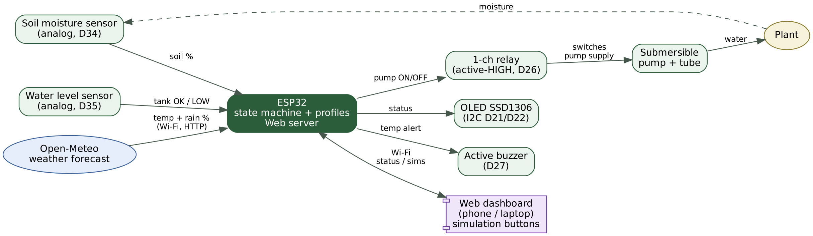
System architecture
Pump supply is isolated from the ESP32 by the relay contacts
Analog sensors on ADC1 (D34, D35), not affected by Wi-Fi
Weather and dashboard use Wi-Fi; watering still works without it
Notes:
Walk left to right: sensors and weather in, ESP32 decides, relay and pump act, OLED, buzzer and dashboard report.

Slide 4
Hardware and wiring (real ESP32)
ESP32 | Component | Notes
D34 | Soil sensor (S) | ~0 in air, ~1500 in water; V to 3V3
D35 | Water level sensor (S) | Tank LOW below raw 300; V to 3V3
D26 | Relay header (S) | Active-HIGH; relay + to VIN (5 V)
COM / NO | Relay screws | Pump supply (+) → COM; NO → pump red; black → supply (−)
D21 / D22 | OLED SSD1306 (0x3C) | I2C; VCC to 3V3
D27 | Active buzzer | Temperature alert
D0 (BOOT) | Button | Manual pump test, max 5 s
Also: MB102 power module + optional 9 V battery, breadboard, jumper wires, tank and plant.
Notes:
Mention parts are Keyestudio sensors, Elegoo relay, and that the relay is active-HIGH as measured.

Slide 5
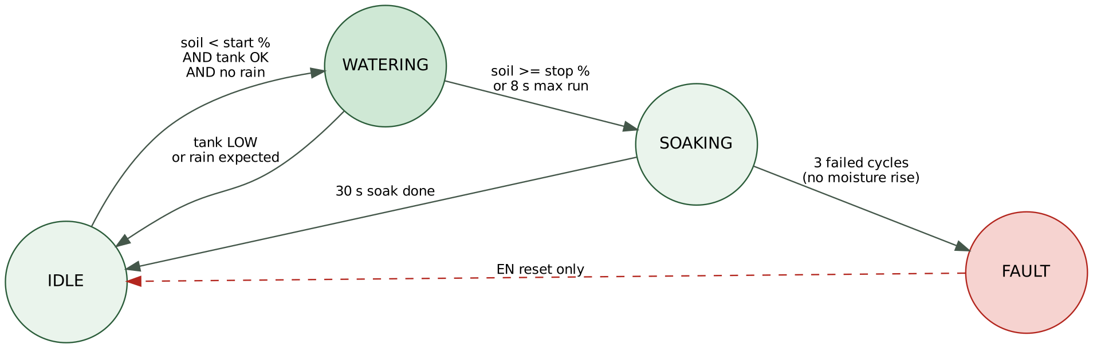
How it decides: a four-state machine
Hysteresis start/stop thresholds per plant · 8 s run limit · 30 s soak (demo)
Soil must rise ≥ 3% per run, otherwise the cycle counts as failed
3 failed cycles → FAULT: pump stays off until a physical EN reset
Notes:
Explain hysteresis: start below the profile threshold, stop above the higher one so the pump does not chatter. Soak lets water reach the probe.

Slide 6
Layered safety
1 Boot OFF
2 Tank interlock
3 Rain block
Relay is forced off in the first line of setup().
Low tank blocks and stops the pump; no fault counted.
Rain chance ≥ 60% in 3 h blocks watering.
4 Run limit
5 FAULT latch
8 s maximum per cycle; BOOT test 5 s.
3 failed cycles disable the pump until EN reset.
The pump runs only if every condition allows it.
Notes:
Each layer is independent. Boot OFF first, then interlocks, then limits, then fault latch.

Slide 7
Weather awareness and plant profiles
Rain likely → skip watering, the rain will do it
Temperature outside the plant’s range → dashboard + OLED alert + buzzer
Two short beeps = too hot · one long beep = too cold
Wi-Fi down → soil logic still works; own network "PlantWater" for the dashboard
Profile | Start < | Stop | Temp °C
Basil (thirsty) | 40% | 70% | 12–32
Aloe (drought-tolerant) | 15% | 35% | 10–35
Fern (moist) | 50% | 80% | 16–27
Default values — [update if your three plants differ]
Notes:
Weather from Open-Meteo every 10 min, never while the pump runs. Temperature is forecast outdoor temperature, a stated limitation. Profiles are default values, tunable.

Slide 8
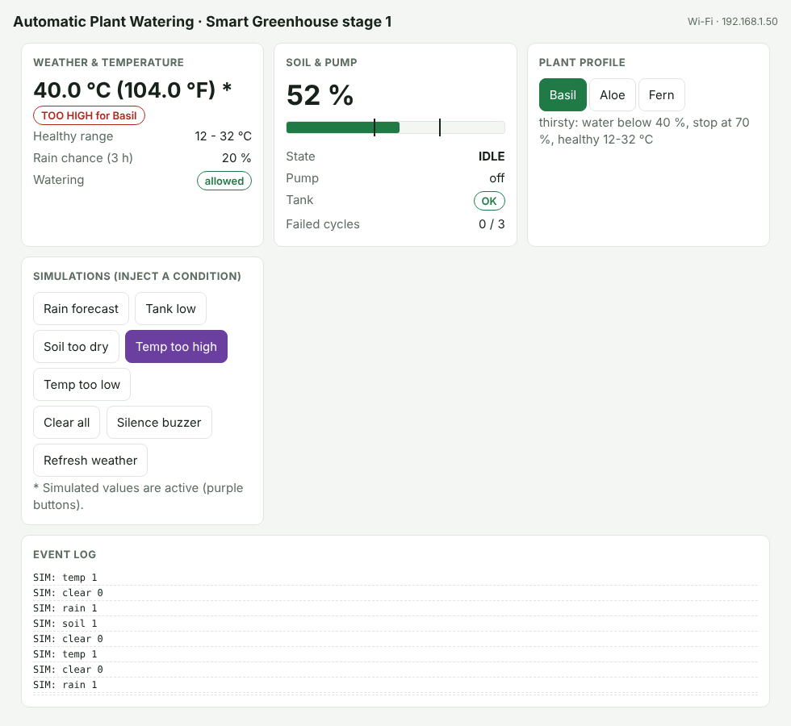
Dashboard with simulation buttons
Button | System response
Rain forecast | Watering blocked; running pump stops
Tank low | Pump blocked, no fault counted
Soil too dry | Pump starts, stops at 8 s limit
Temp too high | Alert + two short beeps
Temp too low | Alert + one long beep
Simulations cannot disable the run limit, tank interlock or fault latch.
UI preview — [replace with real screenshot]
Notes:
The ESP32 serves this page itself. Simulations inject a condition on top of the real readings so we can demo each safety behavior on demand. Replace the preview image with a real screenshot.

Slide 9
Live demo plan
Open the dashboard; select the Basil profile
Soil too dry → pump starts, stops at 8 s
Rain forecast → pump blocked, dashboard says "rain will water it"
Tank low → pump blocked, OLED "TANK LOW"
Temp too high / too low → alert and buzzer; Silence button
Switch to Aloe or Fern → thresholds and healthy range change
Backup: hold the BOOT button for a 5 s manual pump run.
Notes:
Do these in order; each takes about 20 seconds. Have the manual BOOT test ready as a fallback.

Slide 10
Test results
Test | Expected | Result
Relay polarity | Click ON with D26 HIGH | Active-HIGH ✓
Soil calibration | Distinct dry / wet values | ~0 air, ~1500 water ✓
Full watering cycle | IDLE→WATERING→SOAKING→IDLE | [TO FILL]
Tank low (real) | Pump blocked, no fault | [TO FILL]
FAULT after 3 failed cycles | Pump off until EN reset | [TO FILL]
Rain / tank / soil simulations | Block, block, run ≤ 8 s | [TO FILL]
Temp alerts + buzzer | Alert, two short / one long beep | [TO FILL]
Live weather | Matches reference source | [TO FILL]
Notes:
Fill the yellow cells from the real tests before presenting. Tests 1 and 2 were done during the build.

Slide 11
Evidence: photos and video
[PHOTO: full setup]
[PHOTO: OLED states]
[SCREENSHOT: serial log / calibration]
[VIDEO STILL: pump starting]
Notes:
Drop in the photos and a short video clip of the pump starting.

Slide 12
What the hardware taught us
Relay is active-HIGH
Soil reads LOW when dry
Plan for the network
We first assumed active-low. A relay-only test sketch with the pump disconnected caught it before anything ran by surprise.
The opposite of YL-69 style probes in tutorials. We map percent from measured air and water readings (~0 and ~1500).
Campus Wi-Fi can block device-to-device links. The ESP32 falls back to its own "PlantWater" network so the dashboard always works.
[Add one lesson from connecting the pump]
Notes:
These are the findings from the real board. Stress verify-before-trust.

Slide 13
Limits, security and what’s next
Limitations
Stage 2: Smart Greenhouse
Temperature is the forecast for the location, not at the plant
Rain skip uses forecast probability
Resistive probe corrodes over time
Dashboard: no login, plain HTTP — demo only
Profile values are defaults to tune
Temperature/humidity sensor at the plant
Grow light and shade control
Plant profiles stored on the device
Login, HTTPS, signed OTA updates
Capacitive soil probe
Notes:
Be honest about limitations. Security: dashboard has no login and plain HTTP, fine for a demo only. Stage 2 roadmap.

Slide 14
Questions?
Credit: "Automatic Plant Watering System" by eazytronic3795 (Instagram) · Weather data: Open-Meteo (CC BY 4.0) · Libraries: Adafruit SSD1306 / GFX, Arduino-ESP32
Full references in the Project Report, Appendix B.
Notes:
Invite questions. Mention the report has the full code and references.

