Slide 1
Finite Element Method applied to Poisson Equation
Logan Freeman

Slide 2
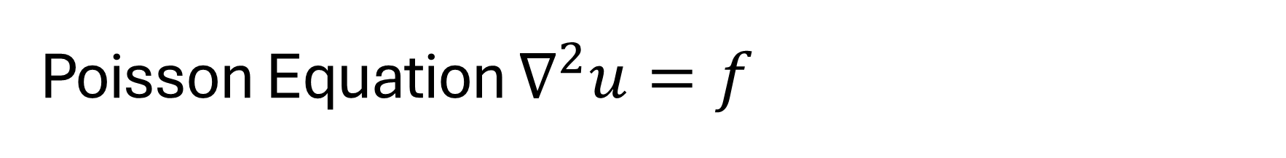
Poisson Equation $∇^{2}u=f$
Solid Mechanics: Stress Distribution
Heat Transfer: Temperature Distribution
Electromagnetics: Electric Potential
Fluid Mechanics: Potential Flow, Viscous Operator in Navier-Stokes

Slide 3
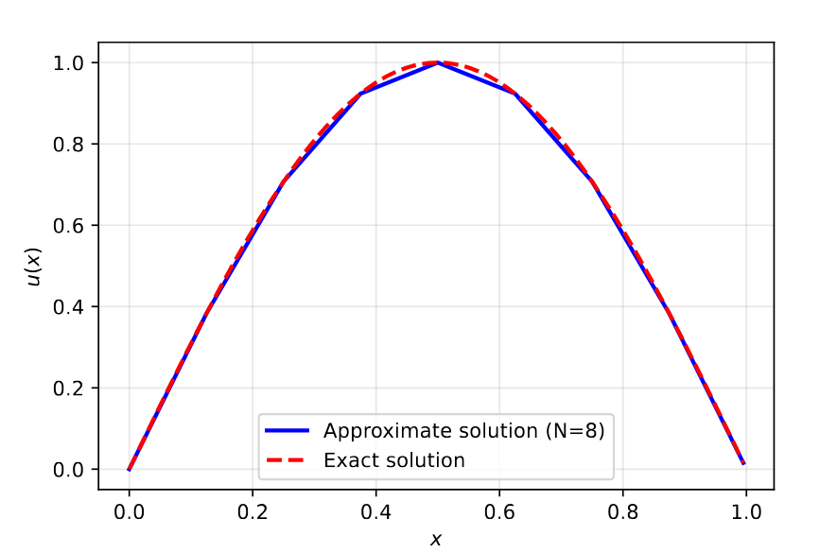
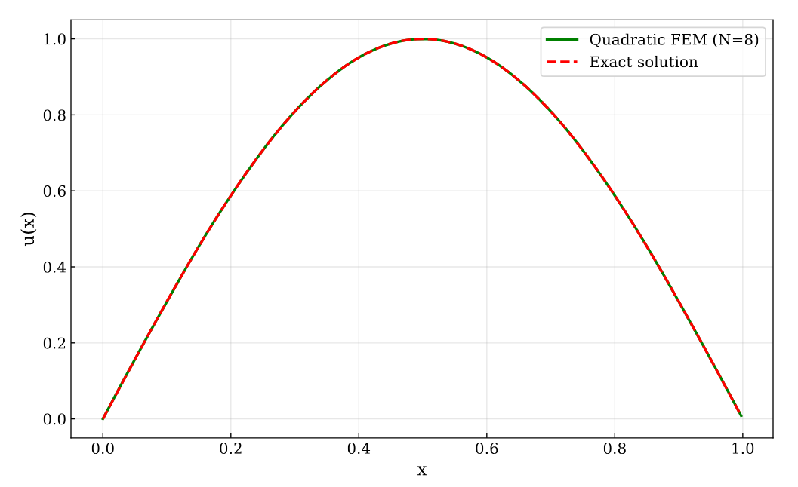
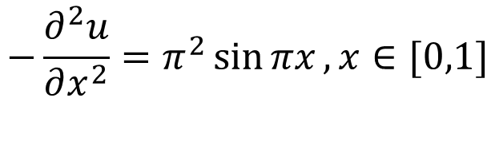

Steady Poisson
$$−\frac{∂^{2}u}{∂x^{2}}=f\left(x\right)$$
In General:
In this case:
Which has exact solution:
$$−\frac{∂^{2}u}{∂x^{2}}=π^{2}\sin{πx}, x∈[0,1]$$
$$u\left(x\right)=\sin{πx}$$

Slide 4
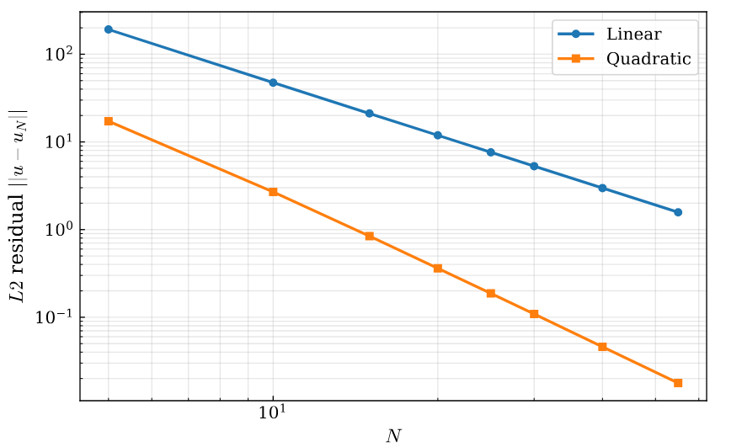

One-Dimensional Spatial Convergence
L2 Norm: $\left|u−u_{N}\right|=\sqrt{\int_{0}^{L}{{\left(u−u_{N}\right)}^{2} }}$

Slide 5
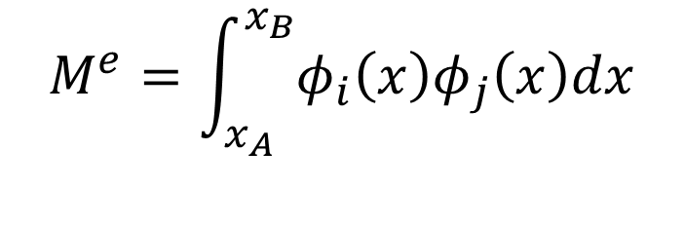

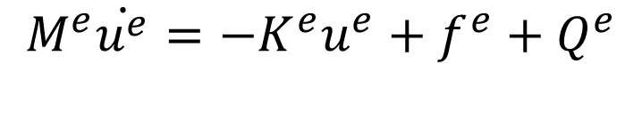
Transient Poisson Derivation
$\frac{∂u}{∂t}=α\frac{∂^{2}u}{∂x^{2}}+f\left(x,t\right)$
Temporal Discretization brings mass matrix:
Elemental equation:
$$M^{e}=\int_{x_{A}}^{x_{B}}{φ_{i}\left(x\right)φ_{j}\left(x\right)dx}$$
$$M^{e}\dot{u^{e}}=−K^{e}u^{e}+f^{e}+Q^{e}$$

Slide 6
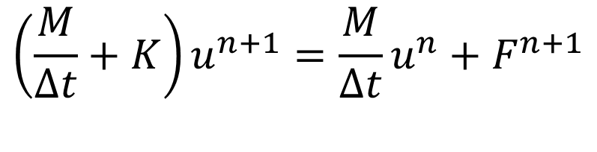
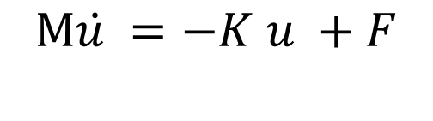
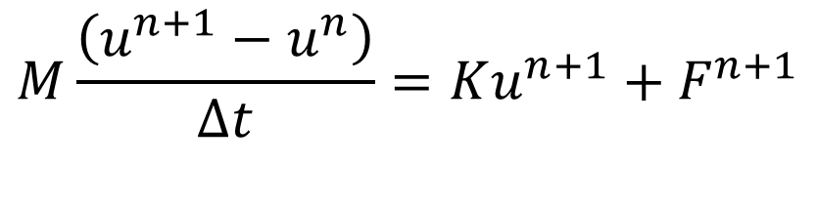
Transient Poisson Derivation, cont.
Global Equation:
Temporal Discretization with Backwards Euler:
Rearranging:
$$M\dot{u^{ }}=−K^{ }u^{ }+F$$
$$M\frac{\left(u^{n+1}−u^{n}\right)}{Δt}=Ku^{n+1}+F^{n+1}$$
$$\left(\frac{M}{Δt}+K\right)u^{n+1}=\frac{M}{Δt}u^{n}+F^{n+1}$$

Slide 7
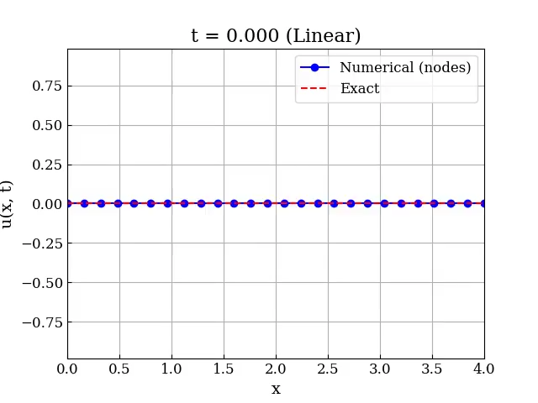

Transient Poisson Results
Method of Manufactured solutions
PDE Technique – choose $u\left(x,t\right)$ and calculate $f\left(x,t\right)$ which produces that exact solution

Slide 8
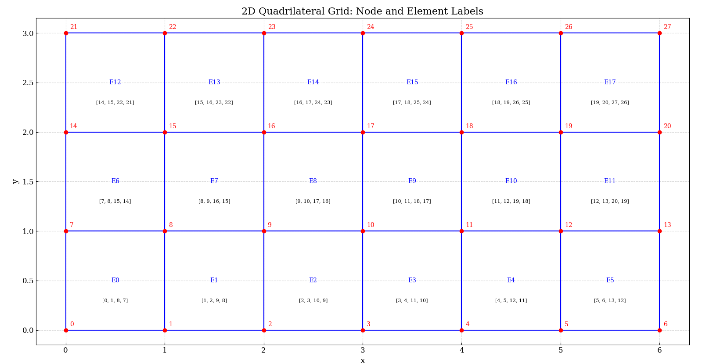
2D Transient Poisson

Slide 9
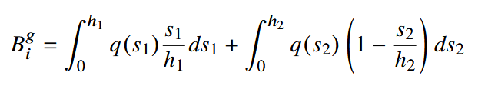
2D Transient Poisson – Boundary integral
Boundary integral on a node is sum of neighbor elements

Slide 10
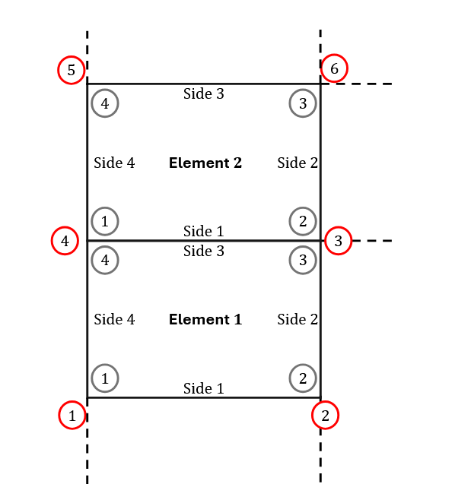
2D Transient Poisson – Boundary integral

Slide 11
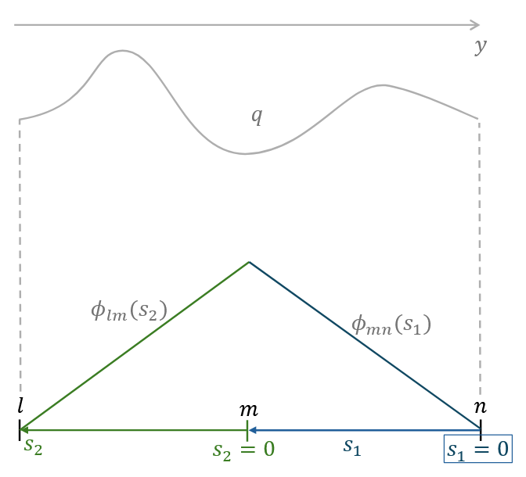
2D Transient Poisson Boundary integral

Slide 12
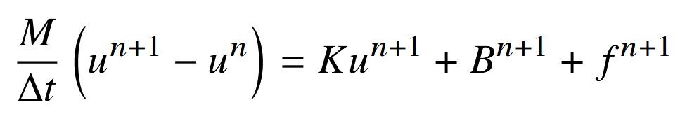
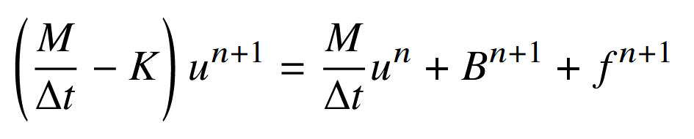
2D Transient Poisson
Global System:
Rearrange:

Slide 13
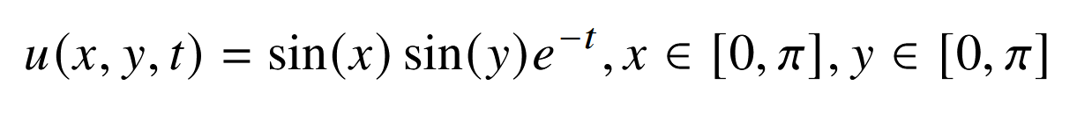

2D Transient Poisson
Exact Solution with homogenous Dirichlet boundaries, $α=\frac{1}{2}$

Slide 14
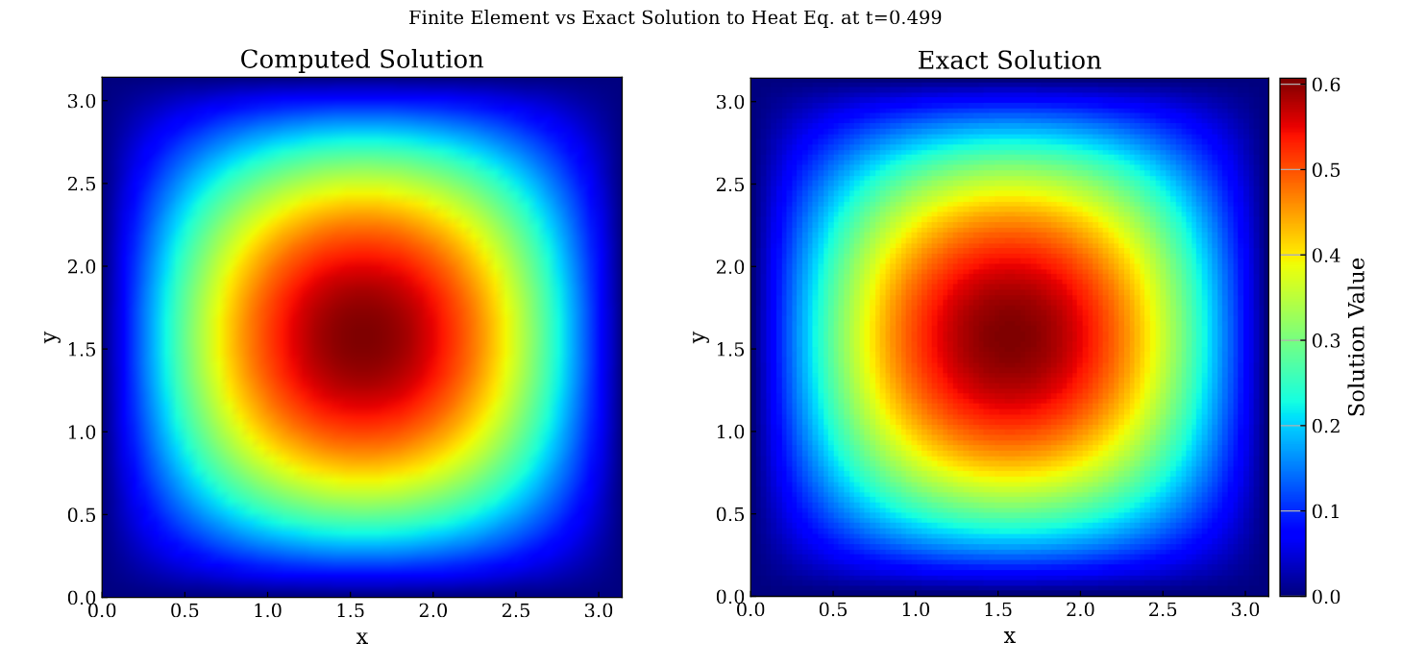
2D Transient Poisson

Slide 15
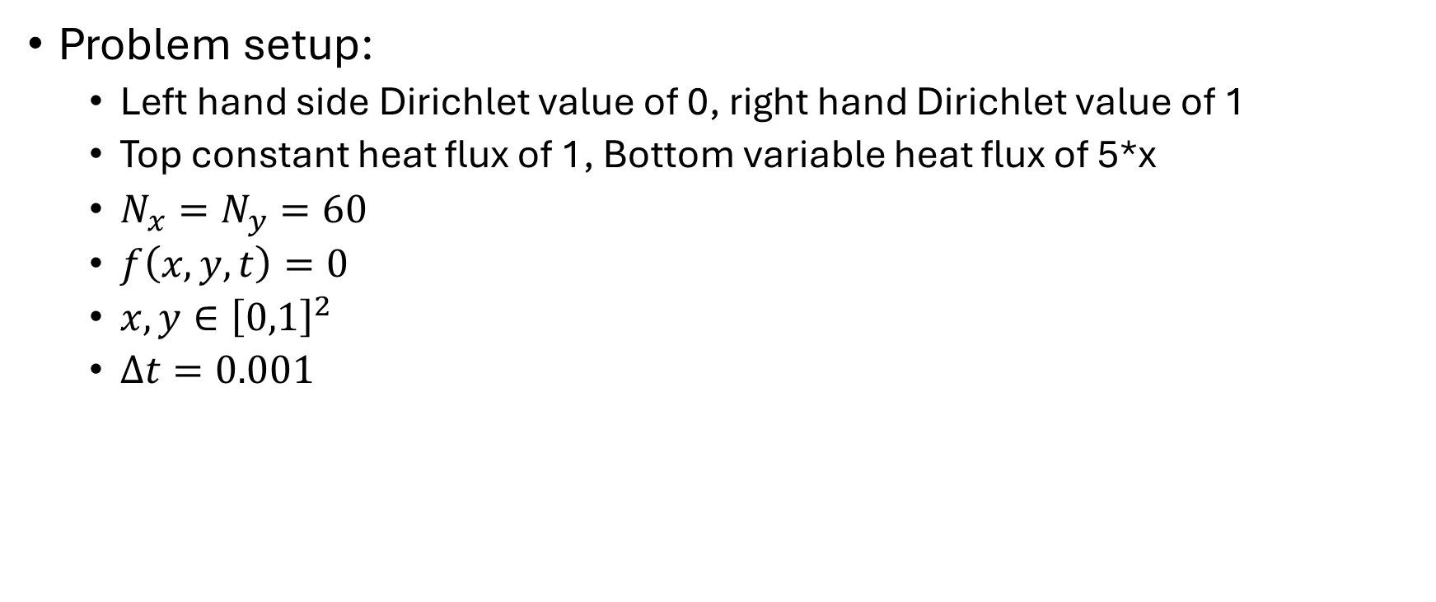
2D Transient Poisson
Problem setup:
Left hand side Dirichlet value of 0, right hand Dirichlet value of 1
Top constant heat flux of 1, Bottom variable heat flux of 5*x
$N_{x}=N_{y}=60$
$f\left(x,y,t\right)=0$
$x,y∈{\left[0,1\right]}^{2}$
$Δt=0.001$

Slide 16
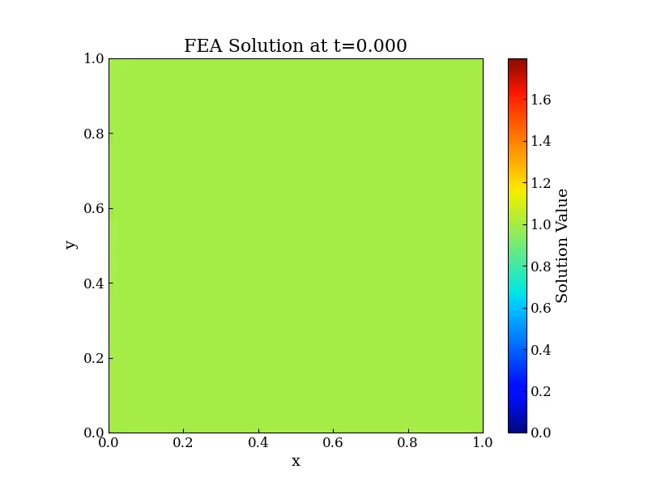
q=1 Neumann
U=0 Dirichlet
U=1 Dirichlet
q=5x Neumann

