Slide 1
Dynamics of Norton’s Dome

Slide 2

Dynamics for point mass moving on slope
$h=h\left(r\right)$
r is the geodesic coordinate on the curve (distance along the surface)
Dynamics for r:
$$\ddot{r}=g sin(θ)$$
$$\ddot{r}=−g\frac{dh}{dr}$$
WLOG g=1
$$F_{N}$$
$$r$$
$$θ$$
$$F_{g}$$

Slide 3
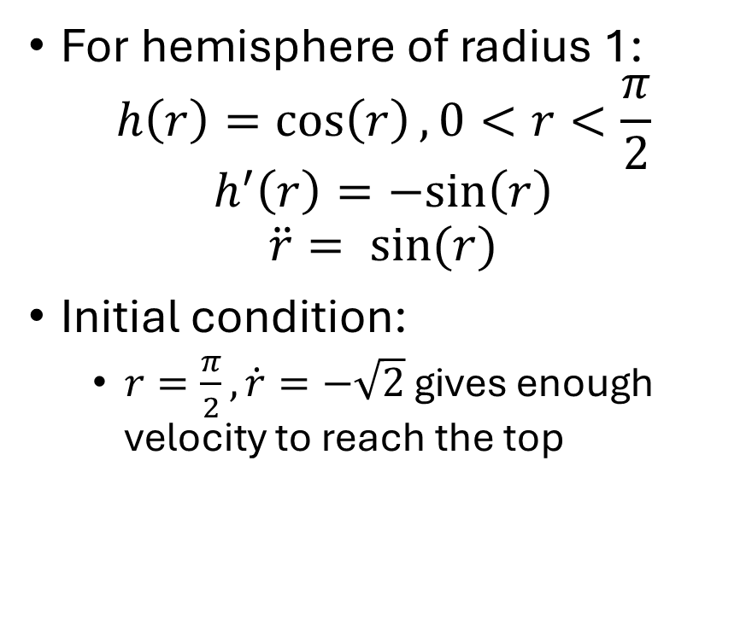
Dynamics for point mass on hemisphere
For hemisphere of radius 1:
$$h\left(r\right)=\cos\left(r\right), 0<r<\frac{π}{2}$$
$$h^{′}\left(r\right)=−sin\left(r\right)$$
$$\ddot{r}= sin⁡(r)$$
Initial condition:
$r=\frac{π}{2}, \dot{r}=−\sqrt{2}$ gives enough velocity to reach the top
$$r$$
$$h(r)$$

Slide 4
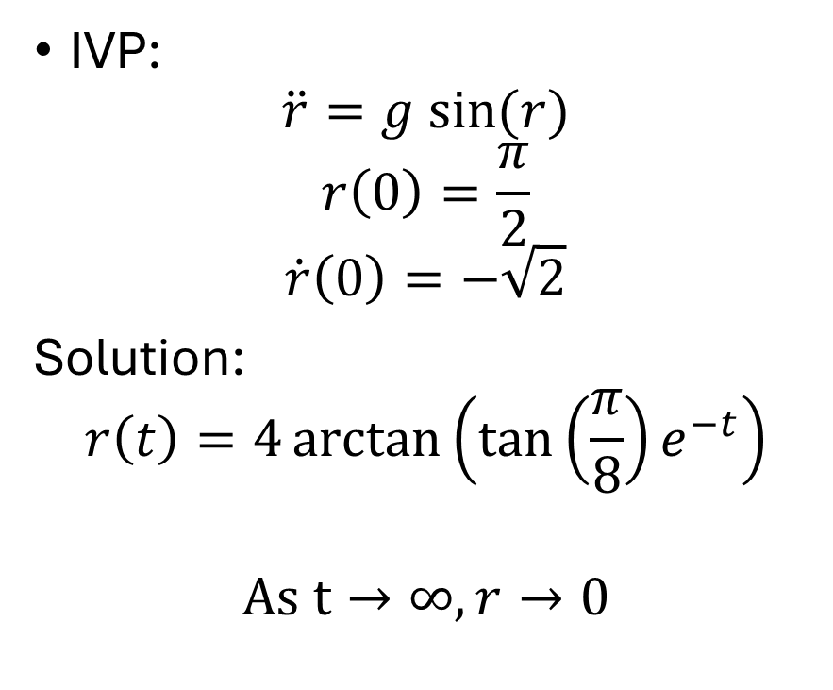
Dynamics for point mass on hemisphere
IVP:
$$\ddot{r}=g sin⁡(r)$$
$$r\left(0\right)=\frac{π}{2}$$
$$\dot{r}\left(0\right)=−\sqrt{2}$$
Solution:
$$r\left(t\right)=4\arctan\left(\tan\left(\frac{π}{8}\right)e^{−t}\right)$$
$$As t→∞,r→0$$
$$r$$
$$h(r)$$

Slide 6
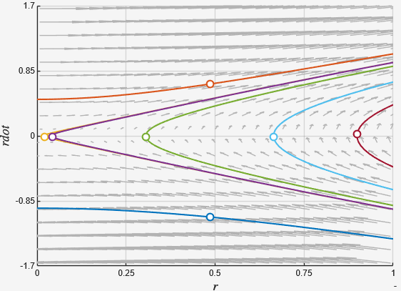

Stability for point mass on hemisphere
Linearization at fixed point $r=0$, $\dot{r}=0$:
$$A=\begin{matrix}0 & 1 \\ 1 & 0\end{matrix}$$
Saddle point, restricted to r>0

Slide 7
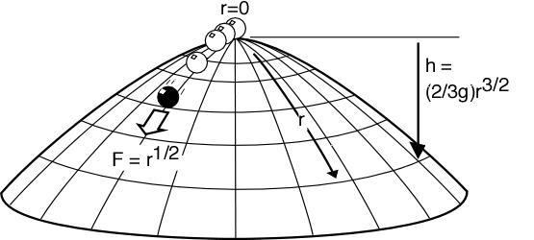
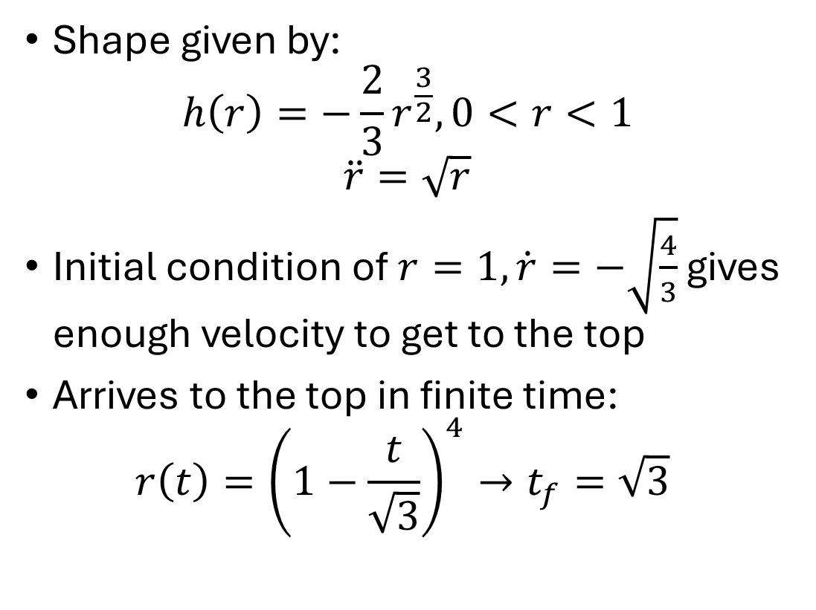
Dynamics for point mass on Norton’s Dome
Shape given by:
$$h\left(r\right)=−\frac{2}{3}r^{\frac{3}{2}},0<r<1$$
$$\ddot{r}=\sqrt{r}$$
Initial condition of $r=1,\dot{r}=−\sqrt{\frac{4}{3}}$ gives enough velocity to get to the top
Arrives to the top in finite time:
$$r\left(t\right)={\left(1−\frac{t}{\sqrt{3}}\right)}^{4}→t_{f}=\sqrt{3}$$

Slide 9
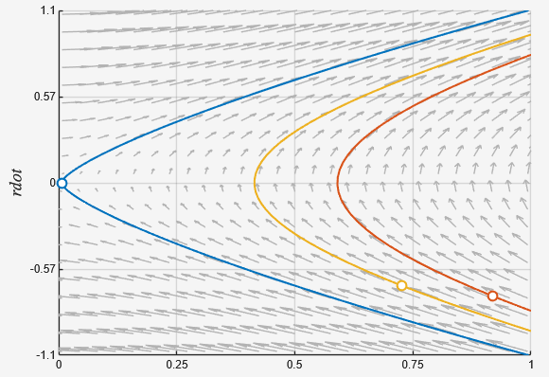

Stability for point mass on Norton’s Dome
Linearization at fixed point $r=0$, $\dot{r}=0$:
$$A=\begin{matrix}0 & 1 \\ ∞ & 0\end{matrix}$$
Behaves like an unstable saddle point

Slide 10
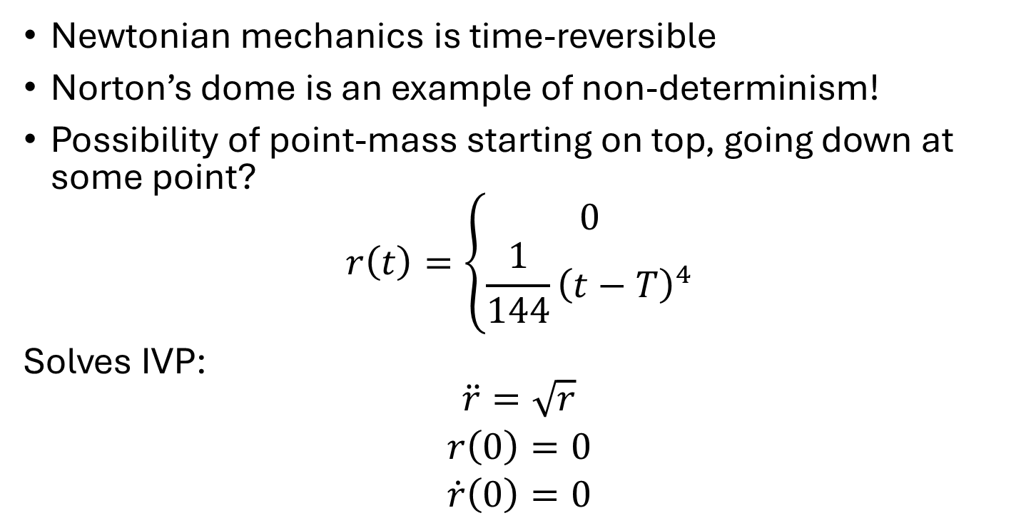
Behavior for point mass on Norton’s Dome
Newtonian mechanics is time-reversible
Norton’s dome is an example of non-determinism!
Possibility of point-mass starting on top, going down at some point?
$$r\left(t\right)=\left\{\begin{aligned}0 \\ \frac{1}{144}{\left(t−T\right)}^{4}\end{aligned}\right.$$
Solves IVP:
$$\begin{matrix}\ddot{r}=\sqrt{r} \\ r\left(0\right)=0 \\ \dot{r}\left(0\right)=0\end{matrix}$$

