Slide 2

Dynamics for point mass moving on slope
$h=h\left(r\right)$
r is the geodesic coordinate on the curve (distance along the surface)
Dynamics for r:
$$\ddot{r}=g sin(θ)$$
$$\ddot{r}=g\frac{dh}{dr}$$
WLOG g=1
$$F_{N}$$
$$r$$
$$θ$$
$$F_{g}$$

Slide 3
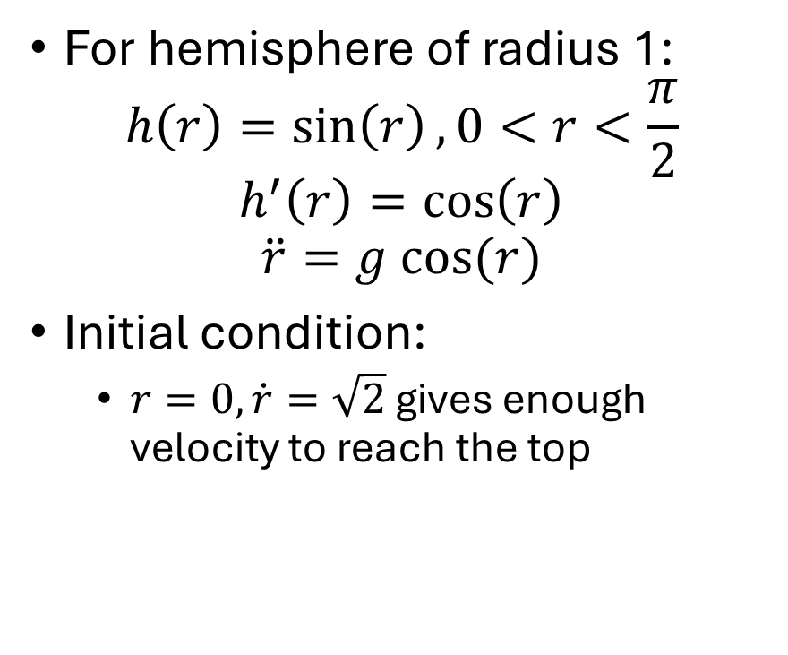
Dynamics for point mass on hemisphere
For hemisphere of radius 1:
$$h\left(r\right)=\sin\left(r\right), 0<r<\frac{π}{2}$$
$$h^{′}\left(r\right)=\cos\left(r\right)$$
$$\ddot{r}=g cos⁡(r)$$
Initial condition:
$r=0, \dot{r}=\sqrt{2}$ gives enough velocity to reach the top
$$r$$

Slide 4
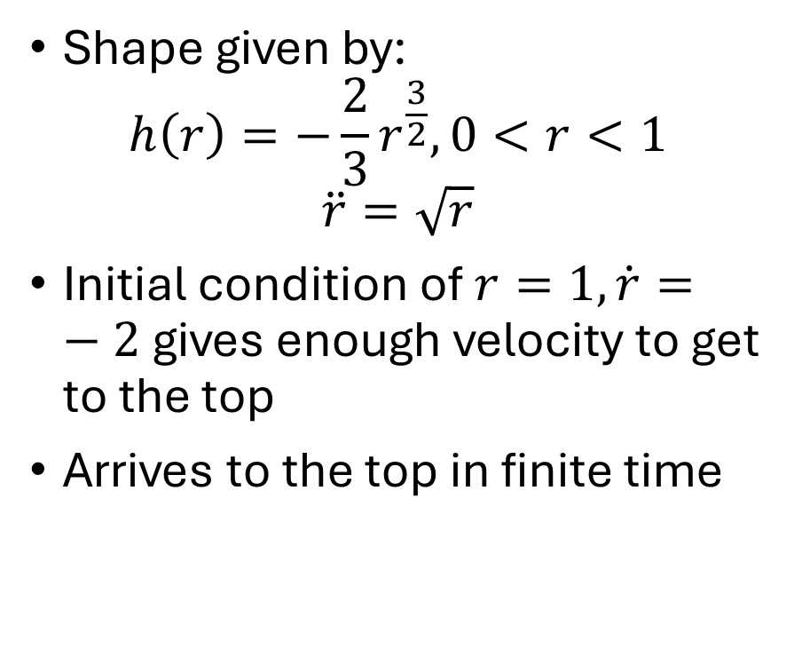
Dynamics for point mass on Norton’s Dome
Shape given by:
$$h\left(r\right)=−\frac{2}{3}r^{\frac{3}{2}},0<r<1$$
$$\ddot{r}=\sqrt{r}$$
Initial condition of $r=1,\dot{r}=−2$ gives enough velocity to get to the top
Arrives to the top in finite time
$$r$$

Slide 5
Dynamics for point mass on Norton’s Dome
Stab
$$r$$

Slide 6
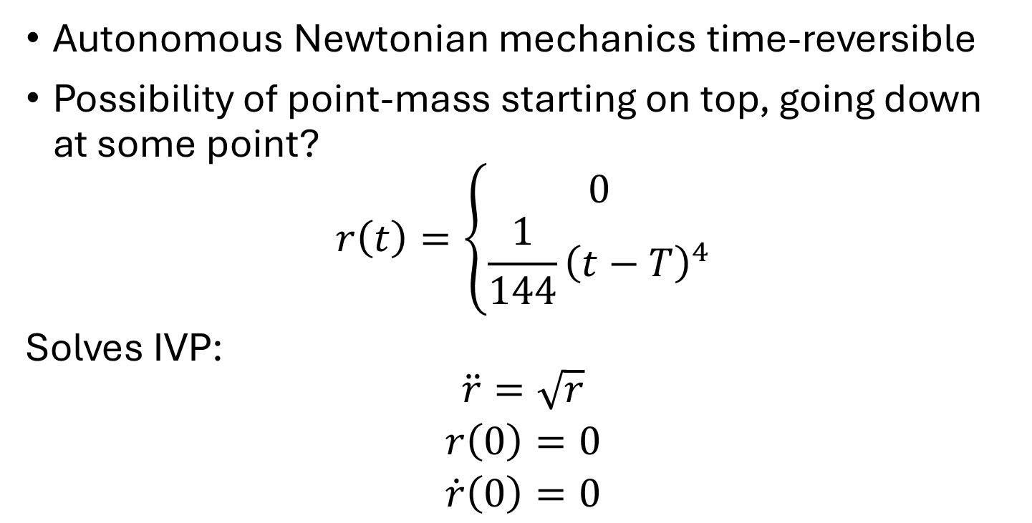
Stability for point mass on Norton’s Dome
Autonomous Newtonian mechanics time-reversible
Possibility of point-mass starting on top, going down at some point?
$$r\left(t\right)=\left\{\begin{aligned}0 \\ \frac{1}{144}{\left(t−T\right)}^{4}\end{aligned}\right.$$
Solves IVP:
$$\begin{matrix}\ddot{r}=\sqrt{r} \\ r\left(0\right)=0 \\ \dot{r}\left(0\right)=0\end{matrix}$$

