Slide 1
Lukáš Fryč
Visual Testing of
Browser Screen Captures
using RushEye

Slide 2
Agenda
Motivation
Sample Application
Present Tools
Introducing RushEye
Methods of Result Stabilization
Automation
Future

Slide 3
Motivation
Visual testing = Subset of manual testing
  repetitious and so error-prone
Visual testing can be automated
  Automated testing can be more extensive
  Testers may focus on critical areas

Slide 4
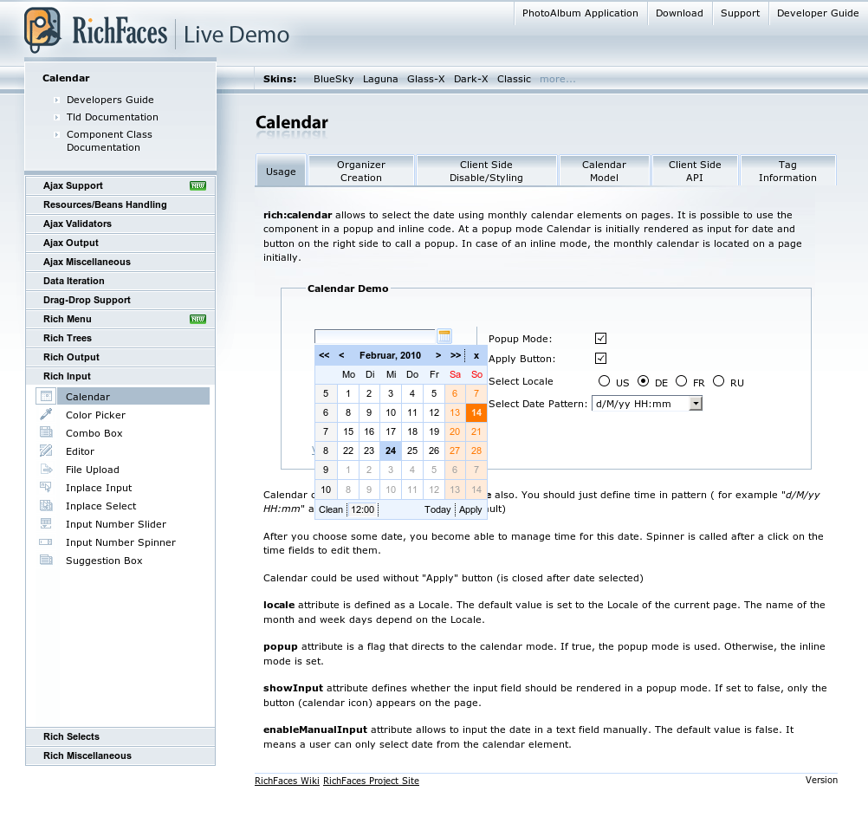
Sample Application
RichFaces Live Demo
  http://livedemo.exadel.com/richfaces-demo/index.jsp
  77 components
  12 skins
  3 major browsers (FF, IE7, IE8)
  77 * 12 * 3 = 2772
Functional tests in place

Slide 5


Conditions of Sample App.
Ready for capturing screen-shots
  using Selenium
Idea of automated screen-shot
  generation
  comparison
The problem: existing screen-shot comparison tools

Slide 6
Real Needs
Static Analysis of 2D images
Filtering as much wrong hits as possible

Slide 7
Introducing RushEye
RushEye
is able to output perceptual statistics
is able to process filtering

Slide 8
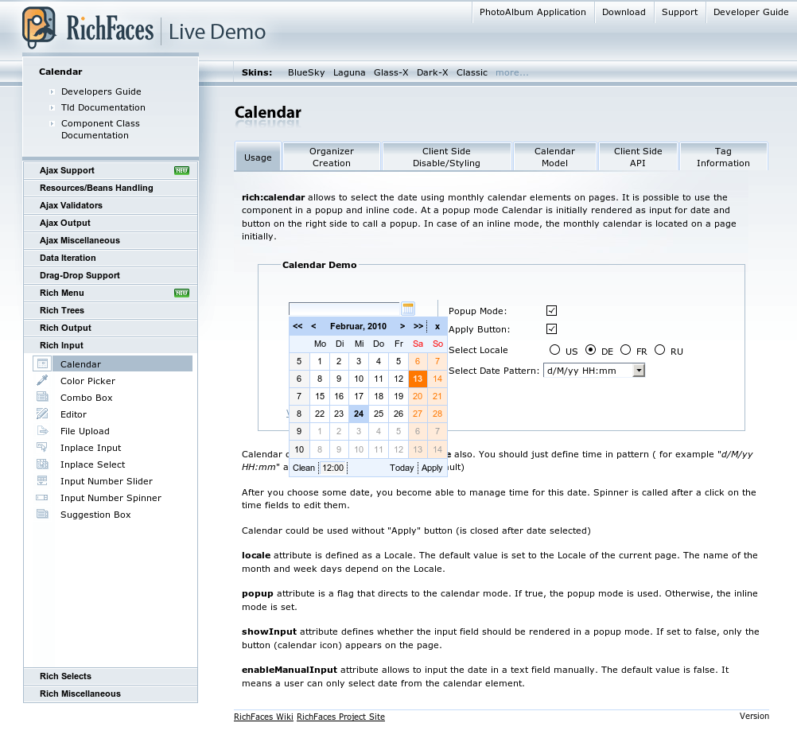
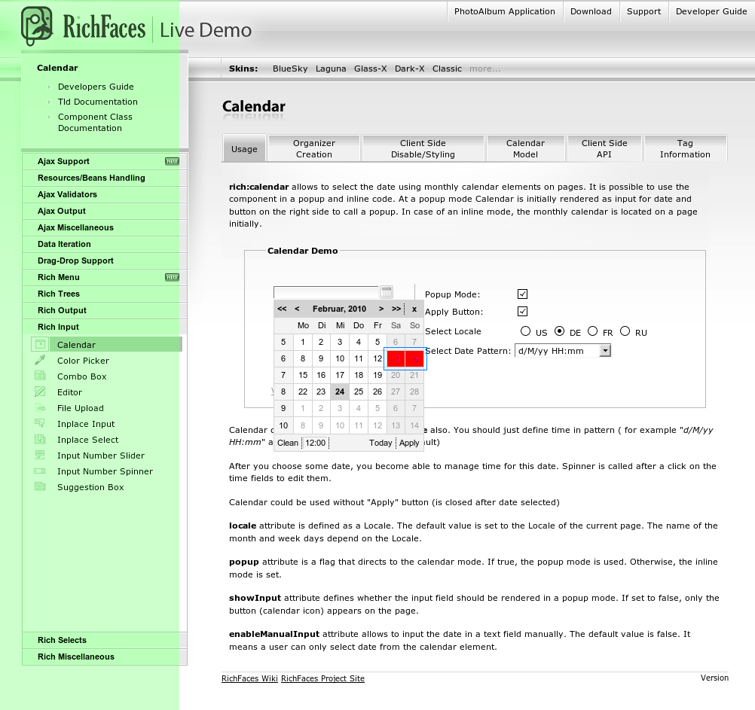
RushEye at Work
Take 1..* patterns
stats: same images: 356 stats: different images: 38 stats: errors: 0 stats: run duration: 239s
Mask time-variant changes
Same pixels are gray-scaled
compare
Take a sample
Highlight differences

Slide 9
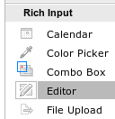

Perceptual Statistics
How much was pixel in image changed?
  locally
  in global measure
Accepting images on basis of perceptual settings
Examples:

Slide 10
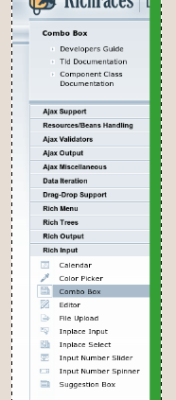
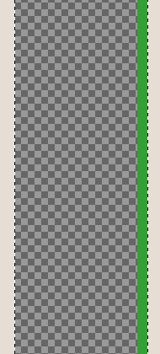
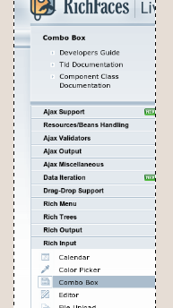
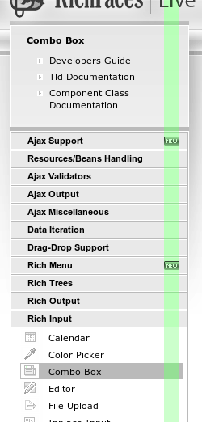
Selective-Alpha in Action
Do you face version-specific
changes on each screen?
3. export
PNG
[new-features.png]
(alignment: top-left)
1.
Filter it out!
4. apply RushEye
2.
And hide
background

Slide 11
Ignore-Bitmap masks

Slide 12

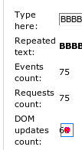
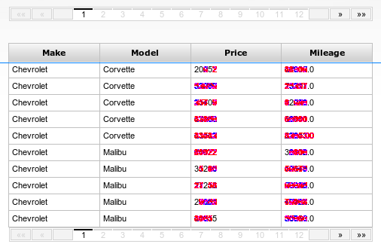
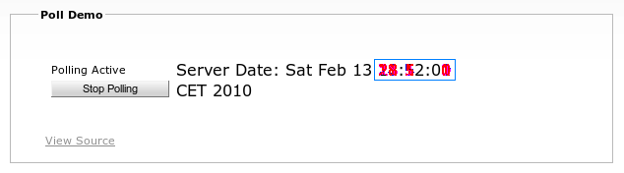

Failures
stats: same images: 356 stats: different images: 38 stats: errors: 0 stats: run duration: 239s
But it isn't only successful
Random data
Animated GIF
Non-deterministic tests
Time-variant data

Slide 13
Time-Variant and Random Changes
Redefining system methods or library features without changes to tested binaries
  Using BootClassLoader
    to redefine java.util.Random in order to get non-random data
    to redefine System.currentTimeMillis()

Slide 14
Stabilized Results
The only problematic aspect is based on animations
Random data
Animated GIF
Non-deterministic tests
Time-variant data
determinable
de-randomized
stabilized

Slide 15
Statistics
Only 25 from 394 tests were identified as changes in underlying application
13 screens still wait for proper method of stabilization

Slide 16
How it works
Awaits images
in predefined structure
(bound by test-id
with visual-suite)
Image Generation
Samples
[test-id.png]
Results
[visual-suite-result.xsd]
+
Rejected Diffs
Patterns
+
Masks
RushEye Core
Images + XML Descriptor
[visual-suite.xsd ]
<test name=“test-id“ … />
Test report
HTML report
visual-suite.xml can be generated
automatically from predefined structure

Slide 17
Concept of Automation
CI
Image Generation
Patterns
+
Masks
[git]
RushEye Core
Results
[http]
RushEye Manager

Slide 18
Lukáš Fryč
Visual Testing of
Browser Screen Captures
using RushEye

