Slide 1
CPU SCHEDULING
OS PBL

Slide 2
Agenda
INTRODUCTION 3
TYPES OF CPU SCHEDULING 4
ALGORITHMS 5
EXAMPLES 10
SUMMARY 11

Slide 3

Introduction
Scheduling of processes/work is done to finish the work on time. CPU Scheduling is a process that allows one process to use the CPU while another process is delayed (in standby) due to unavailability of any resources such as I / O etc, thus making full use of the CPU. The purpose of CPU Scheduling is to make the system more efficient, faster, and fairer.

Slide 4
Types of CPU Scheduling
PREEMPTIVE: Preemptive scheduling is when a process transitions from a running state to a ready state or from a waiting state to a ready state.
NON PREEMPTIVE: Non-preemptive scheduling is employed when a process terminates or transitions from running to waiting state.

Slide 5
SCHEDULING ALGORITHMS
1. First Come First Serve(FCFS)
2.Longest Job First (LJF)
3. Shortest job First (SJF)
4.Priority
5.Round Robin(RR)

Slide 6
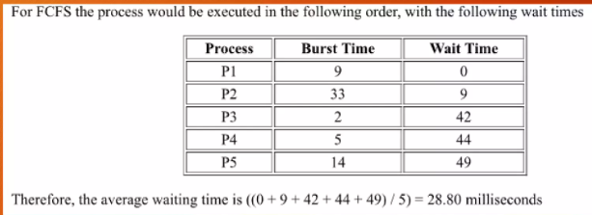
FCFS

Slide 7
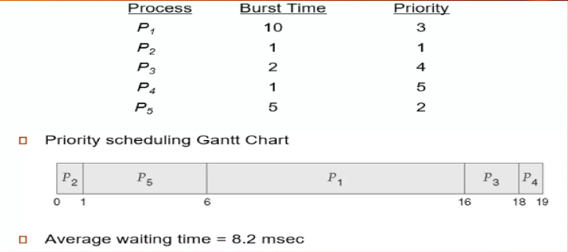
PRIORITY SCHEDULING

Slide 8
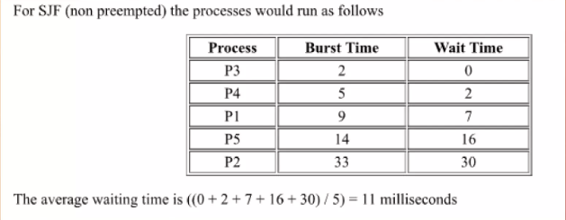
SJF

Slide 9
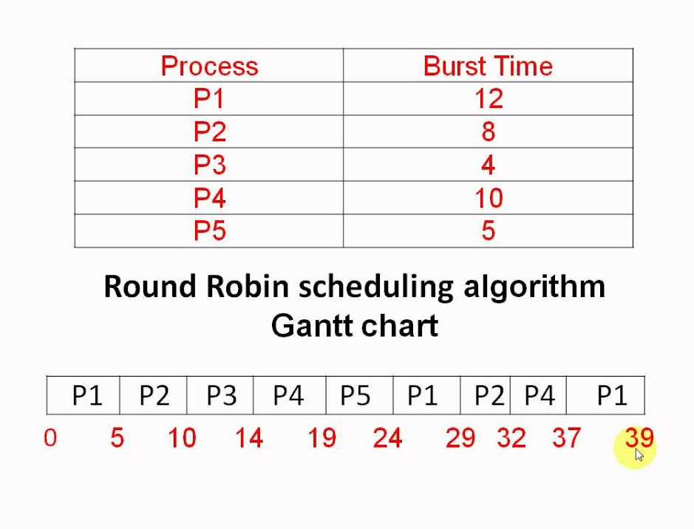
ROUND ROBIN

Slide 10
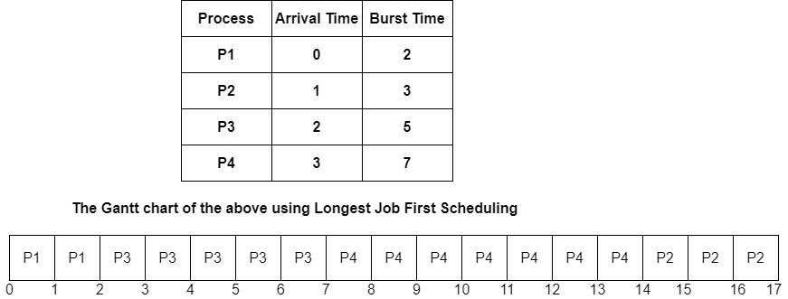
LJF

Slide 11
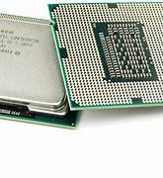
Summary
The above mentioned are the various CPU Scheduling used in present day. These algorithms are inherited based on the recruitment of the processor.

Slide 12
Thank you
Anay Dwivedi 2100290110027
Aman Dwivedi 2100290110017
Aman Khan 2100290110018

