Slide 1
Computational Thinking
Laura Gutierrez Funderburk
Richard Hoshino
Michael Lamoureux

Slide 2
What is computational thinking?
Formulating a problem so that the solution can be obtained by computational means
Often accesses data (a large amount) as input to the solution
Choice and design of algorithms for a solution is important

Slide 3
Example – Can we see global warming?
Access some data: Vancouver weather records
Plot it, do we see the evidence?
Dive deeper, use computational methods to see trends

Slide 4
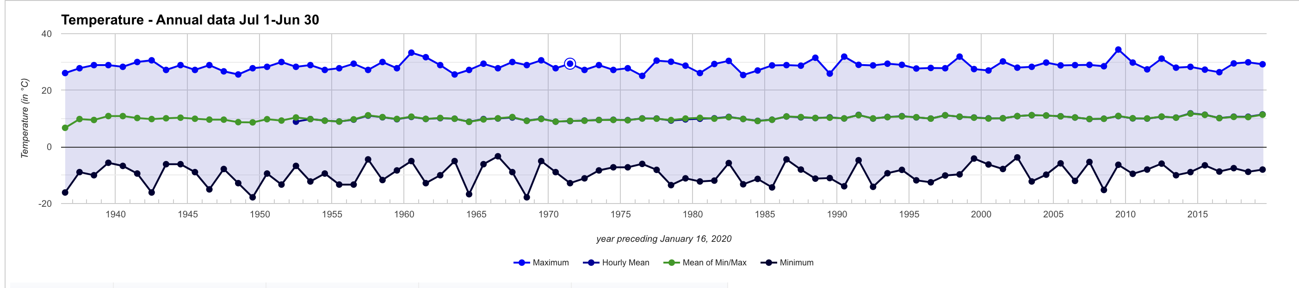
Vancouver temperatures: 1935 - 2020
Notes:
https://vancouver.weatherstats.ca/charts/temperature-wyearly.html. It is not clear that we can see any trends here.

Slide 5
Grab the numbers, and analyze
Notes:
Dive deeper into the data. Grab values that are available over the internet. In this case, monthly max and min temperatures going back to 1936

Slide 6
Trends in Monthly Min Temperatures
Notes:
Minimum temperature shows a downward trend. Except I charted this backwards, with year 2020 on the left. So it is actually an increasing trend!

Slide 7
Trend line y = 0.00123x + 6.778
X is measure in months, so temp is rising at .00123 degrees per month
.00123 x 12 x 100 = 1.5 degrees per century.
Notes:
Excel gives us the trend line, using linear regression. The coefficient 0.00123 tells us the slope, or the number of degrees increase per month, on average. Convert this to degrees increase per century, and we see the worrisome number of 1.5 degrees Celcius per century.

Slide 8
Summary
Computational thinking:
We used available data to look for trends in temperature.
We used computational tools to put a number to the average increases.
Going further:
Can we apply this to more data, from more cities around the world? To other projects?

Slide 9

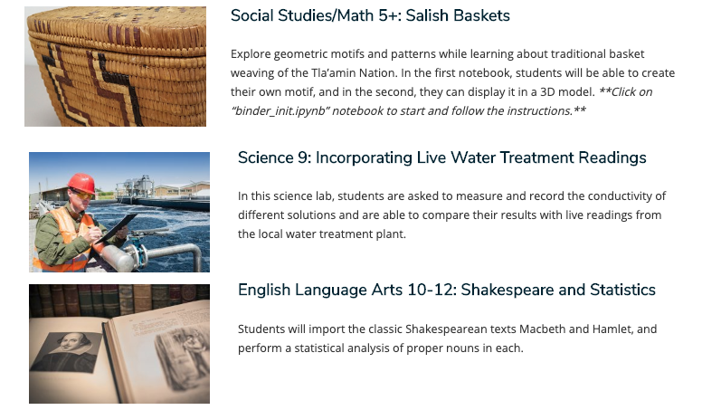
Tools for teaching CT

Slide 10
Thank you !

Slide 12
Quadratic trend show the increase
Notes:
Quadratic fit shows increasing trend, so perhaps we do have to worry.

Slide 13
Trends in Monthly Max temperatures
Notes:
For the monthly Max temperature, the trend is not so clear. Hmm, think about this.

