Slide 1

AI Teaching Toolkit
Prompts and guidelines
Fabrício Góes

Slide 2
About the AI Teaching Toolkit
This AI Teaching Toolkit provides a set of prompts and guidelines that can be used for different academic purposes to support teachers and students.
It provides prompts and guidelines to:
Improving accessibility to learning material
Assessing student coursework with a rubric
Interviewing students
Providing multiple feedback to students
Writing essays
Interpreting documents/policies/papers
Rubric criteria for AI Use

Slide 3
AI as Tutor

Slide 4
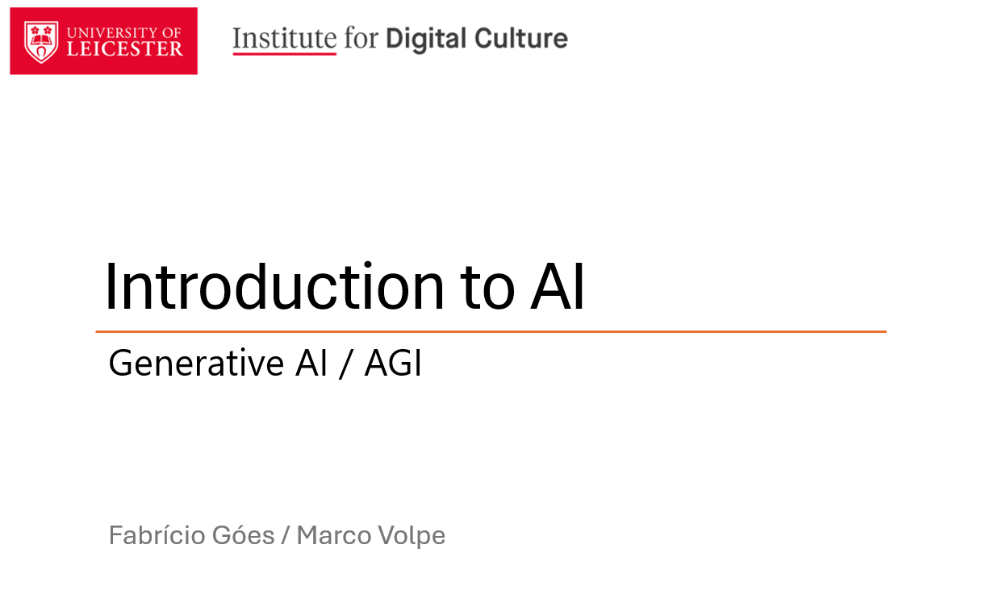

AI as Tutor
When we write some slides, we have some “persona in mind”
Our slides/explanations don’t work for all different people
AI can help each individual to understand your slides (accessibility)
Act as a tutor, your goal is to make this presentation more accessible to me. Ask me as many questions you judge important. Ask me one question at a time. Ask questions about the style I would like the explanations to be. When you gathered enough information, create a friendly tutorial about these slides.

Slide 5
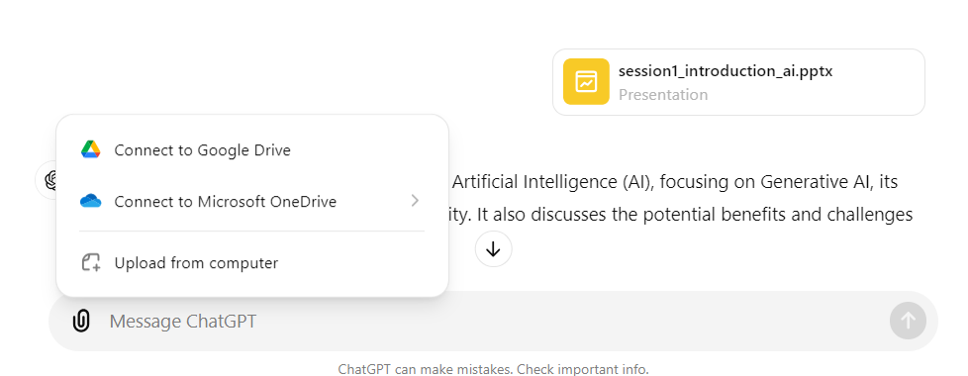
AI as Tutor
ChatGPT allows you to upload your material or attach any type of files.

Slide 6
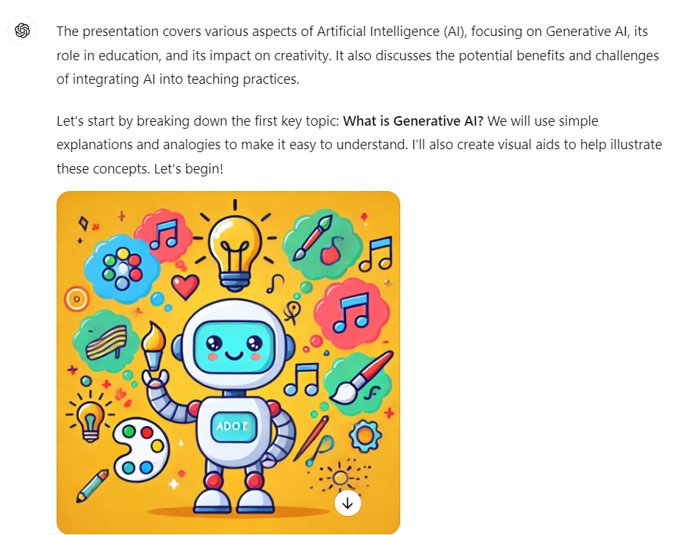
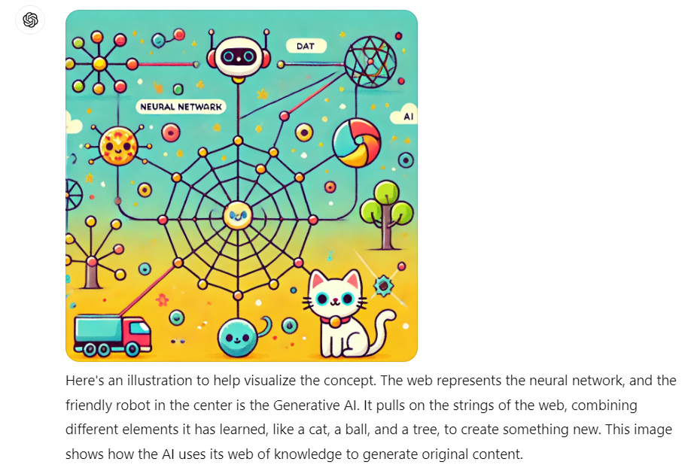
AI as Tutor
Tutor asks about your level of knowledge about the topic, if you like to use analogies, images, academic or conversational language.
Then it generates the explanations.

Slide 7
AI as Examiner

Slide 8
AI as Examiner
It is a hard task to interview each student for each specific assignment.
AI can help to create specific questions and interview students about their assignment submissions.
These interviews can be used to help assess the student work.
Act as an examiner. Your goal is to ask two specific questions about the student essay attached. You are interacting with the undergraduate student, and you should ask one question at a time. After asking all questions, provide a summary on how close was the student response to the correct one.

Slide 9
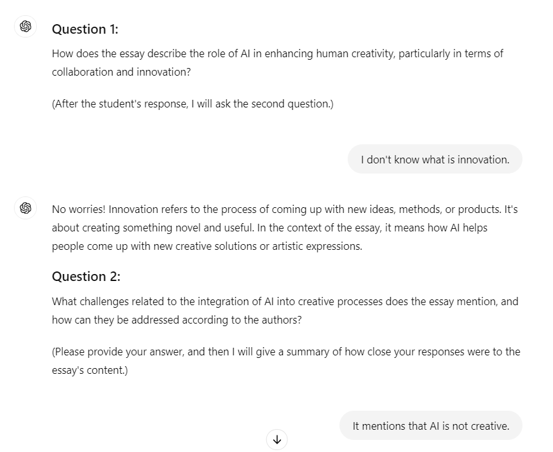
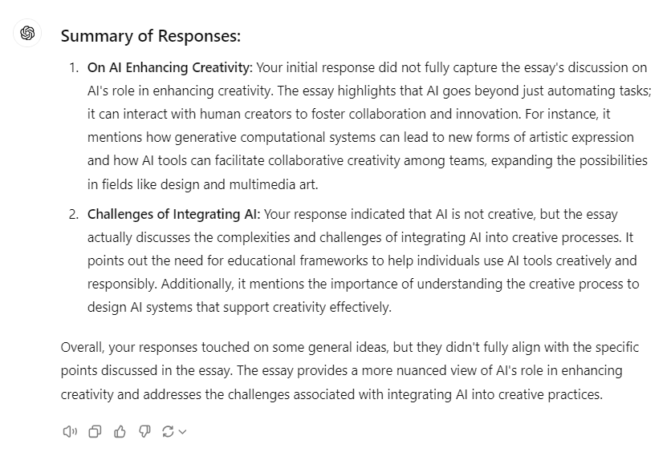
Interviewing a student about an essay

Slide 10
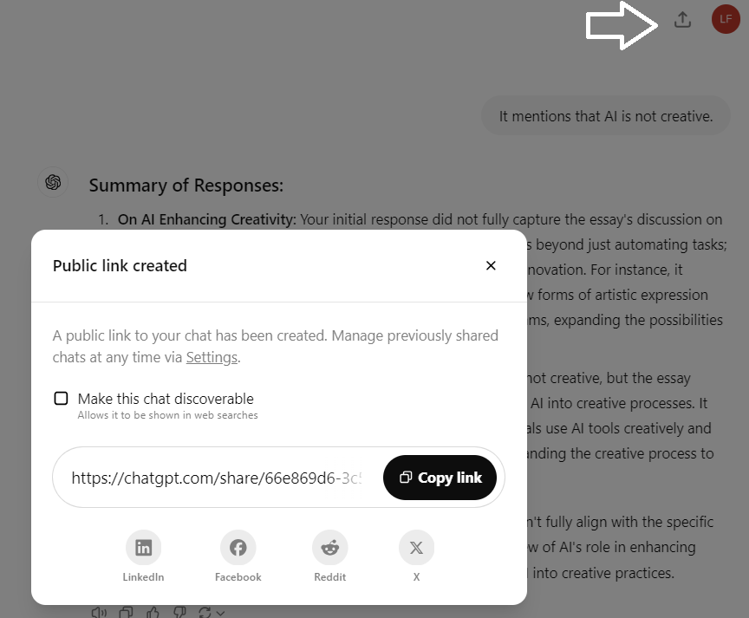
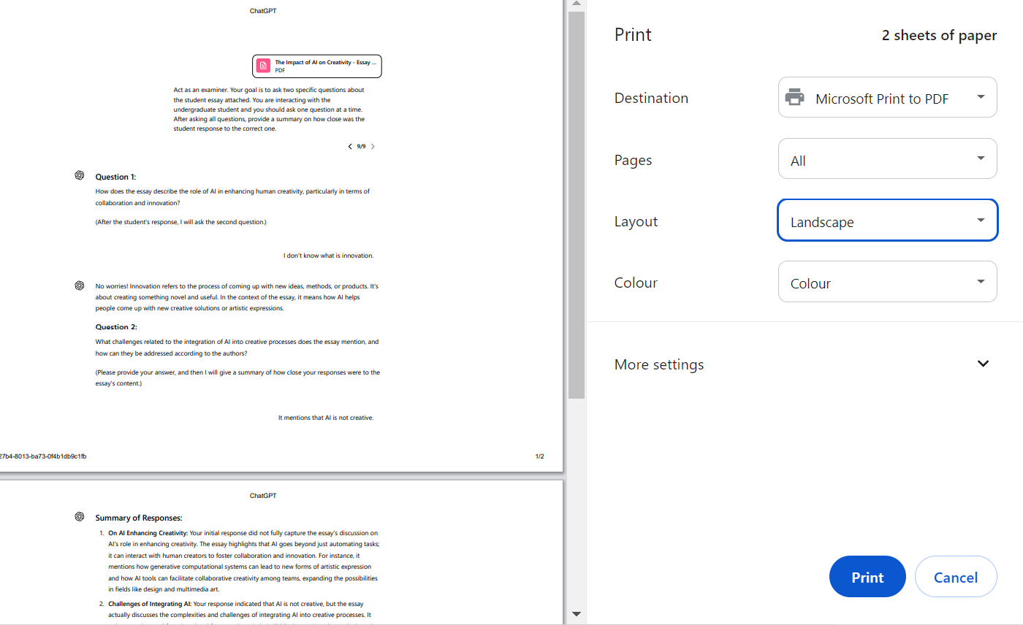
How can students share their dialogues?
Public link (follow the white arrow) – not recommended
Private file (select all text and print as .pdf - landscape)

Slide 11
AI as Reviewer

Slide 12
AI as Reviewer
Students usually get feedback from only one point of view (teacher’s view).
AI can help by using different personas and evaluating student work with different points of view.
Act as Shakespeare. Your task is to provide feedback about the quality, form and novelty of this poem.
Act as a social scientist. Your task is to provide feedback about the impact and wider implications of this poem.

Slide 13
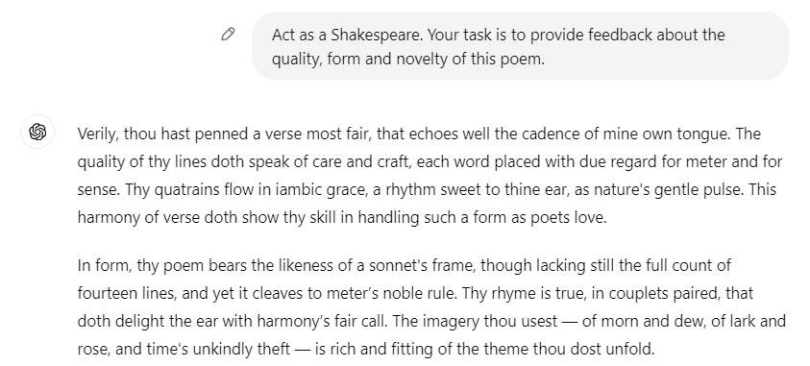
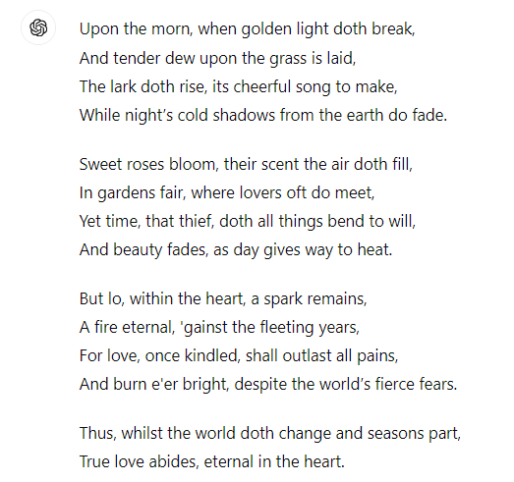
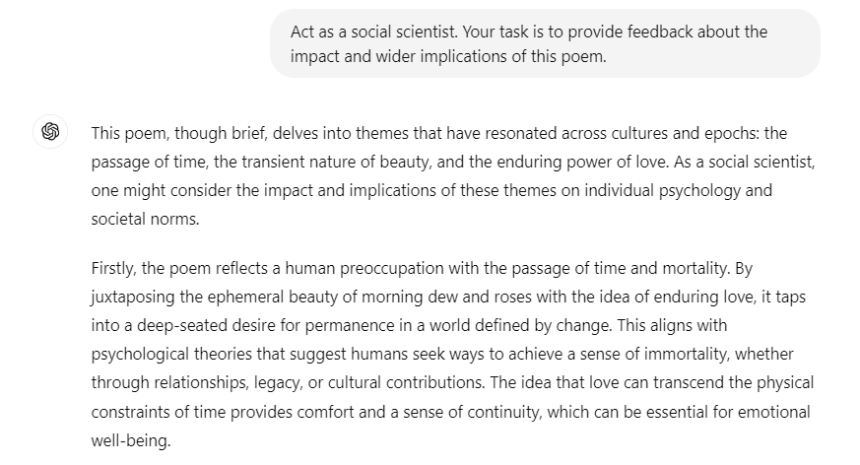
Reviewer feedback for poetry writing

Slide 14
AI as Document Interpreter

Slide 15
AI as Document Interpreter
Sometimes academics and students don’t find the time to read or familiarize with all documents, papers and univerisity policies.
AI can provide a way to “talk” to a document and ask questions directly to it.
You are an AI policy maker. All you know is contained in the attached file. You will be answering questions about this policy to a professor.

Slide 16
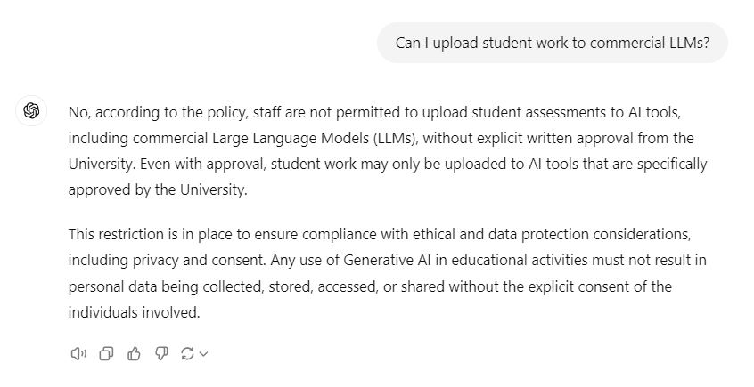
Asking questions about AI use in classrooms
UoL AI policy: https://le.ac.uk/-/media/uol/docs/policies/quality/ai-policy.pdf

Slide 17
AI as Essay Generator

Slide 18
Essay Generator
This prompt write a full essay based on a list of legit references as an undergraduate student in academic style.
Act as an undergraduate student, your job is to create an essay in academic style about a topic with a certain word count. I will provide you a list of references and you should use only them. The focus of the essay should be supported by the references provided. It should have a references section at the end in a specific reference style. You should ask me as many questions as necessary to do the job. You should ask one question at a time, and I will respond to each question. When you have enough information to generate the essay, you should generate it. Do you understand?

Slide 19


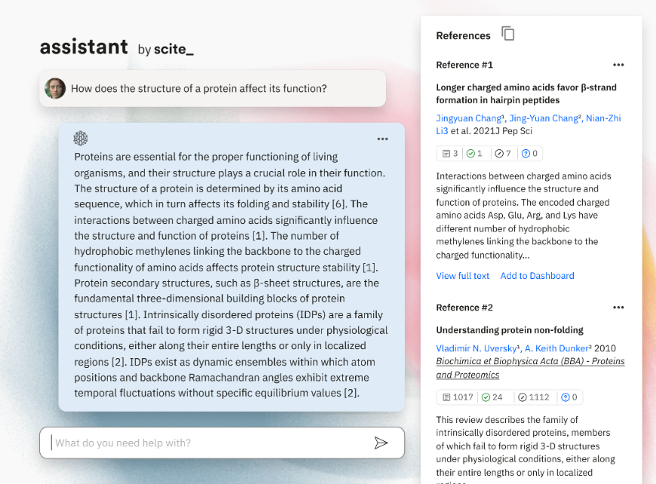
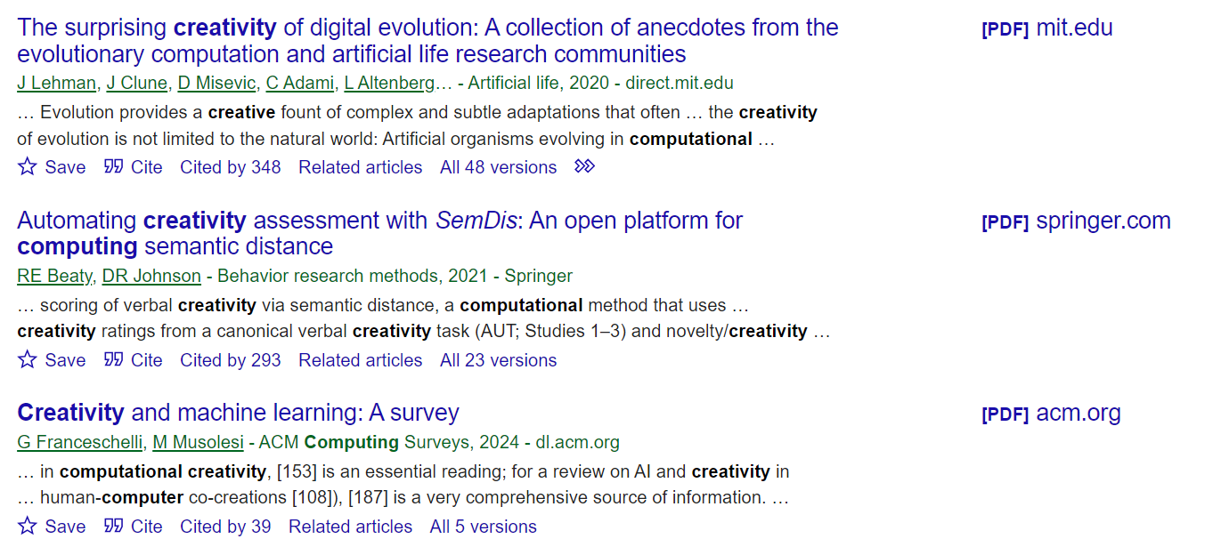
Essay Generator – References List
Current main LLM models make up references. However, you can find legit references list from other AI and non-AI systems and create an essay based on them.
https://scite.ai
https://scholar.google.com/

Slide 20
Full Example – The Impact of AI on Creativity
The Impact of AI on Creativity
Artificial Intelligence (AI) has significantly transformed various aspects of human life, and one of its most intriguing impacts is on creativity. This essay explores how AI influences creativity across different domains, drawing on recent research to illuminate the ways in which computational systems enhance and reshape creative processes.
…
Furthermore, Jordanous and Keller (2016) contribute to the discussion by modeling creativity and identifying key components through a corpus-based approach. Their work provides a deeper understanding of the creative process and how AI can be designed to support various elements of creativity, such as originality and relevance.
References
Brown, A. (2021). Creative partnerships with technology: how creativity is enhanced through interactions with generative computational systems. Proceedings of the Aaai Conference on Artificial Intelligence and Interactive Digital Entertainment, 8(4), 14-20. https://doi.org/10.1609/aiide.v8i4.12555
Jordanous, A., & Keller, B. (2016). Modelling creativity: identifying key components through a corpus-based approach. *Plos One, 11*(10), e0162959. https://doi.org/10.1371/journal.pone.0162959

Slide 21
Rubric Criteria for AI Use

Slide 22
Effective Use of Generative AI
A (70-100%): The student demonstrates a thorough understanding of the generative AI tool, using it effectively to enhance their work. The tool's capabilities are utilized appropriately and to their full potential.
B (60-69%): The student shows a good understanding of the AI tool, with effective use in most aspects. Minor areas could be improved.
C (50-59%): The student demonstrates a basic understanding of the AI tool, with some effective use but noticeable areas for improvement.
D (40-49%): The student shows limited understanding or incorrect use of the AI tool, indicating significant room for improvement.
E (1-39%): The student attempts to use the AI tool but largely fails to do so effectively, showing minimal understanding.
F (0%): No attempt to use the generative AI tool is made.
*generated by ChatGPT

Slide 23
Integration and Application of AI-Generated Content
A (70-100%): The student skillfully integrates AI-generated content into their work, ensuring it complements and enhances the overall quality. The integration is seamless and adds value to the assignment.
B (60-69%): The student effectively integrates AI-generated content, but there are minor areas where the integration could be smoother or more relevant.
C (50-59%): The student attempts to integrate AI-generated content, but it may seem forced, disjointed, or irrelevant in parts.
D (40-49%): The integration of AI-generated content is present but poorly executed, showing a lack of understanding.
E (1-39%): The integration of AI-generated content is attempted but is largely ineffective or irrelevant.
F (0%): No AI-generated content is integrated into the work.
*generated by ChatGPT

Slide 24
Ethical Considerations and Attribution
A (70-100%): The student shows a strong understanding of ethical considerations, properly attributing AI-generated content and being transparent about its use. They also address potential biases in the AI output.
B (60-69%): The student mostly considers ethical issues and attributes AI-generated content, with minor lapses in transparency or bias considerations.
C (50-59%): The student demonstrates some awareness of ethical considerations but fails to fully attribute AI-generated content or address biases.
D (40-49%): The student shows limited understanding of ethical considerations, with improper attribution and little attention to bias.
E (1-39%): The student shows minimal awareness of ethical considerations or attribution requirements.
F (0%): No consideration of ethical issues or attribution is evident.
*generated by ChatGPT

Slide 25
Critical Evaluation of AI Output
A (70-100%): The student critically evaluates the AI-generated content, identifying strengths, weaknesses, and areas for improvement. They reflect on the appropriateness and accuracy of the output.
B (60-69%): The student provides some evaluation of the AI output, with a basic understanding of its strengths and limitations.
C (50-59%): The student's evaluation is minimal, showing limited critical thinking about the AI-generated content.
D (40-49%): The student shows minimal effort in evaluating the AI output, lacking critical engagement.
E (1-39%): The student makes an attempt to evaluate the AI output but fails to provide meaningful insight.
F (0%): No evaluation of the AI output is provided.
*generated by ChatGPT

Slide 26
Skill in Prompt Engineering
A (70-100%): The student demonstrates advanced skill in creating effective prompts for the generative AI, resulting in highly relevant and targeted output.
B (60-69%): The student shows a good ability to craft prompts, generally yielding relevant and useful AI output.
C (50-59%): The student has some difficulty in creating effective prompts, leading to less relevant or lower-quality AI output.
D (40-49%): The student shows limited skill in prompt creation, resulting in poor or irrelevant AI output.
E (1-39%): The student attempts to create prompts but fails to generate meaningful or relevant AI output.
F (0%): No attempt to create prompts for generative AI is evident.
*generated by ChatGPT

Slide 27
AI as Rubric

Slide 28
AI as Rubric
Students can get feedback for their work based on the evaluation criteria (rubric).
AI can provide a simple way for students to double check if they are follwing the rubric properly.
You are a rubric for an essay. You will critique and provide specific feedback to a student for their essay strictly based on each rubric criterion. Highlight some of their own text to strengthen your argumentation.
* .doc .txt files work better than .pdf files

Slide 29
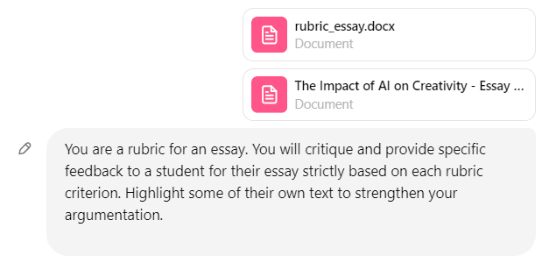
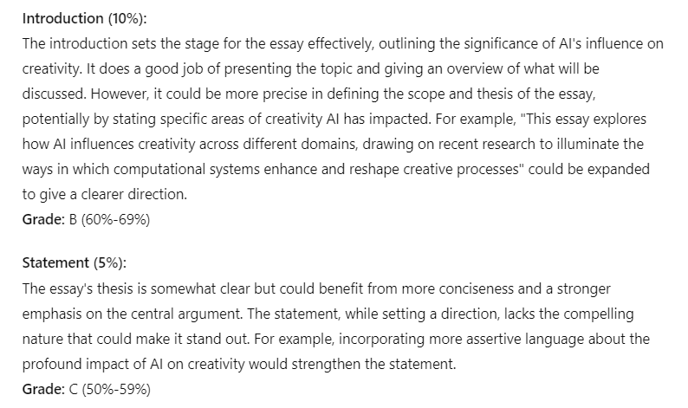
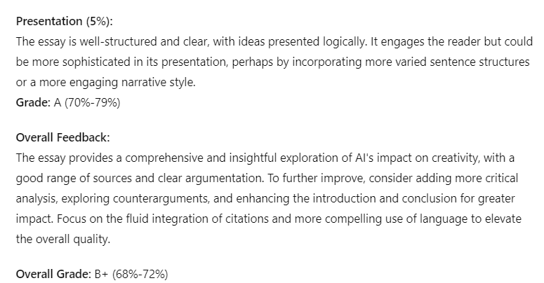
Feedback based on a rubric for an essay

Slide 30
Final Remarks
All the prompts and guidelines in this file are free for use.
All prompts have been tested on GPT4o and Claude 3.5.
Any comments of suggestions can be emailed to: fabricio.goes@leicester.ac.uk

