Slide 1
Scraping and Analyzing Word Frequency in Supreme Court Cases
MS Data Journalism, JOURJ4001, Fall 2024, lg3394@columbia.edu

Slide 2
OBJECTIVE: WHY AND WHAT FOR
Identify how many times a word has been mentioned in Supreme Court cases between October 2023 and October 2024.
Technical perspective: practice merging dataframes, analyzing and mapping word frequency
Journalistic perspective: understand how many times a word is mentioned in SC cases and in what context as a means of informing a hypothesis or arriving to other conclusions.
Lucia de la Torre / lg3394@columbia.edu

Slide 3
PROCESS: HOW
Scraping data from Supreme Court Websites
Oral Argument Transcripts: minutes of oral arguments of Supreme Court cases, exchanges between justices and attorneys
Slip Opinions: official written opinions of the Court, final decisions on cases and justices’ reasoning.
Creating and merging dataframes
My final dataframe and dictionary contained: docket number, case name, date, a link to the case transcript and a link to the slip opinion..
Lucia de la Torre / lg3394@columbia.edu

Slide 4
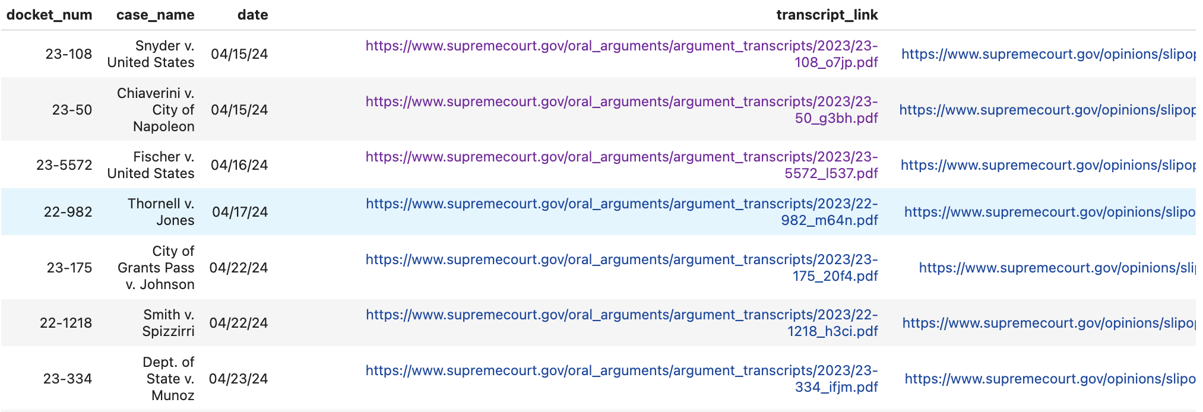
Lucia de la Torre / lg3394@columbia.edu

Slide 5
PROCESS: HOW
3. Data analysis
I tried using tika to parse all the pdfs (around 120), but it took too much time. The right step was to converting the pdfs to txt files and using loops to find keywords.
4. Obtaining and understanding results
Initially, I was interested in tech-related words
The results were irrelevant
Time limitations
Lucia de la Torre / lg3394@columbia.edu

Slide 6
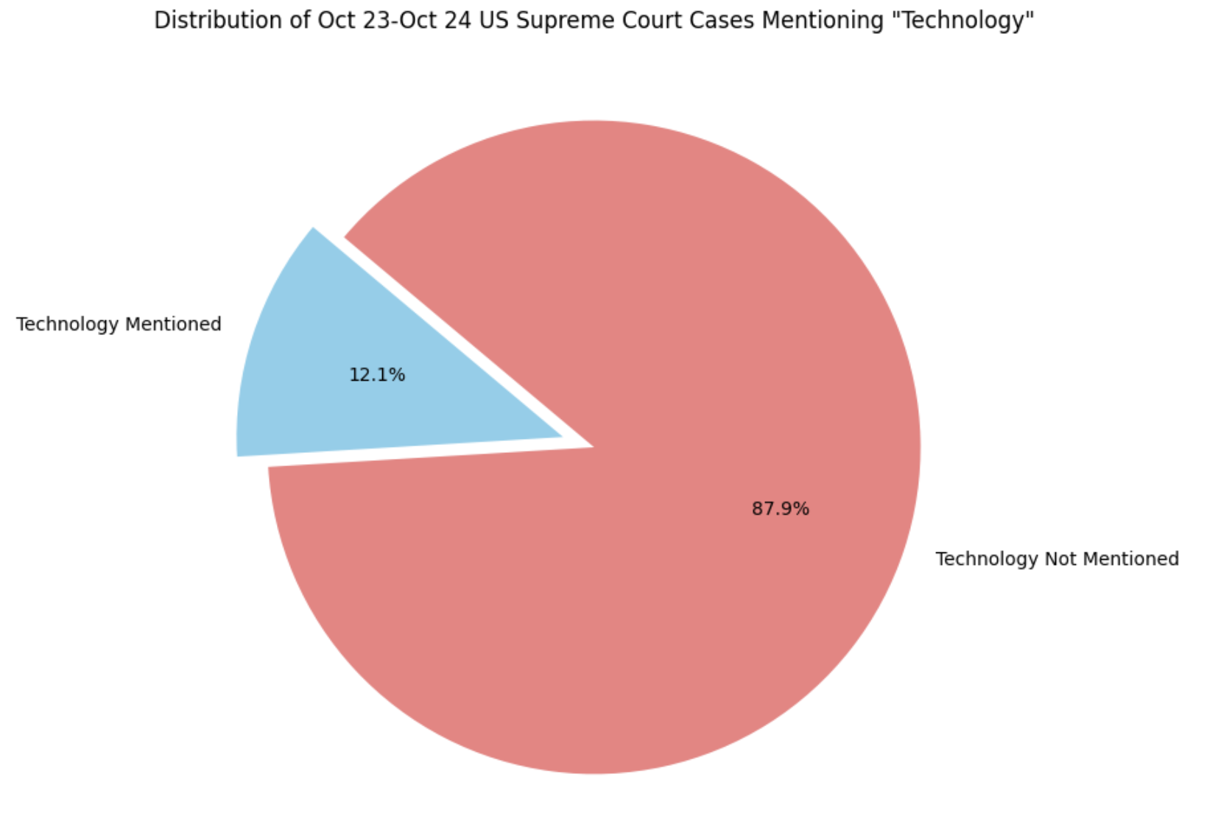
PROCESS: HOW
5. Mapping
Few options due to limitation of findings
Appended the results to a list, converted to a df and visualized using matplotlib
More advanced possibilities: heatmaps using geographical data
Lucia de la Torre / lg3394@columbia.edu

Slide 7
STRENGTHS AND WEAKNESSES
STRENGTHS
Robust structure/framework to analyze word frequency in Supreme Court Cases
Skills used: scraping, parsing, pandas, regex.
WEAKNESSES
Relevant data missing
Execution: the findings don’t lead to any significant conclusions.
Lucia de la Torre / lg3394@columbia.edu

Slide 8
NEXT STEPS
Add more data to the court_cases dataframe/dictionary
Geographical data of lower courts
Case summaries?
More complex word frequency search
Find the whole sentence or context
Find what section of the transcript/opinions doc it’s mentioned in
Using AI (e.g. spaCy) to understand in what context the word is used
Identify relevant keywords to search
Lucia de la Torre / lg3394@columbia.edu

Slide 9
Scraping and Analyzing Word Frequency in Supreme Court Cases
MS Data Journalism, JOURJ4001, Fall 2024
Lucia de la Torre / lg3394@columbia.edu

