Slide 1
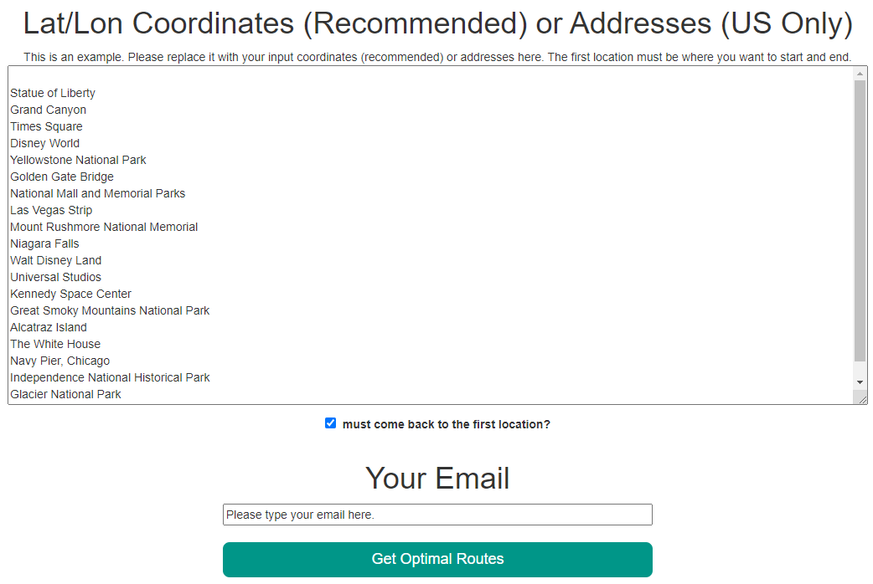
1. Add your location (coordinate/address) where you want to start your travel.
35.82518293311117, -84.33563716512076
2. Put your email address
3. Click

