Slide 1
Background

Slide 2
40 years ago began the digital revolution in the publishing industry. The history of the book is due to a series of technological innovations that have allowed, over the centuries, to improve the quality of preservation of texts and access to information, also improving the handling and cost of production. Globalization and the current era of intelligent computers allows us to give the next step in the creation, management and distribution of thousands of books, we are speaking of Ebook.

Slide 3




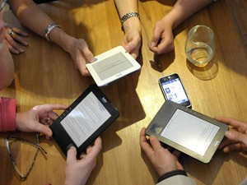

Slide 4
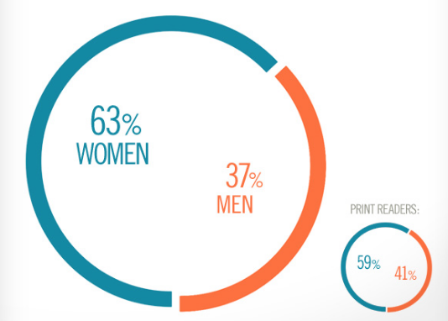
Who?

Slide 5
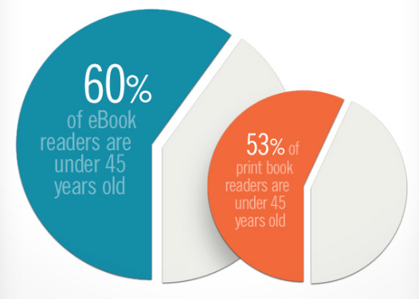
Age?

Slide 6
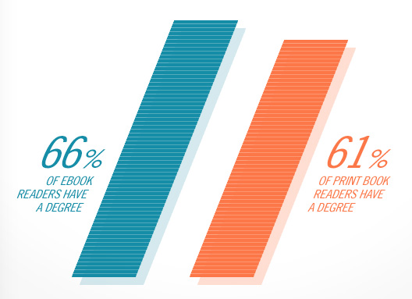
Education

Slide 7
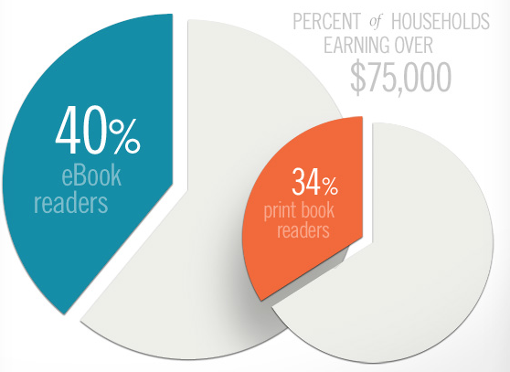
Earning

Slide 8
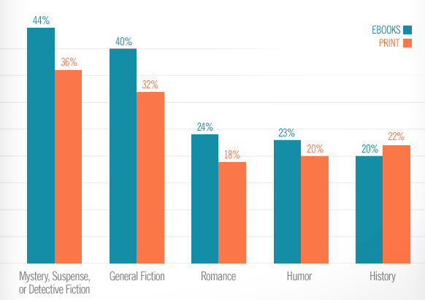
Reading Plans

Slide 9
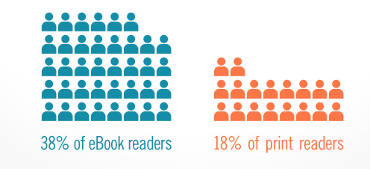
Spend

Slide 10
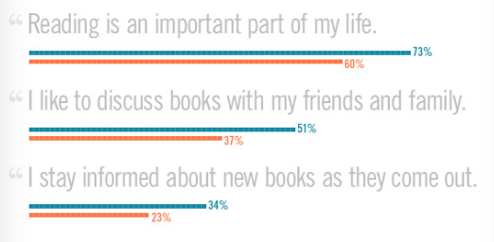
Books and Life

Slide 11


Media
The media to use for this campaign are mainly TV commercials and Press

Slide 12
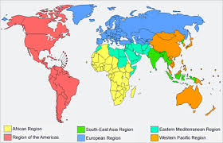
Several TV Commercials will be developed according to Region.

Slide 13
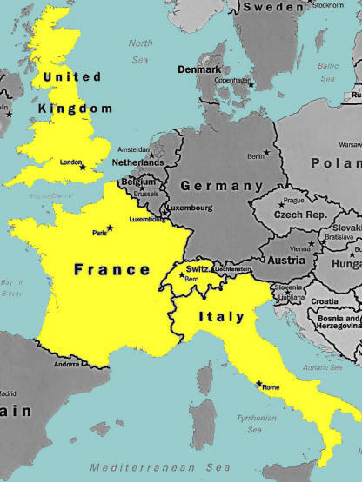
Press conference will be scheduled for most important countries of every Region

