Slide 1
Dealing with Sequence redundancy
Morten Nielsen
Department of Systems Biology, DTU

Slide 2
Outline
What is data redundancy?
Why is it a problem?
How can we deal with it?

Slide 3
Databases are redundant
Biological reasons
  Some protein functions, or sequence motifs are more common than others
Laboratory artifacts
  Some protein families have been heavily investigated, others not
  Mutagenesis studies makes large and almost identical replica of data
  This bias is non-biological

Slide 4
Date redundancy
10 MHC restricted peptides
What can we learn?
A at P1 favors
  binding?
I is not allowed at P9?
K at P4 favors binding?
Which positions are important for binding?
ALAKAAAAM
ALAKAAAAN
ALAKAAAAR
ALAKAAAAT
ALAKAAAAV
GMNERPILT
GILGFVFTM
TLNAWVKVV
KLNEPVLLL
AVVPFIVSV

Slide 5
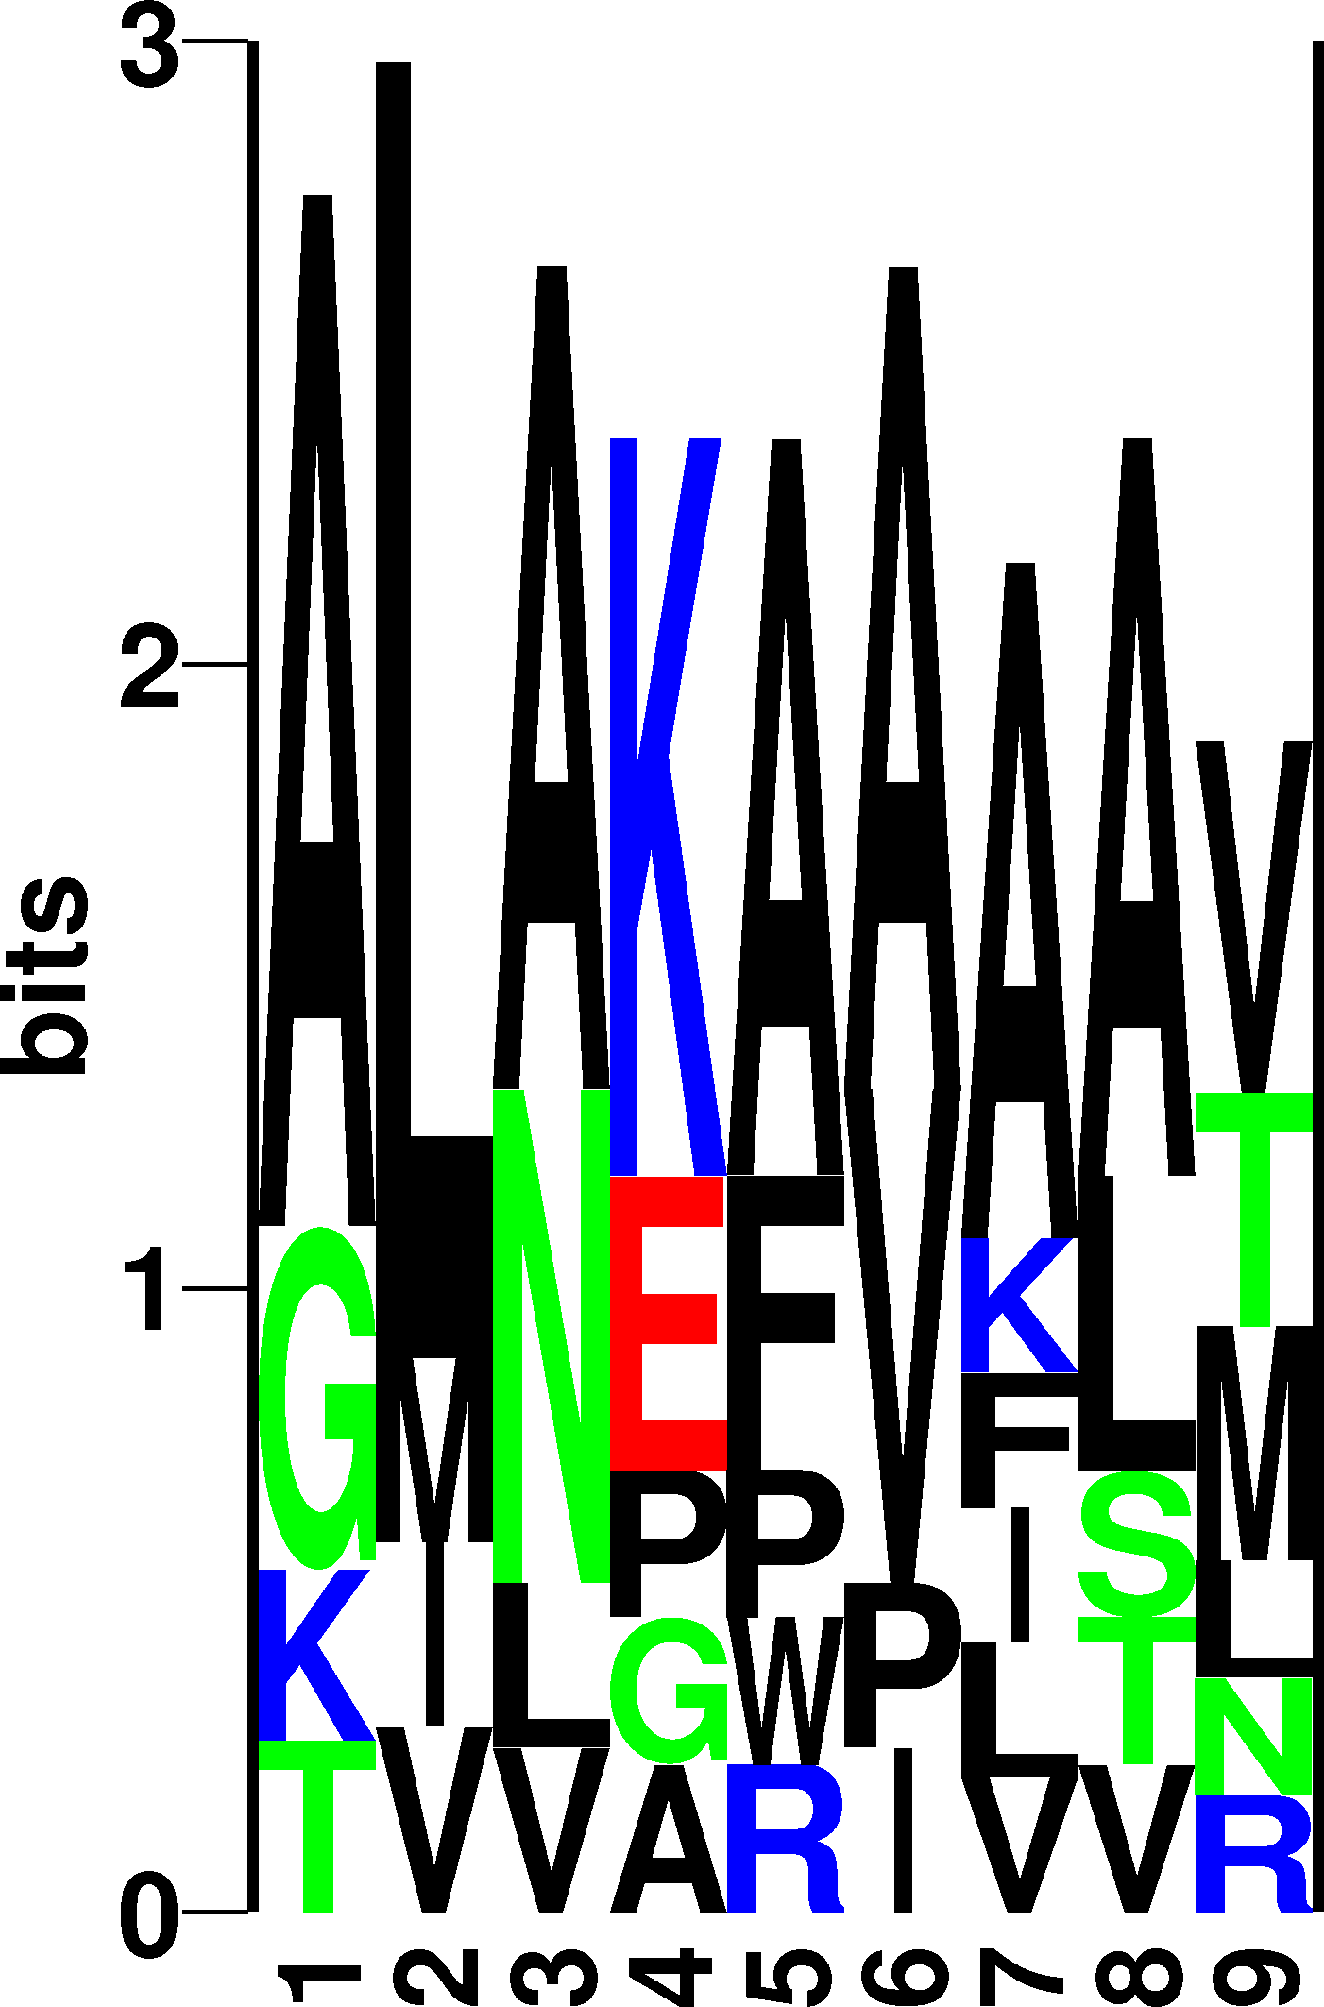
Redundant data
ALAKAAAAM
ALAKAAAAN
ALAKAAAAR
ALAKAAAAT
ALAKAAAAV
GMNERPILT
GILGFVFTM
TLNAWVKVV
KLNEPVLLL
AVVPFIVSV

Slide 6
PDB. Example
1055 protein sequence
Len 50-2000
142 Function annotations
  ACTIN-BINDING
  ANTIGEN
  COAGULATION
  HYDROLASE/DNA
  LYASE/OXIDOREDUCTASE
  ENDOCYTOSIS/EXOCYTOSIS
  …

Slide 7
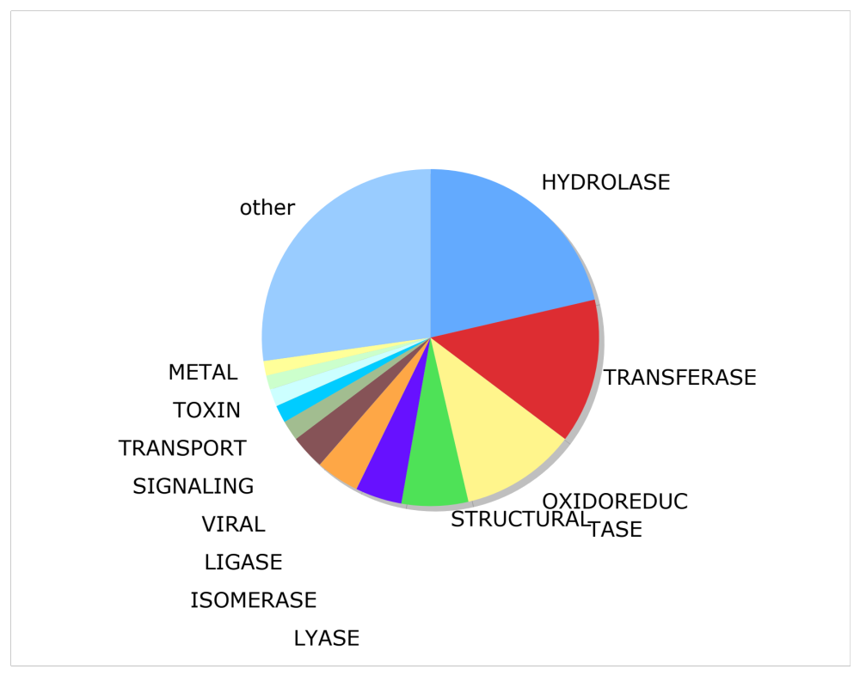
PDB. Example

Slide 8
What is similarity?
Sequence identity?
Blast e-values
  Often too conservative
Other
ACDFG
ACEFG
80% ID versus 24% ID
DFLKKVPDDHLEFIPYLILGEVFPEWDERELGVGEKLLIKAVA------------MATGIDAKEIEESVKDTGDL-GE
DVLLGADDGSLAFVP---------- SEFSISPGEKIVFKNNAGFPHNIVFDEDSIPSGVDASKISMSEEDLLNAKGE

Slide 9
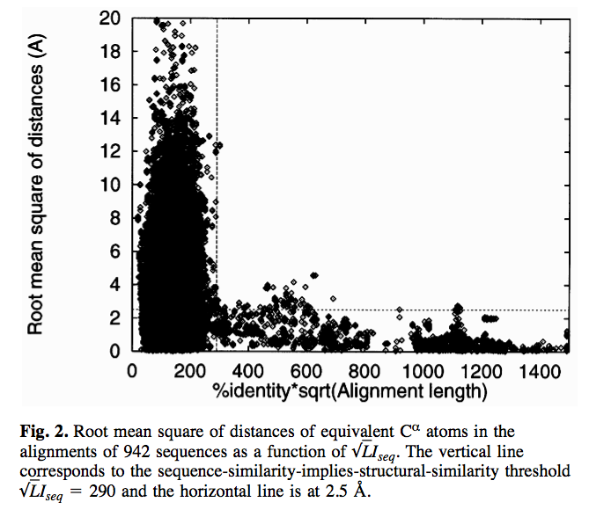
Ole Lund et al.
(Protein engineering 1997)

Slide 10
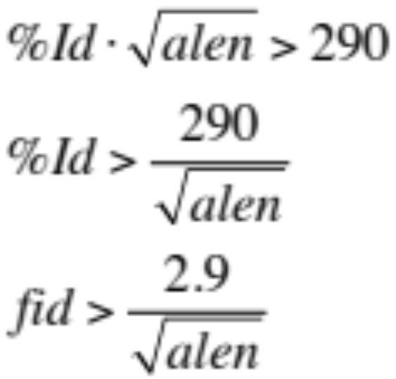
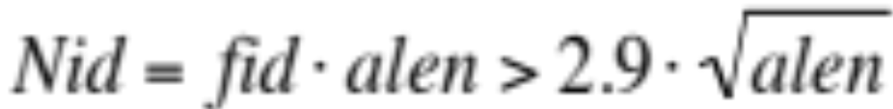
Ole’s formula

Slide 11
How to deal with redundancy
Hobohm 1
  Fast
  Requires a prior sorting of data
Hobohm 2
  Slow
  Gives unique answer always
  No prior sorting

Slide 12
Hobohm 1
Input data - sorted list
Unique
A
B
C
Add next data point to list of unique if it is NOT similar to any of the elements already on the unique list
D
E
F
G
H
I

Slide 13
Hobohm 1
Input data
Unique
A
B
C
Add next data point to list of unique if it is NOT similar to any of the elements already on the unique list
D
E
F
G
H
I

Slide 14
Hobohm 1
Input data
Unique
B
A
C
Add next data point to list of unique if it is NOT similar to any of the elements already on the unique list
D
E
F
G
H
I

Slide 15
Hobohm 1
Input data
Unique
B
A
D
C
E
F
G
I
H
Add next data point to list of unique if it is NOT similar to any of the elements already on the unique list
Need only to align sequences against the Unique list!

Slide 16
Hobohm-2
Align all against all
Make similarity matrix D (N*N) with value 1 if is similar to j, otherwise 0
While data points have more than one neighbor
  Remove data point S with most nearest neighbors

Slide 17
Hobohm-2
D:
A B C D E F G H I
A 1 1 1 0 0 0 0 0 0
B 1 1 1 0 0 0 0 1 1
C 1 1 1 0 0 0 0 0 0
D 0 0 0 1 1 1 1 1 1
E 0 0 0 1 1 1 1 1 1
F 0 0 0 1 1 1 0 0 1
G 0 0 0 1 1 0 1 1 1
H 0 1 0 1 1 0 1 1 1
I 0 1 0 1 1 1 1 1 1
Make similarity matrix N*N

Slide 18
Hobohm-2
D:
A B C D E F G H I
A 1 1 1 0 0 0 0 0 0
B 1 1 1 0 0 0 0 1 1
C 1 1 1 0 0 0 0 0 0
D 0 0 0 1 1 1 1 1 1
E 0 0 0 1 1 1 1 1 1
F 0 0 0 1 1 1 0 0 1
G 0 0 0 1 1 0 1 1 1
H 0 1 0 1 1 0 1 1 1
I 0 1 0 1 1 1 1 1 1
N
3
5
3
6
6
4
5
6
7
S
Find point S with the largest number of similarities

Slide 19
Hobohm-2
D:
D:
A B C D E F G H I
A 1 1 1 0 0 0 0 0 0
B 1 1 1 0 0 0 0 1 1
C 1 1 1 0 0 0 0 0 0
D 0 0 0 1 1 1 1 1 1
E 0 0 0 1 1 1 1 1 1
F 0 0 0 1 1 1 0 0 1
G 0 0 0 1 1 0 1 1 1
H 0 1 0 1 1 0 1 1 1
I 0 1 0 1 1 1 1 1 1
N
3
5
3
6
6
4
5
6
7
A B C D E F G H
A 1 1 1 0 0 0 0 0
B 1 1 1 0 0 0 0 1
C 1 1 1 0 0 0 0 0
D 0 0 0 1 1 1 1 1
E 0 0 0 1 1 1 1 1
F 0 0 0 1 1 1 0 0
G 0 0 0 1 1 0 1 1
H 0 1 0 1 1 0 1 1
N
3
4
3
5
5
3
4
5
Remove point S with the largest number of similarities, and update N counts

Slide 20
Hobohm-2 (repeat this)
D:
D:
A B C D E F G H
A 1 1 1 0 0 0 0 0
B 1 1 1 0 0 0 0 1
C 1 1 1 0 0 0 0 0
D 0 0 0 1 1 1 1 1
E 0 0 0 1 1 1 1 1
F 0 0 0 1 1 1 0 0
G 0 0 0 1 1 0 1 1
H 0 1 0 1 1 0 1 1
N
3
4
3
5
5
3
4
5
A B C E F G H
A 1 1 1 0 0 0 0
B 1 1 1 0 0 0 1
C 1 1 1 0 0 0 0
E 0 0 0 1 1 1 1
F 0 0 0 1 1 0 0
G 0 0 0 1 0 1 1
H 0 1 0 1 0 1 1
N
3
4
3
4
2
3
4
Remove point S with the largest number of similarities

Slide 21
Hobohm-2 (until N=1 for all)
D:
D’:
A B C D E F G H I
A 1 1 1 0 0 0 0 0 0
B 1 1 1 0 0 0 0 1 1
C 1 1 1 0 0 0 0 0 0
D 0 0 0 1 1 1 1 1 1
E 0 0 0 1 1 1 1 1 1
F 0 0 0 1 1 1 0 0 1
G 0 0 0 1 1 0 1 1 1
H 0 1 0 1 1 0 1 1 1
I 0 1 0 1 1 1 1 1 1
N
3
5
3
6
6
4
5
6
7
C F H
C 1 0 0
F 0 1 0
H 0 0 1
N
1
1
1
=>
Unique list is C, F, H

Slide 22
Hobohm

Slide 23
Hobohm-1

Slide 24
Hobohm-2

Slide 25
Why two algorithms?
Hobohm-2
  Unbiased
  Slow (O2)
  Focuses on lonely sequences
  Example from exercise
    1000 Sequences alignment 2 hours
    Hobohm-2: 22 seconds
Hobohm-1
  Biased. Prioritized list
  Fast (0)
  Focuses on populated sequence areas
  Example from exercise
    1000 Sequences
    Hobohm-1: 12 seconds
Hobohm2 in general gives more sequences than Hobohm1

Slide 26
Hobohm-1 versus Hobohm-2
Prioritized lists
  PDB structures. Not all structures are equally good
    Low resolution, NMR, old?
  Peptide binding data
    Strong binding more important than weak binding
Quantitative data (yes no data)
  All data are equally important

