Slide 1
Use of R-package BWGS BreedWheat Genomic Selection
Integrated package bwgs
Standalone (install from zip.file)
Louis-Gautier Tran et Gilles Charmet
INRAE-UCA UMR GDEC, Clermont-Ferrand, France

Slide 2
BWGS pipeline : workflow

Slide 3
I. Get started!
# I.1. First step
Enter your R-session, e.g. BWGS.RData
rm (list=ls()) # clean the workspace
Source ("C:/BWGS_pipeline/bwgs.R") # compile BWGS functions, give the right pathway
Install usefull library (download from CRAN mirror if needed)
library(rrBLUP)
library(BGLR)
library(brnn)
library(glmnet)
library(e1071)
library(randomForest)
# I.2. Import DATA:
# INRA 760 breeding lines for training, 989 DH lines as target set
Load (« inra.rda")
# DATA: geno47K (matrix 760*47,839); MAP47K (dataframe 47,839*3), pheno(yield vector 760)
# have a look on data

Slide 4
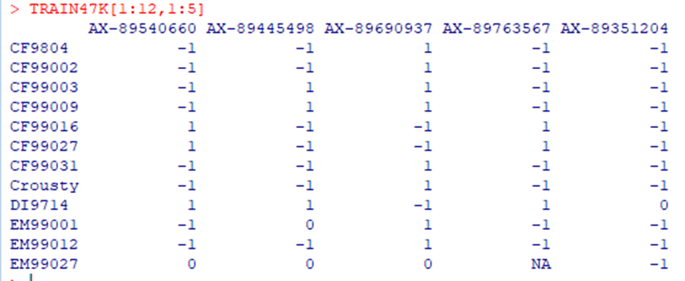
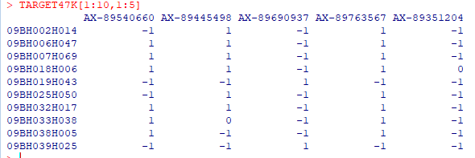
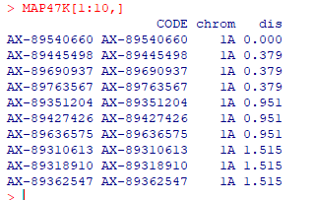
I. Get started!
# I.1. First step
# have a look on data

Slide 5
II. MAIN FUNCTIONS in BWGS Pipeline :
TWO MAIN FUNCTIONS:
# bwgs.cv() # Cross-Validation. To be used on training set to choose model
Usage
bwgs.cv (geno, pheno, MAXNA=0.2, MAF=0.05, pop.reduct.method="NULL", sample.pop.size="NULL", geno.reduct.method="NULL", reduct.marker.size="NULL", pval="NULL", r2="NULL", MAP="NULL", geno.impute.method="NULL", predict.method="NULL", nFolds, nTimes)
# bwgs.predict() # Prédiction of GEBV on genotyped target set
Usage
bwgs.predict (geno_train, pheno_train, geno_valid, MAXNA=0.2, MAF=0.05, geno.impute.method="NULL", geno.reduct.method="NULL", reduct.size="NULL", pval="NULL", r2="NULL", MAP="NULL", predict.method="GBLUP")

Slide 6
II. MAIN FUNCTIONS in BWGS :
Main parameters (see next slide)
# Imputation models: MNI (mean allele frequency) EMI (expectation-maximization)
# Reduction methods:
Marker number: RMR (random), LD (pruning of LD pairs> threshold), ANO (most associated markers), ANO+LD
Training pop size: RPS (random), OPTI (optimization based on Cdmean)
# Prediction models: GBLUP,EGBLUP, RR, LASSO,BA, BB, BC, BL, BRR, RKHS, MKRKHS, RF, SVM, BRNN

Slide 7
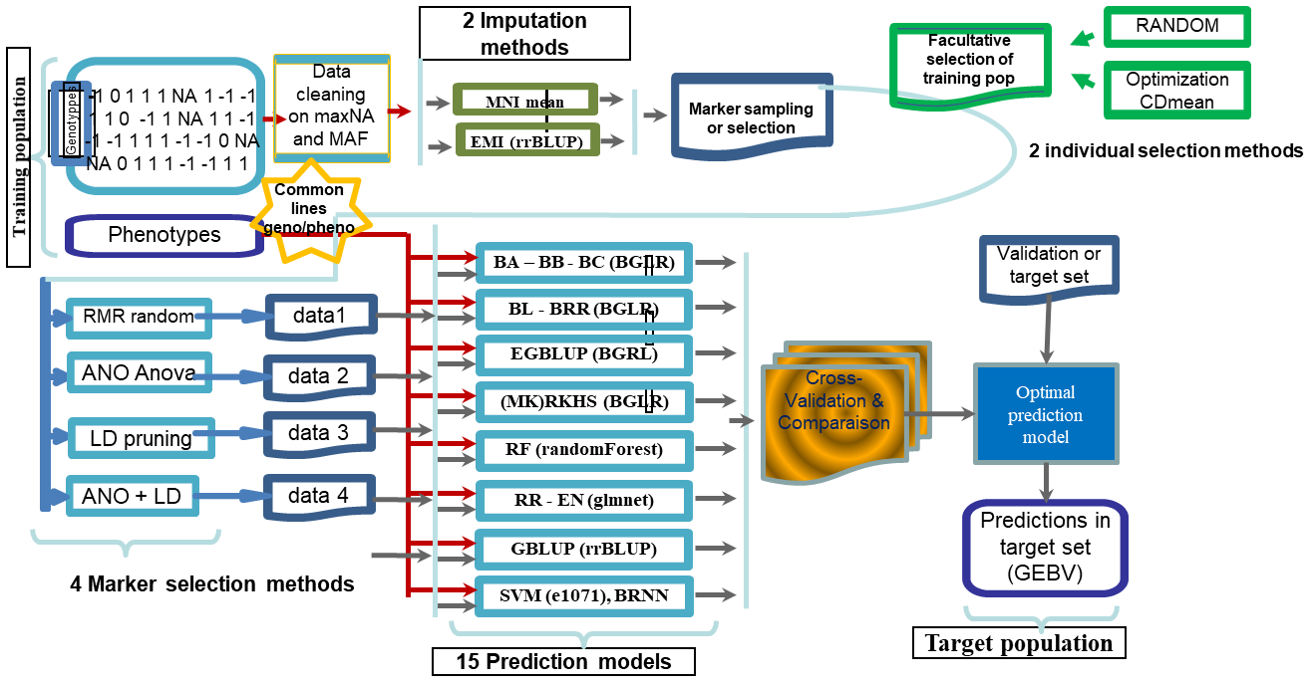
BWGS pipeline: General structure
Notes:
Th

Slide 8
Use of R package BWGS
Influence of some parameters on predictive ability

Slide 9
III a. CROSS-VALIDATION with BWGS.CV() :
# DATA sets: TRAIN47K, YieldBLUE
# syntax for Cross-Validation
YieldGBLUP <-bwgs.cv (TRAIN47K, YieldBLUE, geno.impute.method="mni", predict.method= "gblup", nFolds=10, nTimes=10 )
# missing data are imputed by marker-mean frequncy, GEBV are estimated by GBLUP. Cross validation by 10 folds, i. e. 684 lines for training, 76 for validation x 10, fold sampling replicated 10 times: 100 GEBV estimates.
# Look at
names(YieldGBLUP)
YieldGBLUP$summary

Slide 10
III b. COMPARE PREDICTION METHODS
YieldGBLUP <-bwgs.cv (TRAIN47K, YieldBLUE, geno.impute.method="mni", predict.method= "gblup", nFolds=10, nTimes=10 )
YieldLASSO <-bwgs.cv (TRAIN47K, YieldBLUE, geno.impute.method="mni", predict.method= "LASSO", nFolds=10, nTimes=10 )
YieldBA <-bwgs.cv (TRAIN47K, YieldBLUE, geno.impute.method="mni", predict.method= "BA", nFolds=10, nTimes=10 )
YieldRKHS <-bwgs.cv (TRAIN47K, YieldBLUE, geno.impute.method="mni", predict.method= "RKHS", nFolds=10, nTimes=10 )
YieldEGBLUP <-bwgs.cv (TRAIN47K, YieldBLUE, geno.impute.method="mni", predict.method= "EGBLUP", nFolds=10, nTimes=10 )
compareM=cbind(YieldGBLUP$cv, YieldLASSO$cv, YieldBA$cv, YieldRKHS$cv, YieldEGBLUP$cv)
colnames(compareM) = c("GBLUP","LASSO","BayesA","RKHS","EGBLUP")
boxplot(compareM,xlab="Prediction method",ylab="predictive ability",main="Predictive ability of 5 methods. Yield with 47K markers")

Slide 11
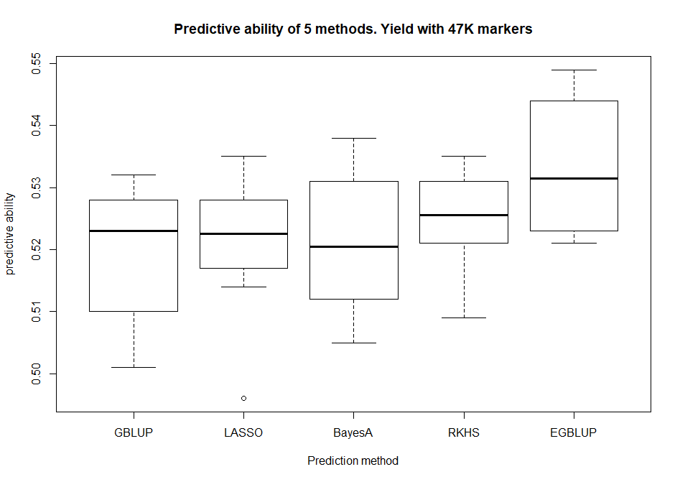
III b. COMPARE PREDICTION METHODS
Methods that account for non-additive marker effects are slightly better

Slide 12
III c. COMPARE Predicted value with diffetent methods
testPREDICT_GBLUP=bwgs.predict(geno_train=TRAIN47K,pheno_train=YieldBLUE,geno_target=TARGET47K,MAXNA=0.2,MAF=0.05,geno.reduct.method="NULL",reduct.size="NULL",r2="NULL",pval="NULL",MAP="NULL",geno.impute.method="MNI",predict.method="GBLUP")
testPREDICT_EGBLUP=bwgs.predict(geno_train=TRAIN47K,pheno_train=YieldBLUE,geno_target=TARGET47K,MAXNA=0.2,MAF=0.05,geno.reduct.method="NULL",reduct.size="NULL",r2="NULL",pval="NULL",MAP="NULL",geno.impute.method="MNI",predict.method="EGBLUP")
testPREDICT_LASSO=bwgs.predict(geno_train=TRAIN47K,pheno_train=YieldBLUE,geno_target=TARGET47K,MAXNA=0.2,MAF=0.05,geno.reduct.method="NULL",reduct.size="NULL",r2="NULL",pval="NULL",MAP="NULL",geno.impute.method="MNI",predict.method="LASSO")
testPREDICT_RKHS=bwgs.predict(geno_train=TRAIN47K,pheno_train=YieldBLUE,geno_target=TARGET47K,MAXNA=0.2,MAF=0.05,geno.reduct.method="NULL",reduct.size="NULL",r2="NULL",pval="NULL",MAP="NULL",geno.impute.method="MNI",predict.method="RKHS")
testPREDICT_BayesA=bwgs.predict(geno_train=TRAIN47K,pheno_train=YieldBLUE,geno_target=TARGET47K,MAXNA=0.2,MAF=0.05,geno.reduct.method="NULL",reduct.size="NULL",r2="NULL",pval="NULL",MAP="NULL",geno.impute.method="MNI",predict.method="BA")
ComparePRED=cbind(testPREDICT_GBLUP[,1] ,testPREDICT_BayesA[,1] ,testPREDICT_LASSO[,1], testPREDICT_RKHS[,1], testPREDICT_EGBLUP[,1])
colnames(ComparePRED=)c("GBLEP","BauesA","LASSO","RKHS","EGBLUP")
pairs(ComparePRED,lower.panel = panel.smooth,upper.panel = panel.cor,diag.panel=panel.hist)

Slide 13
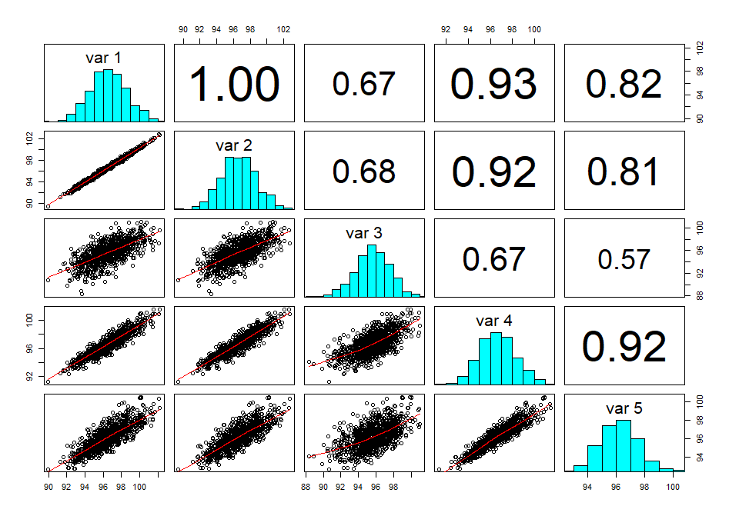
IIIb. COMPARE PREDICTION METHODS
Most methods give consistent prediction
Those fromLASSO are the least correlated to each other

Slide 14
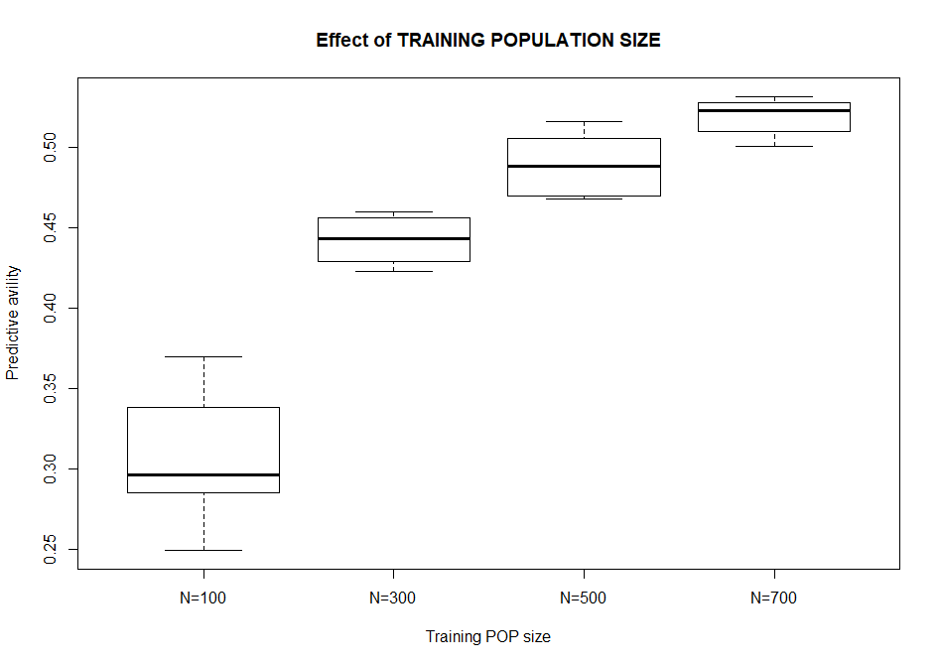
III c. COMPARE Predicted value with diffetent methods
YieldGBLUP100 <-bwgs.cv (TRAIN47K, YieldBLUE, random.pop.size=100, geno.impute.method="mni", predict.method=« gblup", nFolds=10, nTimes=10 )
YieldGBLUP300 <-bwgs.cv (TRAIN47K, YieldBLUE, random.pop.size=300, geno.impute.method="mni", predict.method=« gblup", nFolds=10, nTimes=10 )
YieldGBLUP500 <-bwgs.cv (TRAIN47K, YieldBLUE, random.pop.size=500, geno.impute.method="mni", predict.method=« gblup", nFolds=10, nTimes=10 )
CompareSize=cbind(YieldGBLUP100$cv, YieldGBLUP300$cv, YieldGBLUP500$cv, YieldGBLUP$cv)
colnames(CompareSize)=c("N=100","N=300","N=500","N=700")
boxplot(CompareSize,xlab="Training POP size",Ylab="Predictive avility",main="Effect of TRAINING POPULATION SIZE")
As expected, predictive accuracy increases with training population size

Slide 15
IV use of Simulated Data
Function bwgs.qtlsim allows to simulate QTLs from actual genotyping Data.
Worksflow:
Sample (once) a random subset of NQTL markers with real genotypind Data =(.e. -1, 0, 1, NA)
Assign each QTL an effect a_{i} drawn from a gaussain distribution N (0,1) with R-command rnorm (NQTL)
The « True » Breeding Value TBV of line j equals the algebric sum of weighted marker effects Σ_{i=1,NQTL} M_{ij} * a_{i,} with M_{ij} being the allele at marker(QTL)i for line j.
The empirical variance of TBV_{j} is taken as σ²_{g}
To simulate a quantitative traits with heritability h², a random noise is added from a gaussian (rnom) distribution N (0,srqt(σ²_{g}(1-h2)/h2)
The NQTL markers are skipped out from the GENO matrix to allow realistic prediction with non-causative markers (only markers in LD)

Slide 16
IV Influence of Trait heritability
# SIMULATIONS:
TRAIN47K_NO_NA=MNI(TRAIN47K) # NO NA allowed in qtlSIM
datasim03 <- qtlSIM(TRAIN47K, NQTL=100,h2=0.3)
datasim05 <- qtlSIM(TRAIN47K,NQTL=100,h2=0.5)
datasim08 <- qtlSIM(TRAIN47K,NQTL=100,h2=0.8)
names(datasim03)
#[1] "newSNP" "pheno" "TBV" "Effects" "h2QTL"
SIM03 <- bwgs.cv (datasim03$newSNP, datasim03$pheno, geno.impute.method="NULL", predict.method ="gblup", nTimes=20, nFolds=5) #
SIM05 <- bwgs.cv (datasim05$newSNP, datasim05$pheno, geno.impute.method="NULL", predict.method="gblup", nTimes=20, nFolds=5) #
SIM08 <- bwgs.cv (datasim08$newSNP, datasim08$pheno, geno.impute.method="NULL", predict.method="gblup", nTimes20, nFolds=5) #
CompareH2=cbind (SIM03,SIM05,SIM08)
colnames(CompareH2)=c("h²=0.3","h²=0.5","h²=0.8")
boxplot(CompareH2,xlab="Simulated Trait heritability",ylab="Predictive avility",main="Effect of TRAIT heritability")

Slide 17
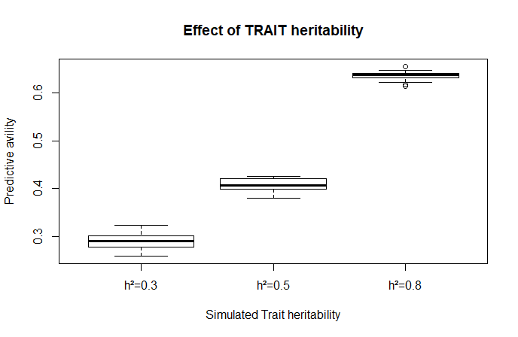
IV Influence of Trait heritability
As expected, predictive ability with the same marker set increases with trait heritability

