Slide 1
Introduction to Genetic Association Studies
Peter Castaldi
January 28, 2013

Slide 2
Objectives
Define genetic association studies
Historical perspective on genetic association and the development of GWAS
Overview of Essential Components of a GWAS Analysis

Slide 3
Definitions
Gene – functional unit of DNA that codes for a protein
Genome – the entirety of an organism’s genetic material
Genetics – study of heredity
Genomics - the study of organism’s entire genome.
Genetic association – genotype → phenotype

Slide 4
Fundamentals of Genetic Association
Genetic association attempts to discern how genotype affects phenotype in populations
Principal elements of genetic association
Measure genetic variation
Measure phenotypic variation
Quantify the association between the two in multiple organisms, cells, etc. (Statistics)
 | AA | AB | BB
Affected
Unaffected

Slide 5
The Strength of the Link Between Genotype and Phenotype is Variable
Phenotypic variation = genetics + environment
Heritability = the extent to which a trait is predictably passed from generation to generation
Some Traits and Diseases are ~100% genetic
Down’s syndrome
Huntington’s Disease
Hair color
Other traits are co-determined by genetics AND environment (and randomness?)
heart disease
height
personality?

Slide 6
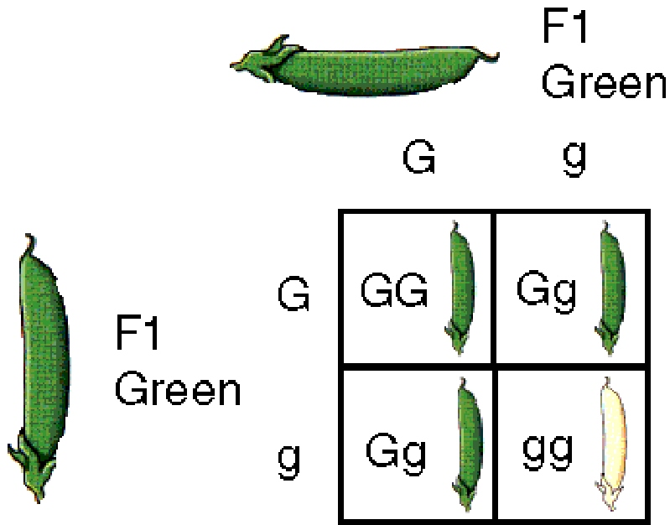
Mendelian Genetics Focuses on Completely Heritable Phenotypes
focused on traits with ~100% heritability
Phenotype = genotype
Used patterns of phenotypic inheritance to infer fundamental rules of “gene” transfer across generations
Much of the fundamental understanding of how genes work arose from phenotype-level observations
http://homeschoolersresources.blogspot.com/2010/04/gregor-mendels-punnet-squares.html

Slide 7
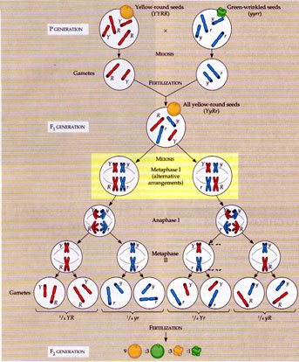
Linking “Genes” to Chromosomes
1915 – The Mechanisms of Mendelian Heritability
“Genes” or units of heredity are located on chromosomes.
Development of genetic maps (first maps based on recombination rates between linked genes)
http://www.bio.georgiasouthern.edu/bio-home/harvey/lect/lectures.html
Notes:
linking phenotypes to chromsomes was spurred by the identification of sex-linked traits by Morgan

Slide 8
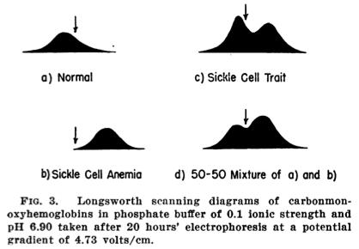
Identifying Genetic/Molecular Diseases
Linus Pauling – 1949, identifies distinct hemoglobin phenotype in individuals with sickle cell disease.
Genes → Protein →Phenotype
Precursor to central dogma DNA → RNA → Protein
Pauling et al. Science 1949

Slide 9
Tools of Mendelian Genetics
Generational Studies
family-based studies
controlled crosses
mutational screens
Phenotypic Observation and Quantification
Genetic Maps for Gene Localization
Genes close to each other on Chromsomes tended not to be randomly assorted during mating
Rough scale genetic maps based purely on observed meioses in generational studies

Slide 10
Selected Landmarks in the Genetics of Human Disease, Mendelian Genetics to Common, Complex Genetics
2005 – First GWAS Published Linking Complement Factor H with AMD
1953 – Watson and Crick, Structure of DNA
1989 - CFTR Gene Mapped Via Positional Cloning
1960 → 1990
1949 – Linus Pauling, “Sickle Cell Anemia, A Molecular Disease”
Mendelian Disease Genetics
Candidate Gene Era
GWAS Era
1990 - Human Genome Project Begins
2001 – First Draft of Human Genome Sequence Published

Slide 11
From Simple Mendelian Disorders to Complex Genetic Diseases
Mendelian Disorders
Rare, “genetic” syndromes
Marfan’s disease, cystic fibrosis, sickle cell anemia
Single Gene Disorders, high penetrance
Family based linkage studies, moderate sample size
Complex Genetic Disorders
Common diseases (diabetes, CAD, arthritis, COPD, cancer)
Multigenic and multifactorial etiology
Population based association studies, large sample sizes

Slide 12
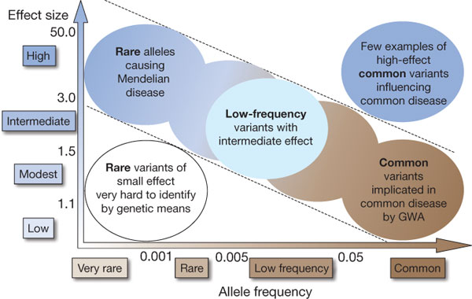

Feasibility of identifying genetic variants by risk allele
frequency and strength of genetic effect (odds ratio).
TA Manolio et al. Nature 461, 747-753 (2009) doi:10.1038/nature08494

Slide 13
Tools of Common, Complex Disease Genetics in Humans
Population-based studies (not family-based)
thousands of human subjects
Detailed, annotated genome maps
Human genome project, ENCODE
Encyclopedia of human genetic variation
HapMap, 1000 Genomes Project
High-throughout genotyping platforms

Slide 14
From Genes to GWAS – A Technology Driven Research Enterprise
Hundreds of thousands of variants, Large Sample Size
Single Variants, Small Sample Size
RFLP
Sanger Sequencing
Days to weeks to identify a single genetic variant in a small number of samples
Chip based genotyping technologies →
>1 million genotypes on a single sample, single assay

Slide 15
What is a GWAS?
Genome-Wide Association Study – study interrogating the relationship between genome-wide genetic variation and a phenotype.
Characteristics
Large volume of data
Much of the data is ‘negative’
Unique information in genome-wide data
Population structure
Evolutionary selection

Slide 16
Key Elements of GWAS (What We’ll Learn This Week)
case-control study design
potential confounders to analysis (population stratification, ascertainment)
genome-wide genotyping
data management, special programs and computing requirements
quality control
statistical association testing
multiple comparisons

Slide 17
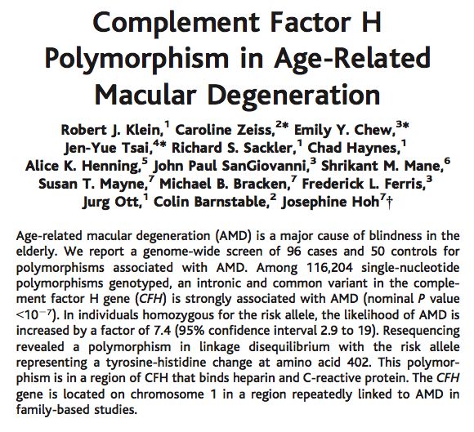

Slide 18
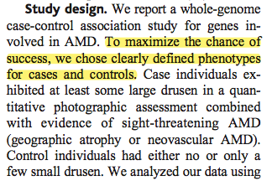
Case-Control Design, Ascertainment

Slide 19
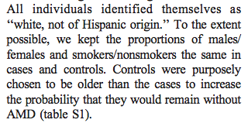
Confounding
Population Stratification (subtle ancestral differences between case and control groups
Traditional confounders (gender, environmental exposures)
Phenotype misclassification (phenocopies, latent cases)

Slide 20
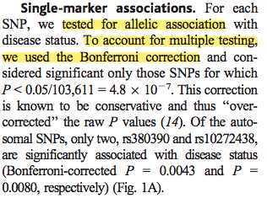
Association Testing

Slide 21
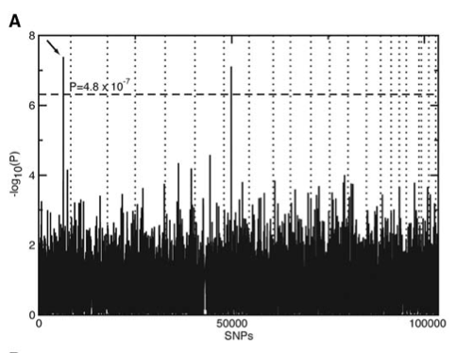
Visualization of Results
Manhattan Plots
genome-wide p-values
Locus Plots
gene-level visualization
QQ Plots
assess bias/significance
LD Plots
visualize local patterns of linkage disequilibrium

Slide 22
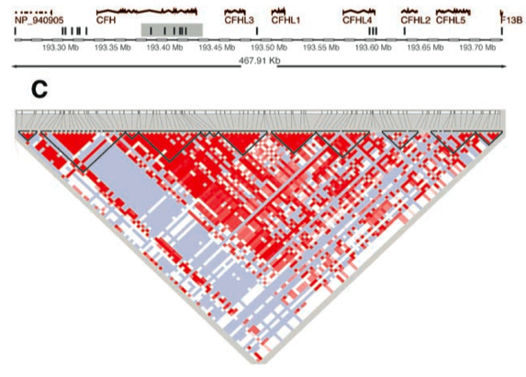
Linkage Disequilibrium (LD)
Fundamental role of LD in chip design
How to Use HapMap to understand LD

Slide 23
Published GWA Reports, 2005 – 6/2012
1350
Total Number of Publications
Calendar Quarter
Through 6/30/12 postings

Slide 24
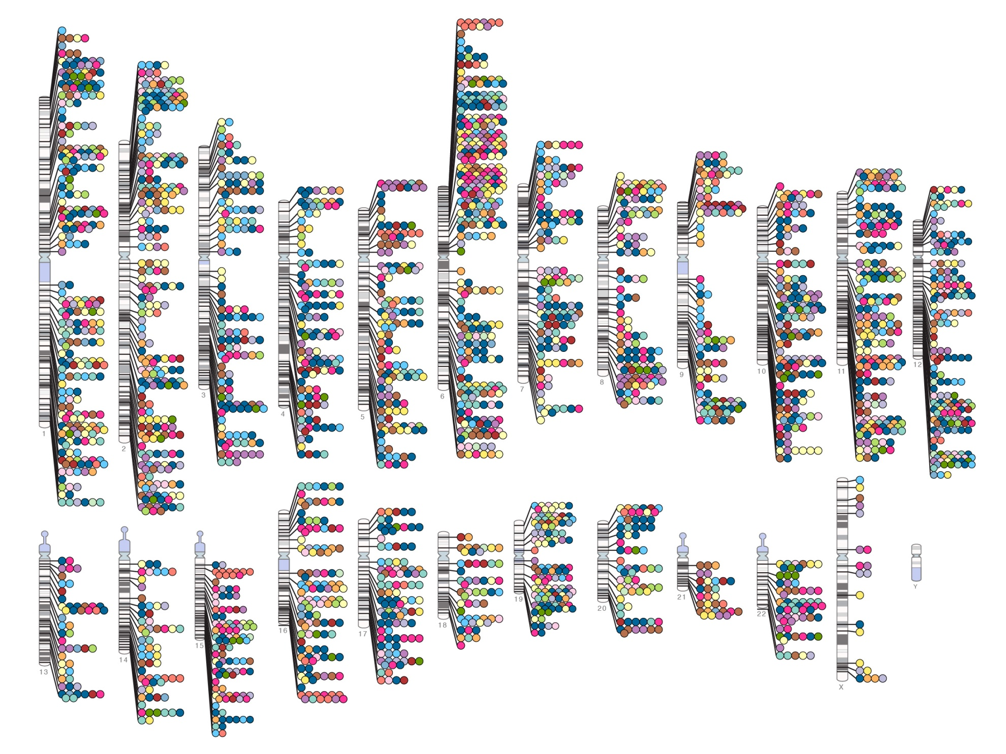
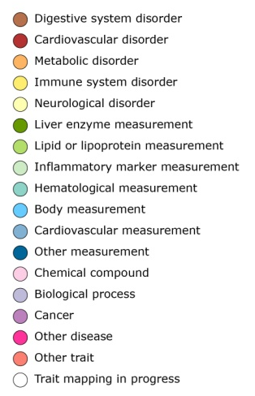

GWAS Has Identified Many Novel, Robust Genetic Associations with Common Diseases
Published Genome-Wide Associations through 07/2012
Published GWA at p≤5X10⁻⁸ for 18 trait categories
NHGRI GWA Catalog
www.genome.gov/GWAStudies
www.ebi.ac.uk/fgpt/gwas/

Slide 25
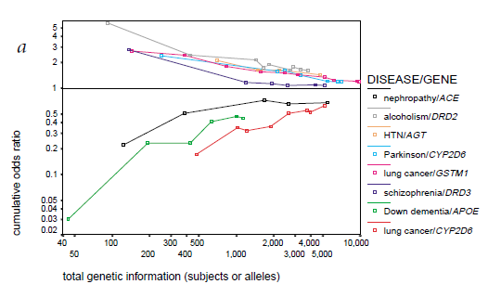
The Candidate Gene Era was Characterized by Poorly Reproducible Results
Ioannidis et al. Nat Gen. 2001

Slide 26
GWAS is a powerful tool
successful study design for identifying robust genetic association with common disease
depends on a great deal of genomic infrastructure
HGP, HapMap, genotyping technology
GWAS only identifies regions of association
causative alleles need to be identified
how loci interact to influence phenotype is poorly understood
the majority of genetic variance for most common, complex diseases remains unexplained.

