Slide 1

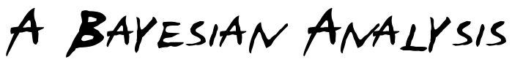

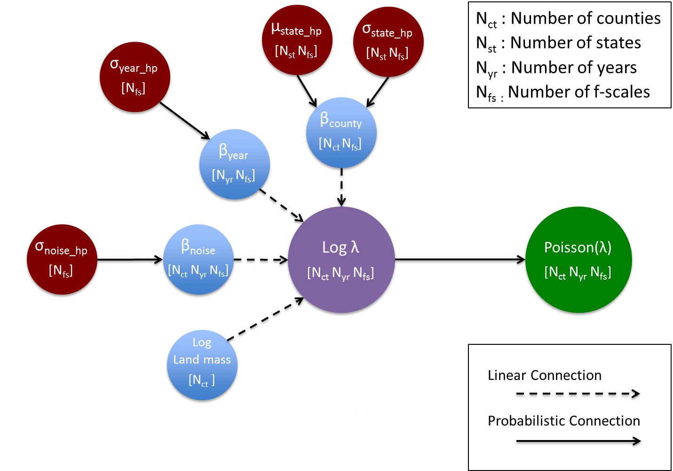
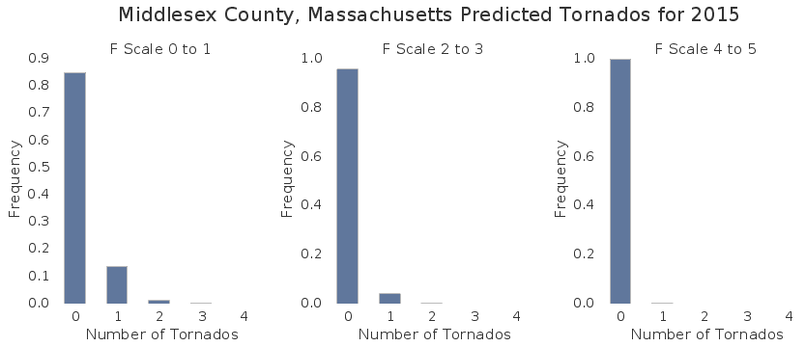
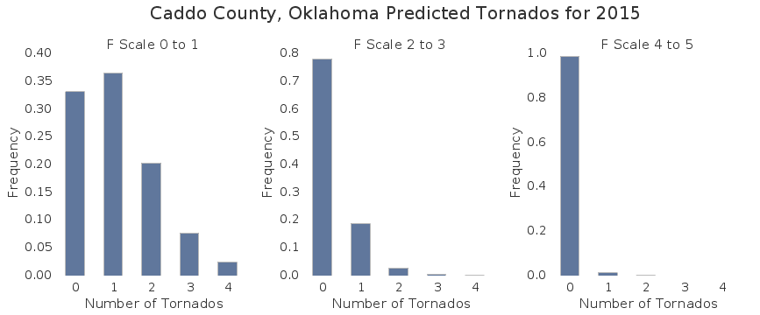
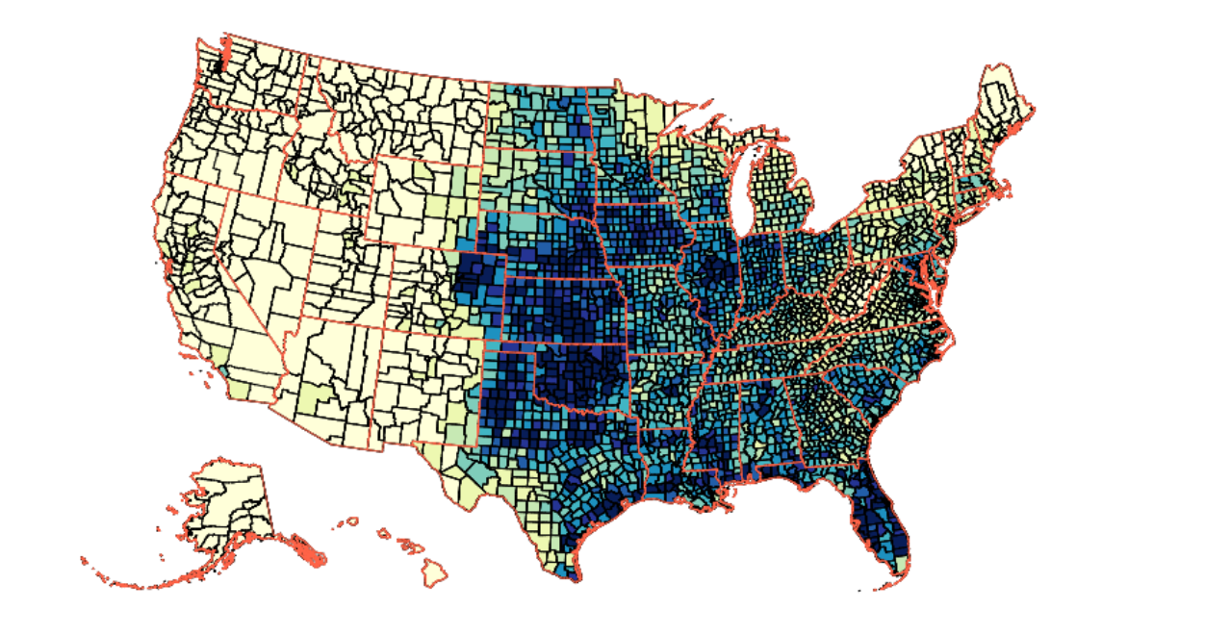
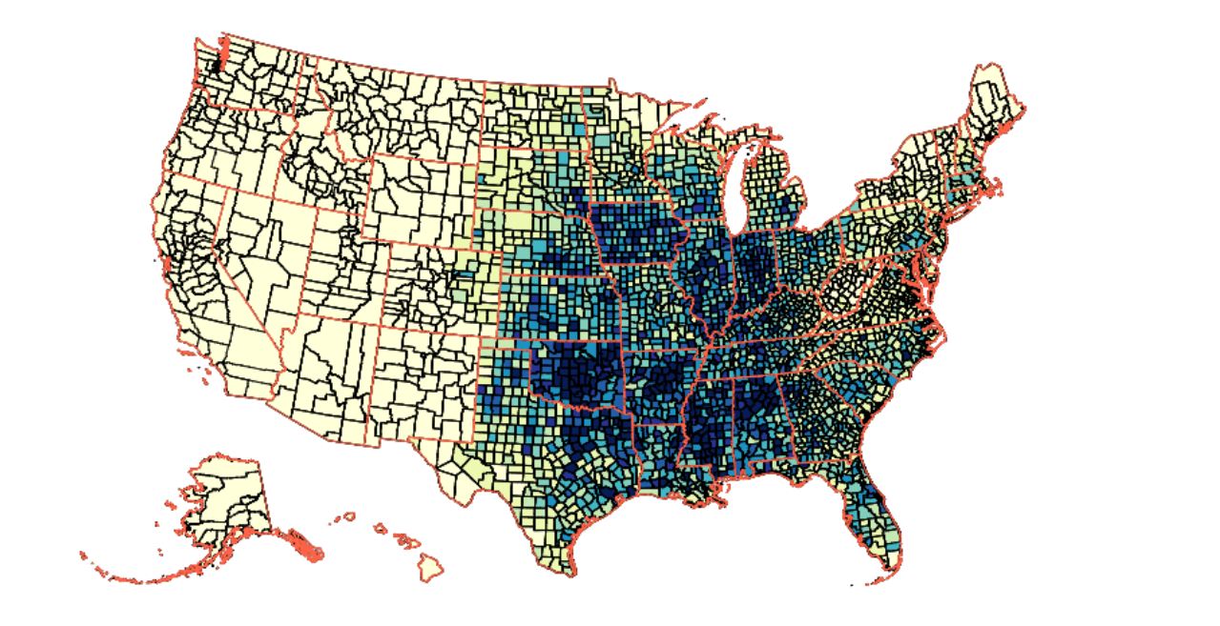
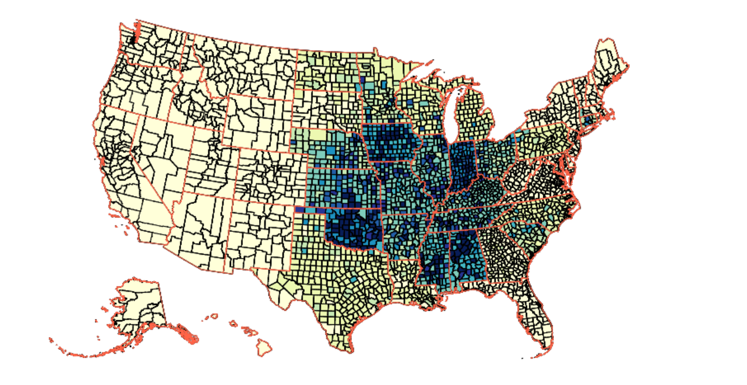
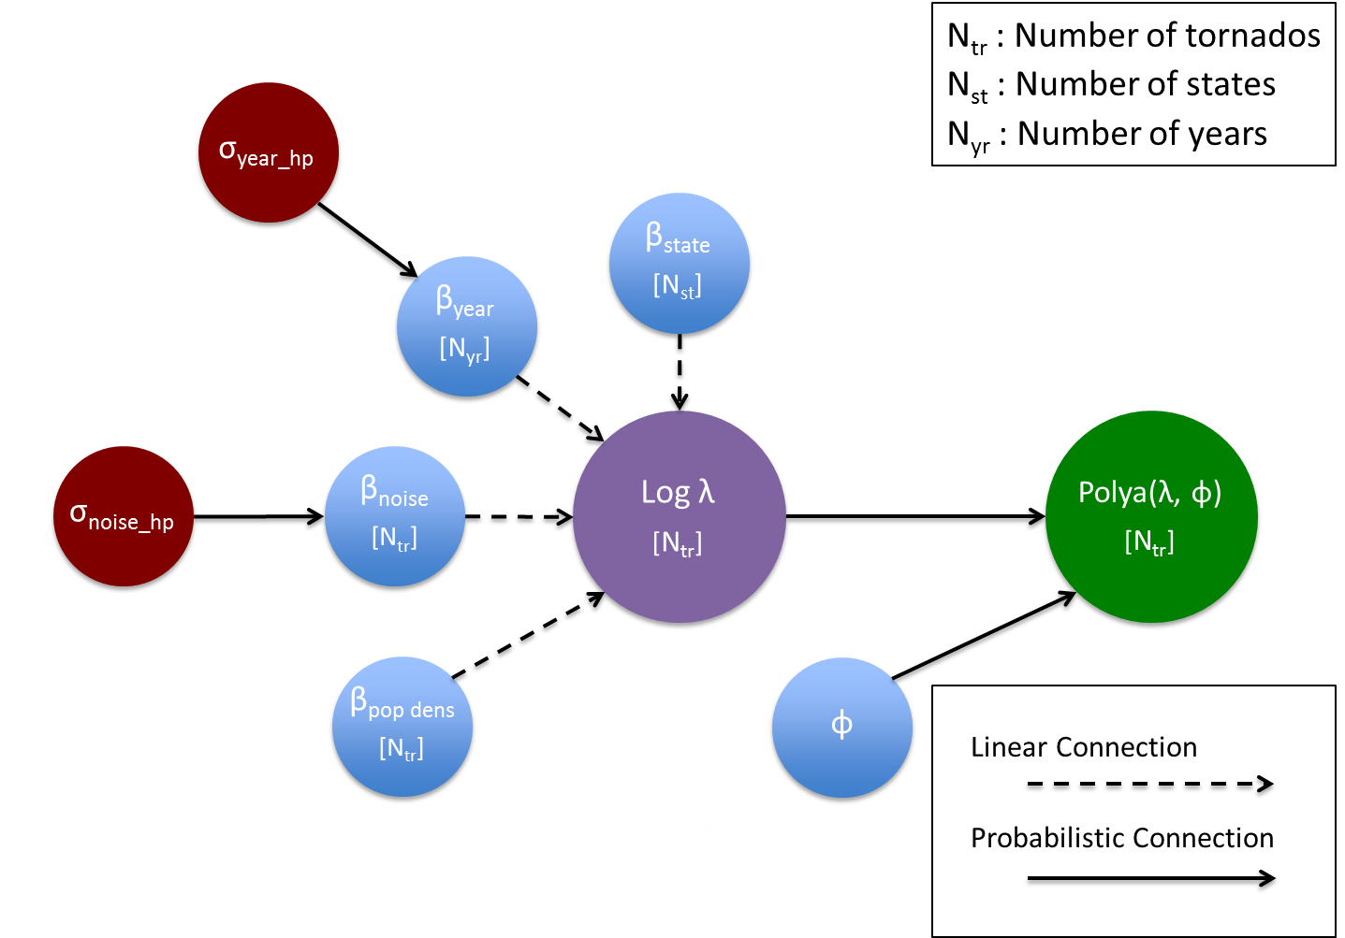
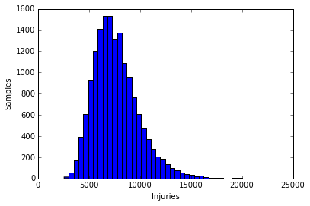

Lehman Garrison, George Miller, and Stephen Portillo
[lgarrison, gfmiller, sportillo] @cfa.harvard.edu
Applied Math 207: Stochastic Optimization Methods
Spring 2015
Introduction
Tornado Frequency
Tornadoes are the most violent of all atmospheric storms, having winds which can destroy property and turn the resulting debris into lethal projectiles. Tornado preparedness is a great public concern, motivating improved forecasts, warning systems, and emergency infrastructure.
Based on historical data, we construct a hierarchical linear Bayesian model for the frequency and injury rate of tornadoes. This model separately captures yearly and geographical effects. Also, geographic effects at the county level are pooled at the state level. We predict the distribution of tornado frequency and injuries counties can expect in the long term.
To model the frequency of tornados in the US, we use a Poisson generalized linear model. The log poisson rate is a linear function of US county, the county’s log land mass, the year of occurrence, and an additional normal error term to allow for overdispersion. Further, the county-level factor is normally dependent on additional hyperpriors corresponding to it’s respective US state. Finally, all parameters are separated by possible tornado F-scales. All priors are either uniform (for means), or cauchy (for variances).
Approach
We employ a Bayesian scheme of hierarchical linear modeling, in which parameter dependences can be constructed on multiple structured levels. These multilevel models are advantageous when examining nested data, such as the occurrence of tornados on a county, state, and nation-wide level.
To build our model, we use the probabilistic programming language Stan. Stan uses a “no U-turn” (NUTS) Hamiltonian Monte Carlo sampler, which models the traversal of the posterior as a dynamics problem to adaptively refine the step size. NUTS tunes the number of leapfrog steps per sample for maximum efficiency.
F0-1
F2-3
F4-5
Figure 1. Posterior mean county-level factors for tornado frequency.
Tornado Injuries
The injury distribution has two sources of dispersion: the broadening ϕ of the Poisson to a Polya distribution, and a noise factor with a normal hyperprior. This broadening creates a replicated injury distribution that matches the actual number of injuries, and yields noise factors that are indeed normally distributed.
Data
Citations and Links
The National Weather Service’s Storm Prediction Center maintains a historical tornado record including Fujita scale intensity, counties along the track, and reported injuries. The Iowa Environmental Mesonet maintains a historical tornado warning record. We match these warnings to the tornado records using the counties and times. We use county land area and population as reported in the United States Census.
Figure 2. Posterior replicated injury distribution for F3 tornados.
Stan. http://mc-stan.org/
NOAA NWS SPC Warning Coordination Meterologist Page. http://www.spc.noaa.gov/wcm/
Iowa Environmental Mesonet. http://mesonet.agron.iastate.edu/
American FactFinder. http://factfinder.census.gov/
School of Engineering and Applied Sciences • Institute for Applied Computational Science

