Slide 1
User functions
2

Slide 2
Introducing ...
User functions
All R commands are functions.
Functions perform calculations, possibly involving several arguments, then return a value to the calling statement.
The calculation maybe any process, might or might not have return value
  It need not be arithmetic
User functions extend the capabilities of R by adapting or creating new tasks that are tailored to your specific requirements.
User functions are a special kind of object

Slide 3
Defining a new function
Parts of function definition: name, arguments, procedural steps, return value
sqXplusX <- function(x){
x^2 + x
}
sqXplusX is the function name
x is the single argument to this function and it exists only within the function
everything between brackets { } are procedural steps
the last calculated value is the function return value
after defining the function, we can use it:
> sqXplusX(10)
[1] 110

Slide 4
Named and default arguments
Example of function with more than one named argument:
powXplusX <- function(x, power=2){
x^power + x
}
Now we have two arguments. The second argument has a default value of 2.
Arguments without default value are required, those with default values are optional.
> powXplusX(10)
[1] 110
> powXplusX(10, 3)
[1] 1010
> powXplusX(x=10, power=3)
[1] 1010
arguments matched based on position
arguments matched based on name

Slide 5
Assignments with arguments
User functions
You can use a blank document in gedit, nedit or other text editor to hold these commands for you, then copy / paste the instructions into R
sqXplusX <- function(x){
x^2 + x
}
Now try this …
a <- matrix(1:100, ncol=10, byrow=T) # make some dummy data
b <- sqXplusX(a) # transform a by sqXplusX, assign result to b
b # to view the result
sqXplusX user function is now an R object, check its arguments and list it in the current workspace
> args(sqXplusX)
> ls()
> sqXplusX
Don’t add brackets to see the
definition of sqXplusX

Slide 6
Assigned or anonymous ...
User functions
Functions may be assigned a name, or anonymously created within an operation
  Anonymous functions are really useful in apply()style procedures
apply(object, margin, function)
  E.g. I have a 10 x 10 matrix and want to square each item, and add the item to itself
a<-matrix(1:100, ncol=10, byrow=T)
a # to view new object
apply(a, c(1,2), function(x) x^2+x)
x is transiently assigned each item of a, and this is passed as an argument to the anonymous function
1 means by rows, 2 means by columns [1st or 2nd margin]
c(1,2) means do both rows and columns

Slide 7
Functions occupy their own space
User functions
Objects created in functions are not available to the general environment unless returned.
  they are said to be out of scope
    Scope relates to the accessibility of an object.
A function can only return one object.
Custom functions disappear when R sessions end, unless the function object is saved in an Rdata file or sourced from a script.
  A really useful function could be added to your .Rprofile file, and would always be ready for you at launch
You could also make a package
  Beyond the scope of the beginners course!!!!

Slide 8
Script / function tips
User functions
If your script repeats the same style command more than twice, you should consider writing a function
Writing functions makes your code more easily understandable because they encapsulate a procedure into a well-defined boundary with consistent input/output
Functions should not be longer than one-to-two screens of code, keep functions clean and simple
Look at other functions to get ideas for how to write your own …
  Display function code by entering the function’s name without brackets.

Slide 9
File commands for extending
scripts & user functions
Generic file commands
dir(...,pattern="txt")
Retrieve working directory file listing filtered by pattern. Note pattern is a regular expression, not a shell wildcard
glob2rx("*.txt")
Changes wildcards to regular expressions!
unlink(...)
Remove (permanently) a file from system
system(...)
Execute a shell command from within R
Result can not be coerced to an object, only available to linux R
> glob2rx("*.txt")
[1] "^.*\\.txt$"

Slide 10
Text manipulation for extending
scripts & user functions
Text manipulation and file name mangling ... that's a technical term
grep( pattern, object )
    If pattern is not found, grep returns a 0 length object.
      Test for null with is.null()
sub( pattern, replacement, object )
gsub( pattern, replacement, object)
    Sub replaces first occurrence only, gsub does them all.
cat( "...", file=...)
    Outputs text to a file, or prints it on screen if file=""
      cat requires "\n" to be given for new lines ... try ...
cat("Hello World!") ; cat("Hello World!",sep="\n") ; cat("Hello World!",sep="\n",file="world.txt")
    cat is extremely useful for writing scripts or generating reports on-the-fly

Slide 11
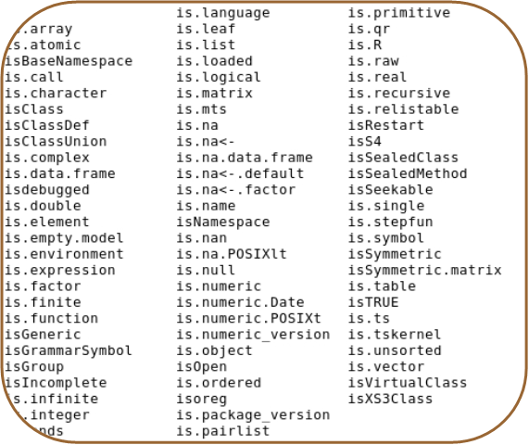
Error reporting for extending
scripts & user functions
Your code should report errors if inconsistency is detected.
stop(...)
  Stops execution of a function and reports a custom error message
is.family(...)
  Functions that can be used to test for a variety of conditions place them inside if structures to check that all is well
if( !is.numeric(x) ){ stop ("Non numeric value entered. Cannot continue.") }
If the object x is non numeric (e.g. Text has been entered when numbers were required), then stop execution and report message
The is.family

Slide 12
Temperature conversion exercise
User functions
Centigrade to Fahrenheit conversion is given by
  F = 9/5 C +32
    Write a function that converts between temperatures.
      The function will need two named arguments
        temperature (t) is numeric
        units (unit) is character
        They will need default values, e.g t=0, unit="c"
      The function should report an appropriate error if inappropriate values are given
if( !is.numeric(t) ) { .... }
if( !(unit %in% c("c","f")) ){...}
      The function should print out the temperature in F if given in C, and vica versa
Functions with named arguments are defined with the following syntax
myFunc<-function(arg=defaultValue,…)
Why not add a third scale?
K=C+273.15
Example code:
12_convTemp.R

Slide 13
Building the solution
It is difficult to write large chunks of code, instead start with something that works and build upon it
E.g. to solve the temperature conversion exercise:
  start with the function powXplusX (from some slides ago)
  modify the argument names
  delete the old code, for now just print out the input arguments
  save the function file, load it into R and try it out
  now add the two lines for input checking from the previous slide
  try it out, see if passing a character for temperature gives the expected error
  now try to convert C into F and print out the result
  when that works, add the conversion from F to C
If you get stuck, call us to help you !

Slide 14
Temperature conversion script
convTemp<-function(t=0,unit="c"){ # convTemp is defined as a new user function requiring two arguments, t and unit, the default values are 0 and "c", respectively.
if( !is.numeric(t) ){
stop("Non numeric temparture entered") # Exception error if character given for temperature
}
if(!(unit %in% c("c","f","k"))){
stop("Unrecognized temperature unit. \n Enter either (c)entigrade, (f)ahreneinheit or (k)elvin") # Exception error if unrecognized units entered
}
# Conversion for centigrade
if(unit=="c"){
fTemp <- 9/5 * t + 32
kTemp <- t + 273.15
output <- paste(t,"C is: \n",fTemp,"F \n",kTemp,"K \n")
cat(output)
}
# Conversion for Fahrenheit
if(unit=="f"){
cTemp <- 5/9 * (t-32)
kTemp <- cTemp + 273.15
output <- paste(t,"F is: \n",cTemp,"C \n",kTemp,"K \n")
cat(output)
}
# Conversion for Kelvin
if(unit=="k"){
cTemp <- t - 273.15
fTemp <- 9/5 * cTemp + 32
output <-paste(t,"K is: \n",cTemp,"C \n",fTemp,"F \n")
cat(output)
}
}
"\n" -> puts text on a new line
Units must be entered in quotes, as it’s a character object
> convTemp(t=-273,unit="c")
-273 C is:
-459.4 F
0.149999999999977 K
Example code:
12_convTemp.R

