Slide 1
DAY 1. A beginners guide to solving biological problems in R
Robert Stojnić (rs550), Laurent Gatto (lg390) and Rob Foy (raf51)
Course material:
http://logic.sysbiol.cam.ac.uk/teaching/Rcourse/
Slides by Ian Roberts and Robert Stojnić

Slide 2
Day 1 schedule
The R environment and basics
  Where to get R
  Brief introduction to essential R
  R help, scripting and packages
Morning coffee
Objects and data types
  Learn how to input and manipulate data
Lunch
Introduction to essential R commands
  Base functions
  Read and write data
Afternoon coffee
R for data analysis
  Statistical tests and maths support

Slide 3
What’s R?
A statistical programming environment
  based on S
  Suited to high level data analysis
Open source & cross platform
Extensive graphics capabilities
Diverse range of add-on packages
Active community of developers
Thorough documentation

Slide 4
The environment and basics
1

Slide 5
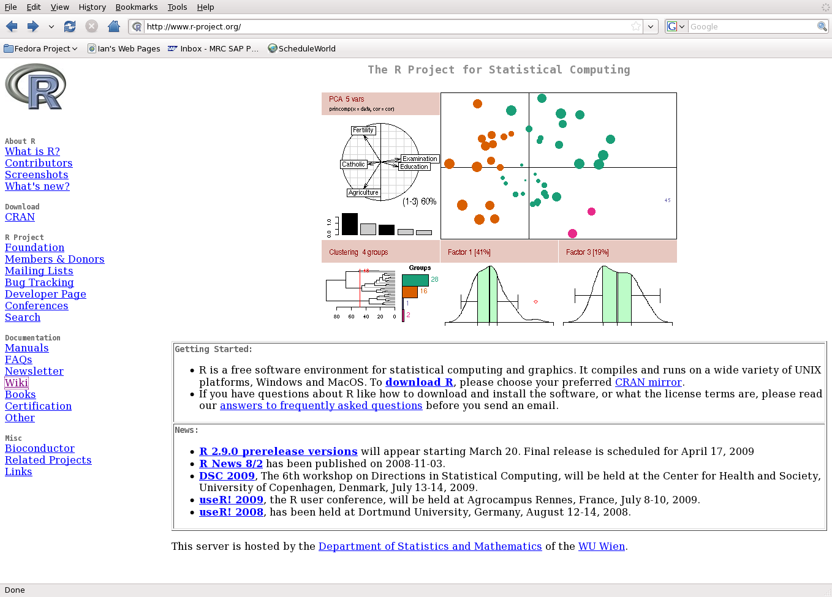
www.r-project.org

Slide 6
Various platforms supported
Release 2.15.0 (March 2012)‏
  Base package
  Contributed packages (general purposes extras)‏
  ~4000 available packages
Windows
  http://www.stats.bris.ac.uk/R/bin/windows/base/R-2.11.1-win32.exe
Mac OS (10.2 +)‏
  http://cran.r-project.org/bin/macosx/
Linux
  http://cran.r-project.org/bin/linux/
Executed using command line, or a graphical user interface (GUI)Executed
  Will demonstrate both, and use all-platform GUI, RStudio

Slide 7
Getting Started
R is a program which, once installed on your system, can be launched and is immediately ready to take input directly from the user
There are two ways to launch R:
  From the command line (particularly useful if you're quite familiar with Linux)
  As an application called RStudio (very good for beginners)

Slide 8
Prepare to launch R
From command line
To start R in Linux we need to enter the Linux console (also called Linux terminal and Linux shell)
To start R, at the prompt simply type:
  $ R
If R doesn't print the welcome message, call us to help!

Slide 9

Prepare to launch R
Using RStudio
To launch RStudio, find the RStudio icon in the menu bar on the left of the screen and double-click

Slide 10
The Working Directory (wd)
Like many programs R has a concept of a working directory (wd)
It is the place where R will look for files to execute and where it will save files, by default
For this course we need to set the working directory to the location of the course scripts
At the command prompt in the terminal or in RStudio console type:
> setwd(“R_course/Day_1_scripts”)
Alternatively in RStudio use the mouse and browse to the directory location
Tools → Set Working Directory → Choose Directory...

Slide 11
Basic concepts in R command line calculation
The command line can be used as a calculator. Type:
> 2 + 2
[1] 4
> 20/5 - sqrt(25) + 3^2
[1] 8
> sin(pi/2)
[1] 1
Note: The number in the square brackets is an indicator of the position in the ouptut. In this case the output is a 'vector' of length 1 (i.e. a single number). More on vectors coming up...

Slide 12
Basic concepts in R variables
A variable is a letter or word which takes (or contains) a value. We use the assignment 'operator', <-
> x <- 10
> x
[1] 10
> myNumber <- 25
> myNumber
[1] 25
We can perform arithmetic on variables:
> sqrt(myNumber)
[1] 5
We can add variables together:
> x + myNumber
[1] 35

Slide 13
Basic concepts in R variables
We can change the value of an existing variable:
> x <- 21
> x
[1] 21
We can modify the contents of a variable:
> myNumber <- myNumber + sqrt(16)
[1] 29

Slide 14
Basic concepts in R functions
Functions in R perform operations on arguments (the input(s) to the function). We have already used sin(x) which returns the sine of x. In this case the function has one argument, x. Arguments are always contained in parentheses, i.e. curved brackets (), separated by commas
Some other common functions: floor(), sum(), max(), mean()
Try these:
> floor(3.142)
[1] 3
> sum(3, 4, 5, 6)
[1] 18
> max(3, 4, 5, 6)
[1] 6
> mean(3, 4, 5, 6)
[1] 3
Something has gone wrong with the last function. We need to understand more about vectors...

Slide 15
Basic concepts in R vectors
The function c() combines its arguments into a vector
> x <- c(3, 4, 5, 6)
> x
[1] 3 4 5 6
As mentioned, the square brackets [] indicate position within the vector. We can extract individual elements by using the [] notation
> x[1]
[1] 3
> x[4]
[1] 6
We can even put a vector inside the square brackets
> y <- c(2, 3)
> x[y]
[1] 4 5
We can now solve the problem from the previous slide
> mean(x)
[1] 4.5

Slide 16
Basic concepts in R vectors
There are a number of shortcuts to create a vector. Instead of:
> x <- c(3, 4, 5, 6, 7, 8, 9, 10, 11, 12)
Write
> x <- 3:12
Using the seq() function...
> x <- seq(2, 10, 2)
> x
[1] 2 4 6 8 10
> x <- seq(2, 10, length.out = 7)
> x
[1] 2.00000 3.33333 4.66667 6.00000 7.33333 8.66667 10.00000
or the rep() function
> y <- rep(3, 5)
> y
[1] 3 3 3 3 3
> y <- rep(1:3, 5)
> y
[1] 1 2 3 1 2 3 1 2 3 1 2 3 1 2 3

Slide 17
Basic concepts in R vectors
We have seen some ways of extracting elements of a vector. We can use these shortcuts to make things easier (or more complex!)
> x <- 3:12
> x[3:7]
[1] 5 6 7 8 9
> x[seq(2, 6, 2)]
[1] 4 6 8
> x[rep(3, 2)]
[1] 5 5
We can add an element to a vector
> y <- c(x, 1)
> y
[1] 3 4 5 6 7 8 9 10 11 12 1
We can glue vectors together
> z <- c(x, y)
> z
[1] 3 4 5 6 7 8 9 10 11 12 3 4 5 6 7 8 9 10 11 12 1

Slide 18
Basic concepts in R vectors
We can remove element(s) from a vector
> x <- 3:12
> x[-3]
[1] 3 4 6 7 8 9 10 11 12
> x[-(5:7)]
[1] 3 4 5 6 10 11 12
> x[-seq(2, 6, 2)]
[1] 3 5 7 9 10 11 12
Finally, we can modify the contents of a vector
> x[6] <- 4
> x
[1] 3 4 5 6 7 4 9 10 11 12
> x[3:5] <- 1
> x
[1] 3 4 1 1 1 4 9 10 11 12
Remember! Square brackets for indexing [], parentheses for function arguments ().

Slide 19
Basic concepts in R vector arithmetic
When applying all standard arithmetic operations to vectors, application is element-wise
> x <- 1:10
> y <- x*2
> y
[1] 2 4 6 8 10 12 14 16 18 20
> z <- x^2
> z
[1] 1 4 9 16 25 36 49 64 81 100
Adding two vectors
> y + z
[1] 3 8 15 24 35 48 63 80 99 120
Vectors don't have to be the same length (what's this?)...
> x + 1:2
[1] 2 4 4 6 6 8 8 10 10 12
but that doesn't always work
> x + 1:3 (...?)

Slide 20

Writing scripts with Rstudio
Typing lots of commands directly to R can be tedious, a better way is to write the commands to a file and then load it into R.
Click on File -> New in Rstudio
Type in some R code, e.g.
x <- 2 + 2
print(x)
Click on Run to execute the current line, and Source to execute the whole script
Sourcing can also be performed manually with source("myScript.R")

Slide 21
Getting Help
To get help on any R function, type ? followed by the function name. For example:
> ?seq
This retrieves the syntax and arguments for the function. It also tells you which package it belongs to. There will typically be example usage
If you can't remember the exact name type ?? followed by your guess. R will return a list of possibles
> ??rint

Slide 22
Interacting with the R console
R console symbols
  ; end of line
    Enables multiple commands to be placed on one line of text
  # comment
    indicates text is a comment and not executed
  + command line wrap
    R is waiting for you to complete an expression
Ctrl-c or escape to clear input line and try again
Ctrl-l to clear window
Press q to leave help (using R from the terminal)
Use the TAB key for command auto completion
Use up and down arrows to scroll through the command history

Slide 23
R packages
R comes ready loaded with various libraries of functions called packages. e.g. the function sum() is in the base package and sd(), which calculates the standard deviation of a vector, is in the stats package
There are 1000s of additional packages provided by third parties, and the packages can be found in numerous server locations on the web called repositories
The two repositories you will come across the most are
    The Comprehensive R Archive Network (CRAN)
    Bioconductor
CRAN is mirrored in many locations. Set your local mirror in RStudio using Tools → Options, and choose a CRAN mirror
Set the Bioconductor package download tool by typing:
> source("http://bioconductor.org/biocLite.R")
Bioconductor packages are then loaded with the biocLite() function:
> biocLite(“PackageName”)

Slide 24
R packages
3900+ packages on CRAN:
  Use CRAN search to find functionality you need:
  http://cran.r-project.org/search.html
  Or, look for packages by theme:
  http://cran.r-project.org/web/views/
550+ packages in Bioconductor:
  Specialised in genomics:
  http://www.bioconductor.org/packages/release/bioc/
Other repositiories:
1000+ projects on R-forge:
  http://r-forge.r-project.org/
R graphical manual:
  http://bg9.imslab.co.jp/Rhelp/
Bottomline: always first look if there is already an R package that does what you want before trying to implement it yourself

Slide 25
Exercise: Install Packages
Matrix and aCGH
Matrix is a CRAN extras package
  Use install.packages() function...
  install.packages("Matrix")
  or in RStudio goto Tools → Install Packages... and type the package name
aCGH is a BioConductor package (www.bioconductor.org)‏
  Use biocLite() function
biocLite("aCGH")
R needs to be told to use the new functions from the installed packages
  Use library(…) function to load the newly installed features
library("Matrix") # loads matrix functions
library("aCGH") # loads aCGH functions
  library()
    Lists all the packages you've got installed locally

Slide 26
Time for ...
MORNING COFFEE

Slide 27
Objects
2

Slide 28
R stores different types of data
Types of data
  Logical, integer, character, floating point
Data is stored in objects
  Vectors, data frames, matrices, arrays, lists
  Vector is the most basic object
Most appropriate type and value is determined by R syntax
a <- 10 # takes the value of number 10
a <- "10" # takes the value of characters "10"
a <- b # takes the value of variable b
a <- "b" # takes the value of character "b"

Slide 29
Data types and storage modes
R creates appropriately sized object variables to hold data
Objects are vectors … they have a length dimension …
  Vectors support vector arithmetic, which is R's big thing
The ‘mode of storage’ used is determined by the ‘data type’
Mode is one of
  logical, numeric, or character
Standard data types
  Logical
    (TRUE or FALSE)‏
  Integer
    (e.g. whole numbers -2 / +2 Billion)‏
  Double / floating point
    ( e.g. fractions, scientific expressions)‏
  Character string - always in quotes!
    (e.g. 4 is a number, "4" or "abc" are characters)
If vectors are generated to hold numbers, and type isn’t specified, they will be held as mode numeric, type double.
> typeof(…)
> mode(…)

Slide 30
Exercise
Data types & storage modes
Create vectors i, l, s and d of length 20 for each data type integer, logical, character, and double
Examine their storage mode & confirm data type
  mode(...)‏
  typeof(...)
Tips:
  you can do this by manually assigning values, or by generating them (see the functions below)
  sample(20) will create a vector of 20 random integer values
  R special character object letters is ‘builtin’, you can subset it
  runif(20) will generate 20 random uniformly distributed 'double' values between 0 and 1
  relationships are ‘tests’ and return logical values (e.g. 2>1 is TRUE, but 5<1 is FALSE)‏
    l <- i >= 10 # test if 'i' is greater or equal to 10

Slide 31
Solution
Example code:
04_objects.R script
> i <- sample(20)‏
> i
[1] 6 1 14 8 5 10 18 12 2 11 16 3 4 20 9 7 19 13 15 17
> s <- letters[i]]
> s
[1] "f" "a" "n" "h" "e" "j" "r" "l" "b" "k" "p" "c" "d" "t" "i" "g" "s" "m" "o"
[20] "q"
> l <- i >= 10
> l
[1] FALSE FALSE TRUE FALSE FALSE TRUE TRUE TRUE FALSE TRUE TRUE FALSE
[13] FALSE TRUE FALSE FALSE TRUE TRUE TRUE TRUE
> d <- runif(20)‏
> d
[1] 0.292480127 0.586057481 0.812791710 0.189530051 0.634724719 0.882981055
[7] 0.358151866 0.003088843 0.900198085 0.905947217 0.032231749 0.330297215
[13] 0.398237377 0.832774598 0.048503020 0.965920822 0.357567181 0.688554482
[19] 0.728918707 0.477420883
> mode(i)‏
[1] "numeric“
> typeof(i)‏
[1] "integer"
> mode(l)‏
[1] "logical"
> typeof(l)‏
[1] "logical"
> mode(s)‏
[1] "character"
> typeof(s)‏
[1] "character"
> mode(d)‏
[1] "numeric"
> typeof(d)‏
[1] "double"
i is mode numeric, type integer
l is mode logical , type logical
t is mode character, type character
(note the quotes in object t)‏
d is a mode numeric,type double

Slide 32
Storage modes & data types
Data types - why care?
  May get an undesired result if calculations are between numbers stored as different types
  R will coerce data types when calculations between differing types are forced
    If the operation is inappropriate, the calculation will fail.
    e.g.
    > 2 + "2"
    will fail as we cannot add a character string to integer!

Slide 33
R Objects - vectors
c(...) or vector(..., mode=…, length=…)‏
Vectors
  one-dimensional sequence of data items of only one data type
> a <- c(1, 2, 3, 4, 5)
> typeof(a)‏
[1] "double"
> aa <- c(1, "2", 3)‏
> typeof(aa)
[1] "character"
  Vector arithmetic is a fundamental R concept
> a <- 1:10 ; b <- 101:110 ; c <- a + b
> c
[1] 102 104 106 108 110 112 114 116 118 120
Arithmetic operation occurs
between corresponding items
of the two vectors. If vectors
are different lengths, shortest
is recycled
+
a: 1 2 3 4 5 6 7 8 9 10
b: 101 102 103 104 105 106 107 108 109 110
C: 102 104 106 108 110 112 114 116 118 120

Slide 34
R Objects
data.frame(var1=…, var2=…, etc.)‏
Data frames
  multiple columns of vectors that form a table
  columns can be of different data types
> a <- 1:10 # shortcut for numbers 1 to 10
> b <- letters[1:10] # shortcut for letters
> c <- month.name[1:10] # shortcut for month names
> d <- data.frame(a, b, c, stringsAsFactors=FALSE)‏ # data frame assignment
> d
a b c
1 1 a January
2 2 b February
3 3 c March
4 4 d April
5 5 e May
6 6 f June
7 7 g July
8 8 h August
9 9 i September
10 10 j October
  Column names can changed
colnames(d) <- c("a", "b", "c")‏
  Address columns with $ notation
    d$a # returns only the column a (as a vector)
‏

Slide 35
R Objects
matrix(..., ncol=…, nrow=…)‏
Matrices
  Like data frames, but for a single data type.
> e <- matrix(1:10, nrow=5, ncol=2)
> e
[,1] [,2]
[1,] 1 6
[2,] 2 7
[3,] 3 8
[4,] 4 9
[5,] 5 10
  Matrices are usually associated with numeric data, and usual operations +, -, *, ... work on whole matrices as well

Slide 36
Indexing data frames,
matrices & arrays
Special cases:
a[i, ] i-th row
a[ ,j] j-th column
Works just like vectors, only in 2 dimensions
object [ rows , columns ]
a <- data.frame(1:10, letters[1:10], month.name[1:10], stringsAsFactors=FALSE)‏
names(a) <- c("numbers","letters","months")‏
a
numbers letters months
1 1 a January
2 2 b February
3 3 c March
4 4 d April
5 5 e May
6 6 f June
7 7 g July
8 8 h August
9 9 i September
10 10 j October
Direct reference row & column
a[1,1]
[1] 1
Direct reference of rows and columns, range notation
a[1:4,1:2]
numbers letters
1 1 a
2 2 b
3 3 c
4 4 d
Omit a value to get all of them, e.g. full first column
a[, 1]
[1] 1 2 3 4 5 6 7 8 9 10

Slide 37
R Objects
list(name1=obj1, name2=obj2, …)‏
Lists
  Store collections of R objects.
    List members (items) can be of any R object, or data type.
a <- 1:10
b <- matrix(runif(100),ncol=10,nrow=10)‏
c <- data.frame(a,month.name[1:10])‏
myList<-list( ls.obj.1=a, ls.obj.2=b,ls.obj.3=c )‏
summary(myList)‏
names(myList)‏
  Using dollar notation($), we can address list items directly, by name, as with columns of a data frame
myList$ls.obj.1
  Alternatively, myList[[1]] to get first item in the list

Slide 38
R Objects
factor(obj, levels=…, labels=…)‏
Factors
  Factors store categorical data
  categorical data is usually expressed in levels.
    They are especially useful where repetition is found
    Exercise may take place on any day of the week
The factor is exercise, and levels are week day names
    A gene may be deleted, lost, normal, gained or amplified
The factor is gene copy number, and levels are -2, -1, 0, 1, 2
  Factors require a good understanding of data dependency
  Experiments often have multiple explanatory variables, and it is interesting to observe interactions between them
Factors are similar to 'enumerated data types' in other languages

Slide 39
Operators
arithmetic
+, -, *, /, ^
comparison
<, >, =<, >=, ==, !=
logical
!, &, |, xor
(equal to, not equal to)‏
these always return logical values !
(TRUE, FALSE)
([!] not, [&] and, [bar, shift-back slash] or, [xor]exclusive or)‏

Slide 40
Advanced indexing / subscripting vectors
Indexing / subscripting
  The process of referencing a particular data value stored in an R object
Indexing can be achieved either with numbers or logicals, e.g.:
> s <- letters[1:5]
> s[c(1,3)]
[1] "a" "c"
> s[c(TRUE, FALSE, TRUE, FALSE, FALSE)]
[1] "a" "c"
Or, with expression resulting in either numbers or logicals:
> a <- 1:5
> s[a[1:4]] # range expression, answer is a to d
> s[a<3] # first 2 items, returns a, b
> s[a>1 & a<3] # answer is 2, returns b

Slide 41
Exercise: objects & indexing
Make a phonebook with 10 listings
Construct your phonebook from 5 vectors (make up the data).
First name
Character vector: firstName
Second name
Character vector: secondName
Telephone number
Numeric vector: telNumber
Listed in directory
Logical vector: notListed
i.e. TRUE or FALSE
Full name
Character vector: fullName
fullName <- paste(firstName,secondName)‏
Combine vectors into a single phoneBook dataframe
‏
Use your phone book to extract the following data items
1. Telephone numbers of people with second names beginning with letters below M
phoneBook$secondName < "M"
2. Telephone numbers of people not listed in a directory
phoneBook$notListed == TRUE
3. Telephone numbers of all odd row people
seq(1,10,2)
Some tips for the indexing expressions are given.

Slide 42
One solution
> typeof(firstName)‏
[1] "character"
> typeof(secondName)‏
[1] "character"
> typeof(telNumber)‏
[1] "double"
> typeof(notListed)‏
[1] "logical"
“+” Line wrap indicator
> firstName<-c("Adam","Eve","John","Mary","Peter","Paul","Luke",
+ "Matthew","David","Sally")‏
> length(firstName)‏
[1] 10
> secondName<-c("Tiny","Large","Small","Davis","Thumb","Daniels",
+ "Edwards","Smith","Howkins","Dutch")‏
> length(secondName)‏
[1] 10
> telNumber<-c(111111,222222,333333,444444,555555,666666,777777,888888,121212,232323)‏
> length(telNumber)‏
[1] 10
> notListed<-c(TRUE,FALSE,TRUE,FALSE,TRUE,FALSE,TRUE,FALSE,TRUE,FALSE)‏
> length(notListed)‏
[1] 10
> phoneBook<-data.frame(firstName,secondName,paste(firstName,secondName),telNumber,notListed,
stringsAsFactors=FALSE)‏
> names(phoneBook)<-c("First_Name","Second_Name","Full_Name","Tel_Number","Not_Listed")‏
> phoneBook
First_Name Second_Name Full_Name Tel_Number Listed
1 Adam Tiny Adam Tiny 111111 TRUE
2 Eve Large Eve Large 222222 FALSE
3 John Small John Small 333333 TRUE
4 Mary Davis Mary Davis 444444 FALSE
5 Peter Thumb Peter Thumb 555555 TRUE
6 Paul Daniels Paul Daniels 666666 FALSE
7 Luke Edwards Luke Edwards 777777 TRUE
8 Matthew Smith Matthew Smith 888888 FALSE
9 David Howkins David Howkins 121212 TRUE
10 Sally Dutch Sally Dutch 232323 FALSE
> phoneBook$Second_Name<"M"
[1] FALSE TRUE FALSE TRUE FALSE
TRUE TRUE FALSE TRUE TRUE
> phoneBook[phoneBook$Second_Name<"M",4]
[1] 222222 444444 666666
777777 121212 232323
> phoneBook[phoneBook$Not_Listed,4]
[1] 111111 333333 555555 777777 121212
Odd
> phoneBook[seq(1,10,2),4]
[1] 222222 444444 666666 888888 232323
05_phoneBook.R script

Slide 43
Time for
LUNCH
(RESUME 1:30 PM)‏

Slide 44
R Commands & flow control
3

Slide 45
Basic R 'Built-in' functions
for working with variables
list & remove objects
ls(), rm()‏
rm(list=ls()) # get rid of everything
Add rows or columns to a data frame, df. Row bind, column bind
rbind(df,...), cbind(df,...)‏
Remove a row, or column, from a data frame.
df[-1,] # remove first row
df[,-1] # remove first column
Sort a data frame. There are three functions, rank, sort and order. Order is the hardest one to understand, but is best suited to reordering data frames.
phoneBook[order(phoneBook$secondName) , ]
Missing values, uses is family of functions
(NA is different from "want to record missing values")‏
is.na(…)‏
Names of objects
names(…)‏
colnames(...)
rownames(...)
Return length of an object, number of rows or columns of a dataframe or matrix
length(…)‏
nrow(…)‏
ncol(…)‏
A note on data sort ...
A<-1:7
B<-c("Mon","Tue","Wed","Thur","Fri","Sat","Sun")‏
names(A)<-B
sort(A) ; sort(names(A))‏
order(A); order(names(A))‏
sort() returns the sorted data. order() returns a permutation
vector showing how to reorder the data
Use sort() to sort a single vector, order() to sort multiple
dependent vectors (e.g. columns in a dataframe)

Slide 46
Basic R 'Built-in' functions
for working with matrices
Adding rows and columns to matrix or data frame
  Make a sample matrix from vector
x <- matrix(x, ncol=4) # converts vector X to matrix, with 4 columns and 5 rows
y <- matrix(y, ncol=4) # converts vector Y to matrix, with 4 columns and 5 rows
Addition of rows with rbind
xx <- rbind(x,y)‏
Addition of columns with cbind
yy <- cbind(x,y)‏
Examine the output
xx
yy
Arithmetic with matrices
  Means & medians of values by row
rowMeans(xx) ; rowMedians(xx)‏
  Means & medians of values by column
colMeans(yy) ; colMedians(yy)‏
  Name rows and columns
rownames(xx) <- c(...)‏
colnames(yy) <- c(...)‏

Slide 47
Basic R 'Built-in' functions
for working with objects
Arithmetic with vectors
  Min / Max value number in a series
min(x) ; max(x)‏
  Sum of values in a series
sum(x)‏
  Average estimates (mean / median)‏
mean(x) ; median(x)‏
  Range of values in a series
range(x)‏
  Correlation, variance & covariance, of series (e.g. heights & yields) of vectors
var(x) # variance of x
cor(x,y) # correlation of x and y
cov(x,y) # covariance of x and y
Arithmetic with vectors
  Rank ordering
rank(x) # returns positions (placement) of elements
  Quantiles
quantile(x); boxplot(x)‏
  Tukey's 5 number summary
fivenum(x)‏
  Square Roots
sqrt(x)‏
  Standard deviations
sd(x)‏
  Median average distance
mad(x)‏
  Trigonometry functions
tan(x) ; cos(x) ; sin(x)‏
x <- sample(10000,20)/rnorm(20,5)‏
y <- sample(10000,20)/rnorm(20,7)‏

Slide 48
Useful vector functions
Commands & flow control
repeat: generates a vector of repeating data units
rep(data, number of repeats)‏
> rep(1:5, 5)‏
[1] 1 2 3 4 5 1 2 3 4 5 1 2 3 4 5 1 2 3 4 5 1 2 3 4 5
Useful to create empty vectors, e.g.
> rep(0, 10)‏
[1] 0 0 0 0 0 0 0 0 0 0
sequence: generates a vector of a data sequence
seq(from, to, by)‏
> seq(1,10,2)‏
[1] 1 3 5 7 9
> seq(2,10,2)‏
[1] 2 4 6 8 10

Slide 49
Looping - informal introduction
Consider a problem where we need to execute a certain command many times
e.g. we want to print numbers 1, 2, .. 10 one-by-one
one solution:
print(1)
print(2)
...
print(9)
print(10)
a better solution:
for(i in 1:10){
print(i)
}
Both give exactly the same output!
The for loop is just more compact.
Output:
[1] 1
[1] 2
[1] 3
[1] 4
[1] 5
[1] 6
[1] 7
[1] 8
[1] 9
[1] 10

Slide 50
R language elements
Commands & flow control
Looping
  Iterate over a set of values (for loop)
  or while a condition is met (while loop)
Remember that all operations in R are vectorized. No need to use loops to e.g. make a sum of two vectors.
Loops are multi-line commands. R will execute them only after the whole loop has been typed in. Use Rstudio editor to type it all in, don't do it in R console!

Slide 51
LOOPS
Commands & flow control
For loops - iterate over a set of values, in this case 1..10
for (f in 1:10) {
print(f)
}
While loops - iterate while a condition is met
f <- 1
while ( f <= 10 ) {
print(f)
f <- f + 1
}
when this condition is
false the loop stops

Slide 52
Loops with breaks
Commands & flow control
Any loop can be prematurely broken with break
for (f in 1:10) {
if (f==6) break
print( f )
}
Output:
[1] 1
[1] 2
[1] 3
[1] 4
[1] 5
What would happen if we switched lines 2 and 3 (i.e. break after print)?
stops when f == 6

Slide 53
Loop exercise
Commands & flow control
1. Write a for loop that prints the letters of the alphabet [ a to z ]
2. Write a while loop that does the same, in reverse [ z to a ]
3. Afterwards, add a break statement to stop the loops when letter 'n' is reached
Hints :
  think about how would you solve this problem without using loops
  base your solution on the for/while examples from previous slides
  try to modify them so they print letters of the alphabet (instead of numbers), use the built-in vector letters to get individual letters

Slide 54
Solution to loop problem
Commands & flow control
For loop
While loop
→
for (f in 1:26){
print(letters[f])‏
}
f <- 26
while(f!=0){
print(letters[f])‏
f <- f-1
}
→
Add this (→) to make it break
if (letters[f]=="n") break
Example code:
06_loopExercise.R

Slide 55
Code formatting avoids bugs!
Code formatting is crucial for readability of loops
f<-26
while(f!=0){
print(letters[f])‏
f<-f-1 }
BAD!!!
f <- 26
while( f != 0 ){
print(letters[f])‏
f <- f-1
}
GOOD!
The code between brackets {} always is indented, this clearly separates what is executed once, and what is run multiple times
Trailing bracket } always alone on the line at the same indentation level as the initial bracket {
Use white spaces to divide the horizontal space between units of your code, e.g. around assignments, comparisons

Slide 56
Conditional branching
Commands & flow control
Some commands might need to be executed only if a condition is met.
if allows different outcomes to be selected based up on a calculation result within brackets.
if (condition) {
… do this …
} else {
… do something else …
}
  condition is any logical value, and can contain multiple conditions
    e.g. (a==2 & b <5), this is a compound conditional argument

Slide 57
Exercise: functions, loops
& branches
Write a function that computes the first i elements of the Fibonacci series
  The Fibonacci series is simply a vector in which the proceeding number is an addition of the two prior items
    1, 1, 2, 3, 5, 8, 13, 21 ...
    think vector arithmetic x[i] = x[i-2] + x[i-1] ; where i is the index number
Solve the problem as follows:
  Work out the steps needed to compute the first 10 items of the series
    Steps
      Define a vector to hold answer
      Use a for loop to iterate 10 times
      Use an if branch to do something different for index numbers <2 and >2
  Later we will embody the steps in a function that takes i as an argument

Slide 58
Fibonacci problem:
procedural solution
07_fibonacci.R
(solution1, procedure)‏
i is a For loop counter that iterates 10 times
if i is less than 2, then Fibonacci can only be 1,
Otherwise the Fibonacci equation is computed . The result is stored in the i -th element of fib
fibResult will store the Fibonacci series,
as it is computed
fib <- rep(0, 10)‏
for (i in 1:10){
if (i>2){
fib[i] <- fib[i-2] + fib[i-1]
} else {
fib[1] <- 1
fib[2] <- 1
}
}
There are 2 sets of procedural braces in the if … else statement, and these are nested inside the For loop { } braces.
{ } → if is TRUE procedure; i counter is greater than 2
{ } → if is FALSE procedure
It is important to ensure there are equal numbers of opening and closing procedural braces!
Q. The if else isn't needed. Show why?
A. See code sheet.

Slide 59
Defining user functions
Commands & flow control
User functions are objects, they are assigned like any other R object!
myFunction <- function(args=...){
...code...
return(...)‏
}
User functions may pass any number of named or unnamed arguments, with or without default values
User functions may only return a single object
  They automatically return the last assigned object. Hence, a return statement is not required unless the object you want to return isn't the last object referenced

Slide 60
Fibonacci problem revistited:
User function solution
07_fibonacci.R
(solution1, function)‏
Modify your Fibonacci code as follows
fibonacci <- function(n=10){
fib <- rep(0, n)‏
for (i in 1:n){
if (i>2){
fib[i] <- fib[i-2] + fib[i-1]
} else {
fib[1] <- 1
fib[2] <- 1
}
}
return(fib)‏
}
n is the named argument
passed to your user defined
fibonacci function. It
specifies the upper index
number to which Fibonnaci
will be calculated. We define
the function with a default
value 10, which will be
automatically passed If the
user doesn't enter any
arguments
Now type fibonacci()‏
Add an argument fibonacci(25)‏

Slide 61
Fibonacci problem:
Streamlined function
This version of the function computes the value at position n, not up to position n
It is more efficient than previous versions because results are not incrementally stored
fibonacciAtPosition <- function(n=10){
nextVal <- 1
prevVal <- 0
while(n > 1){
currentVal <- nextVal
nextVal <- nextVal + prevVal
prevVal <- currentVal
n <- n-1
}
return(nextVal)‏
}
To get a range of values, it's necessary to use the sapply() function:
sapply(1:10,fibonacciAtPosition)‏
prevVal and nextVal are lower and upper elements of the Fibonacci sequence.
n counts down. Each decrement of n sees the values of prev and next swap, via current. Prior to the swap, next is assigned the value of next + prev, which is equivalent to the Fibonacci formula described earlier.
07_fibonacci.R
(solution2, function)‏

Slide 62
Time for
AFTERNOON COFFEE
(RESUME 20 MIN)‏

Slide 63
R for data analysis ... Or ...
Doing stuff with the R you've learnt today
4

Slide 64
3 steps to
Basic data analysis
1. Reading in data
    read.table()‏
    read.csv()‏, read.delim()
2. Analysis
    Manipulating & reshaping the data
    Any maths you like
    Plotting the outcome
      High level plotting functions (covered tomorrow)‏
3. Writing out results
    write.table()‏
    write.csv()

Slide 65
A simple walkthrough
Exemplifies 3 steps to R analysis
50 neuroblastoma patients were tested for NMYC gene copy number by interphase nuclei FISH
  Amplification of NMYC correlates with worse prognosis
  We have count data
    Numbers of cells per patient assayed
      For each we have NMYC copy number relative to base ploidy
We need to determine which patients have amplifications
  (i.e >33% of cells show NMYC amplification)‏

Slide 66
Step 1.
Read in the data
This data is a tab delimited text file
Each row is a record, each column is a field
Columns are separated by tabs in the text.
We need to read in the results table and assign it to an object (rawData)‏
rawData <- read.delim("08_NBcountData.txt")‏
rawData[1:10,] # View the first 10 rows to ensure import is OK
# Note data frame contains a patient index column
If the data had been comma separated values, then sep=”,”
read.csv("08_NBcountData.csv")‏
?read.table for a full list of arguments
08_NBcountData.R
(script commands)‏
08_NBcountData.txt
(data file)‏

Slide 67

Step 2.
Analysis (reshaping data & maths)
Our analysis involves identifying patients with > 33% NB amplification
  prop <- rawData$NB_Amp / rawData$Nuclei # create an index of results
  amp <- which(prop > 0.33) # Get sample names of amplified patients
We can plot a simple chart of the % NB amplification
  plot(prop, ylim=c(0,1.2))‏
  abline(h=0.33,lwd=1.5,lty=2)
These 2 samples are amplified (11 & 23)‏

Slide 68
Step 3.
Outputting the results
We write out a data frame of results (patients > 33% NB amplification) as a 'comma separated values' text file
  write.csv(rawData[amp,],file="selectedSamples.csv") # Export table‏, file name = selectedSamples.csv
    Files are directly readable by Excel and Calc
Its often helpful to double check where the data has been saved
  Use get working directory function
    getwd()‏ # print working directory

Slide 69
Data analysis exercise:
Which samples are near normal?
Patients are near normal if:
(NB_Amp/Nuclei <0.33 & NB_Del ==0)‏
Modify the condition in our previous code to find these patients
Write out a results file of the samples that match these criteria, and open it in a spreadsheet program
08_NBcountData.R
(script commands)‏

Slide 70
Solution to NB normality test
Basic data analysis
> norm <- which( prop < 0.33 & rawData$NB_Del==0)
> norm
[1] 3 4 7 15 20 24 36 37 42 47
> write.csv(rawData[norm,],"My_NB_output.csv")‏

Slide 71
R mathematics support
Basic data analysis
R is a statistical programming language
  Classical statistical tests are built-in
  Statistical modeling functions are built-in
  Regression analysis is fully supported
  Additional mathematical packages are available
    MASS, Waves, sparse matrices, etc

Slide 72

Pseudo-random numbers and
distributions
mostly commonly used distributions are built-in, functions have stereotypical names, e.g. for normal distribution:
  pnorm - cummulative distribution for x
  qnorm - inverse of pnorm (from probability gives x)
  dnorm - distribution density
  rnorm - random number from normal distribution
available for variety of distributions: punif (uniform), pbinom (binomial), pnbinom (negative binomial), ppois (poisson), pgeom (geometric), phyper (hyper-geometric), pt (T distribution), pf (F distribution) ...

Slide 73
Classical tests
Basic data analysis
Tests for normality
  Quantile-quantile plot
    Simply plots your distribution against the same number of randomly distributed events. Looking for a straight line.
qqnorm(...) # generates qq plot
qqline(...) # intersects qq plot
  shapiro.test()‏
    Simple normality test. Significant pValue (<0.05) when test fails. I.e. distribution is not normally spread.

Slide 74
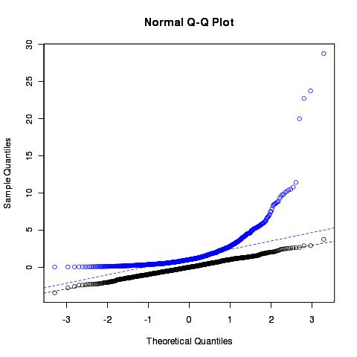
Normality test example
Basic data analysis
y<-rnorm(1000) # normally distributed data
yy<-exp(rnorm(1000)) # exponential data
yScale<-c(min(y),max(yy)) # y axis scale
qqnorm(y, ylim=yScale) # plot normal series
par(new=T)‏
qqnorm(yy, ylim=yScale, col="blue")‏
qqline(y, lty=2, col="black")‏
qqline(yy, lty=2, col="blue")‏
> shapiro.test(y)‏
Shapiro-Wilk normality test
data: y
W = 0.9988, p-value = 0.7452
> shapiro.test(yy)‏
Shapiro-Wilk normality test
data: yy
W = 0.5884, p-value < 2.2e-16
Example code:
09_normalTests.R

Slide 75
Two sample tests
Basic data analysis
Comparing 2 variances
  Fisher's F test
var.test()‏
Comparing 2 sample means with normal errors
  Student's t test
t.test()‏
Comparing 2 means with non-normal errors
  Wilcoxon's rank test
wilcox.test()‏
Comparing 2 proportions
  Binomial test
prop.test()‏
Correlating 2 variables
  Pearson's / Spearman's rank correlation
cor.test()‏
Testing for independence of 2 variables in a contingency table
  Chi-squared
chisq.test()‏
  Fisher's exact test
fisher.test()‏

Slide 76
Comparison of 2 data sets example
Basic data analysis
Men, on average, are taller than women.
  The steps
  1. Determine whether variances in each data series are different
      Variance is a measure of sampling dispersion, its a first estimate in determining the degree of difference
        Fisher's F test
  2. Comparison of the mean heights.
      Determine probability that mean heights really are drawn from different sample populations
        Student's t test, Wilcoxon's rank sum test
  3. Review significance of finding
      What's the likelihood of getting our t statistic?
        What's the critical t value?

Slide 77
1. Comparison of 2 data sets
Fisher's F test
Read in the data file into a new object, heightData
heightData<-read.csv("10_heightData.csv",header=T)‏
Test the variance, calculate F statistic
var(heightData$Male) ; var(heightData$Female)‏
var.height <- var(heightData$Female) / var(heightData$Male)‏
var.height # F ~ 1, no significant difference, but how do we know?
  Determining what a significant difference is?
    Critical value of F
qf(0.975,99,99) # p=(1-α/2) ; α=0.05
  Critical F for 99 d.f = 1.49, at p~0.05
  Our F (~1) < Critical F (1.49). Therefore no difference in variance
    Probability associated with our F test (two tailed test)‏
2*(1-pf(1,99,99))‏
    1 i.e, every single time!!!
var.test(...) does this all in 1 go!
var.test(Female,Male)‏

Slide 78
2. Comparison of 2 data sets
Student's t test
Student's t test is appropriate for comparing the difference in mean height in our data.
  Remember a t test = difference in two sample means
standard error of the difference of the means
In this example we have 198 degrees of freedom (losing 1df per estimate of mean height) and we will accept a significant results if p <= 0.05
  Hence critical t for this test is
    qt(0.975,198) # 1.97
      Test statistic needs to be bigger than 1.97 if we are to reject the null hypothesis that the samples means are equal
    We calculate the t statistic long hand …
mean(heightData$Male-heightData$Female)/sqrt((var(heightData$Male)/100)+(var(heightData$Female)/100))‏
[1] 8.45 # Result is significant, but by how much?
2 * pt(8.45,198, lower.tail=FALSE)‏
[1] 6.2e-15 # two-tailed
t.test(...) does this all in 1 go!
t.test(Female,Male)‏

Slide 79
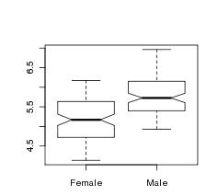
3. Comparison of 2 data sets
Review findings
> t.test(heightData$Male,heightData$Female)‏
Welch Two Sample t-test
data: Male and Female
t = 8.4508, df = 197.997,
p-value = 6.217e-15
alternative hypothesis: true difference in means is not equal to 0
95 percent confidence interval:
0.4841288 0.7788497
sample estimates:
mean of x mean of y
5.800214 5.168725
Notched boxplots are a good way to review t.tests
heightData<-heightData[,-1]
boxplot(heightData,notch=T)‏
Review findings:
1. There is no difference in the location of variance between Males and Females
2. Males are taller than Females, on average (5.8 ft vs. 5.2 ft, pValue=6.2e-15)‏
3. Notched boxplot demonstrates difference in mean heights

Slide 80
Exercise
Work through the previous tests
You should:
Undertake the steps of the variance and t.test 'height exercise'
Make sure you are able to derive the F and t statistics, with probabilities
Generate the simple box plot
Access the help and arguments information for each function used
help("t.test")‏
Shortcut ... ?t.test
args(t.test)‏

Slide 81
Linear regression
Basic data analysis
Linear modeling is supported by the function lm()‏
  example(lm) # the output assumes you know a fair bit about the subject
lm is really useful for plotting lines of best fit to XY data in order to determine, intercept, gradient & Pearson's correlation coefficient
  This is very easy in R
Three steps to plotting with a best fit line
  Plot XY scatter-plot data
  Fit a linear model
  Add bestfit line data to plot with abline() function

Slide 82
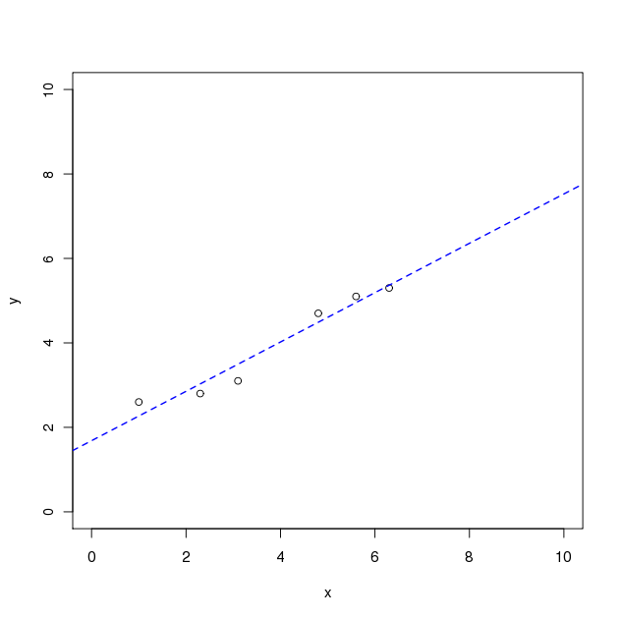
Typical linear regression analysis
Basic data analysis
X
Y
> x<-c(1, 2.3, 3.1, 4.8, 5.6, 6.3)‏
> y<-c(2.6, 2.8, 3.1, 4.7, 5.1, 5.3)‏
> plot(y~x, xlim=c(0,10),ylim=c(0,10))‏
1.0
2.6
2.3
2.8
3.1
3.1
Note formula notation
( y is given by x )‏
4.8
4.7
5.6
5.1
> myModel<-lm(y~x)‏
> abline(myModel,lty=2,lwd=1.5,col="blue")‏
6.3
5.3
Get the coefficients of the fit from:
summary.lm(myModel) and
coef(myModel)‏
resid(myModel)‏
fitted(myModel)‏
Get QC of fit from
plot(myModel)‏
Find out about the fit data from
names(myModel)‏

Slide 83
The linear model object
Basic data analysis
Summary data describing the linear fit is given by
  summary.lm(myModel)‏
> summary.lm(myModel)‏
Call:
lm(formula = y ~ x)‏
Residuals:
1 2 3 4 5 6
0.33159 -0.22785 -0.39520 0.21169 0.14434 -0.06458
Coefficients:
Estimate Std. Error t value Pr(>|t|)
(Intercept) 1.68422 0.29056 5.796 0.0044 **
x 0.58418 0.06786 8.608 0.0010 **
---
Signif. codes: 0 '***' 0.001 '**' 0.01 '*' 0.05 '.' 0.1 ' ' 1
Residual standard error: 0.3114 on 4 degrees of freedom
Multiple R-squared: 0.9488, Adjusted R-squared: 0.936
F-statistic: 74.1 on 1 and 4 DF, p-value: 0.001001
Y intercept
Gradient
Good fit: would happen 1 in 1000 by chance
R^2 , with pValue

Slide 84
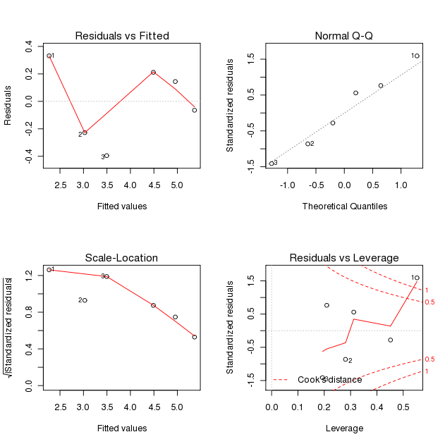
QC plots of regression analysis
Basic data analysis
plot(myModel)‏

Slide 85
End of Day 1

