Slide 1
DAY 2. A beginners guide to solving biological problems in R
Robert Stojnić (rs550), Laurent Gatto (lg390) and Rob Foy (raf51)
Course material:
http://logic.sysbiol.cam.ac.uk/teaching/Rcourse/
Slides by Ian Roberts and Robert Stojnić

Slide 2
Day 1 review
1. Understanding the R environment
  Installing, option setting & customization
2. Creating and manipulating R objects
3. Essential built-in R functions for working with vectors and matrices
  Reading in and writing data frames
4. Basic statistical analysis
  Two sample tests & linear regression

Slide 3
Day 2
Schedule
Writing scripts
  Building scripts for routine analysis
  Script automation using R batch mode
Morning coffee
2. Extending R with customized functions
  Learn how to write your own R functions
Lunch
3. Advanced data analysis and basic R graphics
  Integrate data from different sources and analyze
Afternoon coffee
4. More on R graphics
  Produce publication quality charts

Slide 4
Writing custom scripts & running R batch mode analysis
1

Slide 5
The R scripting language
Scripting
A script is a series of instructions that when executed sequentially automates a task
  A script is a good solution to a repetitive problem
  The art of good script writing is
    understanding exactly what you want to do
    expressing the steps as concisely as possible
    making use of error checking
    including descriptive comments
R is a powerful scripting language, and embodies aspects found in most standard programming environments
  procedural statements
  loops
  functions
  conditional branching
Scripts may be written in any standard text editor, e.g. notepad, gedit, kate
  RGui (Mac and Windows) has a built-in text editor

Slide 6
An example script
Scripting
Colony forming assays provide a measure of cellular proliferation. They are used as read outs for various biological systems
  A well controlled study may involve multiple samples, treatments and controls (probably replicated).
  This produces a lot of ‘count’ data, ideally suited to routine script processing
Encapsulating the analysis into an R script requires a clear understanding of the problem and data structure

Slide 7
CFA experimental design
Scripting
Expression of gene X may prevent cells from proliferating in high concentrations of compound Z. The theory is tested by knocking down gene X and growing cells in varying concentrations of compound Z.
  Three repeat runs (same cell line)‏
    Gene X knockdown --> KdX
    Scramble gene X knockdown control --> ScX
    Control (transfect empty vector) --> CnX‏
  4 concentrations of compound Z
    High (HZ), Medium (MZ), Low (LZ), None (OZ)
  The experiment is replicated over 3 successive weeks
    Run1 (R1), Run2 (R2) and Run3 (R3)
  108 counts in total

Slide 8
Colony forming assay
experimental design
(R3) Run 3
Δ counts significant?
(KdX-Cnx) vs. (Scx-Cnx)
(R2) Run 2
(HZ) High Z
X knockdown
Scramble knockdown
Control
(R1) Run1
KdX
ScX
CnX
(MZ) Medium Z
X knockdown
Scramble knockdown
Control
(LZ) Low Z
X knockdown
Scramble knockdown
Control
Empty transfection
Scramble knockdown
Control
(OZ) No Z
X knockdown
Each plate of each run is in triplicate
X knockdown
Scramble knockdown
Control

Slide 9
Preparing the calculation(s)
Scripting
We need to make barplots of counts for the KDX-CNX and SCX-CNX for each concentration of Z.
We will group the repeat runs & replicates, and take an average.
A Wilcoxon Rank Sum test will tell us whether there is a significant level of protection for KDX in concentrations of Z
We'll add in some data quality checks
  Boxplots of repeat runs
  Variance within replicates
We can copy & paste lines of code into a blank text document, try them out and keep the ones that work!

Slide 10
Importing data
Scripting
Fine for humans, bad for R
We will create a data frame of factors comprising Run, Plate, Treatment, Replicate The response variable is counts.
We have 3 spreadsheets of data
Run1counts.csv
Run2counts.csv
Run3counts.csv
We will need to write a procedure that reads in the data
Note that our script will require a consistent data format
Factors
Response

Slide 11
Prepare for raw data
Script walkthrough 1
Open a blank text document, and prepare to write this script
  The data is contained in three files:
    11_CFA_Run1Counts.csv
    11_CFA_Run2Counts.csv
    11_CFA_Run3Counts.csv
  Load in the data and concatenate it into a single data frame
# load in the data from the three runs into three separate data frames t1, t2, t3
t1 = read.csv("11_CFA_Run1Counts.csv")
t2 = read.csv("11_CFA_Run2Counts.csv")
t3 = read.csv("11_CFA_Run3Counts.csv")
# concatenate the three data frames into a single data frame
colony = rbind(t1, t2, t3)
Example code:
11_CFAcountData.R

Slide 12
Import raw data
Script walkthrough 2
Data is by default read in as factors, i.e. all input strings are enumerated and stored as numbers
The three separate data frame have no indication of which number they came from. We will add a column indicating this:
# add the missing Run column - factors are stored as numbers !
runNum <- factor( rep( 1:3, each=36 ), labels=c("Run1","Run2","Run3") )
colony <- cbind( "Run" = runNum, colony )
# reorder factor levels in their natural order (instead of alphabetical)
colony$Treatment <- factor(colony$Treatment, c("OZ", "LZ", "MZ", "HZ"))
colony$Plate <- factor(colony$Plate, c("KDX","SCX","CNX"))
# show the full table
colony

Slide 13
The tapply function
a brief digression
Assume we have the following data for heights of 5 males and females:
data <- data.frame(gender=c("Male", "Male", "Female",
"Female", "Female"), height=c(6, 6.1, 5.8, 6, 5.95))
gender height
1 Male 6.00
2 Male 6.10
3 Female 5.80
4 Female 6.00
5 Female 5.95
By calling mean() on the height column we can get the average of all 5 people, but how do we get average separately for males and females?
tapply() lets us do exactly this
  It applies a function to grouped data:
tapply( data$height, data$gender, mean )
data groups function

Slide 14
Undertake data analysis
Script walkthrough 3
We need the means of the triplicate counts for each Run
  Broken down by plate type (KDX,SCX,CNX) and Z treatment concentration (OZ,LZ,MZ,HZ)
### Part 2. Investigating data ###
tapply(colony$Count, list(colony$Run, colony$Plate, colony$Treatment), mean)
, , OZ
KDX SCX CNX
Run1 98.33333 129.6667 108.3333
Run2 180.33333 206.0000 188.6667
Run3 282.33333 288.6667 265.6667
, , LZ
KDX SCX CNX
Run1 75.0000 53.0000 21.66667
Run2 136.3333 103.6667 32.00000
Run3 157.0000 180.6667 46.66667
, , MZ
KDX SCX CNX
Run1 29.66667 6.333333 0.3333333
Run2 47.00000 11.666667 2.0000000
Run3 73.00000 17.333333 3.6666667
, , HZ
KDX SCX CNX
Run1 6.333333 1.3333333 0.3333333
Run2 12.000000 0.3333333 0.0000000
Run3 18.666667 0.3333333 0.0000000
We can plot a graph of this. It gives us the variation in counts per run
par(oma=c(4,2,2,2))
boxplot(Count~Run*Plate*Treatment, las=2, cex=0.2, data=colony)
Better still, lets plot a grouped bar chart of mean counts per plate type per Z treatment
barplot(tapply(colony$Count, list(colony$Plate, colony$Treatment), mean),beside=T)

Slide 15
Summarize & save the analysis
Script walkthrough 4
we need a reshaped, background corrected, table of results on which to perform our tests
for clarity where possible use dollar ($) notation (work only with data frames)
### Part 3. Summarizing data ###
result <- tapply(colony$Count, list(colony$Treatment, colony$Plate), mean)
result <- data.frame(result) # result of tapply is matrix, convert to dataframe
result
# calculate kdx and scx values after background correction
kdx = result$KDX - result$CNX
scx = result$SCX - result$CNX
result <- cbind(kdx, scx)
# remove the 0Z entry
result <- result[-1,]
barplot(result,beside=T)
wilcox.test(result[,1],result[,2],paired=T)
cor.test(result[,1],result[,2],paired=T)
write.csv(result,"CFAresults.csv")
We can plot the results as a barchart, and undetake an appropriate two sample classical test
We find that the difference in means is not significant (would expect observation to occur 1:4 times), and that the scramble and knockdown counts have a 90% correlation
-ve subscripts mean 'delete'

Slide 16
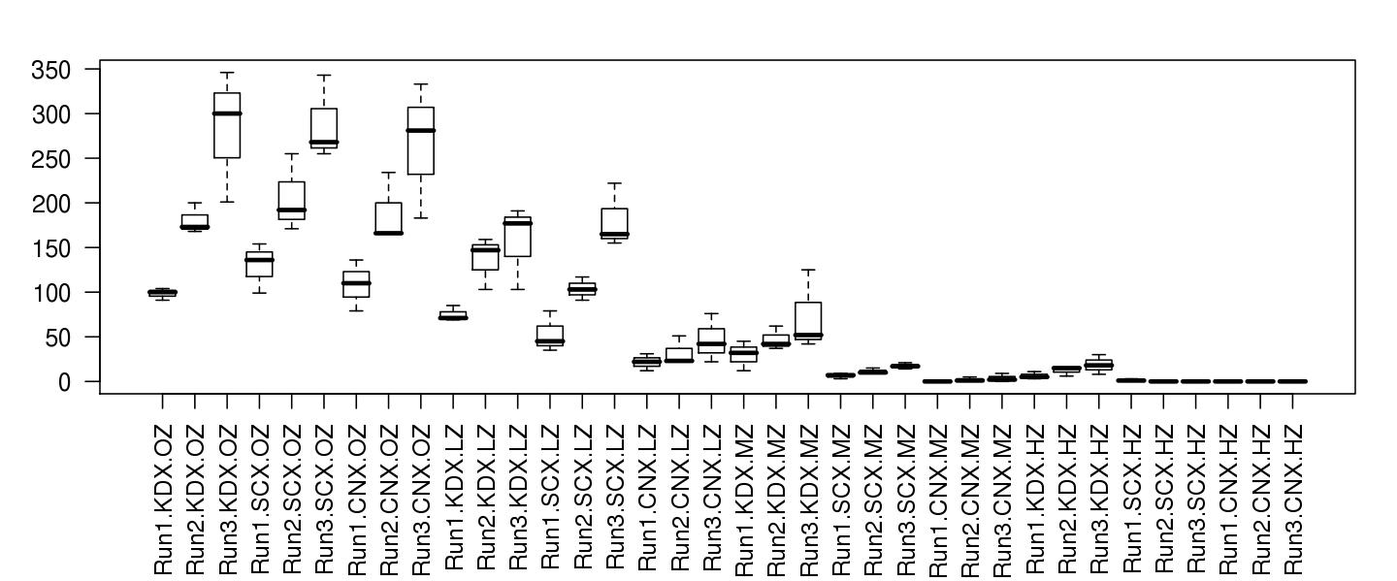
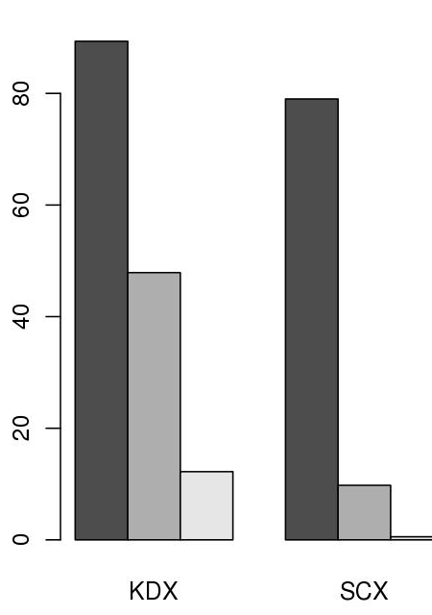
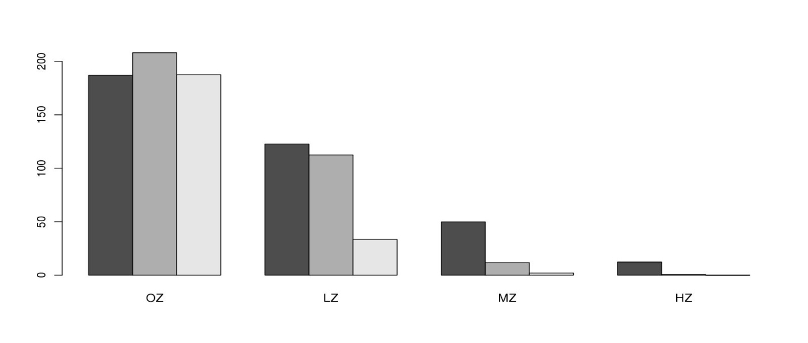
LZ, MZ, HZ
Boxplot shows variation in replicates. Run 3 had greatest count variation.
KDX, SCX, CNX
Barchart shows KDX had greater viability in Z compared to SCX. Treatments are Low, Medium and High.
Barchart shows run average counts of various plate types in different Z treatments. KDX is the only plate type that had growth in high Z.

Slide 17
> wilcox.test(result[,1],result[,2],paired=TRUE)
Wilcoxon signed rank test
data: result[, 1] and result[, 2]
V = 6, p-value = 0.25
alternative hypothesis: true location shift is not equal to 0
> cor.test(result[,1],result[,2],paired=TRUE)
Pearson's product-moment correlation
data: result[, 1] and result[, 2]
t = 2.5584, df = 1, p-value = 0.2372
alternative hypothesis: true correlation is not equal to 0
sample estimates:
cor
0.9313792
Would expect to see trend 1 in 4 times. There is a 93% correlation between the knockdown of gene X and scramble control and cell counts response when grown in compound Z.

Slide 18
Script steps review
Script walkthrough 5
Excel formatted data needs to be exported as comma separated values text (or tab!)
Get the data into R
  read.csv() … to assign the data to an object
Produce exploratory plots
  boxplot()‏
  barplot()‏
Undertake statistical tests
  cor.test()‏
    Spearman’s rank correlation test
  wilcox.test()‏
    Wilcoxon test with two sets of paired data … Mann-Whitney U test
Write out the results
  write.csv()‏
    exports data as comma separated list
  save.image()‏
    could also save the R environment after analysis (we didn't do this)

Slide 19
Exercise
Colony forming assay script
Enter the text of the count data script, and save the file.
  To run the count data script in R, type
  source("filename")‏ # the script is available as 11_countData.R
Each step of the script is executed, and the results displayed.
We need to export the graphical output to a file, and the R objects also need to be saved.
  Modify the script as follows:
Section 3, line directly after tapply command insert:
jpeg(file="fig1.jpg",width=1600,height=800,res=150)
par(oma=c(4,2,2,2))
… <boxplot commands in middle> …
dev.off()
jpeg(file="fig2.jpg",width=675,height=900,res=150)
… <barplot commands in middle> …
dev.off()
Section 4, line directly after result command insert:
jpeg(file="fig3.jpg",width=1600,height=800,res=150)
… <barplot commands in middle> …
dev.off()

Slide 20
Batch processing R scripts
Scripting
Scripts can be run without ever launching R, using R CMD batch mode.
quit R and type the following in a linux terminal
R CMD BATCH –no-restore 11_CFAcountData.R
or if you write all of graphical output to files:
Rscript 11_CFAcountData.R (works only with recent R versions)

Slide 21
Advanced example: multiple file handling
Reading files using loops and regular expressions
Earlier we read in each of the three colony files one-by-one
Easy in this case, but what if there were many more than three files?
Notice that each file contains the terms 'Counts.csv'
# look for patterns like 'Counts.csv'
this.pattern <- "*Counts.csv"
# find all filenames in the current directory containing this pattern
matching.filenames <- dir(pattern=glob2rx(this.pattern))
# see what has been found
matching.filenames
[1] "11_CFA_Run1Counts.csv" "11_CFA_Run2Counts.csv" "11_CFA_Run3Counts.csv"

Slide 22
Advanced example: multiple file handling
Reading files using loops and regular expressions
Using '*' in the pattern is a 'wild card' – means we search for anything that ends in 'Counts.csv'
glob2rx() is a function which translates this pattern into something the file system can recognise
Now loop through the matching filenames and open each in turn
# start with an empty data frame
colony <- data.frame()
# loop through vector of file names
for(filename in matching.filenames){
# open each file
t <- read.csv(matching.filename)
# append rows
colony <- rbind(colony, t)
}

Slide 23
Time for ...
MORNING COFFEE

Slide 24
User functions
2

Slide 25
Introducing ...
User functions
All R commands are functions.
Functions perform calculations, possibly involving several arguments, then return a value to the calling statement.
The calculation maybe any process, might or might not have return value
  It need not be arithmetic
User functions extend the capabilities of R by adapting or creating new tasks that are tailored to your specific requirements.
User functions are a special kind of object

Slide 26
Defining a new function
Parts of function definition: name, arguments, procedural steps, return value
sqXplusX <- function(x){
x^2 + x
}
sqXplusX is the function name
x is the single argument to this function and it exists only within the function
everything between brackets { } are procedural steps
the last calculated value is the function return value
after defining the function, we can use it:
> sqXplusX(10)
[1] 110

Slide 27
Named and default arguments
Example of function with more than one named argument:
powXplusX <- function(x, power=2){
x^power + x
}
Now we have two arguments. The second argument has a default value of 2.
Arguments without default value are required, those with default values are optional.
> powXplusX(10)
[1] 110
> powXplusX(10, 3)
[1] 1010
> powXplusX(x=10, power=3)
[1] 1010
arguments matched based on position
arguments matched based on name

Slide 28
Assignments with arguments
User functions
You can use a blank document in gedit, nedit or other text editor to hold these commands for you, then copy / paste the instructions into R
sqXplusX <- function(x){
x^2 + x
}
Now try this …
a <- matrix(1:100, ncol=10, byrow=T)‏ # make some dummy data
b <- sqXplusX(a)‏ # transform a by sqXplusX, assign result to b
b # to view the result
sqXplusX user function is now an R object, check its arguments and list it in the current workspace
> args(sqXplusX)‏
> ls()‏
> sqXplusX
Don’t add brackets to see the
definition of sqXplusX

Slide 29
Assigned or anonymous ...
User functions
Functions may be assigned a name, or anonymously created within an operation
  Anonymous functions are really useful in apply()style procedures
apply(object, margin, function)
  E.g. I have a 10 x 10 matrix and want to square each item, and add the item to itself
a<-matrix(1:100, ncol=10, byrow=T)‏
a # to view new object
apply(a, c(1,2), function(x) x^2+x)‏
x is transiently assigned each item of a, and this is passed as an argument to the anonymous function
1 means by rows, 2 means by columns [1st or 2nd margin]
c(1,2) means do both rows and columns

Slide 30
Functions occupy their own space
User functions
Objects created in functions are not available to the general environment unless returned.
  they are said to be out of scope
    Scope relates to the accessibility of an object.
A function can only return one object.
Custom functions disappear when R sessions end, unless the function object is saved in an Rdata file or sourced from a script.
  A really useful function could be added to your .Rprofile file, and would always be ready for you at launch
You could also make a package
  Beyond the scope of the beginners course!!!!

Slide 31
Script / function tips
User functions
If your script repeats the same style command more than twice, you should consider writing a function
Writing functions makes your code more easily understandable because they encapsulate a procedure into a well-defined boundary with consistent input/output
Functions should not be longer than one-to-two screens of code, keep functions clean and simple
Look at other functions to get ideas for how to write your own …
  Display function code by entering the function’s name without brackets.

Slide 32
File commands for extending
scripts & user functions
Generic file commands
dir(...,pattern="txt")
Retrieve working directory file listing filtered by pattern. Note pattern is a regular expression, not a shell wildcard
glob2rx("*.txt")
Changes wildcards to regular expressions!
unlink(...)
Remove (permanently) a file from system
system(...)
Execute a shell command from within R
Result can not be coerced to an object, only available to linux R
> glob2rx("*.txt")
[1] "^.*\\.txt$"

Slide 33
Text manipulation for extending
scripts & user functions
Text manipulation and file name mangling ... that's a technical term
grep( pattern, object )
    If pattern is not found, grep returns a 0 length object.
      Test for null with is.null()
sub( pattern, replacement, object )
gsub( pattern, replacement, object)
    Sub replaces first occurrence only, gsub does them all.
cat( "...", file=...)
    Outputs text to a file, or prints it on screen if file=""
      cat requires "\n" to be given for new lines ... try ...
cat("Hello World!") ; cat("Hello World!",sep="\n") ; cat("Hello World!",sep="\n",file="world.txt")
    cat is extremely useful for writing scripts or generating reports on-the-fly

Slide 34
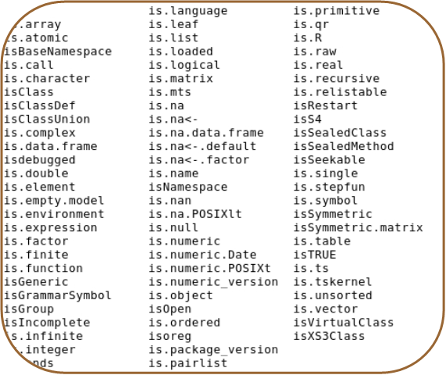
Error reporting for extending
scripts & user functions
Your code should report errors if inconsistency is detected.
stop(...)
  Stops execution of a function and reports a custom error message
is.family(...)
  Functions that can be used to test for a variety of conditions place them inside if structures to check that all is well
if( !is.numeric(x) ){ stop ("Non numeric value entered. Cannot continue.") }
If the object x is non numeric (e.g. Text has been entered when numbers were required), then stop execution and report message
The is.family

Slide 35
Temperature conversion exercise
User functions
Centigrade to Fahrenheit conversion is given by
  F = 9/5 C +32
    Write a function that converts between temperatures.
      The function will need two named arguments
        temperature (t) is numeric
        units (unit) is character
        They will need default values, e.g t=0, unit="c"
      The function should report an appropriate error if inappropriate values are given
if( !is.numeric(t) ) { .... }
if( !(unit %in% c("c","f")) ){...}
      The function should print out the temperature in F if given in C, and vica versa
Functions with named arguments are defined with the following syntax
myFunc<-function(arg=defaultValue,…)‏
Why not add a third scale?
K=C+273.15
Example code:
12_convTemp.R

Slide 36
Building the solution
It is difficult to write large chunks of code, instead start with something that works and build upon it
E.g. to solve the temperature conversion exercise:
  start with the function powXplusX (from some slides ago)
  modify the argument names
  delete the old code, for now just print out the input arguments
  save the function file, load it into R and try it out
  now add the two lines for input checking from the previous slide
  try it out, see if passing a character for temperature gives the expected error
  now try to convert C into F and print out the result
  when that works, add the conversion from F to C
If you get stuck, call us to help you !

Slide 37
Temperature conversion script
convTemp<-function(t=0,unit="c"){ # convTemp is defined as a new user function requiring two arguments, t and unit, the default values are 0 and "c", respectively.
if( !is.numeric(t) ){
stop("Non numeric temparture entered") # Exception error if character given for temperature
}
if(!(unit %in% c("c","f","k"))){
stop("Unrecognized temperature unit. \n Enter either (c)entigrade, (f)ahreneinheit or (k)elvin") # Exception error if unrecognized units entered
}
# Conversion for centigrade
if(unit=="c"){
fTemp <- 9/5 * t + 32
kTemp <- t + 273.15
output <- paste(t,"C is: \n",fTemp,"F \n",kTemp,"K \n")‏
cat(output)‏
}
# Conversion for Fahrenheit
if(unit=="f"){
cTemp <- 5/9 * (t-32)‏
kTemp <- cTemp + 273.15
output <- paste(t,"F is: \n",cTemp,"C \n",kTemp,"K \n")‏
cat(output)‏
}
# Conversion for Kelvin
if(unit=="k"){
cTemp <- t - 273.15
fTemp <- 9/5 * cTemp + 32
output <-paste(t,"K is: \n",cTemp,"C \n",fTemp,"F \n")‏
cat(output)‏
}
}
"\n" -> puts text on a new line
Units must be entered in quotes, as it’s a character object
> convTemp(t=-273,unit="c")‏
-273 C is:
-459.4 F
0.149999999999977 K
Example code:
12_convTemp.R

Slide 38
Time for
LUNCH
(RESUME 1:30 PM)

Slide 39
Advanced data processing
3

Slide 40
Combining data from multiple sources
Gene clustering example
R has powerful functions to combine heterogeneous data into a single data set
Gene clustering example data:
  five sets of differentially expressed genes from various experimental conditions
  file with names of experimentally verified genes
Gene clustering exercise:
  combine this dataset into a single table and cluster to see which conditions are similar
  repeat the clustering but only on a subset of experimentally verified genes

Slide 41
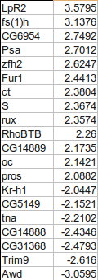
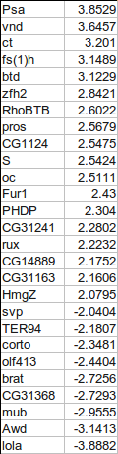
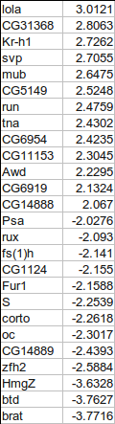
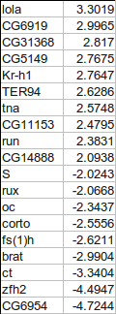
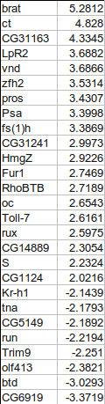
Combining gene tables
input files have two columns: gene names and fold change
we want to combine all five tables into a single table, with 0 for missing values
+
+
+
+

Slide 42
Gene clustering
Script walkthrough 1
To make the big table we first need to find out all the genes present in at least one of the files
Make sure not to use factors in read.delim()
# start with en empty collection of genes
genes <- c()
for( fileNum in 1:5 ){
# load in files 13_DiffGenes1.tsv ...
t <- read.delim(paste("13_DiffGenes", fileNum, ".tsv", sep=""),
as.is=TRUE, header=FALSE)
# label the input columns to help code readability
names(t) <- c("gene", "expression")
genes <- union(genes, t$gene)
}
# for tidiness order our genes by name
genes <- sort(genes)
genes # show all genes
when loading in character data
use as.is=T to prevent it being
converted to factors!
union() is a set operation, combines
two vectors by eliminating duplicates.
There are also intersect() and setdiff()
Example code:
13_geneClustering.R

Slide 43
Gene clustering
Script walkthrough 2
Using the complete list of genes, we can create the big table and fill in the values:
# make the destination table [rows = unique genes, cols = file numbers]
values <- matrix(0, nrow=length(genes), ncol=5)
rownames(values) <- genes # name the rows with the complete gene names
for(fileNum in 1:5){
# read in the file again
t <- read.delim(paste("13_DiffGenes", fileNum, ".tsv", sep=""),
as.is=T, header=F)
names(t) <- c("gene", "expression")
# match the names of the genes to the rows in our big table
index <- match(t$gene, rownames(values))
# copy the expression levels
values[index,fileNum] <- t$expression
}
match() returns the index of first argument in the second, i.e. index of input file genes in the big table
we use index to pick the rows in such way that they match the gene order in the input file

Slide 44
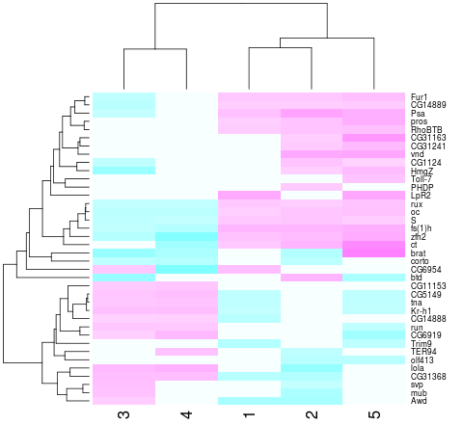
Gene clustering
Script walkthrough 3
Now we can do hierarchical clustering:
heatmap(values, scale="none", col = cm.colors(256))
Values from the matrix
are colour-coded.
Rows and columns
are re-arranged according to similarity

Slide 45
Gene clustering
Script walkthrough 4
In a second part of our analysis, we want to produce the same heatmap but only based on a list of experimentally verified genes
The problem is data is not formatted in the most convenient way:
genes | citation
oc,run,RhoBTB,CG5149,CG11153,S,Fur1 | Segal et al, Development 2001
tna,Kr-h1,rux | Krejci et al, Development 2002

Slide 46
Gene clustering
Script walkthrough 5
We load in this table, and only extract the gene names, then we use them to select a subset of values matrix
# load in the tab-delimited file with genes and citations
t.exp <- read.delim("13_ExperimentalGenes.tsv", as.is=T)
# split all gene names by "," and then flatten it out into a single vector
experim.genes <- unlist( strsplit(t.exp$genes, ",") )
# redo the heatmap by using just the genes in the experimentally verified set
is.experimental <- rownames(values) %in% experim.genes
heatmap(values[ is.experimental, ], scale="none", col = cm.colors(256))
unlist() flattens out a nested
list into a single vector
strsplit() splits a vector of strings by a custom
split character (","), the results is a list of split
values for each element of input vector

Slide 47
Gene clustering review
We load in the five tables twice - first to collect gene names, then to load expression values
Based on expression table (values) we construct a clustered heatmap first on the whole set of genes, then on a selected subset
Go through the code, try it out it and understand it
Try answering the following questions:
  what is rownames(values) ?
  why is rownames(values)[index] and t$gene giving the same output?
  what is a difference between rownames(values) %in% experim.genes and experim.genes %in% rownames(values)
Example code:
13_geneClustering.R

Slide 48
Graphics
4

Slide 49
Starting out with R graphics
Graphics
R provides several mechanisms for producing graphical output
  Functionality depends on the level at which the user seeks interaction with R
    graphics systems, packages, devices & engines
High level graphics
  Functions compute an appropriate chart based up on the information provided. Optional arguments may tailor the chart as required
    Interaction is at traditional graphics system level. The user isn’t required to know much about anything
Low level graphics
  The user interacts with the drawing device to build up a picture of the chart piece by piece.
    This fine granular control is only required if you seek to do something exceptional
R graphics produces plots using a painter’s model
  Elements of the graph are added to the canvas one layer at a time, and the picture built up in levels. Lower levels are obscured by higher levels, allowing for blending, masking and overlaying of objects.

Slide 50
High level vs. Low level plotting
Graphics
High level plotting
example(plot)‏
Low level plotting
(Scotland by blighty package)‏

Slide 51
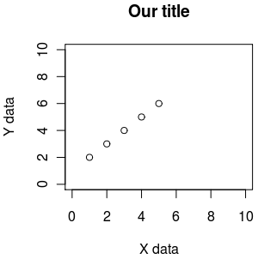
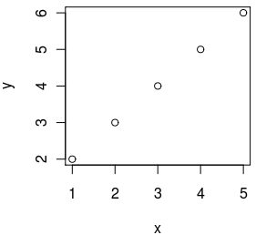
Essential plotting - plot()
plot() is the main function for plotting, it takes x,y values to plot and also lots of graphical parameters (see ?par for all of them)
default plotting
custom plotting
x <- 1:5
y <- 2:6
plot(x,y)
x <- 1:5
y <- 2:6
plot(x,y, xlab="X data", ylab="Y data", xlim=c(0,10), ylim=c(0,10), main="Our title")

Slide 52
R graphics uses a painter’s model
x <- seq(-2, 2, 0.1)‏
y <- sin(x)‏
1
2
3
plot(y~x, ylim=c(-1.5,1.5), xlim=c(-2.5,2.5), col="red" ,pch=16, cex=1.4)‏
lines(y~x, ylim=c(-1.5,1.5), xlim=c(-2.5,2.5), col="blue", lty=1,lwd=2)‏
rect(-2.5,0,2.5,-1.5, col="white", border="white")‏
xlim, ylim = axis limits
col = line colour
pch = plotting character [example(points)]
cex = character expansion [scaling factor]
lty = line type
lwd = line width
rect = rectangle
Example code:
14_painterModel.R

Slide 53
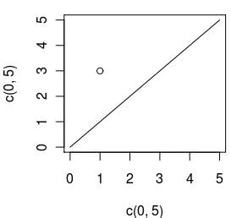
Plotting x,y data - plot(), points(), lines()
plot() is used to start a new plot, accepts x,y data, but also data from some objects (like linear regression). Use the parameter type to draw points, lines, etc (see ?plot)
points() is used to add points to an existing plot
lines() is used to add lines to an existing plot
plot(c(0, 5), c(0, 5), type="l") # draw as line from (0,0) to (5,5)
points(1, 3) # add a point at 1,3

Slide 54
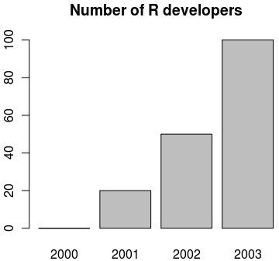
Making bar plots - barplot()
visualizing a vector of data can be done with bar plots, using function barplot()
data <- c("2000"=0, "2001"=20, "2002"=50, "2003"=100)
barplot(data, main="Number of R developers")

Slide 55
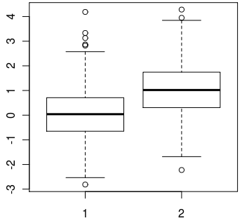
Making box plots - boxplot()
when a spread of data needs to be visualised, we can use boxplots with function boxplot()
data1 <- rnorm(1000, mean=0)
data2 <- rnorm(1000, mean=1)
boxplot(data1, data2)

Slide 56
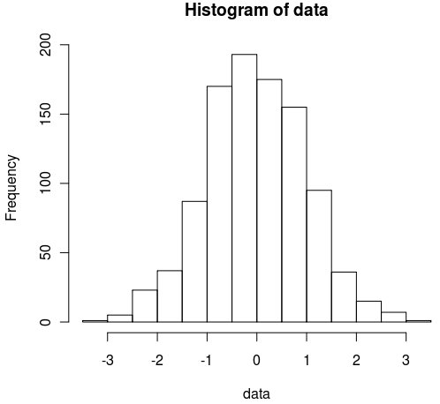
Making histograms - hist()
when we need to look at the distribution of data, we can visualize it using histograms with function hist()
data <- rnorm(1000)
hist(data)

Slide 57
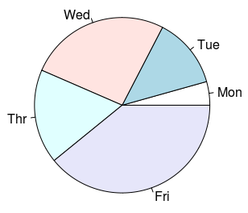
Pie charts - pie()
to visualise percentages or parts of a whole we can use pie charts with function pie()
data <- c("Mon"=1, "Tue"=3, "Wed"=6, "Thr"=4, "Fri"=9)
pie(data)

Slide 58
Typical plotting workflow
Set the plot layout and style - par()
  Set the number of plots you want per page
  Set the outer margins of the figure region
    The distance between the edge of the page and the figure region, or between adjacent plots if there are multiple figures per page
  Set the inner margins of the plot
    The distance between the plot axes and the labels & titles
  Set the styles for the plot
    Colours, fonts, line styles and weights
Draw the plot - plot(x,y, …)‏

Slide 59
Setting graphics layout and style - par()
par() Top level graphics function
  parameter specifies various page settings. These are inherited by subordinate functions, if no other styles are set.
    Specific colours and styles may be set globally with par, but changed ad hoc in plotting commands
    The global setting will remain unchanged, and reused in future plotting calls.
  par sets the size of page and figure margins
    Margin spacing is in ‘lines’
  par is responsible for controlling the number of figures that are plotted on a page
  par may set global colouring of axes, text, background, foreground, line styles (solid/dashed), if figures should be boxed or open etc. etc.
type par() to get a list of top down settings which may be set globally

Slide 60
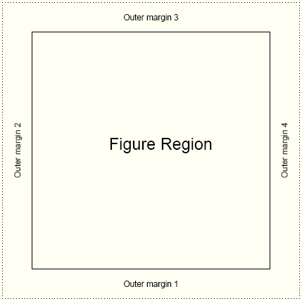
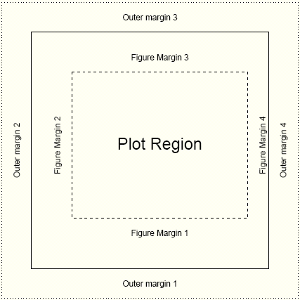
Page settings with par
Graphics
par(mfrow=c(1,1))‏
one figure on page
par(oma=c(2,2,2,2))‏
equal outer margins
par(mar=c(5,4,4,2))‏
Sets space for x & y labels, a main title, and a thin margin on the right
Numbering: bottom, left, top, right

Slide 61
Page layout plot exercise
Graphics
oma 1 line here
par(mfrow=c(2,2))‏
2 x 2 figures per page
par(oma=c(1,0,1,0)‏
1 line spacing top and bottom
par(mar=c(4,2,4,2))‏
4 lines at bottom & top
2 lines left & right
par(bg="lightblue",fg="darkgrey")‏
light blue background
dark grey spots
par(pch=16,cex=1.4)‏
Large circles for spots
Execute 4 times with different colors:
plot(1:10)‏
box("figure",lty=3,col="blue")‏
Draw a blue dashed line around plot
box("outer",lty=1,lwd=3,
col="green")‏
Draw a green solid line around figure
mar 4 lines here
mar 2 lines here
See how the figure margins overlap
Using painter’s model
15_parExample.R

Slide 62
Time for
COFFEE, RESUME 3:30 PM

Slide 63
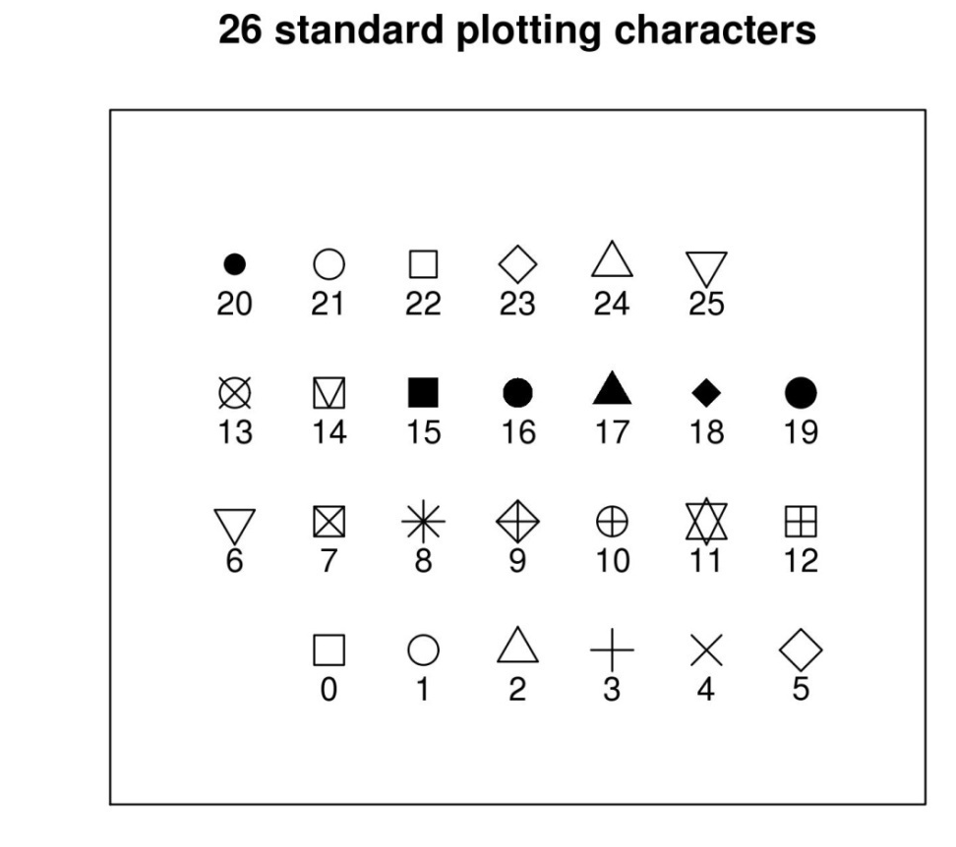
Plotting characters for plot()
size and orientation
pch= ...
Sets one of the 26 standard plotting character used.
Can also use characters, such as "."
cex= ...
Character expansion. Sets the scaling factor of the printing character
las= ...
Axes label style. 1 normal, 2 rotated 90º
4 styles (0-3)

Slide 64
Plotting characters exercise
Graphics
16_plottingChars.R
xCounter<-1
yCounter<-1
plotChar<-0
plot(NULL, xlim=c(0,8), ylim=c(0,5),xaxt="n",
yaxt="n",ylab="",xlab=""
,main="26 standard plotting characters")
while (plotChar < 26){
if(xCounter < 7){
xCounter <- xCounter+1
} else {
xCounter <- 1
yCounter <- yCounter+1
}
points(xCounter,yCounter,pch=plotChar, cex=2)
text(xCounter,(yCounter-0.3),plotChar)
plotChar <- plotChar+1
}
X-Y coordinates,
Plotting character index counter
Sets up an empty plotting area.
Axis scale limits, xlim, ylim
Don't draw axis ticks, xaxt, yaxt="n"
Don't annotate axis, xlab, ylab=""
Set a main title, main
We want to print the characters in a
7 x 4 grid. The if statement sets up the character plotting coordinates such that each time x =7, make it 1 again and increment the y axis by 1 at the same time
While loop counts up to 25
(0 to 25 = 26 iterations)
And cycles through each pch available

Slide 65
Annotating the plot
plot accepts main title, subtitle, X label, Y label as standard arguments
plot(x, y, main="...", sub="...", xlab="...", ylab="...")
mtext(text="…", side= …)‏
  allows text to be written directly into the margin of a plot
text(x,y,labels="…")‏
  allows text to be written in the plot at x,y
legend(x,y, legend=…)‏
  produces a legend for the plot

Slide 66
Appreciating drawing coordinates
How do we know where to place items within the plot region when building up our customized graphs?
Most of the time we can specify X,Y coordinates.
  R calculates sensible pixel coordinates of plots from the data we provide. We don’t need to worry about pixels, centimetre distances etc.
locator(…)‏
    Returns x,y coordinates from a mouse click within a plot
    good for working out where to place legend items
identify(…)‏
    provides an id tag for the closest plotted point to a mouse click
    useful if you want to label points on a chart
xy.coords(…)‏
    translates x,y coordinates into pixel coordinates
Margin spacing is in lines
  The exact distance is a factor of font family, style and size
    Text may appear bunched or squashed if sufficient distance is not left between the axes and the caption

Slide 67
Building up a plot
Graphics
Text
R code
par(mfrow=c(1,1))‏
par(bg="white",fg="black",cex=1)‏
par(oma=c(1,1,1,1))‏
par(mar=c(5,4,4,2)+0.1)
‏
plot(1:10,main="The plot title", sub="A subtitle", xlab="Numbers",
ylab="More numbers")‏
mtext(c("Bottom", "Left", "Top", "Right"), c(1,2,3,4), line=.5)‏
text(2,10,"Text at X=2,Y=10")‏
legend(locator(1),"Some Legend",fill="red")‏
Adding legend ...
Don't forget to mouse click!
mtext
Xlab
Subtitle
align text left, right & centre with adj=(i,j) i.e centre is adj=(0.5,0.5), left is adj=(1,0) and right is adj=(0,1)‏
17_buildingAplot.R

Slide 68
Plots with custom axes
Graphics
R plot doesn’t support multiple Y axis by default
  You have to make additional axes yourself!
Adding custom axis
axis(side=, at=, labels=, …)‏
If you want to specify custom axes, make sure you turn off the automatic axes in the plot / points call
plot( …, axes=F)‏

Slide 69
Adding a second Y axis
Graphics
The trick
plot first Y series
use par(new=T) to overlay a second figure region
plot second series without axes
axis(side=4, …) to add second Y axis
mtext(side=4, …) to label second Y

Slide 70
Example: The second Y series
Graphics
18_secondYaxis.R
x1<-1:20
y1<-sample(1000,20)‏
y2<-runif(20)‏
y2axis<-seq(0,1,.2)‏
par(mar=c(4,4,4,4))‏
plot(x1,y1,type="p",pch=10,cex=2,col="red",
main="A second axis example",
ylab="Big values",ylim=c(0,1100),
xlab="Ordered units")‏
points(x1,y1,type="l",lty=3,lwd=2,col="green")‏
par(new=T)‏
plot(x1,y2,type="p",pch=20,cex=2,col="black",axes=FALSE,bty="n",xlab="",ylab="")‏
points(x1,y2,type="l",lty=2,lwd=2,col="grey")‏
axis(side=4,at=pretty(y2axis))‏
mtext("Little values",side=4,line=2.5)
‏
legend(15,0.2,c("Big Y","Little Y"),lty=1,lwd=2,col=c("green","grey"))‏
Demo data
Set up equivalent figure margins
Plot and label first Y series
Connect dots with a line
Overlay a second plot region
Plot second Y series, but suppress labels
Anotate second Y axis
Add legend, note X,Y is on second Y axis scale

Slide 71
Use of colour in R
Graphics
Colour is usually expressed as a hexadecimal code of Red, Green, and Blue counterparts
  No good for humans.
R supports numerous colour palettes which are available through several "colour" functions.
  colours() # get inbuilt names of known colours
    RGB primaries may take on a decimal intensity value of 0 to 255
      255 is #FF in hexidecimal
        White is #FF FF FF
        Black is #00 00 00
  rgb() # converts red green blue intensities to colour
    Strangely, likes decimalized intensities (ie. 0 is black, 1 is white)
> rgb(1,1,1)
[1] "#FFFFFF"
> par(mfrow=c(2,2))
> plot(1:10,col="#FF00FF")
> plot(1:10,col=rgb(1,0,1))
> plot(1:10,col="magenta")

Slide 72
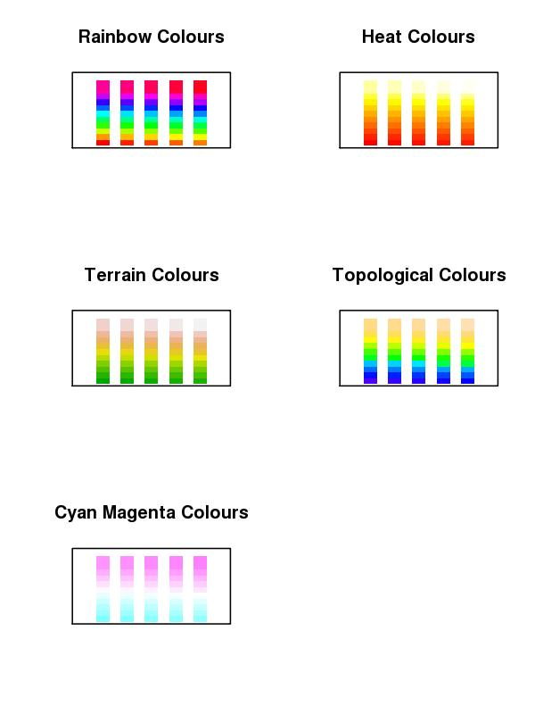
Colour Ramps & Palettes
Graphics
Heatmaps use colour depth to convey data values. Cold colours are typically low values, and light colours are high state values. This is a colour ramp.
R supports numerous graded colour charts. Specify n, to set the number of gradations required in the palette
rainbow(n)
heat.colors(n)
terrain.colors(n)
topo.colors(n)
cm.colors(n)
19_colourCharts.R
You can specify a user defined palette of indexed colours:
palette(rainbow(7)) # creates 7 indexed colours (1:7) based on # rainbow palette R O Y G B I V !!!

Slide 73
Colour packages: RColorBrewer
Graphics
This add on package provides a series of well defined colour palettes. The colours in these palettes are selected to permit maximum visual discrimination
Access the RColorBrewer library functions ...
library("RColorBrewer")
  Check out the available palettes
display.brewer.all(n=NULL, type="all", select=NULL, exact.n=TRUE)
  Define your own palette based on one of RColorBrewers'
myCol<-brewer.pal(n,"...") # n=number of colours, "..." is the palette name

Slide 74
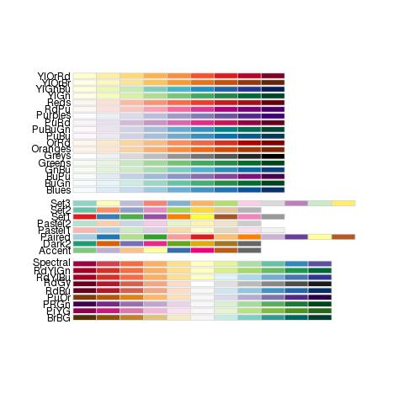
RColorBrewer named palettes
Graphics

Slide 75
Saving plots to files
Unless specified, R plots all graphics to the screen
To send plots to a file, you need to set up an appropriate graphics device …
postscript(file="a_name.ps", …)‏
pdf(file="…pdf", …)‏
jpeg(file=" …jpg", …)‏
png(file=" ….png", …)‏
    Each graphics device will have a specific set of arguments that dictate characteristics of the outputted file
      height=, width=, horizontal=, res=, paper=
        Top tip: jpg, A4 @ 300 dpi, portrait, size in pixels
        jpg(file="my_Figure.jpg", height=3510, width=2490, res=300)
        Postscript & pdf work in inches by default, A4 = 8.3" x 11.7"
Graphics devices need closing when printing is finished
dev.off()‏
for example:
png("tenPoints.png", width=300, height=300)
plot(1:10)
dev.off()

Slide 76
Thoughts when plotting to a file
Graphics
Its very tempting to send all graphical output to a pdf file. Caution!
  For high resolution publication quality images you need postscript. Set up postscript file capture with the following function
postscript("a_file.ps",paper="a4")‏
    postscript images can be converted to JPEG using ghostscript (free to download) for low resolution lab book photos and talks
  PDF images will grow too large for acrobat to render if plots contain many data points (e.g. Affymetrix MA plots)‏
  Automatically send multiple page outputs to separate image files using …file="somename%02d.jpg"
  Don’t forget to close graphics devices (i.e. the file) by using
    dev.off()‏

Slide 77
Plotting exercise
Graphics
Exercise:
  Make a full A4 page figure comprising of 6 plots: 2 each of XY plot (plot()), barchart (barplot()) and box plots (boxplot())
  The two version of each plots should consistent of: the default plot and a customised plot (change for instance colours, range, captions...)
  Output the completed 6-panel figure to: screen, jpeg, postscript and pdf file
Suggested route to solution:
1. Generate some plotting data appropriate for each type of plot
2. Write the code to produce the six plots, once plotting the data by using default plotting, one with some customisations you want
3. To output the plot to screen, jpeg, postscript and pdf you will need to redo the plot multiple times - create a function to do a plotting and call it by redirecting graphical output to screen, jpeg file, poscript file and pdf file
20_6PanelPlotScript.R

Slide 78
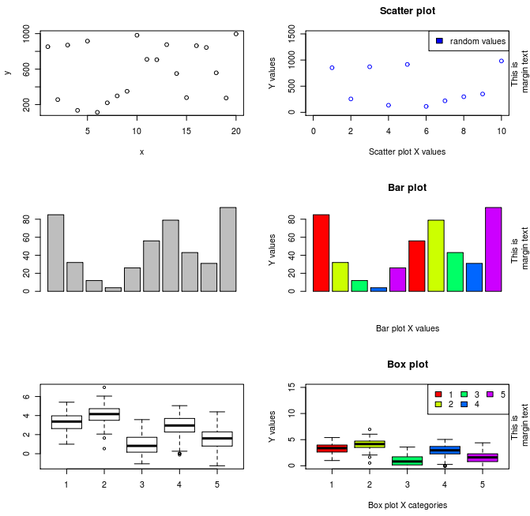
6 Panel plots exercise
Graphics

Slide 79
References
Official documentation on:
  http://cran.r-project.org/manuals.html
A good repository of R recipes:
  Quick-R: http://www.statmethods.net/
Don't forget that many packages come with tutorials (vignettes)
Website of this course:
  http://logic.sysbiol.cam.ac.uk/teaching/Rcourse/
R forums (stackoverflow & official):
  http://stackoverflow.com/questions/tagged/r
  http://news.gmane.org/gmane.comp.lang.r.general
Plenty of textbooks to choose from, comprehensive list + reviews:
  http://www.r-project.org/doc/bib/R-books.html

Slide 80
Thanks for your attention!
END OF COURSE

