Slide 1
Writing custom scripts & running R batch mode analysis
1

Slide 2
The R scripting language
Scripting
A script is a series of instructions that when executed sequentially automates a task
  A script is a good solution to a repetitive problem
  The art of good script writing is
    understanding exactly what you want to do
    expressing the steps as concisely as possible
    making use of error checking
    including descriptive comments
R is a powerful scripting language, and embodies aspects found in most standard programming environments
  procedural statements
  loops
  functions
  conditional branching
Scripts may be written in any standard text editor, e.g. notepad, gedit, kate
  RGui (Mac and Windows) has a built-in text editor

Slide 3
An example script
Scripting
Colony forming assays provide a measure of cellular proliferation. They are used as read outs for various biological systems
  A well controlled study may involve multiple samples, treatments and controls (probably replicated).
  This produces a lot of ‘count’ data, ideally suited to routine script processing
Encapsulating the analysis into an R script requires a clear understanding of the problem and data structure

Slide 4
CFA experimental design
Scripting
Expression of gene X may prevent cells from proliferating in high concentrations of compound Z. The theory is tested by knocking down gene X and growing cells in varying concentrations of compound Z.
  Three repeat runs (same cell line)
    Gene X knockdown --> KdX
    Scramble gene X knockdown control --> ScX
    Control (transfect empty vector) --> CnX
  4 concentrations of compound Z
    High (HZ), Medium (MZ), Low (LZ), None (OZ)
  The experiment is replicated over 3 successive weeks
    Run1 (R1), Run2 (R2) and Run3 (R3)
  108 counts in total

Slide 5
Colony forming assay
experimental design
(R3) Run 3
Δ counts significant?
(KdX-Cnx) vs. (Scx-Cnx)
(R2) Run 2
(HZ) High Z
X knockdown
Scramble knockdown
Control
(R1) Run1
KdX
ScX
CnX
(MZ) Medium Z
X knockdown
Scramble knockdown
Control
(LZ) Low Z
X knockdown
Scramble knockdown
Control
Empty transfection
Scramble knockdown
Control
(OZ) No Z
X knockdown
Each plate of each run is in triplicate
X knockdown
Scramble knockdown
Control

Slide 6
Preparing the calculation(s)
Scripting
We need to make barplots of counts for the KDX-CNX and SCX-CNX for each concentration of Z.
We will group the repeat runs & replicates, and take an average.
A Wilcoxon Rank Sum test will tell us whether there is a significant level of protection for KDX in concentrations of Z
We'll add in some data quality checks
  Boxplots of repeat runs
  Variance within replicates
We can copy & paste lines of code into a blank text document, try them out and keep the ones that work!

Slide 7
Importing data
Scripting
Fine for humans, bad for R
We will create a data frame of factors comprising Run, Plate, Treatment, Replicate The response variable is counts.
We have 3 spreadsheets of data
Run1counts.csv
Run2counts.csv
Run3counts.csv
We will need to write a procedure that reads in the data
Note that our script will require a consistent data format
Factors
Response

Slide 8
Prepare for raw data
Script walkthrough 1
Open a blank text document, and prepare to write this script
  The data is contained in three files:
    11_CFA_Run1Counts.csv
    11_CFA_Run2Counts.csv
    11_CFA_Run3Counts.csv
  Load in the data and concatenate it into a single data frame
# load in the data from the three runs into three separate data frames t1, t2, t3
t1 = read.csv("11_CFA_Run1Counts.csv")
t2 = read.csv("11_CFA_Run2Counts.csv")
t3 = read.csv("11_CFA_Run3Counts.csv")
# concatenate the three data frames into a single data frame
colony = rbind(t1, t2, t3)
# (or use one of the loops from yesterday...)
Example code:
11_CFAcountData.R

Slide 9
Import raw data
Script walkthrough 2
Data is by default read in as factors, i.e. all input strings are enumerated and stored as numbers
The three separate data frame have no indication of which number they came from. We will add a column indicating this:
# add the missing Run column - factors are stored as numbers !
runNum <- factor( rep( 1:3, each=36 ), labels=c("Run1","Run2","Run3") )
colony <- cbind( "Run" = runNum, colony )
# reorder factor levels in their natural order (instead of alphabetical)
colony$Treatment <- factor(colony$Treatment, c("OZ", "LZ", "MZ", "HZ"))
colony$Plate <- factor(colony$Plate, c("KDX","SCX","CNX"))
# show the full table
colony

Slide 10
The tapply function
a brief digression
Assume we have the following data for heights of 5 males and females:
data <- data.frame(gender=c("Male", "Male", "Female",
"Female", "Female"), height=c(6, 6.1, 5.8, 6, 5.95))
gender height
1 Male 6.00
2 Male 6.10
3 Female 5.80
4 Female 6.00
5 Female 5.95
By calling mean() on the height column we can get the average of all 5 people, but how do we get average separately for males and females?
tapply() lets us do exactly this
  It applies a function to grouped data:
tapply( data$height, data$gender, mean )
data groups function

Slide 11
Undertake data analysis
Script walkthrough 3
We need the means of the triplicate counts for each Run
  Broken down by plate type (KDX,SCX,CNX) and Z treatment concentration (OZ,LZ,MZ,HZ)
### Part 2. Investigating data ###
tapply(colony$Count, list(colony$Run, colony$Plate, colony$Treatment), mean)
, , OZ
KDX SCX CNX
Run1 98.33333 129.6667 108.3333
Run2 180.33333 206.0000 188.6667
Run3 282.33333 288.6667 265.6667
, , LZ
KDX SCX CNX
Run1 75.0000 53.0000 21.66667
Run2 136.3333 103.6667 32.00000
Run3 157.0000 180.6667 46.66667
, , MZ
KDX SCX CNX
Run1 29.66667 6.333333 0.3333333
Run2 47.00000 11.666667 2.0000000
Run3 73.00000 17.333333 3.6666667
, , HZ
KDX SCX CNX
Run1 6.333333 1.3333333 0.3333333
Run2 12.000000 0.3333333 0.0000000
Run3 18.666667 0.3333333 0.0000000
We can plot a graph of this. It gives us the variation in counts per run
par(oma=c(4,2,2,2))
boxplot(Count~Run*Plate*Treatment, las=2, cex=0.2, data=colony)
Better still, lets plot a grouped bar chart of mean counts per plate type per Z treatment
barplot(tapply(colony$Count, list(colony$Plate, colony$Treatment), mean),beside=T)

Slide 12
Summarize & save the analysis
Script walkthrough 4
we need a reshaped, background corrected, table of results on which to perform our tests
for clarity where possible use dollar ($) notation (work only with data frames)
### Part 3. Summarizing data ###
result <- tapply(colony$Count, list(colony$Treatment, colony$Plate), mean)
result <- data.frame(result) # result of tapply is matrix, convert to dataframe
result
# calculate kdx and scx values after background correction
kdx = result$KDX - result$CNX
scx = result$SCX - result$CNX
result <- cbind(kdx, scx)
# remove the 0Z entry
result <- result[-1,]
barplot(result,beside=T)
wilcox.test(result[,1],result[,2],paired=T)
cor.test(result[,1],result[,2],paired=T)
write.csv(result,"CFAresults.csv")
We can plot the results as a barchart, and undetake an appropriate two sample classical test
We find that the difference in means is not significant (would expect observation to occur 1:4 times), and that the scramble and knockdown counts have a 90% correlation
-ve subscripts mean 'delete'

Slide 13
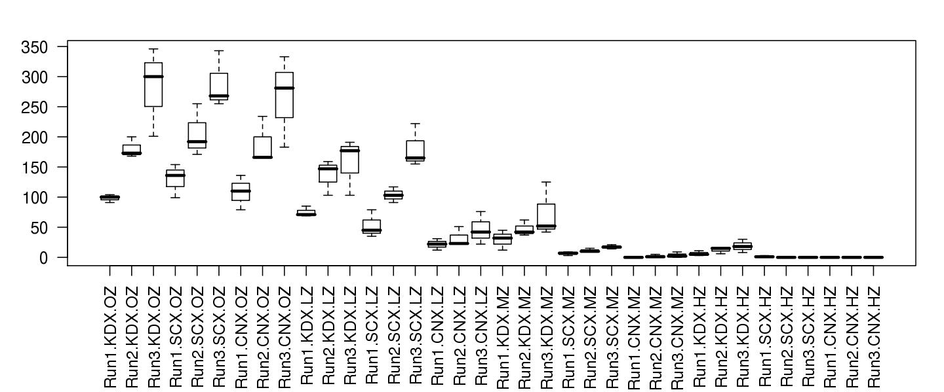
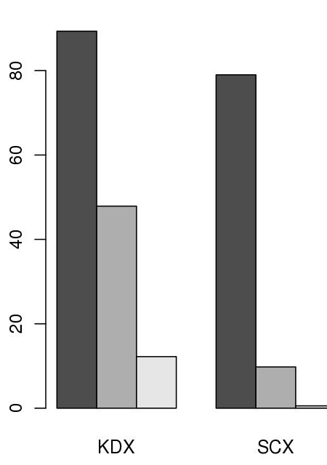
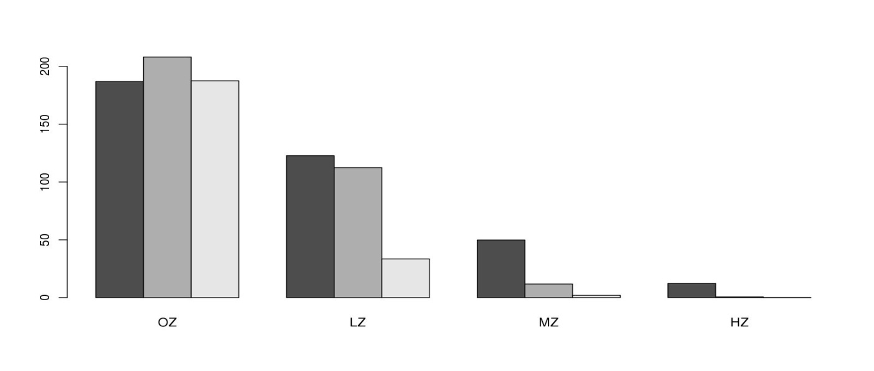
LZ, MZ, HZ
Boxplot shows variation in replicates. Run 3 had greatest count variation.
KDX, SCX, CNX
Barchart shows KDX had greater viability in Z compared to SCX. Treatments are Low, Medium and High.
Barchart shows run average counts of various plate types in different Z treatments. KDX is the only plate type that had growth in high Z.

Slide 14
> wilcox.test(result[,1],result[,2],paired=TRUE)
Wilcoxon signed rank test
data: result[, 1] and result[, 2]
V = 6, p-value = 0.25
alternative hypothesis: true location shift is not equal to 0
> cor.test(result[,1],result[,2],paired=TRUE)
Pearson's product-moment correlation
data: result[, 1] and result[, 2]
t = 2.5584, df = 1, p-value = 0.2372
alternative hypothesis: true correlation is not equal to 0
sample estimates:
cor
0.9313792
Would expect to see trend 1 in 4 times. There is a 93% correlation between the knockdown of gene X and scramble control and cell counts response when grown in compound Z.

Slide 15
Script steps review
Script walkthrough 5
Excel formatted data needs to be exported as comma separated values text (or tab!)
Get the data into R
  read.csv() … to assign the data to an object
Produce exploratory plots
  boxplot()
  barplot()
Undertake statistical tests
  cor.test()
    Spearman’s rank correlation test
  wilcox.test()
    Wilcoxon test with two sets of paired data … Mann-Whitney U test
Write out the results
  write.csv()
    exports data as comma separated list
  save.image()
    could also save the R environment after analysis (we didn't do this)

Slide 16
Exercise
Colony forming assay script
Enter the text of the count data script, and save the file.
  To run the count data script in R, type
  source("filename") # the script is available as 11_countData.R
Each step of the script is executed, and the results displayed.
We need to export the graphical output to a file, and the R objects also need to be saved.
  Modify the script as follows:
Section 3, line directly after tapply command insert:
jpeg(file="fig1.jpg",width=1600,height=800,res=150)
par(oma=c(4,2,2,2))
… <boxplot commands in middle> …
dev.off()
jpeg(file="fig2.jpg",width=675,height=900,res=150)
… <barplot commands in middle> …
dev.off()
Section 4, line directly after result command insert:
jpeg(file="fig3.jpg",width=1600,height=800,res=150)
… <barplot commands in middle> …
dev.off()

Slide 17
Batch processing R scripts
Scripting
Scripts can be run without ever launching R, using R CMD batch mode.
quit R and type the following in a linux terminal
R CMD BATCH –no-restore 11_CFAcountData.R
or if you write all of graphical output to files:
Rscript 11_CFAcountData.R (works only with recent R versions)

