Slide 1
Advanced data processing
3

Slide 2
Combining data from multiple sources
Gene clustering example
R has powerful functions to combine heterogeneous data into a single data set
Gene clustering example data:
  five sets of differentially expressed genes from various experimental conditions
  file with names of experimentally verified genes
Gene clustering exercise:
  combine this dataset into a single table and cluster to see which conditions are similar
  repeat the clustering but only on a subset of experimentally verified genes

Slide 3
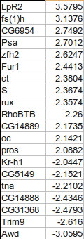
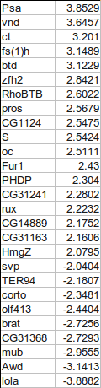
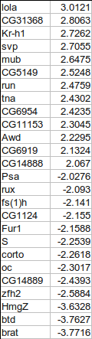
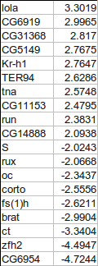
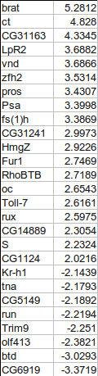
Combining gene tables
input files have two columns: gene names and fold change
we want to combine all five tables into a single table, with 0 for missing values
+
+
+
+

Slide 4
Gene clustering
Script walkthrough 1
To make the big table we first need to find out all the genes present in at least one of the files
Make sure not to use factors in read.delim()
# start with en empty collection of genes
genes <- c()
for( fileNum in 1:5 ){
# load in files 13_DiffGenes1.tsv ...
t <- read.delim(paste("13_DiffGenes", fileNum, ".tsv", sep=""),
as.is=TRUE, header=FALSE)
# label the input columns to help code readability
names(t) <- c("gene", "expression")
genes <- union(genes, t$gene)
}
# for tidiness order our genes by name
genes <- sort(genes)
genes # show all genes
when loading in character data
use as.is=T to prevent it being
converted to factors!
union() is a set operation, combines
two vectors by eliminating duplicates.
There are also intersect() and setdiff()
Example code:
13_geneClustering.R

Slide 5
Gene clustering
Script walkthrough 2
Using the complete list of genes, we can create the big table and fill in the values:
# make the destination table [rows = unique genes, cols = file numbers]
values <- matrix(0, nrow=length(genes), ncol=5)
rownames(values) <- genes # name the rows with the complete gene names
for(fileNum in 1:5){
# read in the file again
t <- read.delim(paste("13_DiffGenes", fileNum, ".tsv", sep=""),
as.is=T, header=F)
names(t) <- c("gene", "expression")
# match the names of the genes to the rows in our big table
index <- match(t$gene, rownames(values))
# copy the expression levels
values[index,fileNum] <- t$expression
}
match() returns the index of first argument in the second, i.e. index of input file genes in the big table
we use index to pick the rows in such way that they match the gene order in the input file

Slide 6
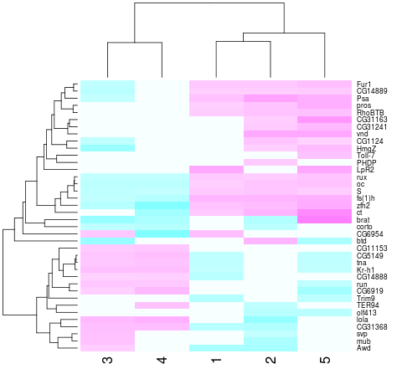
Gene clustering
Script walkthrough 3
Now we can do hierarchical clustering:
heatmap(values, scale="none", col = cm.colors(256))
Values from the matrix
are colour-coded.
Rows and columns
are re-arranged according to similarity

Slide 7
Gene clustering
Script walkthrough 4
In a second part of our analysis, we want to produce the same heatmap but only based on a list of experimentally verified genes
The problem is data is not formatted in the most convenient way:
genes | citation
oc,run,RhoBTB,CG5149,CG11153,S,Fur1 | Segal et al, Development 2001
tna,Kr-h1,rux | Krejci et al, Development 2002

Slide 8
Gene clustering
Script walkthrough 5
We load in this table, and only extract the gene names, then we use them to select a subset of values matrix
# load in the tab-delimited file with genes and citations
t.exp <- read.delim("13_ExperimentalGenes.tsv", as.is=T)
# split all gene names by "," and then flatten it out into a single vector
experim.genes <- unlist( strsplit(t.exp$genes, ",") )
# redo the heatmap by using just the genes in the experimentally verified set
is.experimental <- rownames(values) %in% experim.genes
heatmap(values[ is.experimental, ], scale="none", col = cm.colors(256))
unlist() flattens out a nested
list into a single vector
strsplit() splits a vector of strings by a custom
split character (","), the results is a list of split
values for each element of input vector

Slide 9
Gene clustering review
We load in the five tables twice - first to collect gene names, then to load expression values
Based on expression table (values) we construct a clustered heatmap first on the whole set of genes, then on a selected subset
Go through the code, try it out it and understand it
Try answering the following questions:
  what is rownames(values) ?
  why is rownames(values)[index] and t$gene giving the same output?
  what is a difference between rownames(values) %in% experim.genes and experim.genes %in% rownames(values)
Example code:
13_geneClustering.R

