Slide 1
Graphics
4

Slide 2
Starting out with R graphics
Graphics
R provides several mechanisms for producing graphical output
  Functionality depends on the level at which the user seeks interaction with R
    graphics systems, packages, devices & engines
High level graphics
  Functions compute an appropriate chart based up on the information provided. Optional arguments may tailor the chart as required
    Interaction is at traditional graphics system level. The user isn’t required to know much about anything
Low level graphics
  The user interacts with the drawing device to build up a picture of the chart piece by piece.
    This fine granular control is only required if you seek to do something exceptional
R graphics produces plots using a painter’s model
  Elements of the graph are added to the canvas one layer at a time, and the picture built up in levels. Lower levels are obscured by higher levels, allowing for blending, masking and overlaying of objects.

Slide 3
High level vs. Low level plotting
Graphics
High level plotting
example(plot)‏
Low level plotting
(Scotland by blighty package)‏

Slide 4
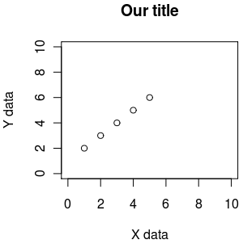
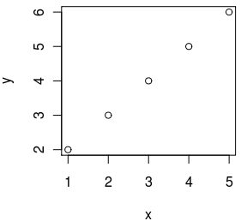
Essential plotting - plot()
plot() is the main function for plotting, it takes x,y values to plot and also lots of graphical parameters (see ?par for all of them)
default plotting
custom plotting
x <- 1:5
y <- 2:6
plot(x,y)
x <- 1:5
y <- 2:6
plot(x,y, xlab="X data", ylab="Y data", xlim=c(0,10), ylim=c(0,10), main="Our title")

Slide 5
R graphics uses a painter’s model
x <- seq(-2, 2, 0.1)‏
y <- sin(x)‏
1
2
3
plot(y~x, ylim=c(-1.5,1.5), xlim=c(-2.5,2.5), col="red" ,pch=16, cex=1.4)‏
lines(y~x, ylim=c(-1.5,1.5), xlim=c(-2.5,2.5), col="blue", lty=1,lwd=2)‏
rect(-2.5,0,2.5,-1.5, col="white", border="white")‏
xlim, ylim = axis limits
col = line colour
pch = plotting character [example(points)]
cex = character expansion [scaling factor]
lty = line type
lwd = line width
rect = rectangle
Example code:
14_painterModel.R

Slide 6
Plotting x,y data - plot(), points(), lines()
plot() is used to start a new plot, accepts x,y data, but also data from some objects (like linear regression). Use the parameter type to draw points, lines, etc (see ?plot)
points() is used to add points to an existing plot
lines() is used to add lines to an existing plot
plot(c(0, 5), c(0, 5), type="l") # draw as line from (0,0) to (5,5)
points(1, 3) # add a point at 1,3

Slide 7
Making bar plots - barplot()
visualizing a vector of data can be done with bar plots, using function barplot()
data <- c("2000"=0, "2001"=20, "2002"=50, "2003"=100)
barplot(data, main="Number of R developers")

Slide 8
Making box plots - boxplot()
when a spread of data needs to be visualised, we can use boxplots with function boxplot()
data1 <- rnorm(1000, mean=0)
data2 <- rnorm(1000, mean=1)
boxplot(data1, data2)

Slide 9
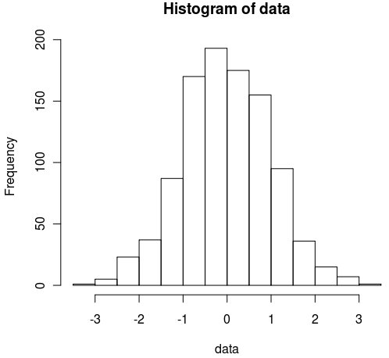
Making histograms - hist()
when we need to look at the distribution of data, we can visualize it using histograms with function hist()
data <- rnorm(1000)
hist(data)

Slide 10
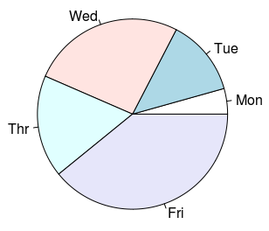
Pie charts - pie()
to visualise percentages or parts of a whole we can use pie charts with function pie()
data <- c("Mon"=1, "Tue"=3, "Wed"=6, "Thr"=4, "Fri"=9)
pie(data)

Slide 11
Typical plotting workflow
Set the plot layout and style - par()
  Set the number of plots you want per page
  Set the outer margins of the figure region
    The distance between the edge of the page and the figure region, or between adjacent plots if there are multiple figures per page
  Set the inner margins of the plot
    The distance between the plot axes and the labels & titles
  Set the styles for the plot
    Colours, fonts, line styles and weights
Draw the plot - plot(x,y, …)‏

Slide 12
Setting graphics layout and style - par()
par() Top level graphics function
  parameter specifies various page settings. These are inherited by subordinate functions, if no other styles are set.
    Specific colours and styles may be set globally with par, but changed ad hoc in plotting commands
    The global setting will remain unchanged, and reused in future plotting calls.
  par sets the size of page and figure margins
    Margin spacing is in ‘lines’
  par is responsible for controlling the number of figures that are plotted on a page
  par may set global colouring of axes, text, background, foreground, line styles (solid/dashed), if figures should be boxed or open etc. etc.
type par() to get a list of top down settings which may be set globally

Slide 13
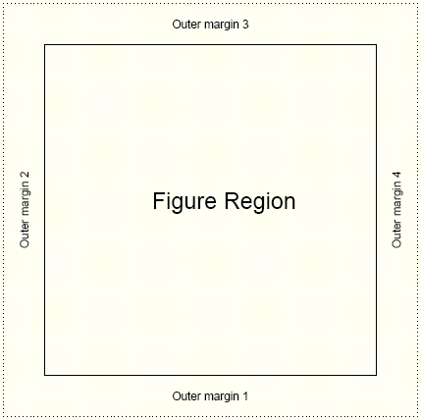
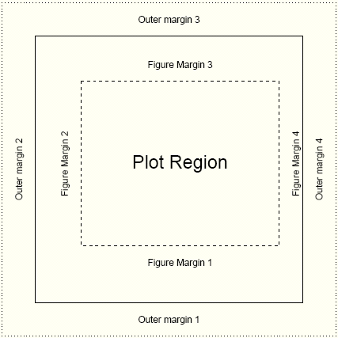
Page settings with par
Graphics
par(mfrow=c(1,1))‏
one figure on page
par(oma=c(2,2,2,2))‏
equal outer margins
par(mar=c(5,4,4,2))‏
Sets space for x & y labels, a main title, and a thin margin on the right
Numbering: bottom, left, top, right

Slide 14
Page layout plot exercise
Graphics
oma 1 line here
par(mfrow=c(2,2))‏
2 x 2 figures per page
par(oma=c(1,0,1,0)‏
1 line spacing top and bottom
par(mar=c(4,2,4,2))‏
4 lines at bottom & top
2 lines left & right
par(bg="lightblue",fg="darkgrey")‏
light blue background
dark grey spots
par(pch=16,cex=1.4)‏
Large circles for spots
Execute 4 times with different colors:
plot(1:10)‏
box("figure",lty=3,col="blue")‏
Draw a blue dashed line around plot
box("outer",lty=1,lwd=3,
col="green")‏
Draw a green solid line around figure
mar 4 lines here
mar 2 lines here
See how the figure margins overlap
Using painter’s model
15_parExample.R

Slide 15
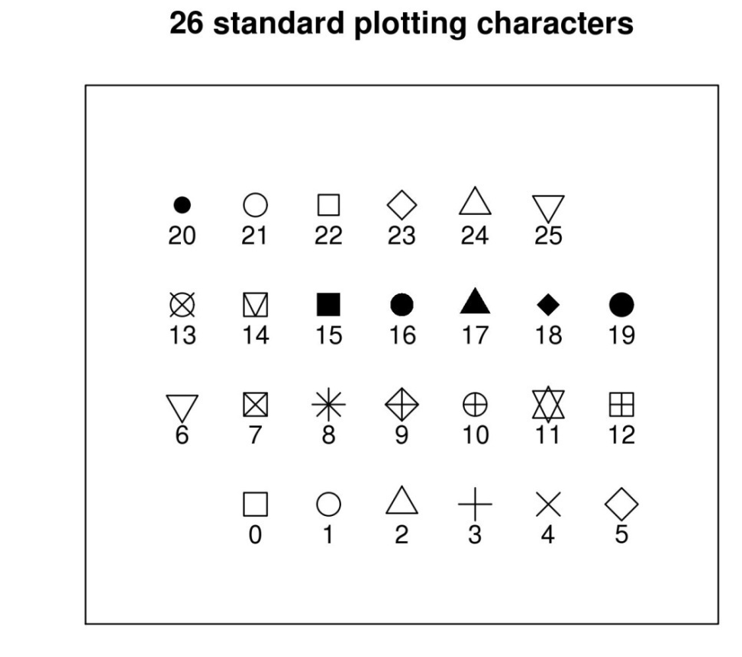
Plotting characters for plot()
size and orientation
pch= ...
Sets one of the 26 standard plotting character used.
Can also use characters, such as "."
cex= ...
Character expansion. Sets the scaling factor of the printing character
las= ...
Axes label style. 1 normal, 2 rotated 90º
4 styles (0-3)

Slide 16
Plotting characters exercise
Graphics
16_plottingChars.R
xCounter<-1
yCounter<-1
plotChar<-0
plot(NULL, xlim=c(0,8), ylim=c(0,5),xaxt="n",
yaxt="n",ylab="",xlab=""
,main="26 standard plotting characters")
while (plotChar < 26){
if(xCounter < 7){
xCounter <- xCounter+1
} else {
xCounter <- 1
yCounter <- yCounter+1
}
points(xCounter,yCounter,pch=plotChar, cex=2)
text(xCounter,(yCounter-0.3),plotChar)
plotChar <- plotChar+1
}
X-Y coordinates,
Plotting character index counter
Sets up an empty plotting area.
Axis scale limits, xlim, ylim
Don't draw axis ticks, xaxt, yaxt="n"
Don't annotate axis, xlab, ylab=""
Set a main title, main
We want to print the characters in a
7 x 4 grid. The if statement sets up the character plotting coordinates such that each time x =7, make it 1 again and increment the y axis by 1 at the same time
While loop counts up to 25
(0 to 25 = 26 iterations)
And cycles through each pch available

Slide 17
Annotating the plot
plot accepts main title, subtitle, X label, Y label as standard arguments
plot(x, y, main="...", sub="...", xlab="...", ylab="...")
mtext(text="…", side= …)‏
  allows text to be written directly into the margin of a plot
text(x,y,labels="…")‏
  allows text to be written in the plot at x,y
legend(x,y, legend=…)‏
  produces a legend for the plot

Slide 18
Appreciating drawing coordinates
How do we know where to place items within the plot region when building up our customized graphs?
Most of the time we can specify X,Y coordinates.
  R calculates sensible pixel coordinates of plots from the data we provide. We don’t need to worry about pixels, centimetre distances etc.
locator(…)‏
    Returns x,y coordinates from a mouse click within a plot
    good for working out where to place legend items
identify(…)‏
    provides an id tag for the closest plotted point to a mouse click
    useful if you want to label points on a chart
xy.coords(…)‏
    translates x,y coordinates into pixel coordinates
Margin spacing is in lines
  The exact distance is a factor of font family, style and size
    Text may appear bunched or squashed if sufficient distance is not left between the axes and the caption

Slide 19
Building up a plot
Graphics
Text
R code
par(mfrow=c(1,1))‏
par(bg="white",fg="black",cex=1)‏
par(oma=c(1,1,1,1))‏
par(mar=c(5,4,4,2)+0.1)
‏
plot(1:10,main="The plot title", sub="A subtitle", xlab="Numbers",
ylab="More numbers")‏
mtext(c("Bottom", "Left", "Top", "Right"), c(1,2,3,4), line=.5)‏
text(2,10,"Text at X=2,Y=10")‏
legend(locator(1),"Some Legend",fill="red")‏
Adding legend ...
Don't forget to mouse click!
mtext
Xlab
Subtitle
align text left, right & centre with adj=(i,j) i.e centre is adj=(0.5,0.5), left is adj=(1,0) and right is adj=(0,1)‏
17_buildingAplot.R

Slide 20
Plots with custom axes
Graphics
R plot doesn’t support multiple Y axis by default
  You have to make additional axes yourself!
Adding custom axis
axis(side=, at=, labels=, …)‏
If you want to specify custom axes, make sure you turn off the automatic axes in the plot / points call
plot( …, axes=F)‏

Slide 21
Adding a second Y axis
Graphics
The trick
plot first Y series
use par(new=T) to overlay a second figure region
plot second series without axes
axis(side=4, …) to add second Y axis
mtext(side=4, …) to label second Y

Slide 22
Example: The second Y series
Graphics
18_secondYaxis.R
x1<-1:20
y1<-sample(1000,20)‏
y2<-runif(20)‏
y2axis<-seq(0,1,.2)‏
par(mar=c(4,4,4,4))‏
plot(x1,y1,type="p",pch=10,cex=2,col="red",
main="A second axis example",
ylab="Big values",ylim=c(0,1100),
xlab="Ordered units")‏
points(x1,y1,type="l",lty=3,lwd=2,col="green")‏
par(new=T)‏
plot(x1,y2,type="p",pch=20,cex=2,col="black",axes=FALSE,bty="n",xlab="",ylab="")‏
points(x1,y2,type="l",lty=2,lwd=2,col="grey")‏
axis(side=4,at=pretty(y2axis))‏
mtext("Little values",side=4,line=2.5)
‏
legend(15,0.2,c("Big Y","Little Y"),lty=1,lwd=2,col=c("green","grey"))‏
Demo data
Set up equivalent figure margins
Plot and label first Y series
Connect dots with a line
Overlay a second plot region
Plot second Y series, but suppress labels
Anotate second Y axis
Add legend, note X,Y is on second Y axis scale

Slide 23
Use of colour in R
Graphics
Colour is usually expressed as a hexadecimal code of Red, Green, and Blue counterparts
  No good for humans.
R supports numerous colour palettes which are available through several "colour" functions.
  colours() # get inbuilt names of known colours
    RGB primaries may take on a decimal intensity value of 0 to 255
      255 is #FF in hexidecimal
        White is #FF FF FF
        Black is #00 00 00
  rgb() # converts red green blue intensities to colour
    Strangely, likes decimalized intensities (ie. 0 is black, 1 is white)
> rgb(1,1,1)
[1] "#FFFFFF"
> par(mfrow=c(2,2))
> plot(1:10,col="#FF00FF")
> plot(1:10,col=rgb(1,0,1))
> plot(1:10,col="magenta")

Slide 24
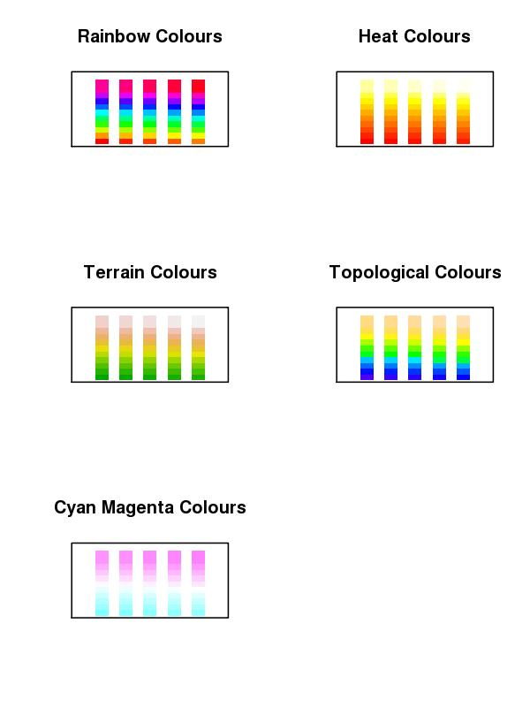
Colour Ramps & Palettes
Graphics
Heatmaps use colour depth to convey data values. Cold colours are typically low values, and light colours are high state values. This is a colour ramp.
R supports numerous graded colour charts. Specify n, to set the number of gradations required in the palette
rainbow(n)
heat.colors(n)
terrain.colors(n)
topo.colors(n)
cm.colors(n)
19_colourCharts.R
You can specify a user defined palette of indexed colours:
palette(rainbow(7)) # creates 7 indexed colours (1:7) based on # rainbow palette R O Y G B I V !!!

Slide 25
Colour packages: RColorBrewer
Graphics
This add on package provides a series of well defined colour palettes. The colours in these palettes are selected to permit maximum visual discrimination
Access the RColorBrewer library functions ...
library("RColorBrewer")
  Check out the available palettes
display.brewer.all(n=NULL, type="all", select=NULL, exact.n=TRUE)
  Define your own palette based on one of RColorBrewers'
myCol<-brewer.pal(n,"...") # n=number of colours, "..." is the palette name

Slide 26
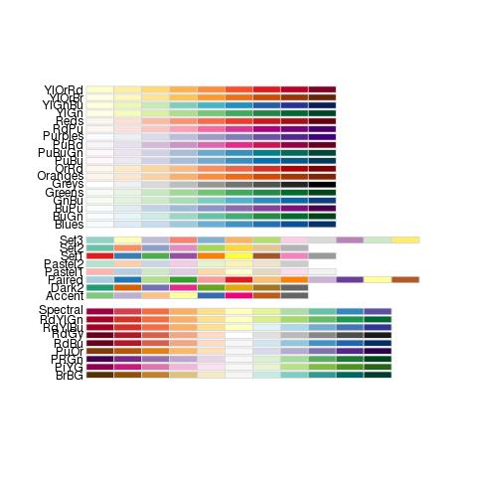
RColorBrewer named palettes
Graphics

Slide 27
Saving plots to files
Unless specified, R plots all graphics to the screen
To send plots to a file, you need to set up an appropriate graphics device …
postscript(file="a_name.ps", …)‏
pdf(file="…pdf", …)‏
jpeg(file=" …jpg", …)‏
png(file=" ….png", …)‏
    Each graphics device will have a specific set of arguments that dictate characteristics of the outputted file
      height=, width=, horizontal=, res=, paper=
        Top tip: jpg, A4 @ 300 dpi, portrait, size in pixels
        jpg(file="my_Figure.jpg", height=3510, width=2490, res=300)
        Postscript & pdf work in inches by default, A4 = 8.3" x 11.7"
Graphics devices need closing when printing is finished
dev.off()‏
for example:
png("tenPoints.png", width=300, height=300)
plot(1:10)
dev.off()

Slide 28
Thoughts when plotting to a file
Graphics
Its very tempting to send all graphical output to a pdf file. Caution!
  For high resolution publication quality images you need postscript. Set up postscript file capture with the following function
postscript("a_file.ps",paper="a4")‏
    postscript images can be converted to JPEG using ghostscript (free to download) for low resolution lab book photos and talks
  PDF images will grow too large for acrobat to render if plots contain many data points (e.g. Affymetrix MA plots)‏
  Automatically send multiple page outputs to separate image files using …file="somename%02d.jpg"
  Don’t forget to close graphics devices (i.e. the file) by using
    dev.off()‏

Slide 29
Plotting exercise
Graphics
Exercise:
  Make a full A4 page figure comprising of 6 plots: 2 each of XY plot (plot()), barchart (barplot()) and box plots (boxplot())
  The two version of each plots should consistent of: the default plot and a customised plot (change for instance colours, range, captions...)
  Output the completed 6-panel figure to: screen, jpeg, postscript and pdf file
Suggested route to solution:
1. Generate some plotting data appropriate for each type of plot
2. Write the code to produce the six plots, once plotting the data by using default plotting, one with some customisations you want
3. To output the plot to screen, jpeg, postscript and pdf you will need to redo the plot multiple times - create a function to do a plotting and call it by redirecting graphical output to screen, jpeg file, poscript file and pdf file
20_6PanelPlotScript.R

Slide 30
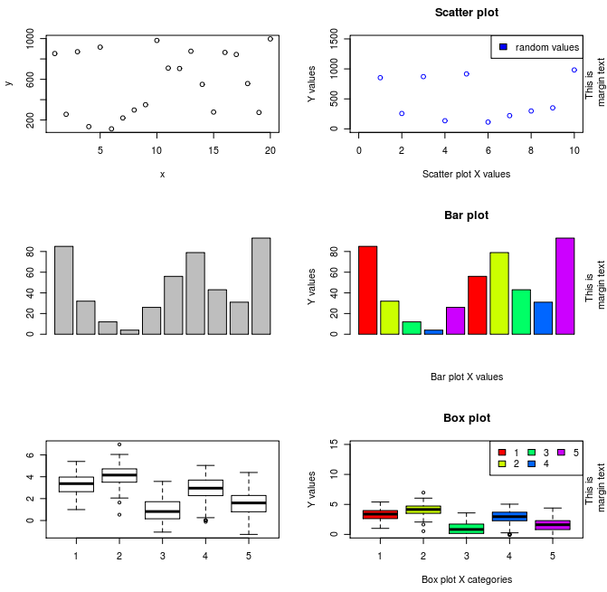
6 Panel plots exercise
Graphics

Slide 31
References
Official documentation on:
  http://cran.r-project.org/manuals.html
A good repository of R recipes:
  Quick-R: http://www.statmethods.net/
Don't forget that many packages come with tutorials (vignettes)
Website of this course:
  http://logic.sysbiol.cam.ac.uk/teaching/Rcourse/
R forums (stackoverflow & official):
  http://stackoverflow.com/questions/tagged/r
  http://news.gmane.org/gmane.comp.lang.r.general
Plenty of textbooks to choose from, comprehensive list + reviews:
  http://www.r-project.org/doc/bib/R-books.html

