Slide 1
Statistics
5

Slide 2
Built-in support for statistics
R is a statistical programming language
  Classical statistical tests are built-in
  Statistical modeling functions are built-in
  Regression analysis is fully supported
  Additional mathematical packages are available
    MASS, Waves, sparse matrices, etc

Slide 3

Pseudo-random numbers and
distributions
mostly commonly used distributions are built-in, functions have stereotypical names, e.g. for normal distribution:
  pnorm - cumulative distribution for x
  qnorm - inverse of pnorm (from probability gives x)
  dnorm - distribution density
  rnorm - random number from normal distribution
available for variety of distributions: punif (uniform), pbinom (binomial), pnbinom (negative binomial), ppois (poisson), pgeom (geometric), phyper (hyper-geometric), pt (T distribution), pf (F distribution) ...

Slide 4
Two sample tests
Basic data analysis
Comparing 2 variances
  Fisher's F test
var.test()
Comparing 2 sample means with normal errors
  Student's t test
t.test()
Comparing 2 means with non-normal errors
  Wilcoxon's rank test
wilcox.test()
Comparing 2 proportions
  Binomial test
prop.test()
Correlating 2 variables
  Pearson's / Spearman's rank correlation
cor.test()
Testing for independence of 2 variables in a contingency table
  Chi-squared
chisq.test()
  Fisher's exact test
fisher.test()

Slide 5
Comparison of 2 data sets example
Basic data analysis
Men, on average, are taller than women.
  The steps
  1. Determine whether variances in each data series are different
      Variance is a measure of sampling dispersion, a first estimate in determining the degree of difference
        Fisher's F test
  2. Comparison of the mean heights.
      Determine probability that mean heights really are drawn from different sample populations
        Student's t test, Wilcoxon's rank sum test

Slide 6
1. Comparison of 2 data sets
Fisher's F test
Read in the data file into a new object, heightData
heightData<-read.csv("10_heightData.csv",header=T)
attach the data frame so we don't have to refer to it by name all the time:
attach(heightData)
Do the two sexes have the same variance?
var.test(Female,Male)
F test to compare two variances
data: Female and Male
F = 1.0073, num df = 99, denom df = 99, p-value = 0.9714
alternative hypothesis: true ratio of variances is not equal to 1
95 percent confidence interval:
0.6777266 1.4970241
sample estimates:
ratio of variances
1.00726

Slide 7
2. Comparison of 2 data sets
Student's t test
Student's t test is appropriate for comparing the difference in mean height in our data.
  Remember a t test = difference in two sample means
standard error of the difference of the means
t.test(Female,Male)
Welch Two Sample t-test
data: Female and Male
t = -8.4508, df = 197.997, p-value = 6.217e-15
alternative hypothesis: true difference in means is not equal to 0
95 percent confidence interval:
-0.7788497 -0.4841288
sample estimates:
mean of x mean of y
5.168725 5.800214

Slide 8
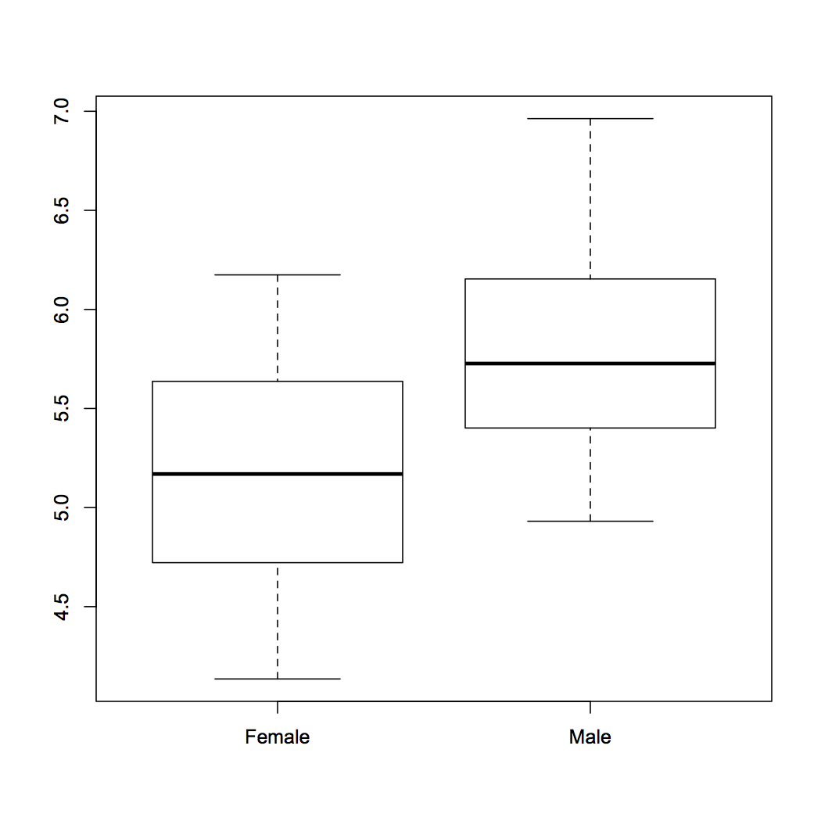
3. Comparison of 2 data sets
Review findings
> boxplot(heightData)

Slide 9
Linear regression
Basic data analysis
Linear modeling is supported by the function lm()
  example(lm) # the output assumes you know a fair bit about the subject
lm is really useful for plotting lines of best fit to XY data in order to determine, intercept, gradient & Pearson's correlation coefficient
  This is very easy in R
Three steps to plotting with a best fit line
  Plot XY scatter-plot data
  Fit a linear model
  Add bestfit line data to plot with abline() function

Slide 10
Modelling formulae
R has a very powerful formula syntax for describing statistical models.
Suppose we had two explanatory variables x and z and one response variable y.
We can describe a relationship between, say, y and x using a tilde ~, placing the response variable on the left of the tilde and the explanatory variables on the right:
> y~x
It is very easy to extend this syntax to do multiple regressions, ANOVAs, to include interactions, and to do many other common modelling tasks. For example:
> y~x # If x is continuous, this is linear regression
> y~x # If x is categorical, this is ANOVA
> y~x+z # If x and z are continuous, this is multiple regression
> y~x+z # If x and z are categorical this is a two-way ANOVA
> y~x+z+x:z # : is the symbol for the interaction term
> y~x*z # * is a shorthand for x+z+x:z

Slide 11
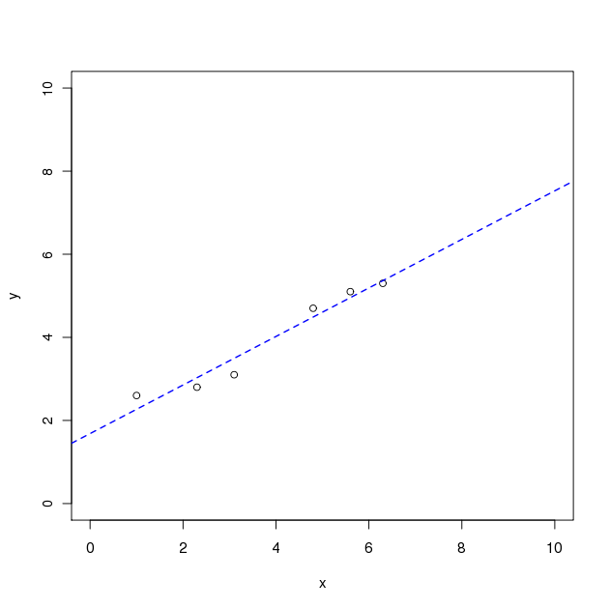
Typical linear regression analysis
Basic data analysis
X
Y
> x<-c(1, 2.3, 3.1, 4.8, 5.6, 6.3)
> y<-c(2.6, 2.8, 3.1, 4.7, 5.1, 5.3)
> plot(y~x, xlim=c(0,10),ylim=c(0,10))
1.0
2.6
2.3
2.8
3.1
3.1
Note formula notation
( y is given by x )
4.8
4.7
5.6
5.1
> myModel<-lm(y~x)
> abline(myModel,lty=2,lwd=1.5,col="blue")
6.3
5.3
Get the coefficients of the fit from:
summary.lm(myModel) and
coef(myModel)
resid(myModel)
fitted(myModel)
Get QC of fit from
plot(myModel)
Find out about the fit data from
names(myModel)

Slide 12
The linear model object
Basic data analysis
Summary data describing the linear fit is given by
  summary.lm(myModel)
> summary.lm(myModel)
Call:
lm(formula = y ~ x)‏
Residuals:
1 2 3 4 5 6
0.33159 -0.22785 -0.39520 0.21169 0.14434 -0.06458
Coefficients:
Estimate Std. Error t value Pr(>|t|)
(Intercept) 1.68422 0.29056 5.796 0.0044 **
x 0.58418 0.06786 8.608 0.0010 **
---
Signif. codes: 0 '***' 0.001 '**' 0.01 '*' 0.05 '.' 0.1 ' ' 1
Residual standard error: 0.3114 on 4 degrees of freedom
Multiple R-squared: 0.9488, Adjusted R-squared: 0.936
F-statistic: 74.1 on 1 and 4 DF, p-value: 0.001001
Y intercept
Gradient
Good fit: would happen 1 in 1000 by chance
R^2 , with pValue

Slide 13
Exercise
The coin toss
To learn how the distribution functions work, try simulating tossing a fair coin 100 times and then show that it is fair.
We can model a coin toss using the binomial distribution. Use the rbinom function to generate a sample of 100 coin tosses. Look up the binomial distribution help page to find out what arguments this function needs.
How many heads or tails were there in your sample? You can do this in two ways; either select the number of successes using indices, or convert your sample to a factor and get a summary of the factor.
If we toss a coin 50 times, what is the probability that we get exactly 25 heads? What about 25 heads or less? Use dbinom and pbinom to find out.
The argument to pbinom is a vector, so try calculating the probabilities for getting any number of coin tosses from 0 to 50 in fifty trials using dbinom. Plot these probabilities using plot. Does this plot remind you of anything?

Slide 14
Coin toss answers
To simulate a coin toss, give rbinom a number of observations, the number of trials for each observation, and a probability of success:
> coin.toss<-rbinom(100, 1, 0.5)
Because we only specified one trial per observation, we either have an outcome of 0 or 1 successes. To get the number of successes, use indices or a factor to look up the number of 1s in the coin.toss vector (your numbers will vary):
> length(coin.toss[coin.toss==1])
[1] 50
> summary(factor(coin.toss))
0 1
50 50

Slide 15
Coin toss answers
The probability of getting exactly 25 heads from 50 observations of a fair coin:
> dbinom(25, 50, 0.5)
The probability of getting 25 heads or less from 50 observations of a fair coin:
> pbinom(25, 50, 0.5)
The probabilities for getting all numbers of coin tosses from 0 to 50 in fifty trials:
> dbinom(0:50, 50, 0.5)
To plot this distribution, which should resemble a normal distribution:
> plot(dbinom(0:50, 50, 0.5))

Slide 16
Exercise
Linear modelling example
Mice have varying numbers of babies in each litter. Does the size of the litter affect the average brain weight of the offspring? We can use linear modelling to find out. (This example is taken from John Maindonald and John Braun's book Data Analysis and Graphics Using R (CUP, 2003), p140-143.)
Install and load the DAAG package. The litters data frame is part of this package. Take a look at it. How many variables and observations does it have? Does summary tell you anything useful? What about plot?
Are any of the variables correlated? Look up the cor.test function and use it to test for relationships.
Use lm to calculate the regression of brain weight on litter size, brain weight on body weight, and brain weight on litter size and body weight together.
Look at the coefficients in your models. How is brain weight related to litter size on its own? What about in the multiple regression? How would you interpret this result?

Slide 17
Linear modelling answers
To install and load the package and look at litters:
> install.packages("DAAG")
> library(DAAG)
> litters
> summary(litters)
> plot(litters)
To calculate correlations between variables:
> attach(litters)
> cor.test(brainwt, lsize)
> cor.test(bodywt, lsize)
> cor.test(brainwt, bodywt)

Slide 18
Linear modelling answers
To calculate the linear models:
> lm(brainwt~lsize)
Call:
lm(formula = brainwt ~ lsize)
Coefficients:
(Intercept) lsize
0.447000 -0.004033
> lm(brainwt~bodywt)
Call:
lm(formula = brainwt ~ bodywt)
Coefficients:
(Intercept) bodywt
0.33555 0.01048
> lm(brainwt~lsize+bodywt)
Call:
lm(formula = brainwt ~ lsize + bodywt)
Coefficients:
(Intercept) lsize bodywt
0.17825 0.00669 0.02431
Interpretation: brain weight decreases as litter size increases, but brain weight increases proportional to body weight (when bodywt is held constant, the lsize coefficient is positive – 0.00669). This is called 'brain sparing'; although the offspring get smaller as litter size increases, the brain does not shrink as much as the body.

