Slide 1
TEAM 5 · LG SW ARCHITECT FINAL
TimeGrapher
Real-time mechanical watch measurement on Windows and Raspberry Pi 5
+/- 1.0
Accuracy first · One codebase · Measured on target hardware
s/d · QAS-1 target
IMPLEMENTED PROGRAM SURFACE
Live mic / WAV playback / simulation inputs
Required displays: Rate/Scope, Beat Error, Trace, Vario, Long-Term, Sweep
Positions, Beat Noise, Waveforms, Filter Scope, Sound Print, Spectrogram
Runtime behavior: A/C sync, signal-quality warnings, latency/status recovery
Demo first, then architecture evidence
Sources: Final presentation script; QAS-1/QAS-2 in Architectural Drivers
01
Notes:
Open with the product, not the diagram.
Frame the talk: architecture choices and evidence behind the demo.

Slide 2
ADR-001 · PLATFORM DECISION
From Qt/C++ to Avalonia/.NET
A deliberate stack choice: maintainability and one codebase over preserving the original implementation stack.
Original pressure
Decision
Result
Qt/C++ created team-skill, LGPL compliance, manual memory, and platform-build risks.
Avalonia + .NET 8 + C# gives one source tree, Skia rendering, and a stack the team can maintain.
Windows x64 and Raspberry Pi ARM64 builds share the same Core and UI logic.
Rejected alternatives
Keep Qt/C++: weak team fit + LGPL/build complexity
.NET MAUI: weak Linux desktop/embedded support
Electron: Chromium footprint too heavy for embedded target
Flutter: Dart mismatch with team skill
Sources: FinalDemo scripts; Milestone/en SW Architect docs
02
Notes:
Mention ADR-001 explicitly.
Tie this slide to portability and modifiability.

Slide 3
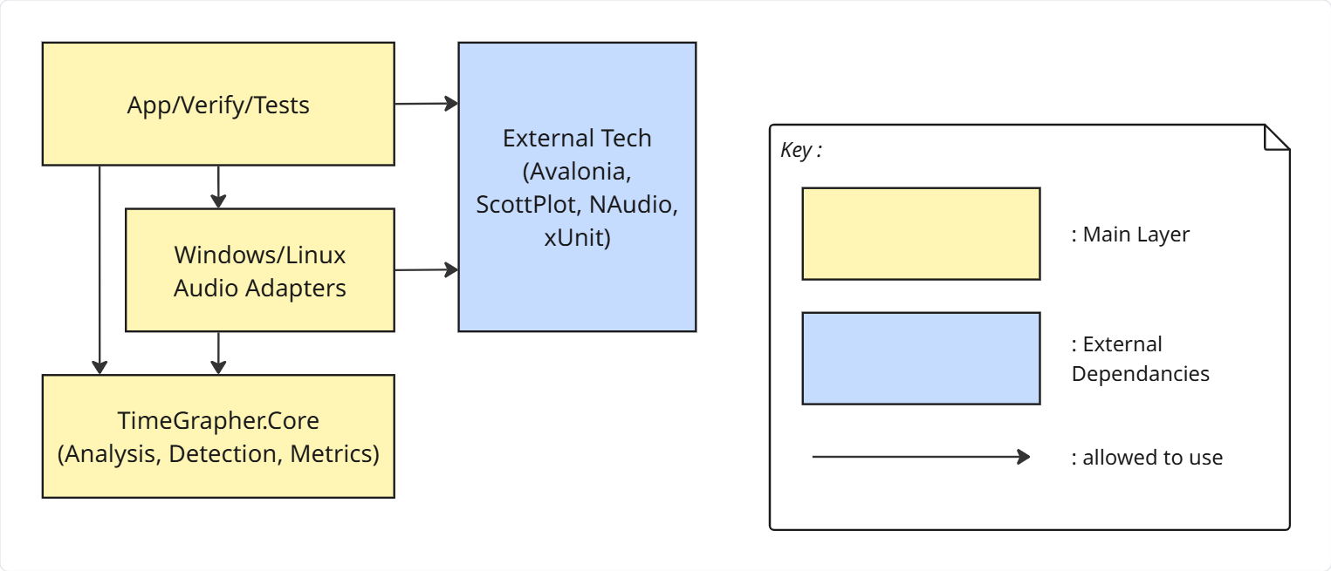
ARCHITECTURE OVERVIEW
Core isolation is enforced, not just drawn
App and platform adapters depend on Core; Core never depends on UI, OS, or audio libraries.
Core
App
Detection, metrics, imaging, simulator. Zero UI/platform dependency.
Avalonia UI renders frames and user controls without owning measurement logic.
Platform
CI boundary
WindowsAudio and LinuxAudio isolate WASAPI vs ALSA/PipeWire.
Build fails if Core imports UI/platform dependencies or wrong adapter is bundled.
ADR-003 · MVVM where it helps
ADR-004 · App/Test/Verify split
Sources: FinalDemo scripts; Milestone/en SW Architect docs
03
Notes:
Point at Core first.
Say the boundary is enforced in CI, not only in a diagram.
Be honest about partial MVVM.

Slide 4
AREA 3 · QUALITY ATTRIBUTES
Measurable QAS, explicit tradeoffs
Quality goals became pass/fail scenarios and documented tradeoffs.
QAS-1
Accuracy
+/- 1.0 s/d over 1,000 beats
Accuracy-first tradeoffs
QAS-2
Latency
<= one beat period, 83.3 ms top target
Longer warm-up before trusting early rate/BPH
QAS-3
Noisy input
>=95% detection at SNR >=30 dB
Higher sample rate improves timestamps but increases load
Worker-level Pipe-and-Filter, not full hot-path splitting
QAS-4
Consistency
0 display mismatches
Latest-Wins may skip visual frames, never measurements
QAS-5
Modifiability
<=1 existing module changed
QAS-6
Touch UI
2.9 mm letters / 9 mm targets
Sources: Milestone/en/2-Architectural-Drivers.md (QAS-1..6)
04
Notes:
Say these are measurable scenarios.
Emphasize ADR-002: worker-level Pipe-and-Filter protects latency.

Slide 5
AREA 4 · PERFORMANCE EVIDENCE
Real-time on Pi 5 has measured margin
Values quoted from 4-Planned-Experiments.md (EXP-02/EXP-05), preserving conditions and pass criteria.
EXP-02 Results & Decisions: RPi5 real-time sample-rate ceiling
0/0 all rows
Date
Condition
Input
E2E worst
Budget
Usage
Drop/Miss
Result
2026-06-11
21600 BPH @ 48 kHz
Simulation
41.975 ms
166.667 ms
25.2%
0 / 0
Pass
2026-06-11
21600 BPH @ 48 kHz
Playback
43.939 ms
166.667 ms
26.4%
0 / 0
Pass
2026-06-11
21600 BPH @ 48 kHz
Live
40.378 ms
166.667 ms
24.2%
0 / 0
Pass
2026-06-11
43200 BPH @ 192 kHz
Simulation
34.003 ms
83.333 ms
40.8%
0 / 0
Pass
2026-06-11
43200 BPH @ 192 kHz
Playback
34.562 ms
83.333 ms
41.5%
0 / 0
Pass
2026-06-21
43200 BPH @ 192 kHz
Simulation
36.46 ms
83.333 ms
43.8%
0 / 0
Pass
EXP-02 decision
Current all-tab check
Drop / miss result
EXP-05 stability
Base at 48 kHz; top support at 192 kHz. 192 kHz is confirmed within budget.
2026-06-21 43200@192k Simulation: 36.46 ms / 83.333 ms = 43.8%.
All EXP-02 rows show Drop 0, Miss 0, and Result Pass.
24h run: RSS ~406 MB, CPU ~36% of 4-core capacity. Re-run for new AI/filter load.
Sources: Milestone/en/4-Planned-Experiments.md (EXP-02, EXP-05)
05
Notes:
Budget is one beat period.
Use measured numbers: 40 ms and 34.6 ms worst, zero drop/miss.
Mention 24-hour stability.

Slide 6
AREA 4 · CORRECTNESS EVIDENCE
Accuracy is live behavior plus regression guards
CI supports the claim; it does not replace live/reference validation.
1 · Runtime design
2 · Reference comparison
3 · Verify / CI
Adaptive floor, PLL onset gating, regime guard, detection-gap handling, and rate warm-up protect timing before numbers are shown.
Same watch on TimeGrapher and a commercial timegrapher/Chronoscope. Explain differences scientifically.
Generated fixtures and adverse scenarios guard BPH, event precision/recall, and regression under weak/noisy inputs.
EXP-06 tolerance targets
If commercial comparison is not complete, say it plainly and show clean-reference pass + planned comparison.
+/- 1 s/d
+/- 1 deg
+/- 0.1 ms
Rate
Amplitude
Beat error
Sources: FinalDemo scripts; Milestone/en SW Architect docs
06
Notes:
CI/CD is a support mechanism, not the product.
Accuracy starts with runtime design and reference comparison.
Do not overclaim Witschi/Weishi if missing.

Slide 7
AREAS 5 & 7 · EXTENSIBILITY AND AI
Small change surfaces, checked AI output
The same structure supports adding displays and reviewing AI-assisted code.
QAS-5 extensibility target
AI use with guardrails
<= 1
existing module changed per new graph/filter/measurement
Product
Develop
Automate
Classifier seam + fallback; model cannot retime events.
Claude/Codex for port, tests, debugging, docs.
AI-assisted CI/CD build, test, Verify, release checks.
InfoTabCatalog entry + consumer + renderer
Immutable AnalysisFrame fan-out to displays
Risk posture: AI over-claims. Mitigation: ADR-004, tests, Verify fixtures, CI, human review, and EXP-04 before TinyML adoption.
App/test/verify separation for six-person work
ViewModel tests and Core dependency checks
ADR-004 · Safety net for AI code
EXP-04 · TinyML Go / Conditional / No-Go
Sources: FinalDemo scripts; Milestone/en SW Architect docs
07
Notes:
Connect Area 5 and Area 7.
AI is product path, development collaborator, and CI/CD automation.
Do not claim TinyML model unless present.

Slide 8
CLOSE
What evaluators should remember
The demo shows the running app; the slides show architectural evidence behind it.
Accuracy first
Measured on target
Extensible structure
AI checked, not trusted
Runtime tactics protect measured numbers before visuals or convenience.
Pi 5 latency, drop/miss, and long-run stability are supported by EXP/Risk evidence.
Core isolation, AnalysisFrame fan-out, and CI-enforced boundaries keep changes local.
AI helped build the software, but Verify/CI/human review remain the authority.
PROGRAM SURFACE SHOWN IN DEMO
Rate/Scope · Beat Error · Trace · Vario · Long-Term · Sweep · Escapement · Positions · Beat Noise · Waveforms · Filter Scope · Sound Print · Spectrogram
Likely Q&A anchors
SW Architect docs: QAS define criteria, ADRs define rationale, Risk/EXP define evidence.
Pipe-and-Filter is worker-level partial, not full DSP-stage splitting.
TinyML is conditional unless the trained model is present in the demo build.
Sources: FinalDemo scripts; Milestone/en SW Architect docs
08
Notes:
Close with the four messages, then invite questions.
Use the Q&A anchors if asked about SW Architect document alignment.

