Slide 1
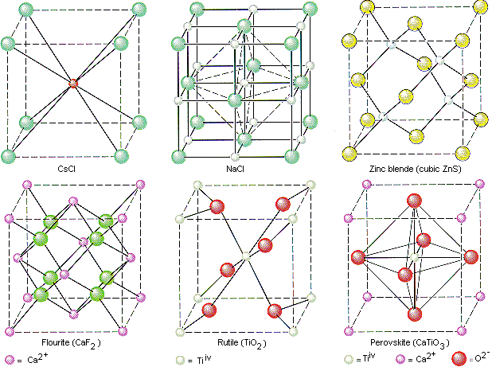
Crystal Structures

Slide 2
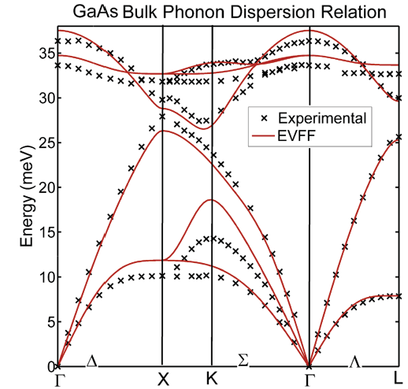
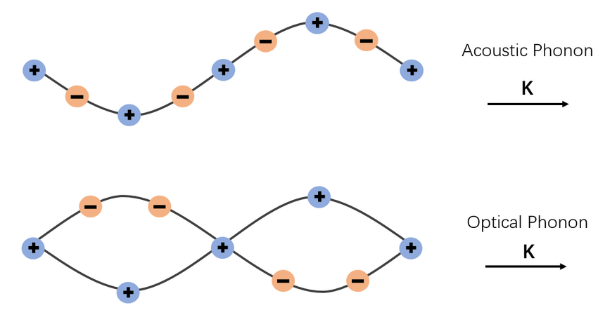
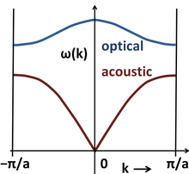
Crystal Structures
EVFF = Enhanced Valence Force Field

Slide 3
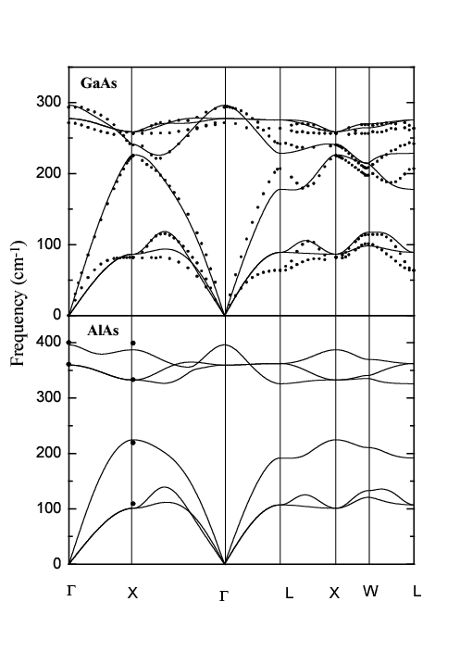
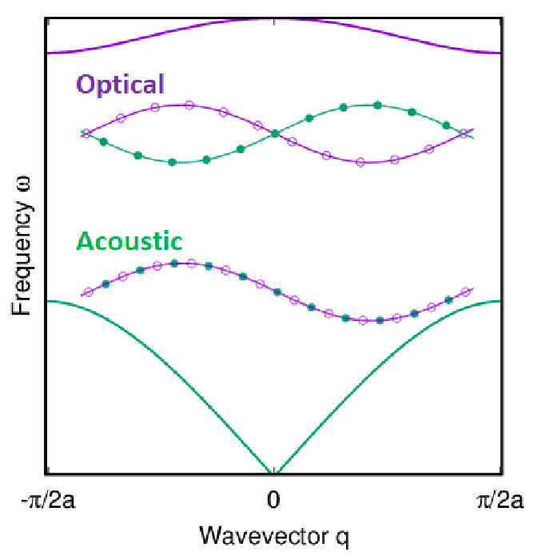
Crystal Structures
-π/a
π/a
● experimento
— cálculo teórico (ab-initio)

Slide 4
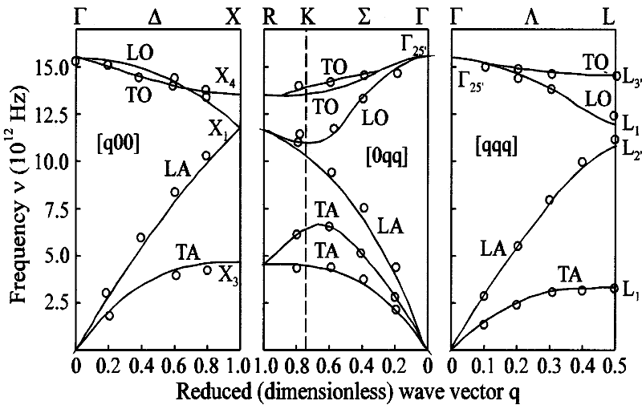
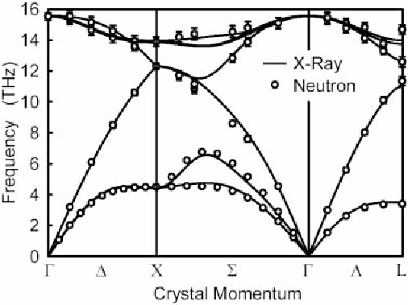
Crystal Structures
Phonon dispersion curves of Si.

Slide 5
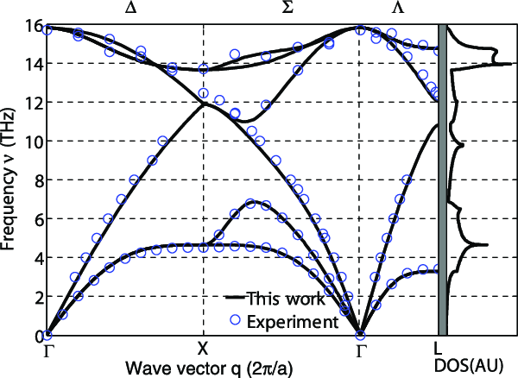
Crystal Structures
Phonon dispersion curves of Si.

Slide 6
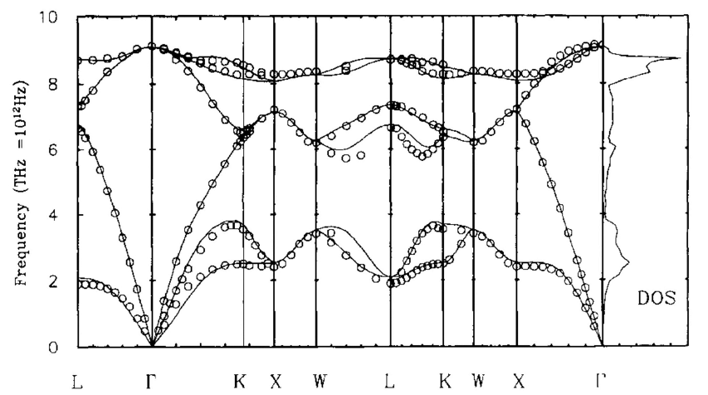
Crystal Structures
Phonon dispersion curves of Ge.

Slide 7
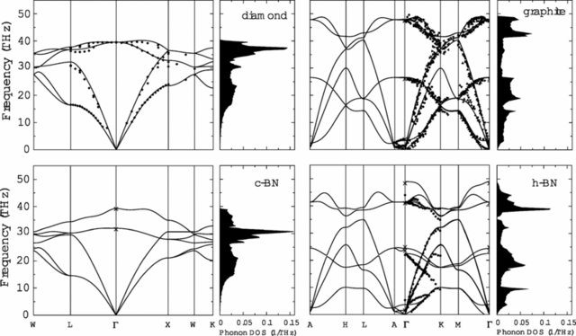
Crystal Structures
cubic-BN
hexagonal-BN

Slide 8
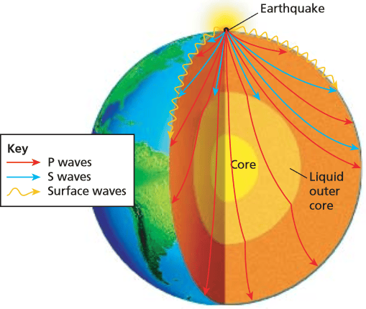
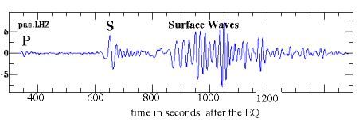
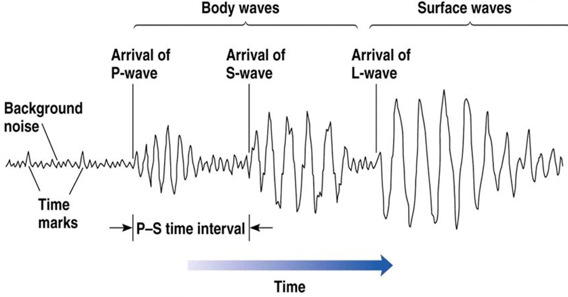
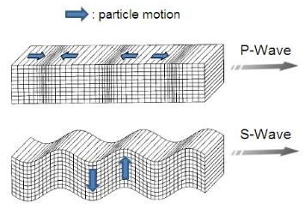
Velocity of Earthquake Waves

Slide 9
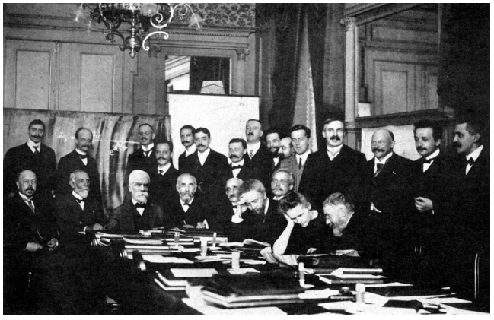
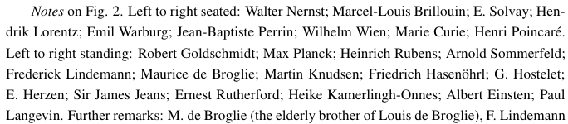
First Solvay Conference - 1911

Slide 10
First Solvay Conference - 1911
Einstein’s report:
“On the Present State of the
Problem of Specific Heats”

Slide 11
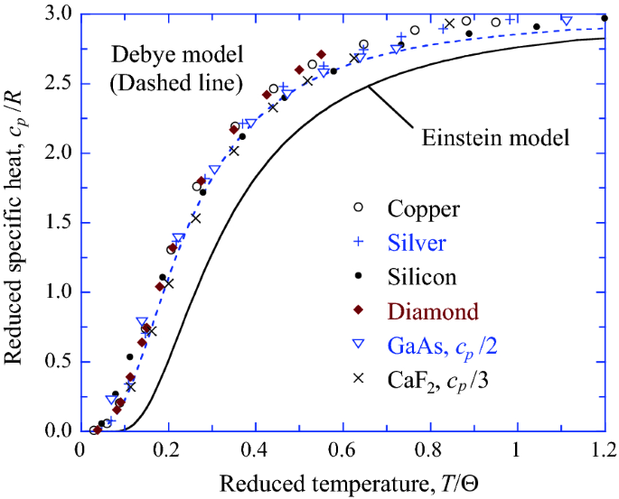
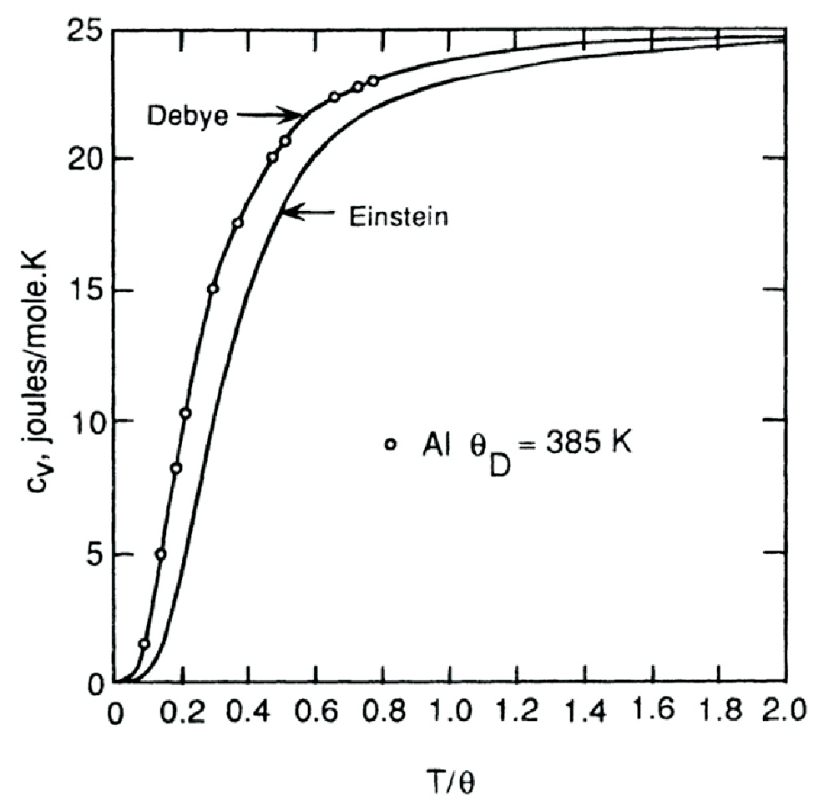
Specific Heat of Solids

Slide 12
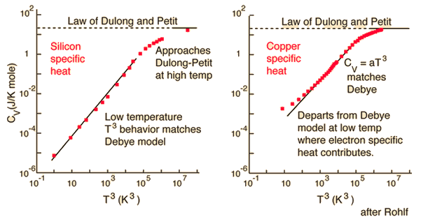
Specific Heat of Solids
Para um metal (Al, Ag,Au,etc.)
Para um dielétrico (Si, diamante)

Slide 13
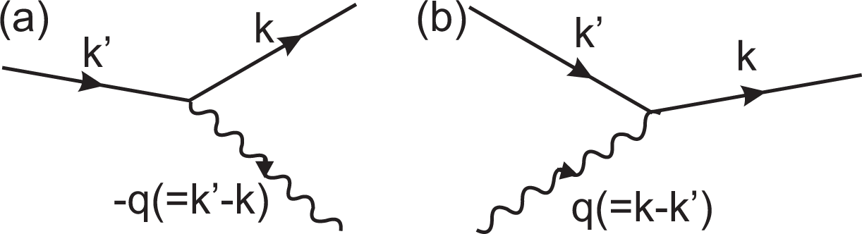
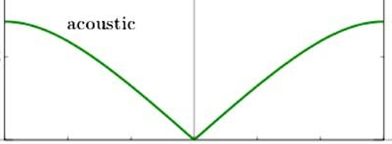
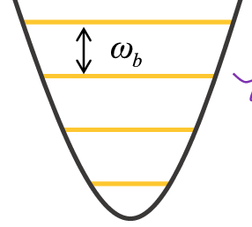
Effects of Electron-Phonon Interaction
Phonon emission
Phonon absorption

Slide 14
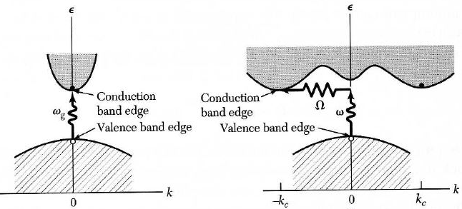
Effects of Electron-Phonon Interaction
Phonon emission
Phonon absorption
Direct band
semiconductor
Indirect band
semiconductor

Slide 15
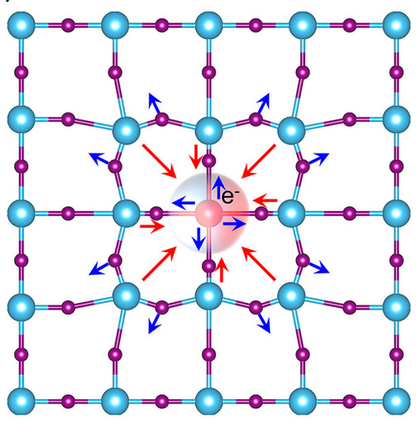
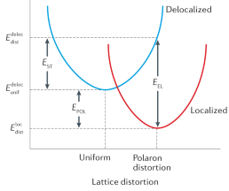
Effects of Electron-Phonon Interaction
Phonon emission
Phonon absorption
POLARON
Polarons in Materials
Nature Rev. Materials vol. 6,
p. 560–586 (2021)

Slide 16
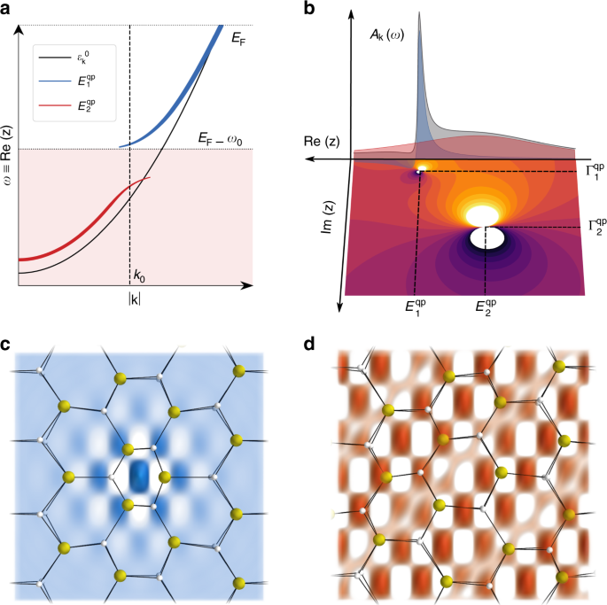

Effects of Electron-Phonon Interaction
Phonon emission
Phonon absorption

Slide 17
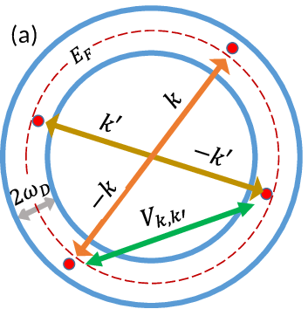
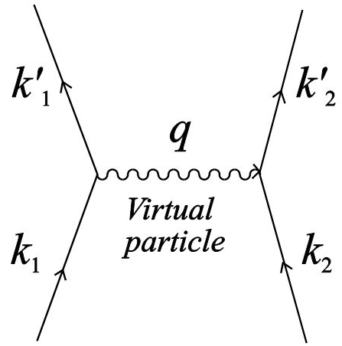
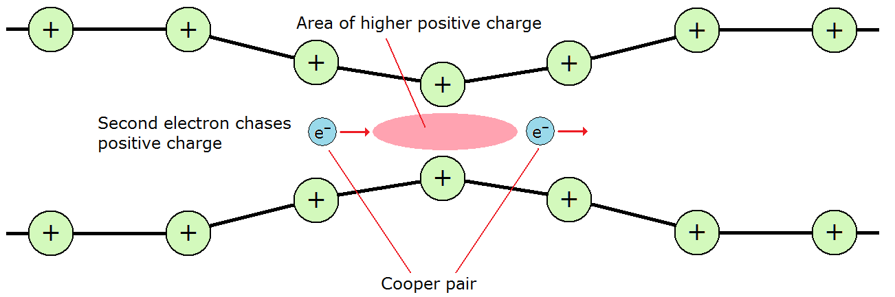
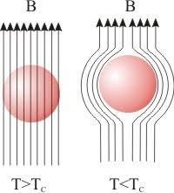
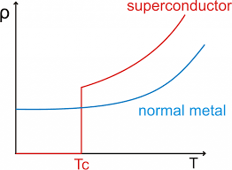
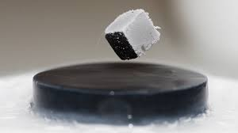
Effects of Electron-Phonon Interaction
Meissner Effect

Slide 18
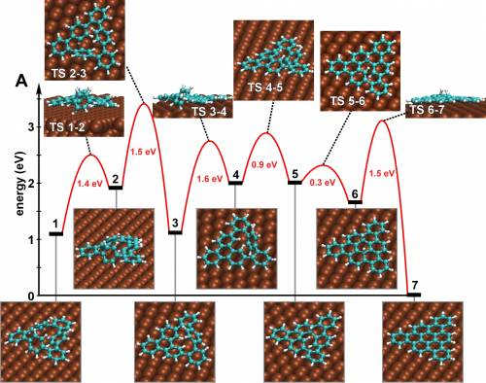
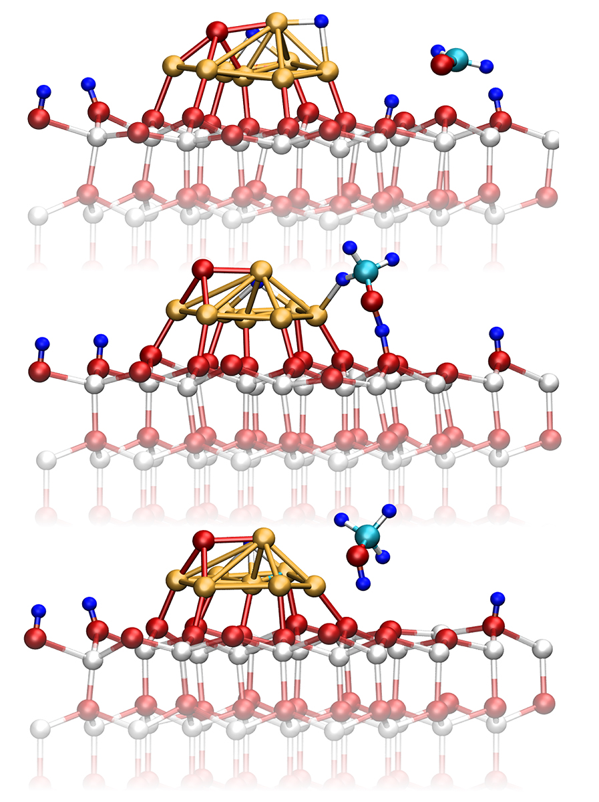
Nuclear Dynamics
Nanostructures and adsorption
on metallic surfaces
Heterogeneous Catalysis

Slide 19
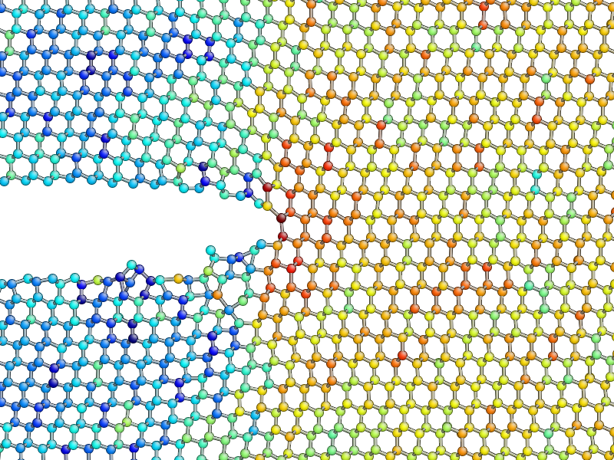
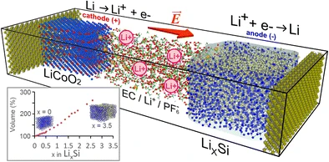
Nuclear Dynamics
Simulation of fracture in Si
Simulation of Li ion nanobattery

Slide 20
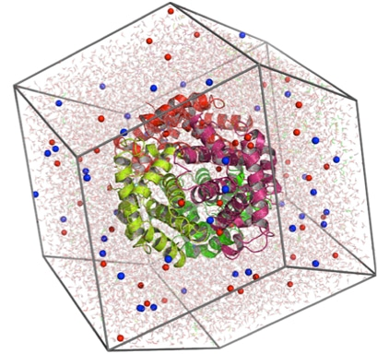
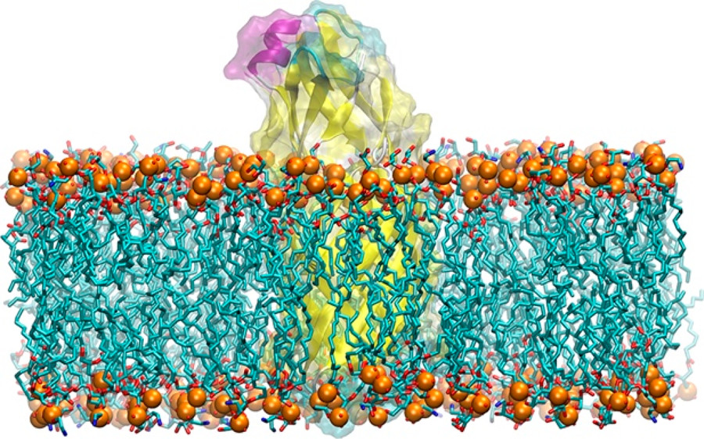
Nuclear Dynamics
Biophyics: Membranes and Proteins

Slide 21
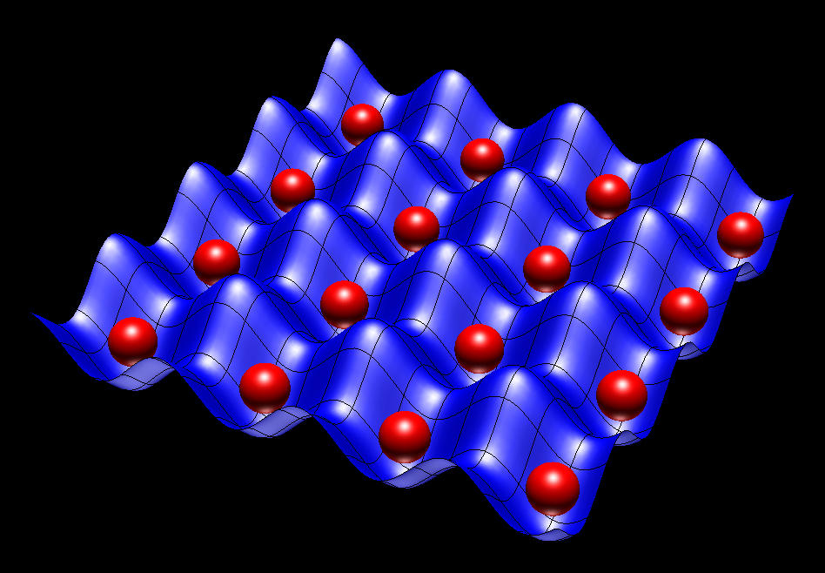
Nuclear Dynamics
Molecular Dynamics solution:
Because of the heavy mass of the nuclei one can assume that they
behave like classical particles, above cryogenic temperatures.
The Schrödinger equation is substituted by the classical dynamical equations
The harmonic approximation can be dropped.
The classical equations of motion can be written as

Slide 22
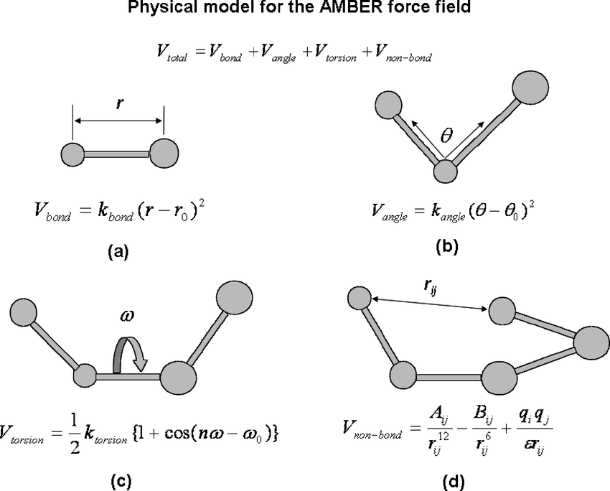
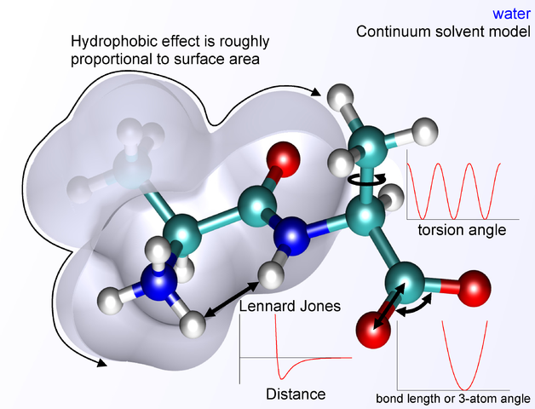
Nuclear Dynamics
Molecular Mechanics with Force-Fields

Slide 23
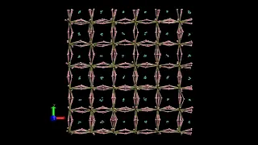
Nuclear Dynamics
CsPbI₃ perovskite

Slide 24
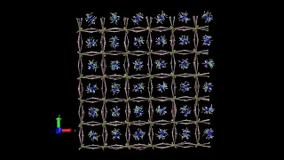
Nuclear Dynamics
CH₃NH₃-PbI₃ hybrid perovskite

Slide 25




Nuclear Dynamics and Density of Vibrational States
velocity power spectrum (VelPS.dat) for stationary state:
Vibrational Density of States (VDOS.dat):

