Slide 1
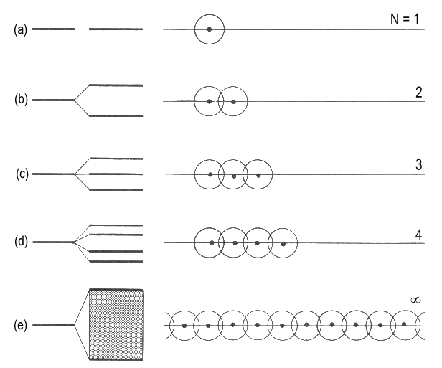
Basic Notions of Electronic Band Structure

Slide 2
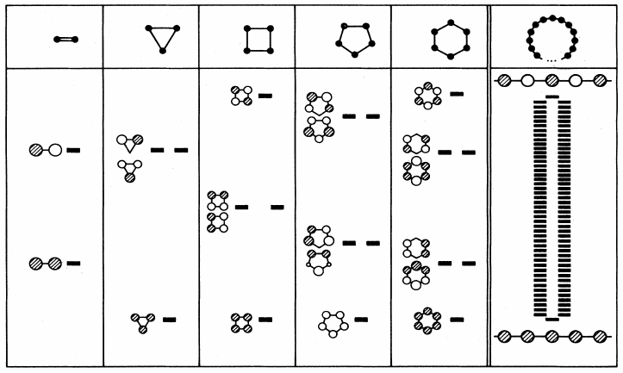
Basic Notions of Electronic Band Structure

Slide 3
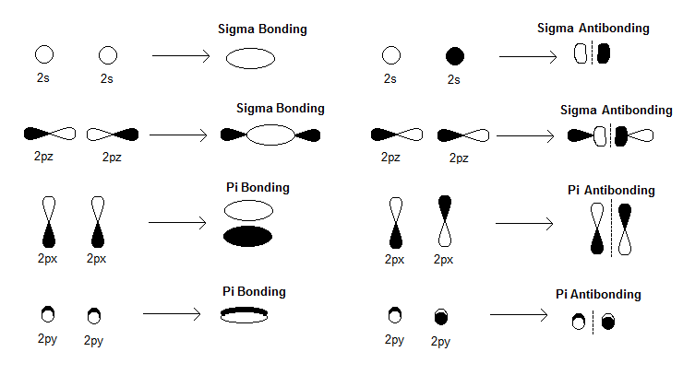
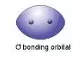
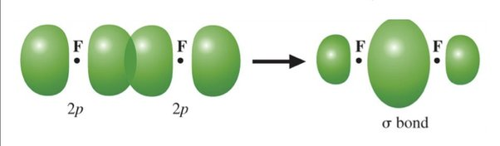
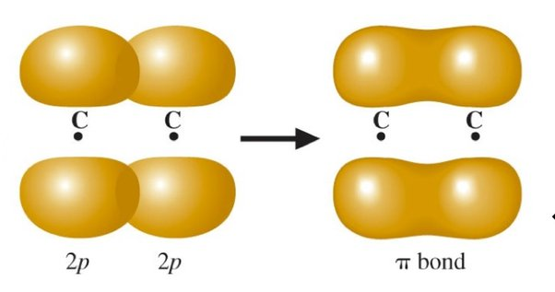
Basic Notions of Electronic Band Structure

Slide 4
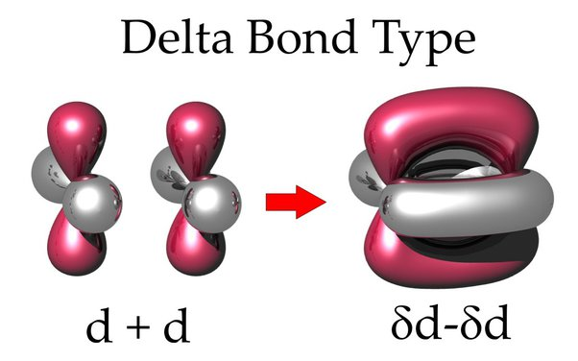
Basic Notions of Electronic Band Structure

Slide 5
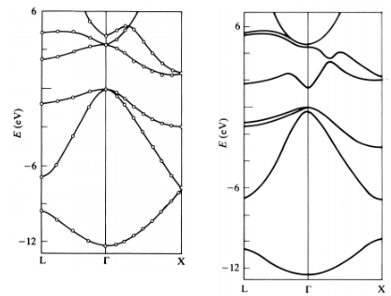
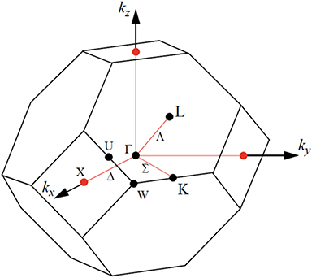
Basic Notions of Electronic Band Structure
Silicon (Si)
Galium-Arsenide (GaAs)

Slide 6
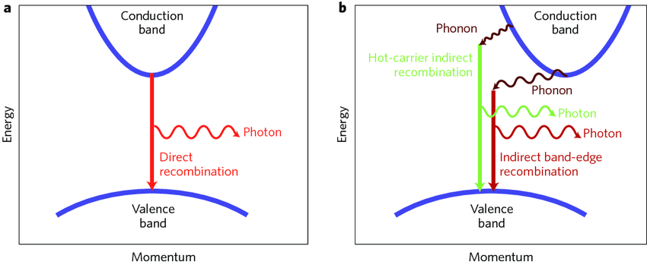
Basic Notions of Electronic Band Structure
Silicon (Si)
Galium-Arsenide (GaAs)

Slide 7
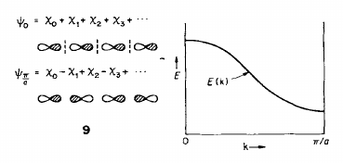
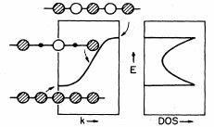
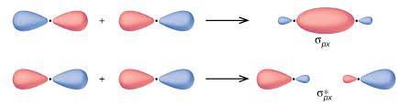
Basic Notions of Electronic Band Structure
type-P orbital band
type-S orbital band
k=0
k=π/a
k=0
k=π/a
Rev. Mod. Phys. Vol. 60, p. 601 (1988)
Angew. Chem. Int. Ed. Vol. 26, p. 846 (1987)

Slide 8
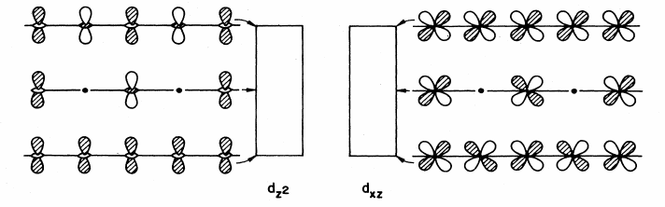
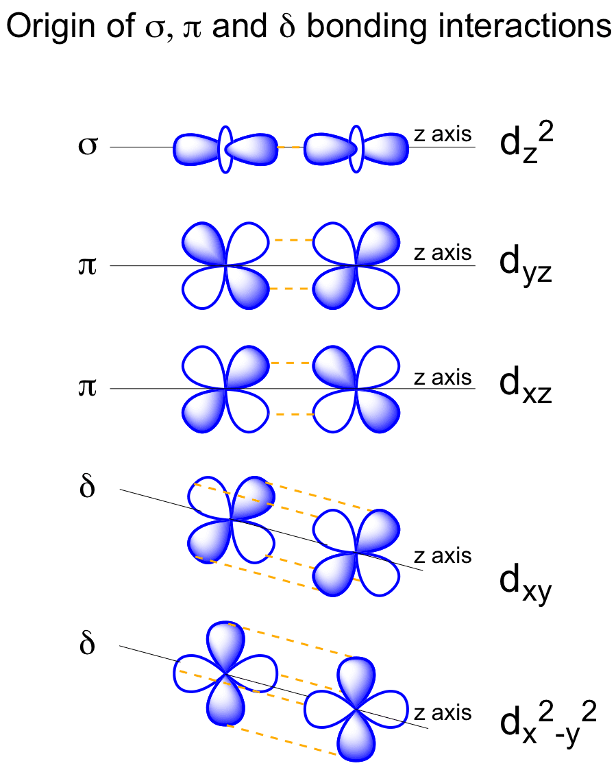
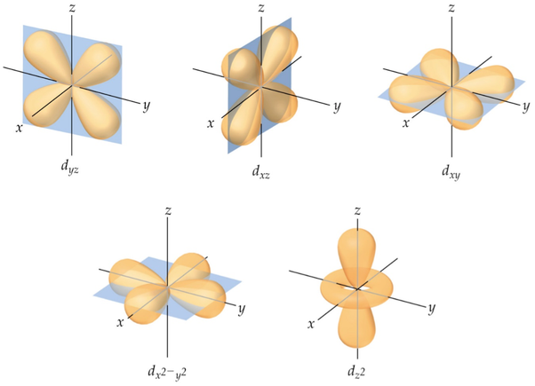
Basic Notions of Electronic Band Structure
type-D orbital band

Slide 9
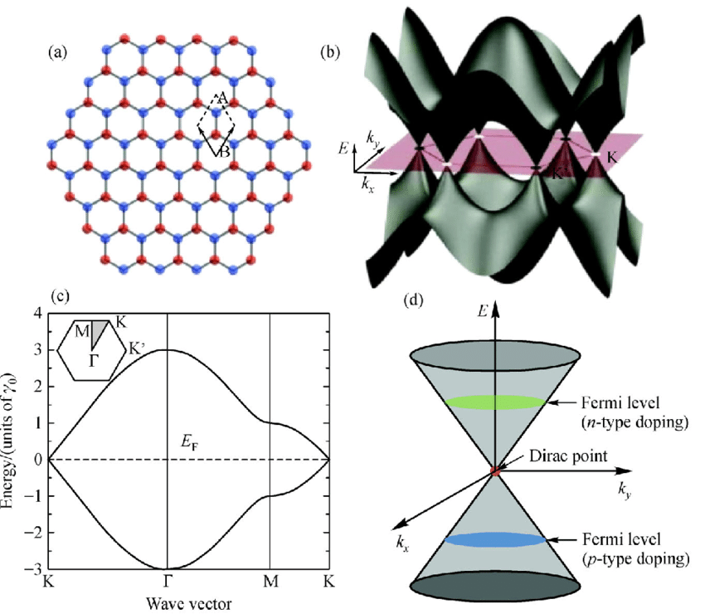
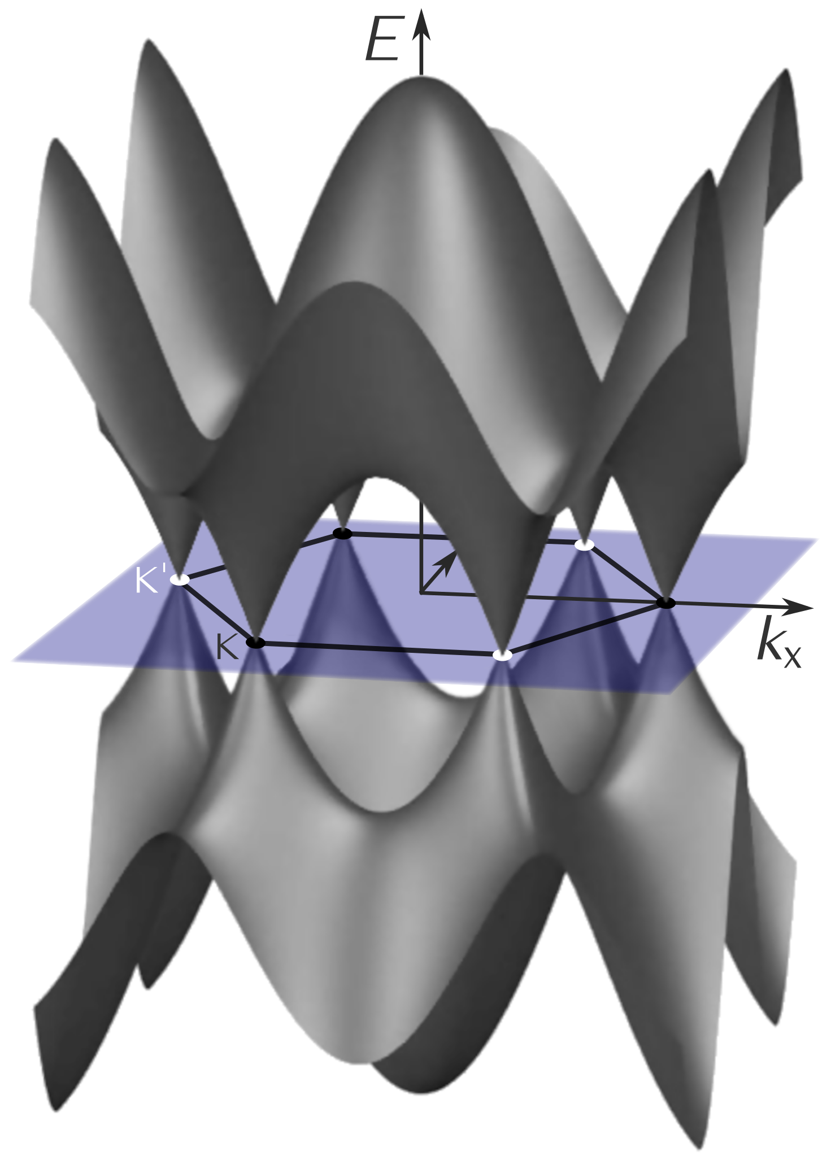
Graphene

