Slide 1
AI Agentic Workflow Automation for S3DF
Integrating Maestro, Claude Code, and ACE3P Simulation Pipelines
Lixin Ge | SLAC National Accelerator Laboratory
July 2026

Slide 2
The Problem: Manual HPC Workflow Management
Researchers manage multi-step simulations with ad-hoc scripts
Pain points on S3DF:
• Manually writing Slurm batch scripts for each solver
• Hand-maintaining directory structures for parameter sweeps
• No automatic dependency tracking between solver steps
• Failures require manual identification and resubmission
• New users face steep learning curve for HPC workflows
Question: Can AI help go from scientific intent to running workflow?

Slide 3
Solution: Agentic AI + Workflow Automation
Natural language → Validated workflow → Autonomous execution → Results + Plots
Components:
• Claude Code — AI agent for reasoning and generation
• Maestro — DAG-based workflow orchestration (LLNL)
• S3DF Slurm — HPC execution (milano, rfar:regular, qos=normal)
• ACE3P — Production EM simulation suite (demo application)
• Auto post-processing — Matplotlib plots for immediate feedback
Key insight: AI coordinates existing tools, doesn't replace them

Slide 4
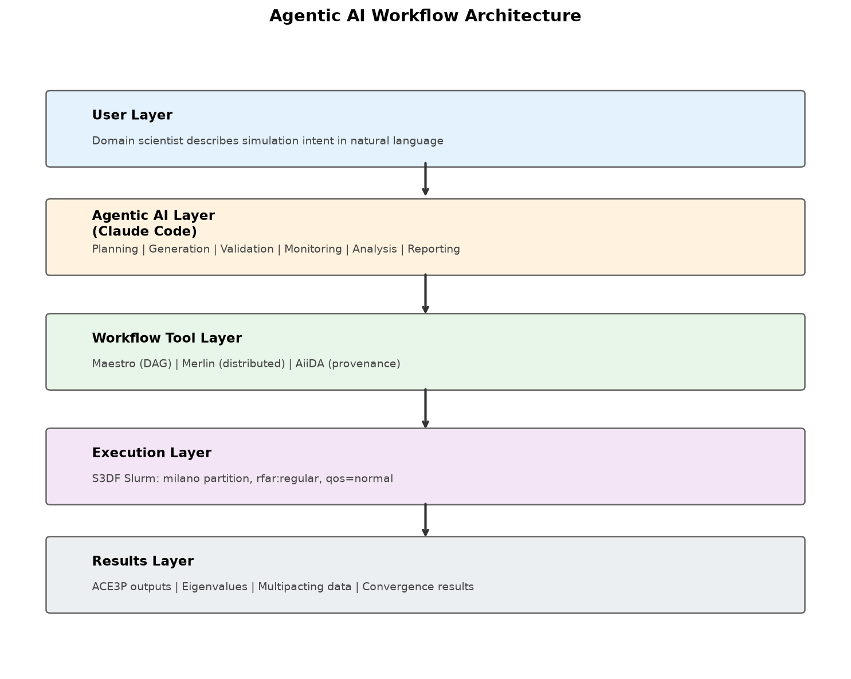
System Architecture
5-layer architecture: User → AI Agent → Workflow Engine → Slurm → Results

Slide 5
What Makes This "Agentic"?
Property | How We Demonstrate It
Natural language interface | User describes intent, not implementation
Domain reasoning | AI knows ACE3P solvers, S3DF config, Slurm patterns
Autonomous execution plan | Generates full DAG with dependencies and resources
Actionable output | YAML runs directly with 'maestro run' — no editing
Multi-step orchestration | Chains solvers (Omega3P → Track3P), manages data flow
Fault tolerance | Merlin workflows include retry logic and distribution

Slide 6
AI Workflow Generator — One Command
Input (natural language):
$ python generator.py "Sweep gradient from 10 to 50 MV/m
in Track3P to find multipacting onset"
Output (executable Maestro YAML):
• 5-step pipeline: mesh → omega3p → rfpost → track3p → analyze
• Correct S3DF Slurm config (partition, account, walltime)
• 9 parameterized gradient levels (10–50 MV/m)
• Fan-in aggregation with multipacting onset detection
• Passes YAML validation automatically
→ Live demo at end of presentation

Slide 7
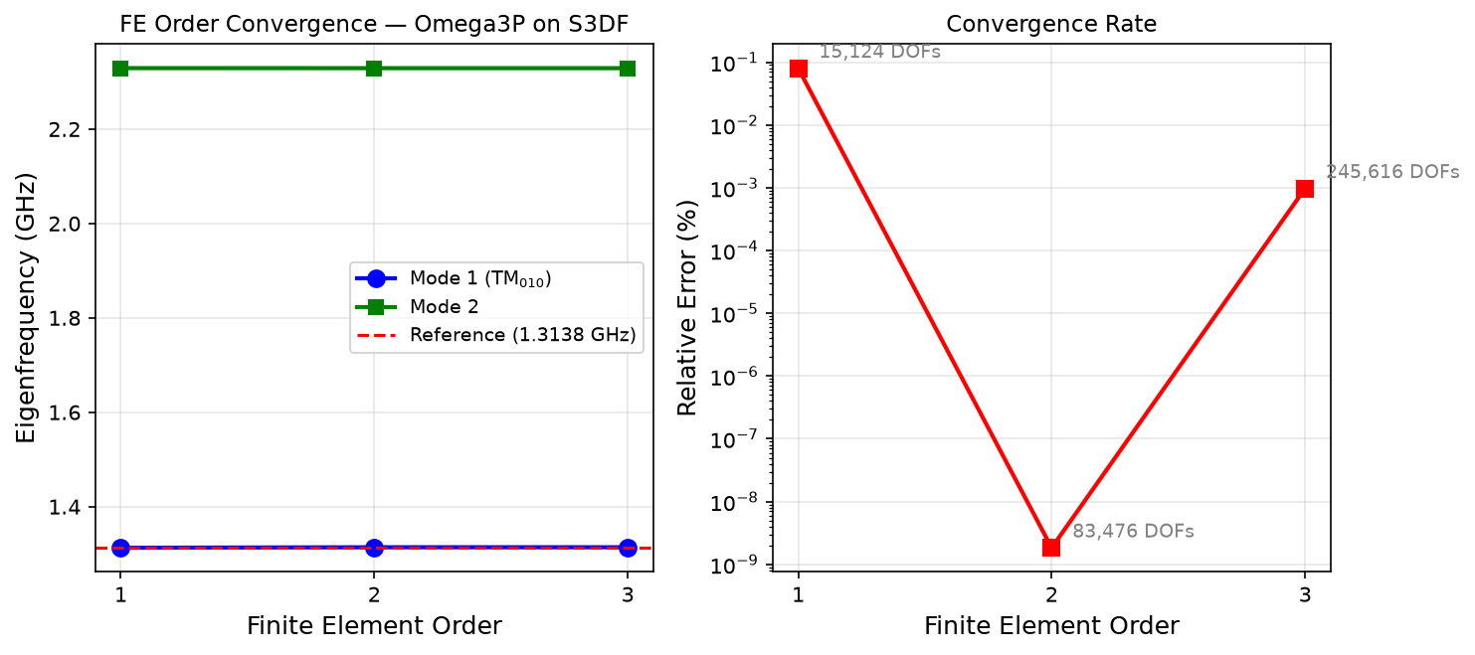
Case Study 1: FE Order Convergence Sweep
3 parallel Slurm jobs on separate nodes. Mode 1 matches reference to 8 digits. Auto-generated plot.

Slide 8
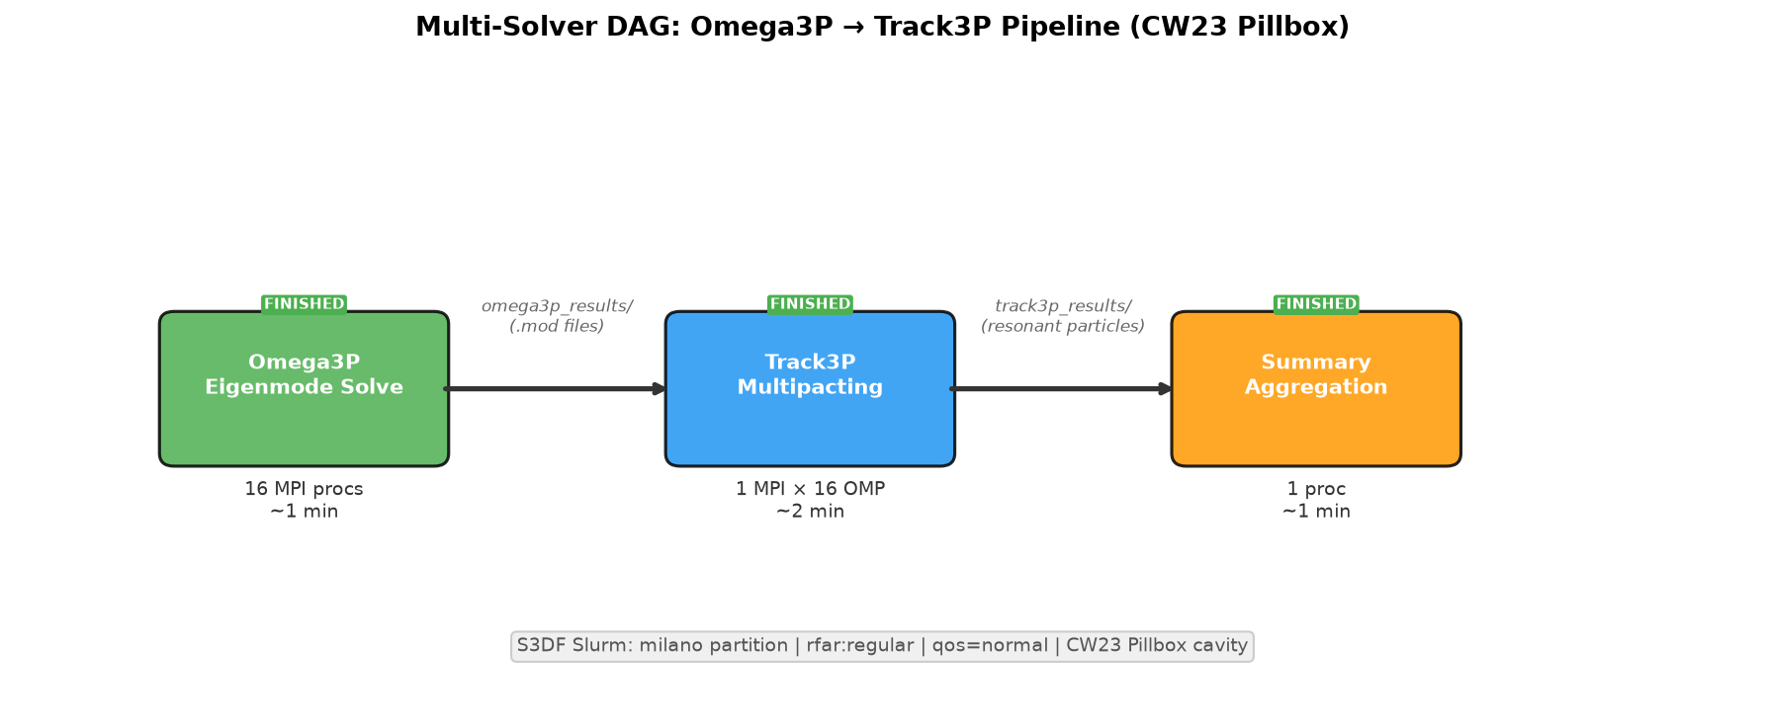
Case Study 2: Multi-Solver DAG (Omega3P → Track3P)
CW23 Pillbox: Omega3P (16 MPI) → Track3P (1 MPI × 16 OMP). Full pipeline ~5 min on S3DF.

Slide 9
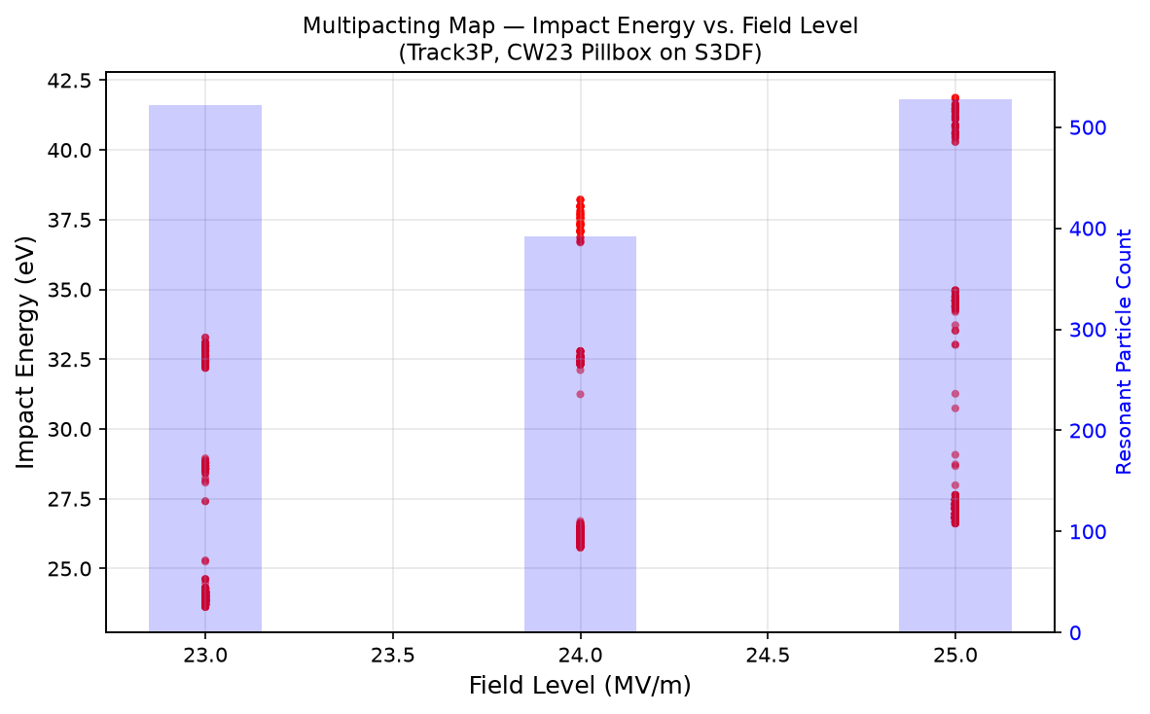
Multipacting Results — Auto-Generated from Workflow
Impact energy vs. field level. Resonant particles at 23, 24, 25 MV/m. Plot generated automatically by workflow.

Slide 10
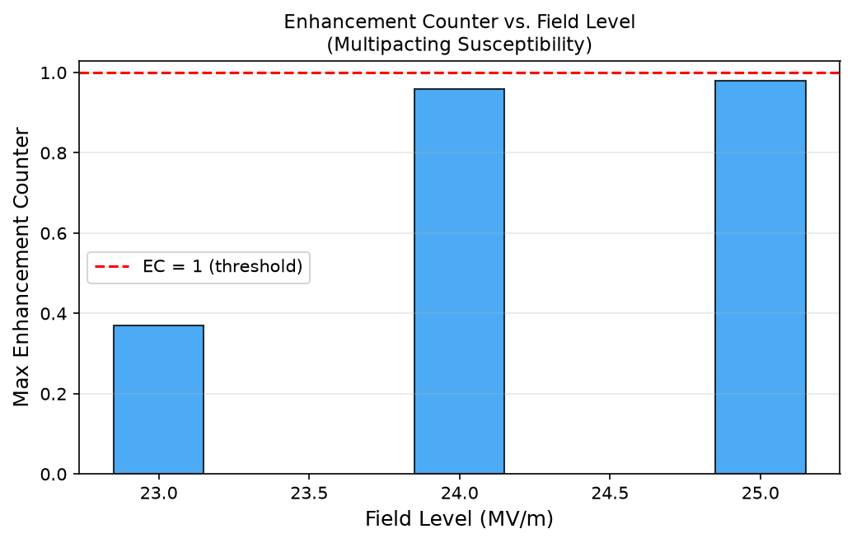
Enhancement Counter — Multipacting Susceptibility
EC approaches 1.0 at 24–25 MV/m — onset of sustained multipacting. Auto-generated.

Slide 11
Web Visualization (Available on S3DF)
ParaView 5.11.1 Web Visualizer:
• Full 3D visualization in browser — no client install
• /sdf/group/rfar/software/ParaView-5.11.1-.../
• Includes: Visualizer, Glance, Lite web apps
Cubit 16.12 (Mesh Generation):
• /sdf/group/rfar/software/Cubit-16.12/
• GUI via NoMachine or batch mode (.jou scripts)
ACE3P Dashboard (Next.js — github.com/lge0303/ace3p-dashboard):
• /workflow/status — real-time Slurm monitoring
• /workflow/generate — AI generator web UI
• /workflow/results — auto-generated plots

Slide 12
Results Summary — All Validated on S3DF Slurm
Test | Result | Time
Omega3P single solve | Eigenvalues match reference (8 digits) | ~1 min
FE convergence (orders 1,2,3) | 0.08% → <0.001% error | 3 parallel, ~2 min each
Multi-solver DAG | Multipacting at 23–25 MV/m | ~5 min total
AI → Maestro YAML | Valid 4-step workflow | ~5 sec
AI → Merlin YAML | 4 worker pools + retry | ~10 sec
AI → Track3P sweep | 5-step + onset detection | ~8 sec

Slide 13
Broader Impact — Beyond ACE3P
Framework is application-agnostic. Potential S3DF applications:
• Any multi-step simulation (LCLS, cryo-EM, materials science)
• AI/ML training workflows (hyperparameter sweeps)
• Data analysis pipelines (reduction, calibration, visualization)
• Performance benchmarking (scaling studies)
Benefits for S3DF community:
• Lower barrier to HPC workflow adoption
• Reduced errors from manual scripting
• Workflow YAML = executable documentation (reproducibility)
• AI assists with monitoring, troubleshooting, documentation

Slide 14
Next Steps
Near-term (August 2026):
• Deploy dashboard with live monitoring + results viewer
• Integrate ParaView Web for 3D field visualization
• Debug Merlin distributed workers for large campaigns
Medium-term (September–October 2026):
• AiiDA provenance tracking for reproducibility
• Additional workflow templates (S3P, TEM3P, gun3p)
• WORKS26 paper submission
Long-term:
• Production deployment for S3DF users
• Agentic monitoring + failure diagnosis + auto-repair

Slide 15
Live Demo
Natural Language → AI Generates Workflow → Runs on S3DF

