Slide 1
Functional enrichment analysis of high-throughput omics data
Ludwig Geistlinger Jul 28, 2020
School of Public Health
City University of New York

Slide 2
Workshop format
This year: 30 min overview / orientation / demo
+ 20 min Q&A
It’s never been so easy to try it out (now + after conference)
Website: https://waldronlab.io/enrichOmics
Workshop live: http://workshop.bioc.cancerdatasci.org
Github: https://github.com/waldronlab/enrichOmics
Bioconductor: https://bioconductor.org/EnrichmentBrowser
Email: ludwig.geistlinger@sph.cuny.edu
Slack: community-bioc.slack.com

Slide 3
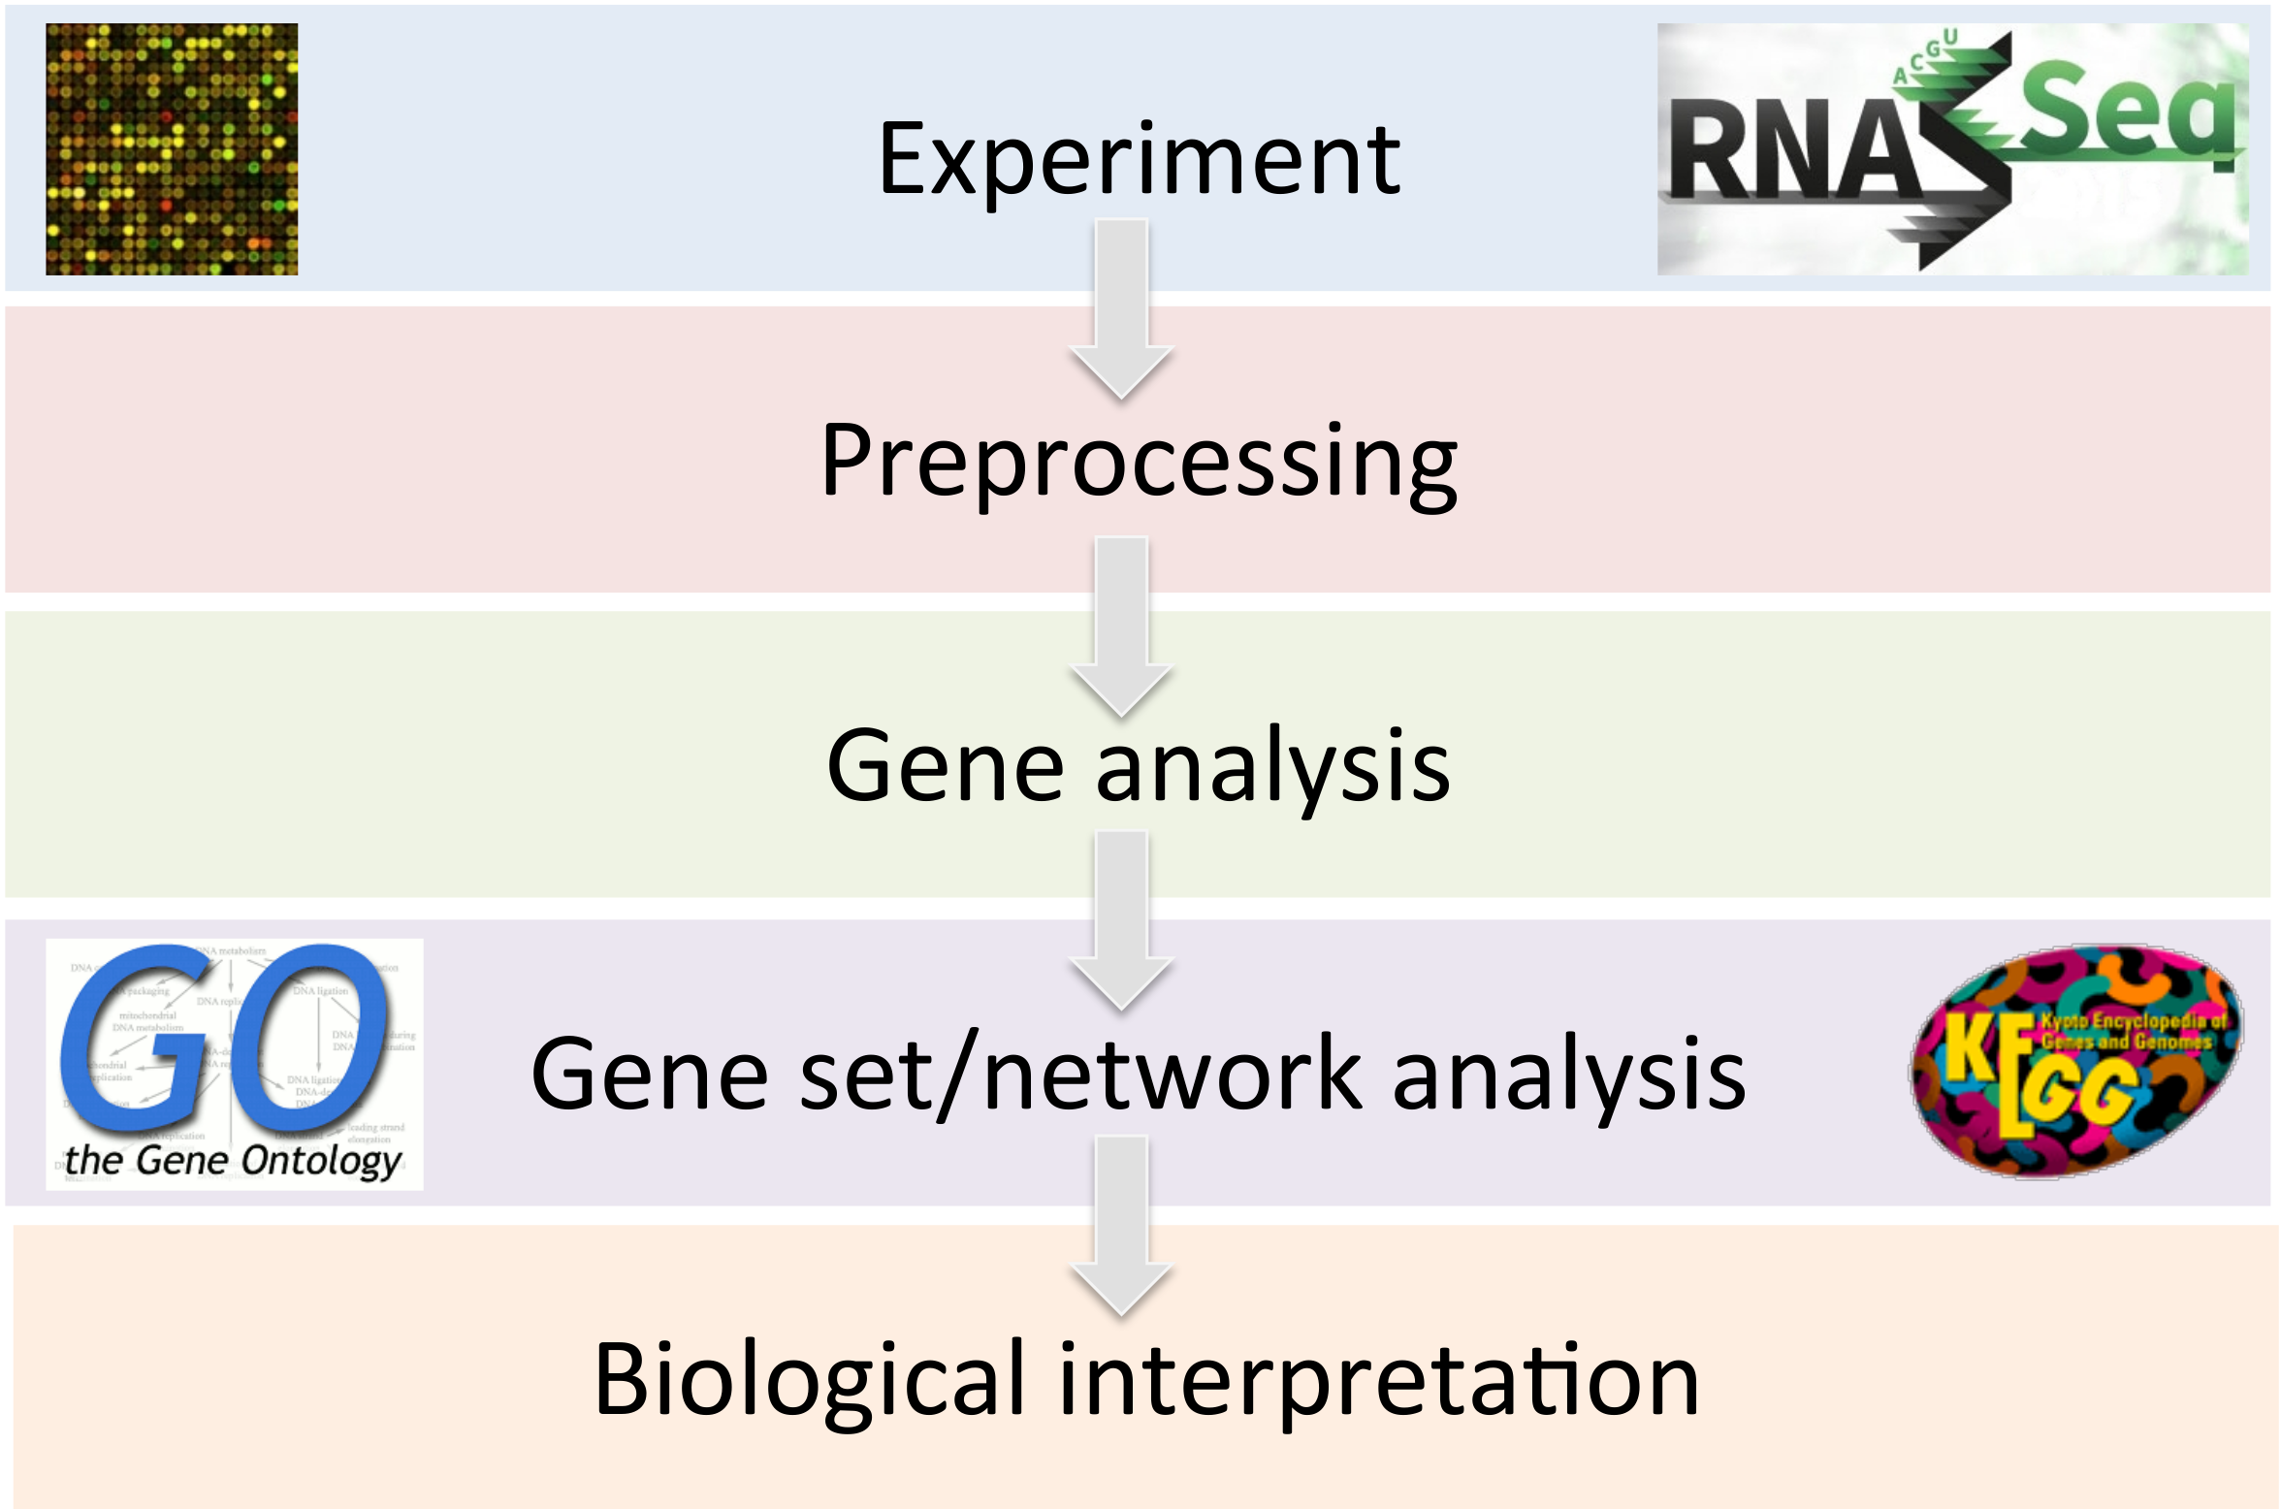
Gene expression data analysis

Slide 4
GSA theory: null hypothesis
Goeman and Bühlmann. Analyzing gene expression data in terms of gene sets: methodological issues. Bioinformatics, 23(8):980-7, 2007.
Competitive:
The genes in the set of interest are at most as often DE as the genes not in the set
Self-contained:
No genes in the set of interest are DE
4

Slide 5
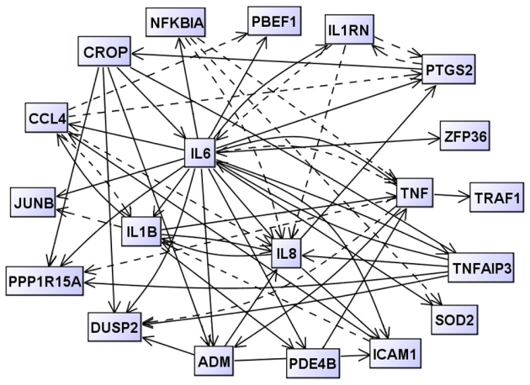
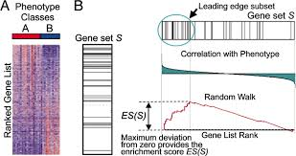
Khatri et al. Ten years of pathway analysis: current approaches and outstanding challenges. PLoS Comput Biol 8(2):1002375, 2012.
1st Generation
(overrepresentation of de genes)
3rd Generation
(integration of network topology)
 | DE | Not DE
In GS | m_{GD} | m_{GD}c
Not in GS | m_{G}c_{D} | m_{G}c_{D}c
2nd Generation
(functional class scoring on all genes)
5

Slide 6
… and more!
microarray vs. RNA-seq
directional vs. mixed hypothesis
sample groups vs. single samples
2-group comparison vs. extended experimental designs
pre-ranked vs. full expression matrix
enrichment method vs. enrichment tool
uniset vs. multi-set statistics
influence of gene set DB: GO, KEGG, MSigDB, …
…

Slide 7
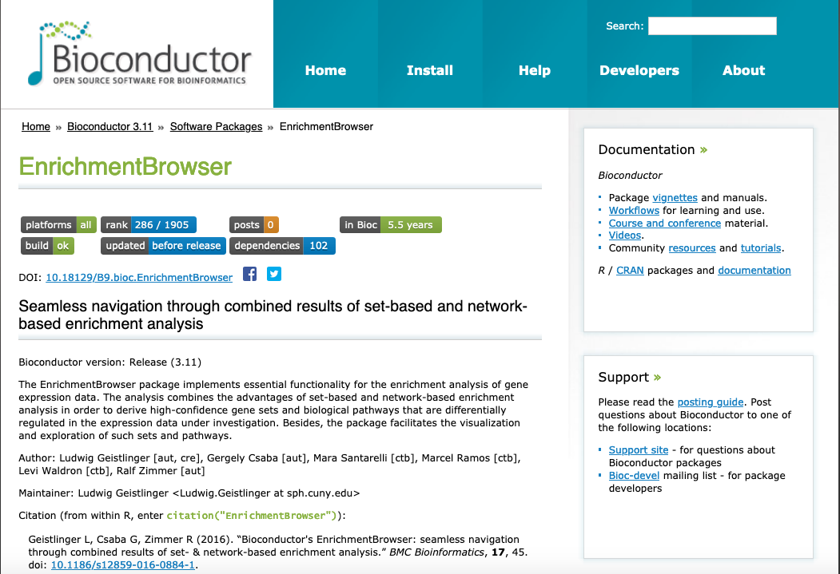

Slide 8
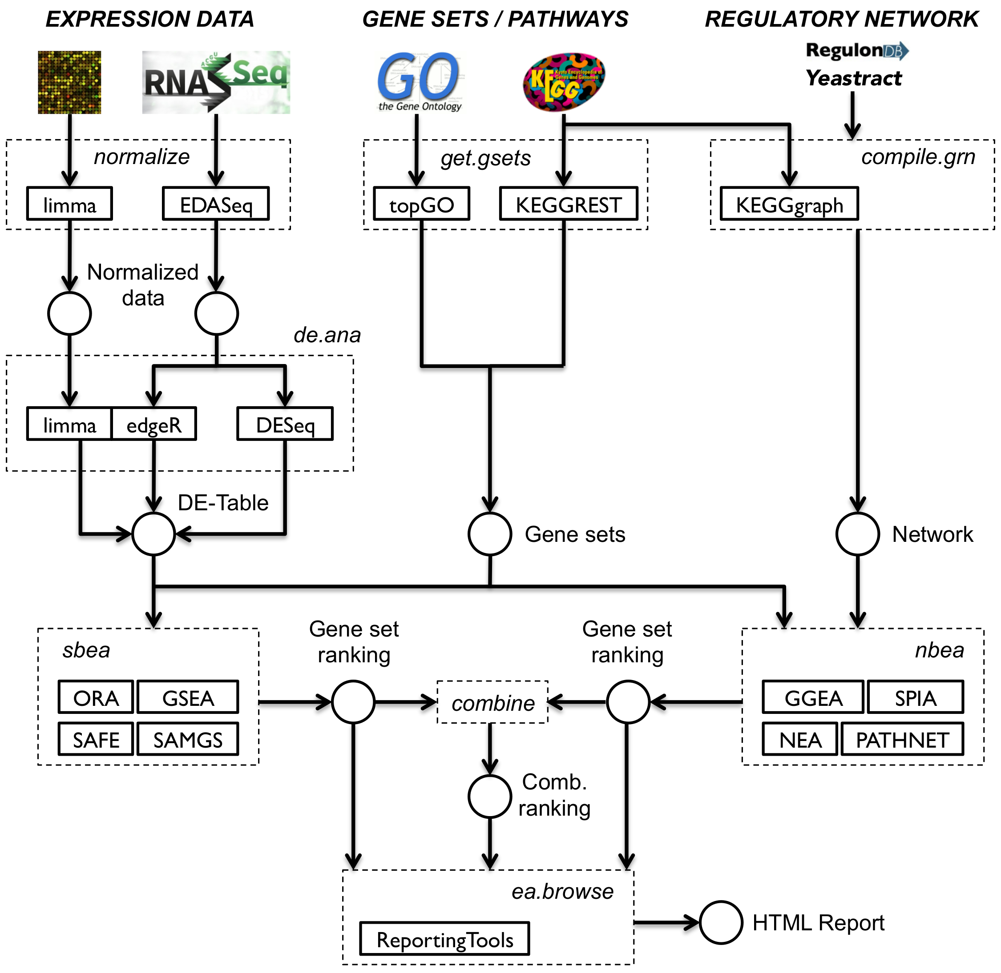

Slide 9
Currently available methods
> EnrichmentBrowser::sbeaMethods()
[1] "ora" "safe" "gsea" "samgs" "ebm"
[6] "mgsa" "gsa" "padog" "globaltest" "roast"
[11] "camera" "gsva"
> EnrichmentBrowser::nbeaMethods()
[1] "ggea" "spia" "pathnet" "degraph" "topogsa"
[6] "ganpa" "cepa" "netgsa" "nea"
9

Slide 10
Enrichment analysis in practice
GO/KEGG overrepresentation (= Fisher‘s exact test)
Dozens of methods published, partly available (in BioC)
Development of additional methods ongoing
Lack of standards for method evaluation
No „best“ method
Existing methods have never been compared consistently
10

Slide 11
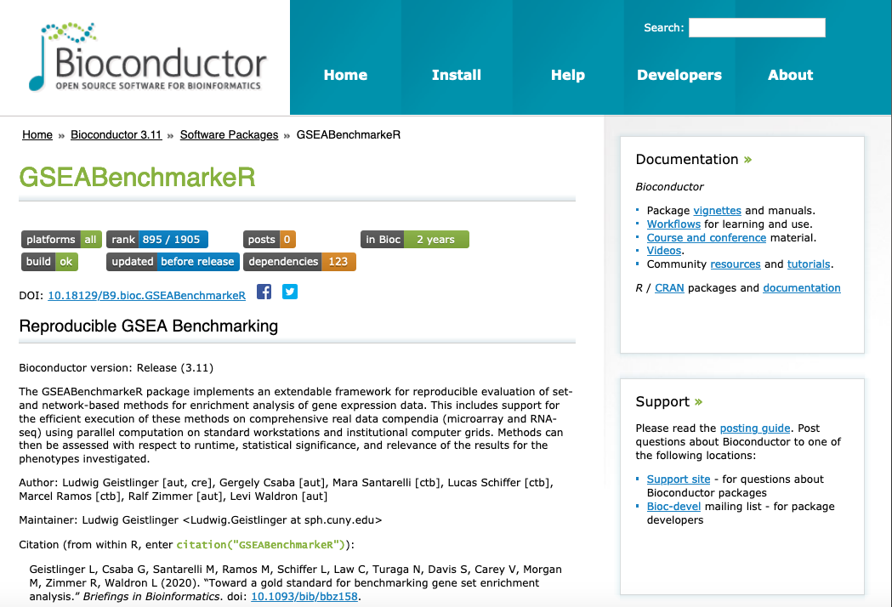

Slide 12
Geistlinger et al. Toward a gold standard for benchmarking gene set enrichment analysis. Brief Bioinform, 2020. doi: 10.1093/bib/bbz158
Efficient parallel execution
Representative and extendable collection of 20 methods
Comprehensive real data compendium
Microarray & RNA-seq
Investigating human diseases (mostly cancer)
Systematic and reproducible assessment of
Runtime
Statistical significance
Phenotype relevance (using a priori defined relevance rankings)
12

Slide 13
Workshop vignette

Slide 14
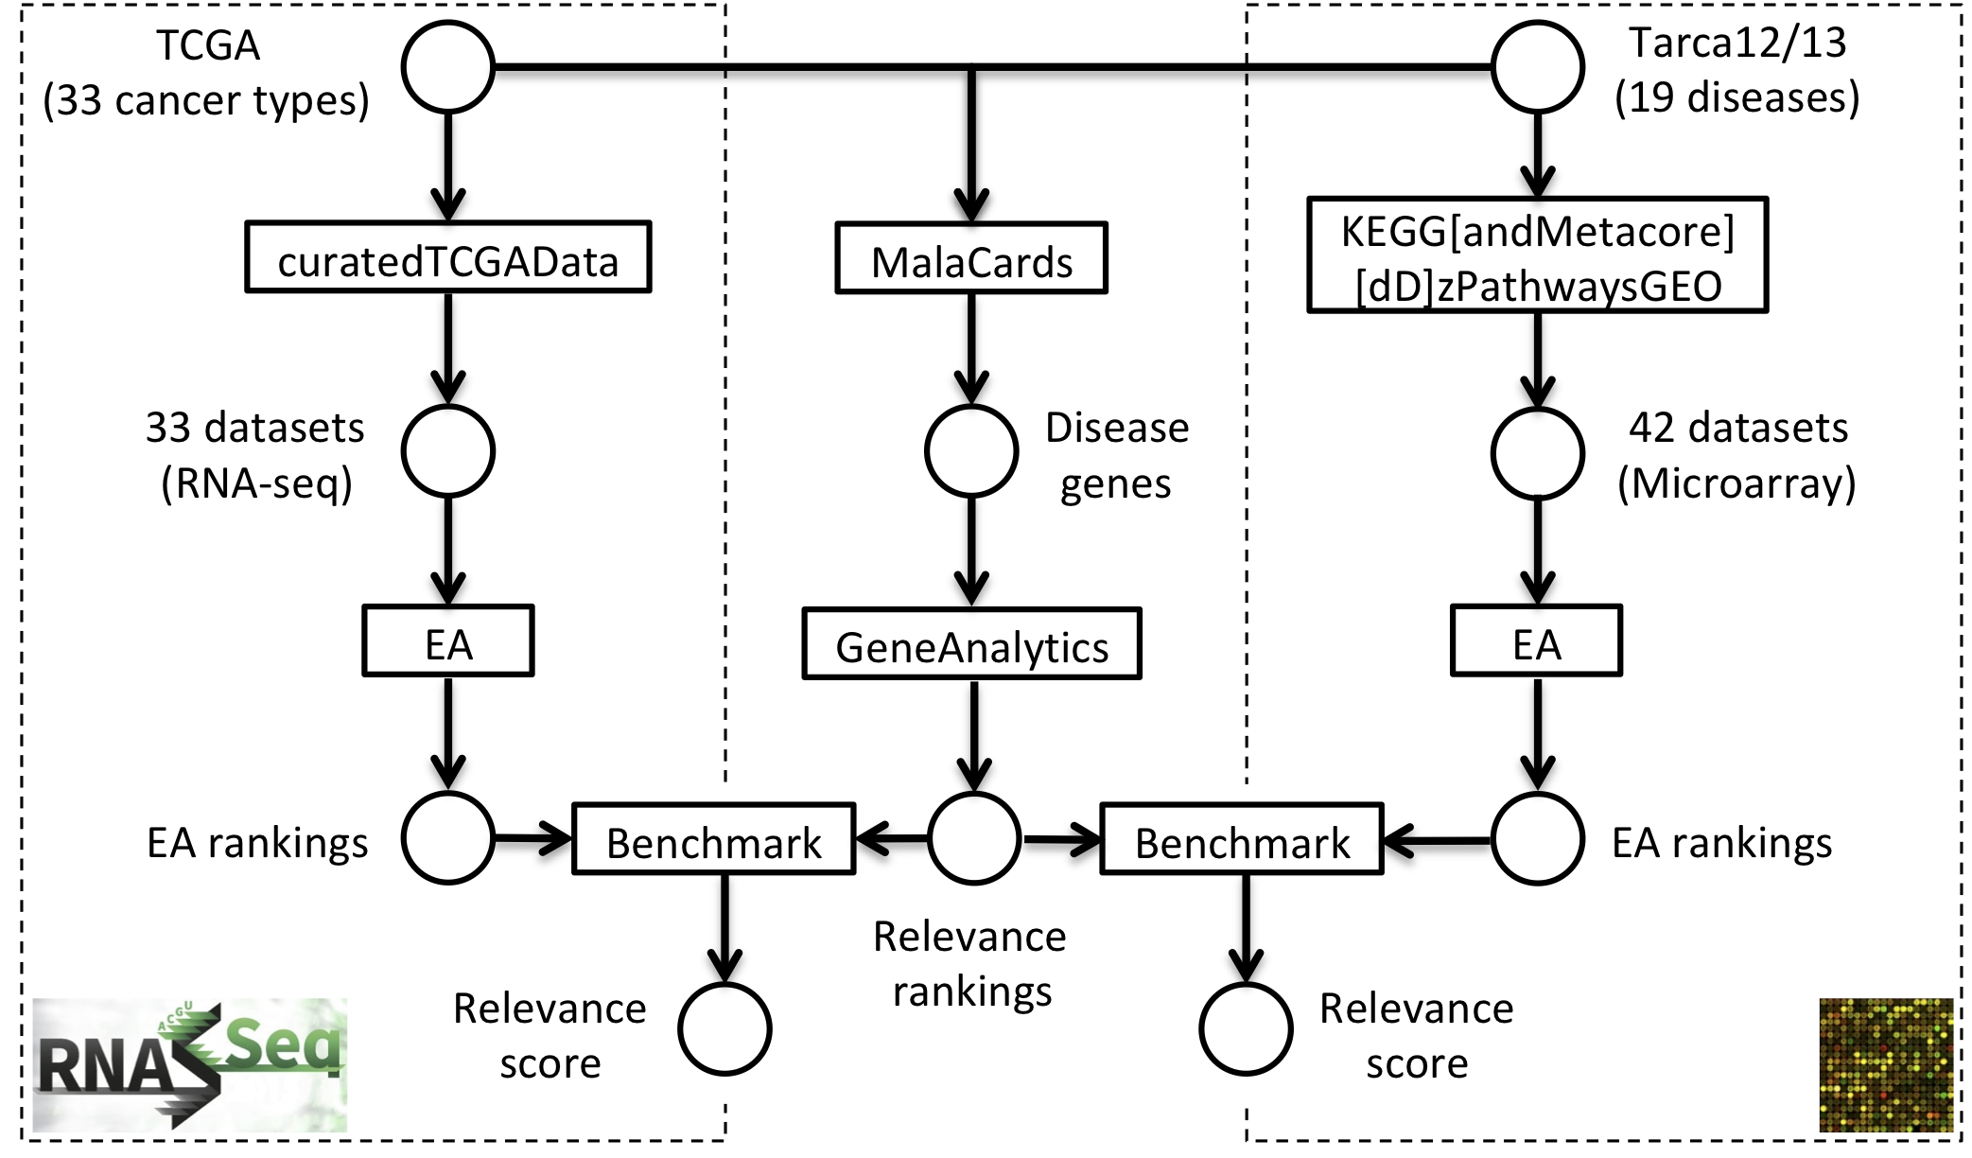
GSEA Benchmark panel

Slide 15
> EnrichmentBrowser::sbeaMethods()
 | METHOD | NAME | AUTHOR | YEAR | CITATIONS Google, 07/2018
1 | ORA | OverRepresentation Analysis
2 | GLOBALTEST | GLOBAL TESTing of groups of genes | Goeman et al. | 2004 | 937
3 | GSEA | Gene Set Enrichment Analysis | Subramanian et al. | 2005 | 14 403
4 | SAFE | Significance Analysis of Function & Expression | Barry et al. | 2005 | 333
5 | GSA | Gene Set Analysis | Efron & Tibshirani | 2007 | 768
6 | SAMGS | Sig. Ana. of Microarrays on Gene Sets | Dinu et al. | 2007 | 258
7 | ROAST | ROtAtion gene Set Test | Wu et al. | 2010 | 209
8 | CAMERA | Correlation Adjusted MEan Rank gs test | Wu et al. | 2012 | 185
9 | PADOG | Path. Ana. with Down-weighting of Ovlp. Genes | Tarca et al. | 2012 | 60
10 | GSVA | Gene Set Variation Analysis | Hänzelmann et al. | 2013 | 293

Slide 16
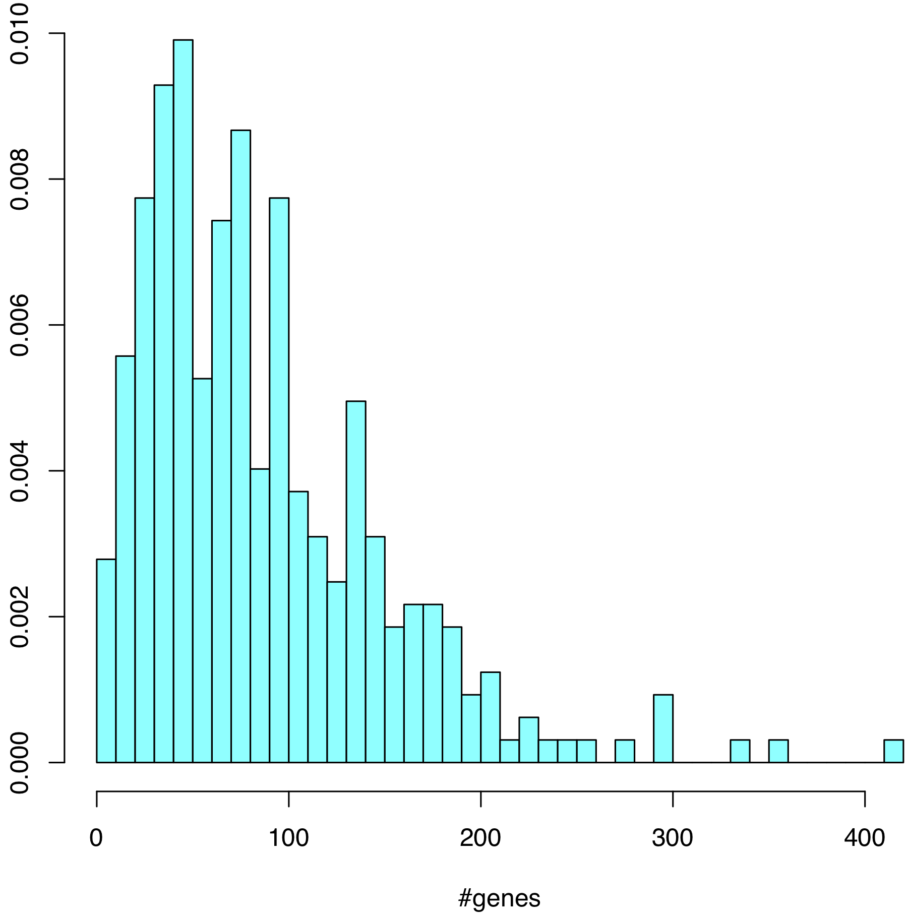
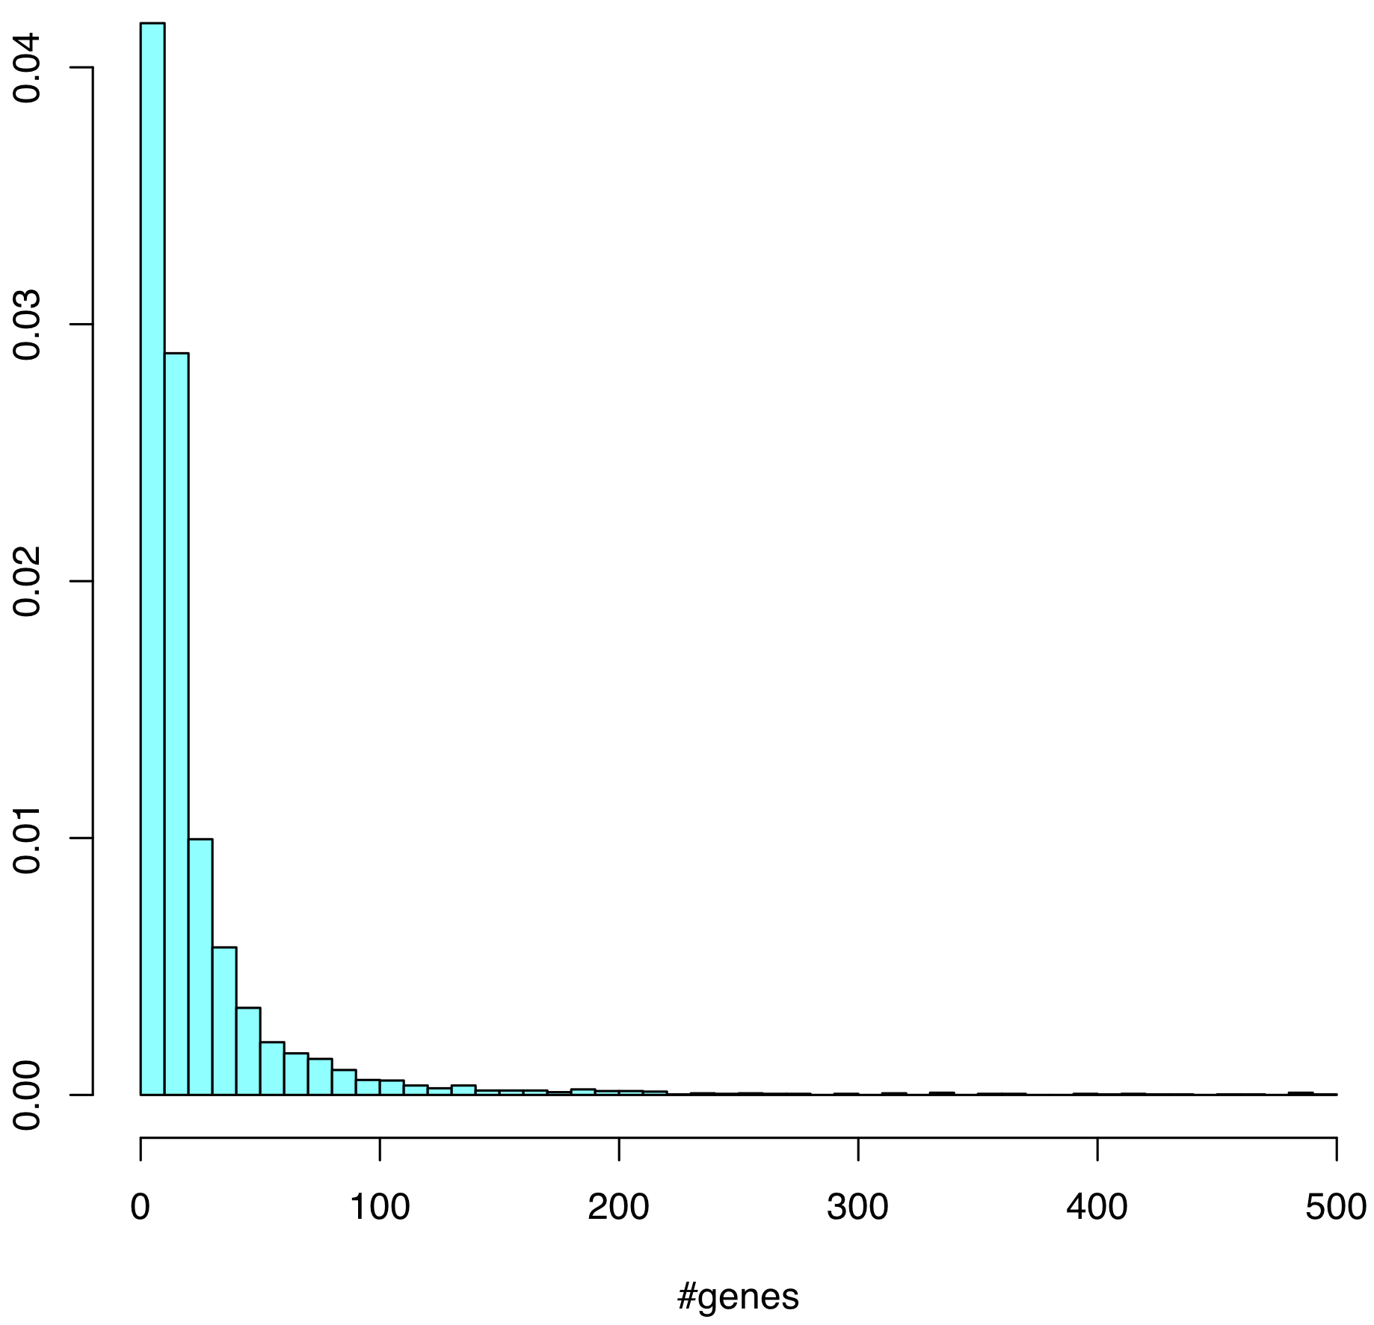
Gene set size (min = 5, max = 500)
KEGG
(N = 323)
GO_BP
(N = 4,631)
median = 72
median = 11
16

Slide 17
Assessing phenotype relevance
Typical approach:
Cherry-pick from enriched gene sets those with link to phenotype
Conclude that there is relevance for the phenotype investigated
An unbiased approach:
A priori investigate phenotype relevance of all gene sets
Quantify relevance accumulated along the gene set ranking
➔ How to score phenotype relevance of a gene set?
17

Slide 18
How to score phenotype relevance of a gene set?
MalaCards:
Human disease database (“GeneCards for maladies“)
Scores genes for disease relevance based on experimental evidence & co-citation in the literature
GeneAnalytics:
Integrative gene list analysis tool (part of the GeneCards Suite)
Summarizes per-gene relevance across GO & KEGG gene sets
18

Slide 19
Similarity between GSEA & MalaCards ranking
Sum over all gene sets
Σ w(i) S_{d}(i)
Weight (GSEA ranking)
Relevance score (MalaCards ranking)
Pathway | w
Cell cycle | 0.9967
Ribosome | 0.9933
Purine metabolism | 0.99
Pyrimidine metabolism | 0.9867
Pancreatic cancer | 0.9833
Glycolysis | 0.98
Pathway | S_{d}
Pancreatic cancer | 122.8
Pathways in Cancer | 105.6
P53 signaling | 92.7
Cell cycle | 89.4
Thyroid cancer | 81.5
Glycolysis | 76.3

Slide 20
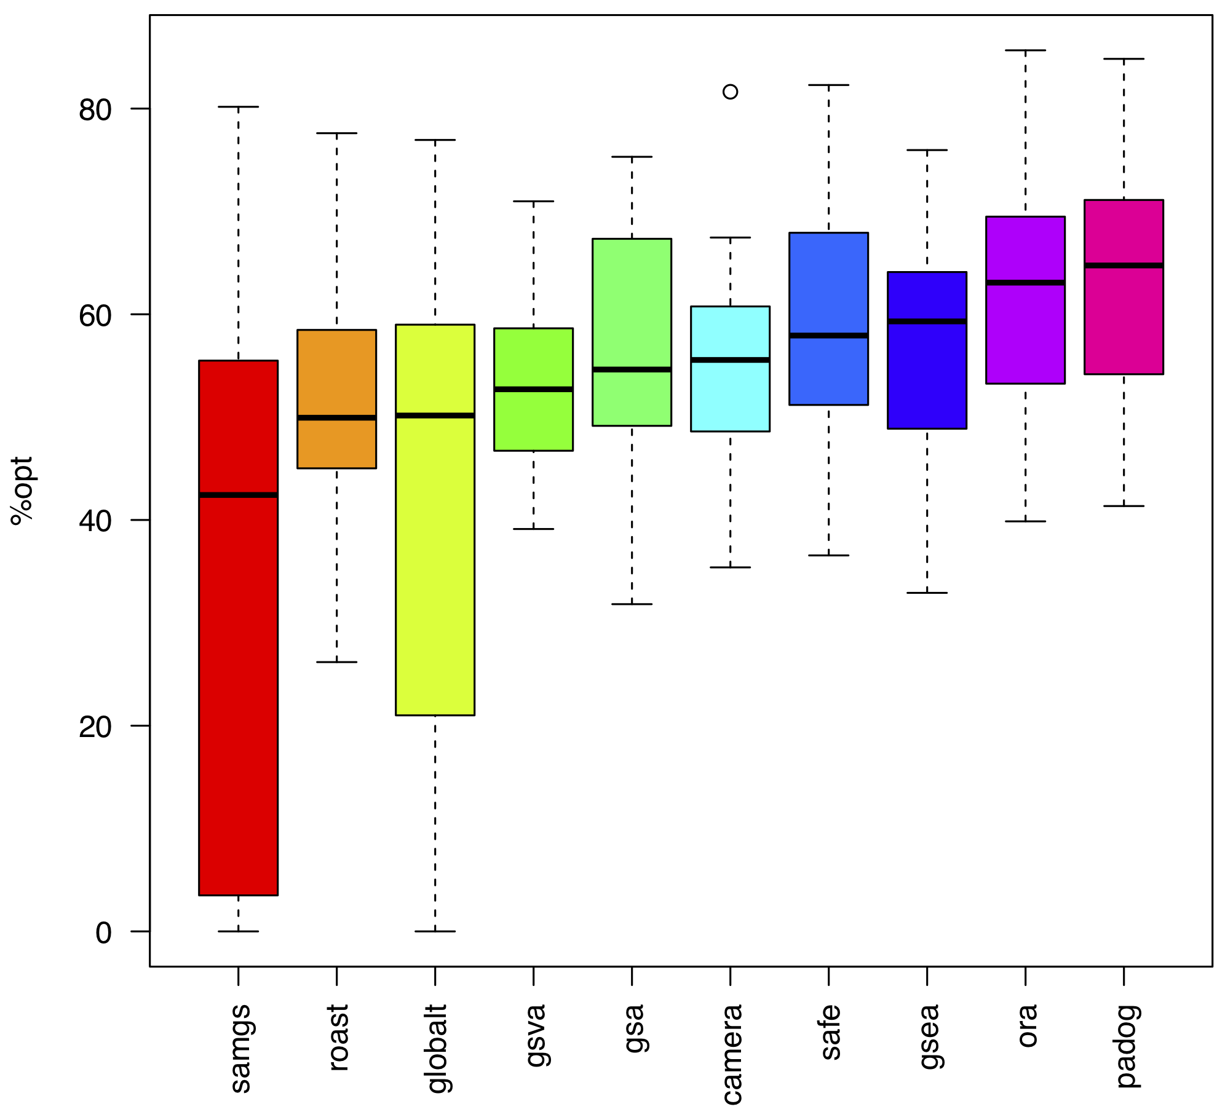
Phenotype relevance
Self-contained
Competitive

Slide 21
Benchmark criteria & issues
Applicability
Runtime & data type (microarray / RNA-seq)
Statistical significance
Type I error inflation & permutation p-values
Phenotype relevance
Ad hoc biological reasoning
Reproducibility and extensibility
Reproduce existing assessments for additional methods
21

Slide 22
Essential functions
Expression data
BiocFileCache
edat <- loadEData("geo2kegg") Microarray compendium
edat <- loadEData("tcga") RNA-seq compendium
edat <- loadEData("/path/to/edata“) User-defined data
Execution of selected DE and EA methods
BiocParallel
edat <- runDE(edat, de.method)
res <- runEA(edat, methods, gs)
Benchmarking
sig.sets <- evalNrSigSets(res, alpha, padj)
typeI <- evalTypeIError(res, alpha, perm)
rel <- evalRelevance(res, rel.ranks, data2pheno)

Slide 23
Statistical significance (nominal p-values)
> kegg.gs <- getGenesets(org="hsa", db="kegg")
> res <- runEA(edat, methods=sbeaMethods(), gs=kegg.gs)
> sig.sets <- evalNrSigSets(res, alpha=0.05, padj="none")
> bpPlot(sig.sets, what="sig.sets")
23

Slide 24
Statistical significance (adjusted p-values)
> sig.sets <- evalNrSigSets(res, alpha=0.05, padj="BH")
> bpPlot(sig.sets, what="sig.sets")
24

Slide 25
Application in a controlled setup
Golub et al. Molecular classification of cancer: class discovery and class prediction by gene expression monitoring. Science, 286(5439):531-7, 1999.
Random sample labels:
Shuffle sample labels (case vs. control) 1000x
In each permutation: #gene sets with p < 0.05 (= type I error rate)
25

Slide 26
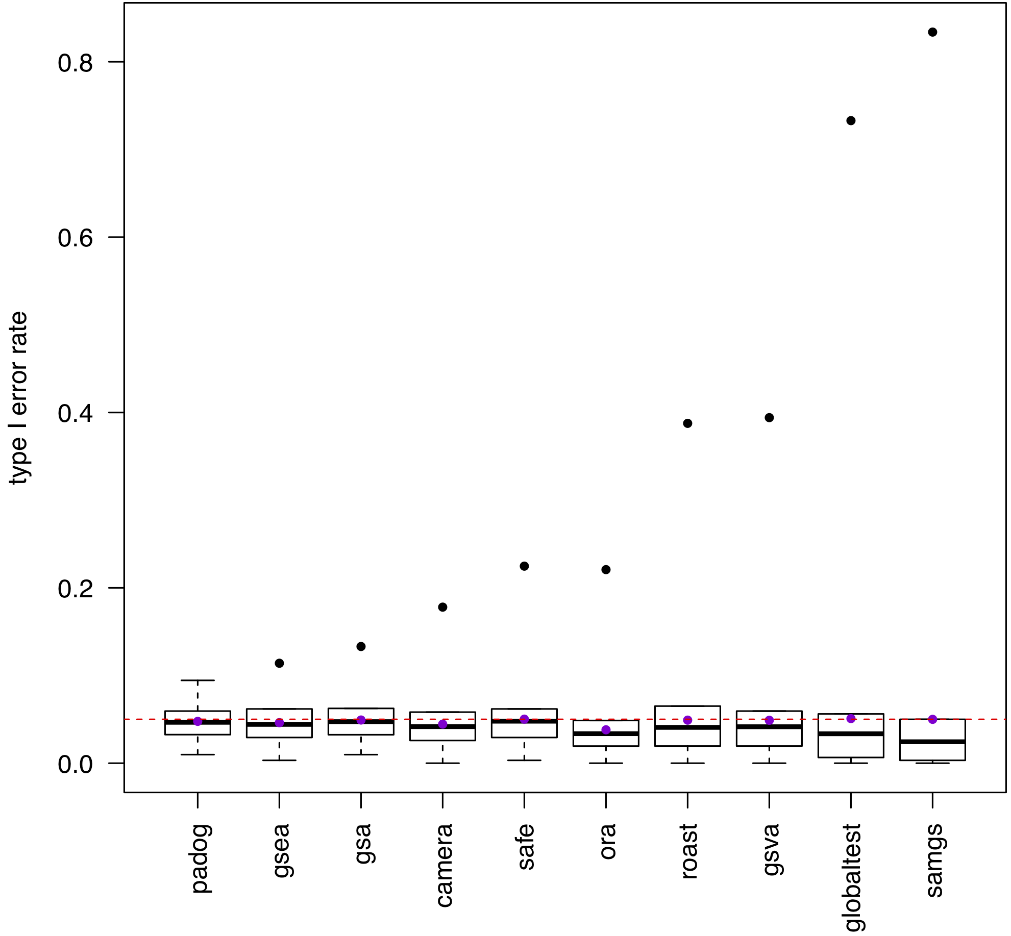
Statistical significance
(Type I error rate)
0.05

Slide 27
Application in a controlled setup
Golub et al. Molecular classification of cancer: class discovery and class prediction by gene expression monitoring. Science, 286(5439):531-7, 1999.
Random sample labels:
Shuffle sample labels (case vs. control) 1000x
In each permutation: #gene sets with p < 0.05 (= type I error rate)
Random gene sets:
100 random gene sets of defined size s in {5, 10, ... , 250, 500}
Are methods affected by gene set size?
27

Slide 28
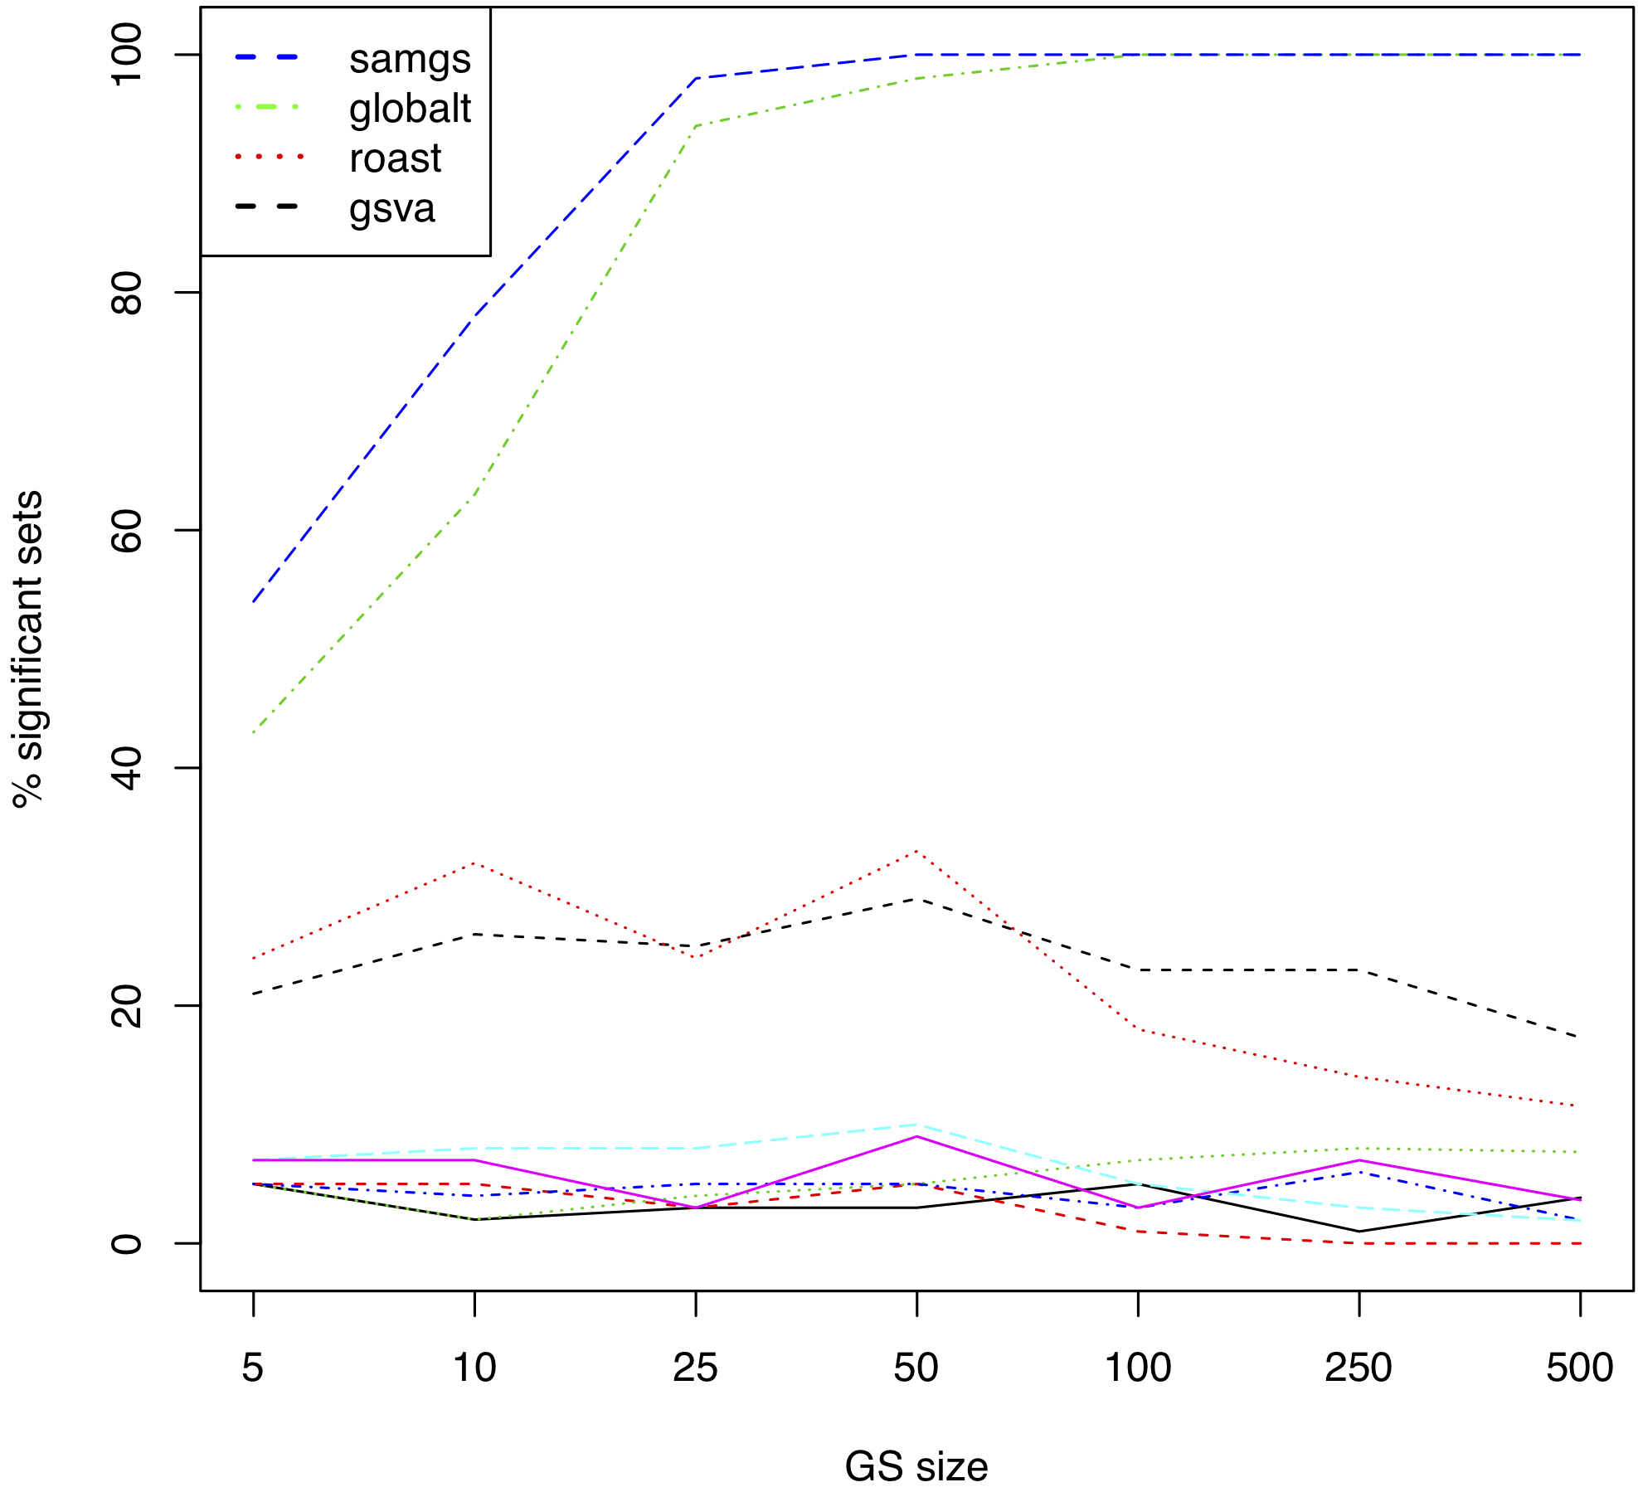
Random gene sets

Slide 29
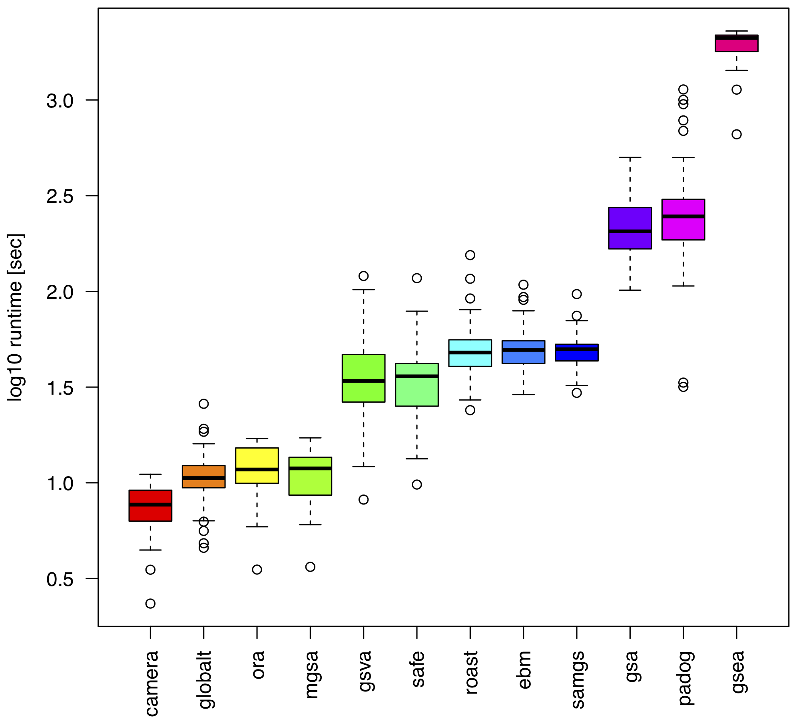
Runtime
15 min 40 sec
1 min 40 sec
10 sec
Intel Xeon 2.7 GHz

Slide 30
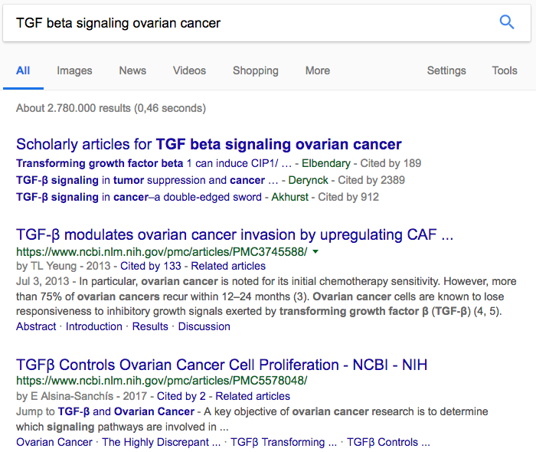

Slide 31
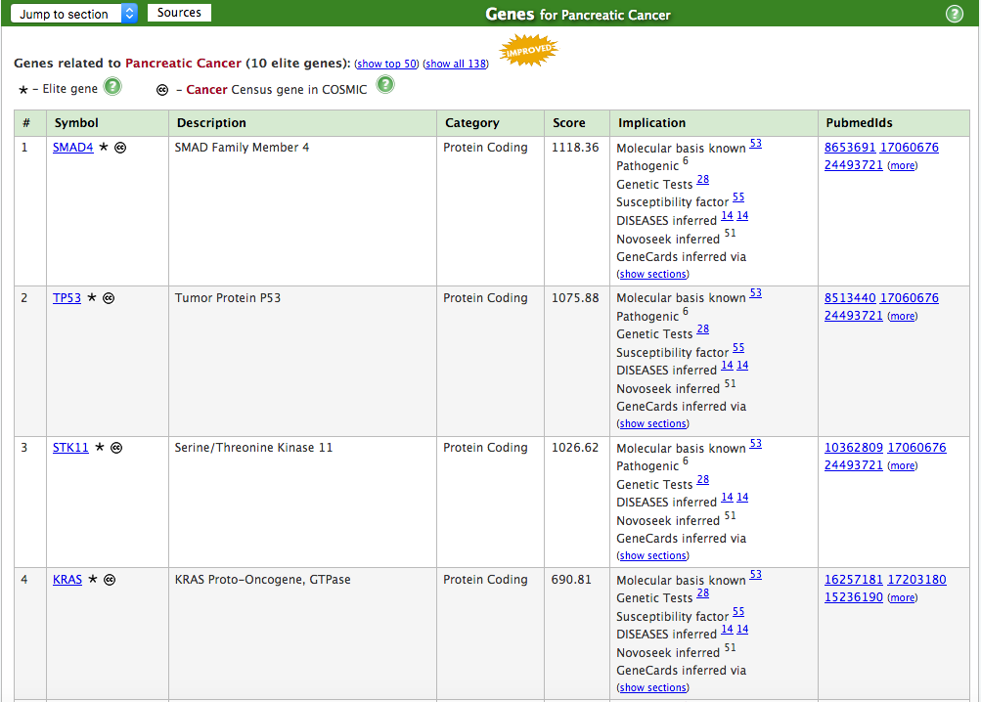

Slide 32
Similarity between GSEA & MalaCards ranking
Sum over all gene sets
Σ w(i) S_{d}(i) = X
➔ Theoretical optimum X_{opt} :
GSEA ranking is identical to MalaCards ranking
➔ Ratio X / X_{Opt} :
Comparison between datasets (MalaCards scores scale differently!)
Weight (GSEA ranking)
Relevance score (MalaCards ranking)
32

Slide 33






Acknowledgements
Mara Santarelli
Gergely Csaba
Ralf Zimmer
Lucas Schiffer
Marcel Ramos
Levi Waldron
33

