Slide 1

Vault
A password manager app that allows you to save all your passwords in one place.
Smart. Simple. Secure.
Created by:
Leonardo Gelbman | Yossi Rotenstreich

Slide 2

Activities
The app contains six activities:
Splash Activity
Create PIN Activity
Login Activity
Main Activity
Add New Account Activity (popup)
Settings Activity

Slide 3
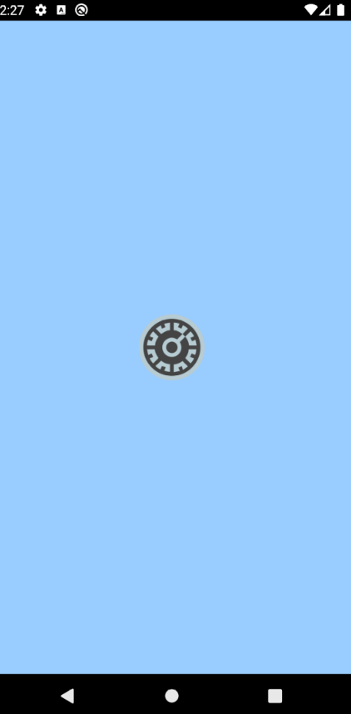
Splash Activity
The Splash Activity displays the app icon with a light blue background (as pictured) and sets the theme (night/day). If a PIN has not yet been created, the Create PIN Activity is started. If a PIN has already been created, the Login Activity is started.

Slide 4
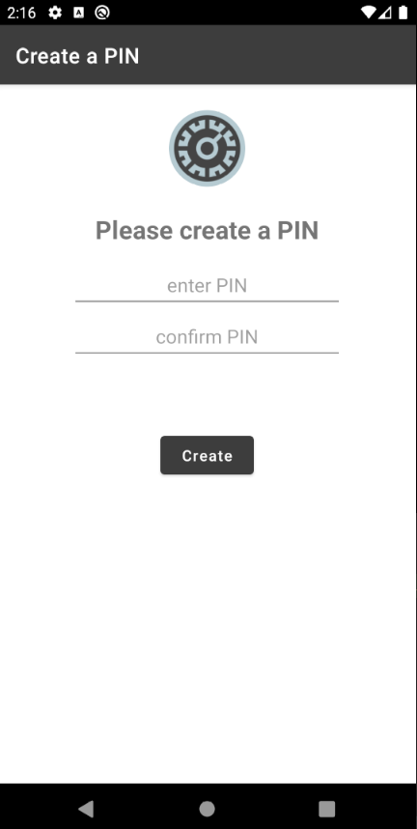
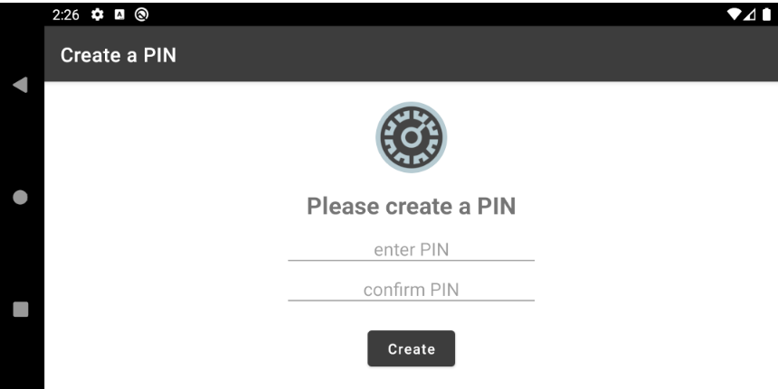
Create PIN Activity
The Create PIN Activity is started when the user opens the app for the first time. The user is prompted to create a PIN to securely access the app and then starts the login activity. The PIN must be made up of four digits. Invalid input is rejected.

Slide 5
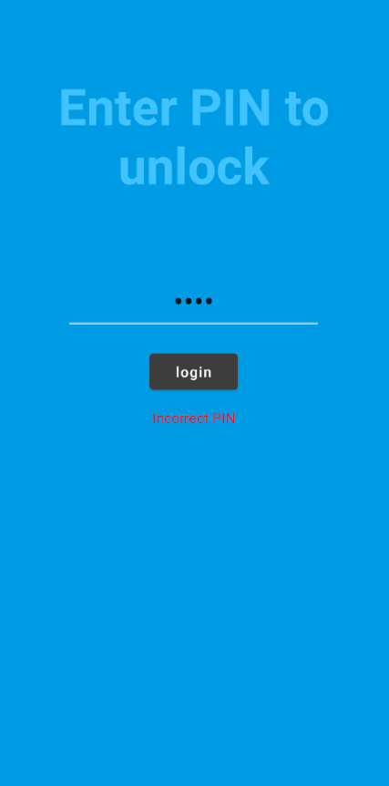
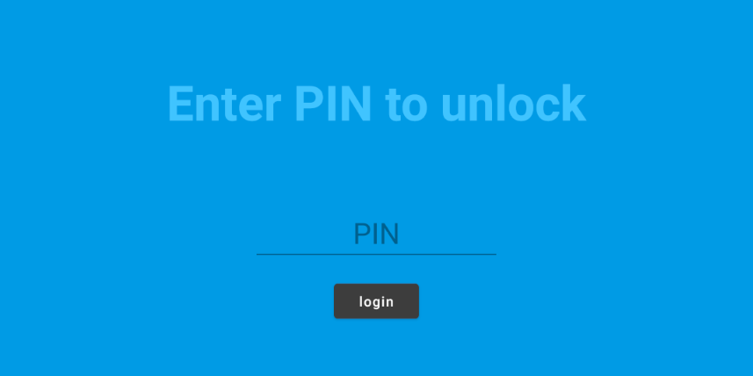
Login Activity
The Login Activity is a full screen activity that simply prompts the user to login to the app. If the correct PIN is entered, the Main Activity is started. If an incorrect PIN is entered, a message is displayed to the user.

Slide 6
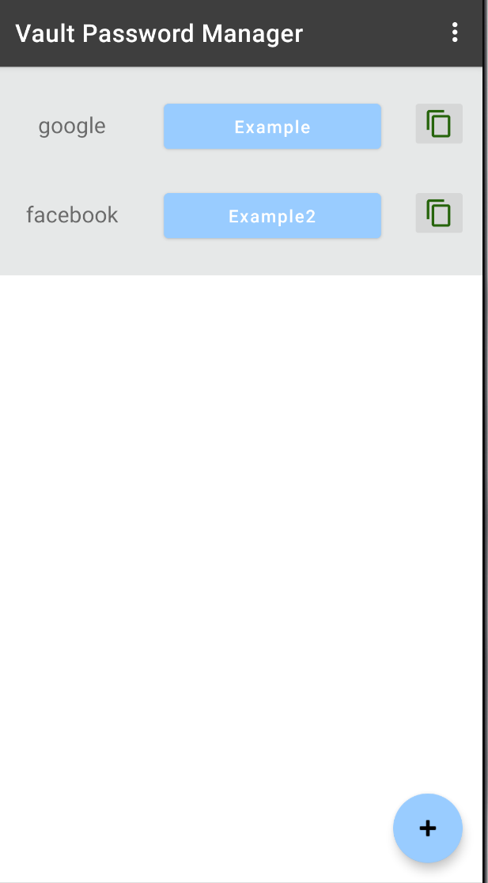
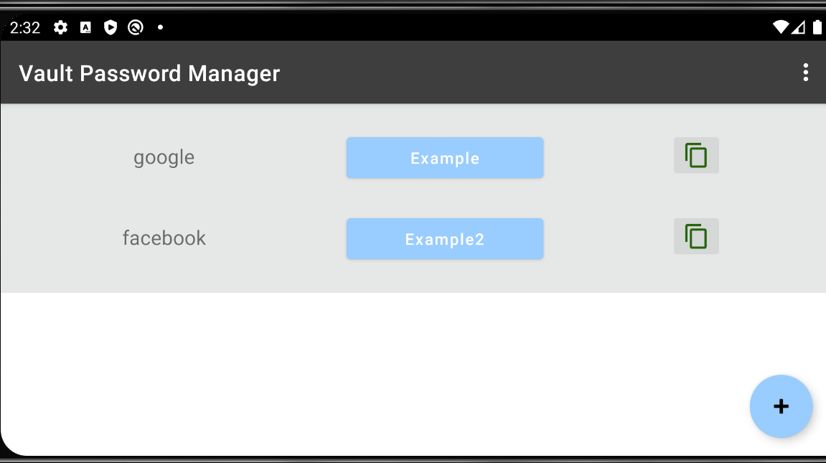
Main Activity
Once the user entered his or her pin, the home activity starts. For each account, it lists the account type, has a button displaying the account username, which changes to the password when clicked on and a copy button which copies the username or password (depending on the state of the main button) to the clipboard.

Slide 7
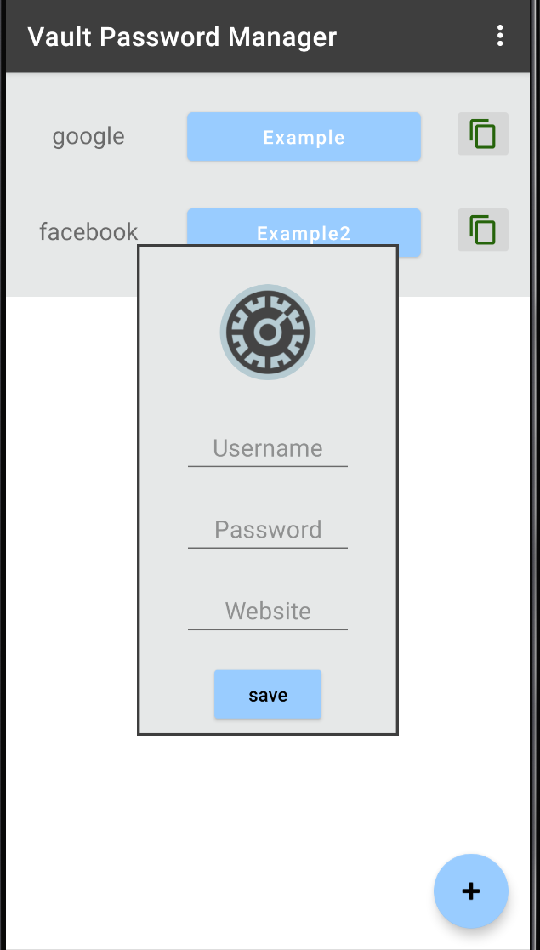
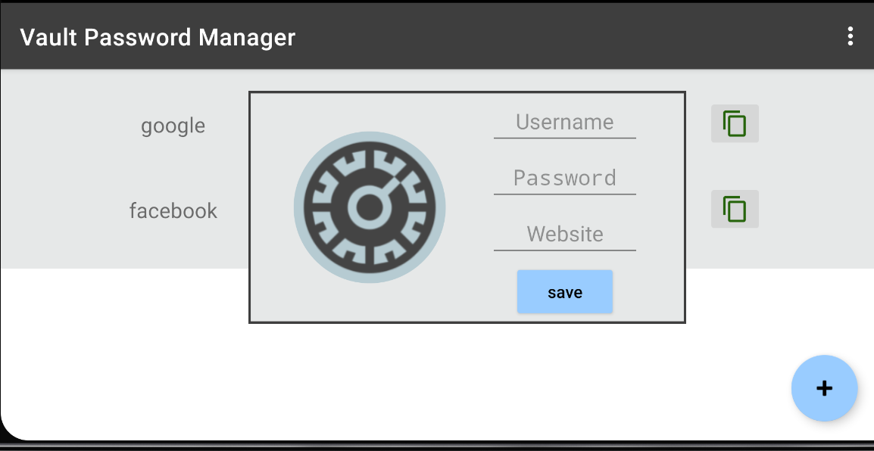
Add Account
The user can add a new account by clicking the fab in the main activity this pauses main and starts Create Pin. This activity is displayed as a popup window and closes when the user clicks outside of it.

Slide 8
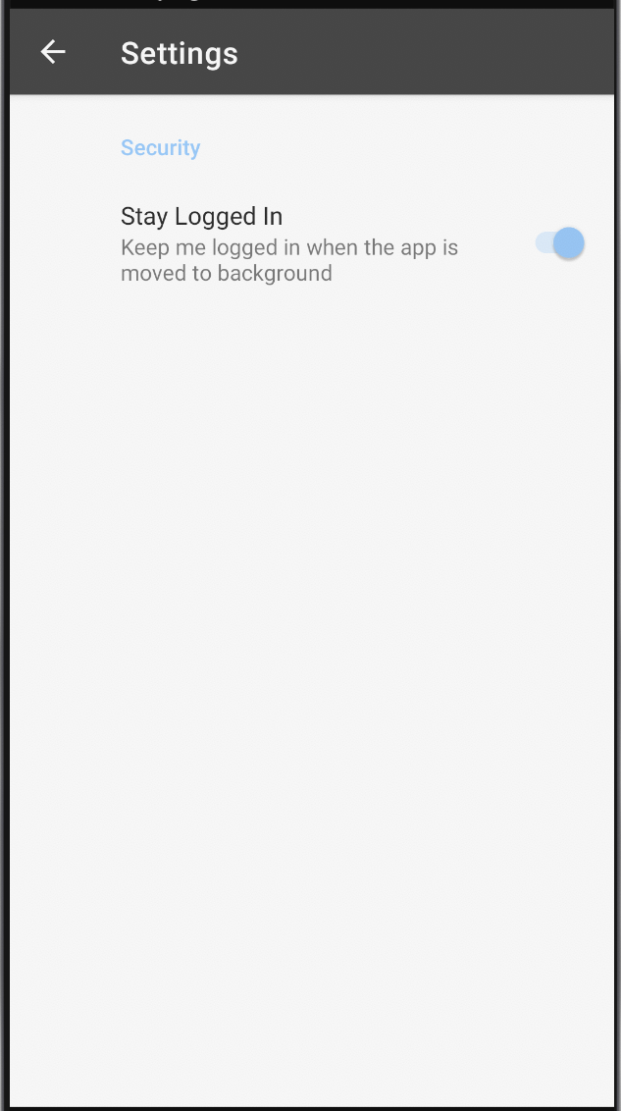
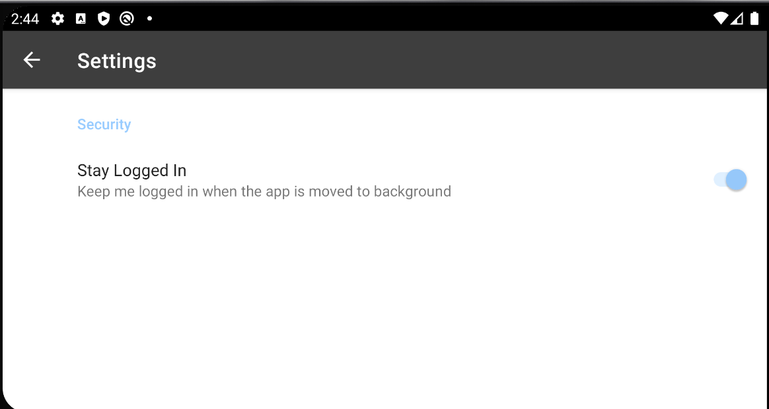
Settings Activity
The user can choose to log out or stay logged in when they leave the app.

Slide 9
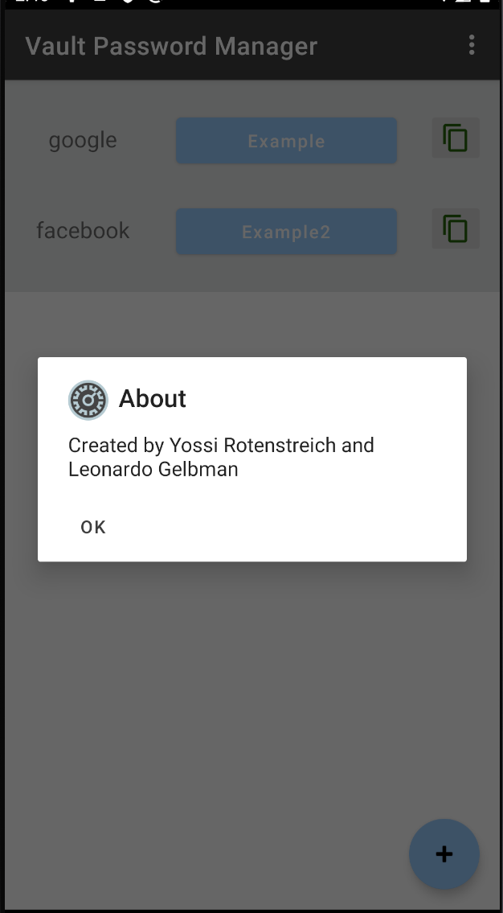
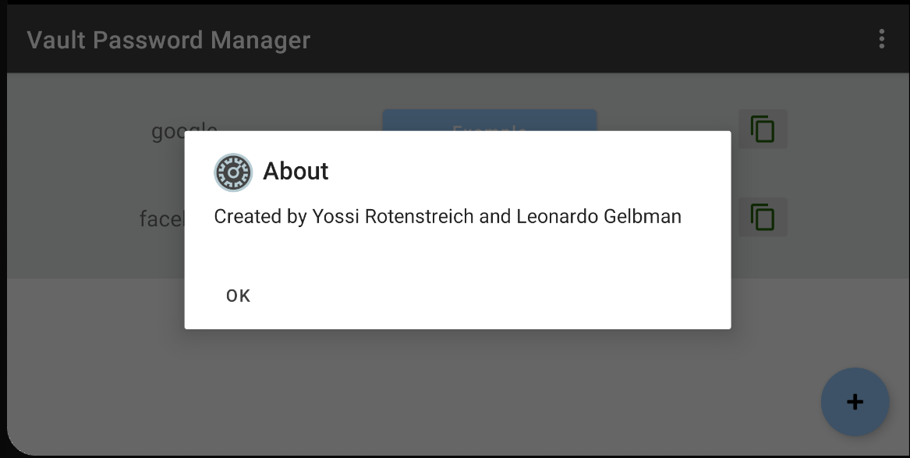
About Window
Can be launched from the menu and it displays information about the app

Slide 10
Future Updates
Encryption
We already started working on encryption. Currently, all passwords, including the user PIN, are stored in a json file in plain text. We plan on encrypting all passwords using our Encrypter class and only saving the hashed version of the password in storage. When the user chooses to view the password, we will decrypt the password with a decryption key. The algorithm is on the way…
Password Generator
We plan on adding a password generator feature that would allow the user to randomly generate new secure passwords by clicking a “Generator” button. We did not start building this feature into our app yet, but plan on doing so in the future.

Slide 11
Future Updates
Editing
We also want to add features allowing the user to delete, edit, and reorder the accounts as well as possibly more security preferences/settings.

