Slide 1

Instructor Kick-off
Analyze A/B Test Results
© 2019 Udacity. All rights reserved.

Slide 2
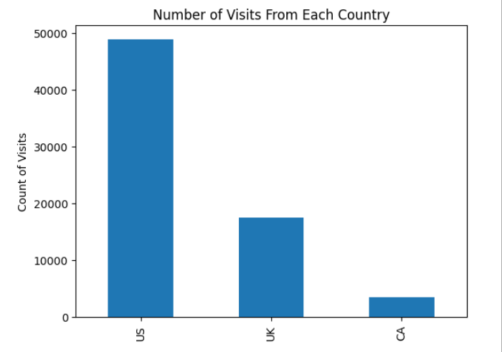
How Was The Experiment Implemented?​
Total Variant Visitors: 69889
Total Control Participants:​ 34678
​

Slide 3
Conversion Rates
 | U.S. | U.K. | CA
Control | 10.7% | 10.2% | 9.4%
Treatment | 15.8% | 14.9% | 15.4%
Executive Summary: Independently of countries, we can see a 5 % increase in conversion rate between the old and the new page.

Slide 4
Experiment Results
Treatment Conversion Rate: 15.5%
Control Conversion Rate:​ 10.5%
Delta in Treatment vs. Control Conversion Rate:​ 5%
p-value:​ 0
Conclusion:​ With a p-value of 0, we get significantly confidence about the Treatment page effect over the audience.

Slide 5
Country Results
Conclusion:​ Further investigation confirms that improvment in conversion rate between Control and Experiment groups does not rely on countries the audience is originated from.

