Slide 1
Chapter 12 JavaFX Graphical User Interfaces: Part 1
Java How to Program, 11/e
Questions? E-mail paul.deitel@deitel.com

Slide 2
Eclipse with SceneBuilder
If you don’t have SceneBuilder, download SceneBuilder from
https://gluonhq.com//products/scene-builder/
Follow instructions to integrate SceneBuilder into eclipse here
https://code.makery.ch/library/javafx-tutorial/part1/
We want to be able to Create… a New JavaFX project
We want to be able to Create… an FMXL file for the GUI Layout
We want to be able to Open… SceneBuilder on the FXML file.

Slide 3
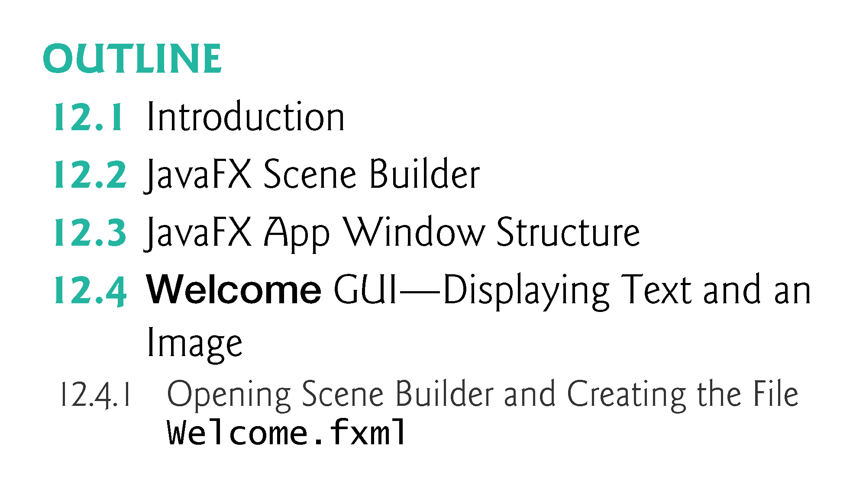

Slide 4
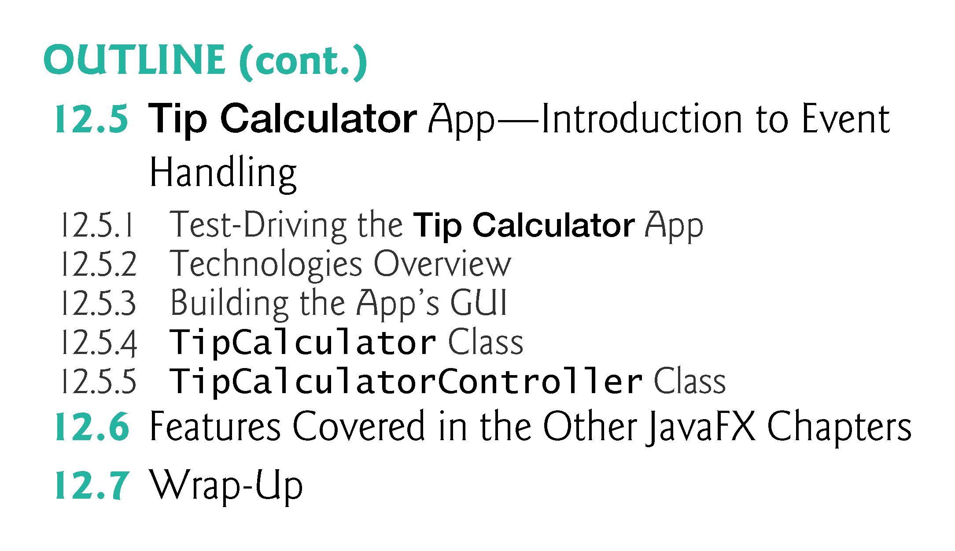

Slide 5
Introduction
A graphical user interface (GUI) presents a user-friendly mechanism for interacting with an app. A GUI (pronounced “GOO-ee”) gives an app a distinctive “look-and-feel.”
GUIs are built from GUI components—sometimes called controls or widgets.
“Look-and-feel” is defined as the mechanism needed to interact with an app.

Slide 6
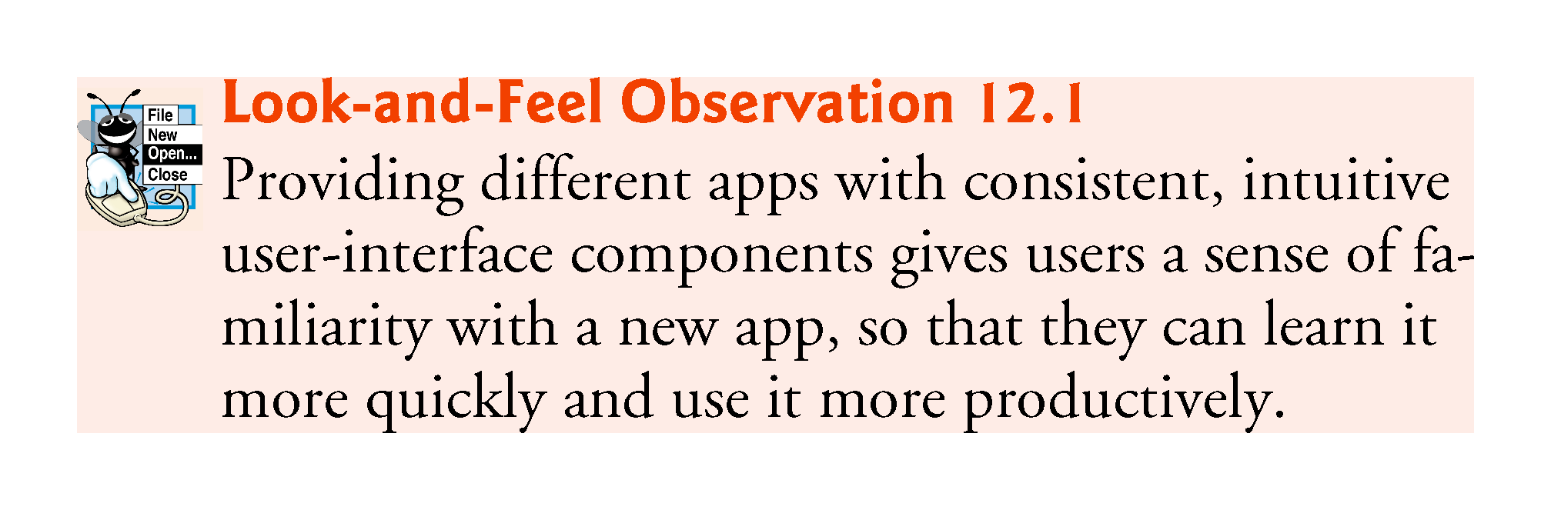

Slide 7
Introduction (Cont.)
Providing different apps with consistent, intuitive user-interface components gives users a sense of familiarity with a new app, so that they can learn it more quickly and use it more productively.
Java’s GUI, graphics and multimedia API of the future is JavaFX.
Think about the “look-and-feel” for MS Word or PowerPoint.
A Menu Bar across the top has the same set of options such as File, Home, Insert, Design, etc. Wherever the interfaces can be similar, they are similar. This makes it easier to switch between them

Slide 8
JavaFX Parts
JavaFX has 3 parts
A GUI builder called SceneBuilder allows drag-and-drop manipulation of widgets.
A configuration language called FXML that records the widgets in the GUI, their visible attributes and their relationship to each other.
A Controller class that must be completed by the programmer to bring the GUI to life.
A JavaFX application has some additional parts
A set of classes to describe the model, which is what the GUI allows the user to interact with.
A set of cascading style sheets (CSS files) to further specify “look-and-feel”.

Slide 9
JavaFX Scene Builder
JavaFX Scene Builder is a standalone JavaFX GUI visual layout tool that can also be used with various IDEs including eclipse, NetBeans and IntelliJ.
JavaFX Scene Builder enables you to create GUIs by dragging and dropping GUI components from Scene Builder’s library onto a design area, then modifying and styling the GUI—all without writing any code.
JavaFX Scene Builder generates FXML (FX Markup Language)—an XML vocabulary for defining and arranging JavaFX GUI controls without writing any Java code.

Slide 10
JavaFX Scene Builder (Cont.)
The FXML code is separate from the program logic that’s defined in Java source code—this separation of the interface (the GUI) from the implementation (the Java code) makes it easier to debug, modify and maintain JavaFX GUI apps.
Placing GUI components in a window can be tedious. Being able to do it dynamically using a configuration file makes the job much easier.
No additional compilation is needed unless actions need to be programmed in the Controller.java class.

Slide 11
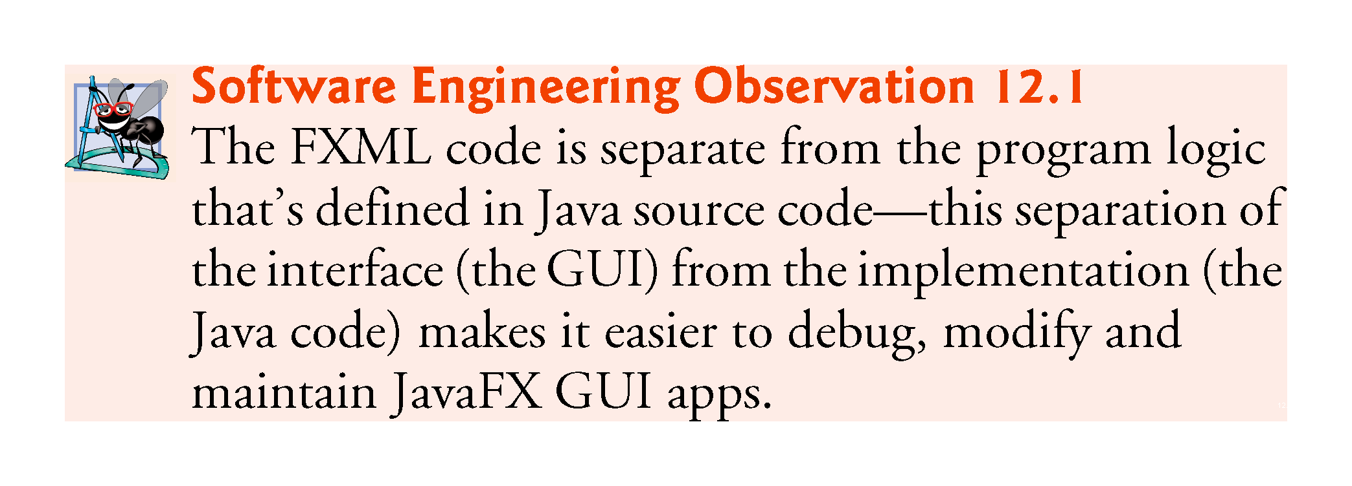

Slide 12
JavaFX App Window Structure
A JavaFX app window consists of several parts (Fig. 12.1)
Figure 12.1 contains a labelled image of a Tip Calculator GUI.

Slide 13
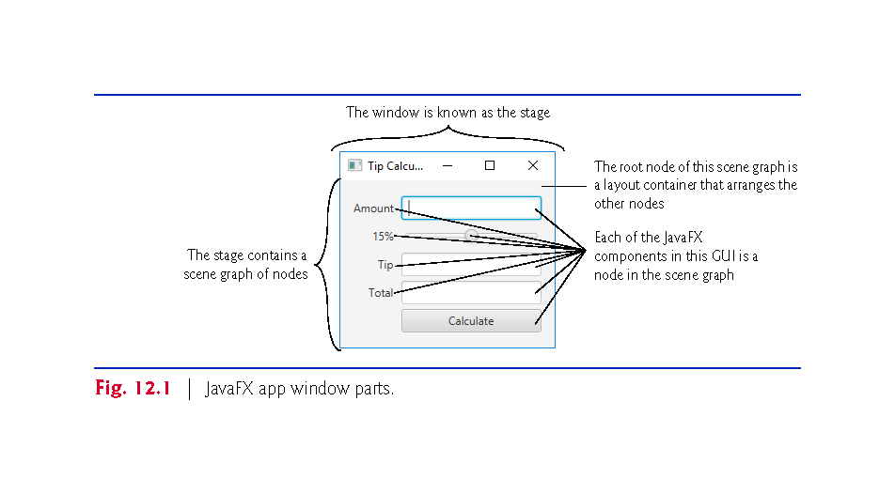

Slide 14
JavaFX App Window Structure (cont.)
The Stage is the window in which a JavaFX app’s GUI is displayed
It’s an instance of class Stage (package javafx.stage).
The Stage contains one active Scene that defines the GUI as a scene graph—a tree data structure of an app’s visual elements, such as GUI controls, shapes, images, video, text and.
The scene is an instance of class Scene (package javafx.scene).
Controls are GUI components, such as
Labels that display text,
TextFields that enable a program to receive user input,
Buttons that users click to initiate actions, and more.

Slide 15
JavaFX Application Layout
An application Window in JavaFX is known as a Stage.
package javafx.stage
A Stage contains an active Scene which is set to a Layout container.
package javafx.scene
The Scene may have other Layout containers for organizing Controllers in a Tree organization.
Nodes with children are layout containers.
Nodes without children are widgets.

Slide 16
JavaFX App Window Structure (cont.)
Each visual element in the scene graph is a node—an instance of a subclass of Node (package javafx.scene), which defines common attributes and behaviors for all nodes
With the exception of the first node in the scene graph—the root node—each node in the scene graph has one parent.
Nodes can have transforms (e.g., moving, rotating and scaling), opacity (whether a node is transparent, partially transparent or opaque), effects (e.g., drop shadows, blurs, reflection and lighting) and more.

Slide 17
JavaFX controls
Nodes with children are typically layout containers that arrange their child nodes in the scene.
Layout containers contain controls that accept inputs or other layout containers.
When the user interacts with a control, the control generates an event.
Programs can respond to these events—known as event handling—to specify what should happen when each user interaction occurs.
An event handler is a method that responds to a user interaction. An FXML GUI’s event handlers are defined in a so-called controller class.

Slide 18
Welcome App—Displaying Text and an Image
In this section, without writing any code you’ll build a GUI that displays text in a Label and an image in an ImageView (Fig. 12.2).
You'll use only visual programming techniques to drag-and-drop JavaFX components onto Scene Builder’s content panel—the design area.
You’ll use Scene Builder’s Inspector to configure options, such as the Label’s text and font size, and the ImageView’s image.
You’ll view the completed GUI using Scene Builder’s Show Preview in Window option.

Slide 19
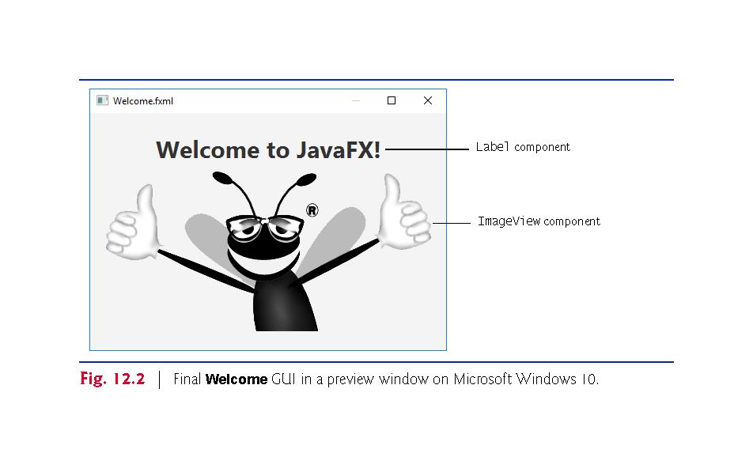

Slide 20
Opening Scene Builder and Creating the File Welcome.fxml
Open Scene Builder so that you can create the FXML file that defines the GUI. The window initially appears as shown in Fig. 12.3.
Untitled at the top of the window indicates that Scene Builder has created a new FXML file that you have not yet saved.
Select File > Save to display the Save As dialog, then select a location in which to store the file, name the file Welcome.fxml and click the Save button.

Slide 21
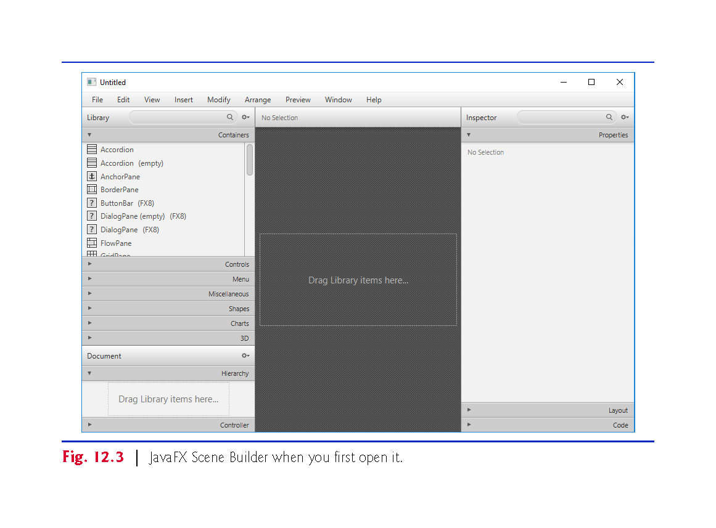
Builder
Panel on
The right
Inspector
Panel on
The right

Slide 22
Adding an Image to the Folder Containing Welcome.fxml
The image you’ll use for this app (bug.png) is located in the images- subfolder of this chapter’s examples folder.
To make it easy to find the image when you’re ready to add it to the app, locate the images folder on your file system, then copy bug.png into the folder where you saved Welcome.fxml.
https://storm.cis.fordham.edu/harazduk/cs3400/bug.png
Right-click and download.

Slide 23
Getting SceneBuilder ready
SceneBuilder automatically adds an AnchorPane to the canvas.
Delete the AnchorPane from the SceneBuilder main canvas.
On the left-hand side of the tool, find the hierarchy panel 2/3’s of the way down and open it.
Right-click on the AnchorPane in the hierarchy section of the panel on the left-hand side.
Select x Delete

Slide 24
Creating a VBox Layout Container
You'll use a VBox layout container (package javafx.scene.layout), which will be the scene graph’s root node.
Layout containers help you arrange and size GUI components.
A VBox arranges its nodes vertically from top to bottom.
To add a VBox to Scene Builder’s, double-click VBox in the Library window’s Containers section.
You also can drag-and-drop a VBox from the Containers section onto Scene Builder’s content panel.

Slide 25
Configuring the VBox Layout Container
Specifying the VBox’s Alignment
A VBox’s alignment determines the layout positioning of the VBox’s children.
Click the Alignment property’s drop-down list and click CENTER to set it.
We’d like both children to be centered vertically, so that they are spaced equally above the Label and below the ImageView.
Select the VBox in Scene Builder’s content panel by clicking it. Scene Builder displays many VBox properties in the Scene Builder Inspector’s Properties section.
Each property value you specify for a JavaFX object is used to set one of that object’s instance variables when JavaFX creates the object at runtime.

Slide 26
Configuring the VBox Layout Container (cont.)
Specifying the VBox’s Preferred Size
The preferred size (width and height) of the scene graph’s root node is used by the scene to determine its window size when the app begins executing
Select the VBox.
Click the right arrow next to Inspector’s Layout section to expand it.
The section expands and the right arrow changes to a down arrow. Clicking the arrow again would collapse the section.
Click the Pref Width property’s text field, type 450 and press Enter to change the preferred width.
Click the Pref Height property’s text field, type 300 and press Enter to change the preferred height.

Slide 27
Adding and Configuring a Label
Adding a Label to the VBox
Expand the Scene Builder Library window’s Controls section by clicking the right arrow next to Controls, then drag-and-drop a Label from the Controls section onto the VBox
Scene Builder automatically centers the Label object horizontally and vertically in the VBox, based on the VBox’s Alignment property.

Slide 28
Adding and Configuring a Label (cont.)
Changing the Label’s Text
Two ways to set the Label
double click the Label and input the new text directly, or
single click to select the Label, then in the Inspector’s Properties section on the right, set the Text property.
Set the Label’s text to "Welcome to JavaFX!".

Slide 29
Adding and Configuring a Label (cont.)
Changing the Label’s Font
Set the Label to display in a large bold font.
Select the Label, then in the Inspector’s Properties section, click the value to the right of the Font property.
In the window that appears, set the Style property to Bold and the Size property to 30 (or 36).
The design should now appear as shown in Fig 12.4.

Slide 30
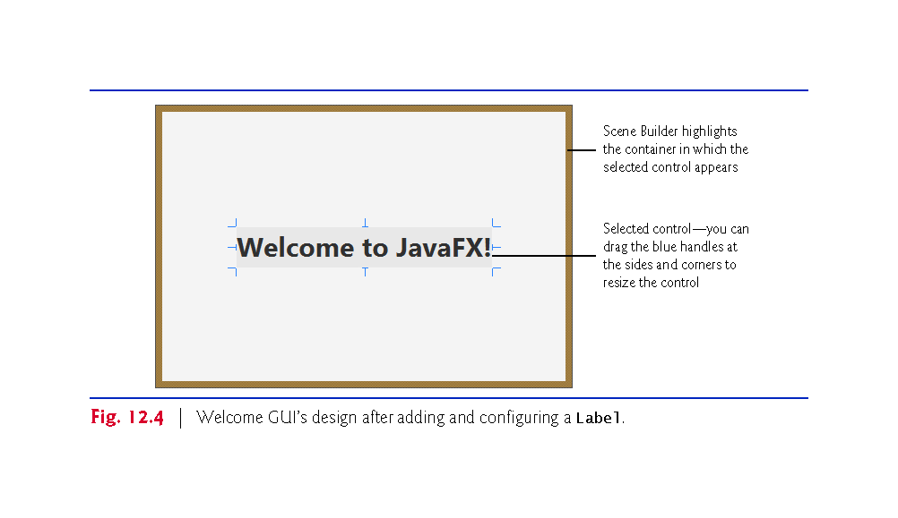

Slide 31
Adding and Configuring an ImageView
Drag and drop an ImageView from the Library window’s Controls section to just below the Label, as shown in Fig. 12.5.
You can also double-click ImageView in the Library window, in which case Scene Builder automatically places the new ImageView object below the Label.
You can reorder a VBox’s controls by dragging them in the VBox or in the Document window’s Hierarchy section (Fig. 12.3).
Scene Builder automatically centers the ImageView horizontally in the VBox.
The Label and ImageView are centered vertically such that the same amount of space appears above the Label and below the ImageView.

Slide 32
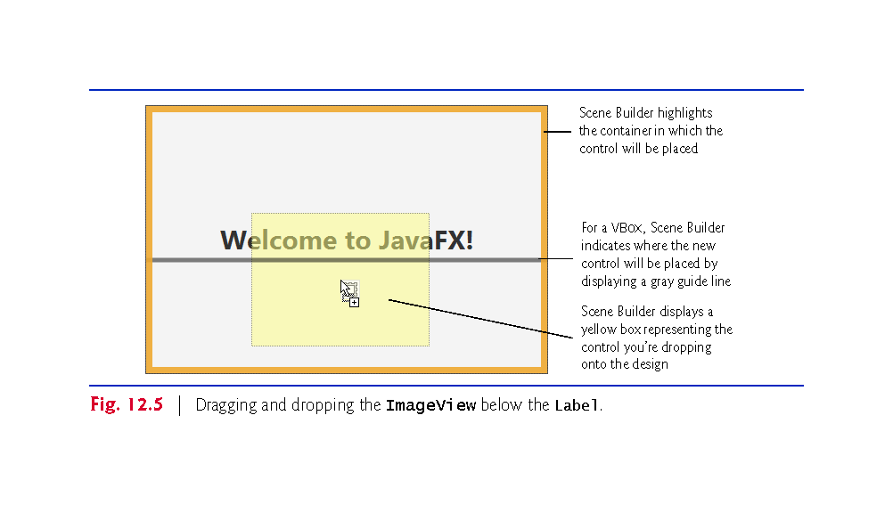

Slide 33
Adding and Configuring an ImageView (cont.)
Setting the ImageView's Image
Next you’ll set the image to display:
Select the ImageView, then in the Inspector’s Properties section click the ellipsis (…) button to the right of the Image property.
By default, Scene Builder opens a dialog showing the folder in which the FXML file is saved.
Select the image file, then click Open.
Scene Builder displays the image and resizes the ImageView to match the image’s aspect ratio—that is, the ratio of the image’s width to its height.

Slide 34
Adding and Configuring an ImageView (cont.)
Changing the ImageView’s Size
We’d like to display the image at its original size
Reset the ImageView’s default Fit Width and Fit Height property values, Scene Builder will resize the ImageView to the image’s exact dimensions.
Expand the Inspector’s Layout section.
Hover the mouse over the Fit Width property’s value. This displays the button to the right property’s value.
Click the button and select Reset to Default to reset the value.
Repeat Step 2 to reset the Fit Height property’s value.
Scene Builder’s content panel should now appear as shown in Fig. 12.6.
Save the FXML file by selecting File > Save.

Slide 35
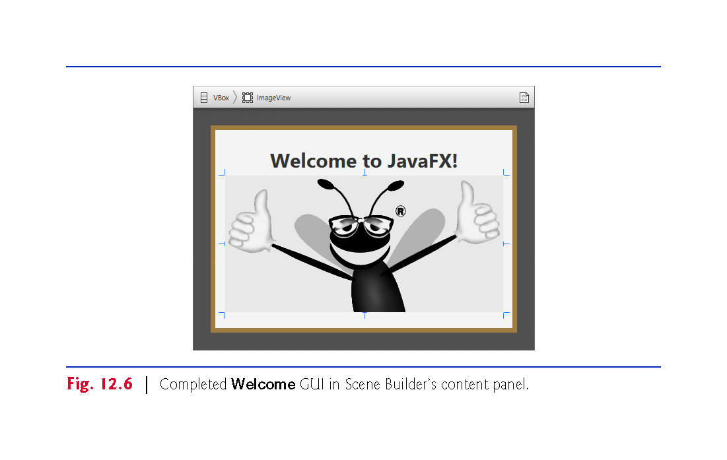

Slide 36
Previewing the Welcome GUI
You can preview what the design will look like in a running application’s window.
Select Preview > Show Preview in Window, which displays the window in Fig. 12.7.

Slide 37
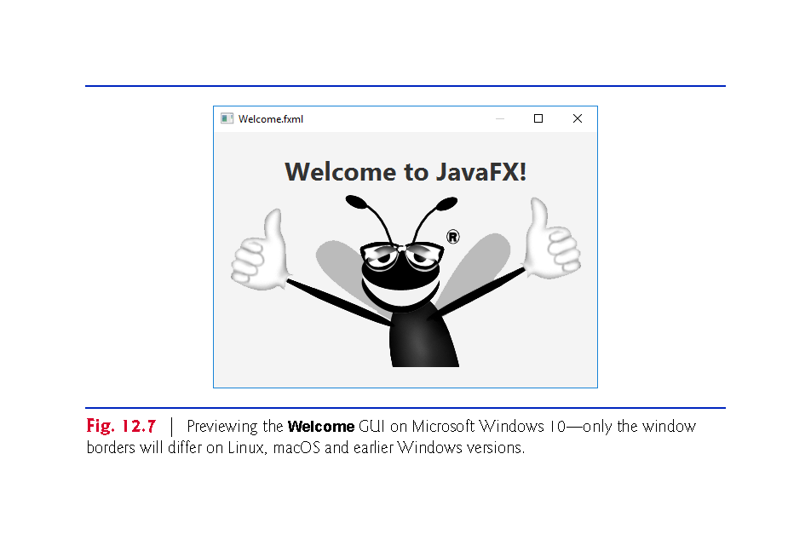

Slide 38
Tip Calculator App—Introduction to Event Handling
The Tip Calculator app (Fig. 12.8(a)) calculates and displays a restaurant bill tip and total.
By default, the app calculates the total with a 15% tip.
You can specify a tip percentage from 0% to 30% by moving the Slider thumb—this updates the tip percentage (Fig. 12.8(b) and (c)).
In this section, you’ll build a Tip Calculator app using several JavaFX components and learn how to respond to user interactions with the GUI.

Slide 39
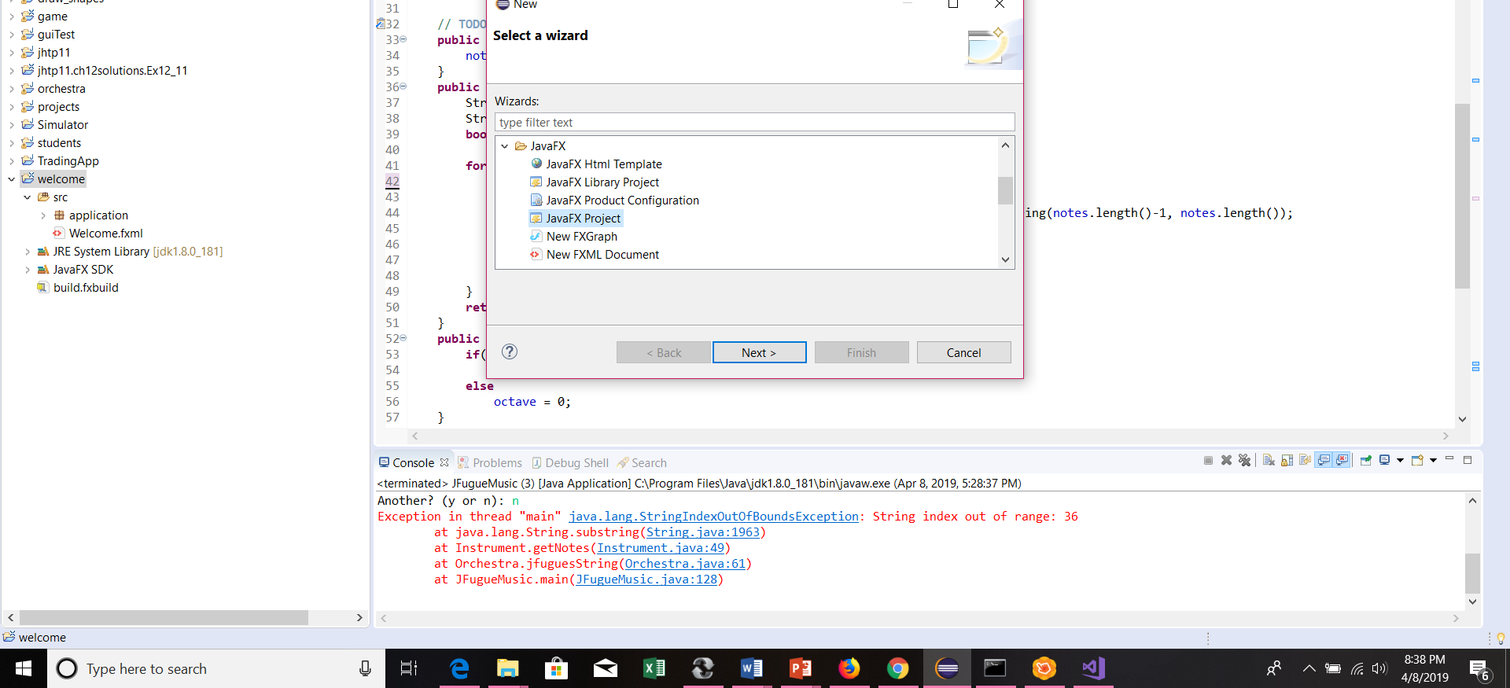
Eclipse JavaFX project
File menu, select New -> Other and then JavaFX Project

Slide 40
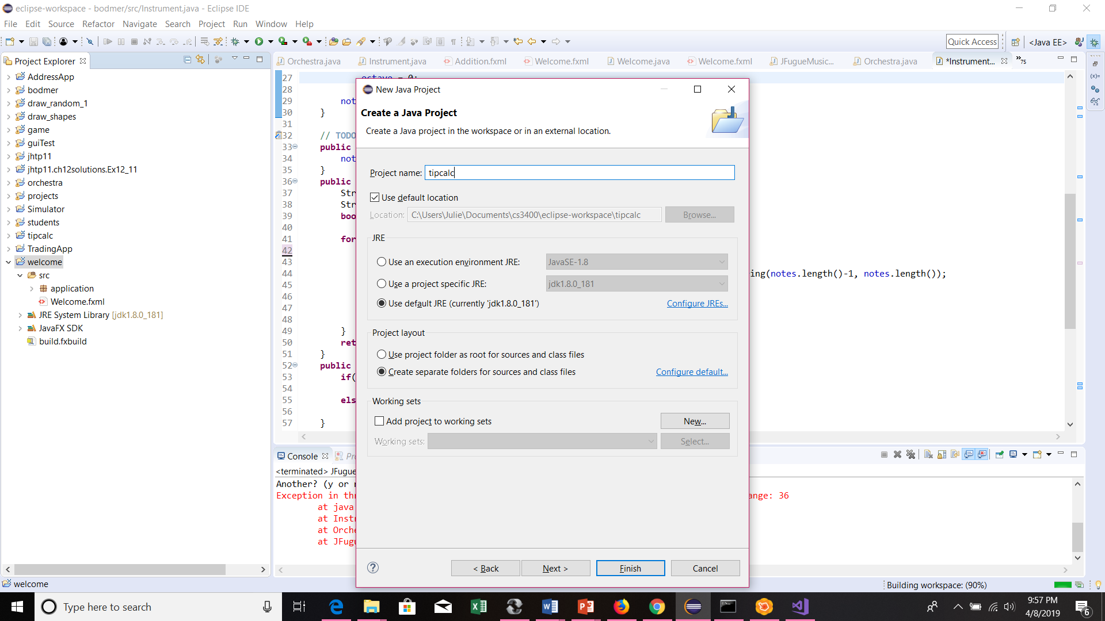
New JavaFX Project

Slide 41
Eclipse FXML Document
File menu, select New -> Other and then FXML Document

Slide 42
SceneBuilder
Right click the TipCalculator.fxml file and Open with SceneBuilder.

Slide 43
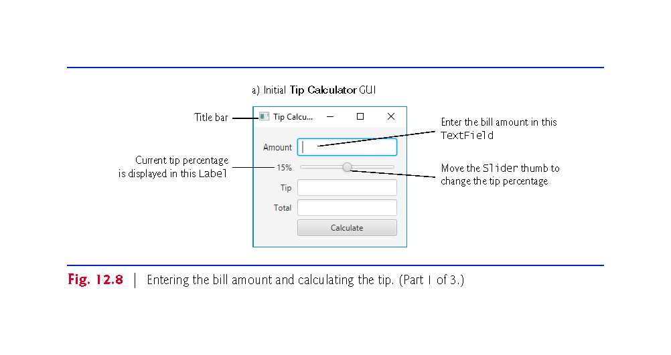

Slide 44
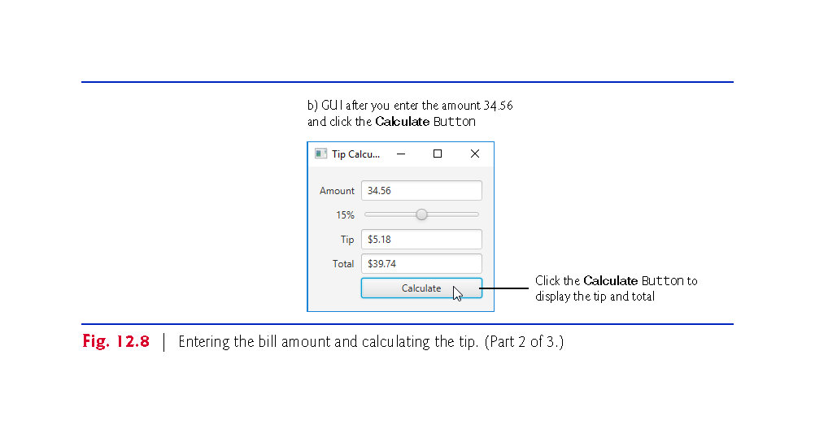

Slide 45
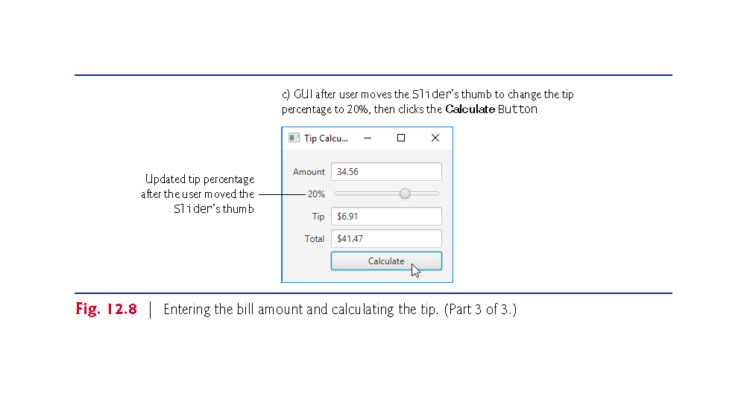

Slide 46
Technologies Overview
Class Application
A subclass of the Application class is necessary to launch a JavaFX app
(package javafx.application).
When the subclass’s main method is called:
Application’s static launch method is called which transfers control to JavaFX to start the app.
The launch method, causes the JavaFX runtime to create an object of the Application subclass and call its start method.
The Application subclass’s start method creates the GUI, attaches it to a Scene and places it on the Stage that start receives as an argument.

Slide 47
GridPane is a Layout Container with a Grid
Arranging JavaFX Components with a GridPane
A GridPane (package javafx.scene.layout) arranges JavaFX components into columns and rows in a rectangular grid.
The Tip Calculator app uses a GridPane (Fig. 12.9) to arrange views into two columns and five rows.
Each cell in a GridPane can be empty or can hold one or more JavaFX components, including layout containers that arrange other controls.
Each component in a GridPane can span multiple columns or rows, though we did not use that capability in this GUI.
When you drag a GridPane onto Scene Builder’s content panel, Scene Builder creates the GridPane with two columns and three rows by default.

Slide 48
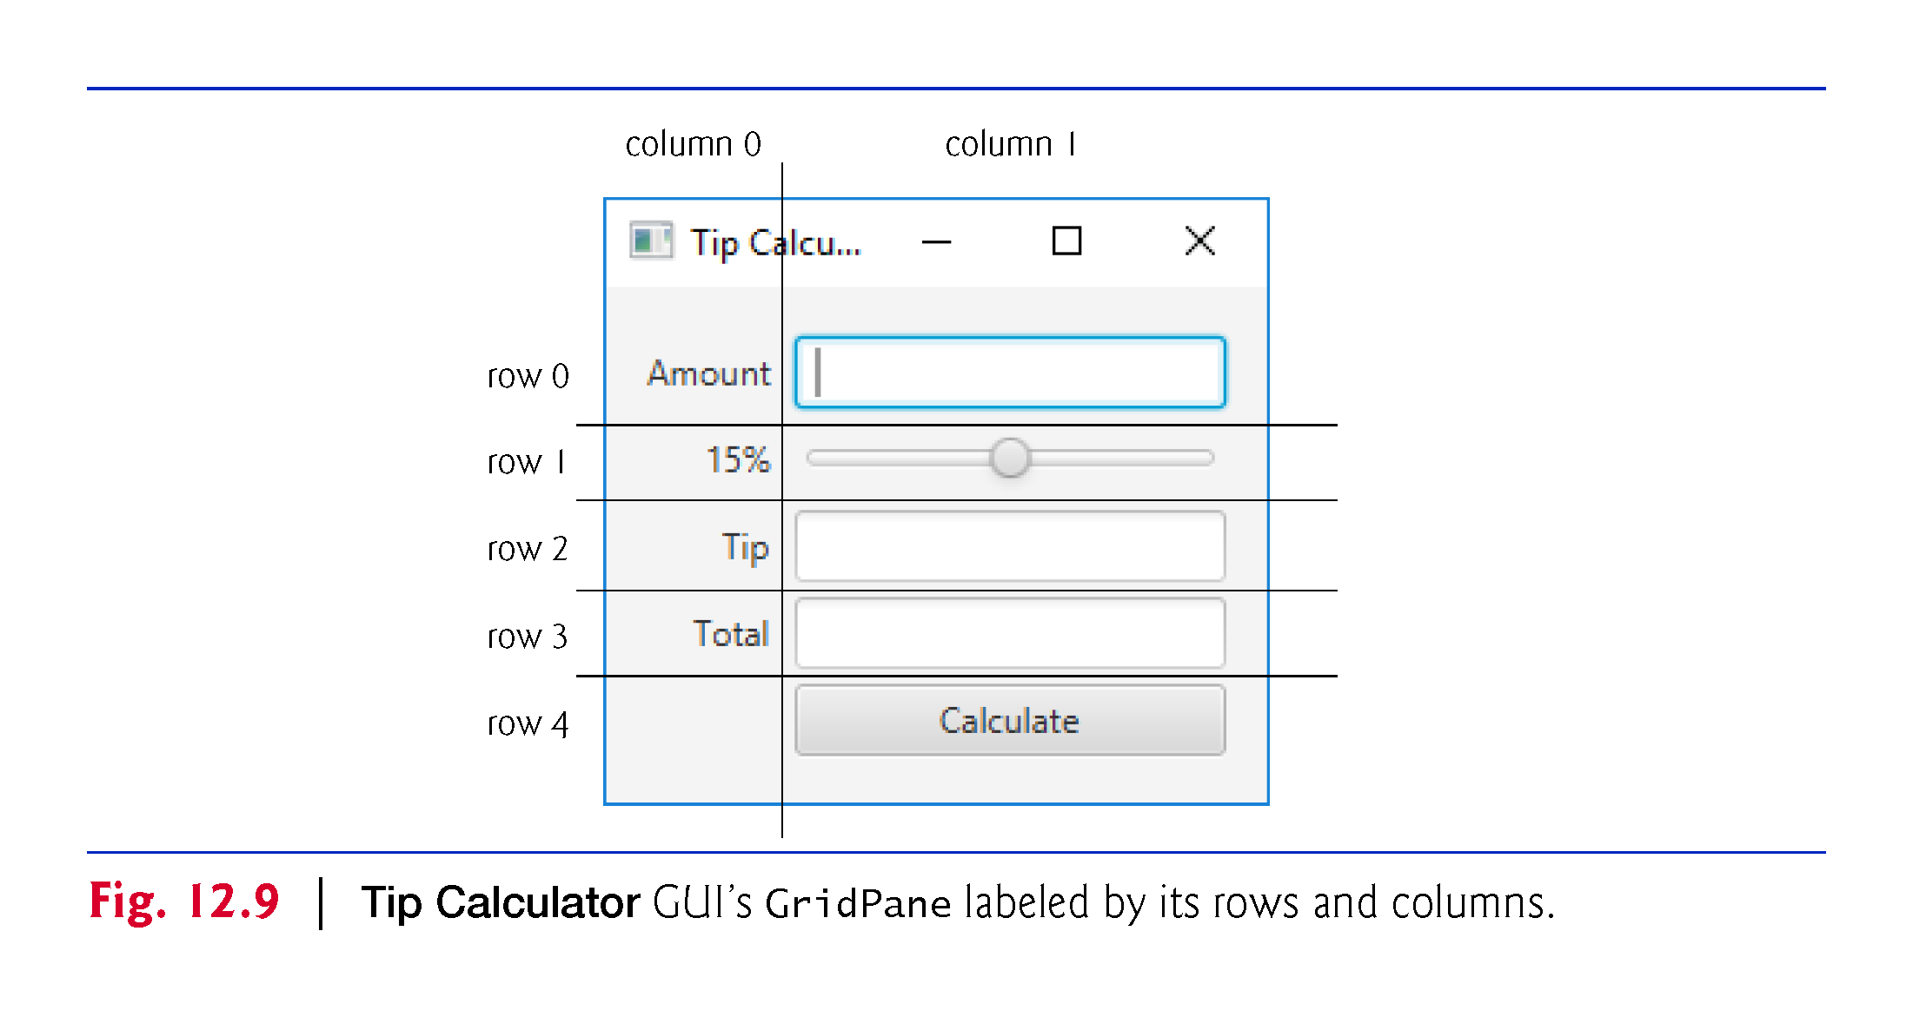

Slide 49
A GUI is Made up of Controls
A TextField (package javafx.scene.control) can accept text input or display text.
A Slider (package javafx.scene.control) represents a value in the range 0.0–100.0 by default and allows the user to select a number in that range by moving the Slider’s thumb.
A Button (package javafx.scene.control) allows the user to initiate an action.
Class NumberFormat (package java.text) can format locale-specific currency and percentage strings.

Slide 50
GUIs are Event Driven
GUIs are event driven.
When the user interacts with a GUI component, the interaction—known as an event—drives the program to perform a task.
The code that performs a task in response to an event is called an event handler.
For certain events you can link a control to its event-handling method by using the Code section of Scene Builder’s Inspector window.
You'll create the event handler entirely in code.

Slide 51
Event Handler for a Slider
You implement the ChangeListener interface (package javafx.beans.value) to respond when the user moves the Slider’s thumb.
JavaFX applications in which the GUI is implemented as FXML adhere to the Model-View-Controller (MVC) design pattern, which separates an app’s data (contained in the model) from the app’s GUI (the view) and the app’s processing logic (the controller).

Slide 52
MVC means Model-View-Controller
The model is the domain logic of the application.
The controller implements logic for processing user inputs.
The view presents the data stored in the model.
User input via the controllers modifies the model with the given input.
Updates to the view from the model come via the controller as well.
In a simple app, the model and controller are often combined into a single class.
In a JavaFX FXML app, you define the app’s event handlers in a controller class.

Slide 53
Model
- interfaces to long term storage
- interfaces to data members
- interfaces to functions
Controller
- responds to events
- accesses model / view
- propagates data
Model and view.
View
- tables to display
- forms to change
- controls to listen listen for events.
Model-View-Controller
Should probably be Model-Controller-View

Slide 54
FXMLLoader and the FXML file
The controller class defines instance variables for interacting with controls programmatically, as well as event-handling methods.
Class FXMLLoader’s static method load uses the FXML file that represents the app’s GUI to creates the GUI’s scene graph and returns a Parent (package javafx.scene) reference to the scene graph’s root node.
It also initializes the controller’s instance variables, and creates and registers the event handlers for any events specified in the FXML.

Slide 55
Building the App’s GUI
The fx:id property must be provided to access the controller in the program. Each object’s name is specified via its fx:id property.
You can set this property’s value by selecting a component in your scene, then expanding the Inspector window’s Code section—the fx:id property appears at the top.
Figure 12.10 shows the fx:id properties of the Tip Calculator’s programmatically manipulated controls.
For clarity, our naming convention is to use the control’s class name in the fx:id property.

Slide 56
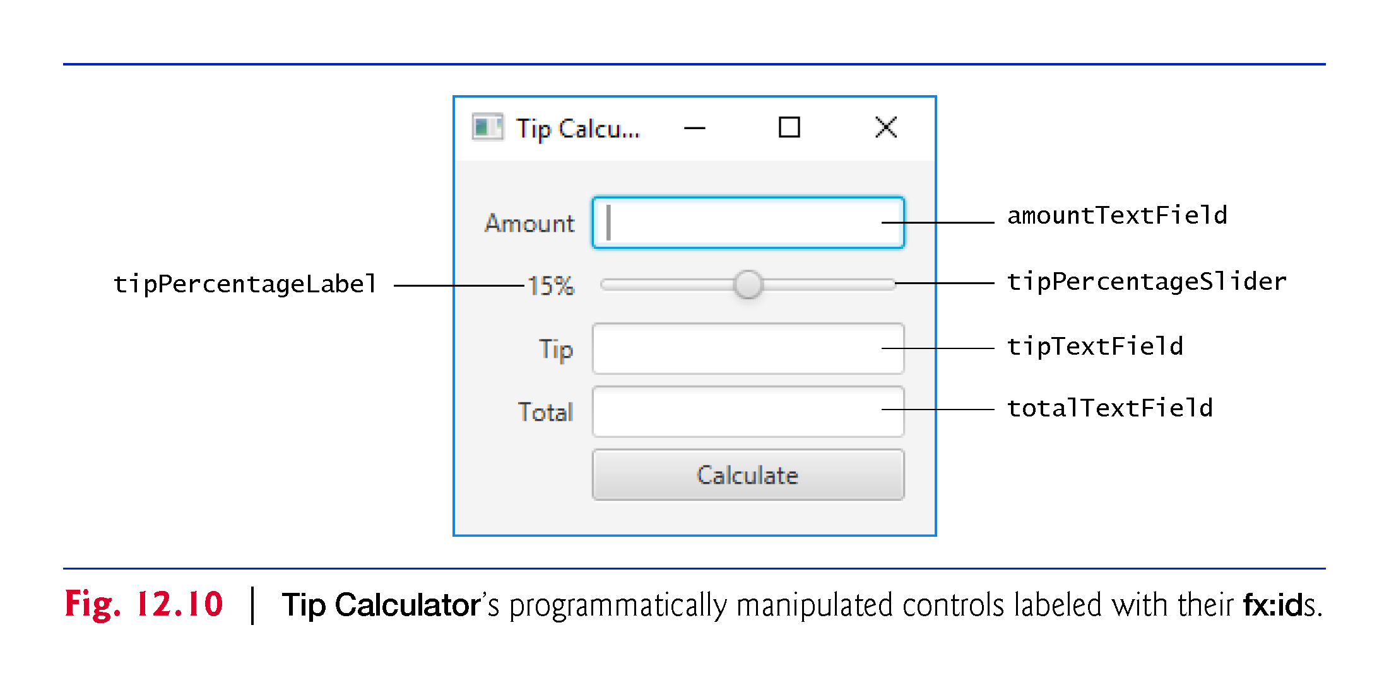

Slide 57
Building the App’s GUI (Cont.)
Open Scene Builder to create a new FXML file. Then, select File > Save to display the Save As dialog, specify the location in which to store the file, name the file TipCalculator.fxml and click the Save button.
Drag a GridPane from the Library window’s Containers section onto Scene Builder’s content panel.
By default, the GridPane contains two columns and three rows as shown in Fig. 12.11
By default, the GridPane contains two columns and three rows. You can add a row above or below an existing row by right clicking a row and selecting Grid Pane > Add Row Above or Grid Pane > Add Row Below.
You can delete a row or column by right clicking the tab containing its row or column number and selecting Delete.
After adding two rows, the GridPane should appear as shown in Fig. 12.11.

Slide 58
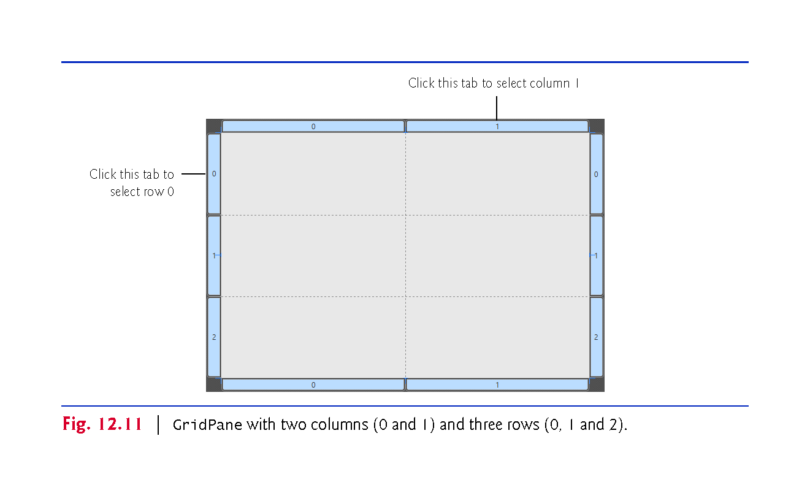

Slide 59
Building the App’s GUI (Cont.)
By default, the GridPane contains two columns and three rows.
You can add a row above or below an existing row by right clicking a row and selecting Grid Pane > Add Row Above or Grid Pane > Add Row Below.
You can delete a row or column by right clicking the tab containing its row or column number and selecting Delete.
After adding two rows, the GridPane should appear as shown in Fig. 12.12.

Slide 60
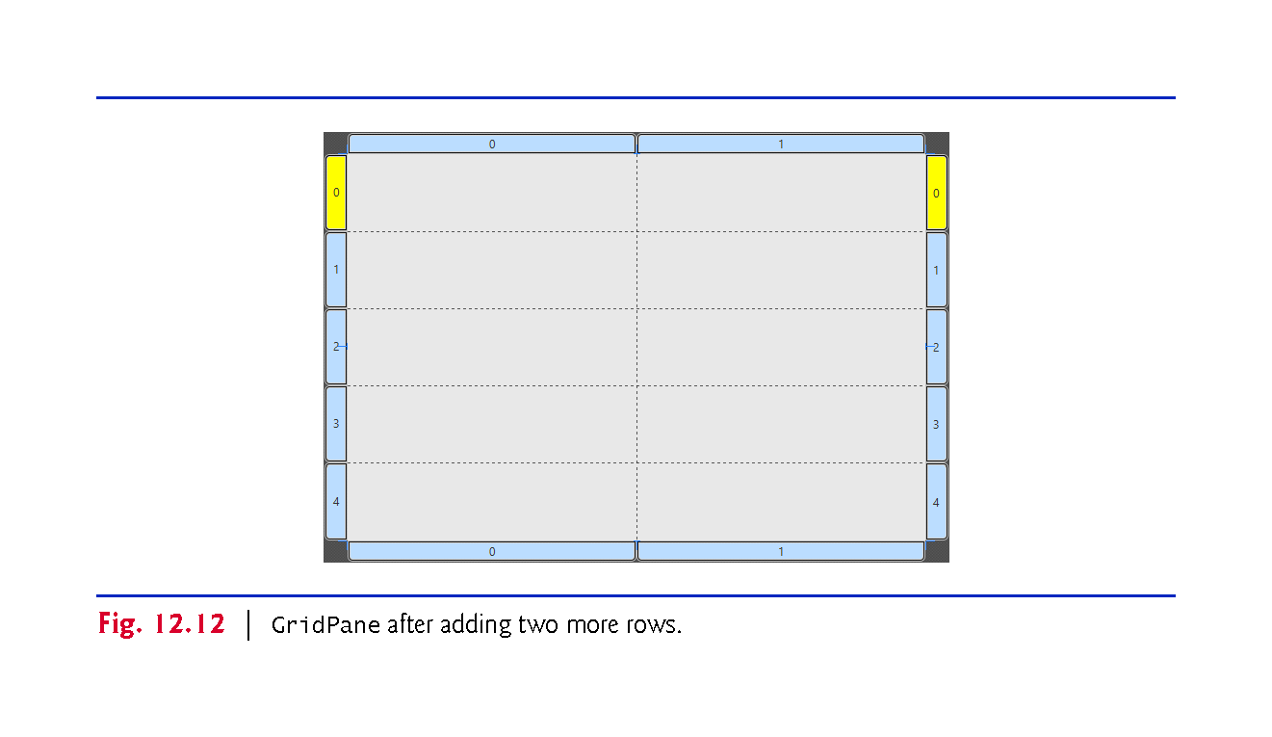

Slide 61
Building the App’s GUI (Cont.)
You’ll now add the controls to the GridPane.
For those that have fx:ids, while the control is selected, set its fx:id property in the Inspector window’s Code section.
Perform the following steps:
Drag Labels from the Library window’s Controls section into the first four rows of the GridPane’s column 0.
As you add each Label, set its text as shown Fig. 12.10.

Slide 62
Building the App’s GUI (Cont.)
Drag TextFields from the Library window’s Controls section into rows 0, 2 and 3 of the GridPane’s column 1
Drag a horizontal Slider from the Library window’s Controls section into row 1 of the GridPane’s column 1
Adding a Button. Drag a Button from the Library window’s Controls section into row 4 of the GridPane’s right column. You can set the Button’s text by double clicking it, or by selecting the Button, then setting its Text property in the Inspector window’s Properties section.
The GridPane should appear as shown in Fig. 12.13.

Slide 63
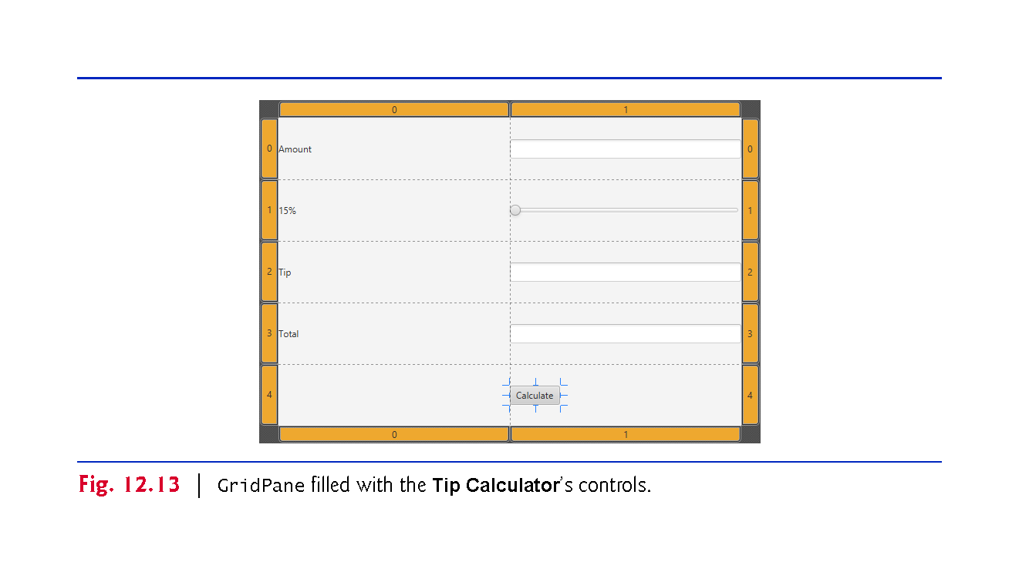

Slide 64
Sizing the GridPane
Sizing the GridPane to Fit Its Contents
When you begin designing a GUI by adding a layout, Scene Builder sets the layout object’s Pref Width property to 600 and Pref Height property to 400
We’d like the layout’s size to be computed, based on the layout’s contents.
Select the GridPane by clicking inside the GridPane, but not on any of the controls you’ve placed into its columns and rows.
Sometimes, easier to select the GridPane in the Document window’s Hierarchy section.
In the Inspector’s Layout section, reset the Pref Width and Pref Height property values to their defaults (as you did in Section 12.4.4).
Sets both properties’ values to USE_COMPUTED_SIZE, so the layout calculates its own size.
The layout now appears as shown in Fig. 12.14.

Slide 65
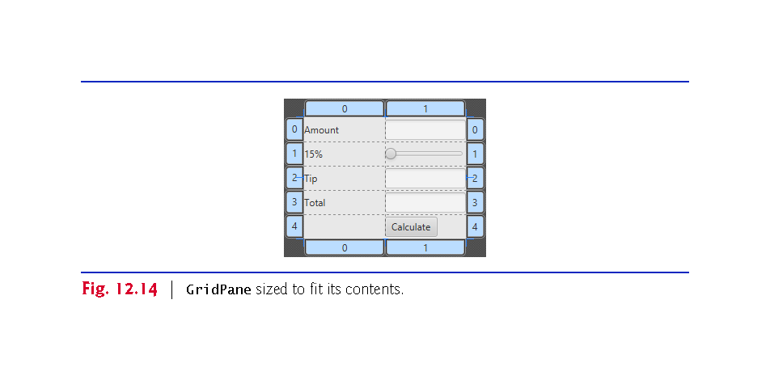

Slide 66
Align the GridPane
A GridPane column’s contents are left-aligned by default.
To right-align the contents of column 0, select it by clicking the tab at the top or bottom of the column, then in the Inspector’s Layout section, set the Halignment (horizontal alignment) property to RIGHT.

Slide 67
Configure the GridPane
By default, Scene Builder sets each GridPane column’s width to 100 pixels and each row’s height to 30 pixels to ensure that you can easily drag controls into the GridPane’s cells. In this app, we sized each column to fit its contents.
Select the column 0 by clicking the tab at the top or bottom of the column, then in the Inspector’s Layout section, reset the Pref Width property to its default size (that is, USE_COMPUTED_SIZE) to indicate that the column’s width should be based on its widest child—the Amount Label in this case.
Repeat this process for column 1.
The GridPane should appear as shown in Fig 12.15.

Slide 68
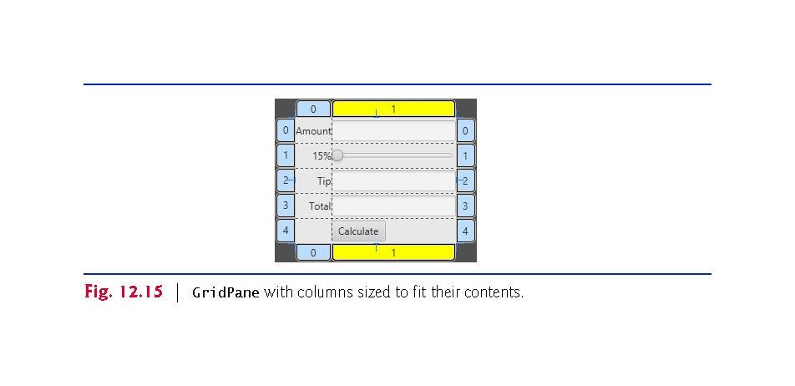

Slide 69
Configure the Button
By default, Scene Builder sets a Button’s width based on its text.
For this app, we chose to make the Button the same width as the other controls in the GridPane’s right column.
To do so, select the Button, then in the Inspector’s Layout section, set the Max Width property to MAX_VALUE.
The Button’s width grows to fill the column’s width.

Slide 70
See a Preview
Preview the GUI by selecting Preview > Show Preview in Window.
As you can see in Fig. 12.16,
There’s no space between the Labels in the left column and the controls in the right column.
There’s no space around the GridPane, because by default the Stage is sized to fit the Scene’s contents. Thus, many of the controls touch the window’s borders.
You’ll fix these issues in the next step.

Slide 71
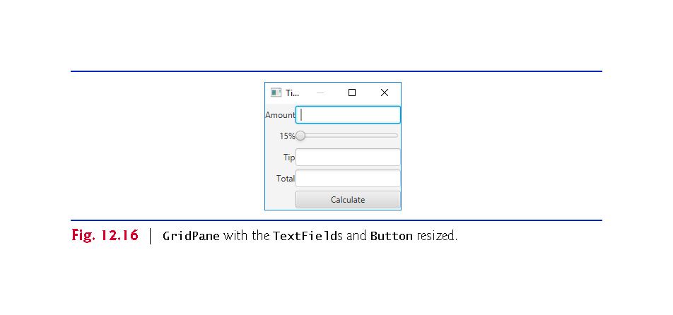

Slide 72
Padding fills the Edges
The space between a node’s contents and its top, right, bottom and left edges is known as the padding, which separates the contents from the node’s edges.
Since the GridPane’s size determines the Stage’s window size, the GridPane’s padding separates its children from the window’s edges.

Slide 73
The Gap between Controls
To set the padding, select the GridPane, then in the Inspector’s Layout section, set the Padding property’s four values (which represent the TOP, RIGHT, BOTTOM and LEFT) to 14
The recommended distance between a control’s edge and the Scene’s edge.
You can specify the default amount of space between a GridPane’s columns and rows with its Hgap (horizontal gap) and Vgap (vertical gap) properties, respectively.
Because Scene Builder sets each GridPane row’s height to 30 pixels—which is greater than the heights of this app’s controls—there’s already some vertical space between the components.

Slide 74
The Gap between Controls
To specify the horizontal gap between the columns, select the GridPane in the Document window’s Hierarchy section
In the Inspector’s Layout section, set the Hgap property to 8
Recommended distance between controls.
If you’d like to precisely control the vertical space between components, you can reset each row’s Pref Height to its default value, then set the GridPane’s Vgap property.

Slide 75
Keyboard Focus
You can type in a TextField only if it’s “in focus”—that is, it’s the control that the user is interacting with.
When you click an interactive control, it receives the focus.
When you press the Tab key, the focus transfers from the current focusable control to the next in the order the controls were added to the GUI.
In this app, the tipTextField and totalTextField are neither editable nor focusable.
Select both TextFields, then in the Inspector’s Properties section uncheck the Editable and Focus Traversable properties.
To select multiple controls at once, you can click the first (in the Document window’s Hierarchy section or in the content panel), then hold the Shift key and click each of the others.

Slide 76
Configure the Slider
By default, a Slider’s range is 0.0 to 100.0 and its initial value is 0.0.
This app allows only integer tip percentages in the range 0 to 30 with a default of 15.
Select the Slider, then in the Inspector’s Properties section, set the Max property to 30 and the Value property to 15.
Set the Block Increment property to 5
The amount by which the Value property increases or decreases when the user clicks between an end of the Slider and the Slider’s thumb.
Save the FXML file by selecting File > Save.
We’ll restrict the Slider’s values to integers when we respond to its events in Java code

Slide 77
Preview the TipCalculator
Select Preview > Show Preview in Window to view the final GUI (Fig. 12.16).
When we discuss the TipCalculatorController class in Section 12.5.5, we’ll show how to specify the Calculate Button’s event handler in the FXML file.

Slide 78
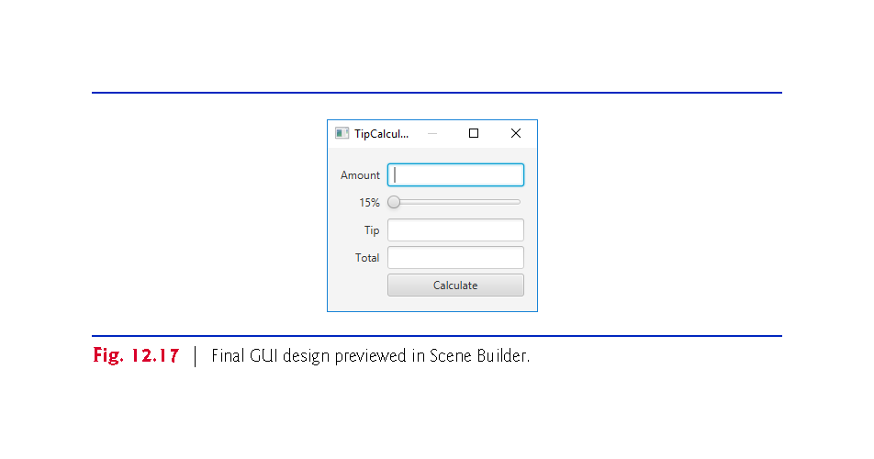

Slide 79
Associate TipCalculatorController as Controller Class
To ensure that an object of the controller class is created when the app loads the FXML file at runtime, you must specify the controller class’s name in the FXML file:
Expand Scene Builder Document window’s Controller section (located below the Hierarchy section in ).
In the Controller Class field, type TipCalculatorController
By convention, the controller class’s name starts with the same name as the FXML file (TipCalculator) and ends with Controller.

Slide 80
Associate calculateButtonPressed with Button OnAction
You can specify in the FXML file the names of the methods that will be called to handle specific control’s events
When you select a control, the Inspector window’s Code section shows all the events for which you can specify event handlers in the FXML file.
When the user clicks a Button, the method specified in the On Action field is called
This method is defined in the controller class you specify in Scene Builder’s Controller window.
Enter calculateButtonPressed in the On Action field.

Slide 81
SceneBuilder can Generate Controller class
You can have Scene Builder generate the initial controller class containing the variables you’ll use to interact with controls programmatically and the empty Calculate Button event handler.
Scene Builder calls this the “controller skeleton.”
Select View > Show Sample Controller Skeleton to generate the skeleton in Fig. 12.18.
The sample class has the class name you specified, a variable for each control that has an fx:id and an empty Calculate Button event handler.
You can click the Copy button, then paste the contents into a file named TipCalculatorController.java in the same folder as the TipCalculator.fxml file you created in this section.

Slide 82
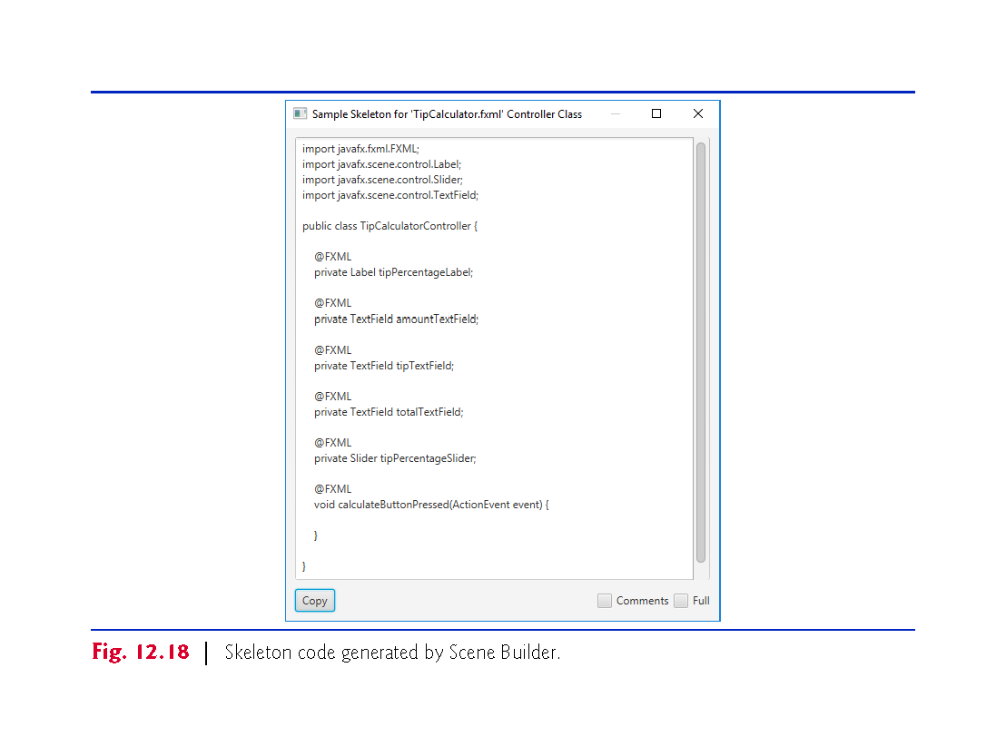

Slide 83
TipCalculator Class
A simple JavaFX FXML-based app has two Java source-code files
TipCalculator.java—This file contains the TipCalculator class, which declares the main method that loads the FXML file to create the GUI and attaches the GUI to a Scene displayed on the app’s Stage.
TipCalculatorController.java—This file contains the TipCalculatorController class, where you’ll specify the Slider and Button controls’ event handlers.

Slide 84
TipCalculator Class
Fig. 12.19 presents class TipCalculator.
The starting point for a JavaFX app is an Application subclass, so class TipCalculator extends Application (line 9).
main calls class Application’s static launch method (line 23) to initialize the JavaFX runtime and to begin executing the app.
This causes the JavaFX runtime to create an object of the TipCalculator class and calls its start method (lines 10–19), passing the Stage object representing the window in which the app will be displayed.
The JavaFX runtime creates the window.

Slide 85
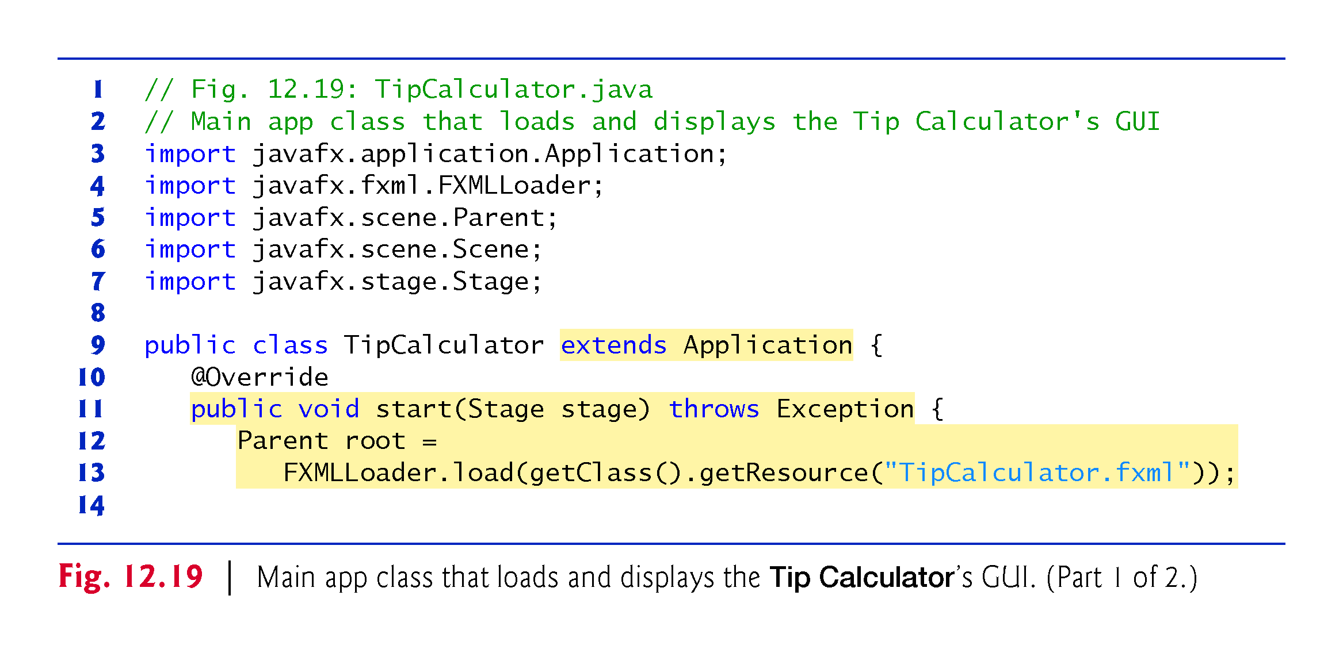

Slide 86
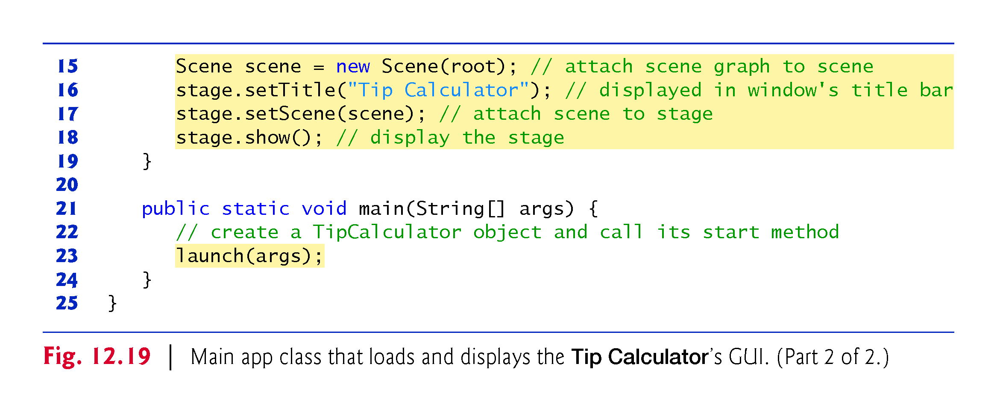

Slide 87
TipCalculator Class (Cont.)
Method start (lines 11–19) creates the GUI, attaches it to a Scene and places it on the Stage that method start receives as an argument.
Lines 12–13 use class FXMLLoader’s static method load to create the GUI’s scene graph. This method:
Returns a Parent (package javafx.scene) reference to the scene graph’s root node—the GUI’s GridPane in this app.
Creates an object of the TipCalculatorController class that we specified in the FXML file.
Initializes the controller’s instance variables for the components that are manipulated programmatically.
Registers the event handlers specified in the FXML to the appropriate controls.
Enables the controls to call the corresponding methods when the user interacts with the app.

Slide 88
TipCalculator Class (Cont.)
To display the GUI, you must attach it to a Scene, then attach the Scene to the Stage that method start receives as an argument.
To attach the GUI to a Scene, line 15 creates a Scene, passing root (the scene graph’s root node) as an argument to the constructor.
By default, the Scene’s size is determined by the size of the scene graph’s root node.
Line 16 uses Stage method setTitle to specify the text that appears in the Stage window’s title bar.
Line 17 calls Stage method setScene to place the Scene onto the Stage.
Line 18 calls Stage method show to display the Stage window.

Slide 89
TipCalculatorController Class
Figures 12.20–12.23 present the class TipCalculatorController

Slide 90
TipCalculatorController Class (Cont.)
Figure 12.20 shows class TipCalculatorController’s imports.
The RoundingMode enum of package java.math is used to specify how BigDecimal values are rounded during calculations or when formatting floating-point numbers as Strings.
Class NumberFormat of package java.text provides numeric formatting capabilities, such as locale-specific currency and percentage formats.
A Button’s event handler receives an ActionEvent, which indicates that the Button was clicked. Many JavaFX controls support ActionEvents.

Slide 91
TipCalculatorController Class (Cont.)
ChangeListener and ObservableValue are used to respond to Slider events.
The annotation FXML (package javafx.fxml) is used in a JavaFX controller class’s code to mark instance variables that should refer to JavaFX components in the GUI’s FXML file and methods that can respond to the events of JavaFX components in the GUI’s FXML file.
Package javafx.scene.control contains many JavaFX control classes.

Slide 92
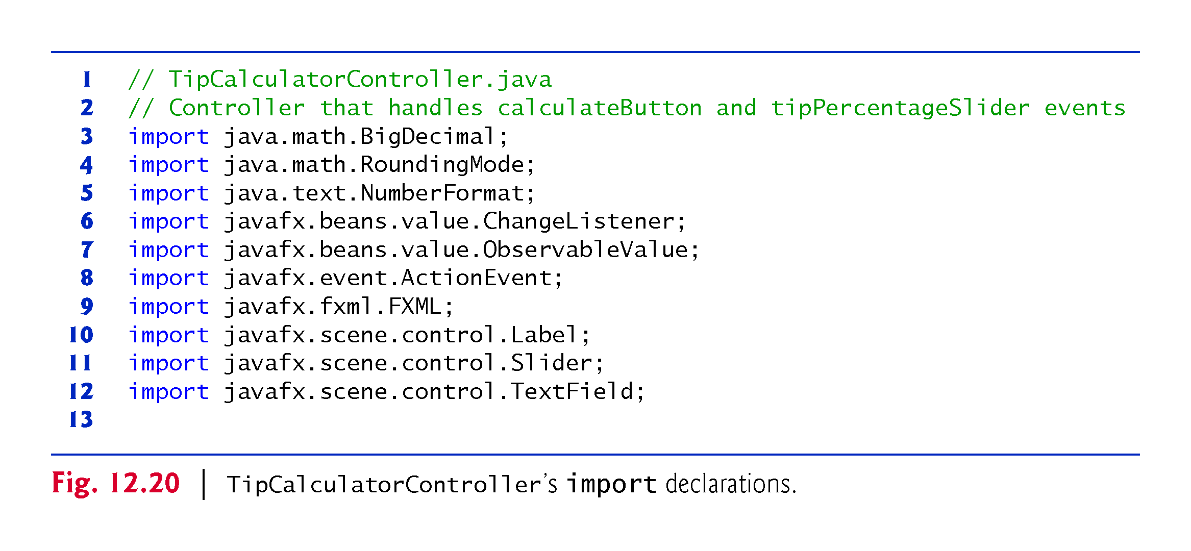

Slide 93
TipCalculatorController Class (Cont.)
Fig. 12.21 presents class TipCalculatorController’s static and instance variables.
The @FXML annotation preceding an instance variable indicates that the variable’s name can be used in the FXML file that describes the app’s GUI.
The variable names that you specify in the controller class must precisely match the fx:id values you specified when building the GUI.
When the FXMLLoader loads an FXML file to create a GUI, it also initializes each of the controller’s instance variables that are declared with @FXML to ensure that they refer to the corresponding GUI components in the FXML file.

Slide 94
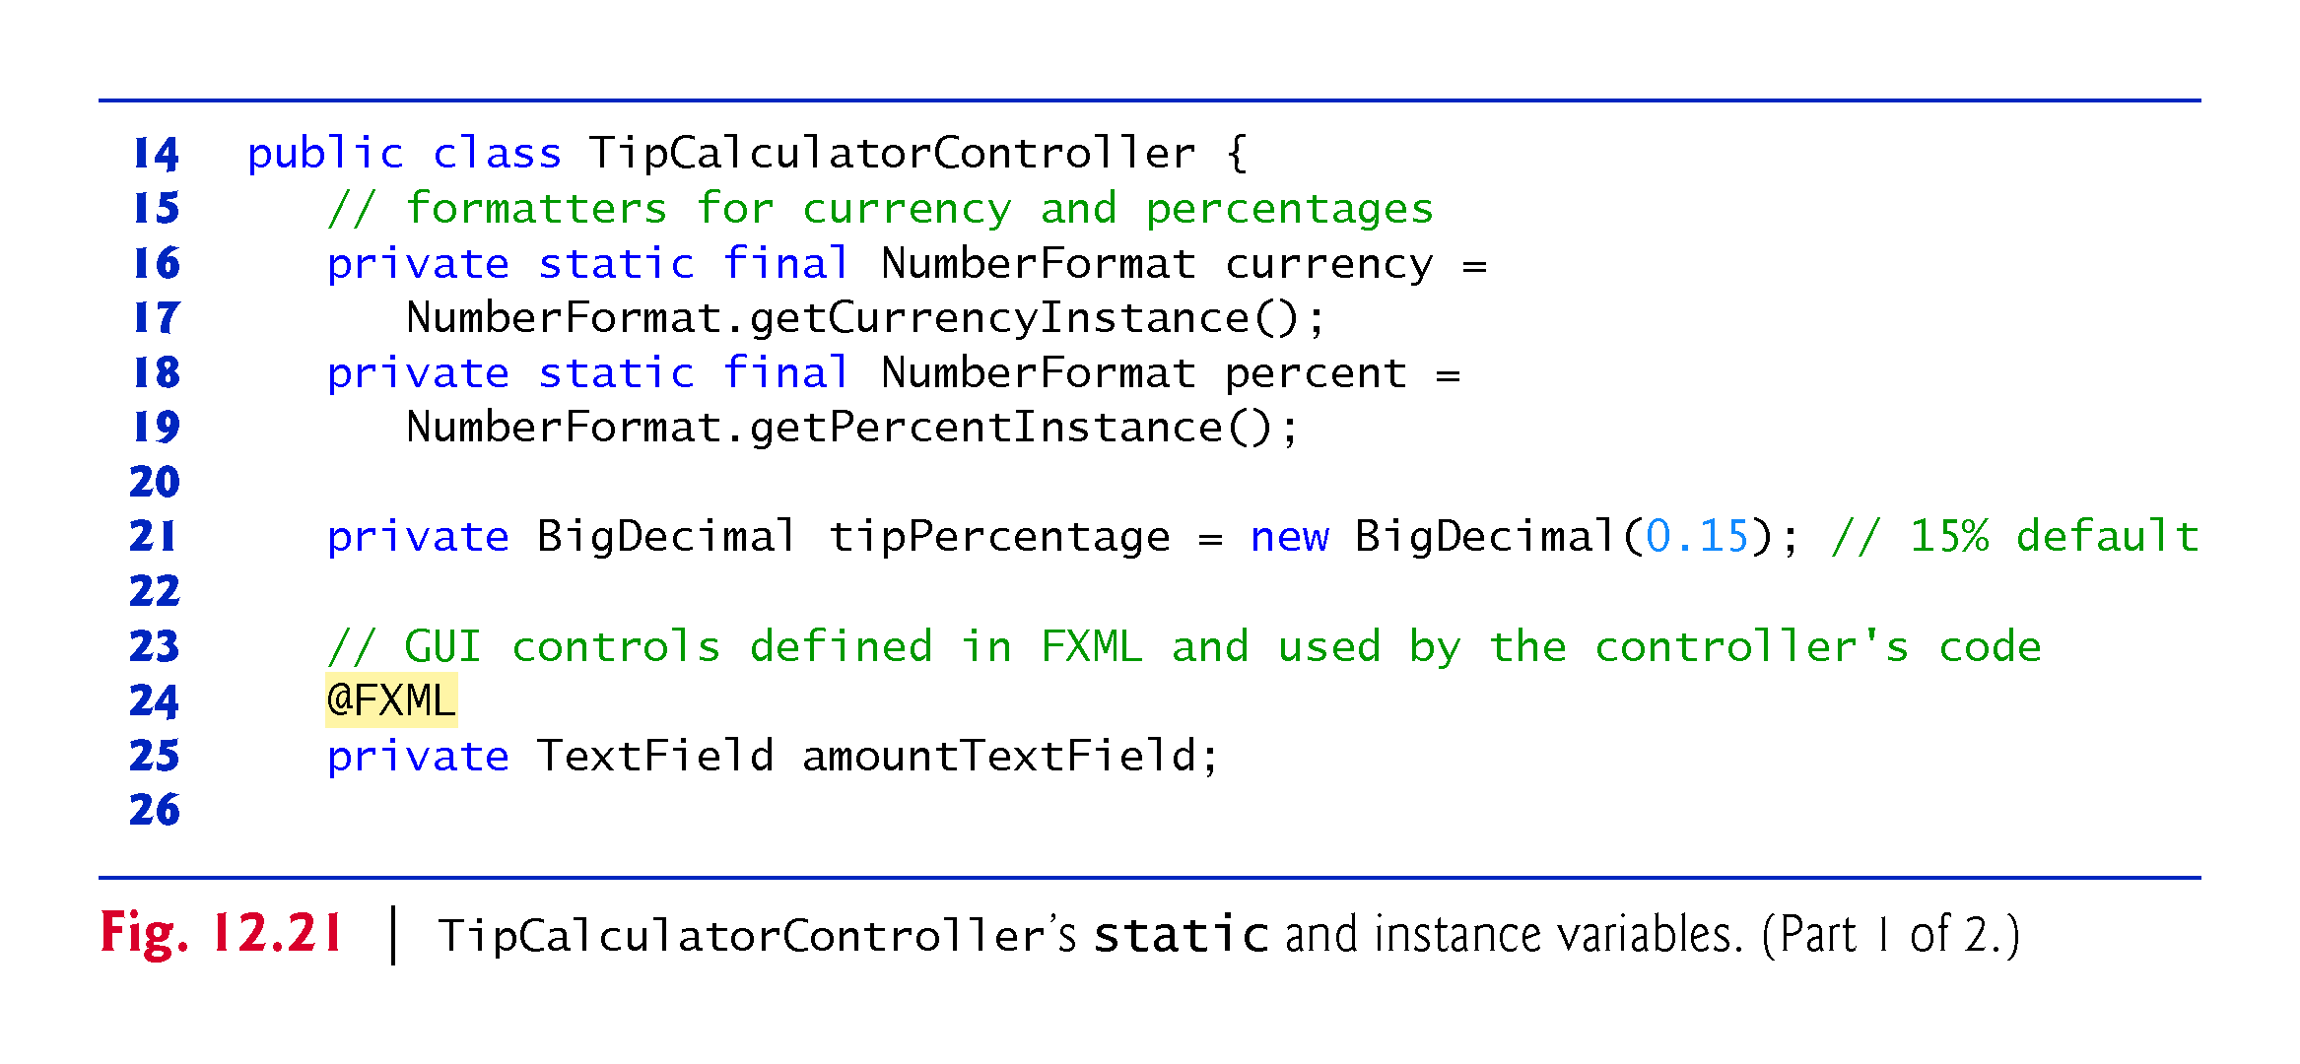

Slide 95
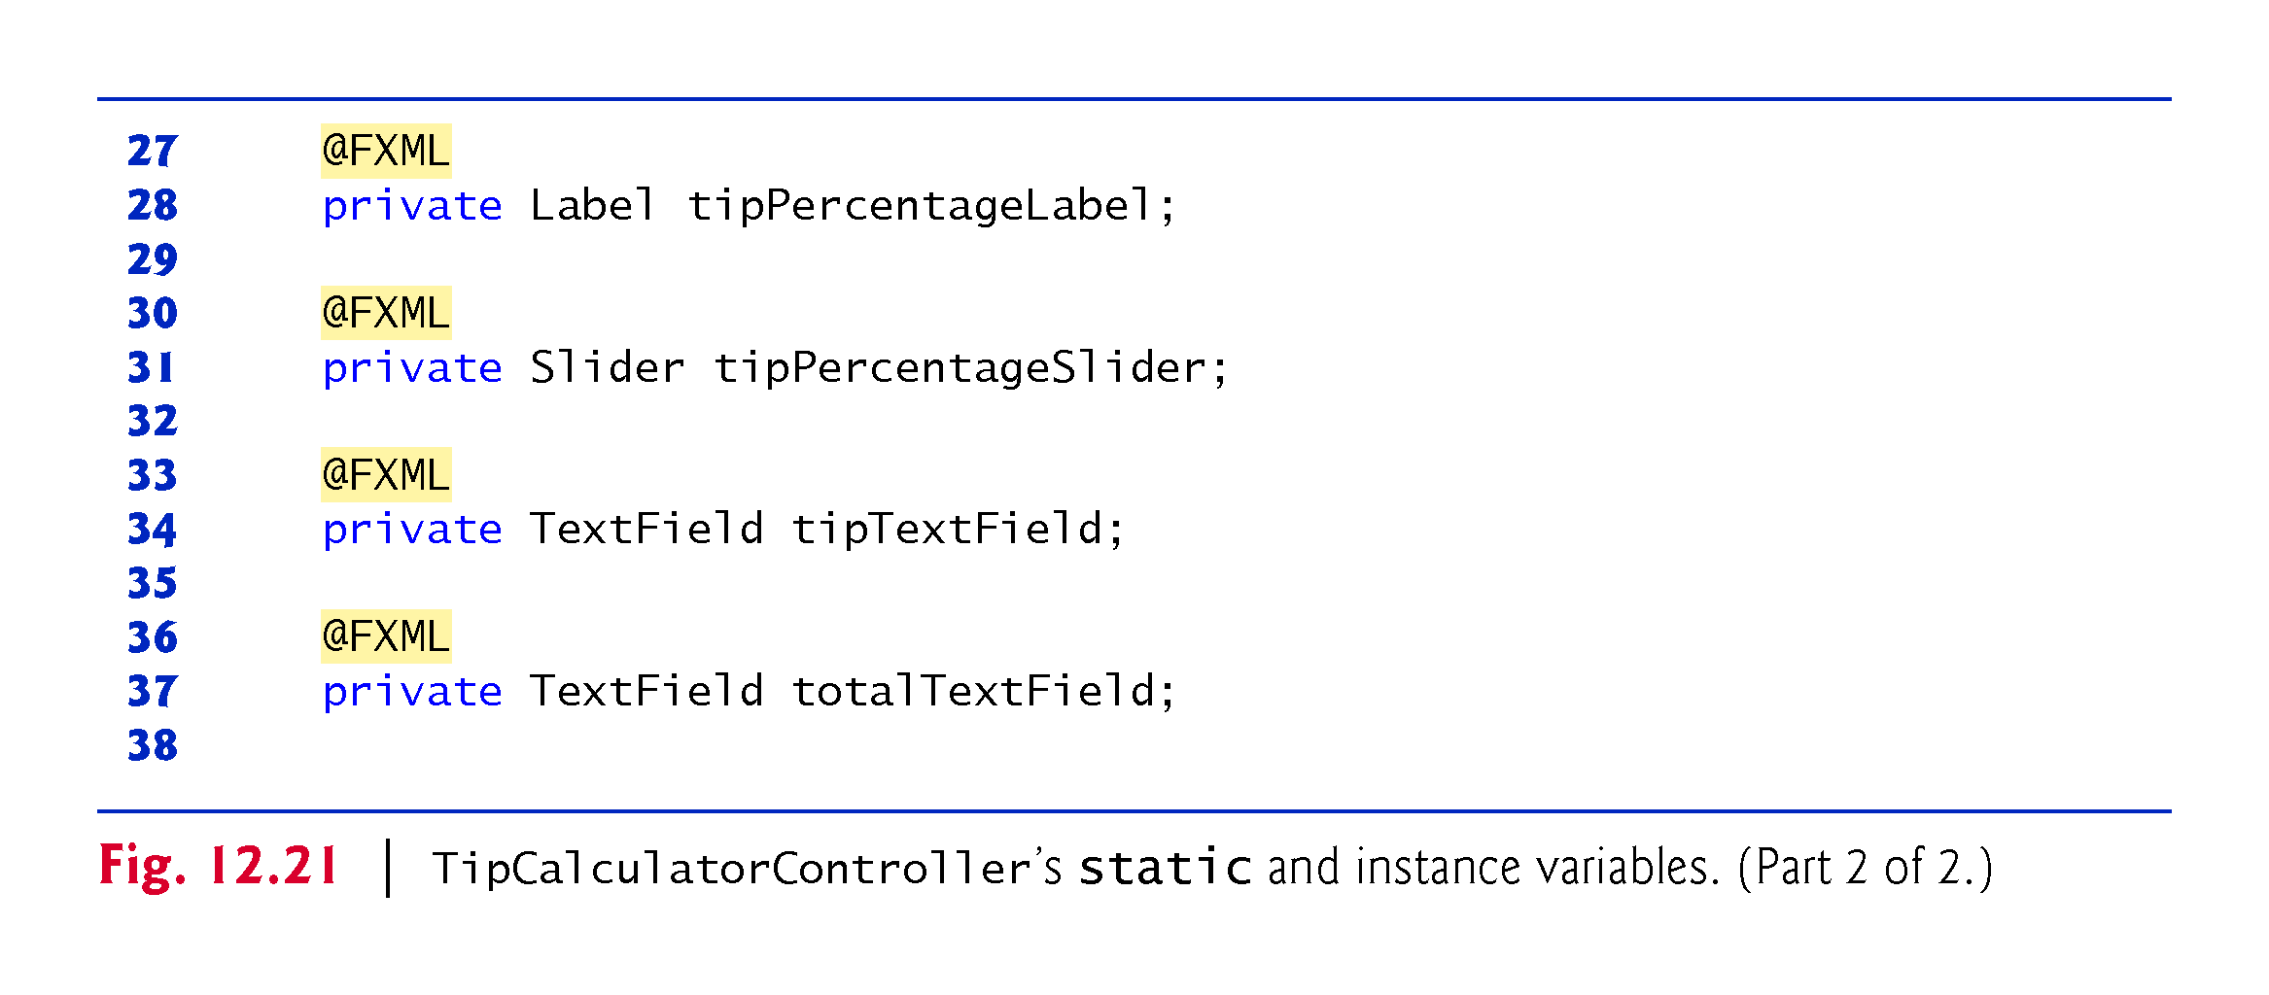

Slide 96
TipCalculatorController Class (Cont.)
Figure 12.22 presents class TipCalculatorController’s calculateButtonPressed method, which is called with the user clicks the Calculate Button.
The @FXML annotation preceding a method indicates that the method can be used to specify a control’s event handler in the FXML file that describes the app’s GUI.

Slide 97
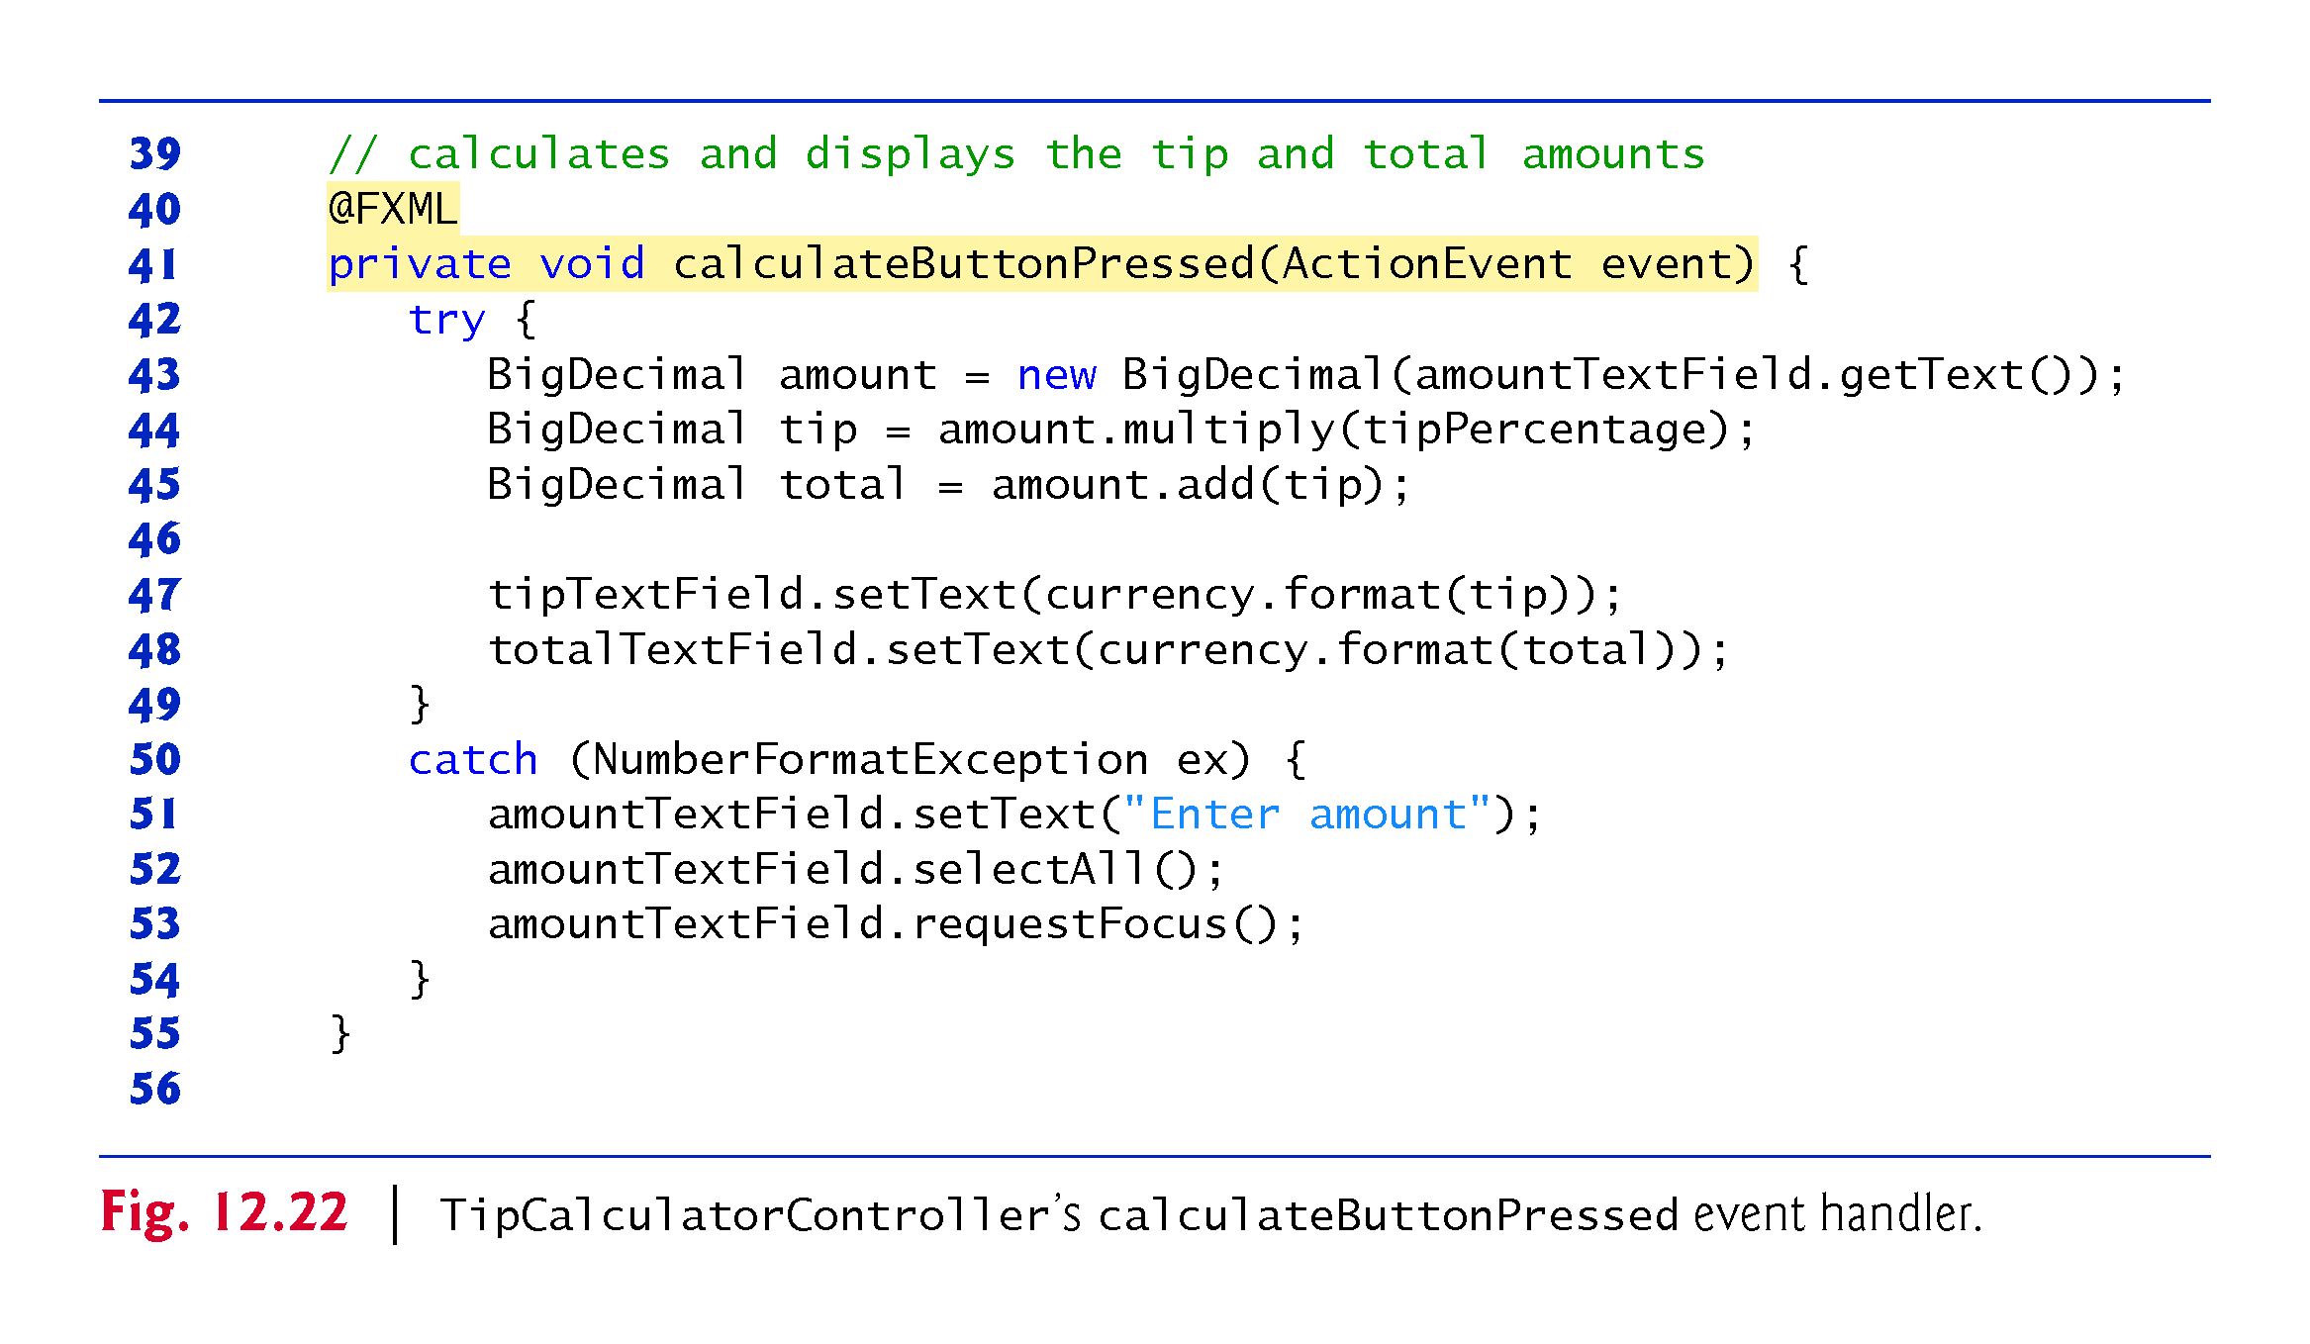

Slide 98
TipCalculatorController Class (Cont.)
When the FXMLLoader loads TipCalculator.fxml to create the GUI, it creates and registers an event handler for the Calculate Button’s ActionEvent.
The event handler for this event must implement interface EventHandler<ActionEvent
This interface contains a handle method that returns void and receives an ActionEvent parameter.
This method’s body, in turn, calls method calculateButtonPressed when the user clicks the Calculate Button.
FXMLLoader performs similar tasks for every event listener you specify via the Scene Builder Inspector window’s Code section.

Slide 99
TipCalculatorController Class (Cont.)
Figure 12.23 presents class TipCalculatorController’s initialize method.
When the FXMLLoader creates an object of a controller class, it determines whether the class contains an initialize method with no parameters and, if so, calls that method to initialize the controller.
This method can be used to configure the controller before the GUI is displayed.

Slide 100
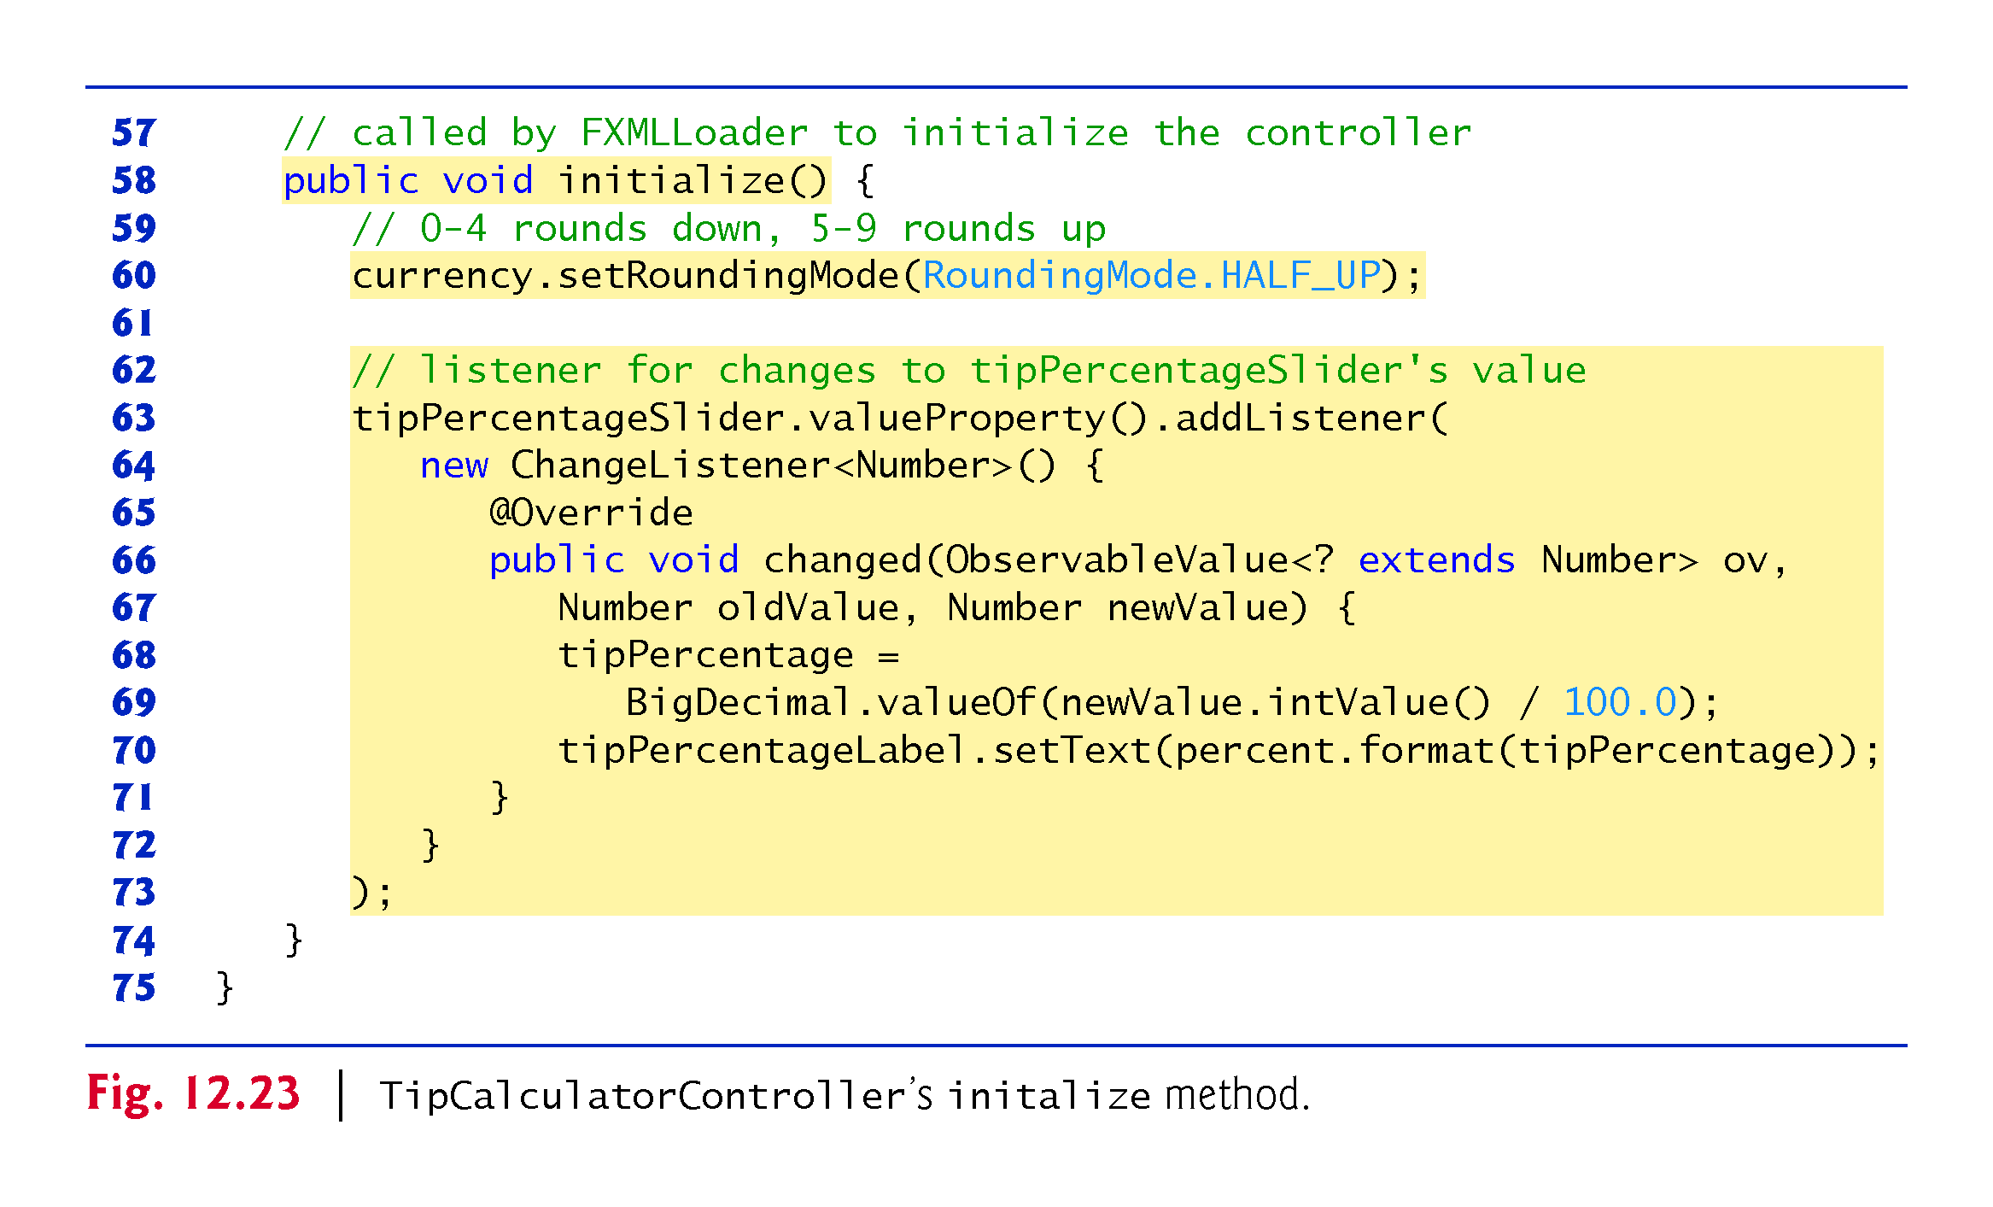

Slide 101
TipCalculatorController Class (Cont.)
Each JavaFX control has properties and some generate events when they change.
For such events, you must manually register as the event handler an object that implements the ChangeListener interface (package javafx.beans.value).
ChangeListener is a generic type that’s specialized with the property’s type.
The call to valueProperty (line 63) returns a DoubleProperty (package javax.beans.property) that represents the Slider’s value.
A DoubleProperty is an ObservableValue<Number> that can notify listeners when a value changes.
Each class that implements interface ObservableValue provides method addListener (called on line 63) to register an event-handler that implements interface ChangeListener.
For a Slider’s value, addListener’s argument is an object that implements ChangeListener<Number>, because the Slider’s value is a numeric value.

Slide 102
TipCalculatorController Class (Cont.)
If an event handler is not reused, you often define it as an instance of an anonymous inner class
The argument in lines 64–72 is one statement that
declares the event listener’s class,
creates an object of that class and
registers it as the listener for changes to the tipPercentageSlider’s value.
Since an anonymous inner class has no name, you must create an object of the class at the point where it’s declared (thus the keyword new in line 64).
ChangeListener<Number>() in line 64 begins the declaration of an anonymous inner class that implements ChangeListener<Number>
Similar to beginning a class declaration with public class MyHandler implements ChangeListener<Number>

Slide 103
TipCalculatorController Class (Cont.)
The opening left brace at 64 and the closing right brace at line 72 delimit the anonymous inner class’s body.
Lines 65–71 declare the interface’s changed method, which receives a reference to the ObservableValue that changed, a Number containing the old value before the event occurred and a Number containing the new value.
When the user moves the Slider’s thumb, lines 68–69 store the new tip percentage and line 70 updates the tipPercentageLabel.

Slide 104
TipCalculatorController Class (Cont.)
An anonymous inner class can access its top-level class’s instance variables, static variables and methods
However, an anonymous inner class has limited access to the local variables of the method in which it’s declared—it can access only the final or effectively final (Java SE 8) local variables declared in the enclosing method’s body.

Slide 105
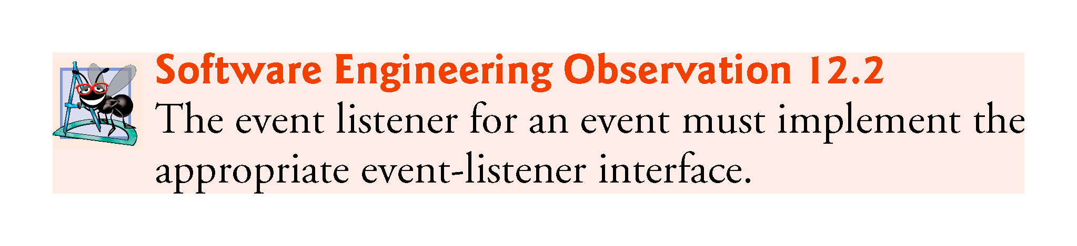

Slide 106
