Slide 1
Chapter 13 JavaFX GUI: Part 2
Java How to Program, 11/e
Questions? E-mail paul.deitel@deitel.com

Slide 2
Introduction
In this chapter, you’ll:
Use additional layouts (TitledPane, BorderPane and Pane) and controls (RadioButton- and ListView).
Handle mouse and RadioButton events.
Set up event handlers that respond to property changes on controls (such as the value of a Slider).
Display Rectangles and Circles as nodes in the scene graph
Bind a collection of objects to a ListView that displays the collection’s contents
Customize the appearance of a ListView’s cells.

Slide 3
Laying Out Nodes in a Scene Graph
A layout determines the size and positioning of nodes in the scene graph
In general, a node’s size should not be defined explicitly
Doing so often creates a design that looks pleasing when it first loads, but deteriorates when the app is resized or the content updates

Slide 4
Laying Out Nodes in a Scene Graph (cont.)
In addition to the width and height properties, most JavaFX nodes have the properties prefWidth, prefHeight, minWidth, minHeight, maxWidth and maxHeight that specify a node’s range of acceptable sizes as it’s laid out within its parent node
The minimum size properties specify a node’s smallest allowed size in points
The maximum size properties specify a node’s largest allowed size in points
The preferred size properties specify a node’s preferred width and height that should be used by the layout in most cases.

Slide 5
Laying Out Nodes in a Scene Graph (cont.)
A node’s position should be defined relative to its parent node and the other nodes in its parent
JavaFX layout panes are container nodes that arrange their child nodes in a scene graph relative to one another, based on their sizes and positions
Child nodes are controls, other layout panes, shapes and more.
Most JavaFX layout panes use relative positioning—if a layout-pane node is resized, it adjusts its children’s sizes and positions accordingly, based on their preferred, minimum and maximum sizes

Slide 6
Laying Out Nodes in a Scene Graph (cont.)
Figure 13.1 describes each of the JavaFX layout panes, including those presented in Chapter 12
In this chapter, we’ll use Pane, BorderPane, GridPane and VBox from the javafx.scene.layout package

Slide 7
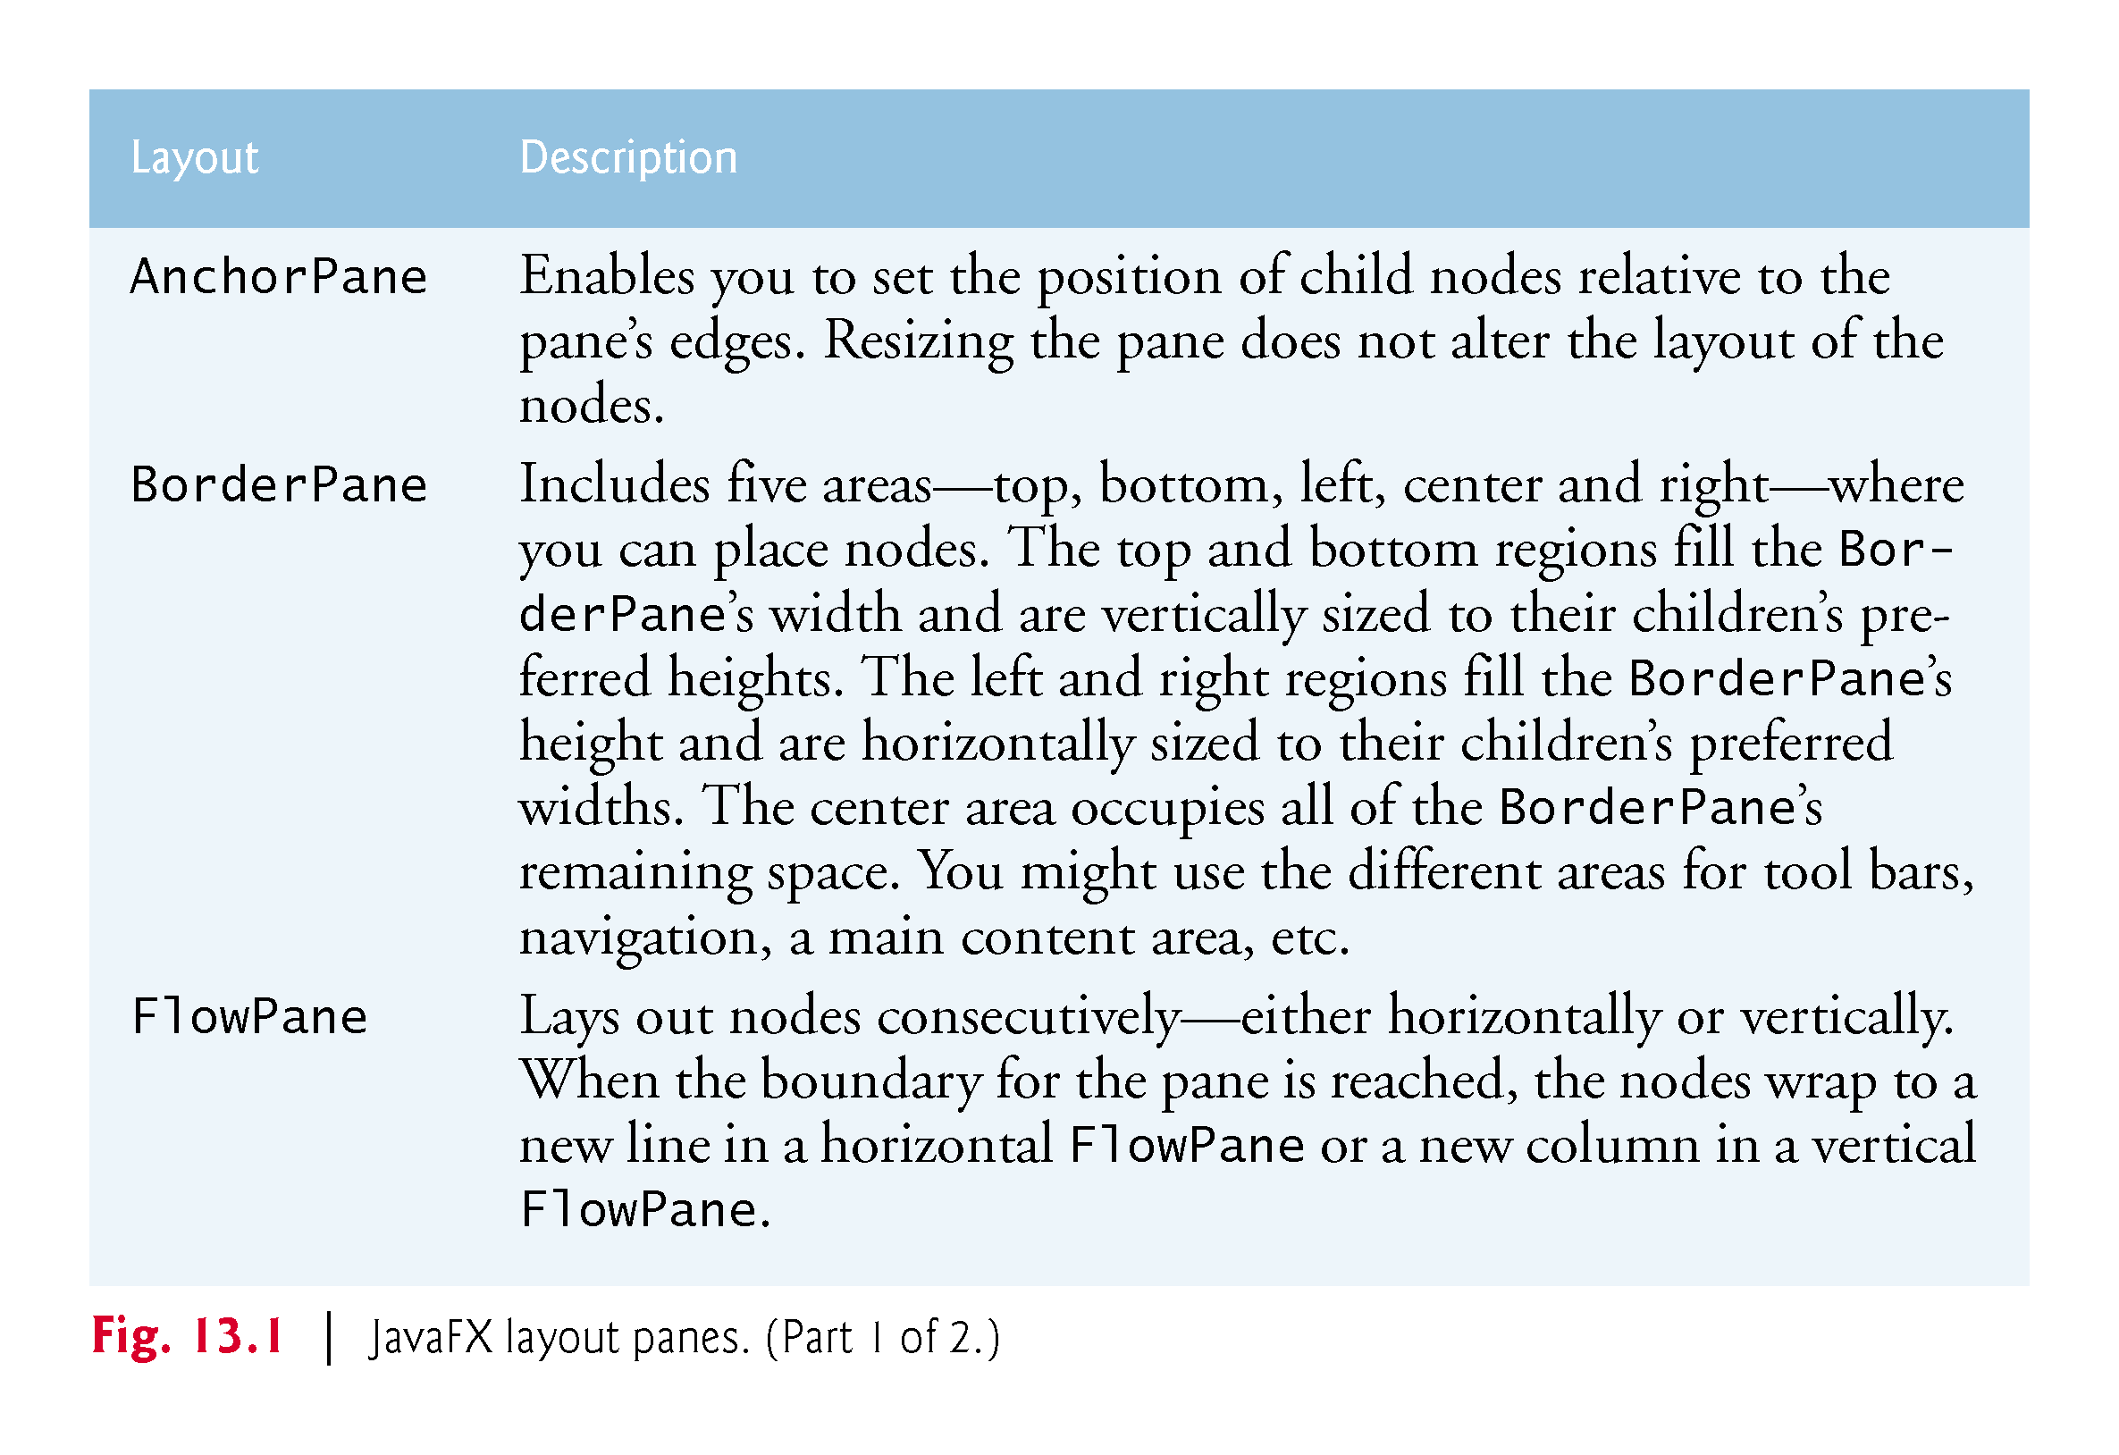

Slide 8
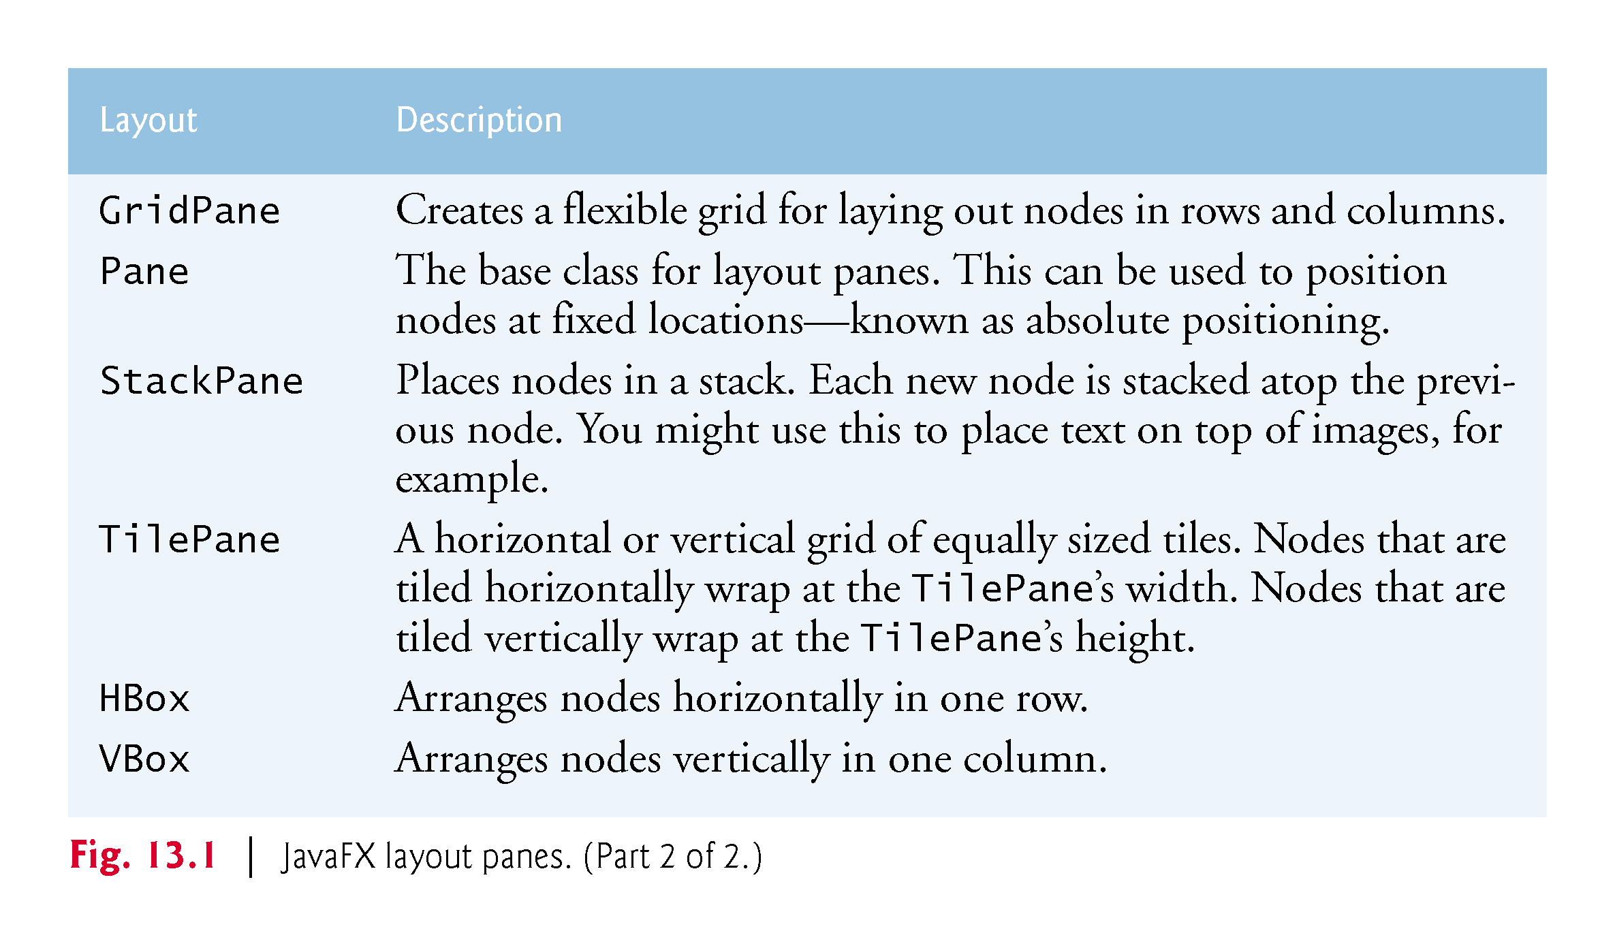

Slide 9
Painter App: RadioButtons, Mouse Events and Shapes
In this section, you’ll create a simple Painter app (Fig. 13.2) that allows you to drag the mouse to draw
First, we’ll overview the technologies you’ll use, then we’ll discuss creating the app’s project and building its GUI
Finally, we’ll present the source code for its Painter and PainterController classes.

Slide 10
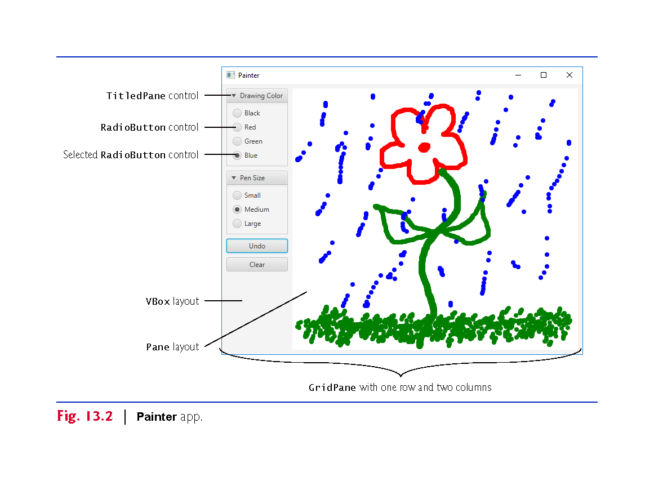

Slide 11
Technologies Overview
RadioButtons and ToggleGroups
RadioButtons function as mutually exclusive options
You add multiple RadioButtons to a ToggleGroup to ensure that only one RadioButton in a given group is selected at a time
For this app, you’ll use JavaFX Scene Builder’s capability for specifying each RadioButton’s ToggleGroup in FXML
Can also create a ToggleGroup in Java, then use a RadioButton’s setToggleGroup method to specify its ToggleGroup.

Slide 12
Technologies Overview (cont.)
BorderPane Layout Container
A BorderPane layout container arranges controls into one or more of the five regions shown in Fig. 13.3
The top and bottom areas have the same width as the BorderPane
The left, center and right areas fill the vertical space between the top and bottom areas
Each area may contain only one control or one layout container that, in turn, may contain other controls

Slide 13
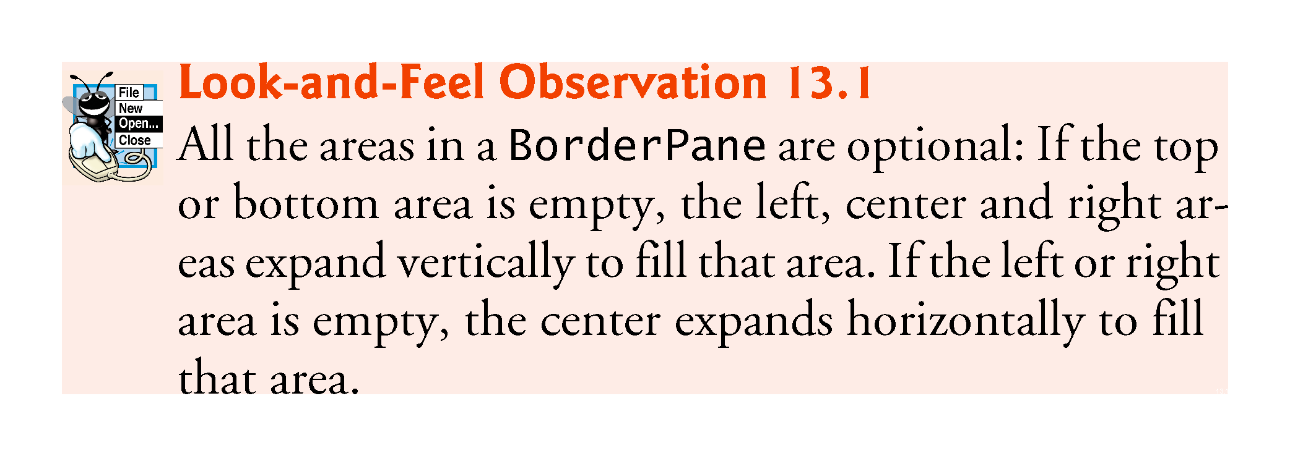

Slide 14
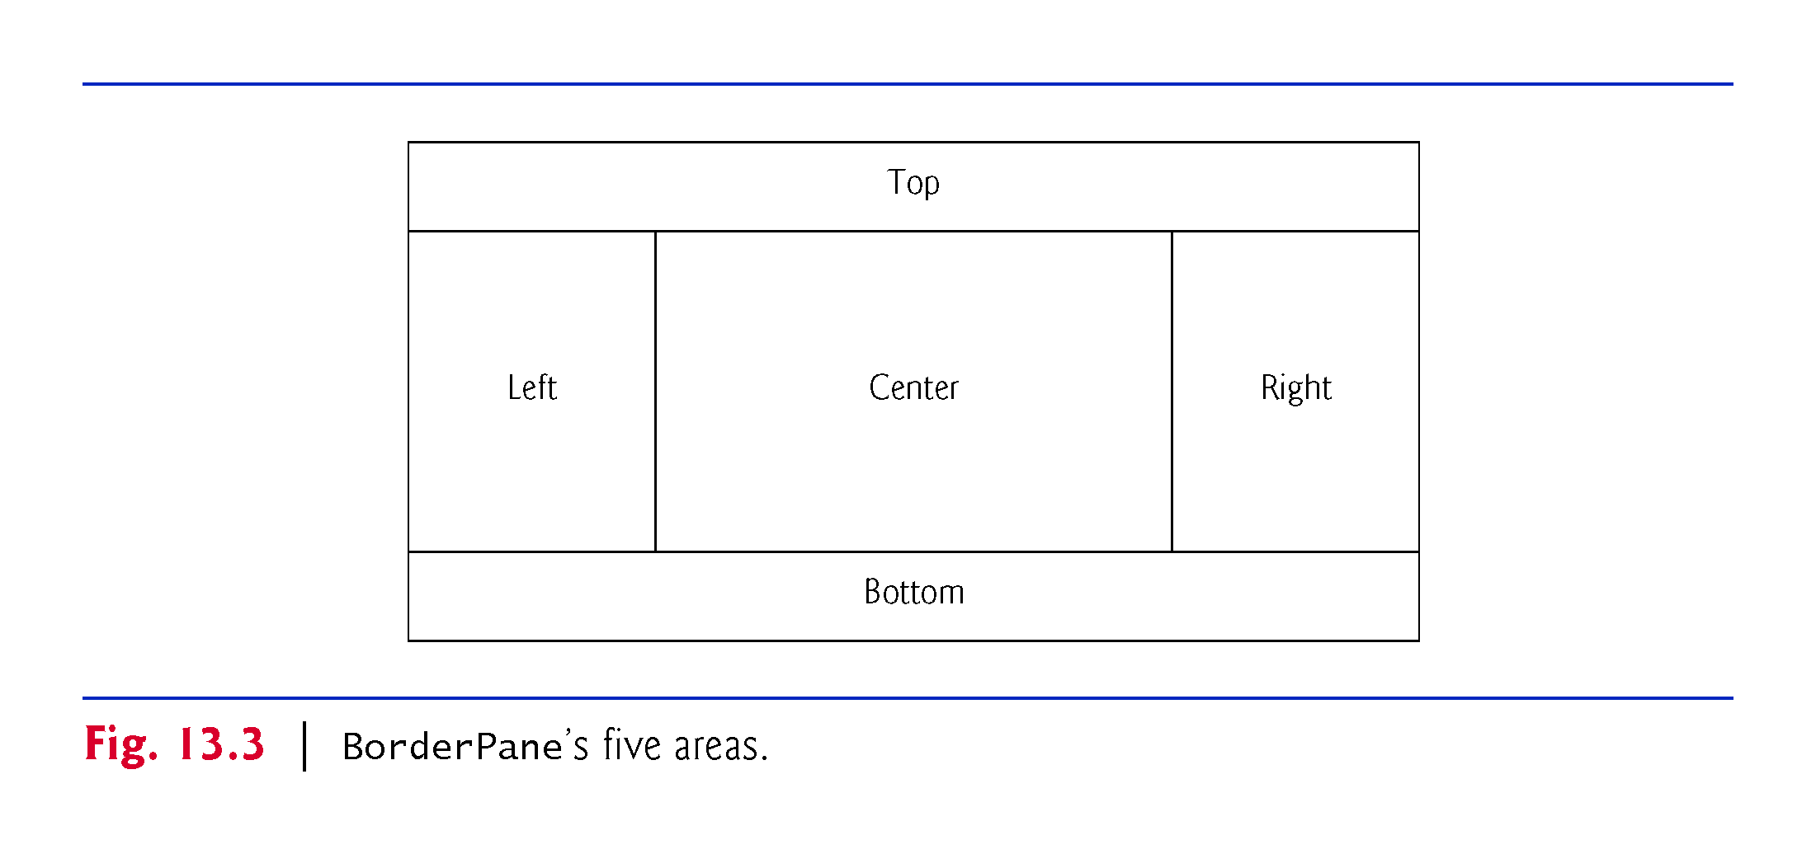

Slide 15
Technologies Overview (cont.)
Mouse Event Handling
When you drag the mouse, the app’s controller responds by displaying a Circle (in the currently selected color and pen size) at the current mouse position in the Pane
JavaFX nodes support various mouse events (Fig. 13.4)
You’ll configure an onMouseDragged event handler for this app's Pane
JavaFX supports other input events
For example, for touchscreen devices there are various touch-oriented events and for keyboards there are various key events
For a complete list of JavaFX node events, see the Node class’s properties that begin with the word “on” at:
http://docs.oracle.com/javase/8/javafx/api/javafx/scene/Node.html

Slide 16
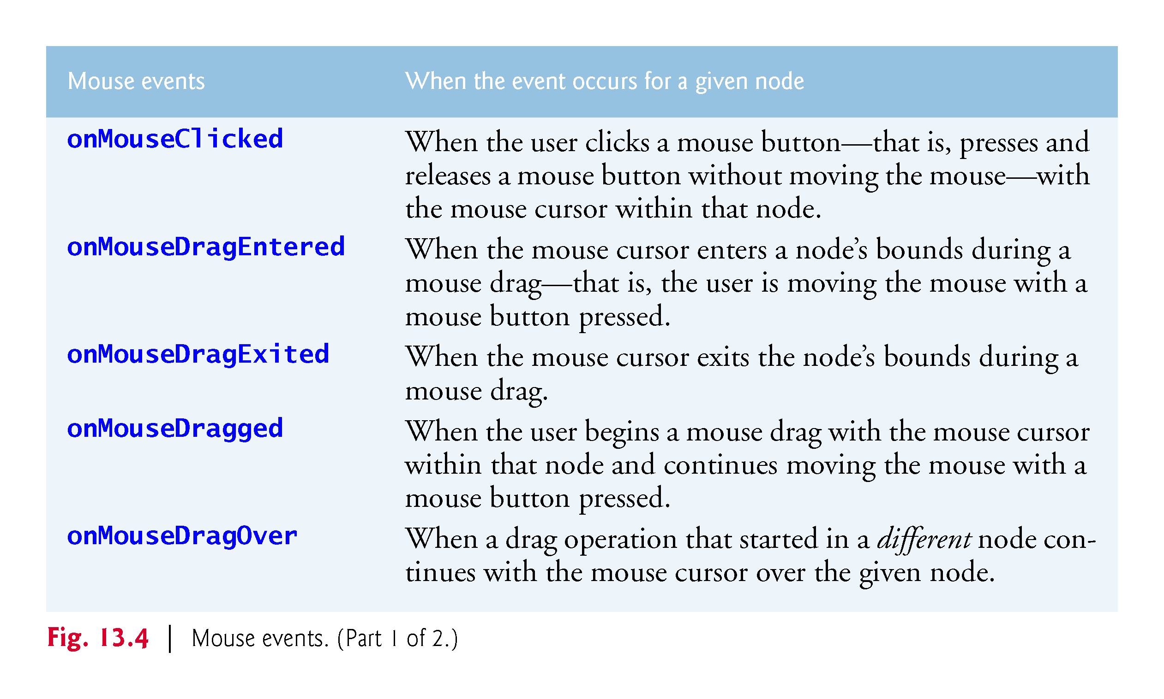

Slide 17
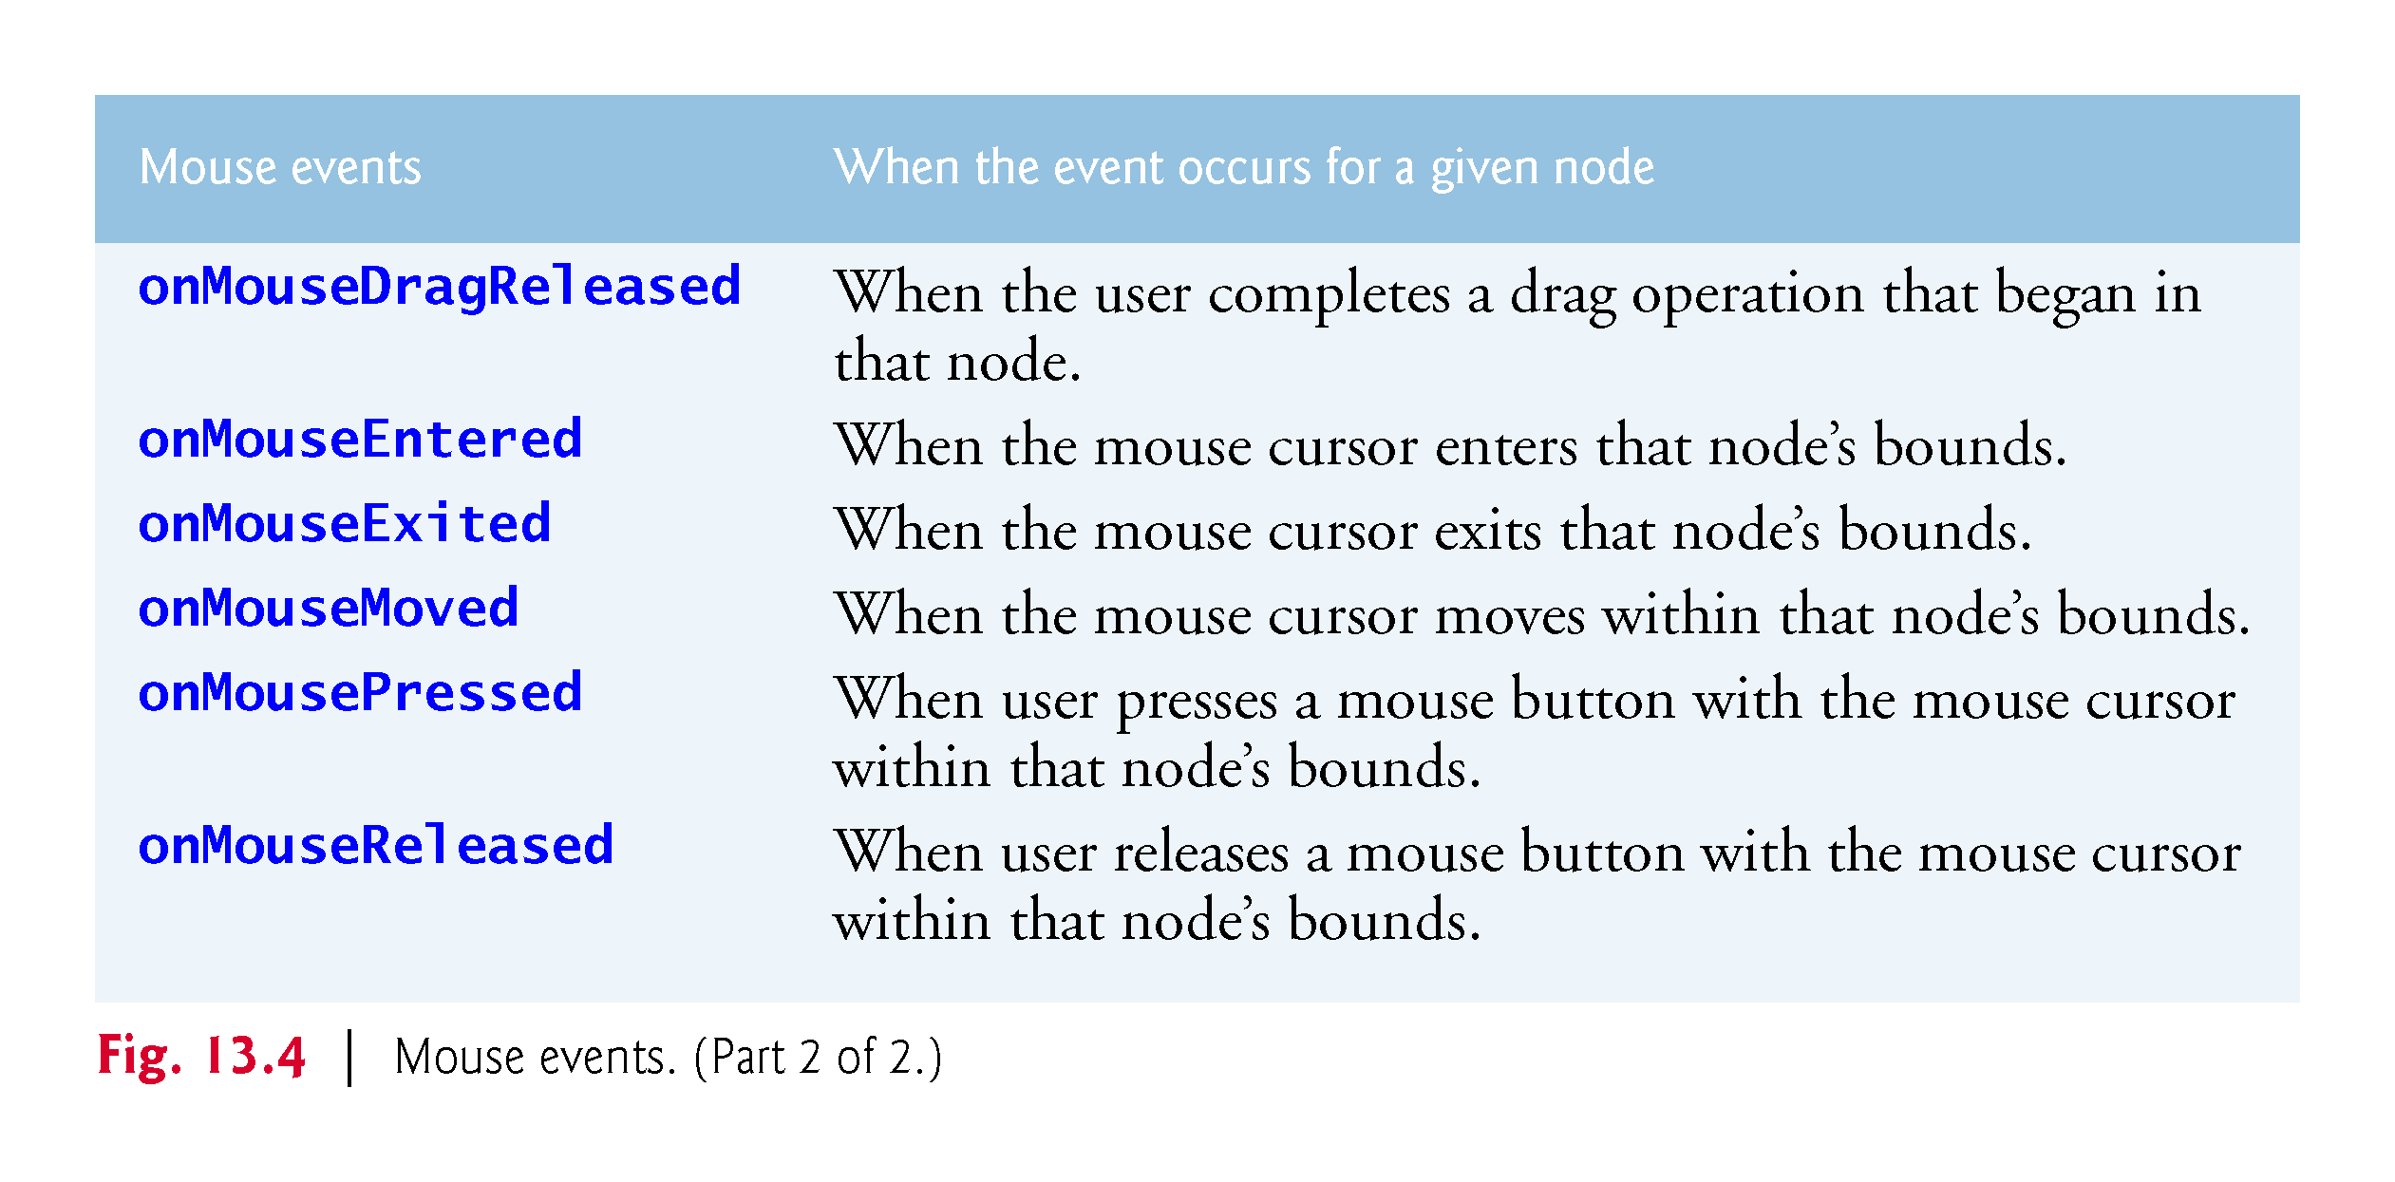

Slide 18
Technologies Overview (cont.)
Setting a Control’s User Data
Each control has a setUserData method that receives an Object
Use this to store any object you’d like to associate with that control
With each drawing-color RadioButton, we store the specific Color that the RadioButton represents
With each pen size RadioButton, we store an enum constant for the corresponding pen size
We then use these objects when handling the RadioButton events.

Slide 19
Creating the Painter.fxml File
Create a folder on your system for this example’s files, then open Scene Builder and save the new FXML file as Painter.fxml
If you already have an FXML file open, you also can choose File > New to create a new FXML file, then save it

Slide 20
Building the GUI
In this section, we’ll discuss the Painter app’s GUI
Rather than providing the exact steps as we did in Chapter 12, we’ll provide general instructions for building the GUI and focus on specific details for new concepts

Slide 21
Technologies Overview (cont.)
TitledPane Layout Container
A TitledPane layout container displays a title at its top and is a collapsible panel containing a layout node, which in turn contains other nodes
You’ll use TitledPanes to organize the app’s Radio-Buttons and to help the user understand the purpose of each RadioButton group

Slide 22
Technologies Overview (cont.)
JavaFX Shapes
The javafx.scene.shape package contains various classes for creating 2D and 3D shape nodes that can be displayed in a scene graph
You’ll programmatically create Circle objects as the user drags the mouse, then attach them to the app’s drawing area so that they’re displayed in the scene graph.
Pane Layout Container
Each Circle you programmatically create is attached to an Pane layout (the drawing area) at a specified x-y coordinate measured from the Pane’s upper-left corner.

Slide 23
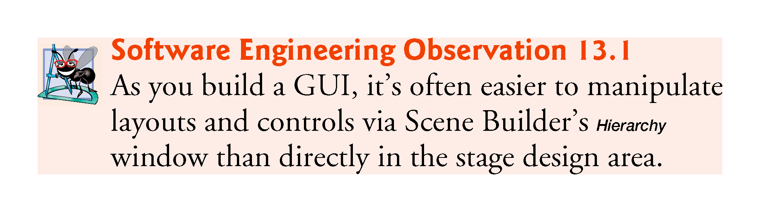

Slide 24
Building the GUI (cont.)
fx:id Property Values for This App’s Controls
Figure 13.5 shows the fx:id properties of the Painter app’s programmatically manipulated controls
As you build the GUI, you should set the corresponding fx:id properties in the FXML document, as we discussed in Chapter 12

Slide 25
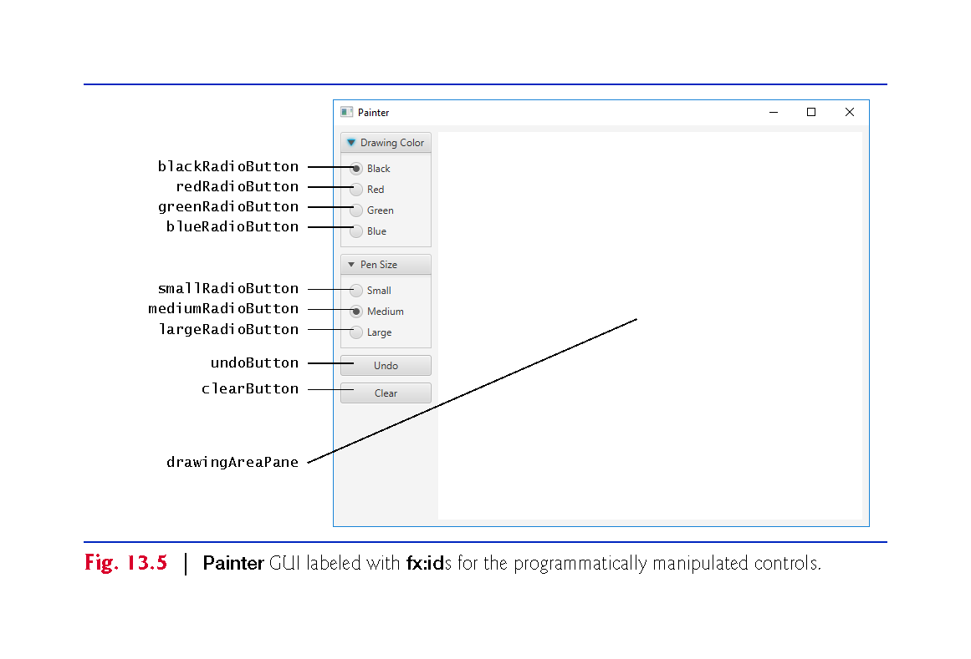

Slide 26
VBox
Pane
TitlePane
Radio
Button
TitlePane
Radio
Button
BorderPane
Button
Button
VBox

Slide 27
Building the GUI (cont.)
Step 1: Adding a BorderPane as the Root Layout Node
Drag a BorderPane from the Scene Builder Library window’s Containers section onto the content panel
Step 2: Configuring the BorderPane
We set the GridPane’s Pref Width and Pref Height properties to 640 and 480 respectively
Recall that the stage’s size is determined based on the size of the root node in the FXML document
Set the BorderPane’s Padding property to 8 to inset it from the stage’s edges

Slide 28
Building the GUI (cont.)
Step 3: Adding the VBox and Pane
Drag a VBox into the BorderPane’s left area and an Pane into the center area
As you drag over the BorderPane, Scene Builder shows the layout’s five areas and highlights the area in which area the item you’re dragging will be placed when you release the mouse
Set the Pane’s fx:id to drawingAreaPane as specified in Fig. 13.5
For the VBox, set its Spacing property (in the Inspector’s Layout section) to 8 to add some vertical spacing between the controls that will be added to this container

Slide 29
Building the GUI (cont.)
Step 3: Adding the VBox and Pane (cont.)
Set its right Margin property to 8 to add some horizontal spacing between the VBox and the Pane be added to this container
Also reset its Pref Width and Pref Height properties to their default values (USE_COMPUTED_SIZE) and set its Max Height property to MAX_VALUE
This will enable the VBox to be as wide as it needs to be to accommodate its child nodes and occupy the full column height

Slide 30
Building the GUI (cont.)
Step 3: Adding the VBox and Pane (cont.)
Reset the Pane’s Pref Width and Pref Height to their default USE_COMPUTED_SIZE values, and set its Max Width and Max Height to MAX_VALUE so that it occupies the full width and height of the BorderPane’s center area
In the JavaFX CSS category of the Inspector window’s Properties section, click the field below Style (which is initially empty) and select -fx-background-color to indicate that you’d like to specify the Pane’s background color
In the field to the right, specify white.

Slide 31
Building the GUI (cont.)
Step 4: Adding the TitledPanes to the VBox
From the Library window’s Containers section, drag two TitledPane (empty) objects onto the VBox
For the first TitledPane, set its Text property to Drawing Color
For the second, set its Text property to Pen Size

Slide 32
Building the GUI (cont.)
Step 5: Customizing the TitledPanes
Each TitledPane in the completed GUI contains multiple RadioButtons
We’ll use a VBox within each TitledPane to help arrange those controls
Drag a VBox onto each TitledPane
For each VBox, set its Spacing property to 8 and its Pref Width and Pref Height to USE_COMPUTED_SIZE so the VBoxes will be sized based on their contents

Slide 33
Building the GUI (cont.)
Step 6: Adding the RadioButtons to the VBox
From the Library window’s Controls section, drag four RadioButtons onto the VBox for the Drawing Color TitledPane, and three RadioButtons onto the VBox for the Pen Size Titled-Pane, then configure their Text properties and fx:ids as shown in Fig. 13.5
Select the blackRadioButton and ensure that its Selected property is checked, then do the same for the mediumRadioButton.

Slide 34
Building the GUI (cont.)
Step 7: Specifying the ToggleGroups for the RadioButtons
Select all four RadioButtons in the first TitledPane’s VBox, then set the Toggle Group property to colorToggleGroup
When the FXML file is loaded, a ToggleGroup object by that name will be created and these four RadioButtons will be associated with it to ensure that only one is selected at a time
Repeat this step for the three RadioButtons in the second TitledPane’s VBox, but set the Toggle Group property to sizeToggleGroup

Slide 35
Building the GUI (cont.)
Step 8: Changing the TitledPanes’ Preferred Width and Height
For each TitledPane, set its Pref Width and Pref Height to USE_COMPUTED_SIZE so the Titled-Panes will be sized based on their contents.
Step 9: Adding the Buttons
Add two Buttons below the TitledPanes, then configure their Text properties and fx:ids as shown in Fig. 13.5
Set each Button’s Max Width property to MAX_VALUE so that they fill the VBox’s width

Slide 36
Building the GUI (cont.)
Step 10: Setting the Width the VBox
We’d like the VBox to be only as wide as it needs to be to display the controls in that column
To specify this, select the VBox in the Document window’s Hierarchy section
Set the column’s Min Width and Pref Width to USE_COMPUTED_SIZE, then set the Max Width to USE_PREF_SIZE (which indicates that the maximum width should be the preferred width)
Also, reset the Max Height to its default USE_COMPUTED_SIZE value
The GUI is now complete and should appear as shown in Fig. 13.5.

Slide 37
Building the GUI (cont.)
Step 11: Specifying the Controller Class’s Name
As we mentioned in Section 12.5.2, in a JavaFX FXML app, the app’s controller class typically defines instance variables for interacting with controls programmatically, as well as event-handling methods
To ensure that an object of the controller class is created when the app loads the FXML file at runtime, you must specify the controller class’s name in the FXML file:
Expand Scene Builder’s Controller window (located below the Hierarchy window).
In the Controller Class field, type PainterController

Slide 38
Building the GUI (cont.)
Step 12: Specifying the Event-Handler Method Names
Next, you’ll specify in the Inspector window’s Code section the names of the methods that will be called to handle specific control’s events:
For the drawingAreaPane, specify drawingAreaMouseDragged as the On Mouse Dragged event handler (located under the Mouse heading in the Code section)
This method will draw a circle in the specified color and size for each mouse-dragged event.
For the four Drawing Color RadioButtons, specify colorRadioButtonSelected as each RadioButton’s On Action event handler
This method will set the current drawing color, based on the user’s selection.

Slide 39
Building the GUI (cont.)
Step 12: Specifying the Event-Handler Method Names (cont.)
For the three Pen Size RadioButtons, specify sizeRadioButtonSelected as each RadioButton’s On Action event handler. This method will set the current pen size, based on the user’s selection.
For the Undo Button, specify undoButtonPressed as the On Action event handler. This method will remove the last circle the user drew on the screen.
For the Clear Button, specify clearButtonPressed as the On Action event handler. This method will clear the entire drawing.

Slide 40
Building the GUI (cont.)
Step 13: Generating a Sample Controller Class
As you saw in Section 12.5, Scene Builder generates the initial controller-class skeleton for you when you select View > Show Sample Controller Skeleton
You can copy this code into a PainterController.java file and store the file in the same folder as Painter.fxml
We show the completed PainterController class in Section 13.3.5.

Slide 41
Painter Subclass of Application
Figure 13.6 shows class Painter subclass of Application that launches the app, which performs the same tasks to start the Painter app as described for the Tip Calculator app in Section 12.5.4

Slide 42
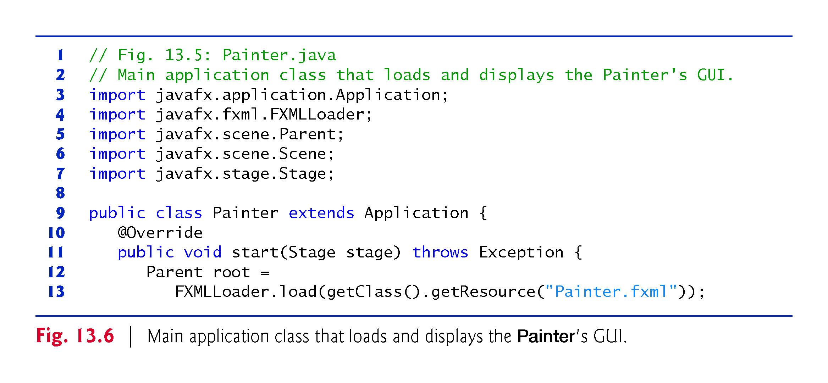

Slide 43
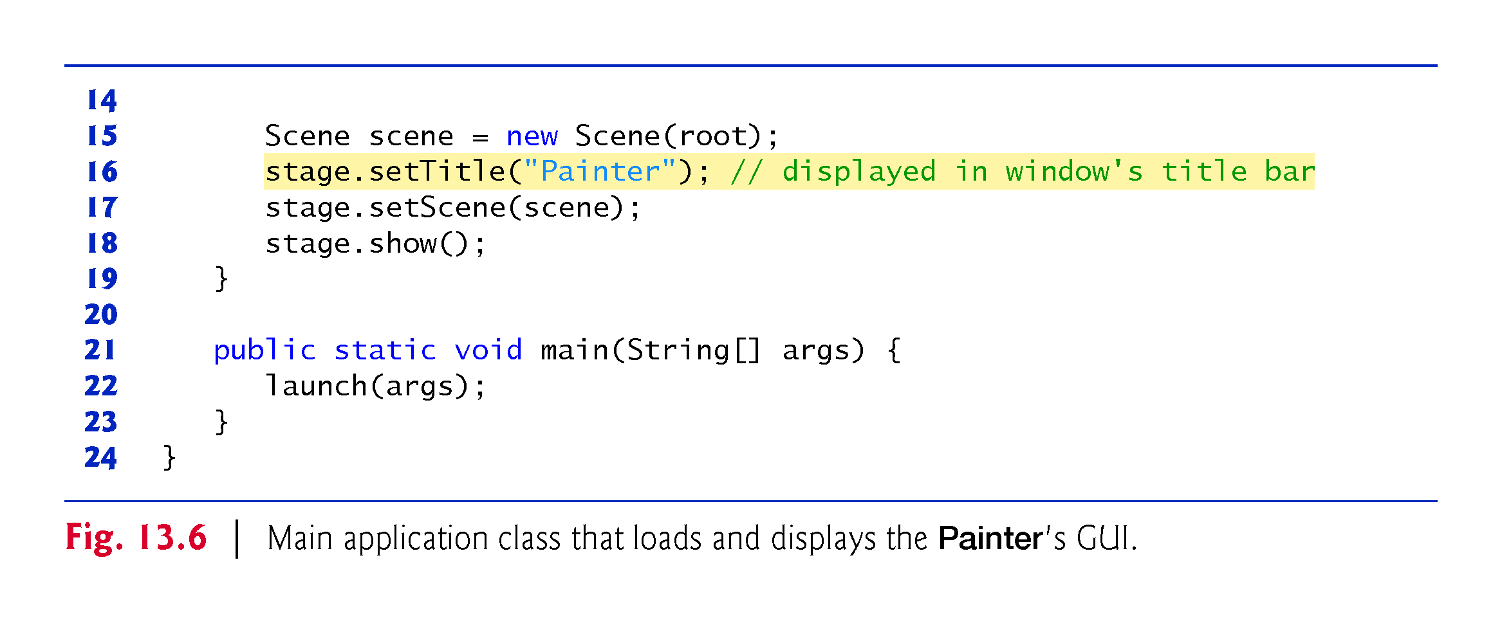

Slide 44
PainterController Class
Figure 13.7 shows the final version of class PainterController with this app’s new features highlighted

Slide 45
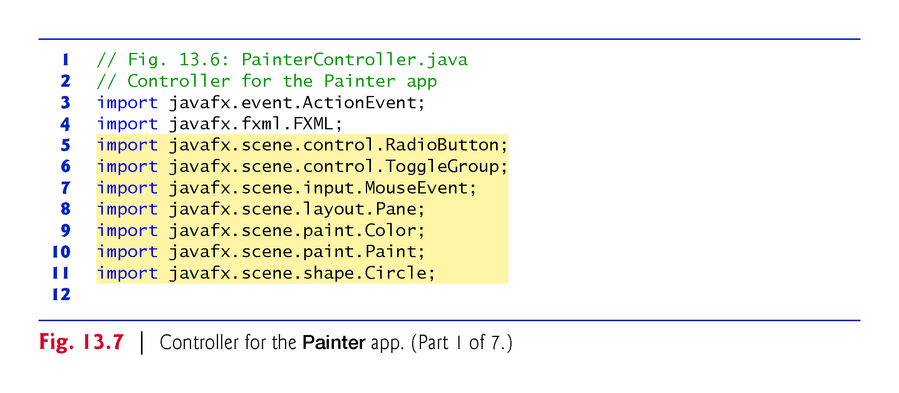

Slide 46
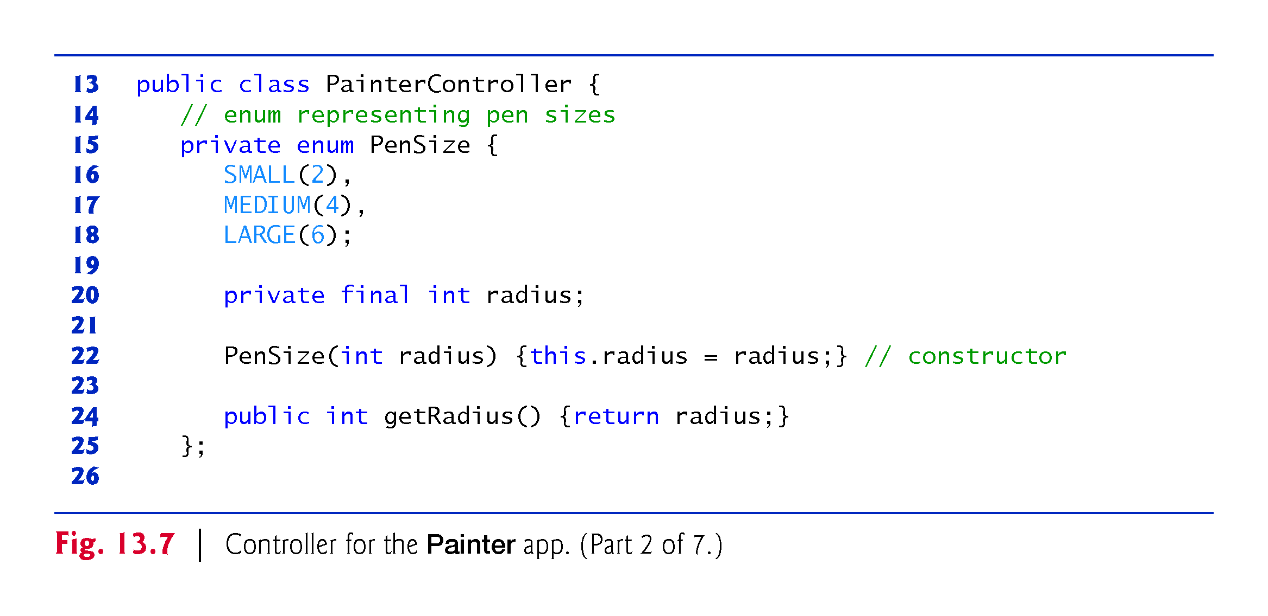

Slide 47
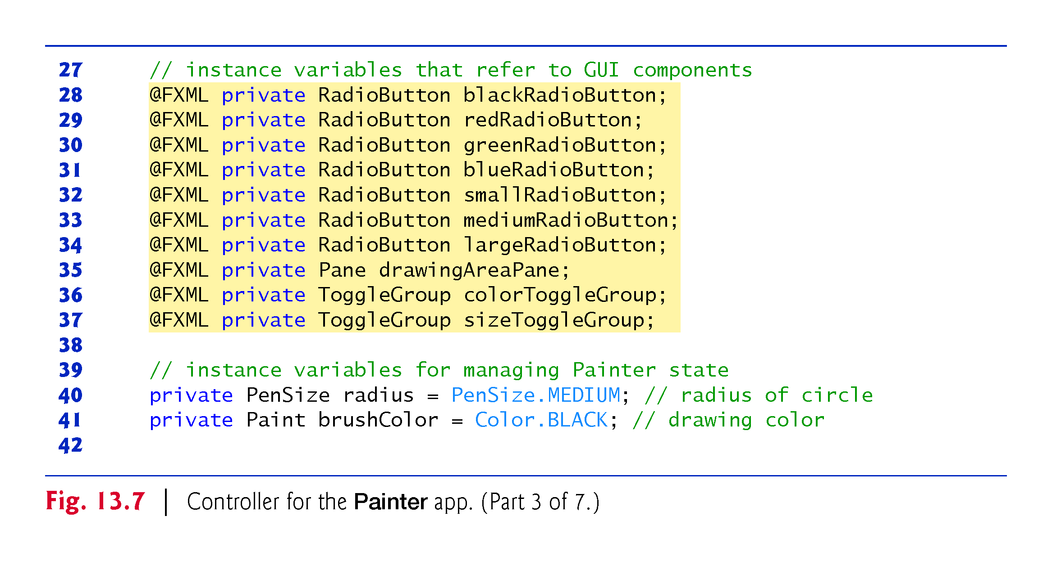

Slide 48
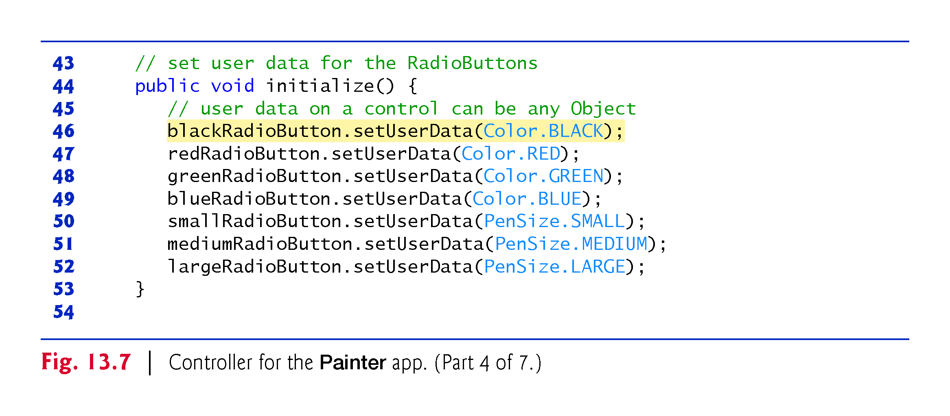

Slide 49
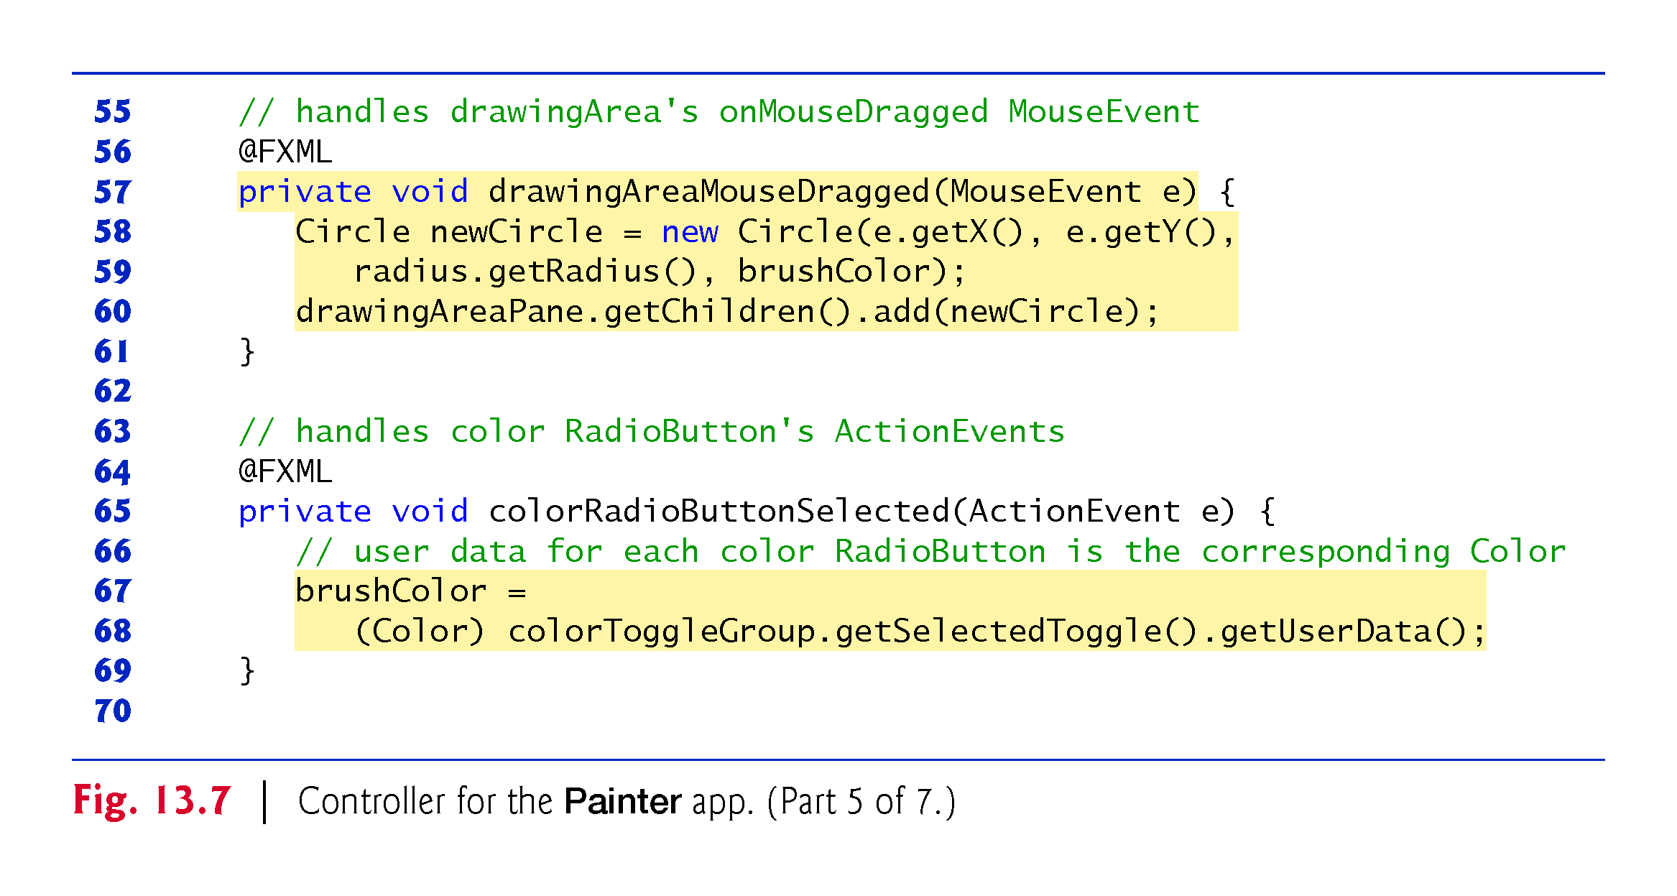

Slide 50
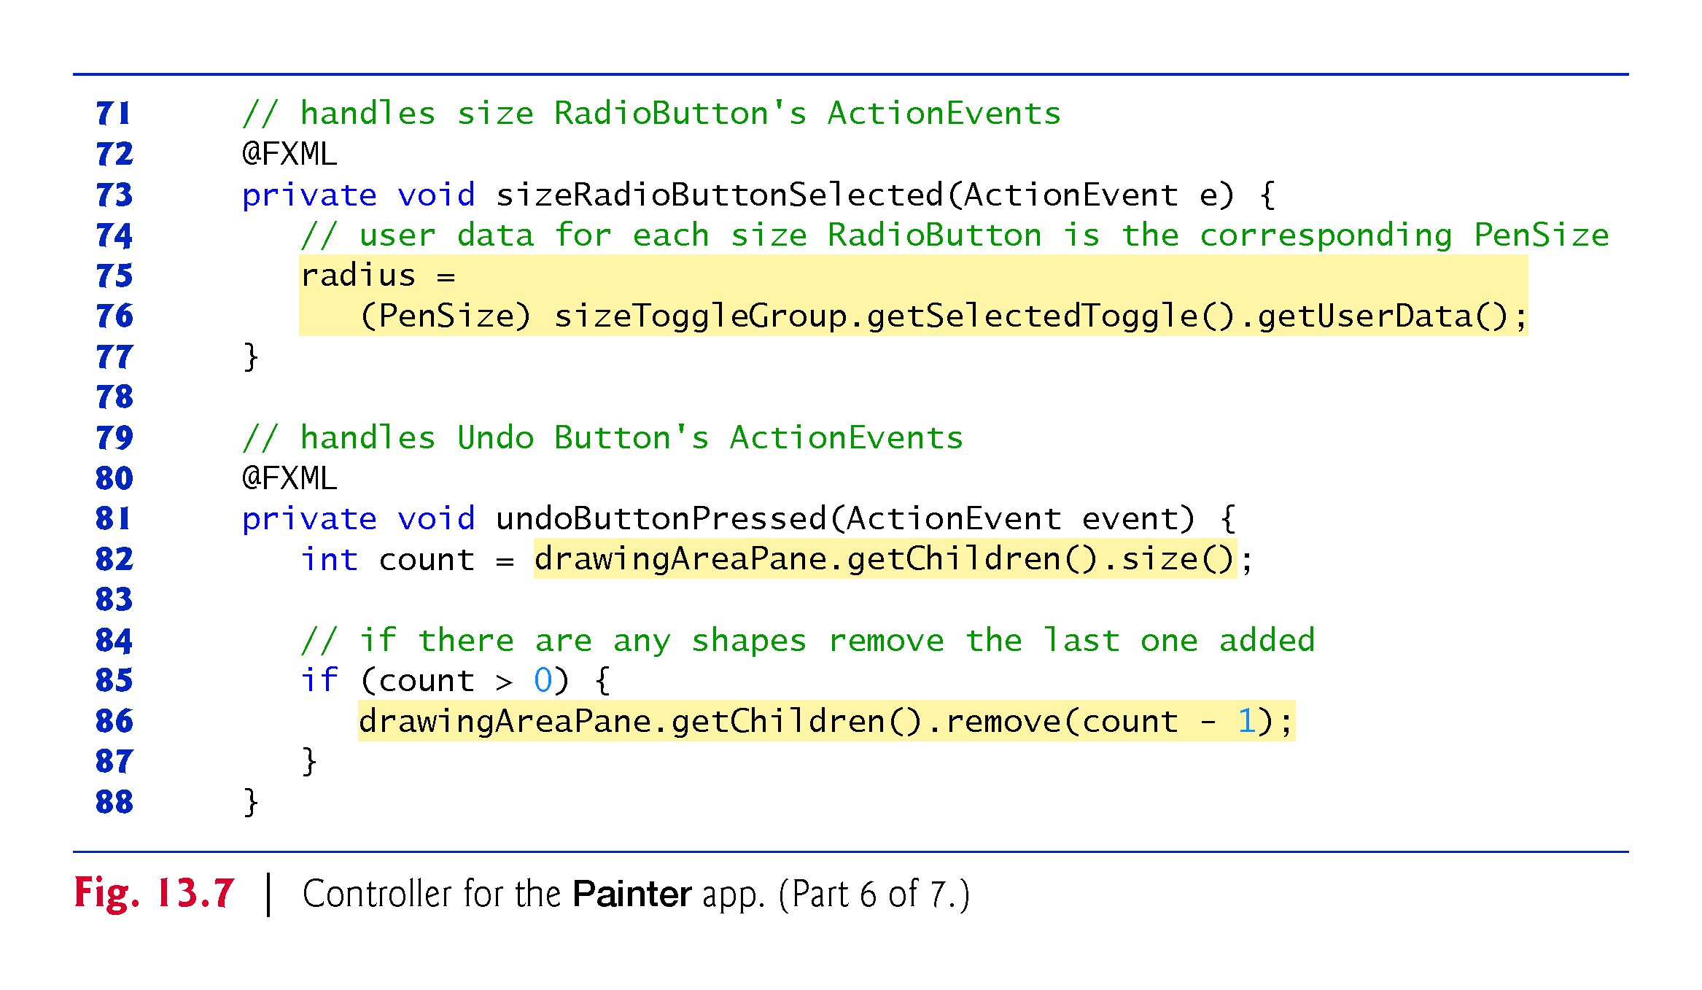

Slide 51
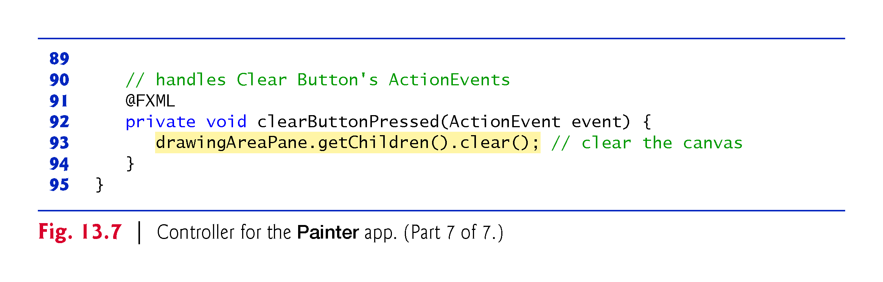

Slide 52
PainterController Class
PenSize enum
Lines 15–25 define the nested enum type PenSize, which specifies three pen sizes—SMALL, MEDIUM and LARGE
Each has a corresponding radius that will be used when creating a Circle- object to display in response to a mouse-drag event
Java allows you to declare classes, interfaces and enums as nested types inside other classes
Except for the anonymous inner class introduced in Section 12.5.5, all the classes, interfaces and enums we’ve discussed were top level—that is, they were not declared inside another type
The enum type PenSize is declared here as a private nested type because it’s used only by class PainterController

Slide 53
PainterController Class (cont.)
Instance Variables
Lines 28–37 declare the @FXML instance variables that the controller uses to programmatically interact with the GUI
These variables must match the corresponding fx:id values that you specified in Painter.fxml
Two of the @FXML instance variables are ToggleGroups—in the RadioButton event handlers
Used to determine which RadioButton was selected
Lines 40–41 define two additional instance variables that store the current drawing Color and the current PenSize, respectively.

Slide 54
PainterController Class (cont.)
Method initialize
When the FXMLLoader creates a controller-class object, FXMLLoader determines whether the class contains an initialize method with no parameters and, if so, calls that method to initialize the controller
Lines 44–53 define method initialize to specify each RadioButton’s corresponding user data object—either a Color or a PenSize
You’ll use these objects in the RadioButton-s’ event handlers

Slide 55
PainterController Class (cont.)
drawingAreaMouseDragged Event Handler
Lines 56–61 define drawingAreaMouseDragged, which responds to drag events in the drawingAreaPane
Each mouse event handler you define must have one MouseEvent parameter (package javafx.scene.input)
This parameter contains information about the event, such as its location, whether any mouse buttons were pressed, which node the user interacted with and more

Slide 56
PainterController Class (cont.)
drawingAreaMouseDragged Event Handler (cont.)
You specified drawingAreaMouseDragged in Scene Builder as the drawingAreaPane’s On Mouse Dragged event handler
Lines 58–59 create a new Circle object using the constructor that takes as arguments the center point’s x-coordinate, the center point’s y-coordinate, the Circle’s radius and the Circle’s Color
Next, line 60 attaches the new Circle to the drawingAreaPane

Slide 57
PainterController Class (cont.)
drawingAreaMouseDragged Event Handler (cont.)
Each layout pane has a getChildren method that returns an ObservableList<Node> collection containing the layout’s child nodes
An ObservableList provides methods for adding and removing elements
You’ll learn more about ObservableList later in this chapter
Line 60 uses the ObservableList’s add method to add a new Node to the drawingAreaPane—all JavaFX shapes inherit indirectly from class Node in the javafx.scene package.

Slide 58
PainterController Class (cont.)
colorRadioButtonSelected Event Handler
Lines 64–69 define colorRadioButtonSelected, which responds to the ActionEvents of the Drawing Color RadioButtons—these occur each time a new color RadioButton is selected
You specified this event handler in Scene Builder as the On Action event handler for all four Drawing Color RadioButtons
Lines 67–68 set the current drawing Color

Slide 59
PainterController Class (cont.)
colorRadioButtonSelected Event Handler (cont.)
ColorToggleGroup method getSelectedToggle returns the Toggle that’s currently selected
Class RadioButton is one of several controls (others are RadioButtonMenuItem and ToggleButton) that implement interface Toggle
We then use the Toggle’s getUserData method to get the user data Object that was associated with the corresponding RadioButton in method initialize
For the color RadioButtons, this Object is aways a Color, so we cast the Object to a Color and assign it to brushColor

Slide 60
PainterController Class (cont.)
sizeRadioButtonSelected Event Handler
Lines 72–77 define sizeRadioButtonSelected, which responds to the pen size RadioButtons’ ActionEvents
You specified this event handler as the On Action- event handler for all three Pen Size RadioButtons
Lines 75–76 set the current PenSize-, using the same approach as setting the current color in method colorRadioButtonSelected

Slide 61
PainterController Class (cont.)
undoButtonPressed Event Handler
Lines 80–88 define undoButtonPressed, which responds to an ActionEvent from the undo-Button by removing the last Circle displayed
You specified this event handler in Scene Builder as the undoButton’s On Action event handler
To undo the last Circle, we remove the last child from the drawingAreaPane’s collection of child nodes
First, line 82 gets the number of elements in that collection
Then, if that’s greater than 0, line 86 removes the node at the last index in the collection.

Slide 62
PainterController Class (cont.)
clearButtonPressed Event Handler
Lines 91–94 define clearButtonPressed, which responds to the ActionEvent from the clear-Button by clearing drawingAreaPane’s collection of child nodes
You specified this event handler in Scene Builder as the clearButton’s On Action event handler
Line 93 clears the collection of child nodes to erase the entire drawing.

Slide 63
Color Chooser App: Property Bindings and Property Listeners
In this section, we present a Color Chooser app (Fig. 13.8) that demonstrates property bindings and property listeners

Slide 64
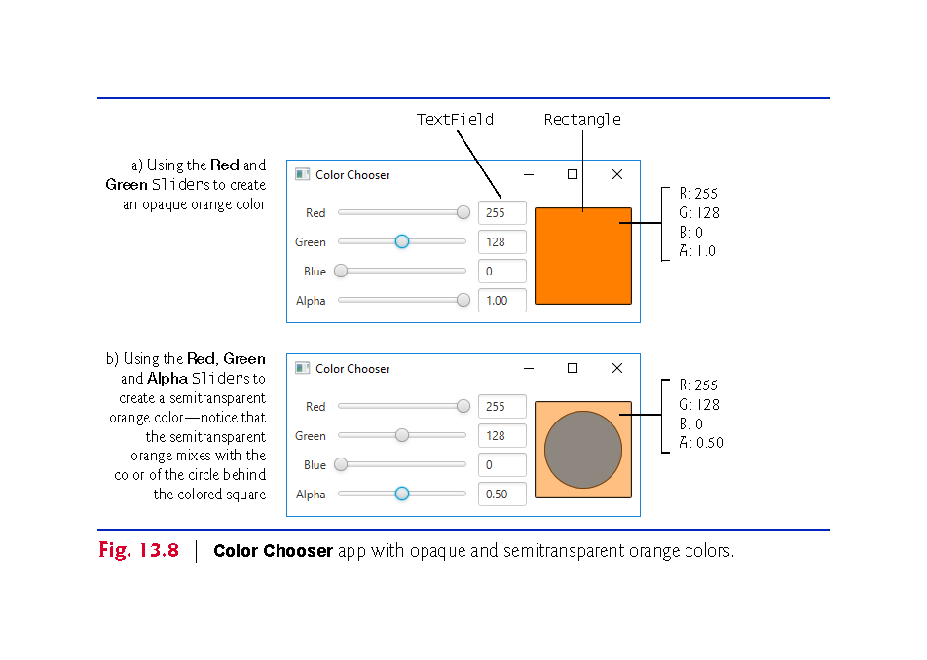

Slide 65
Technologies Overview
RGBA Colors
The app uses the RGBA color system to display a rectangle of color based on the values of four Sliders
In RGBA, every color is represented by its red, green and blue color values, each ranging from 0 to 255, where 0 denotes no color and 255 full color
The alpha value (A)—which ranges from 0.0 to 1.0—represents a color’s opacity, with 0.0 being completely transparent and 1.0 completely opaque
The color displayed in Fig. 13.8(b) is semitransparent
You’ll use a Color object that’s created with RGBA values to fill a Rectangle that displays the Color.

Slide 66
Technologies Overview (cont.)
Properties of a Class
JavaFX makes extensive use of properties
A property is defined by creating set/get methods named as follows
public final void setPropertyName(Type propertyName) public final Type getPropertyName()
Typically, such methods manipulate a corresponding private instance variable that has the same name as the property, but this is not required
Methods setHour and getHour together represent a property named hour and typically would manipulate a private hour instance variable
If the property represents a boolean value, its get method name typically begins with “is” rather than “get”—for example, ArrayList method isEmpty.

Slide 67
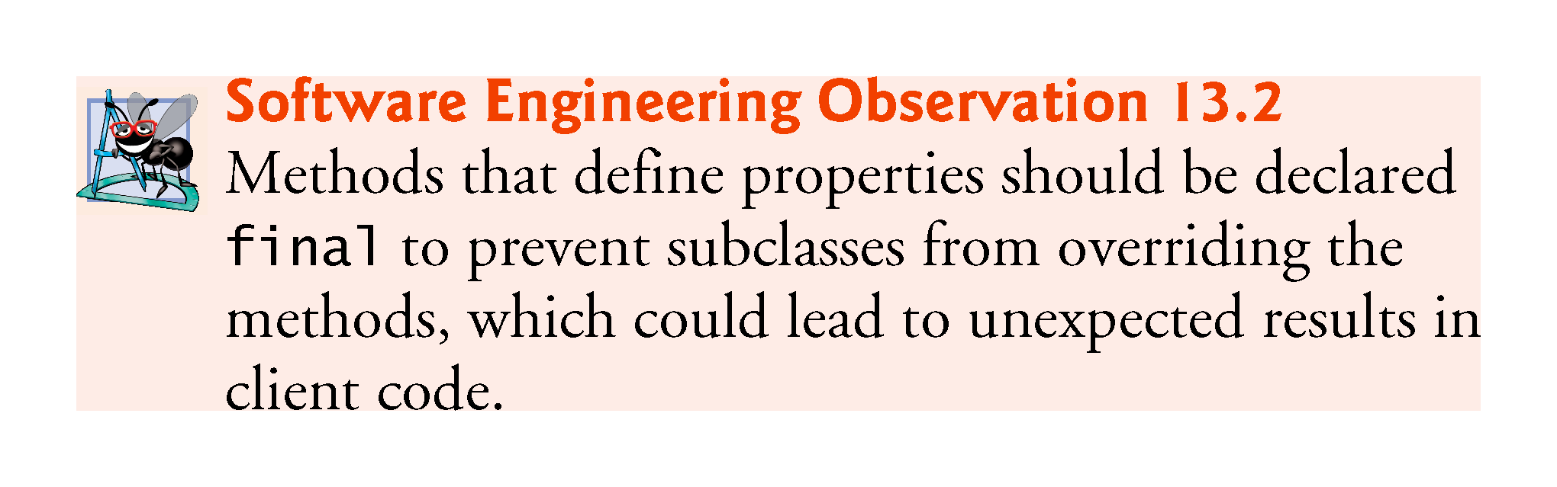

Slide 68
Technologies Overview (cont.)
Property Bindings
JavaFX properties are observable—when a property’s value changes, other objects can respond accordingly
This is similar to event handling
One way to respond to a property change is via a property binding—enables a property of one object to be updated when a property of another changes
You’ll use property bindings to enable a TextField to display the corresponding Slider’s current value when the user moves that Slider’s thumb
Property bindings are not limited to JavaFX controls
Package javafx.beans.property contains many classes that you can use to define bindable properties in your own classes

Slide 69
Technologies Overview (cont.)
Property Listeners
Property listeners are similar to property bindings
A property listener is an event handler that’s invoked when a property’s value changes
In this app, when a Slider’s value changes, a property listener will store the value in a corresponding instance variable, create a new Color based on the values of all four Sliders and set that Color as the fill color of a Rectangle object that displays the current color
More on properties, property bindings and property listeners:
http://docs.oracle.com/javase/8/javafx/properties-binding-tutorial/binding.htm

Slide 70
Building the GUI
In this section, we’ll discuss the Color Chooser app’s GUI
As you build the GUI, recall that it’s often easier to manipulate layouts and controls via the Scene Builder Document window’s Hierarchy section than directly in the stage design area
Before proceeding, open Scene Builder and create an FXML file named ColorChooser.fxml.

Slide 71
Building the GUI (cont.)
fx:id Property Values for This App’s Controls
Figure 13.9 shows the fx:id properties of the Color Choooser app’s programmatically manipulated controls
As you build the GUI, you should set the corresponding fx:id properties in the FXML document, as you learned in Chapter 12

Slide 72
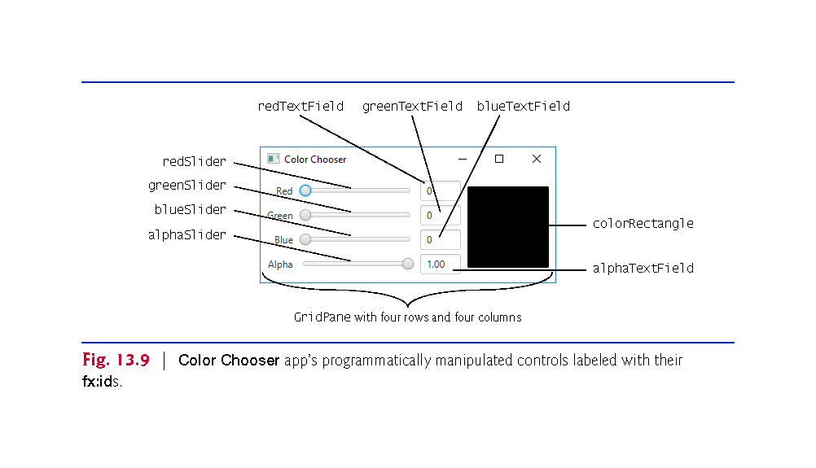

Slide 73
Building the GUI (cont.)
Step 1: Adding a GridPane
Drag a GridPane from the Library window’s Containers section onto Scene Builder’s content panel
Step 2: Configuring the GridPane
This app’s GridPane requires four rows and four columns
Use the techniques you’ve learned previously to add two columns and one row to the GridPane
Set the GridPane’s Hgap and Padding properties to 8 to inset the GridPane from the stage’s edges and to provide space between its columns

Slide 74
Building the GUI (cont.)
Step 3: Adding the Controls
Using Fig. 13.9 as a guide, add the Labels, Sliders, TextFields, a Circle and a Rectangle to the GridPane—Circle and Rectangle are located in the Scene Builder Library’s Shapes section
When adding the Circle and Rectangle, place both into the rightmost column’s first row
Be sure to add the Circle before the Rectangle so that it will be located behind the rectangle in the layout
Set the text of the Labels and TextFields as shown and set all the appropriate fx:id properties as you add each control.

Slide 75
Building the GUI (cont.)
Step 4: Configuring the Sliders
For the red, green and blue Sliders, set the Max properties to 255 (the maximum amount of a given color in the RGBA color scheme)
For the alpha Slider, set its Max property to 1.0 (the maximum opacity in the RGBA color scheme).
Step 5: Configuring the TextFields
Set all of the TextField’s Pref Width properties to 50.

Slide 76
Building the GUI (cont.)
Step 6: Configuring the Rectangle
Set the Rectangle’s Width and Height properties to 100, then set its Row Span property to Remainder so that it spans all four rows.
Step 7: Configuring the Circle
Set the Circle’s Radius property to 40, then set its Row Span property to Remainder so that it spans all four rows.

Slide 77
Building the GUI (cont.)
Step 8: Configuring the Rows
Set all four columns’ Pref Height properties to USE_COMPUTED_SIZE so that the rows are only as tall as their content
Step 9: Configuring the Columns
Set all four columns’ Pref Width properties to USE_COMPUTED_SIZE so that the columns are only as wide as their content
For the leftmost column, set the Halignment property to RIGHT
For the rightmost column, set the Halignment property to CENTER.
Step 10: Configuring the GridPane
Set the GridPane’s Pref Width and Pref Height properties to USE_COMPUTED_SIZE so that it sizes itself, based on its contents
Your GUI should now appear as shown in Fig. 13.9

Slide 78
Building the GUI (cont.)
Step 11: Specifying the Controller Class’s Name
To ensure that an object of the controller class is created when the app loads the FXML file at runtime, specify ColorChooserController as the controller class’s name in the FXML file as you’ve done previously.
Step 12: Generating a Sample Controller Class
Select View > Show Sample Controller Skeleton, then copy this code into a ColorChooserController.java file and store the file in the same folder as ColorChooser.fxml

Slide 79
ColorChooser Subclass of Application
Figure 13.6 shows the ColorChooser subclass of Application that launches the app
This class loads the FXML and displays the app as in the prior JavaFX examples

Slide 80
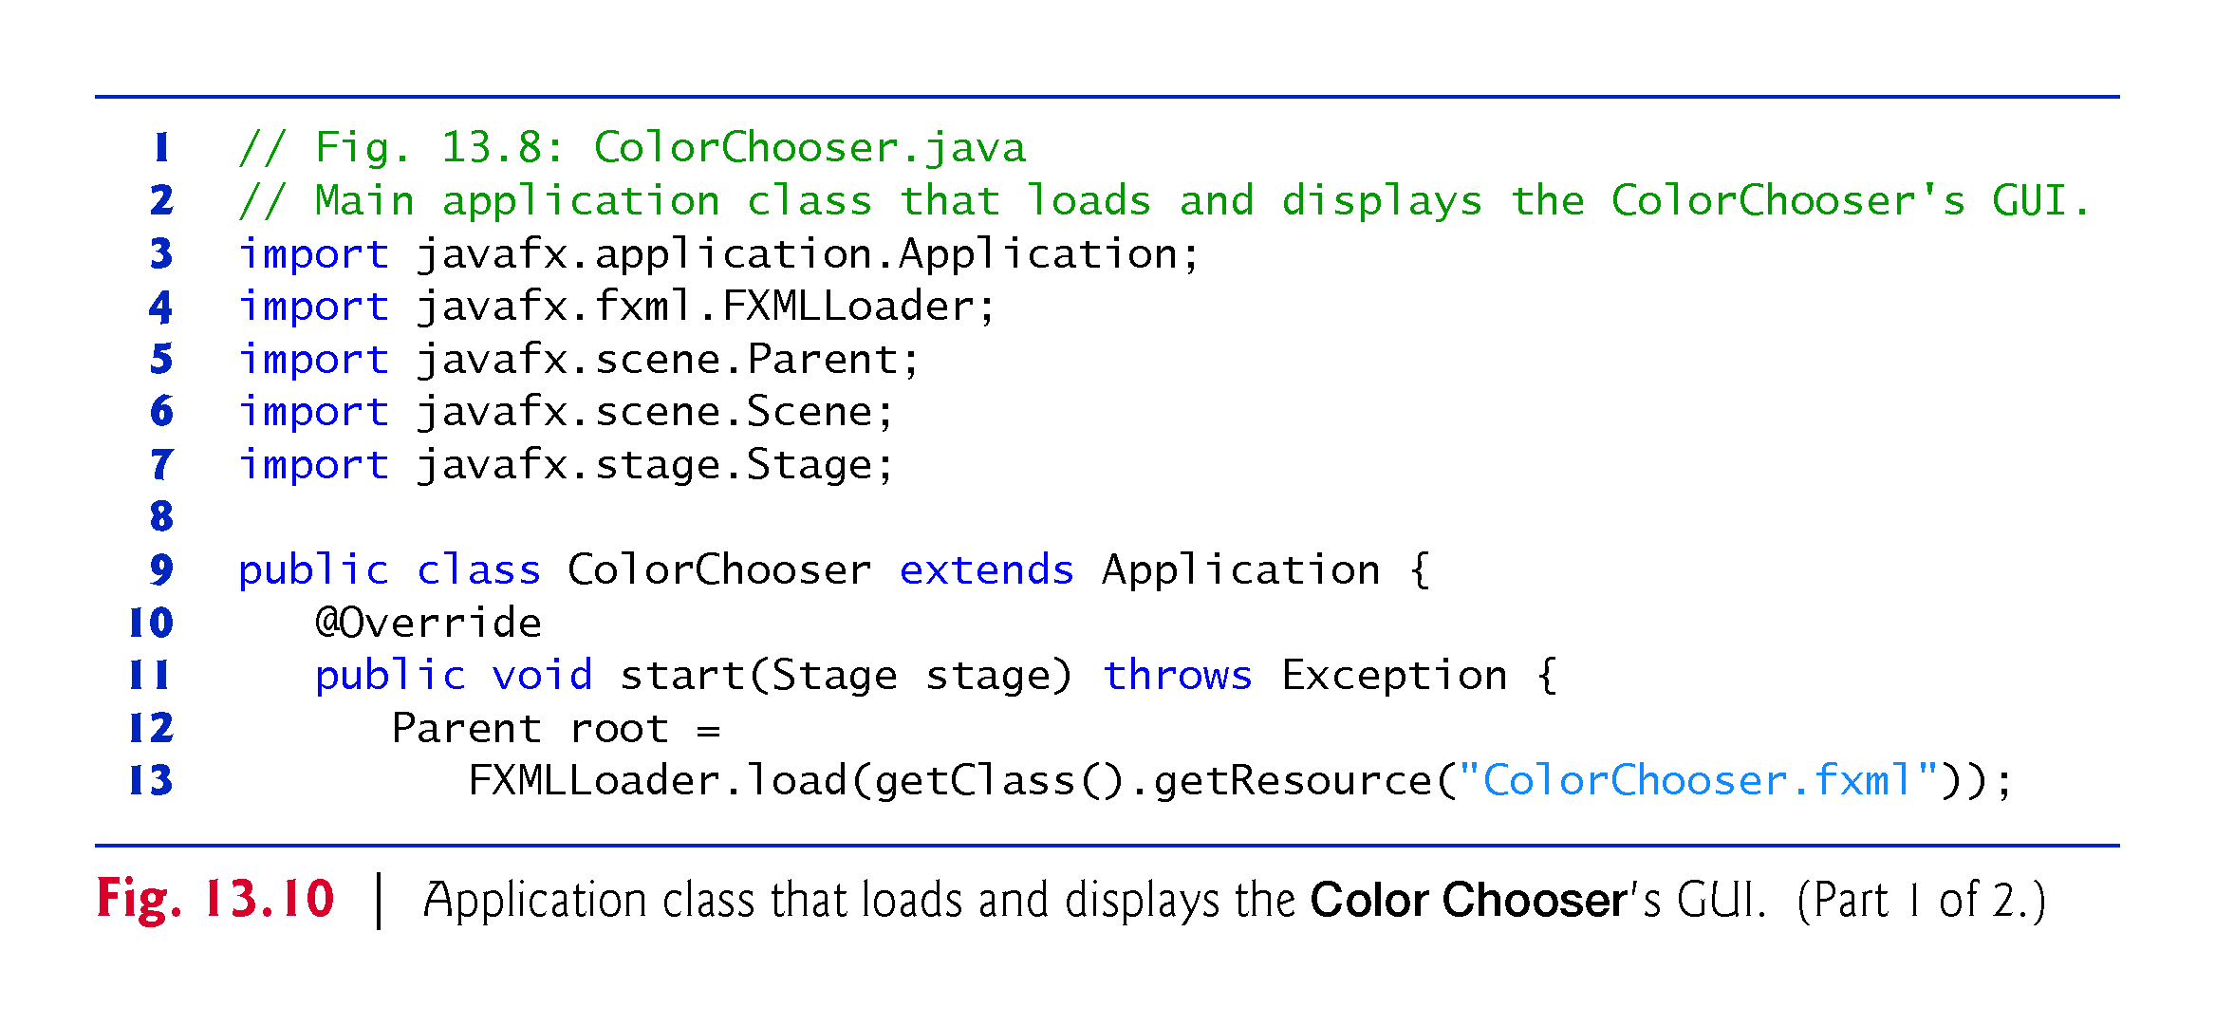

Slide 81
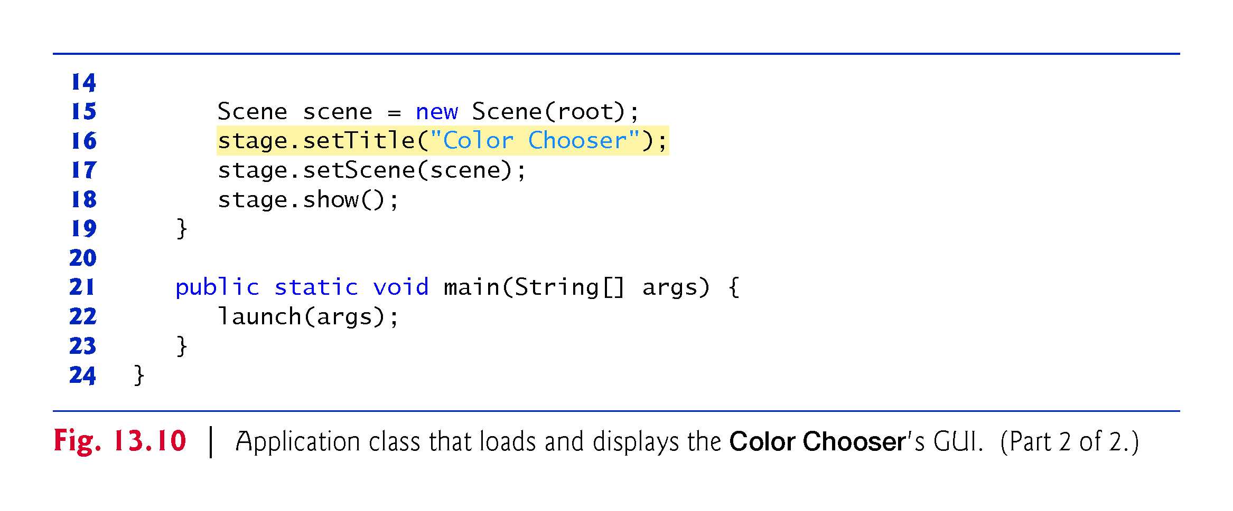

Slide 82
ColorChooserController Class
Figure 13.11 shows the final version of class ColorChooserController with this app’s new features highlighted

Slide 83
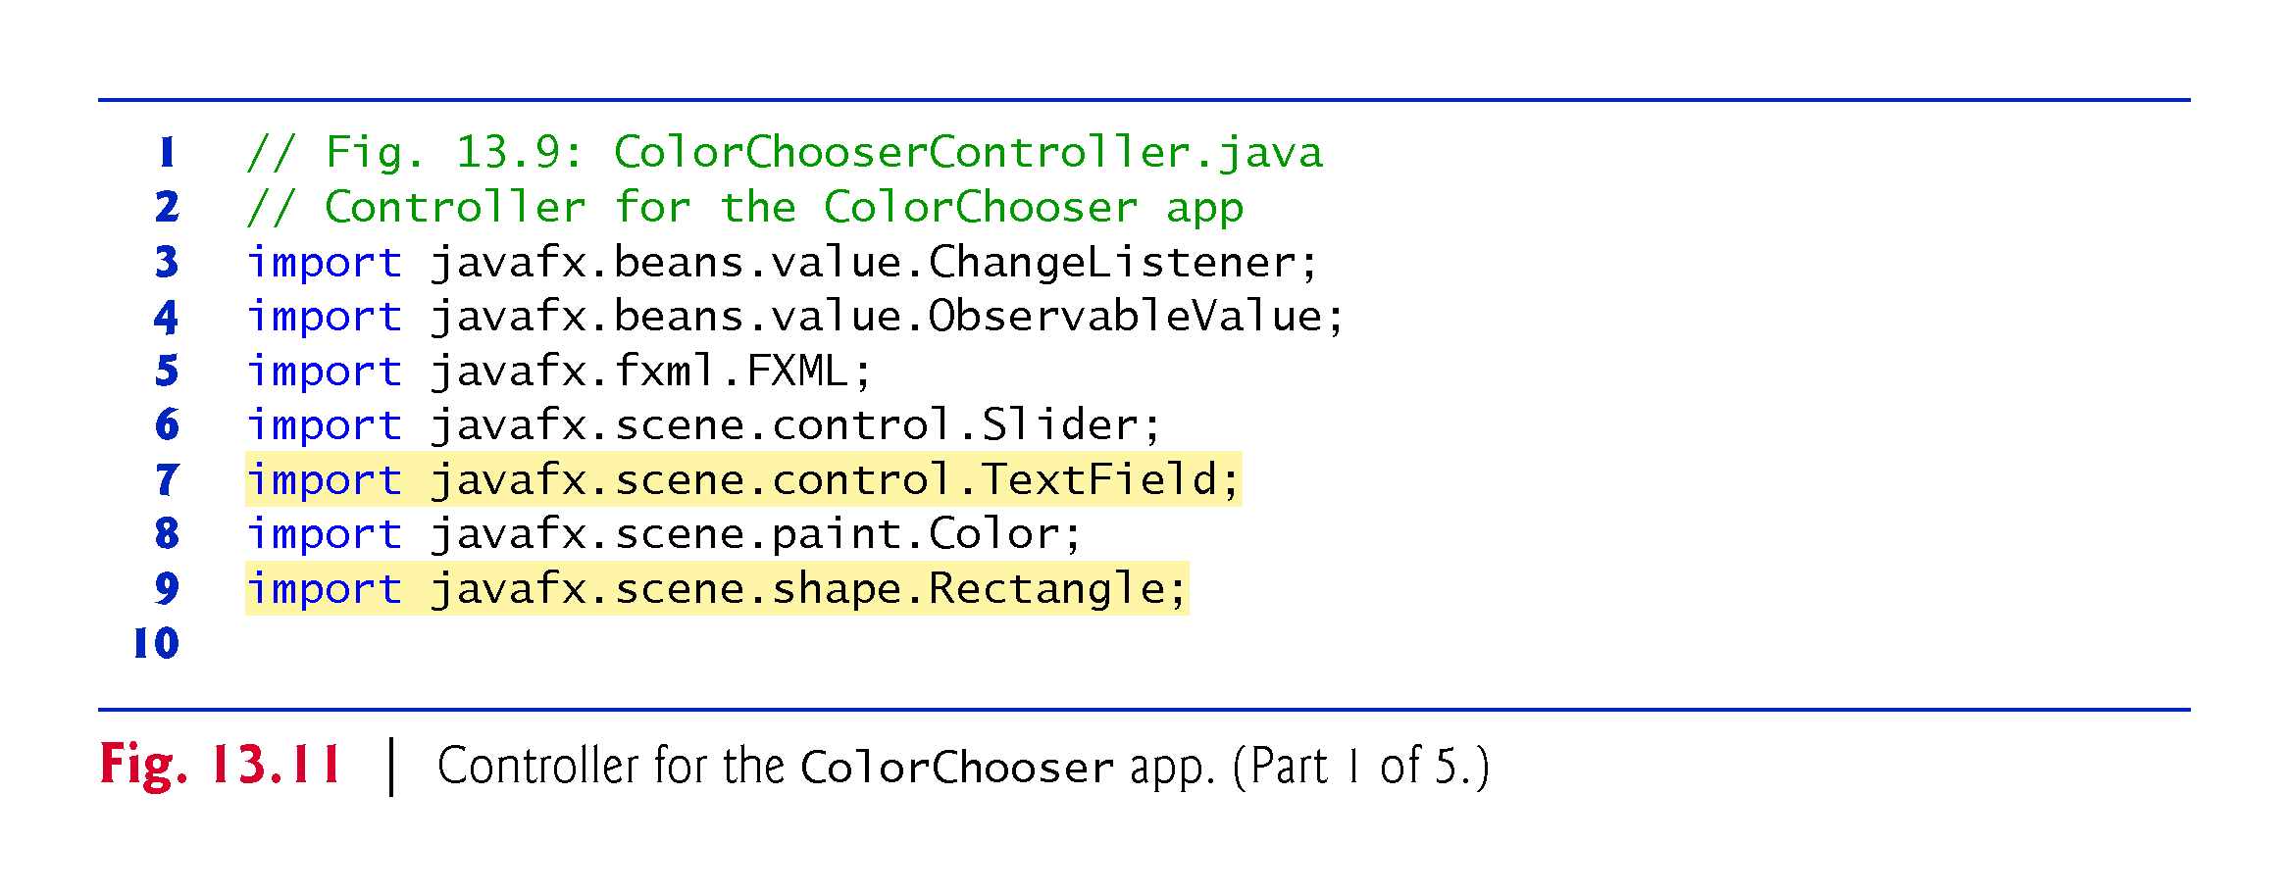

Slide 84
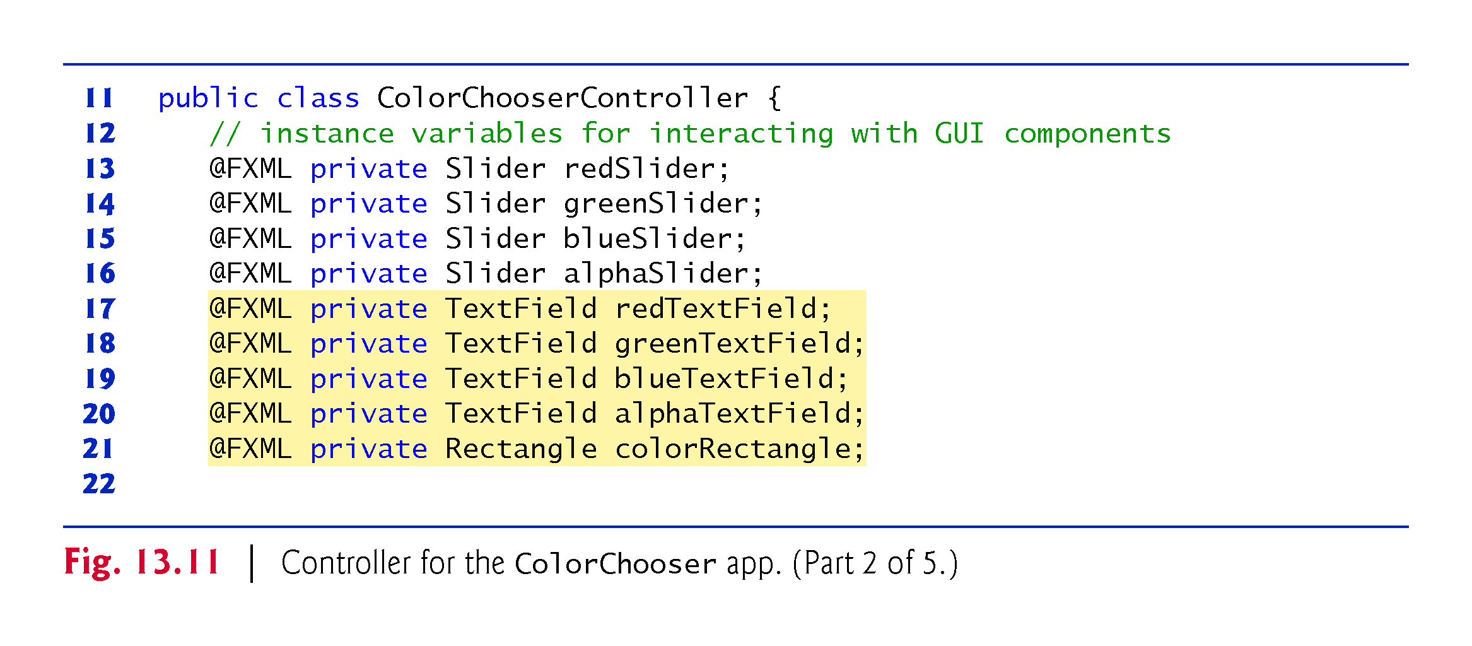

Slide 85
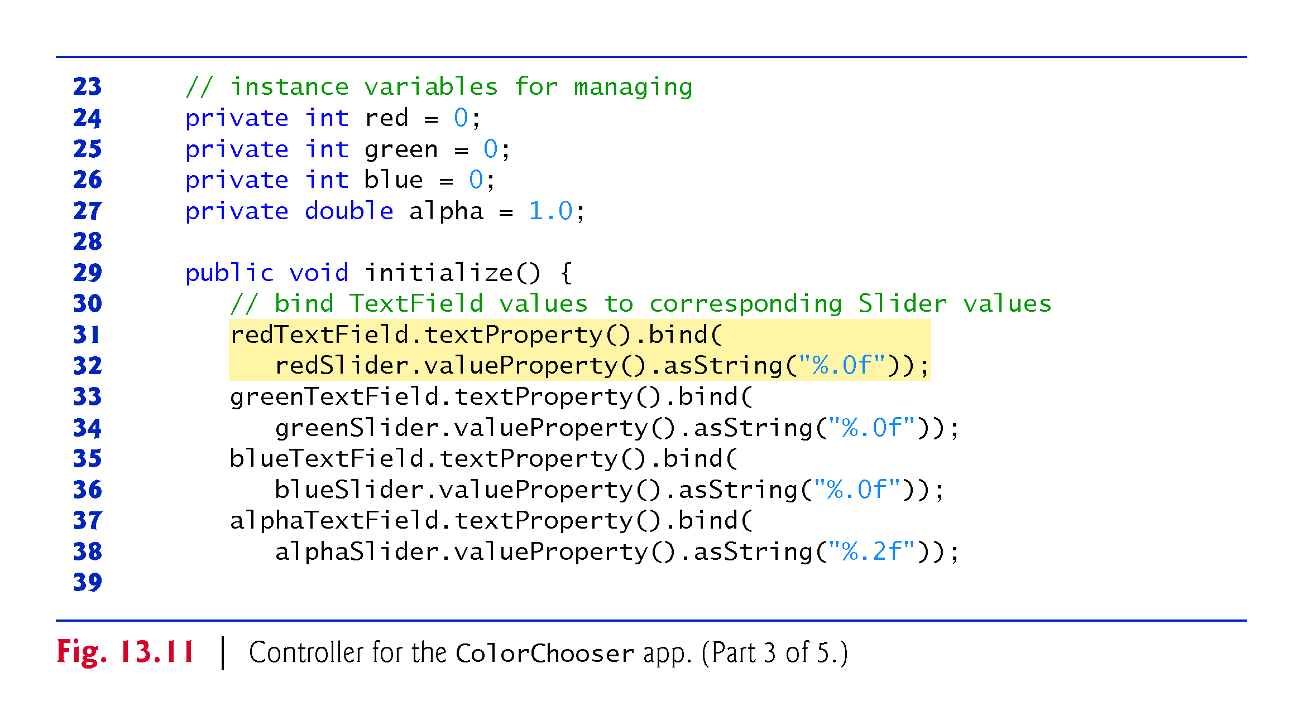

Slide 86
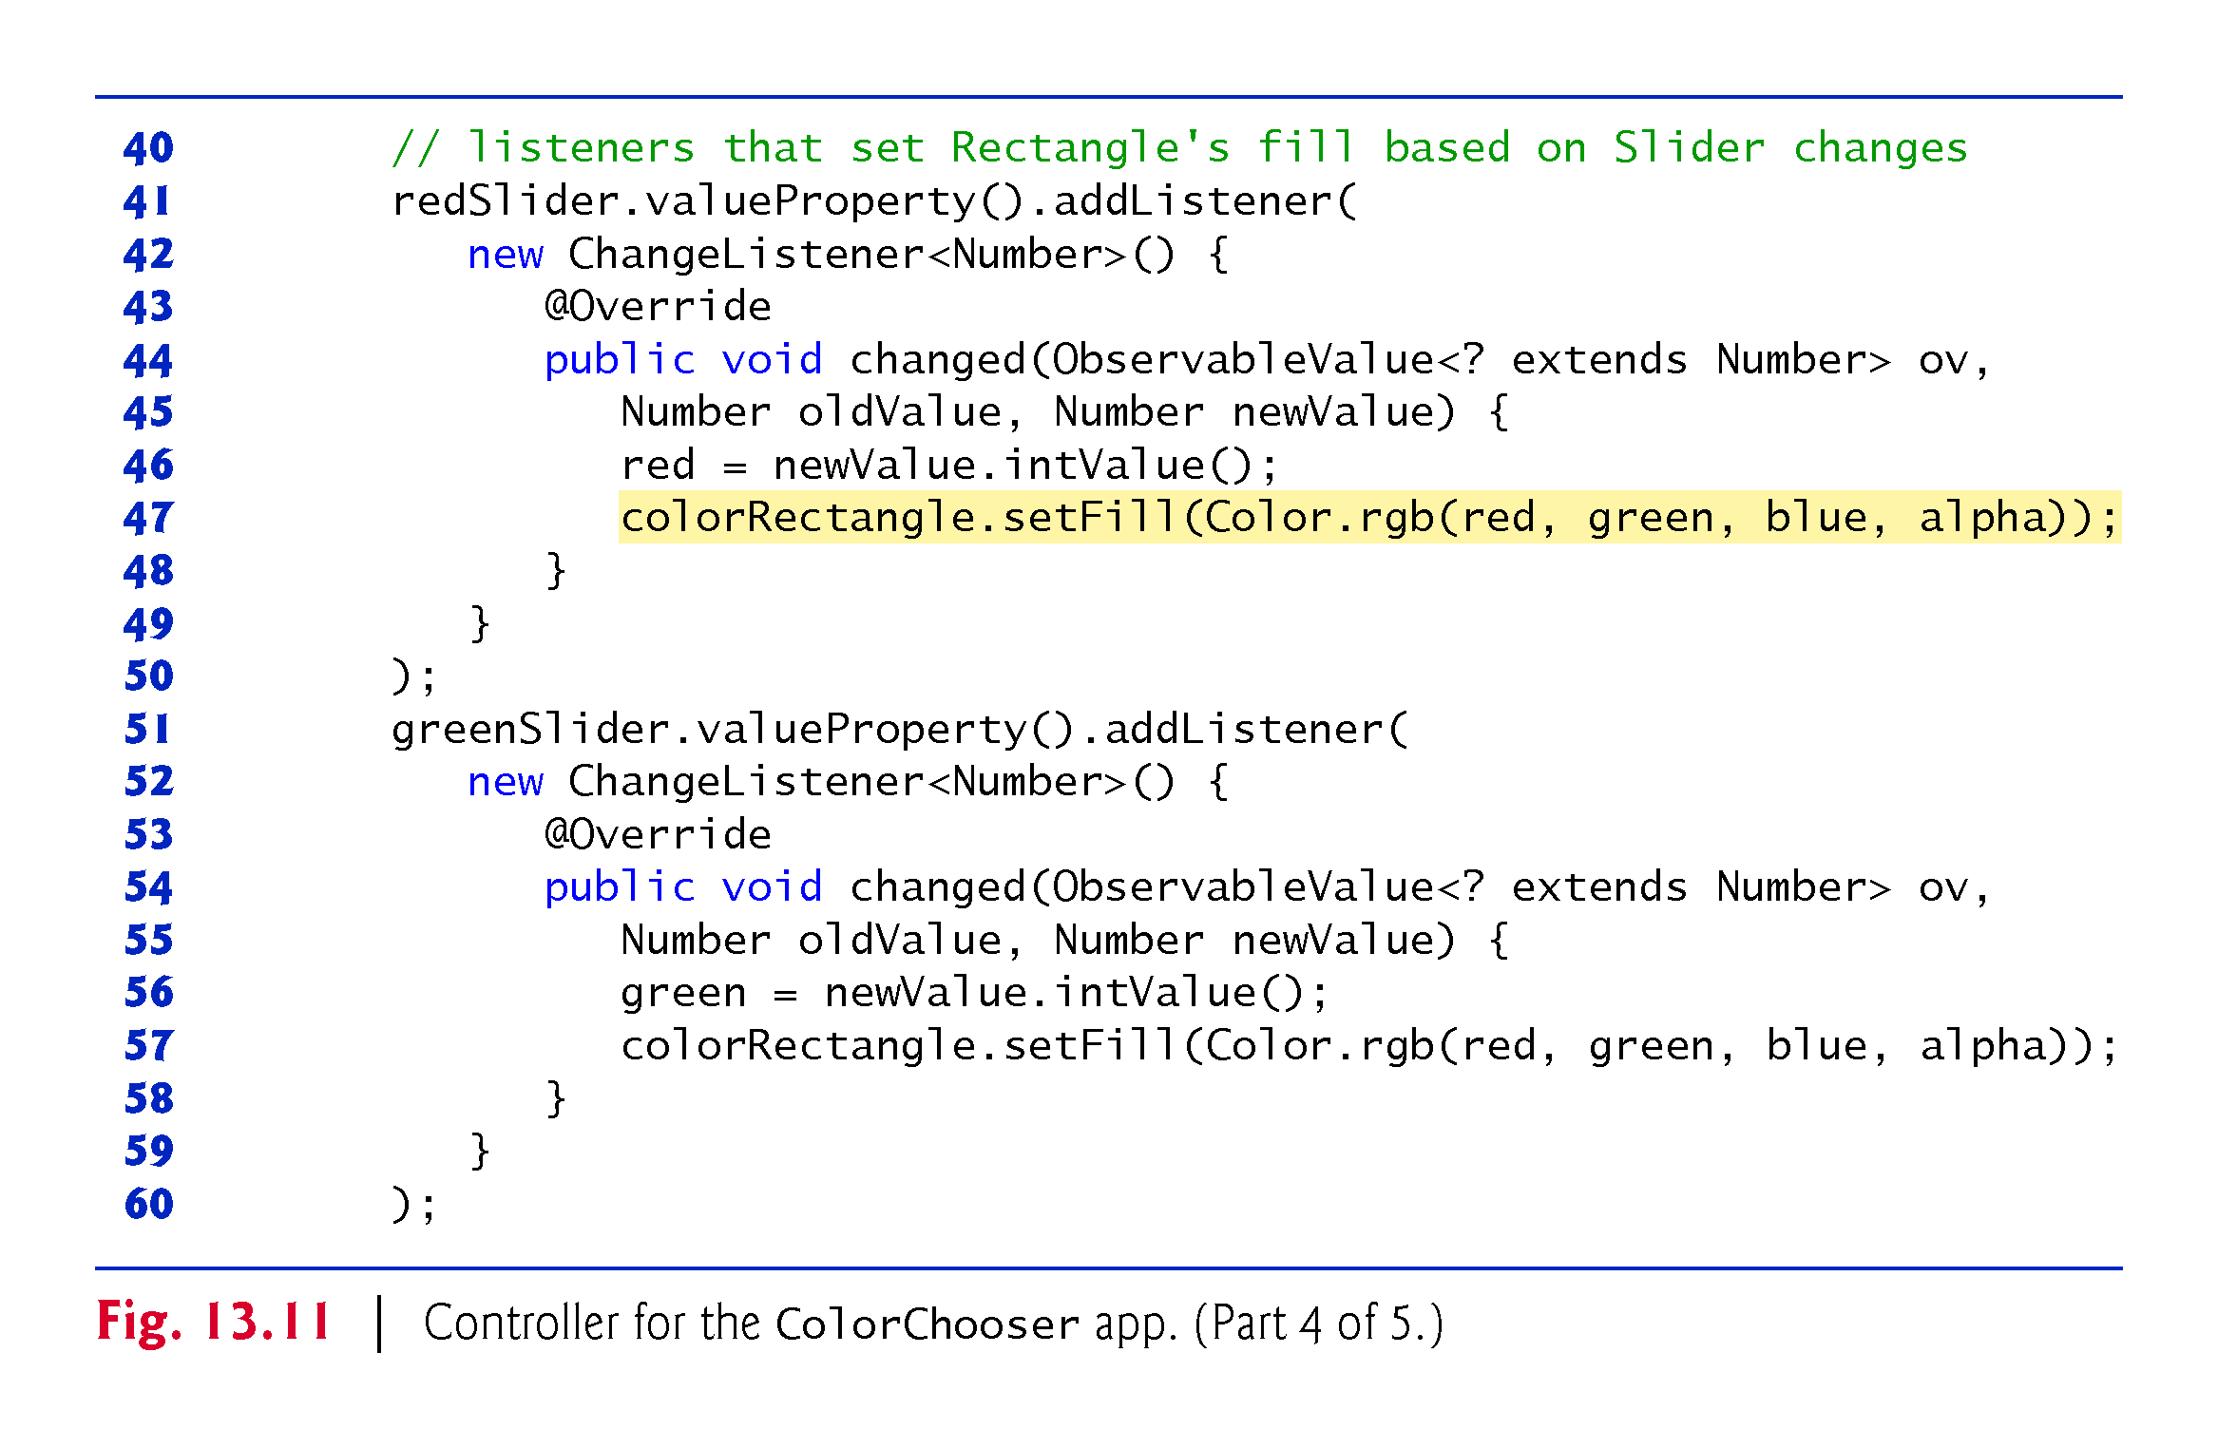

Slide 87
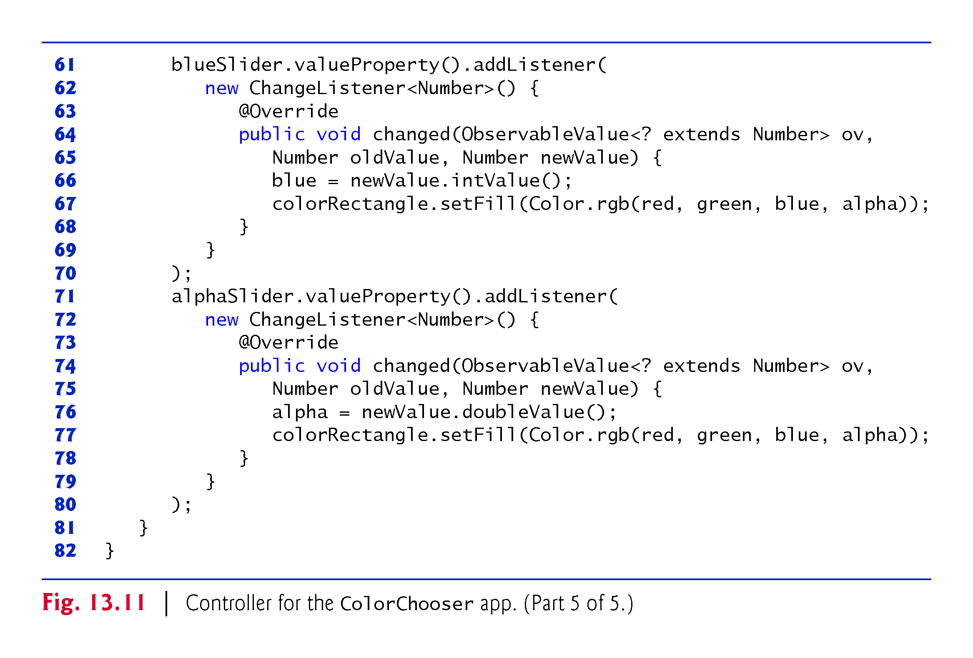

Slide 88
ColorChooserController Class (cont.)
Instance Variables
Lines 13–27 declare the controller’s instance variables
Variables red, green, blue and alpha- store the current values of the redSlider, greenSlider, blueSlider and alphaSlider-, respectively
These values are used to update the colorRectangle’s fill color each time the user moves a Slider’s thumb.

Slide 89
ColorChooserController Class (cont.)
Method initialize
Lines 29–81 define method initialize, which initializes the controller after the GUI is created
In this app, initialize configures the property bindings and property listeners.

Slide 90
ColorChooserController Class (cont.)
Property-to-Property Bindings
Lines 31–38 set up property bindings between a Slider’s value and the corresponding Text-Field’s text so that changing a Slider updates the corresponding TextField
Consider lines 31–32, which bind the redSlider’s valueProperty to the redText-Field’s textProperty:
redTextField.textProperty().bind( redSlider.valueProperty().asString("%.0f"));

Slide 91
ColorChooserController Class (cont.)
Property-to-Property Bindings (cont.)
Each TextField has a text property that’s returned by its textProperty method as a StringProperty (package javafx.beans.property)
StringProperty method bind receives an ObservableValue as an argument
When the ObservableValue changes, the bound property updates accordingly
In this case the ObservableValue is the result of the expression redSlider.valueProperty().asString("%.0f")

Slide 92
ColorChooserController Class (cont.)
Property-to-Property Bindings (cont.)
Slider’s valueProperty method returns the Slider’s value property as a DoubleProperty—an observable double value
Because the TextField’s text property must be bound to a String, we call DoubleProperty method asString, which returns a StringBinding object (an ObservableValue) that produces a String representation of the DoubleProperty
This version of asString receives a format-control String specifying the DoubleProperty’s format

Slide 93
ColorChooserController Class (cont.)
Property Listeners
To perform an arbitrary task when a property’s value changes, register a property listener
Lines 41–80 register property listeners for the Sliders’ value properties
Consider lines 41–50, which register the ChangeListener that executes when the user moves the redSlider’s thumb
Each ChangeListener stores the int value of the newValue parameter in a corresponding instance variable, then calls the colorRectangle’s setFill method to change its color, using Color method rgb to create the new Color object

Slide 94
Cover Viewer App: Data-Driven GUIs with JavaFX Collections
Often an app needs to edit and display data
JavaFX provides a comprehensive model for allowing GUIs to interact with data
In this section, you’ll build the Cover Viewer app (Fig. 13.12), which binds a list of Book objects to a ListView
When the user selects an item in the ListView, the corresponding Book’s cover image is displayed in an ImageView.

Slide 95
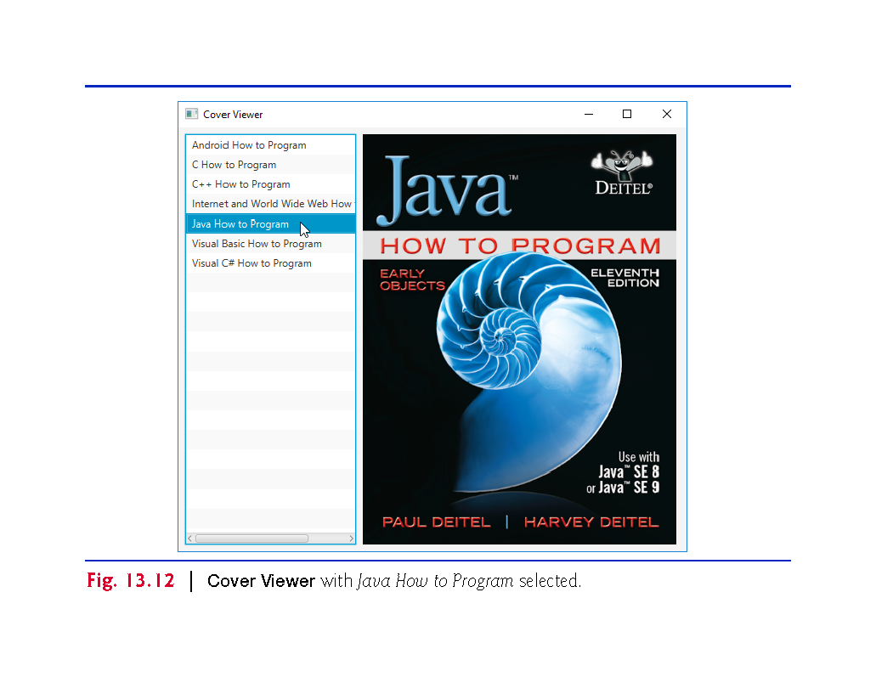

Slide 96
Technologies Overview
This app uses a ListView control to display a collection of book titles
Though you can individually add items to a ListView, in this app you’ll bind an ObservableList object to the ListView
If you make changes to an ObservableList, its observer (the ListView in this app) will automatically be notified of those changes
Package javafx.collections defines ObservableList (similar to an ArrayList) and other observable collection interfaces
The package also contains class FXCollections, which provides static methods for creating and manipulating observable collections
You’ll use a property listener to display the correct image when the user selects an item from the ListView—in this case, the property that changes is the selected item

Slide 97
Adding Images to the App’s Folder
From this chapter’s examples folder, copy the images folder (which contains the large and small subfolders) into the folder where you’ll save this app’s FXML file, and the source-code files CoverViewer.java and CoverViewerController.java
Though you’ll use only the large images in this example, you’ll copy this app’s folder to create the next example, which uses both sets of images

Slide 98
Building the GUI
In this section, we’ll discuss the Cover Viewer app’s GUI
As you’ve done previously, create a new FXML file, then save it as CoverViewer.fxml.
fx:id Property Values for This App’s Controls
Figure 13.13 shows the fx:id properties of the Cover Viewer app’s programmatically manipulated controls
As you build the GUI, you should set the corresponding fx:id properties in the FXML document

Slide 99
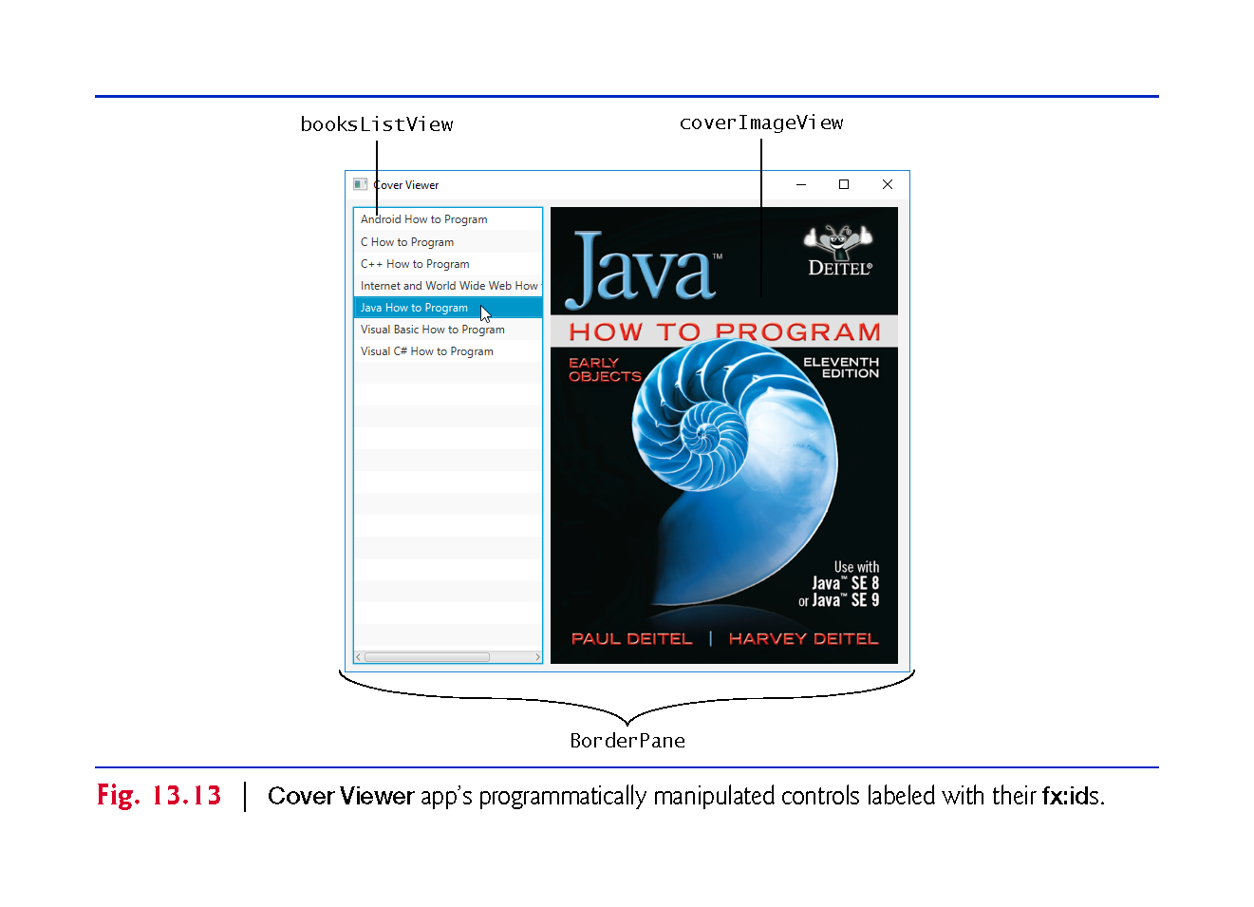

Slide 100
Building the GUI (cont.)
Adding and Configuring the Controls
Using the techniques you learned previously, create a BorderPane
In the left area, place a ListView control, and in the center area, place an ImageView control
For the ListView, set the following properties:
Margin—8 (for the right margin) to separate the ListView from the ImageView
Pref Width—200
Max Height—MAX_VALUE
Min Width, Min Height, Pref Height and Max Width—USE_COMPUTED_SIZE

Slide 101
Building the GUI (cont.)
Adding and Configuring the Controls (cont.)
For the ImageView, set the Fit Width and Fit Height properties to 370 and 480, respectively
To size the BorderPane based on its contents, set its Pref Width and Pref Height to USE_COMPUTED_SIZE
Also, set the Padding property to 8 to inset the BorderPane from the stage.

Slide 102
Building the GUI (cont.)
Specifying the Controller Class’s Name
To ensure that an object of the controller class is created when the app loads the FXML file at runtime, specify CoverViewerController as the controller class’s name in the FXML file as you’ve done previously.
Generating a Sample Controller Class
Select View > Show Sample Controller Skeleton, then copy this code into a CoverViewerController.java file and store the file in the same folder as CoverViewer.fxml

Slide 103
CoverViewer Subclass of Application
Figure 13.14 shows class CoverViewer subclass of Application

Slide 104
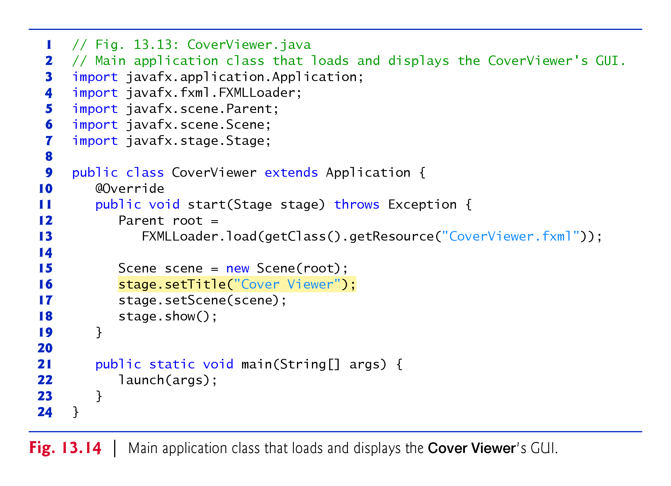

Slide 105
CoverViewerController Class
Figure 13.15 shows the final version of class CoverViewerController with the app’s new features highlighted

Slide 106
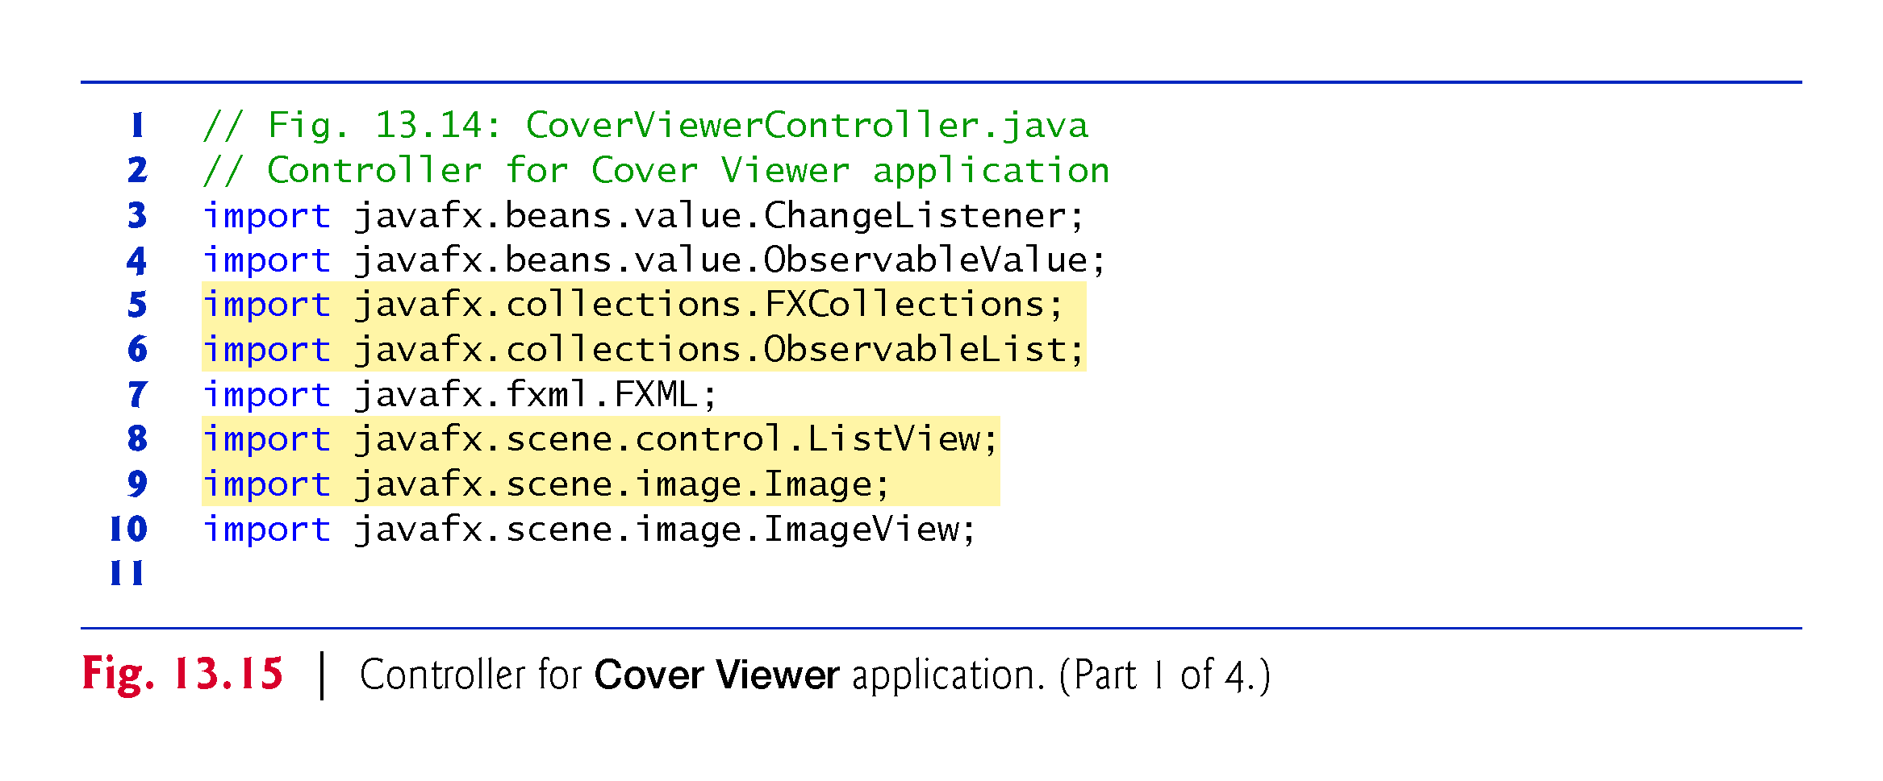

Slide 107
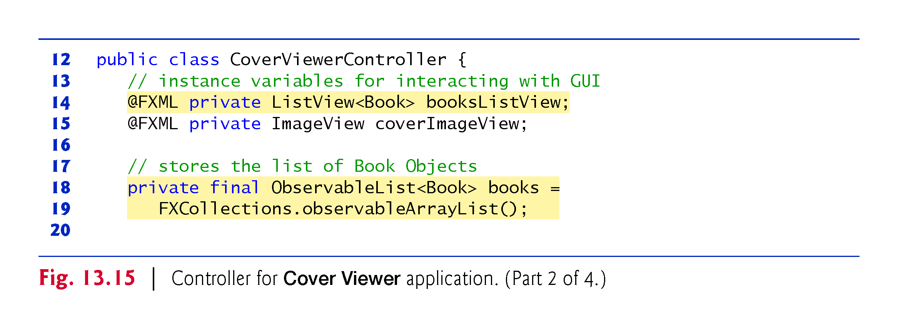

Slide 108
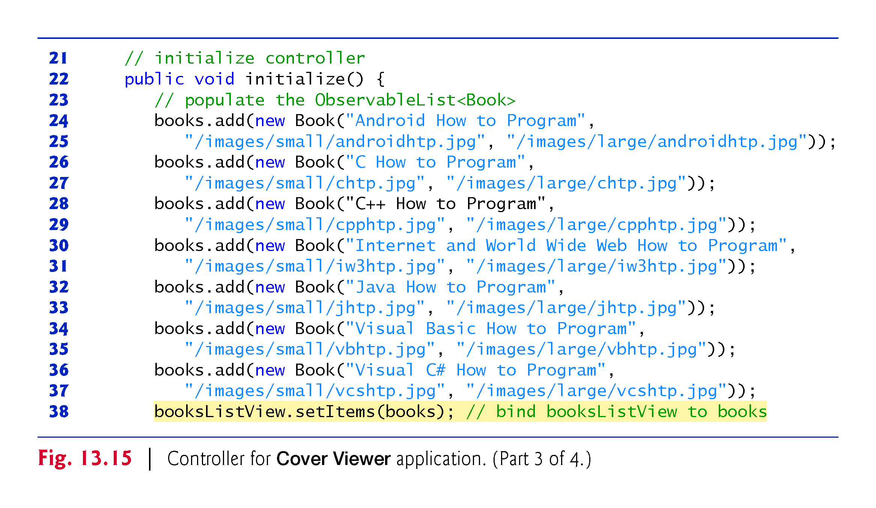

Slide 109
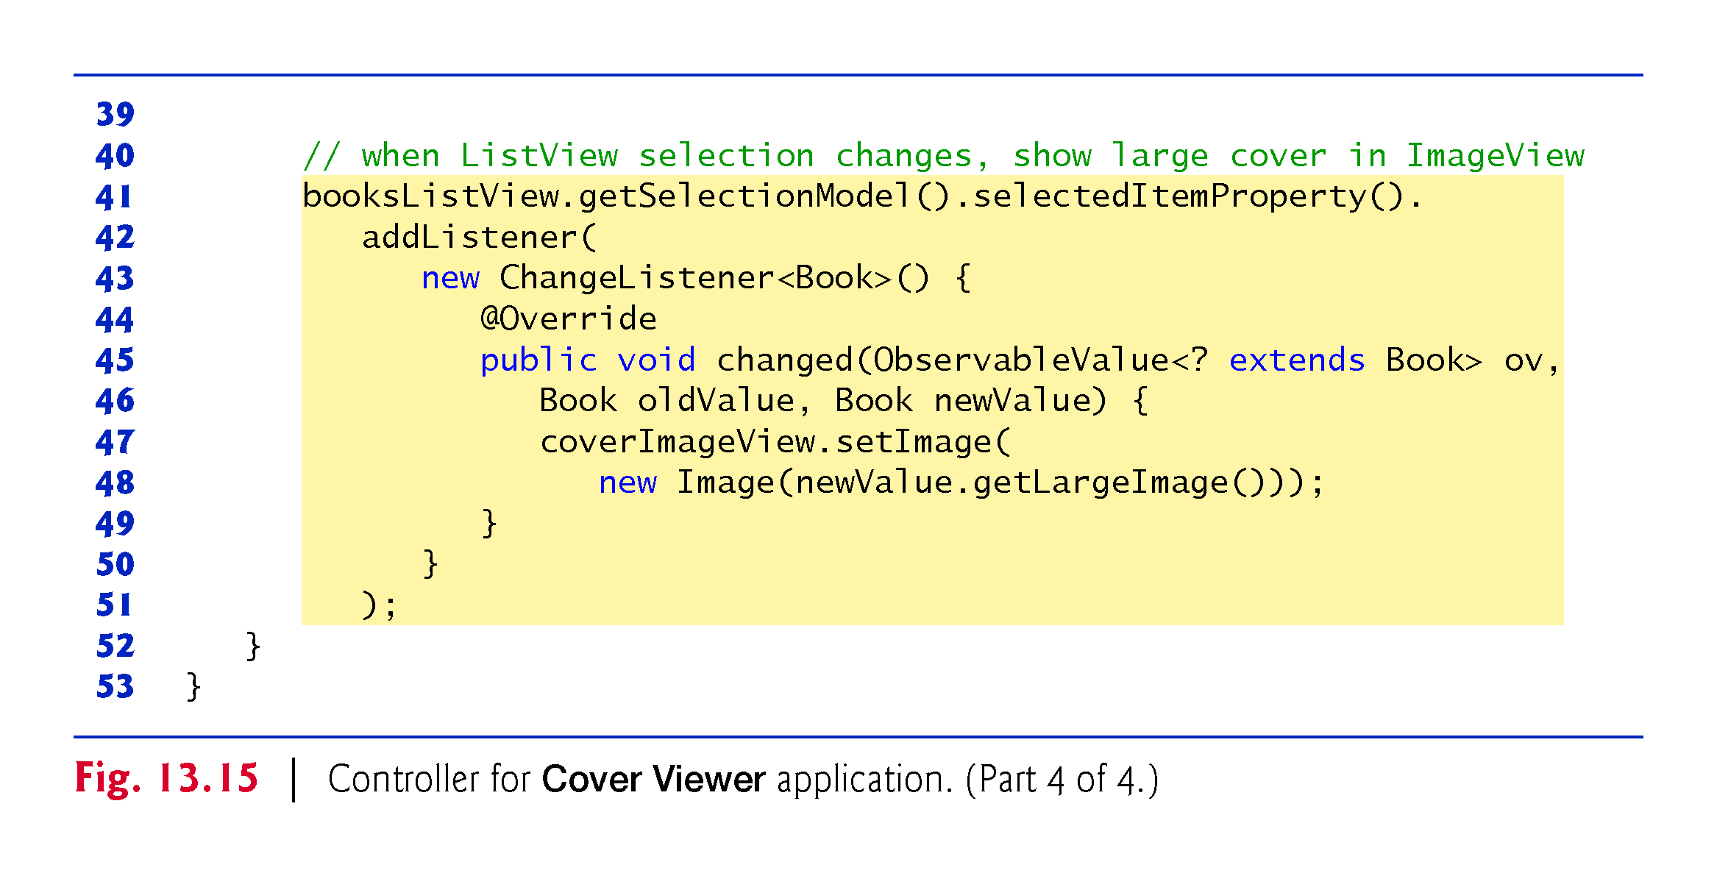

Slide 110
CoverViewerController Class (cont.)
@FXML Instance Variables
Lines 14–15 declare the controller’s @FXML instance variables
In this case, the ListView displays Book objects
Class Book contains three String instance variables with set/get methods:
title—the book’s title.
thumbImage—the path to the book’s thumbnail image (used in the next example).
largeImage—the path to the book’s large cover image
The class also provides a toString method that returns the Book’s title and a constructor that initializes the three instance variables
Copy Book.java from this chapter’s examples folder into the folder that contains CoverViewer.fxml, CoverViewer.java and CoverViewerController.java

Slide 111
CoverViewerController Class (cont.)
Instance Variable books
Lines 18–19 define the books instance variable as an ObservableList<Book> and initialize it by calling FXCollections static method observableArrayList
This method returns an empty collection object (similar to an ArrayList) that implements the Observable-List interface

Slide 112
CoverViewerController Class (cont.)
Initializing the books ObservableList
Lines 24–37 in method initialize create and add Book objects to the books collection
Line 38 passes this collection to ListView method setItems, which binds the ListView to the ObservableList
This data binding allows the ListView to display the Book objects automatically
By default, the ListView displays each Book’s String representation

Slide 113
CoverViewerController Class (cont.)
Listening for ListView Selection Changes
To synchronize the book cover that’s being displayed with the currently selected book, we listen for changes to the ListView’s selected item
By default a ListView supports single selection
ListViews also support multiple selection
Selection is managed by the ListView’s MultipleSelectionModel (a subclass of SelectionModel from package javafx.scene.control
Contains observable properties and various methods for manipulating the corresponding ListView’s items
To respond to selection changes, you register a listener for the MultipleSelectionModel’s selectedItem property (lines 41–51)

Slide 114
CoverViewerController Class (cont.)
Listening for ListView Selection Changes (cont.)
ListView method getSelectionModel returns a MultipleSelectionModel object
In this example, MultipleSelectionModel’s selectedItemProperty method returns a ReadOnlyObjectProperty<Book>
Corresponding ChangeListener receives as oldValue and newValue the previously selected and newly selected Book objects, respectively
Lines 47–48 use newValue’s large image path to initialize a new Image (package javafx.scene.image)—this loads the image from that path
We then pass the new Image to the coverImageView’s setImage method to display the Image

Slide 115
Cover Viewer App: Customizing ListView Cells
In the preceding example, the ListView displayed a Book’s String representation (i.e., its title)
In this example, you’ll create a custom ListView cell factory to create cells that display each book as its thumbnail image and title using a VBox, an ImageView and a Label (Fig. 13.16)

Slide 116
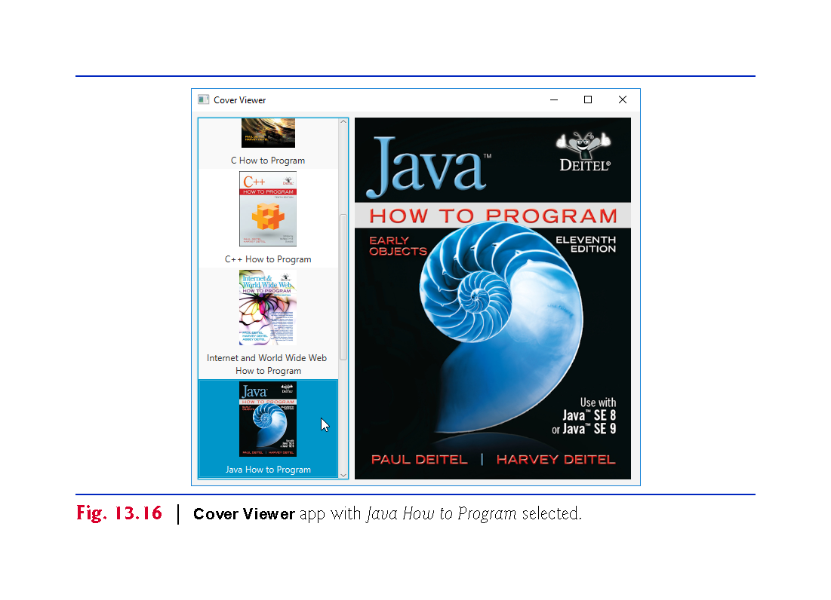

Slide 117
Technologies Overview
ListCell Generic Class for Custom ListView Cell Formats
As you saw in Section 13.5, ListView cells display the String representations of a ListView’s items by default
To create a custom cell format, you must first define a subclass of the ListCell generic class (package javafx.scene.control) that specifies how to create a ListView cell
As the ListView displays items, it gets ListCells from its cell factory
You’ll use the ListView’s setCellFactory method to replace the default cell factory with one that returns objects of the ListCell subclass
You’ll override this class’s updateItem method to specify the cells’ custom layout and contents

Slide 118
Technologies Overview (cont.)
Programmatically Creating Layouts and Controls
So far, you’ve created GUIs visually using JavaFX Scene Builder
In this app, you’ll also create a portion of the GUI programmatically—in fact, everything we’ve shown you in Scene Builder also can be accomplished in Java code directly
In particular, you’ll create and configure a VBox layout containing an ImageView and a Label
The VBox represents the custom ListView cell format

Slide 119
Copying the CoverViewer App
This app’s FXML layout and classes Book and CoverViewer are identical to those in Section 13.5, and the CoverViewerController class has only one new statement
For this example, we’ll show a new class that implements the custom ListView cell factory and the one new statement in class CoverViewerController
Rather than creating a new app from scratch, copy the CoverViewer app from the previous example into a new folder named CoverViewerCustomListView

Slide 120
ImageTextCell Custom Cell Factory Class
Class ImageTextCell (Fig. 13.17) defines the custom ListView cell layout for this version of the Cover Viewer app
The class extends ListCell<Book> because it defines a customized presentation of a Book in a ListView cell

Slide 121
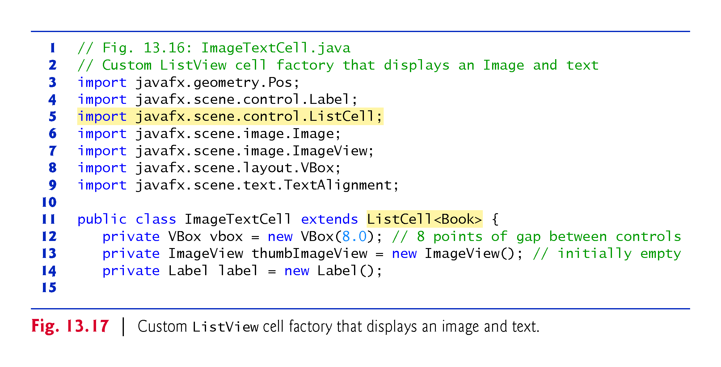

Slide 122
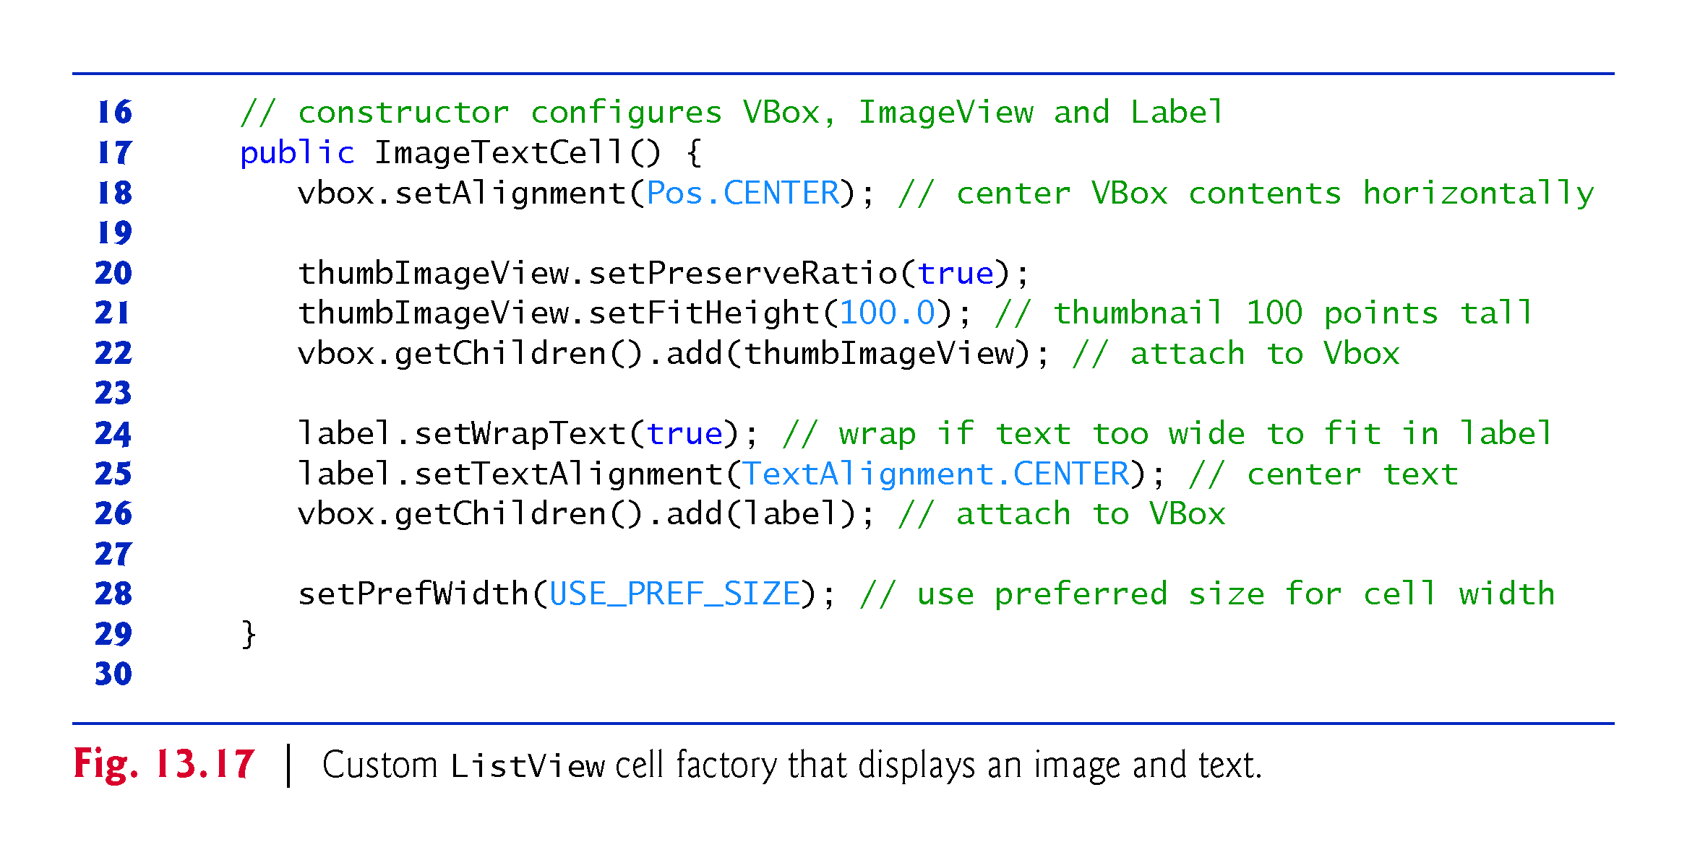

Slide 123
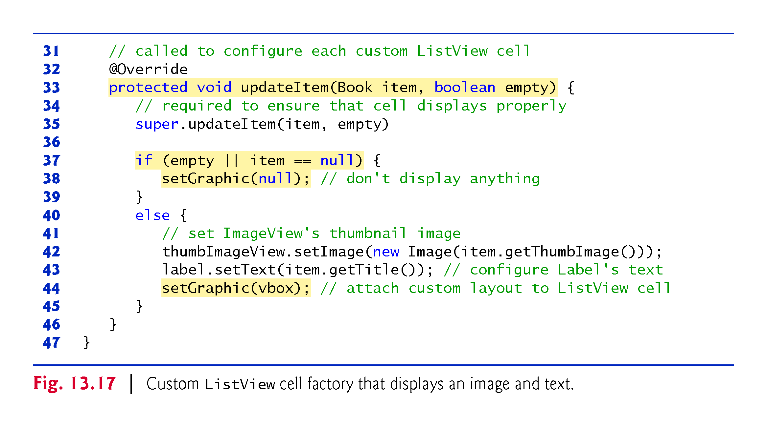

Slide 124
ImageTextCell Custom Cell Factory Class (cont.)
Constructor
The constructor (lines 17–29) configures the instance variables we use to build the custom presentation
Line 18 indicates that the VBox’s children should be centered
Lines 20–22 configure the ImageView and attach it to the VBox’s collection of children
Line 20 indicates that the ImageView should preserve the image’s aspect ratio, and line 21 indicates that the ImageView should be 100 points tall

Slide 125
ImageTextCell Custom Cell Factory Class (cont.)
Constructor (cont.)
Line 22 attaches the ImageView to the VBox.
Lines 24–26 configure the Label and attach it to the VBox’s collection of children
Line 24 indicates that the Label should wrap its text if its too wide to fit in the Label’s width, and line 25 indicates that the text should be centered in the Label
Line 26 attaches the Label to the VBox
Finally, line 28 indicates that the cell should use its preferred width, which is determined from the width of its parent ListView.

Slide 126
ImageTextCell Custom Cell Factory Class (cont.)
Method updateItem
Method updateItem (lines 32–46) configures the Label’s text and the ImageView’s Image then displays the custom presentation in the ListView
This method is called by the ListView’s cell factory when a ListView cell is required—that is, when the ListView is first displayed and when ListView cells are about to scroll onto the screen
The method receives the Book to display and a boolean indicating whether the cell that’s about to be created is empty

Slide 127
ImageTextCell Custom Cell Factory Class (cont.)
Method updateItem
You must call the superclass’s version of updateItem (line 35) to ensure that the custom cells display correctly.
If the cell is empty or the item parameter is null, then there is no Book to display and line 38 calls the ImageTextCell’s inherited setGraphic method with null
This method receives as its argument the Node that should be displayed in the cell
Any JavaFX Node can be provided, giving you tremendous flexibility for customizing a cell’s appearance

Slide 128
ImageTextCell Custom Cell Factory Class (cont.)
Method updateItem
If there is a Book to display, lines 40–45 configure the ImageTextCell’s the Label and ImageView
Line 42 configures the Book’s Image and sets it to display in the ImageView
Line 43 sets the Label’s text to the Book’s title
Finally, line 38 uses method setGraphic to set the ImageTextCell’s VBox as the custom cell’s presentation.

Slide 129
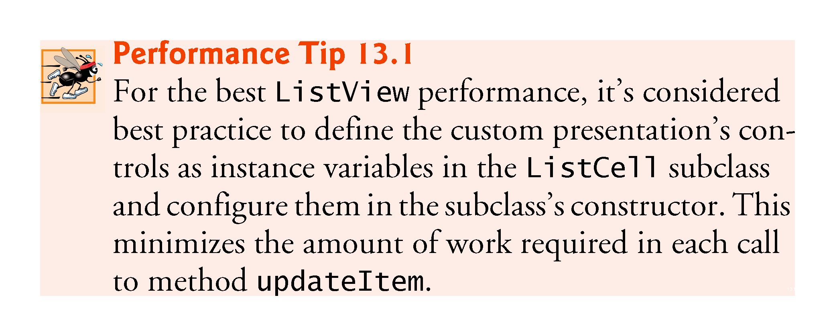

Slide 130
CoverViewerController Class
Updating the CoverViewerController to use it requires that you set the ListView’s cell factory
Insert the following code as the last statement in the CoverViewerController’s initialize method and add an import for javafx.util.Callback
booksListView.setCellFactory( new Callback<ListView<Book>, ListCell<Book>>() { @Override public ListCell<Book> call(ListView<Book> listView) { return new ImageTextCell(); } } );

Slide 131
CoverViewerController Class (cont.)
The argument to ListView method setCellFactory is an implementation of the functional interface CallBack (package javafx.util)
This generic interface provides a call method that receives one argument and returns a value
In Callback’s angle brackets the first type (ListView<Book>) is the parameter type for the interface’s call method and the second (ListCell<Book>) is the call method’s return type
The parameter represents the ListView in which the custom cells will appear
The call method call simply creates and returns an object of the ImageTextCell class

Slide 132
CoverViewerController Class (cont.)
Each time the ListView requires a new cell, the anonymous inner class’s call method will be invoked to get a new ImageTextCell
Then the ImageTextCell’s update method will be called to create the custom cell presentation
Note that by using a Java SE 8 lambda (Chapter 17) rather than an anonymous inner class, you can replace the entire statement that sets the cell factory with a single line of code

Slide 133
13.7 Additional JavaFX Capabilities
This section overviews various additional JavaFX capabilities that are available in JavaFX 8 and JavaFX 9
TableView Control
Section 13.5 demonstrated how to bind data to a ListView control
You often load such data from a database (Chapter 24, Accessing Databases with JDBC, and Chapter 29, Java Persistence API (JPA))
JavaFX’s TableView control (package javafx.scene.control) displays tabular data in rows and columns, and supports user interactions with that data.

Slide 134
13.7 Additional JavaFX Capabilities (cont.)
Accessibility
In a Java SE 8 update, JavaFX added accessibility features to help people with visual impairments use their devices
For example, the screen readers in various operating systems can speak screen text or text that you provide to help users with visual impairments understand the purpose of a control
Visually impaired users must enable their operating systems’ screen-reading capabilities

Slide 135
13.7 Additional JavaFX Capabilities (cont.)
Accessibility (cont.)
JavaFX controls also support:
GUI navigation via the keyboard—for example, the user can press the Tab key to jump from one control to the next. If a screen reader also is enabled, as the user moves the focus from control to control, the screen reader will speak appropriate information about each control (discussed below).
A high-contrast mode to make controls more readable—as with screen readers, visually impaired users must enable this feature in their operating systems.
See your operating system’s documentation for information on enabling its screen reader and high-contrast mode.

Slide 136
13.7 Additional JavaFX Capabilities (cont.)
Accessibility (cont.)
Every JavaFX Node subclass also has these accessibility-related properties:
accessibleTextProperty—A String that a screen reader speaks for a control
accessibleHelpProperty—A more detailed control description String than that provided by the accessibleTextProperty
Should help the user understand the purpose of the control in the context of your app
accessibleRoleProperty—A value from the enum AccessibleRole (package javafx-.scene)
Screen reader uses this to determine attributes and actions supported for a control
accessibleRoleDescriptionProperty—A String text description of a control that a screen reader typically speaks followed by the control’s contents or the value of the accessibleTextProperty

Slide 137
13.7 Additional JavaFX Capabilities (cont.)
Accessibility (cont.)
In addition, you can add Labels to a GUI that describe other controls
In such cases, you should set each Label’s labelFor property to the specific control the Label describes
For example, a TextField in which the user can enter a phone number might be preceded by a Label containing the text "Phone Number"
If the Label’s labelFor property references the TextField, then a screen reader will read the Label’s text as well when describing the TextField to the user

Slide 138
13.7 Additional JavaFX Capabilities (cont.)
Third-Party JavaFX Libraries
Various libraries for additional JavaFX capabilities
ControlsFX (http://www.controlsfx.org/) provides common dialogs, additional controls, validation capabilities, TextField enhancements, a SpreadSheetView, TableView enhancements and more
JFXtras (http://jfxtras.org/) provides many additional JavaFX controls, including date/time pickers, controls for maintaining an agenda, a calendar control, additional window features and more.
Medusa provides many JavaFX gauges that look like clocks, speedometers and more. You can view samples at https://github.com/HanSolo/Medusa/blob/master/README.md

Slide 139
13.7 Additional JavaFX Capabilities (cont.)
Creating Custom JavaFX Controls
You can create custom controls by extending existing JavaFX control classes to customize them or by extending JavaFX’s Control class directly
JavaFXPorts: JavaFX for Mobile and Embedded Devices
Oracle officially supports JavaFX only for desktop apps
Gluon’s open-source JavaFXPorts project (http://javafxports.org/) brings desktop JavaFX to mobile devices (iOS and Android) and devices like the Raspberry Pi (https://www.raspberrypi.org/)
In addition, Gluon Mobile provides a mobile-optimized JavaFX implementation for iOS and Android
http://gluonhq.com/products/mobile/

Slide 140
13.7 Additional JavaFX Capabilities (cont.)
Scenic View for Debugging JavaFX Scenes and Nodes
Scenic View is a debugging tool for JavaFX scenes and nodes
Embed Scenic View directly into apps or run it as a standalone app
Inspect your JavaFX scenes and nodes, and modify them dynamically to see how changes affect their presentation on the screen
Without having to edit your code, recompile it and re-run it
For more information, visit
http://www.scenic-view.org

Slide 141
13.7 Additional JavaFX Capabilities (cont.)
JavaFX Resources and JavaFX in the Real World
Visit the following website for a lengthy and growing list of JavaFX resources
http://bit.ly/JavaFXResources

Slide 142
13.8 JavaFX 9: Java SE 9 JavaFX Updates
Java SE 9 Modularization
Java SE 9’s biggest new software-engineering feature is the module system
The key JavaFX 9 modules are:
javafx.base—Required by all JavaFX 9 apps
javafx.controls—Controls, layouts and charts
javafx.fxml—For working with FXML
javafx.graphics—For working with graphics, animation, CSS (for styling nodes), text and more
javafx.media—For incorporating audio and video
javafx.swing—For integrating into JavaFX 9 apps Swing GUI components
javafx.web—For integrating web content

Slide 143
13.8 JavaFX 9: Java SE 9 JavaFX Updates (cont.)
In your apps, if you use modularization and JDK 9, only the modules required by your app will be loaded at runtime
Otherwise, your app will continue to work as it did previously, provided that you did not use so-called internal APIs—that is, undocumented Java APIs that are not meant for public use
In the modularized JDK 9, such APIs are automatically private and inaccessible to your apps—any code that depends on pre-Java-SE-9 internal APIs will not compile

Slide 144
13.8 JavaFX 9: Java SE 9 JavaFX Updates (cont.)
New Public Skinning APIs
If a JavaFX GUI’s presentation is determined entirely by a style sheet (which specifies the rules for styling the GUI), you can simply swap in a new style sheet—sometimes called a skin—to change the GUI’s appearance
This is commonly called skinning

Slide 145
13.8 JavaFX 9: Java SE 9 JavaFX Updates (cont.)
New Public Skinning APIs (cont._
Each JavaFX control also has a skin class that determines its default appearance
In JavaFX 8, skin classes are defined as internal APIs, but many developers create custom skins by extending these skin classes
In JavaFX 9, the skin classes are now public APIs in the package javafx.scene.control.skin
You can extend the appropriate skin class to customize the look-and-feel for a given type of control
You then create an object of your custom skin class and set it for a control via its setSkin method

Slide 146
13.8 JavaFX 9: Java SE 9 JavaFX Updates (cont.)
GTK+ 3 Support on Linux
GTK+ (GIMP Toolkit—http://gtk.org) is a GUI toolkit that JavaFX uses behind the scenes to render GUIs and graphics on Linux
In Java SE 9, JavaFX now supports GTK+ 3—the latest version of GTK+
High-DPI Screen Support
In a Java SE 8 update, JavaFX added support for High DPI (dots-per-inch) screens on Windows and macOS
Java SE 9 adds Linux High-DPI support, as well as capabilities to programmatically manipulate the scale at which JavaFX apps are rendered on Windows, macOS and Linux.

Slide 147
13.8 JavaFX 9: Java SE 9 JavaFX Updates (cont.)
Updated GStreamer
JavaFX implements its audio and video multimedia capabilities using GStreamer (https://gstreamer.freedesktop.org)
JavaFX 9 incorporates a more recent version of GStreamer
Updated WebKit
WebView control embeds web content in JavaFX apps
Based on WebKit framework (http://www.webkit.org)—a web browser engine that supports loading and rendering web pages
JavaFX 9 incorporates an updated version of WebKit

