Slide 1
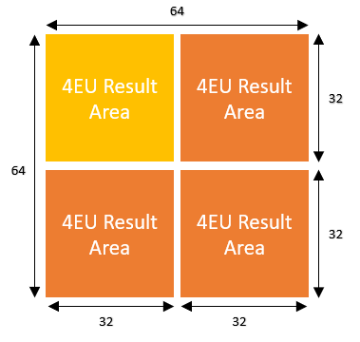
B
32
kK
32
kW
16
A
C
32
32
16
kH
kH
16
16
kK
kW

