Slide 1
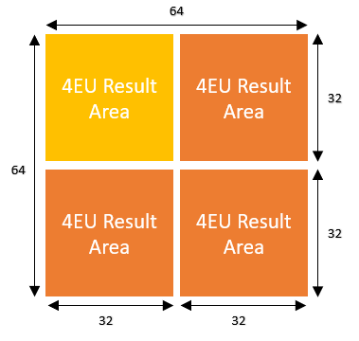
B
64
kK
kW
A
C
64
kH
kH
kK
kW

