Slide 1
Holiday Ting

Slide 2
Table of Contents Here
Introduction
Community
Problem
Competitor Research
Personas
Design Development
App Flow
Code Development
User Testing
Reflection
References.

Slide 3
Intro
App Concept
A mobile app designed for young travellers and students who struggle deciding where to travel. The app helps users discover destinations through preference-based random city recommendations while also acting as a lightweight travel organiser for itineraries, saved trips, and travel essentials.

Slide 4
Community
Young travellers, students, and first-time independent travellers aged 18–30.
Why this community?
Because younger travellers increasingly travel independently but rely heavily on fragmented digital tools.

Slide 5
Problems
Overwhelmed choosing destinations
Too many travel options
Planning feels stressful
Multiple apps required
Budget uncertainty
Difficulty starting the planning process

Slide 6
Competitor Research
Wanderlog
TripIt
Google Travel
Booking.com
Polarsteps (good reference for discovery)

Slide 7
Personas
Name: Maya
Age: 21
Occupation: University student
Goals:
- Find affordable destinations quickly
- Travel during breaks
- Avoid spending hours researching
Frustrations:
- Too many travel options
- Doesn't know where to start
- Uses multiple apps
Name: Daniel
Age: 25
Occupation: Junior Designer
Goals:
- Organise trips easily
- Save locations and plans
- Reduce planning stress
Frustrations:
- Planning feels exhausting
- Constant tab switching
- Difficult itinerary organisation

Slide 8
Initial Feature List
Core Features
Preference questionnaire
Random city generator
Comfort/weather comparison
Saved trips
Simple itinerary planner
Travel hub
Future Features
AI recommendations
Real booking integration
Currency converter
Offline map
Group planning

Slide 9
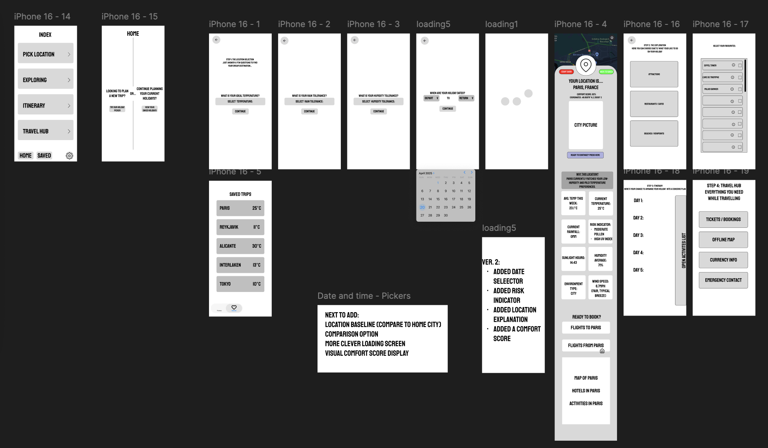
App Flow

