Slide 1
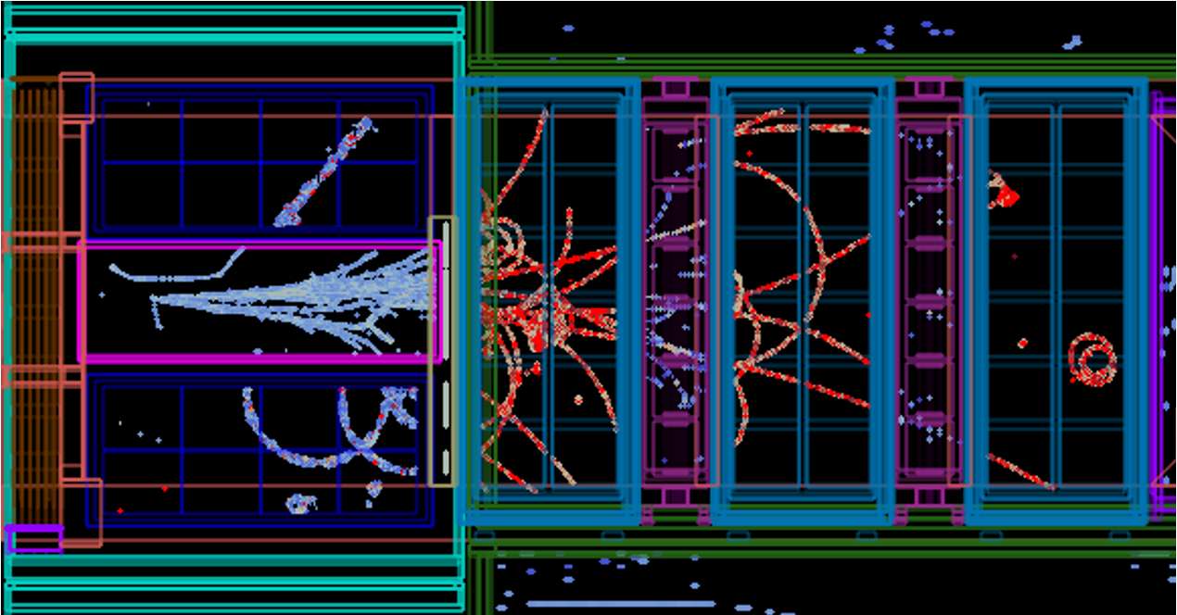
CITIROC simulation
SFGD electronics meeting
February 10th, 2025 - CERN

Slide 2
Outline
Why
  Detach from datasheet parameters
  Understand time resolution
  (Hopefully) understand pedestal calibration
What
  Simulate the signal response:
    Input: optical simulation
    MPPC model
    Preamplifier (HG and LG)
    Shapers (fast shaper for timing, slow shaper for charge)
    Discriminator (DAC10b/DAC10b_t) and discrete time stamp
How
  Solve the circuit in Laplace space
  Numerically inverse-Laplace-transform
  Include tolerances (next step)

Slide 3
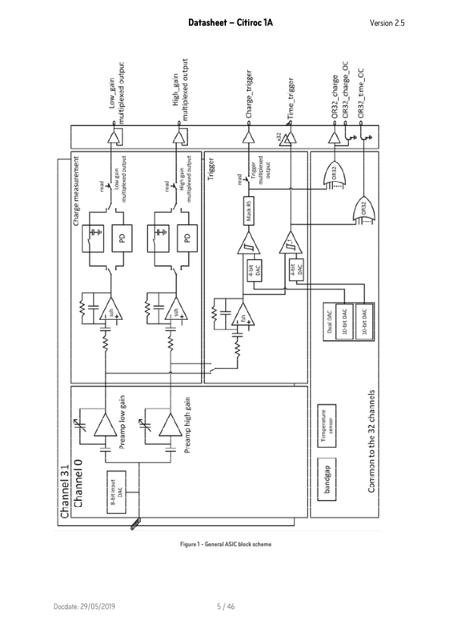
Circuit

Slide 4
Back up

Slide 5
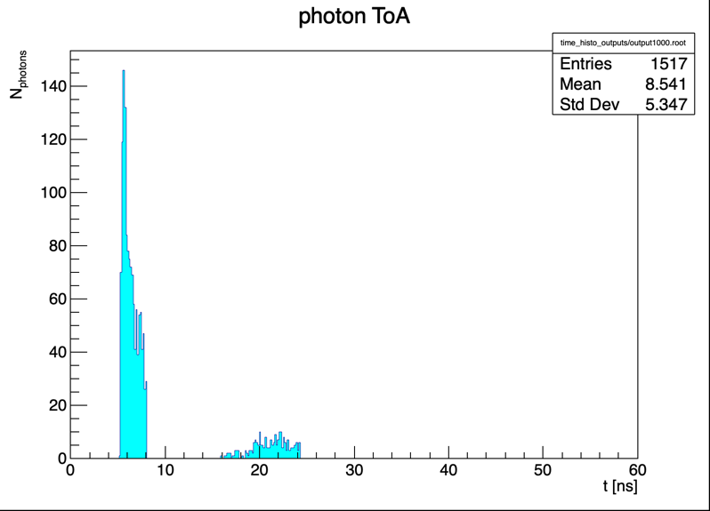
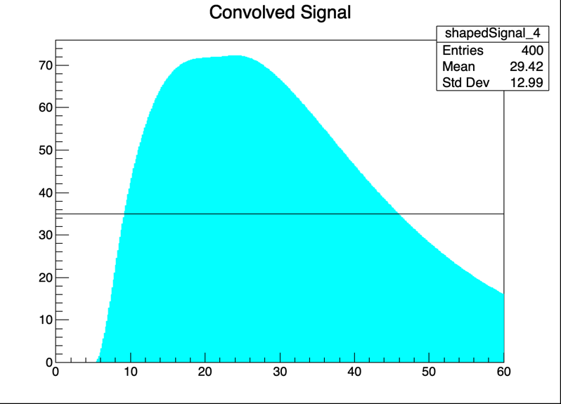
Intro
Fast shaper (15 ns): time stamping
Slow shaper (50 ns): charge measurement
  We use this to parametrize time walk!
The charges that these two shapers measure can be different.
Simulation of the shaper:
$V_{out}\left(t\right)=∫i\left(t^{′}\right)∗f\left(t−t^{′}\right)dt$ where: $f\left(t\right)=\frac{t}{τ}e^{−t/τ}$
Opt sim by
Kikawa-san
NB: I am using a fiber simulation by Kikawa-san. Simulate all photons at once in the fiber. With Botao’s simulation we include the scintillation decay time.

Slide 6
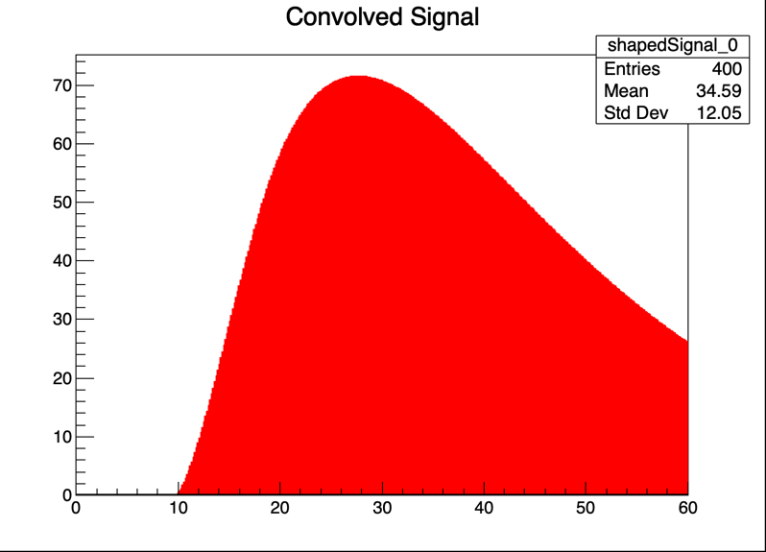
Time stamping and time walk
Time stamp: a fixed threshold on the FSH output. Threshold set to 3.5 p.e.
Time walk = time difference between t_{threshold} and t₀ on the FSH signal
In real life, we parametrize it as a function of the SSH signal amplitude
No problem if FSH = SSH
amplitude [a.u.]
time [ns]

Slide 7
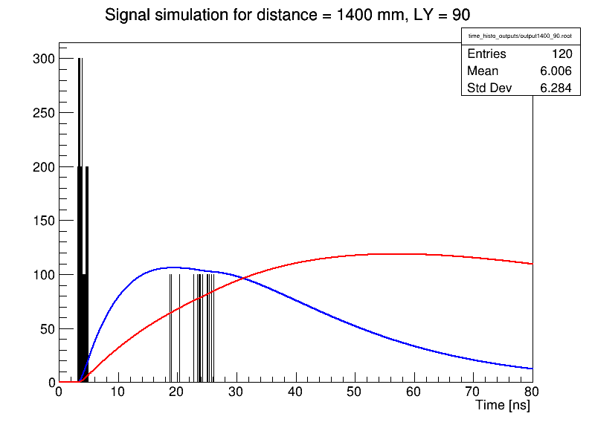
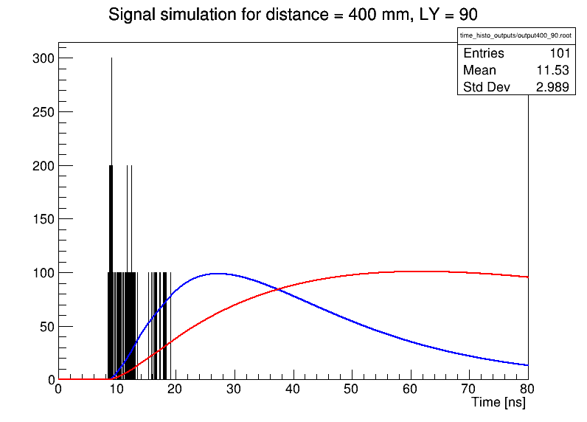
Direct + reflected pulse
The SSH integrates also the reflected signal
But the time (and time walk) only depend on the direct signal
FSH and SSH measure the same charge only for signals from the far end of the fiber
  And signal very close to the MPPC
Distance: 60 cm
Distance: 160 cm

Slide 8
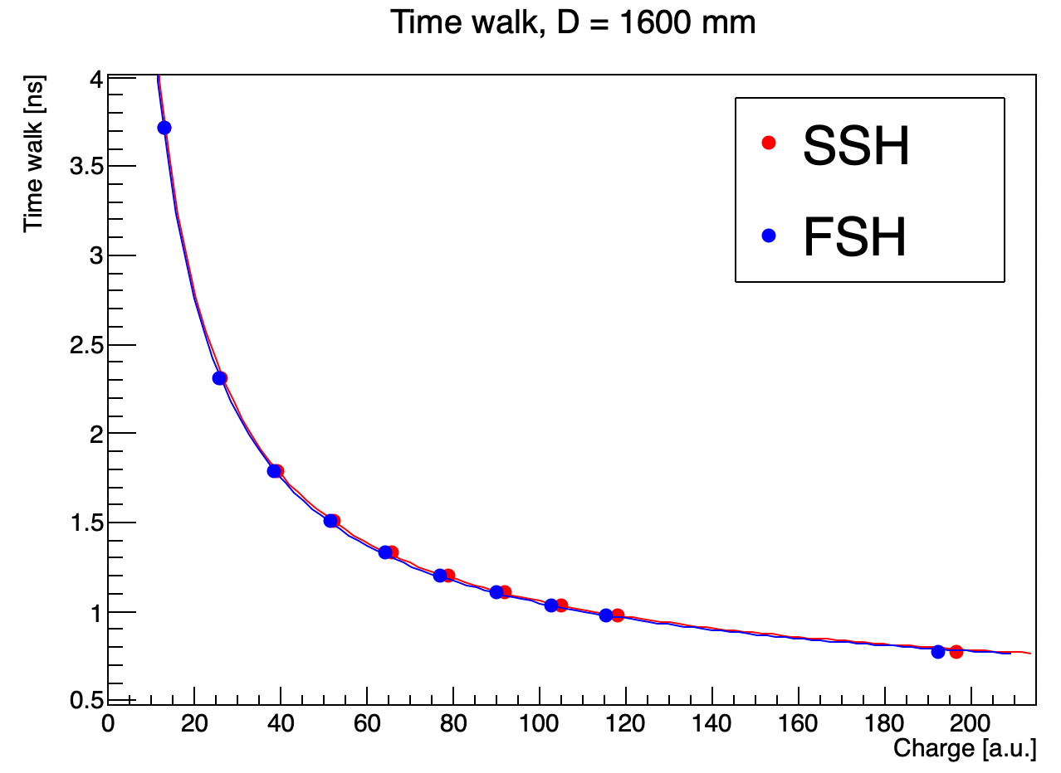
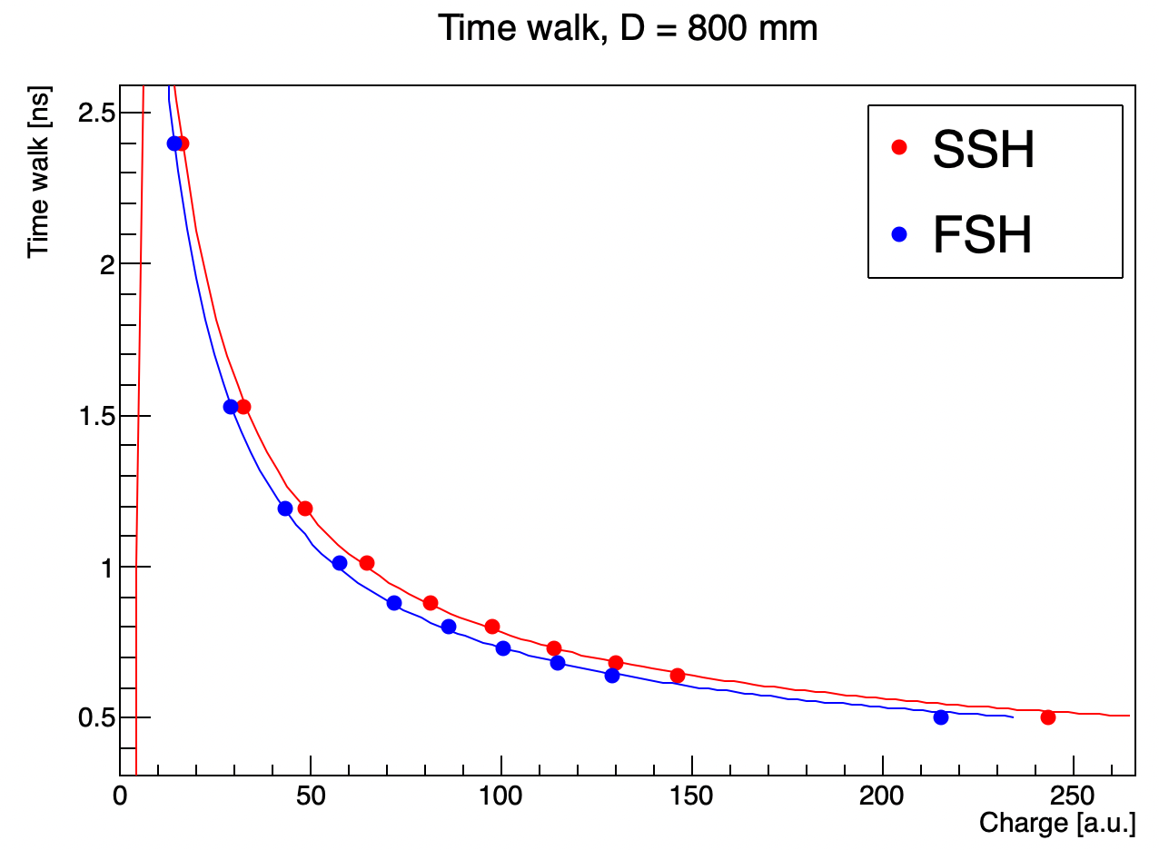
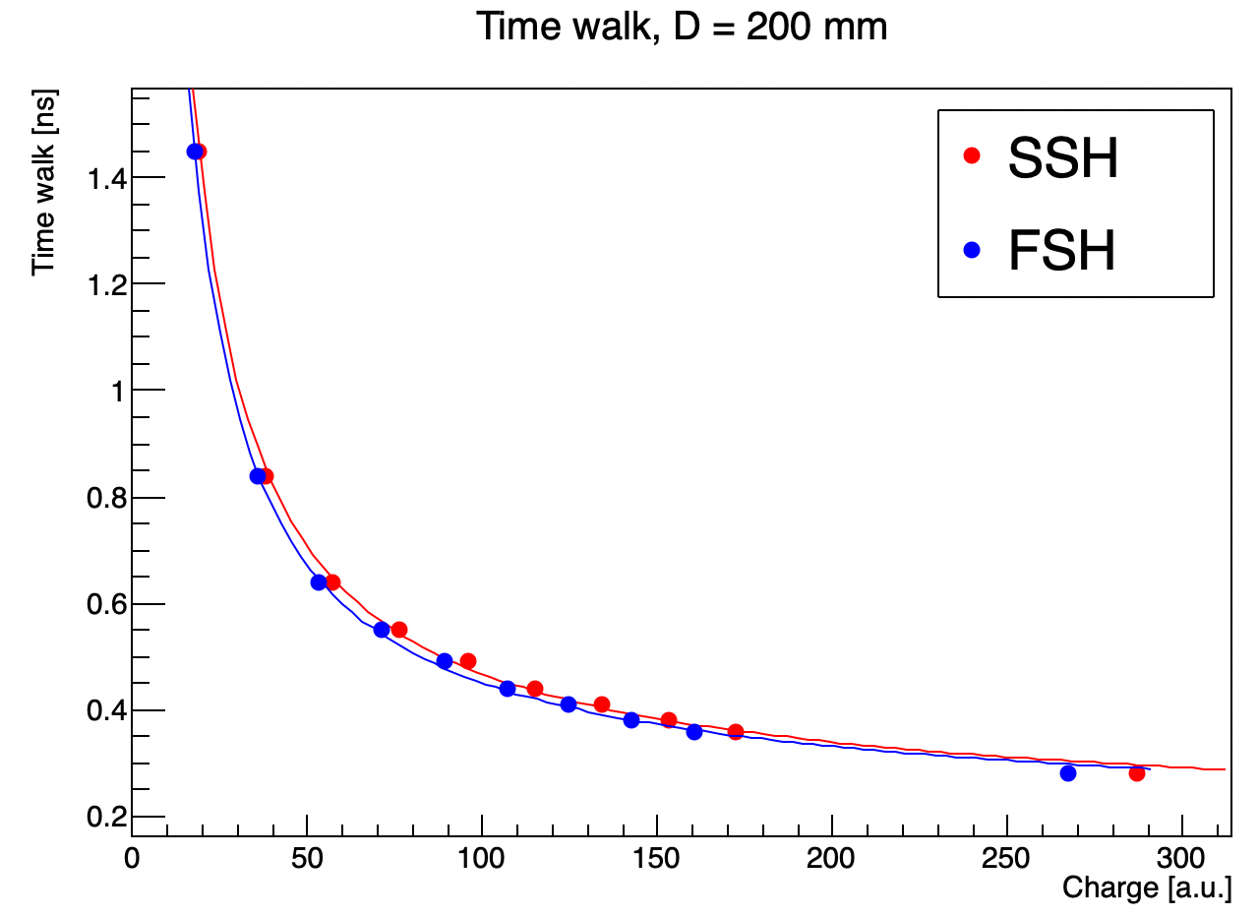
time walk - 1
Maybe the time walk we apply at large distances is wrong?
Long distance: the reflected pulse comes together with the direct pulse: No difference between FSH and SSH
Medium distance: the reflected pulse is delayed and consistent. Maximum difference between FSH and SSH.
Small distance: the reflected pulse is attenuated with respect to the direct pulse. The effect is small.
FSH-SSH time walk difference < 200 ps

Slide 9
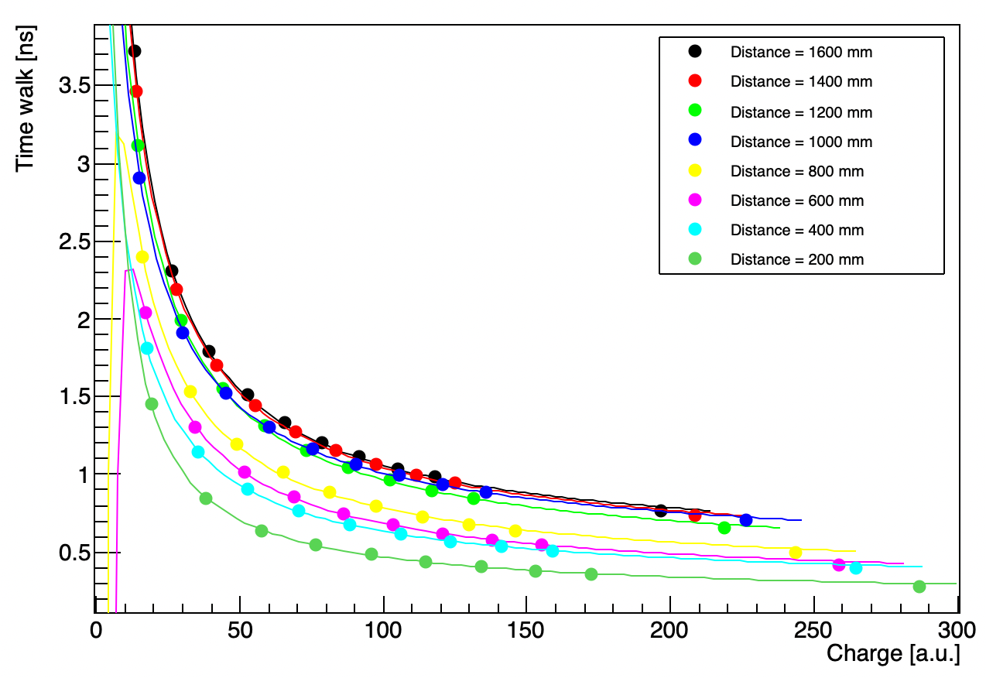
time walk - 2
Another effect on time walk is the signal spread in time for large distances (“first photon”)
The FSH/SSH difference might be negligible
Anyways, the time walk depends on the distance:
Should we parametrize the time walk as a function of distance?
Botao’s simulation important
*scint. decay time not taken into account!
Charge [p.e.]

Slide 10
Summary
2 effects contributing to time walk in the Super-FGD:
Signal spread in time along the fiber (“first photon effect”)
FSH-SSH amplitude mismatch
Results in time walk depending on cube distance from the MPPC
Effect 2 probably negligible in our case
Next:
More accurate optical simulation (Botao’s)
More accurate electronics simulation
Try to fit time walk as a function of charge and distance ?

Slide 11
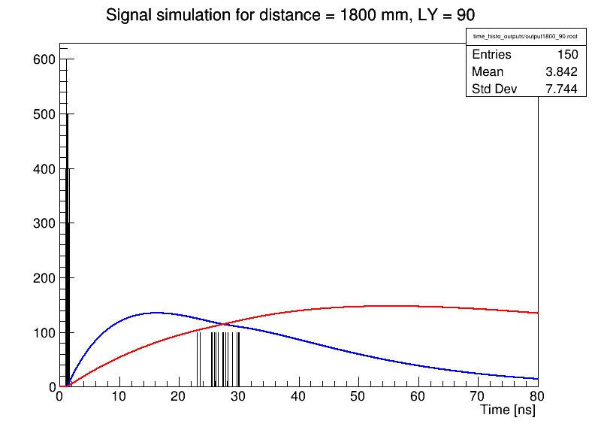
Distance: 20 cm

Slide 12
Shaper simulation
$V_{out}\left(t\right)=∫i\left(t^{′}\right)∗f\left(t−t^{′}\right)dt$ where: $f\left(t\right)=\frac{t}{τ}e^{−t/τ}$
Assuming CR-RC:
i(t)
Fast shaper (τ=15 ns)
Slow shaper (τ=50 ns)

Slide 13
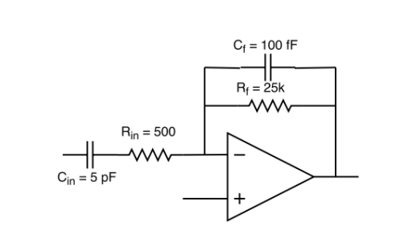
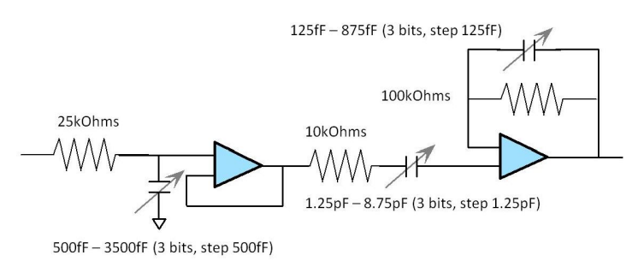
Shaper simulation
from CITIROC datasheet
Fast shaper (15 ns)
Slow shaper (12.5 ns – 87.5 ns)
CR-RC²
How do I get 15 ns peaking time here?
How do I get the transfer function?
Is the CR-RC transfer function a good approx.?

Slide 14
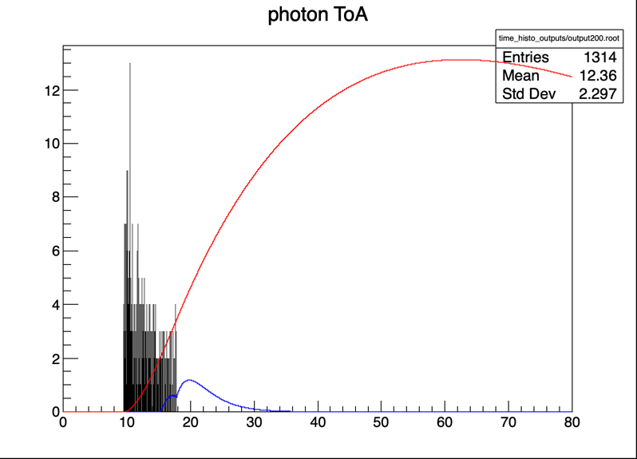
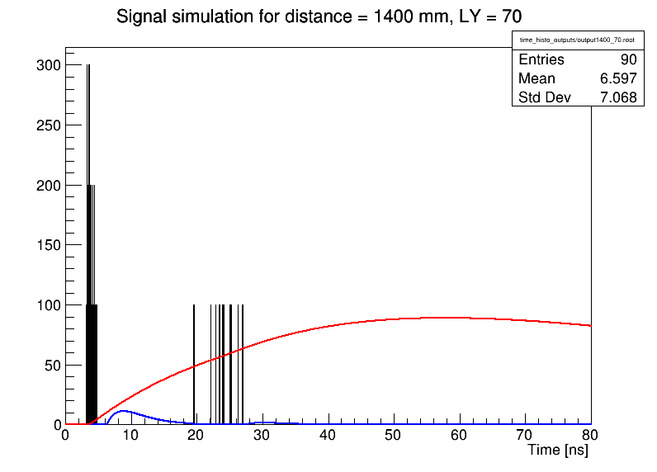
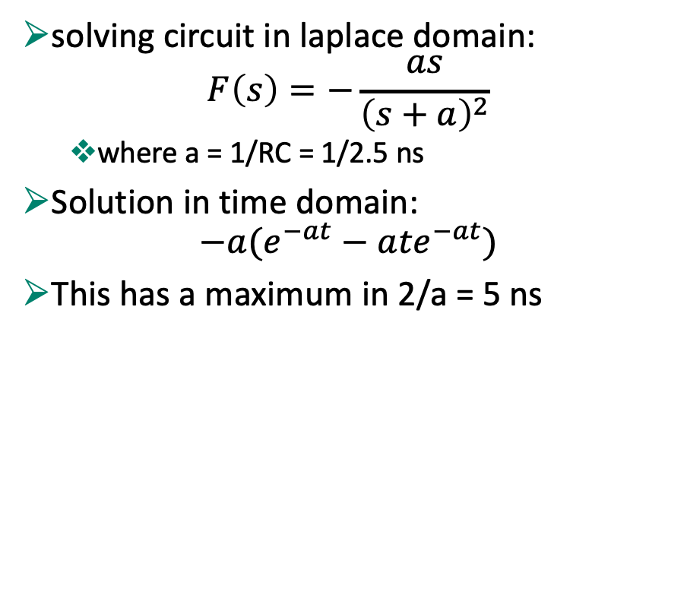
Solving shaper
WRONG
solving circuit in laplace domain:
$$F\left(s\right)=−\frac{as}{{\left(s+a\right)}^{2}}$$
  where a = 1/RC = 1/2.5 ns
Solution in time domain:
$$−a(e^{−at}−a{te}^{−at})$$
This has a maximum in 2/a = 5 ns
Only photons in the first 2,5 ns matter…
This is not what it says on the datasheet (15 ns)

Slide 15
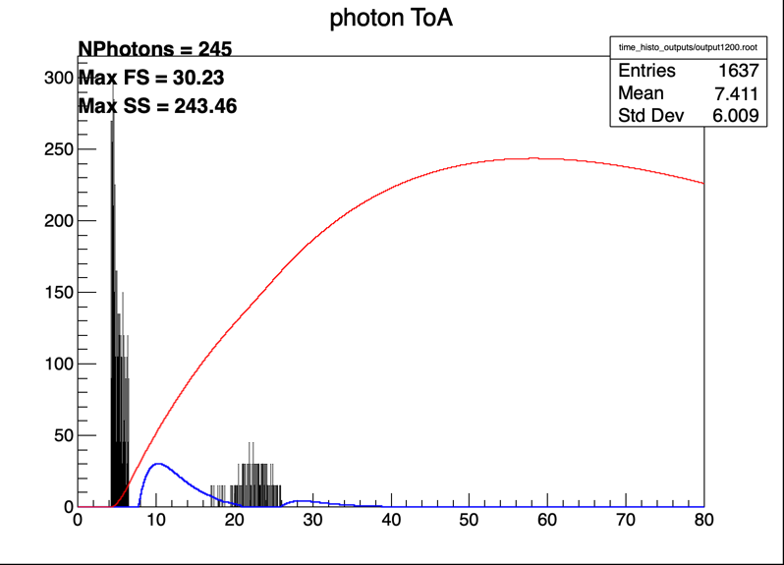
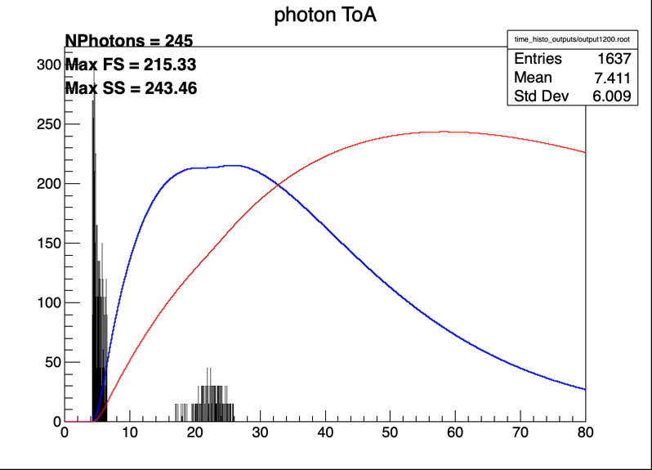
What shaper???
WRONG
With Laplace solution
Simple CR-RC with τ=15 ns
a.u.
a.u.
t [ns]
t [ns]

Slide 16
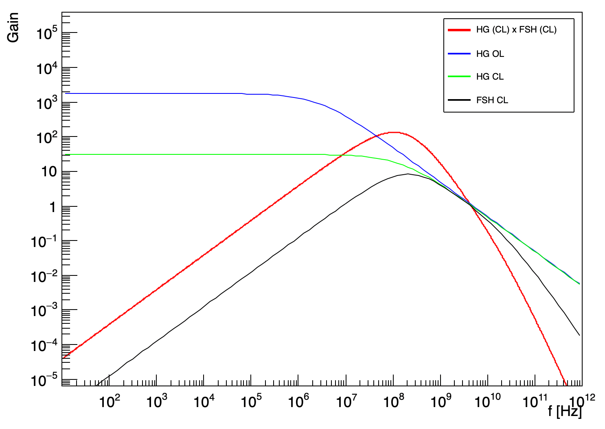
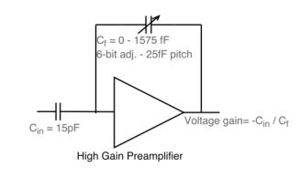
Transfer functions
HG preamp:
A_{ol} = 65 dB
cut off frequency: 450 kHz
67 MHz
Fast shaper:
A_{ol} = 60 dB
cut off frequency: 1.2 MHz

Slide 17
