Slide 1
Machine Learning
with a Dementia Dataset
Vincent Chiodo & Lisa Gibson
Notes:
Introduce dataset

Slide 2
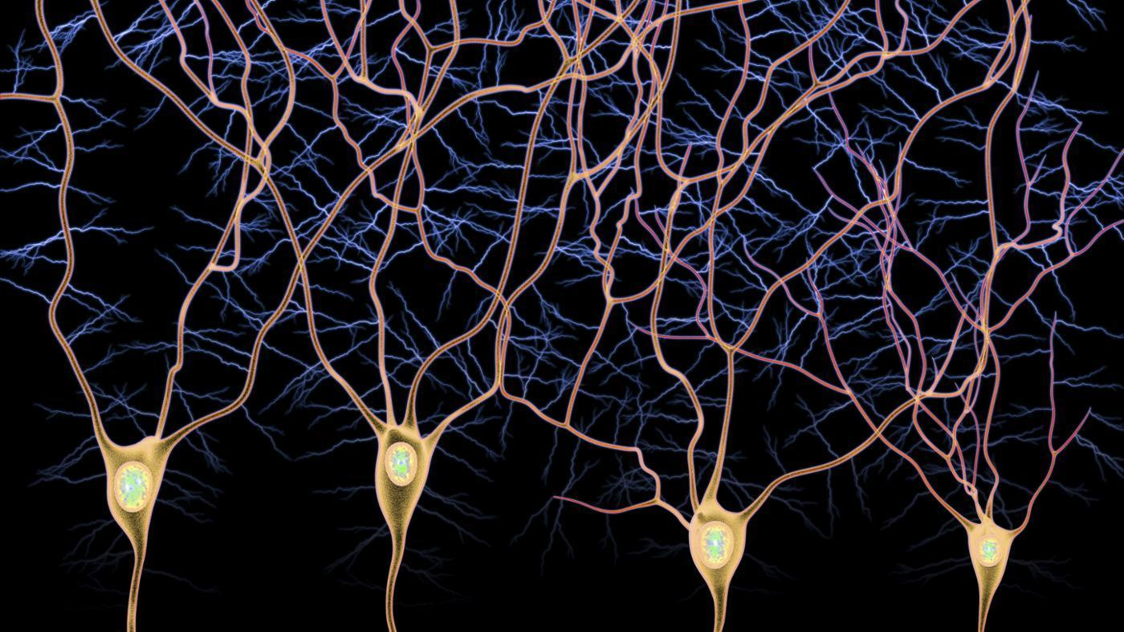
Introduction
Purpose and goals of project:
Learn about Machine Learning
- Neural Networks
Apply it to a dataset in health or biology
Notes:
Predict dementia using patient data
Mention NN before data set

Slide 3

Data & Technologies
Data
Allen Institute for Brain Science
Demographic data (age, brain injury(y/n), education level)
50,000 RNA sequences - backtracked to DNA (genes)
Brain pathology/signaling proteins (tau, tnf, vegf)
Technologies
Python and Pandas
Notes:
Tnf = tumor necrosis factor (involved in inflammation, cell death)
Tau - abnormal protein inside neurofibrillary tangles found in brain cells - transport decreases and brain cells die ...leads to alzheimers
Vegf - vascular endothelial growth factor - this staves off dementia (a loss of vegf increases dementia)

Slide 4
INITIALIZING & TRAINING A NEURAL NETWORK

Slide 5
Example Input:
Example Data:
age
Inputs (X) |  | Outputs (Y)
age | apoe4 | dementia
100 yrs | Yes | Yes
80 yrs | Yes | Yes
68 yrs | No | No
73 yrs | No | Yes
100
apoe4 allele
apoe4
1
0 - absent
1 - present
Notes:
Fix allele
Straightforward experiment

Slide 6
inputs
hidden layer
outputs
age
dementia
100
apoe4 allele
no dementia
1
0 - absent
1 - present

Slide 7
inputs
hidden layer
outputs
RANDOMweights
60
dementia
age
100
.6
.4
40
apoe4 allele
no dementia
.2
1
20
0 - absent
1 - present

Slide 8
inputs
hidden layer
outputs
weights1
60
60
60+.3
dementia
age
100
40
40
40+.5
apoe4 allele
no dementia
.3
1
.5
20
20
.6
20+.6
0 - absent
1 - present

Slide 9
transfer/activation function
inputs
outputs
weights1
60+.3
1
dementia
age
100
40
40
40+.5
1
apoe4 allele
no dementia
1
20
20
20+.6
.99
0 - absent
1 - present
Notes:
We used sigmoid
There are a number of others
Normalizes the node, which is to be used as the input for the next feed
Explain that age is not valued more than allele so we need to normalize our hidden layer

Slide 10
inputs
hidden layer
outputs
weights1
weights2
60+.3
1
dementia
age
R
100
.53
A
N
40
40
40+.5
1
apoe4 allele
D
no dementia
1
O
.47
20
20
20+.6
.99
M
0 - absent
1 - present
Notes:
Hidden layer is new set of inputs for the outputs
Classification - machine must decide yes or no

Slide 11
inputs
hidden layer
outputs
weights1
weights2
60+.3
1
dementia
age
R
100
.53
A
N
40
40
40+.5
1
1
apoe4 allele
D
no dementia
final
decision
1
O
.47
20
20
20+.6
.99
M
0 - absent
1 - present
1
actual patient outcome
Notes:
Hidden layer is new set of inputs for the outputs
Classification - machine must decide yes or no

Slide 12
BACK PROPAGATION
Notes:
This is how the ‘machine learns’
Description of neural pruning / image
How a neuron “learns”

Slide 13
inputs
hidden layer
outputs
weights1
Recalculate/adjust
weights2
60+.3
dementia
age
.53
40
40
40+.5
apoe4 allele
no dementia
final
decision
.47
20
20
20+.6
0 - absent
1 - present
1
actual patient outcome
Notes:
How to visualize the error function
Readjusts the weights to reduce the error in the next run
Because lots of weights to adjust can take the decreasing slope to see if getting closer to minimizing error function
Minimize error function to improve NN

Slide 14
inputs
hidden layer
outputs
Recalculate/adjust
Recalculate/adjust
60+.3
dementia
age
.53
40
40
40+.5
apoe4 allele
no dementia
final
decision
.47
20
20
20+.6
0 - absent
1 - present
1
actual patient outcome
This particular algorithm runs forward and backward 300 times

Slide 15
inputs
hidden layer
outputs
new
weights1
new
weights2
60+.3
dementia
age
80
40
40
apoe4 allele
no dementia
final
decision
0
20
20
20+.6
0 - absent
1 - present
1
actual patient outcome
Notes:
Algorithm can change number of cycles and learning rate
60% of the time correct.

Slide 16
YOU THINK THIS IS COMPLEX?

Slide 17
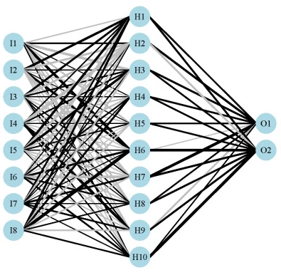
Demographic inputs

Slide 18
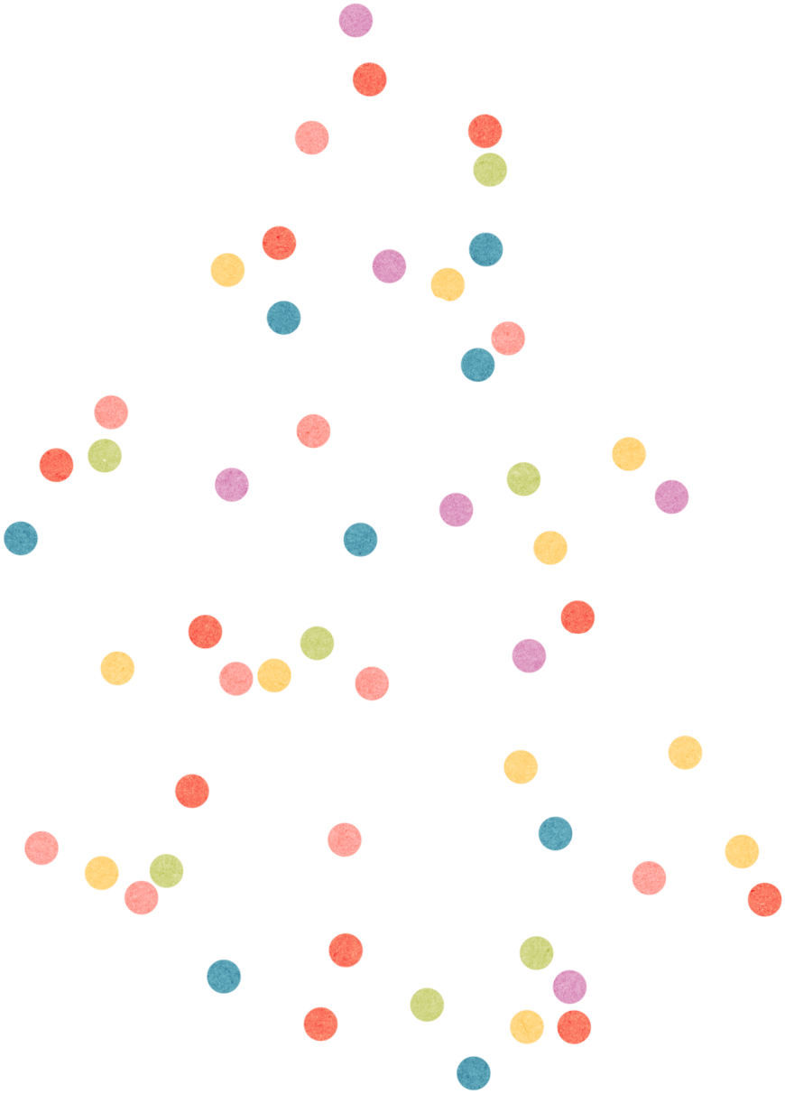
Using a total of 11 features, the algorithm was able to predict dementia ~70% of the time!!
Notes:
Make sure its clear that this is the conclusion. Final output!!
Conversational features: education leve, age at tbi, age at death

Slide 19
Successes & Obstacles
Getting an accurate output
Understanding of Neural Networks and Machine Learning
Learned how much there is left to learn

Slide 20
Learning
When NOT to use Machine Learning
When you can do basic stats and get reasonable answers
Machine Learning does not tell you which input is significant
Need to do more stats
Pandas to organize large dataset CSVs

Slide 21
Looking Forward
Create our own neural network
Incorporate more data
Determine significant inputs
Animate and visualize the neural network
Notes:
Genes, rna, proteins

Slide 22
Thank You
Questions?

Slide 23
Make a story
Audience- Why do I care
-simplify the error calculation in relation to the ‘softmax’? vs binary outcome
-difference between number of training rows vs epochs
Trains 300 times on one input, repeats for all rows
-1 output node or 2?

