Slide 1
Alvin Healthcare
Medical Pricing Map
Vincent Chiodo & Lisa Gibson

Slide 2


Alvin Healthcare
Subscription service for tele-access doctors & nurses
High insurance/deductible/uninsured clients
Medical price map
Notes:
Alvin Health is a subscription service for tele-access of doctors and nurses. Clients are usually those with a high insurance deductible or are otherwise uninsured.
Alvin Health would like a proof of concept of a medical price map.

Slide 3
Problem
There is a lack of platform that allows patients to look for cost effective solutions for medical services as prescribed by doctors
Patients should be able to search by procedure:
App will provide:
Location
Price
Rating
Notes:
prescriptions and labs later
Doctor or nurse practitioner procedure

Slide 4
Solution
Find data
Gather from websites and providers
Input into database
ex: Service, Address, Cost
Display
Map with total price of operation and other details
Notes:
Geotagging, search, filter/rank functionality
UI modeled after expedia? Seamless? Grubhub?
Pricing for certain procedure

Slide 5



Technologies Used
Google Maps API
Digital Ocean with Ubuntu
LAPP stack
Linux
Apache
PostgreSql
Python
HTML, CSS, Javascript
Learned along the way: Pandas, GeoJSON

Slide 6
medicalmap.us
DEMO
Notes:
Zoom in on info box

Slide 7
Looking Forward
Markers display price
Additional search filters:
Price
Radius
Rating
ex: health grades, zocdocs, and real patient reviews
Saved searches (log in required)
More data
Notes:
-frequent searches

Slide 8
Challenges & Successes
Getting data
Applying Google Maps API
Hosting on Digital Ocean with Postgres without an ORM
Notes:
Explain ORM (translation)

Slide 9
Thank You
questions?

Slide 10
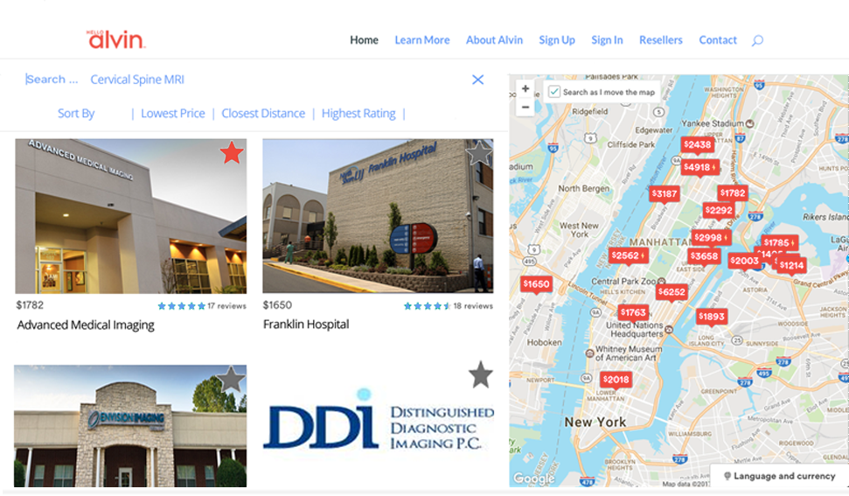
Airbnb as example

Slide 11
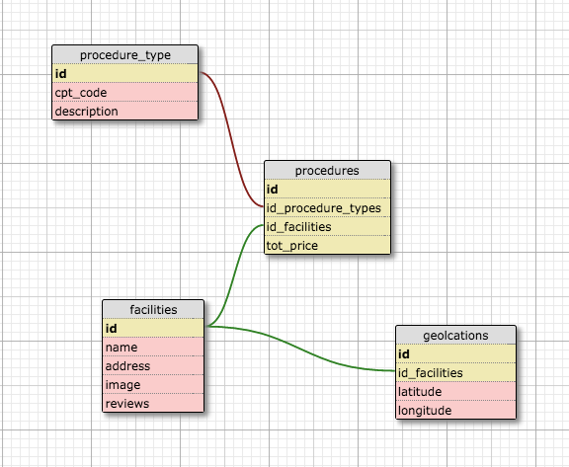
Notes:
Schema. Can scale database

Slide 12
Entity
Action
Attribute
Procedure Type
CPTcode
geolocation
Depends on procedure
Price
User
Search
Procedure
Descriptions
Summary
Account
Facility
photo
name
geolocation
address
Notes:
An entity relationship diagram (ERD) shows the relationships of entity sets stored in a database.

