Slide 1
Proposal for Multi-Bakery
Manish Shrestha
Kushal Kapri
Kshitij Gurung

Slide 2
Introduction
Fast-paced baking industry demands adaptable solutions.
Multi-bakery is a ERP tool and flexible software for bakeries
Multi-Bakery is a ground-breaking innovation revolutionizing traditional baking.
Addresses pressing need for adaptability in baking landscape.
Explore its transformative impact on modern bakeries.

Slide 3
Problem statement
Bakery management software lacks integration, requiring disjointed tools.
Small bakeries struggle with complex, costly ERP and POS systems.
Manual processes and disconnected systems lead to inefficiencies.
Fragmented platforms hinder customer discovery and ordering.

Slide 4
Objectives
Develop integrated ERP and POS platform for bakeries of all sizes.
Provide scalable solutions to meet budget constraints of small and large bakeries.
Streamline operations by automating inventory, orders, and accounting.
Enhance customer experience with user-friendly discovery and ordering platform.

Slide 5
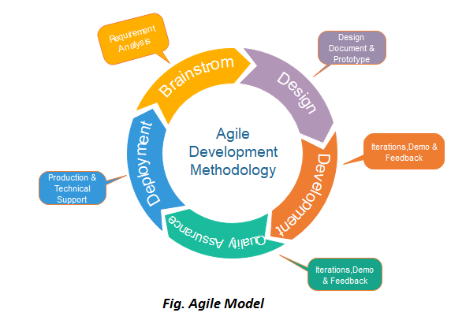
Methodology
Agile process: Iterative development, minimal long-term planning.
Defined project scope and requirements.
Weekly iterations encompass full development lifecycle, delivering working product.

Slide 6
Gantt Chart

Slide 7
Deliverables
Integrated bakery management software: ERP and POS.
Scalable platform for small to large bakeries.
Automated inventory, orders, accounting.
User-friendly interface for customer orders.
Technical support, documentation, training for implementation.

Slide 8
Conclusion
In conclusion, our integrated bakery management software offers scalable solutions with comprehensive ERP and POS functionality. It aims to streamline operations, enhance efficiency, and improve customer experience. With a focus on automation, scalability, and user-friendliness, we are confident it will empower bakery businesses to thrive in a competitive market.

