Slide 1
Bookly: online bookstore
-Bishal Adhikari
-Deepak Chhantyal
-Roshan Adhikari

Slide 2
Introduction
📌 What is Bookly?
An e-commerce platform for buying and organizing books.
Designed for both users (book lovers) and admin (storage manager).
📌 Key Features & Benefits
Simple navigation with advance search filters (genre, name)..
Easy cart and checkout system for smooth book purchasing.
CRUD functionality for administrators to manage inventory and orders.
Order placement for secure transaction.

Slide 3
Problem statements
📌 Challenges in Existing Online Bookstores
Poor searching capabilities
Inefficient Cart Management
Limited admin tools
Lack of payment integration

Slide 4
Objectives
📌 Key Objectives:
To Create an online platform where customers can shop for books of their choice with ease.
To Expand the bookstore’s customer base by offering a wide variety of books to readers.

Slide 5
Background Study
📌 Research & Project Selection
Identified a need for a better online bookstore.
Existing platforms lack essential features like stock management & recommendations
📌 Key Issues in Current Bookstores
❌ Weak search & poor categorization ❌ No localized payment options ❌ Inefficient book & order management

Slide 6
Requirements
📌 User Requirements
Customers: Register, browse, search, add to cart, and purchase books.
Admins: Manage books, inventory, and orders.
📌 Functional Requirements
✅ User Accounts – Registration, login/logout ✅ Book Catalog – Search, filter, and browse books ✅ Cart & Checkout – Add/remove books, update quantities ✅ Order Management – Process and track orders

Slide 7
Requirements
📌 Non-Functional Requirements
🔒 Security – Secure login & transactions ⚡ Performance – Fast and responsive user experience 📊 Reliability – Ensures smooth system operation

Slide 8
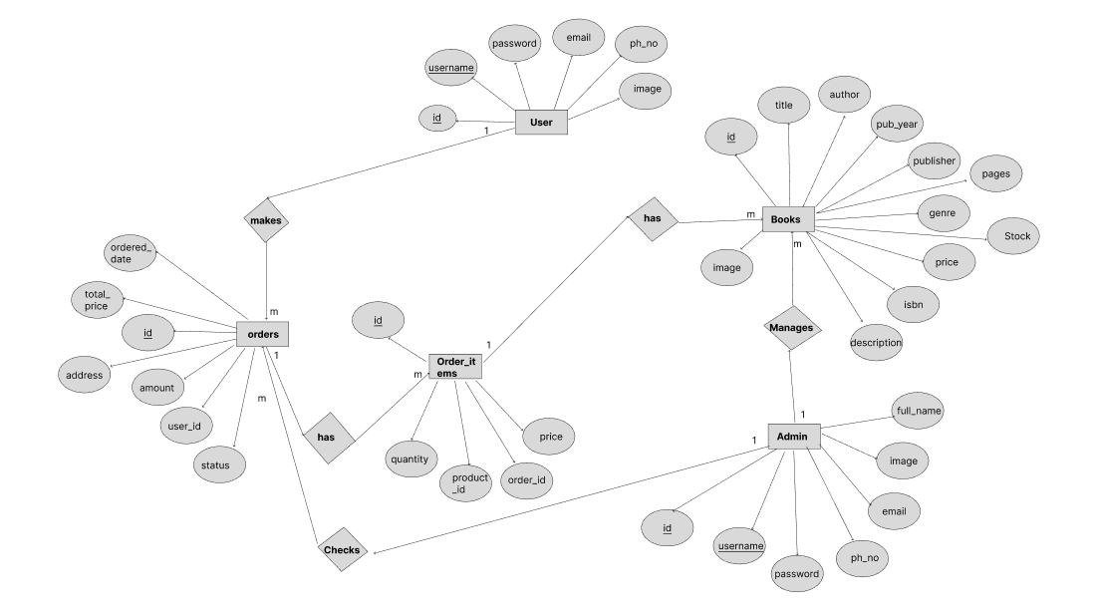
ER Diagram
FIG: ER DIAGRAM

Slide 9
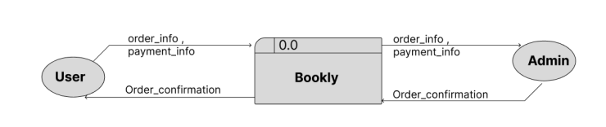
Data FLow Diagram
FIG: DATAFLOW DIAGRAM-LEVEL 0

Slide 10
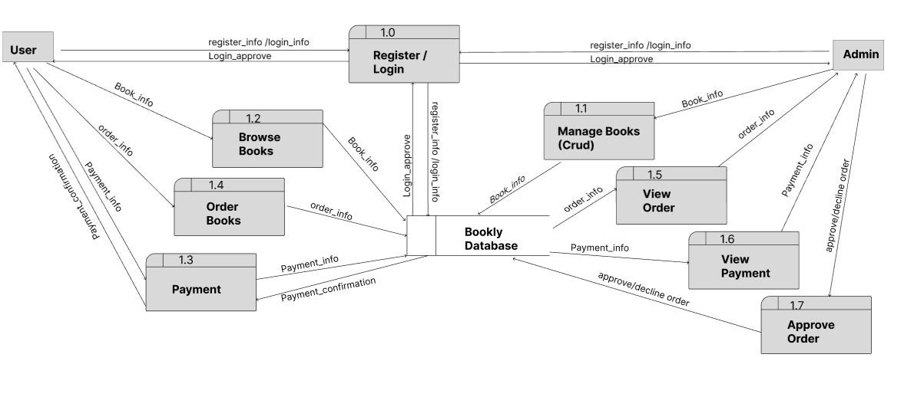
Data FLow Diagram
FIG: DATAFLOW DIAGRAM-LEVEL 1

Slide 11
Project Results
📌 Outcome:
Bookly improves book purchasing and management for users and admins.
📌 Key Achievements:
✅ User Login & Registration – authentication for users and admins. ✅ Efficient Inventory Management – Admins can easily manage books. ✅ Cart & Order Management – Users can add books, update carts, and place orders. ✅ Order Tracking – Users can view purchase history and track orders.

Slide 12
Future Enhancements
📌 Upcoming Features:
Book Reviews & Ratings – Users can share reviews and rate books.
Admin Analytics Dashboard – Track sales, trends, and customer behavior.
Enhanced Search Filters – Filter by price, format, and publication year.
Loyalty Program – Earn points for discounts and exclusive offers.

Slide 13
THANK YOU

