Slide 1

BOOKLY: Book Ecommerce
Bishal Adhikari
Roshan Adhikari
Deepak chhantyal

Slide 2
Introduction: Simplifying Book Shopping and Management
For Readers:
Browse and search books easily by genre, author, or keywords.
Add books to a cart and purchase seamlessly.
For Admins:
Manage inventory with CRUD tools.
Monitor and process orders efficiently.

Slide 3
Introduction: Progress & Future Goals
Achievements:
User login, registration, and order placement features.
Upcoming Features:
Payment gateway integration (Khalti, eSewa).
Personalized recommendations and streamlined checkout.

Slide 4
Challenges:
Poor Search Capabilities: Limited options to filter by author, genre, or keywords.
Inefficient Cart Management: Difficulty updating quantities or removing items.
Limited Administrative Tools: Challenges in managing inventory, orders, and CRUD operations.
Lack of Payment Integration: Absence of region-specific payment gateways causes user inconvenience.

Slide 5
Objectives:
To make user-friendly online platform where customers can shop book of their choice on their comfort.
To increase the bookstore’s customer base by providing wide variety of books to the readers.

Slide 6
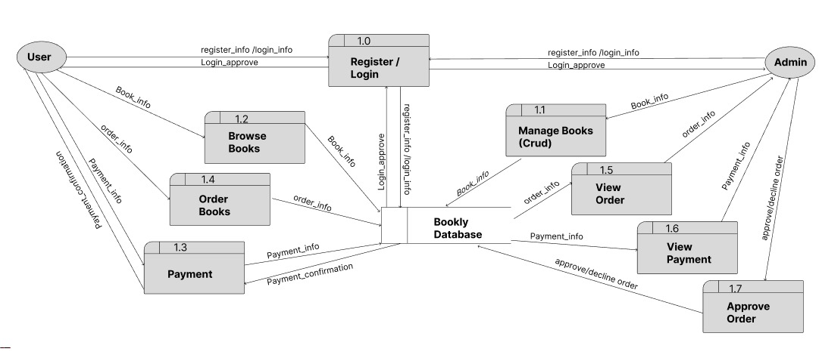
Data Flow Diagram

Slide 7
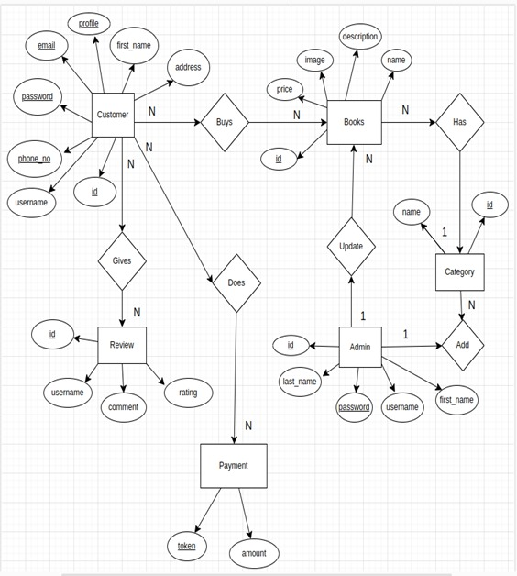
ER- DIAGRAM

Slide 8
Progress Report: Completed Features
User Login and Registration: Fully functional for secure access.
Interface Development: Rough interface created for both users and admins.

Slide 9
Progress Report: Admin Features
CRUD operations on books.
Search functionality for easier inventory management.

Slide 10
Progress Report: User Features
Book browsing with detailed information.
Cart functionalities to add and manage books.
Order placement mechanism for finalized purchases.

Slide 11
Progress Report: Pending Features
Payment Integration: APIs for Khalti or eSewa will be incorporated.
Order Tracking: Users will have a detailed history of their orders.
Interface Refinement: Enhancements for a more polished and intuitive user experience.

Slide 12
Progress Report: Challenges and Mitigation
API Integration:
Researched APIs to prepare for a seamless payment integration process.
User Feedback Incorporation:
Early feedback has been addressed, ensuring usability improvements.

