Slide 1
PEOPLE PROCESS TOOLS EXPERIENCE
ELEMENT ONE
Your description here.
ELEMENT TWO
Your description here.
ELEMENT THREE
Your description here.
ELEMENT FOUR
Your description here.
ELEMENT FIVE
Your description here.
ELEMENT SIX
Your description here.

Slide 2
Welcome To e-book pasal
1
Diverse Collection
2
Easy Shopping
Explore books across different genres.
Purchase books from home with simple searches and secure payments.
3
On-Time Delivery
4
User-Friendly
Receive your books promptly.
Enjoy a smooth and hassle-free shopping experience.
5
Building Connections
Bringing readers and
authors together to celebrate a shared love for books.

Slide 3
Problem Statements
Complex Interface
Hard to browse and buy books.
Payment Security Concern
Unsafe Transaction options
Device Compatibality
Poor experience on mobile and tablet
Limited Browsing Tools
Difficult to navigate large collections
Incomplete Book Details
Delays in receiving ordered books.
Lacking image, prices and descriptions
Slow Delivery

Slide 4
Objectives
User-Friendly
Platform
Expand
Customer Base

Slide 5
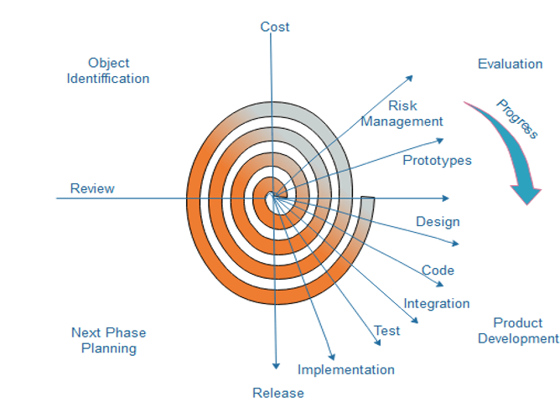
_{Methodology}

