Slide 1



Home
Menu
Hotels
Rooms
Contact
Hamro Booking Sewa
Start searching for your hotel room
Laxman Parajuli
Sandhya Banstola
Ujjwal Adhikari

Slide 2

Hamro Booking Sewa
Home
Menu
Hotels
Rooms
Contact
Introduction
Hamro Booking Sewa is a laravel and react native based android application project on online hotel booking where users can view, select and book hotel.
The project has different modules in the development work, which are divided among super admin, hotel owners, customers, and search option

Slide 3
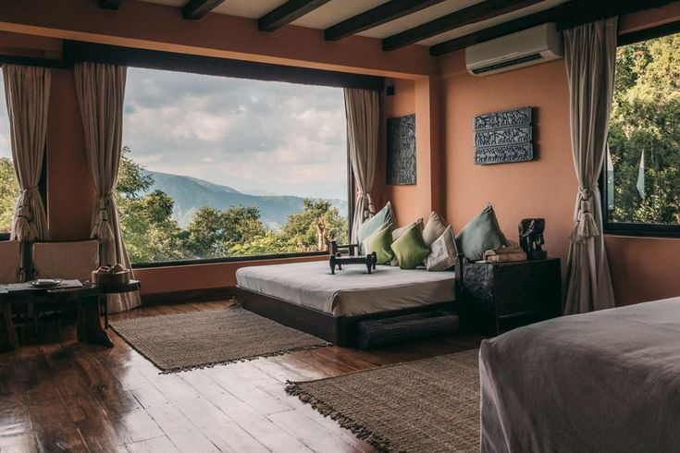
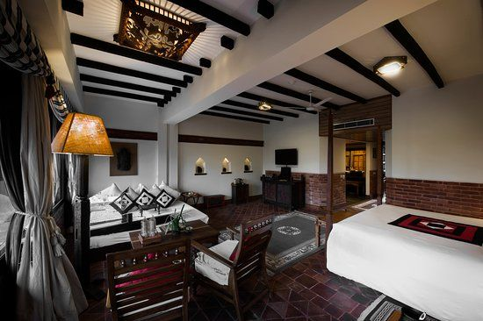
Hamro Booking Sewa
Home
Menu
Hotels
Rooms
Contact
Objectives
To provide a platform where users can find the best deals in hotel rooms
To streamline the reservation process by allowing users to reserve rooms at their own convenience

Slide 4
Hotel Booking Sewa
Home
Menu
Hotels
Rooms
Contact
Problem Statement
01.
02.
03.
Pricing Transparency
Information Inconsistency
Customer Assistance
Online hotel booking apps lacks of transparency in pricing.
Online hotel booking apps are often inconsistent in the quality of information provided.
Online hotel booking apps may lack customer support and assistance.

Slide 5
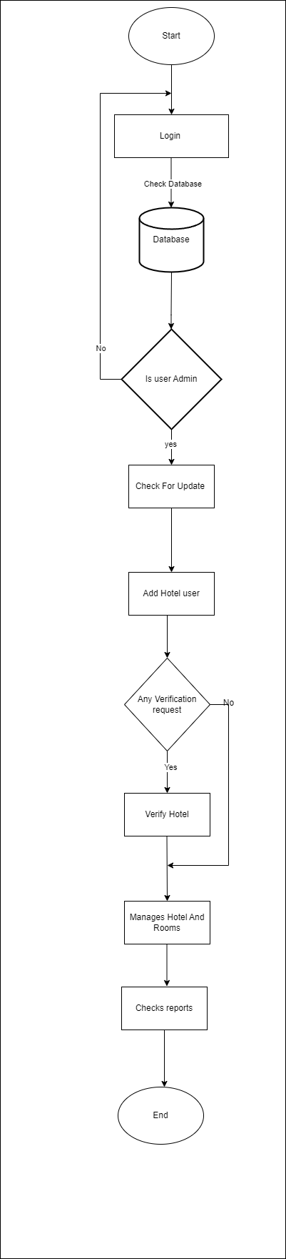
Hamro Booking Sewa
Flowchart: Admin
Home
Menu
Hotels
Rooms
Contact

Slide 6
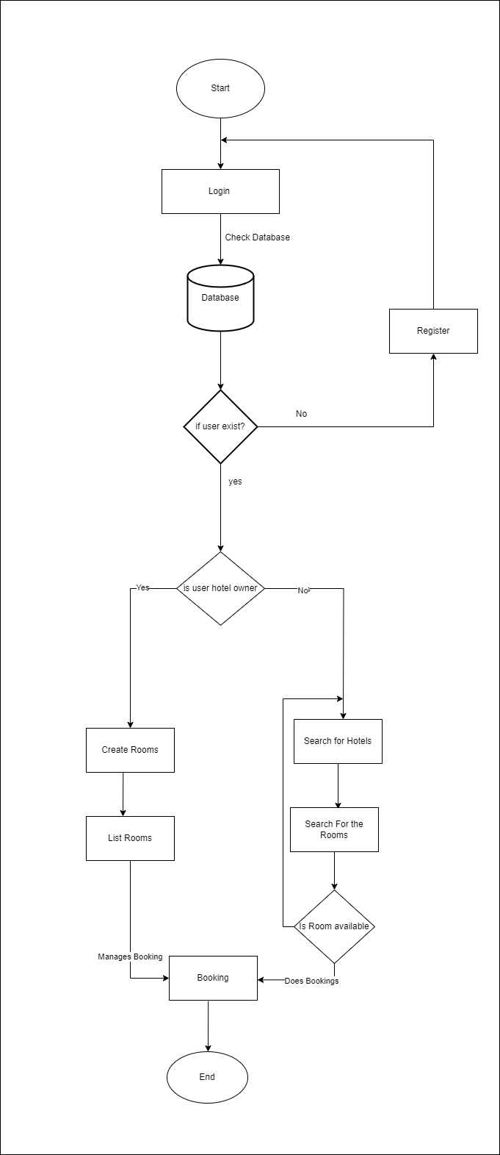
Hamro Booking Sewa
Flowchart:
End User
Home
Menu
Hotels
Rooms
Contact

Slide 7
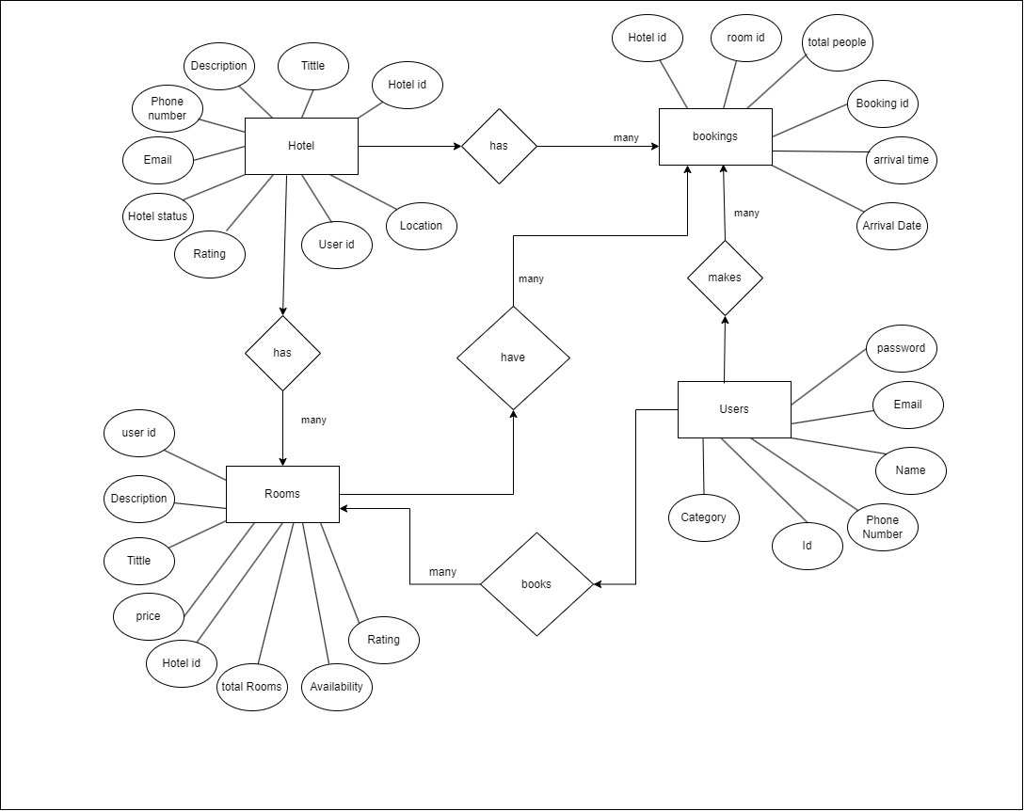
Hamro Booking Sewa
Home
Menu
Hotels
Rooms
Contact
ER Diagram

Slide 8
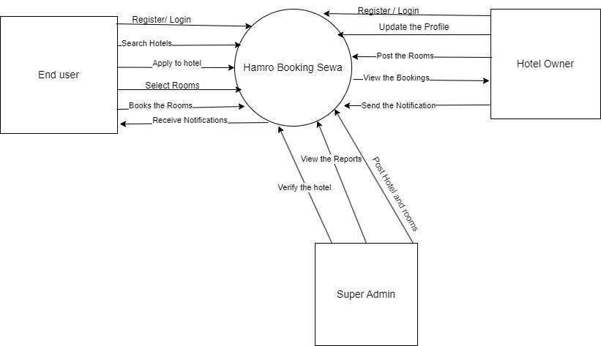
Hamro Booking Sewa
Home
Menu
Hotels
Rooms
Contact
DFD 0

Slide 9
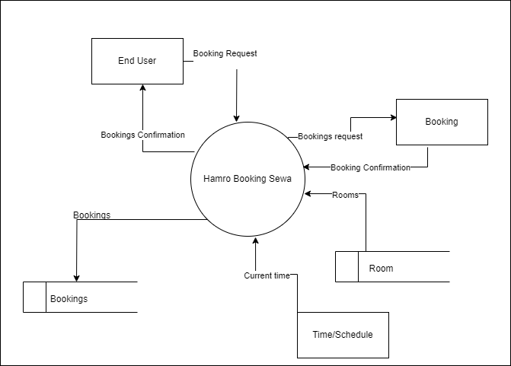
Hamro Booking Sewa
Home
Menu
Hotels
Rooms
Contact
DFD 1

Slide 10
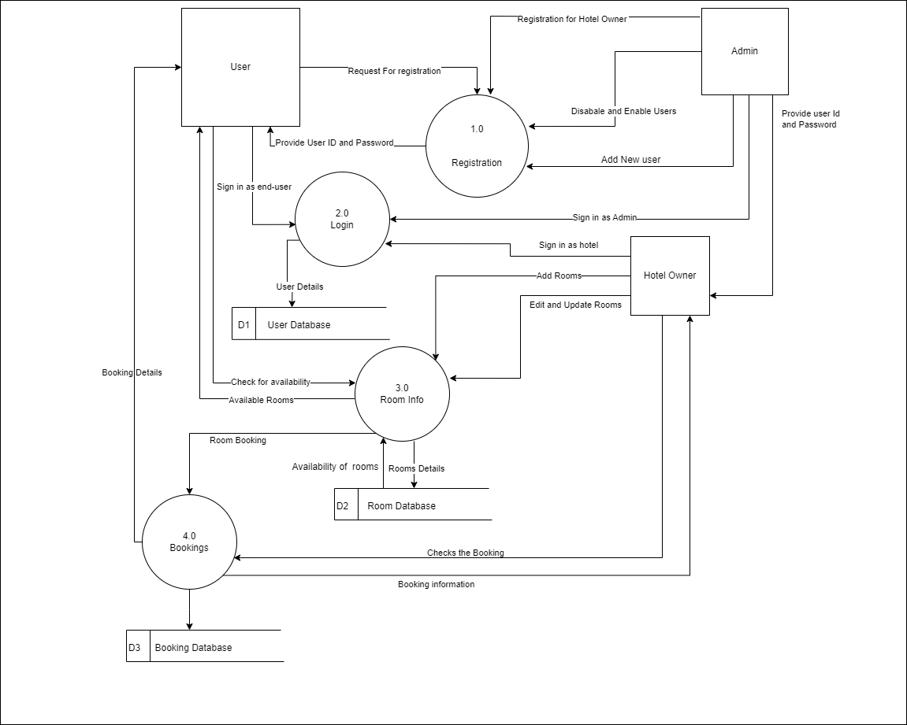
DFD 2
Hamro Booking Sewa
Home
Menu
Hotels
Rooms
Contact

Slide 11

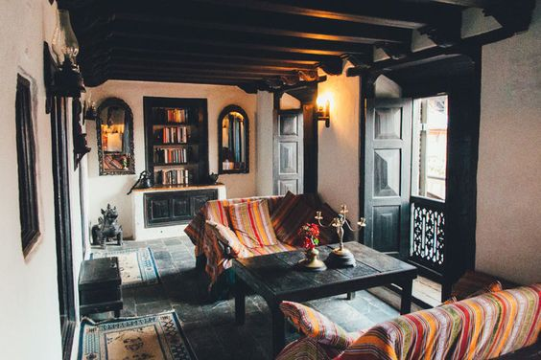
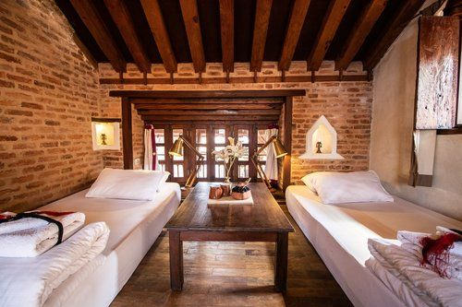
Hamro Booking Sewa
Home
Menu
Hotels
Rooms
Contact
Methodology

Slide 12

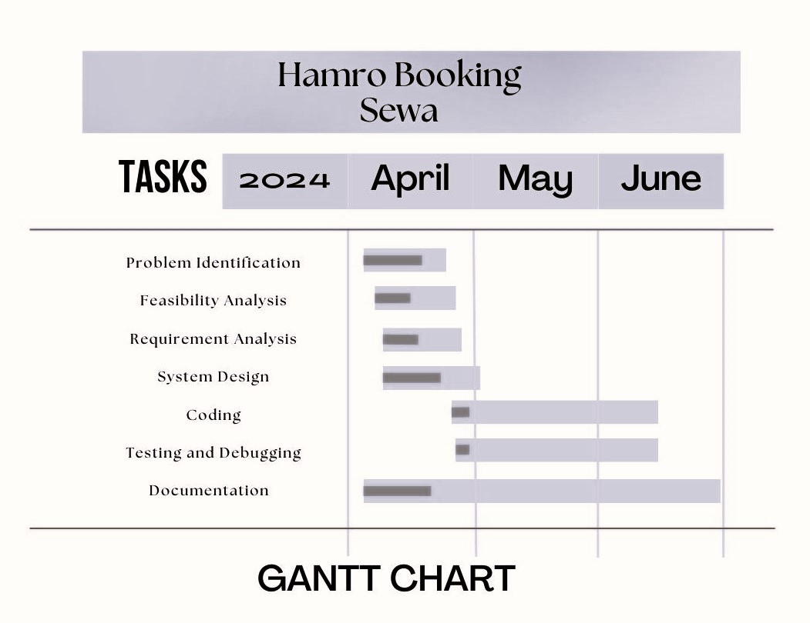
Hamro Booking Sewa
Home
Menu
Hotels
Rooms
Contact
Gantt Chart

Slide 13


Hamro Booking Sewa
Home
Menu
Hotels
Rooms
Contact
Results
01.
Find hotels based on price range streamlining the booking process.
02.
Access to hotels and their pictures, offering insights into overall experience, aiding in decision-making.
03.
Access to reliable booking history and cancellation for assistance with bookings, and queries.

Slide 14


Hamro Booking Sewa
Home
Menu
Hotels
Rooms
Contact
Navigation
Home
About
Hotels
Rooms
Contact
Thank You

