Slide 1


KinMel
"Bringing Nepal's Charm to Your Palm: Shop, Smile, and Save with Us!"

Slide 2



APPLICATION
OVERVIEw
KinMel, the best place to shop online without any hassles.
At KinMel, prioritizing security: email and payment verification ensure a safe shopping environment.
Utilizing performance optimization strategies for lightning-fast page loads, ensuring a seamless shopping journey.
2

Slide 3
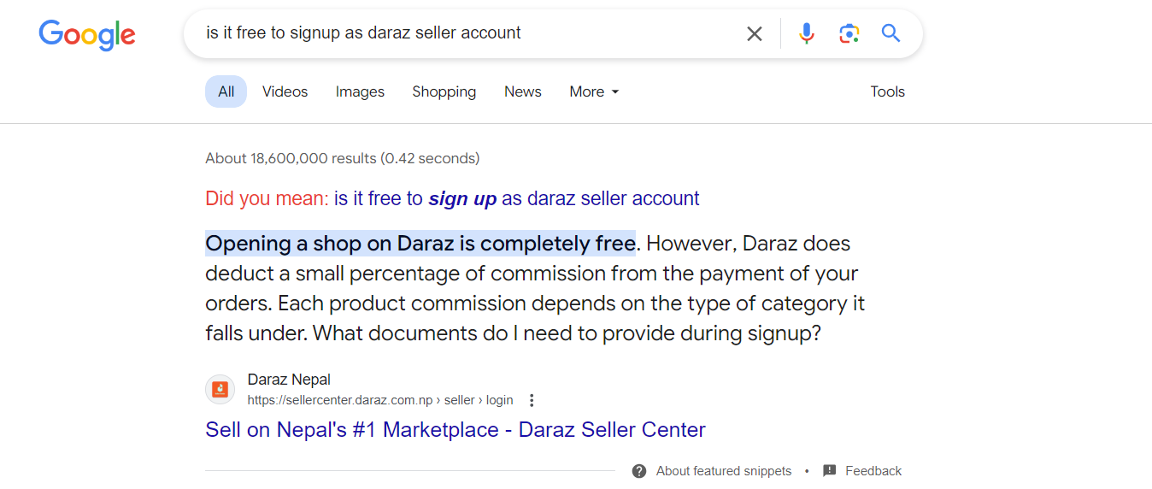
Problem statement
Free seller sign-up may lead to inactive accounts, posing a potential challenge.
3

Slide 4
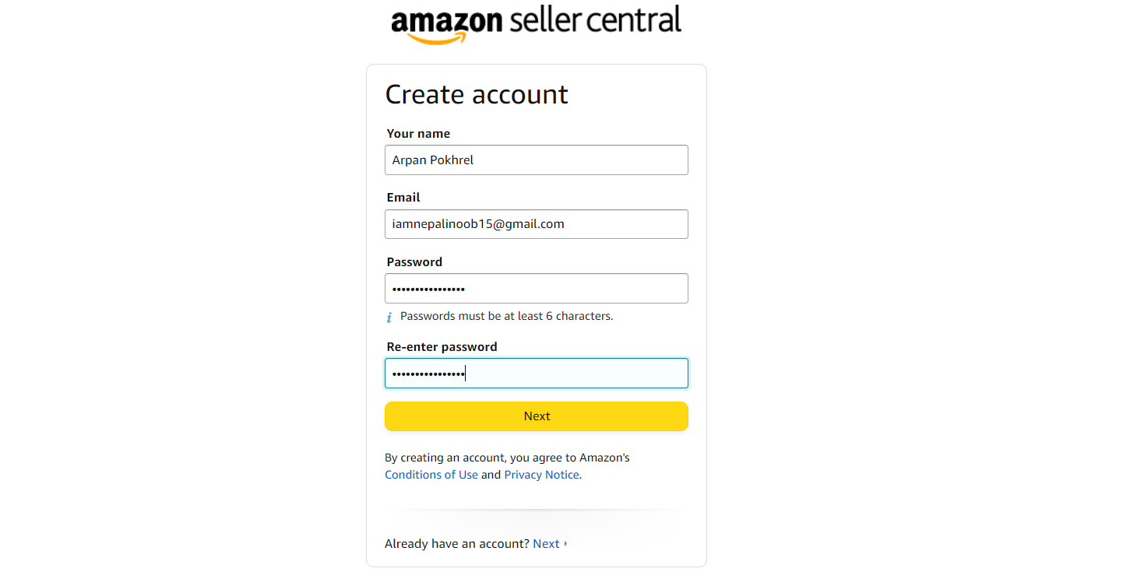
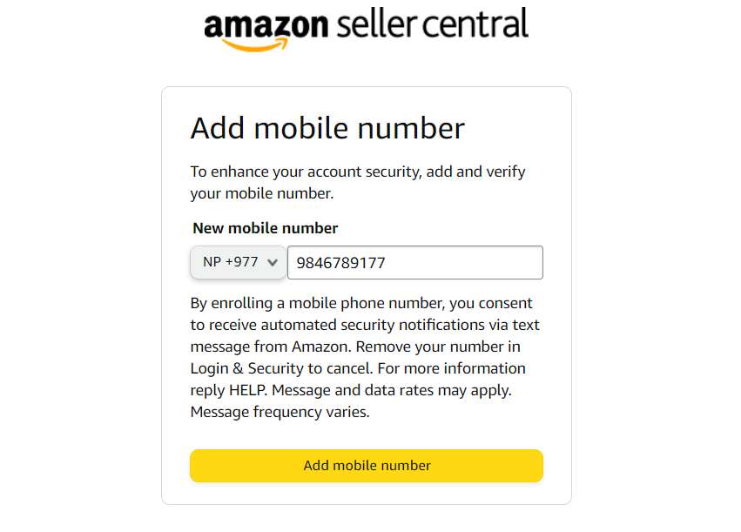
Problem statement
4

Slide 5
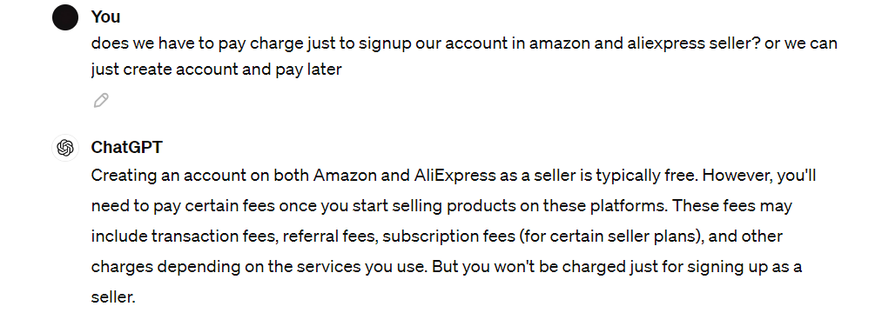
Problem statement
5

Slide 6
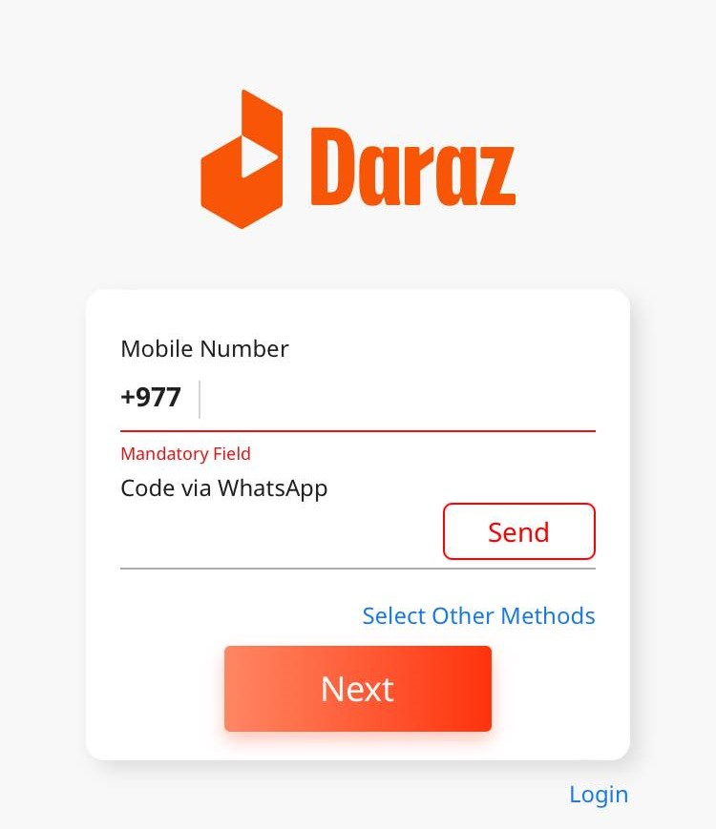
Problem statement
Signing up for the ecommerce application proves to be a challenging process.
6

Slide 7
Objective
To mitigate idle seller accounts to enhance platform effectiveness and user interaction.
To enable sellers to request new categories, facilitating dynamic category to meet market demands and enhance product visibility.
7

Slide 8
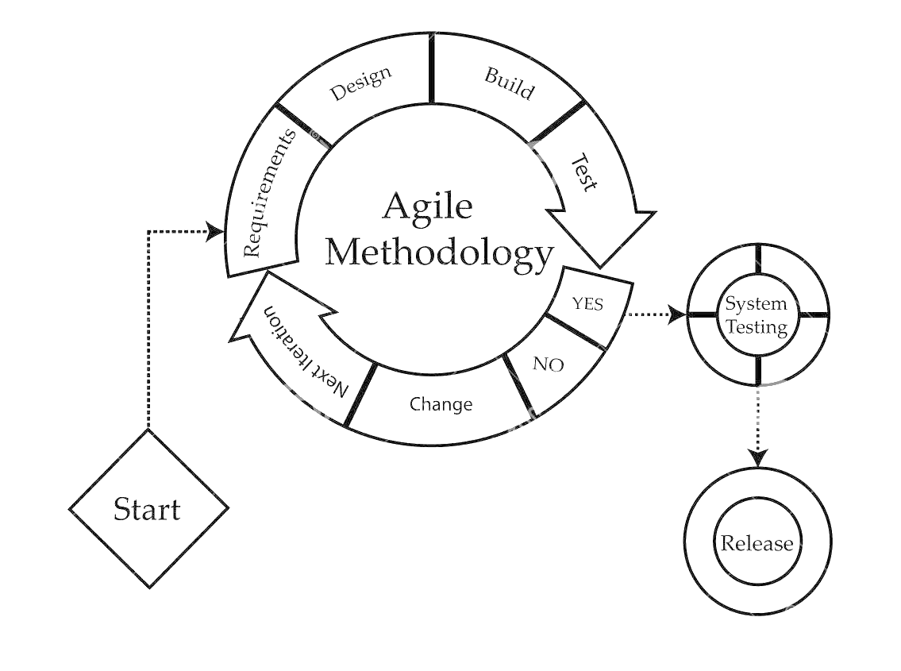
Methodology
TO ACHIEVE OUR BUSINESS OBJECTIVES, WE HAVE Agile methodology
Agile methods break tasks into smaller iterations, or parts do not directly involve long term planning.
8

Slide 9
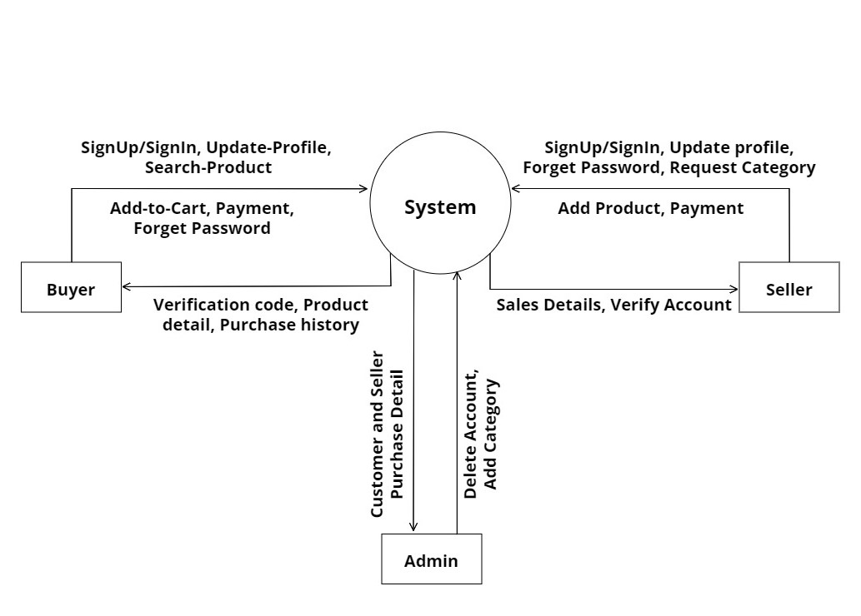
KinMel DFD Level-0
9

Slide 10
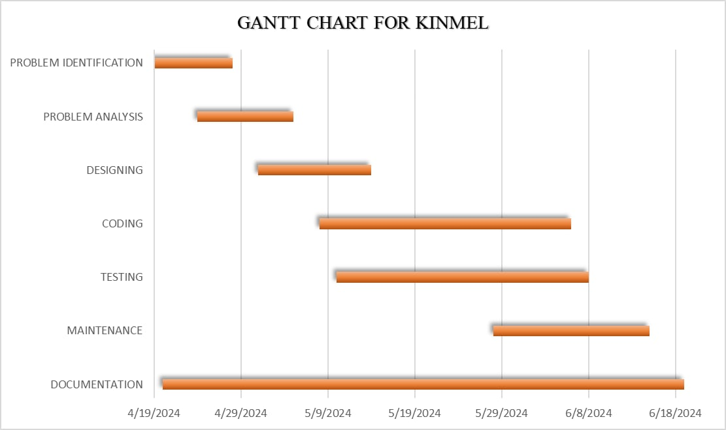
KinMel Gantt chart
10

Slide 11
deliverables
It will create an attractive interface that improves the shopping experience.
Implementing user verification system to ensure only verified users can login to the app.
Constructing an administrative panel to handle seller lists, categories, and product lists.
To enable sellers to request new categories, facilitating dynamic category to meet market demands and enhance product visibility.
11

Slide 12

CONCLUSION
KinMel will make sure that everyone have their customized experience they deserve by offering different apps for buyers and sellers.
Thank You
From
KinMel !

