Slide 1
THRIFT-STORE
PRESENTED BY: RAKESH CHHETRI
PRESENTED BY: ANISH THAPA

Slide 2
INTRODUCTION
Thrifting is simply buying from stores that sell pre-loved, second-hand clothes, accessories, and lifestyle products.
Thrift stores are not only popular for their budget-friendly shopping options but also for the treasure-hunting experience they offer.
thrift stores are run by charitable organizations or non-profits, with proceeds often going towards supporting various social causes or community programs.

Slide 3
OBJECTIVES
Thrift stores encourage recycling and reusing items, reducing waste and environmental impacted.
Thrift stores offer affordable options for shoppers, including low-income individuals and families helping them access necessities at lower prices.

Slide 4
Problem Statement
Due to lack of sustainable shopping options.
Due to limited access to affordable goods.
Due to lack of education and awareness of purchasing goods.

Slide 5
METHODOLOGY
Design
Implementation
Requirements
Maintenance
Testing
Specification
WATERFALL MODEL

Slide 6
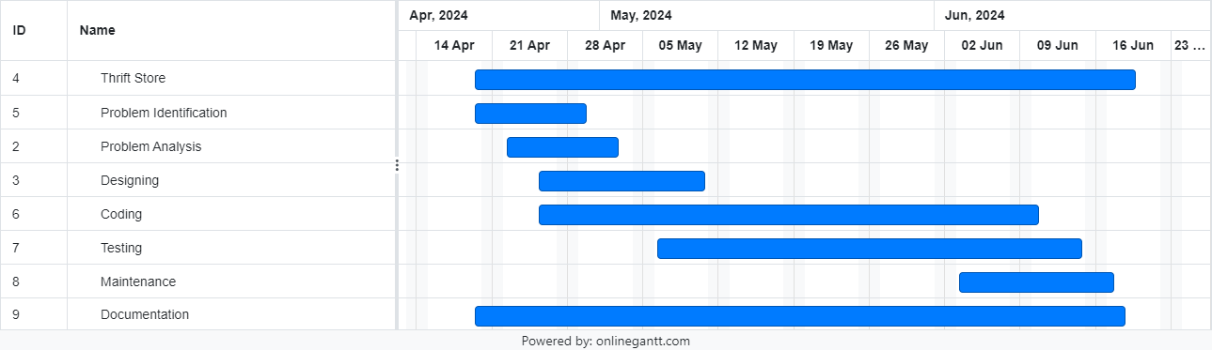
PROJECT GANTT CHART

Slide 7
DELIVERABLES
To collection of second-hand items including clothing and books.
To sustainable income generated through the sale of thrifted goods.
To creates the contribution to social or environmental causes, such as promoting sustainability or supporting local charities.
To established collaborations with local organizations, businesses, and charities to enhance impact and reach.

Slide 8
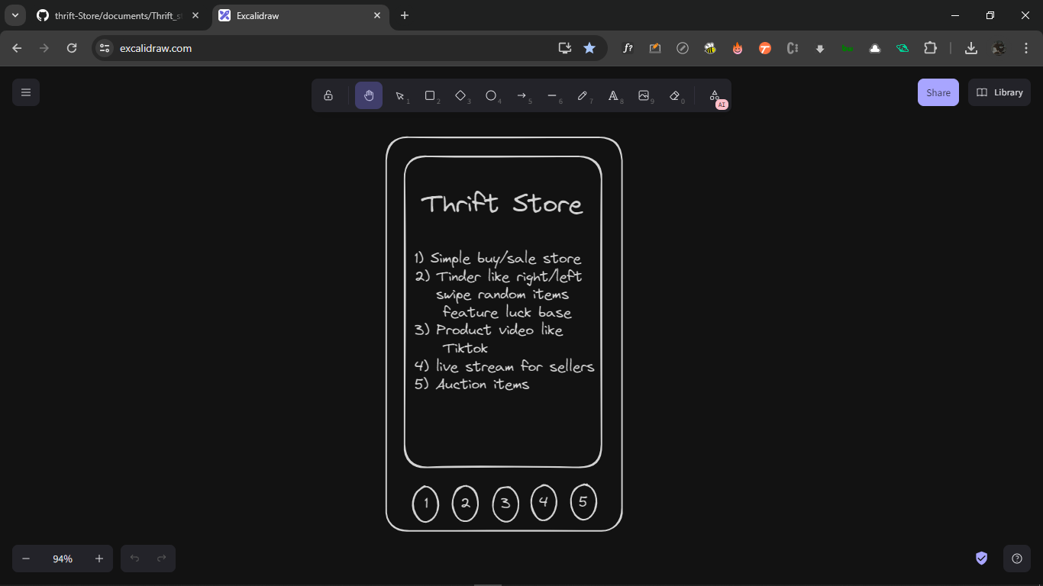

Slide 9
THANK YOU

