Slide 1
Financial Statement Database
By: Luke Glayat
Notes:
http://lukeg.sgedu.site/Companylist.php
Audit table
Sitegrounds functions and procedures

Slide 2
Background Information
Publicly traded companies are required to release a 10-k every year, which is a very long document that contains 3 different Financial Statements.
These Financial Statements are used by investors primarily to analyze various aspects of the company.
The names of these financial statements are the Balance Sheet, Income Statement, and Statement of Cash Flows.
Three of the most common types of analyses are Efficiency, Profitability, and Liquidity.
Notes:
http://lukeg.sgedu.site/Companylist.php

Slide 3
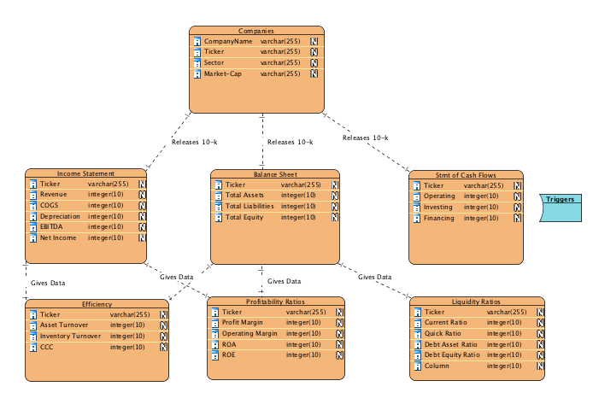
Notes:
http://lukeg.sgedu.site/Companylist.php

Slide 4
Isolation Level/Integrity Enforcement
In this type of Database, transaction issues with the Isolation Level would very seldom arise because they should only occur once a year when the new 10-k is releases(Updates), when companies go bankrupt(Deletes) or when they go Public(Insert).
Therefore I have decided to go with Read Committed so I can only view data that has been committed to the database.
The guest user account has very limited options due to the sensitivity of this information. If anybody was able to modify Yahoo! Finance’s stock data, they would potentially be able to cause disastrous effects on the market. The guest only has “SELECT” and “SHOW VIEW” permissions in this database. Where I (the admin) am able to update, insert, and delete when necessary.
Integrity enforcement as trigger

Slide 5
Normalization
My Database is in 4th Normal Form
Its crucial for every field(column) to be determined by the key in the table and no other column.
The numbers you will see for each Financial Statement and ratio are determined by the stock ticker for the most recent year.
If my database contained previous years data, there would be MVDs

Slide 6
Triggers/Constraint
I have created a ”BEFORE INSERT” trigger that adds any tuples added to the relation “cashFlows” to an audit table. This audit table will let me check for historical cash flows, for any type of growth analysis I may need. However for the sake of this project, all data being analyzed is for the most recent year.
BalanceChecker trigger that acts as a constraint for bad data

Slide 7
Procedure/Functions
I have made a procedure that returns all of the companies in the “Technology Sector” that are available in the database for analysis.
Function to determine capital structure of a company based upon its Balance Sheet.
Notes:
SELECT ticker, Credit_Rating('AAPL') FROM balanceSheet WHERE ticker ='AAPL';

Slide 8
How to make use of this data?
These financial ratios to the untrained eye may appear good or bad, however its difficult to tell when just looking at them alone, or comparing them to an unrelated company.
A common tool investors use is ”Benchmarking” to display averages of these ratios depending on what sector they belong to.
I have created a View called “Sector Performance” which calculates the averages of various ratios, grouped by their sector.

Slide 9
The End

