Slide 1
Model elements identifcation using neural networks:
a comprehensive study
Authors:
Kaushik Madala, Shraddha Piparia, Eduardo Blanco, Hyunsook Do, Renee Bryce
University of North Texas, USA
Published in journal：
Requirements Engineering， 2020.03
CCF B
Li Guang Long
2022.6.25
Notes:
Information and Software Technology is the international archival journal focusing on research and experience that contributes to the improvement of software development practices. The journal's scope includes methods and techniques to better engineer software and manage its development. Articles submitted for review should have a clear component of software engineering or address ways to improve the engineering and management of software development. Areas covered by the journal include:
• Software management, quality and metrics,
• Software processes,
• Software architecture, modelling, specification, design and programming
• Functional and non-functional software requirements
• Software testing and verification & validation
• Empirical studies of all aspects of engineering and managing software development

Slide 2
Outline
1. Introduction
2. Background
3. Research questions
4. Empirical Study
5. Conclusion
6. My related work

Slide 3
1. Introduction
Context
Requirements analysis is one of the important software development processes because it can prevent defects from propagating to later phases of development. One of the model driven methodology, which provides a clear understanding of the system as well as an easy transformation into different types of software artifacts
some researchers have proposed several methods to create models automatically from the requirements documents. However, their usage is limited by the structure of sentences they process. For example, if the heuristics are created based on the assumption that a sentence is written in active voice, it cannot identify model elements correctly for the sentences in passive voice.
The application of state-of-the-art neural network architectures to automated model element identifcation tasks has not been studied.
Objective
This paper perform an empirical study on automatic model elements identifcation for component state transition models from use case documents.
Notes:
Modeling of natural language requirements, especially for a large system, can take a signifcant amount of efort and time.
Many automated model-driven approaches partially address this problem. However, the application of state-of-the-art neural network architectures to automated model element identifcation tasks has not been studied.
In this paper, we perform an empirical study on automatic model elements identifcation for component state transition models from use case documents.
We analyzed four diferent neural network architectures: feed forward neural network, convolutional neural network, recurrent neural network (RNN) with long short-term memory, and RNN with gated recurrent unit (GRU), and the trade-ofs among them using six use case documents.
We analyzed the efect of factors such as types of splitting, types of predictions, types of designs, and types of annotations on performance of neural networks. The results of neural networks on the test and unseen data showed that RNN with GRU is the most efective neural network architecture.
However, the factors that result in efective predictions of neural networks are dependent on the type of the model element.

Slide 4
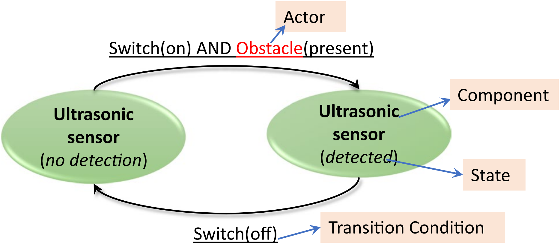
2. Background
Component state transition diagrams
A component state transition (CST) diagram is used to provide an abstract representation of behaviors of components in a system.
This paper identify four major elements of a CST diagram:
Components: A component is defined as part of the system, and each component can have multiple states.
States: The states of components can be changed because of actions known as transition conditions.
Transition conditions: There are two types of transition conditions:
Actor: An actor is any external agent who interacts with the system to perform an action.
1) A system transition condition refers to components’ states that result in the state change of other components.
2) An environmental transition condition is an action performed by humans or other external entities that are not part of the system.
Fig. 1 Example of a component state transition diagram for ultrasonic sensor(超声波传感器)
Notes:
We identify three major elements of a CST diagram: components, their states, and transition conditions to formulate component transition rules, which can be provided as input to requirements analysis approaches such as causal component model (CCM).

Slide 5
3. Research questions
Central RQ: Which neural network architectures are effective in performing automated model element identification and what are the factors affecting their performance?
RQ1: What is the effectiveness of the neural network architectures on test and unseen data?
RQ2: What are the factors that affect the performance of neural networks when predicting the model elements?
RQ2.1: How does the partitioning of data into training, validation, and test affect the performance of neural networks?
RQ2.2: How does experimental design affect the performance of neural networks?
RQ2.3: Do neural networks predict model elements better when we use a single classifer for all model elements or separate classifers for each type of model elements?
RQ2.4: Does the way we perform human annotations affect the predictions of model elements by neural networks?
RQ3: Are there trade-offs among neural network architectures for automatic model element identification task? If so, what can we infer?
Fig. 2 Relationships among research questions
Notes:
How does the partitioning of data into training, validation, and test afect the performance of neural networks?
How does experimental design afect the performance of neural networks?
Do neural networks predict model elements better when we use a single classifer for all model elements or separate classifers for each type of model elements?
Does the way we perform human annotations afect the predictions of model elements by neural networks?

Slide 6
4. Study
4.1 Objects of analysis
Table 1 List of use case documents used
ID | Description | No. of use cases
1 | A use case document on personalized health informatics (PHI) compliant system | 21
2 | A use case document on online shopping system | 4
3 | A use case document on automated guided vehicle system | 2
4 | A use case document on emergency monitoring system | 4
5 | A use case document on ambulance dispatch system | 10
6 | A part of use case document on an system, which ofers assisted mobility | 11
The table1 shows that the size of documents varies from 2 use cases to 21 use cases.
The frst four documents in the table are from the usecasedoc data set.
The fifth document is written as part of the academic course materials
The sixth document is an industrial use case document.
This paper uses documents 1–5 to create training, validation, and test data, and document 6 as unseen data.
Notes:
BP model demonstrates the overall picture of system’s functionality by portraying all the user and system operations, interactions and their sequencing. It details the steps involved to produce the required output from a given input. It acts as a blueprint for the implementation phase
we perform an extensive empirical study to investigate the efectiveness of four types of neural networks (feed forward (FF) neural network , convolutional neural network (CNN) , recurrent neural network with long short-term memory (LSTM), and recurrent neural network with gated recurrent unit (GRU)) to identify model elements of component state transition diagrams automatically. We selected these neural network architectures (NNAs) for the following reasons:

Slide 7
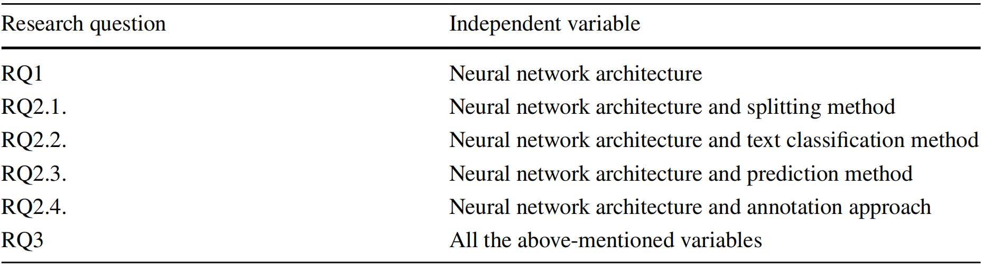
4. Study
4.2 Variables
4.2.1 Independent variables
The list of independent variables for each research question is shown in Table 2.
Table 2 Independent variables
Notes:
BP model demonstrates the overall picture of system’s functionality by portraying all the user and system operations, interactions and their sequencing. It details the steps involved to produce the required output from a given input. It acts as a blueprint for the implementation phase
we perform an extensive empirical study to investigate the efectiveness of four types of neural networks (feed forward (FF) neural network , convolutional neural network (CNN) , recurrent neural network with long short-term memory (LSTM), and recurrent neural network with gated recurrent unit (GRU)) to identify model elements of component state transition diagrams automatically. We selected these neural network architectures (NNAs) for the following reasons:

Slide 8
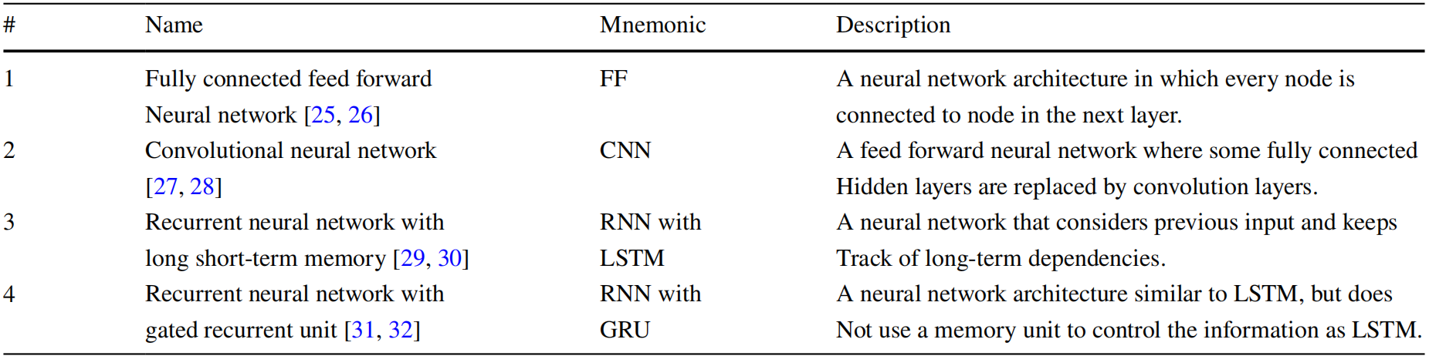
4. Study
4.2.1 Independent variables
Neural network architecture: In this study, they used four neural network architectures
Table 3 Types of neural network architectures being
The reasons for choosing these neural network architectures (NNAs) are as follows:
Traditional natural language processing techniques do not consider the similarity between words based on their meaning, whereas neural networks consider similarity between words by using word embeddings.
Neural networks provide state-of-the-art results in tasks such as named entity recognition and relation extraction, which are similar to tasks involved in automated model generation from the requirements.
If the results with the four basic NNAs are proven to be efective, then they plan to use the advanced NNAs such as XLNet and BERT for their task.
Notes:
BP model demonstrates the overall picture of system’s functionality by portraying all the user and system operations, interactions and their sequencing. It details the steps involved to produce the required output from a given input. It acts as a blueprint for the implementation phase
we perform an extensive empirical study to investigate the efectiveness of four types of neural networks (feed forward (FF) neural network , convolutional neural network (CNN) , recurrent neural network with long short-term memory (LSTM), and recurrent neural network with gated recurrent unit (GRU)) to identify model elements of component state transition diagrams automatically. We selected these neural network architectures (NNAs) for the following reasons:

Slide 9
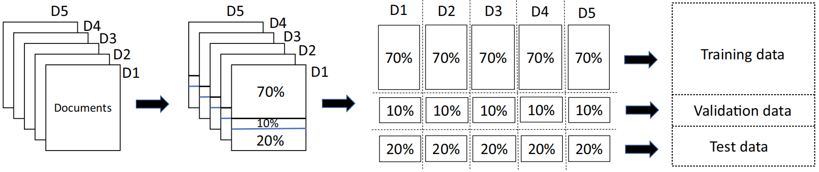
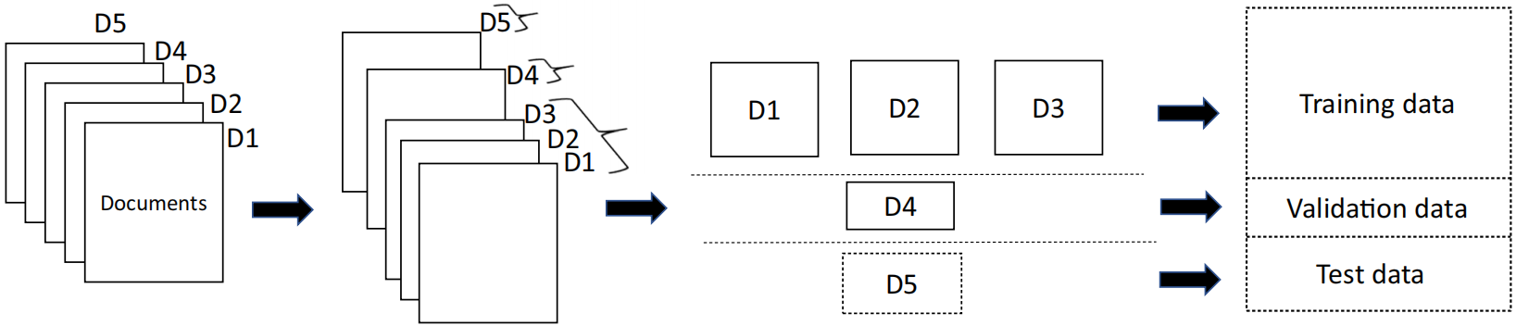
4. Study
4.2.1 Independent variables
Splitting method: Splitting refers to the process of dividing the data into training, validation, and test data. The study considered two types of splitting method: intra- and inter-document splitting.
Table 4 Splitting methods
# | Name | Description
1 | Intra-document splitting (withindoc) | this method divides each document in the data set in the ratio of 70:10:20 to generate training, validation, and test data for that document. Once the documents are divided, all the training splits of the documents are grouped to form the training data for the neural network.
2 | Inter-document splitting (between doc) | this method groups diferent documents into non-overlapping sets of ratio similar to 70:10:20 to create training, validation, and test data.
(a) Intra-document Splitting
(b) Inter-document Splitting
Fig. 5 Splitting methods
Notes:
Table 4 provides details about these methods, and Fig. 5 illustrates their process with 5 sample documents.

Slide 10
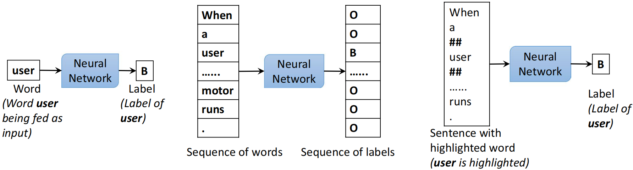
4. Study
4.2.1 Independent variables
Text classifcation method: it refers to how they planned to approach the model elements prediction problem. In this study, they considered three types of design: wordlevel, seq2seq, and seqlvlword.
Example sentence: When a user presses switch, the motor runs.
(a) wordlevel
(b) seq2seq
(c) seqlevelword
(a) wordlevel:Word as input and word as output
The neural network is trained on each word without any context. The network takes a word as input and generates its label, respectively. The study consider this as baseline to the approach of paper. Because this design does not consider the context of the words, the study use only a fully connected neural network to identify model elements.
Notes:
In natural language an object is often written as a noun phrase rather than a single noun.
To ensure that an object is represented as a collection of nouns or a combination of a modifier and nouns, the proposed approach scans all the consecutive nouns and constructs a single word as atm_card_number. It also checks any consecutive modifier and nouns for combining words as a single entity.
To avoid any conflict with upper and lower case words, the system converts the content to all lower case first, then combines the words with ‘_’ symbol. We consider a maximum of three consecutive nouns or modifiers as a combined single word to simplify the procedure and eliminate lengthy words.

Slide 11
4. Study
4.2.1 Independent variables
Text classifcation method: it refers to how they planned to approach the model elements prediction problem. In this study, they considered three types of design: wordlevel, seq2seq, and seqlvlword.
Example sentence: When a user presses switch, the motor runs.
(a) wordlevel
(b) seq2seq
(c) seqlevelword
(b) seq2seq: Sequence as input and sequence as output
This design is similar to a sequence labeling task. In this design, the context dependencies among words are considered. The study use all four neural architectures for this design.
Notes:
In natural language an object is often written as a noun phrase rather than a single noun.
To ensure that an object is represented as a collection of nouns or a combination of a modifier and nouns, the proposed approach scans all the consecutive nouns and constructs a single word as atm_card_number. It also checks any consecutive modifier and nouns for combining words as a single entity.
To avoid any conflict with upper and lower case words, the system converts the content to all lower case first, then combines the words with ‘_’ symbol. We consider a maximum of three consecutive nouns or modifiers as a combined single word to simplify the procedure and eliminate lengthy words.

Slide 12
4. Study
4.2.1 Independent variables
Text classifcation method: it refers to how they planned to approach the model elements prediction problem. In this study, they considered three types of design: wordlevel, seq2seq, and seqlvlword.
Example sentence: When a user presses switch, the motor runs.
(a) wordlevel
(b) seq2seq
(c) seqlevelword
(c) seqlevelword: Sequence with highlighted word as input and the label of highlighted word as output
this design translates the problem of sequence labeling to a token classifcation task. They highlight each word in the sentence and train the neural network by feeding the highlighted sentence and making it learn the label of the highlighted word. The method highlight a word by adding the ’##’ symbol before and after the word. Similar to seq2seq design, the stuy consider all four neural network architectures in this design.
Notes:
In natural language an object is often written as a noun phrase rather than a single noun.
To ensure that an object is represented as a collection of nouns or a combination of a modifier and nouns, the proposed approach scans all the consecutive nouns and constructs a single word as atm_card_number. It also checks any consecutive modifier and nouns for combining words as a single entity.
To avoid any conflict with upper and lower case words, the system converts the content to all lower case first, then combines the words with ‘_’ symbol. We consider a maximum of three consecutive nouns or modifiers as a combined single word to simplify the procedure and eliminate lengthy words.

Slide 13
4. Study
4.2.1 Independent variables
Prediction method: The paper considered two types of predictions, their details are shown in Table 6 and Fig. 7.
Component Classifier
predicition
State Classifier
predicition
separate
predictions
Actor Classifier
predicition
Transition Condition Classifier
predicition
Classifier that identifies all model elements
predicition
combined
predictions
Fig. 7 Examples of prediction methods
Table 6 Prediction methods
# | Name | Description
1 | Predicting each type of model elements separately (separate predictions) | this method train the neural network for each type of model elements to learn and predict only that specifc model element type use BIO tags.
2 | Predicting all model element types together (combined predictions) | this method train a single neural network classifer to predict all types of model elements use a set of labels { A, TC, C, S, O }, where ‘A’ denotes actor, ‘TC’ denotes transition condition, ‘C’ denotes component, ‘S’ denotes state and ‘O’ denotes not a model element.
Notes:
In natural language an object is often written as a noun phrase rather than a single noun.
To ensure that an object is represented as a collection of nouns or a combination of a modifier and nouns, the proposed approach scans all the consecutive nouns and constructs a single word as atm_card_number. It also checks any consecutive modifier and nouns for combining words as a single entity.
To avoid any conflict with upper and lower case words, the system converts the content to all lower case first, then combines the words with ‘_’ symbol. We consider a maximum of three consecutive nouns or modifiers as a combined single word to simplify the procedure and eliminate lengthy words.

Slide 14
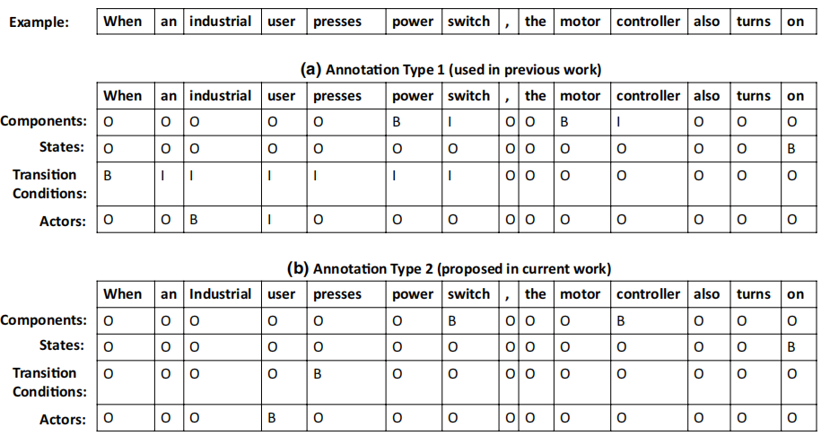
4. Study
4.2.1 Independent variables
Annotation approach: In this study, they used two types of annotations:
Annotation type 1 (AT1): if a model element is a phrase, i.e., the model element comprises of more than one word, this method consider the entire phrase as part of the model element.
Annotation type 2 (AT2): This method requires each model element to be restricted to one word. It achieve this by choosing the head/core word in a phrase.
Fig. 8 Example of annotation approaches
Notes:
In natural language an object is often written as a noun phrase rather than a single noun.
To ensure that an object is represented as a collection of nouns or a combination of a modifier and nouns, the proposed approach scans all the consecutive nouns and constructs a single word as atm_card_number. It also checks any consecutive modifier and nouns for combining words as a single entity.
To avoid any conflict with upper and lower case words, the system converts the content to all lower case first, then combines the words with ‘_’ symbol. We consider a maximum of three consecutive nouns or modifiers as a combined single word to simplify the procedure and eliminate lengthy words.

Slide 15
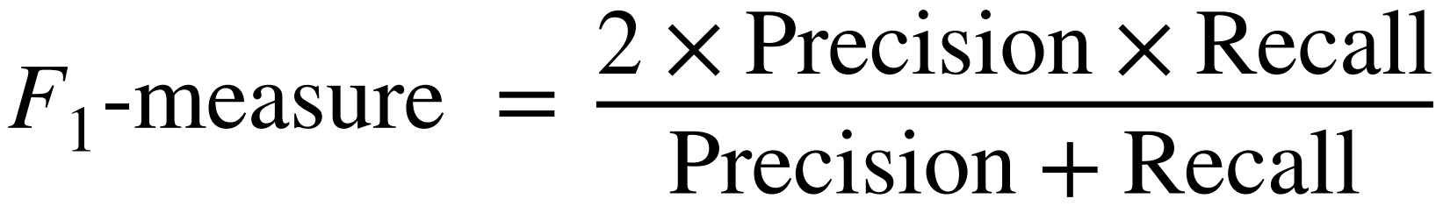
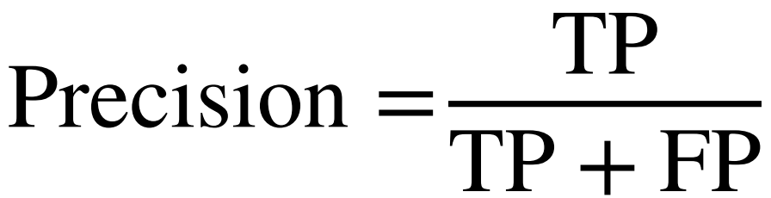
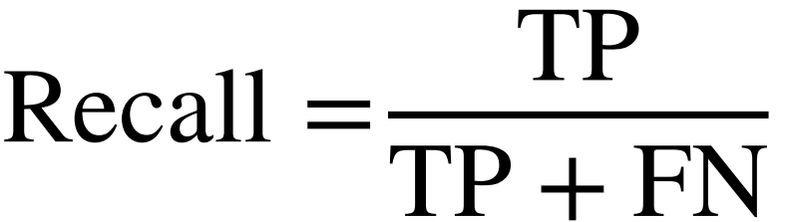
4. Study
4.2.2 Dependent variable (Evaluation metric)
The dependent variable for all research questions is the effectiveness of neural network architectures in predicting the model elements. The study measured the efectiveness of neural networks using F1-measure, which is the harmonic mean of precision and recall.
where TP is the number of true positives, FP is the number of false positives, and FN is the number of false negatives.
True positives refer to correctly identifed model elements.
False positives refer to the entities that are incorrectly classifed as model elements.
False negatives are the occurrences of model elements that are incorrectly classifed as not model elements.
Notes:
In natural language an object is often written as a noun phrase rather than a single noun.
To ensure that an object is represented as a collection of nouns or a combination of a modifier and nouns, the proposed approach scans all the consecutive nouns and constructs a single word as atm_card_number. It also checks any consecutive modifier and nouns for combining words as a single entity.
To avoid any conflict with upper and lower case words, the system converts the content to all lower case first, then combines the words with ‘_’ symbol. We consider a maximum of three consecutive nouns or modifiers as a combined single word to simplify the procedure and eliminate lengthy words.

Slide 16
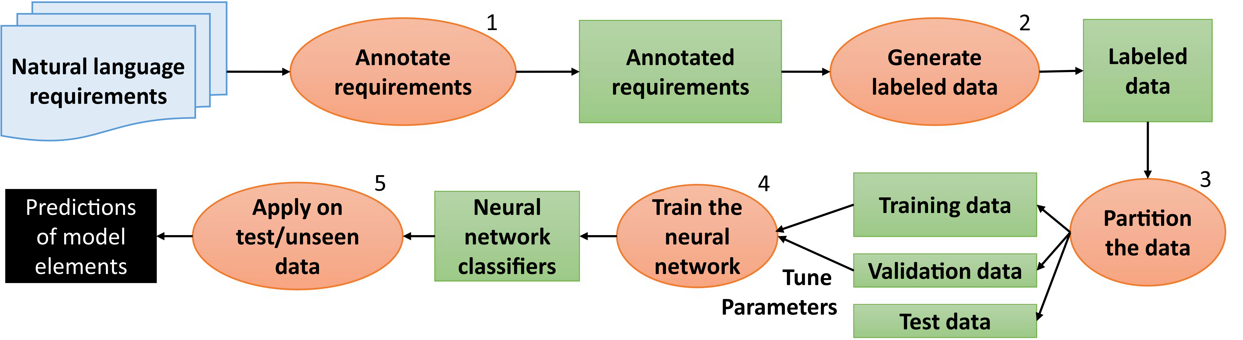
4. Study
4.3 Experimental procedure
Fig. 9 Overview of approach used to conduct experiments
Step 1: Annotate requirements documents by following the guidelines.
Step 2: Create a gold standard from labeled data.
Step 3: The generated data are partitioned into training, validation, and test sets.
Step 4: Use training data and GloVe embeddings to train the neural networks to predict model elements and use validation data to tune the hyperparameters of neural networks.
Step 5: The generated classifer is treated as the finalized classifer and can be used to predict model elements on test data and unseen data (out of domain data).
Notes:
In natural language an object is often written as a noun phrase rather than a single noun.
To ensure that an object is represented as a collection of nouns or a combination of a modifier and nouns, the proposed approach scans all the consecutive nouns and constructs a single word as atm_card_number. It also checks any consecutive modifier and nouns for combining words as a single entity.
To avoid any conflict with upper and lower case words, the system converts the content to all lower case first, then combines the words with ‘_’ symbol. We consider a maximum of three consecutive nouns or modifiers as a combined single word to simplify the procedure and eliminate lengthy words.

Slide 17
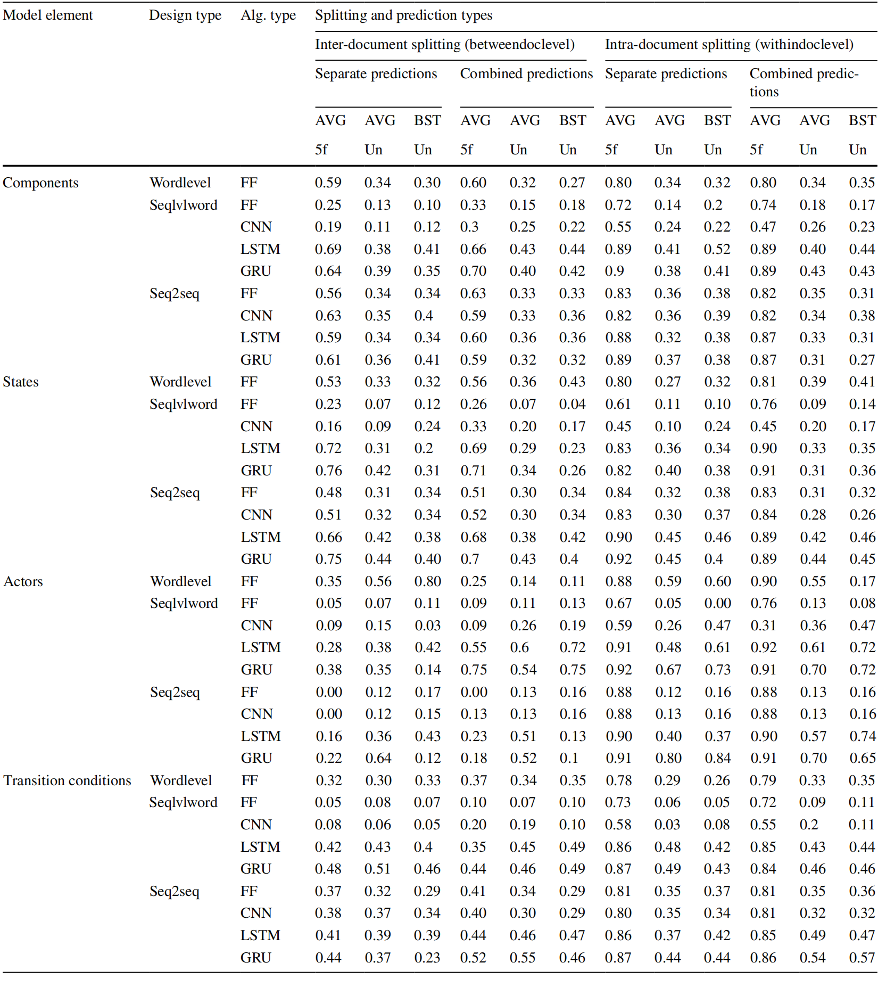
4. Study
4. Study
Table 9 Results of classifers on model elements (F1-measure)
4.4 Results
To measure the performance of each classifer, the study averaged F1-measures of 5-fold cross-validation on test data that is evaluated in each iteration (represented as AVG 5-fold) and on unseen data (represented as AVG unseen).
Paper also identifed the F1-measure on unseen data given by the classifer trained on the fold that produced the best results on test data during 5-fold cross-validation (represented as BEST unseen).
Notes:
In natural language an object is often written as a noun phrase rather than a single noun.
To ensure that an object is represented as a collection of nouns or a combination of a modifier and nouns, the proposed approach scans all the consecutive nouns and constructs a single word as atm_card_number. It also checks any consecutive modifier and nouns for combining words as a single entity.
To avoid any conflict with upper and lower case words, the system converts the content to all lower case first, then combines the words with ‘_’ symbol. We consider a maximum of three consecutive nouns or modifiers as a combined single word to simplify the procedure and eliminate lengthy words.

Slide 18
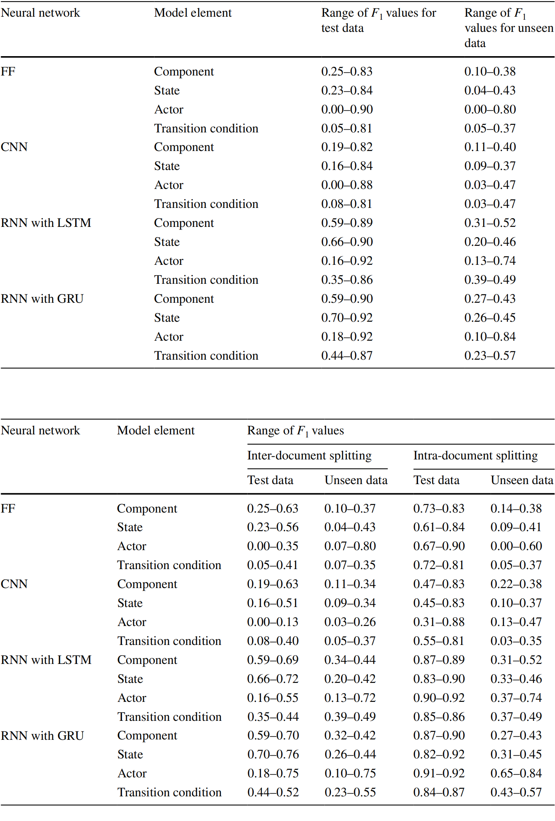
4. Study
RQ1: What is the effectiveness of the neural network architectures on test and unseen data?
4.4.1 RQ1 results
To evaluate RQ1 and find the efectiveness of neural network architectures, the study analyzed their performance on test data and unseen data.
Overall, RNN with LSTM and RNN with GRU perform better on both test and unseen data when compared to FF and CNN.
Table 10 Range of F1-measures for neural network architectures (considering all factors affecting the performance of neural networks)
Notes:
In natural language an object is often written as a noun phrase rather than a single noun.
To ensure that an object is represented as a collection of nouns or a combination of a modifier and nouns, the proposed approach scans all the consecutive nouns and constructs a single word as atm_card_number. It also checks any consecutive modifier and nouns for combining words as a single entity.
To avoid any conflict with upper and lower case words, the system converts the content to all lower case first, then combines the words with ‘_’ symbol. We consider a maximum of three consecutive nouns or modifiers as a combined single word to simplify the procedure and eliminate lengthy words.

Slide 19
4. Study
RQ2.1: How does the partitioning of data into training, validation, and test affect the performance of neural networks?
4.4.2 RQ2.1 results
For RQ2.1, they analyzed the effect of splitting methods on the performance of neural networks. Summarized results of splitting methods are in Table 11.
Overall, we can observe that inter-document splitting produced a smaller range of F1-measure values compared to intra-document splitting for all neural network architectures and all model elements.
Table 11 Range of F1-measures for splitting methods
Notes:
In natural language an object is often written as a noun phrase rather than a single noun.
To ensure that an object is represented as a collection of nouns or a combination of a modifier and nouns, the proposed approach scans all the consecutive nouns and constructs a single word as atm_card_number. It also checks any consecutive modifier and nouns for combining words as a single entity.
To avoid any conflict with upper and lower case words, the system converts the content to all lower case first, then combines the words with ‘_’ symbol. We consider a maximum of three consecutive nouns or modifiers as a combined single word to simplify the procedure and eliminate lengthy words.

Slide 20
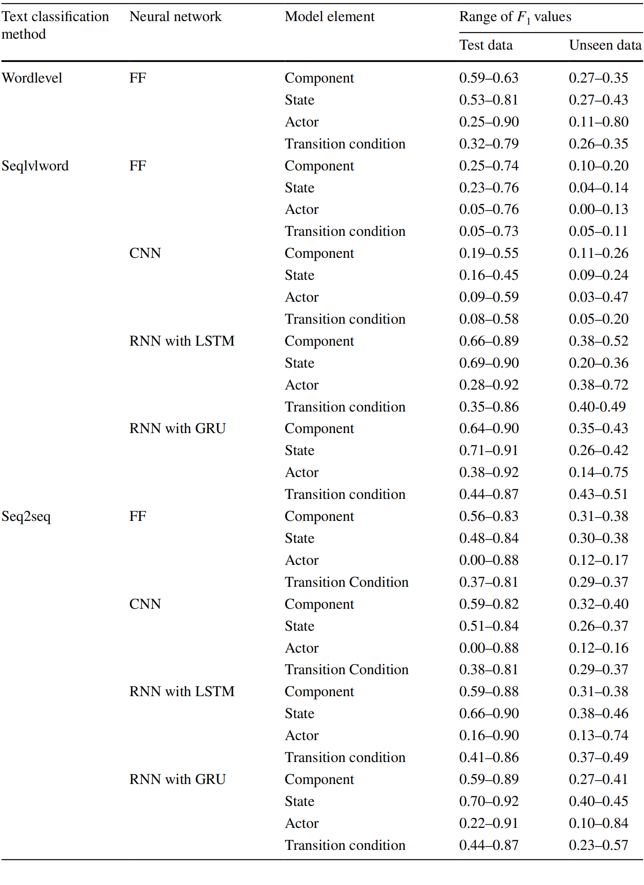
4. Study
Table 12 Range of F1-measures for text classifcation methods
RQ2.2: How does experimental design affect the performance of neural networks?
4.4.3 RQ2.2 results
To evaluate RQ2.2, study analyzed the performance of neural networks using three types of text classifcation methods (wordlevel, seqlvlword, and seq2seq).
Overall, we found that the performance of text classifcation methods varied on the type of neural network architectures and model elements.
Seqlvlword and seq2seq methods produced higher ranges of results using RNN with LSTM and RNN with GRU.
While their results on test and unseen data are similar to those for transition conditions, seqlvlword method produced slightly higher results for components, and seq2seq method produced slightly higher results for states.
In the case of actors, while both the seq2seq and seqlvlword methods produced similar results on test data for RNN with LSTM and RNN with GRU, seq2seq RNN with GRU produced higher results on unseen data
Notes:
Seqlvlword and seq2seq methods produced higher ranges of results using RNN with LSTM and RNN with GRU.
While their results on test and unseen data are similar to those for transition conditions, seqlvlword method produced slightly higher results for components, and seq2seq method produced slightly higher results for states.
In the case of actors, while both the seq2seq and seqlvlword methods produced similar results on test data for RNN with LSTM and RNN with GRU, seq2seq RNN with GRU produced higher results on unseen data.
Furthermore, wordlevel FF also produced slightly lower scores compared to seq2seq RNN with GRU for actors.

Slide 21
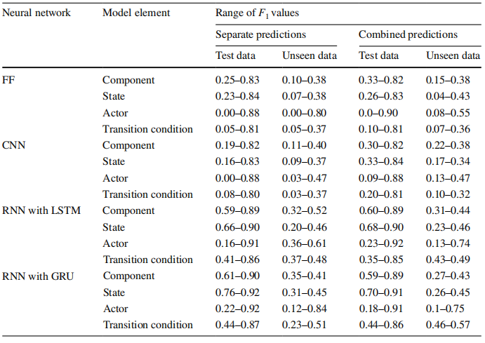
4. Study
RQ2.3: Do neural networks predict model elements better when we use a single classifer for all model elements or separate classifers for each type of model elements?
4.4.4 RQ2.3 results
Table 13 Range of F1-measures for prediction methods
To answer RQ2.3, study analyzed the efect of prediction methods on neural networks and the performance of classifers by training them for separate predictions and combined predictions.
Overall, we can observe that all neural network architectures produced similar results for separate and combined predictions on both test and unseen data with a few exceptions.
For example, for FF, separate predictions produced a higher upper bound value (0.00–0.80) than combined predictions (0.08–0.55) for unseen data for actors.
In the case of transition conditions, for both RNN with LSTM and RNN with GRU, the range values are higher and with a small variance for combined predictions than separate predictions.
In the case of actors, for RNN with LSTM, combined predictions produced a higher upper bound value (0.74) than separate predictions (0.61), whereas for RNN with GRU, separate predictions produced a higher upper bound value (0.84) than combined predictions (0.75).
Notes:
In natural language an object is often written as a noun phrase rather than a single noun.
To ensure that an object is represented as a collection of nouns or a combination of a modifier and nouns, the proposed approach scans all the consecutive nouns and constructs a single word as atm_card_number. It also checks any consecutive modifier and nouns for combining words as a single entity.
To avoid any conflict with upper and lower case words, the system converts the content to all lower case first, then combines the words with ‘_’ symbol. We consider a maximum of three consecutive nouns or modifiers as a combined single word to simplify the procedure and eliminate lengthy words.

Slide 22
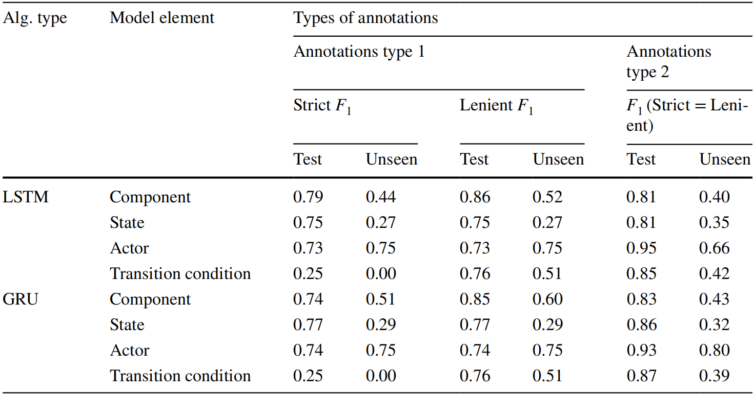
4. Study
RQ2.4: Does the way we perform human annotations afFect the predictions of model elements by neural networks?
4.4.5 RQ2.4 results
To investigate RQ2.4, to have a better understanding on how annotation methods can affect results, the study fixed the text classifcation method to seq2seq, splitting method to withindoclevel, and predictions method to separate predictions.
Table 14 Results of classifers using diferent types of annotations (in F1-measure)
Strict F1: predicting all words of the model element
lenient F1: predicting at least one word of the model element
Overall, results shows that annotation type 2 performs well on test data for all model element types except for components and on unseen data for states (for both LSTM and GRU) and actors (only for GRU). Annotation type 1 (AT1) performs well on components and transition conditions for unseen data when we consider lenient F1-measure, i.e., when we consider partial matches of model elements.
Notes:
In natural language an object is often written as a noun phrase rather than a single noun.
To ensure that an object is represented as a collection of nouns or a combination of a modifier and nouns, the proposed approach scans all the consecutive nouns and constructs a single word as atm_card_number. It also checks any consecutive modifier and nouns for combining words as a single entity.
To avoid any conflict with upper and lower case words, the system converts the content to all lower case first, then combines the words with ‘_’ symbol. We consider a maximum of three consecutive nouns or modifiers as a combined single word to simplify the procedure and eliminate lengthy words.

Slide 23
4. Study
RQ3: Are there trade-offs among neural network architectures for automatic model element identification task? If so, what can we infer?
4.4.6 RQ3 results
From the results of RQ1 and RQ2, we can say that every neural network architecture is infuenced by various factors such as the types of text classifcation methods, splitting methods, annotation methods, and predictions methods.
Overall, the splitting methods can affect the results of model elements on test data and it is preferable to use withindoclevel partitioning, in particular when the data size is small.
For components, whether it is betweendoclevel splitting or withindoclevel splitting, we can obtain better results using seqlvlword LSTM or GRU with combined predictions.
For states, we can achieve better results using seq2seq GRU or LSTM with separate predictions.
For actors, using seq2seq GRU with separate predictions, we can get higher scores on test and unseen data for withindoclevel splitting. However, we can achieve higher scores at betweendoclevel partitioning using seqlvlword GRU or LSTM with combined predictions.
For transition conditions, seq2seq GRU with combined predictions will aid in getting higher scores.
Notes:
In natural language an object is often written as a noun phrase rather than a single noun.
To ensure that an object is represented as a collection of nouns or a combination of a modifier and nouns, the proposed approach scans all the consecutive nouns and constructs a single word as atm_card_number. It also checks any consecutive modifier and nouns for combining words as a single entity.
To avoid any conflict with upper and lower case words, the system converts the content to all lower case first, then combines the words with ‘_’ symbol. We consider a maximum of three consecutive nouns or modifiers as a combined single word to simplify the procedure and eliminate lengthy words.

Slide 24
4. Study
4.4.7 Central RQ results
Paper’s central research question seeks to find the most efective neural network architectures and factors affecting their performance. The answers to central research questions are as follows:
1. RNN with LSTM and RNN with GRU are the neural network architectures with the highest performance.
However, there are diferent factors that must be considered for diferent model elements.
2. Theyfound that the splitting method we used might affect performance of classifers on test data but not on unseen (out-of-domain) data.
3. They found that text classifcation methods can affect prediction scores. They found that wordlevel FF performs on par with top performing classifers and produced results whose F1 values are higher than the ones produced by seqlvlword FF and seq2seq FF. They also found that seqlvlword LSTM is suitable for learning components and seq2seq GRU is suitable for states and actors.
4. Regarding the prediction methods used, They found that there is not much diference in F1-measures between prediction methods for all neural network architectures.
5. They observed that the way in which annotations are performed can affect the results. However, the efective annotation mechanisms can require additional post-processing and analysis.
6. From our results, They also found that the classifer trained on the fold that produced the best result on test data during 5-fold cross-validation does not necessarily produce the best results on unseen data. They found that some other folds can produce better results on unseen data.

Slide 25
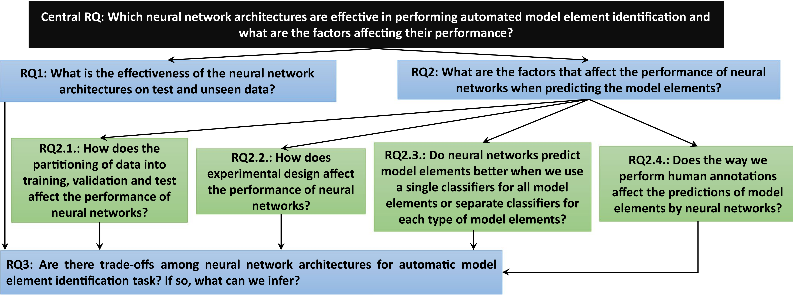
5. Conclusion
The application of state-of-the-art neural network architectures to automated model element identifcation tasks has not been studied.
RQ* answers
RQ* results
Notes:
The paper primary contribution to overcoming some of the shortcomings mentioned earlier nis to provide a methodology for deriving SD from textual use cases written in free form English language with minimal user involvement.
The paper further attempted to establish various metrics for evaluating the quality of a behavioural model. Similar experiments can benefit from the quality measures.
The results from the case studies are promising, the overall completeness factor achieved is over 90%, while the correctness is above 85%.
an automated approach towards generating behavioral models as UML sequence diagrams from textual use cases written in natural language.

Slide 26
5. Conclusion
The application of state-of-the-art neural network architectures to automated model element identifcation tasks has not been studied.
Perform an empirical study on automatic model elements identifcation for component state transition models from use case documents.
research questions
Central RQ: Which neural network architectures are effective in performing automated model element identification and what are the factors affecting their performance?
RQ1: What is the effectiveness of the neural network architectures on test and unseen data?
RQ2: What are the factors that affect the performance of neural networks when predicting the model elements?
RQ2.1: How does the partitioning of data into training, validation, and test affect the performance of neural networks?
RQ2.2: How does experimental design affect the performance of neural networks?
RQ2.3: Do neural networks predict model elements better when we use a single classifer for all model elements or separate classifers for each type of model elements?
RQ2.4: Does the way we perform human annotations affect the predictions of model elements by neural networks?
RQ3: Are there trade-offs among neural network architectures for automatic model element identification task? If so, what can we infer?
Overview of approach used to conduct experiments
RQ* results and answers

Slide 27
6. My related work
Software Security Requirements Elicitation
In my work, I first classify the requirements described in natural language, get the security objectives that the requirements should focus on, and then obtain a security requirement template that can meet the corresponding security objectives through a set of mappings, and finally fill in some placeholders on the template symbols, such as entities(such as users, user data and data processing) in requirements.
This paper makes an empirical study on the automatic identification of model elements of component state transition model in use case documents. In my work, I need to identify some elements from requirements, such as users, user data, data processing, etc, these elements are conducive to revealing the security issues that the software should pay attention to.
The experiment in this paper gives me some inspiration from the experiment. It makes me know that using the method based on deep learning to automatically identify the demand elements should not only rely on the neural network model, but also consider the division method, classification method and prediction method of the factor data set. I consider to carry out some of the same experimental configurations in my work.

Slide 28
Thanks！

